Slide 1


AttnMove: History Enhanced Trajectory Recovery via Attentional Network
Tong Xia, Yunhan Qi, Jie Feng, Fengli Xu, Funing Sun, Diansheng Guo, Yong Li
Tsinghua University, China
xia-t17@mails.tsinghua.edu.cn

Slide 2
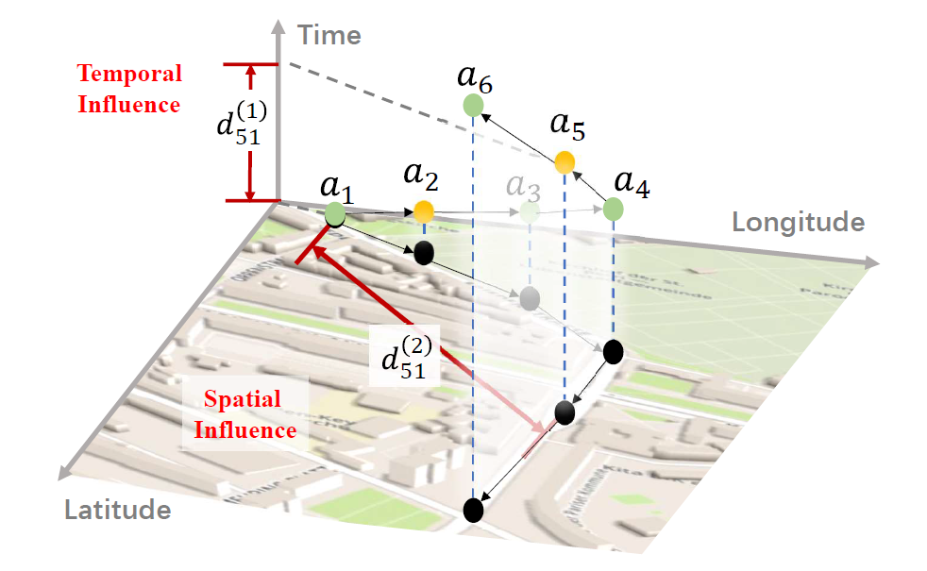




Background
Mobility Data
Observed
Missing
Short interaction
High sparsity!
Uneven distribution!
Privacy concerns
Battery consumption
Notes:
With popularity of location based service, large-scale long-term mobility data is available to be collected, However, it suffers from sparsity issue since users do not allow continuous tracing due to privacy and battery consumption concerns.

Slide 3

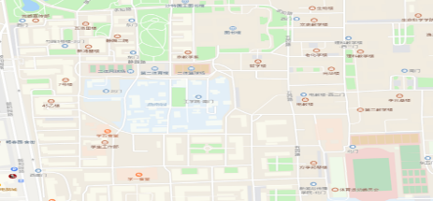

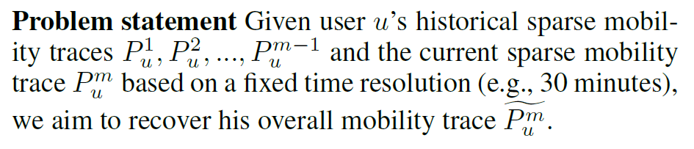





Problem
Combine current spatio-temporal constrains and historical period to
recover overall mobility trajectory
Current dense trajectories
user1
$$P_{u}^{1}$$
user1
user2
$$\hat{P_{n}^{m}}$$
user1
user1
$$P_{u}^{2}$$
Day1
user2
Day2
user2
user2
$$P_{u}^{m−1}$$
Day3
DayN
…
History sparse trajectories
user1
$$P_{u}^{m}$$
user2
DayN
Current sparse trajectories
Notes:
Considering that this kind of data can cover a long periodical, we aim to reconstruct personal trajectory at fine spatial-temporal granularity from history.

Slide 4
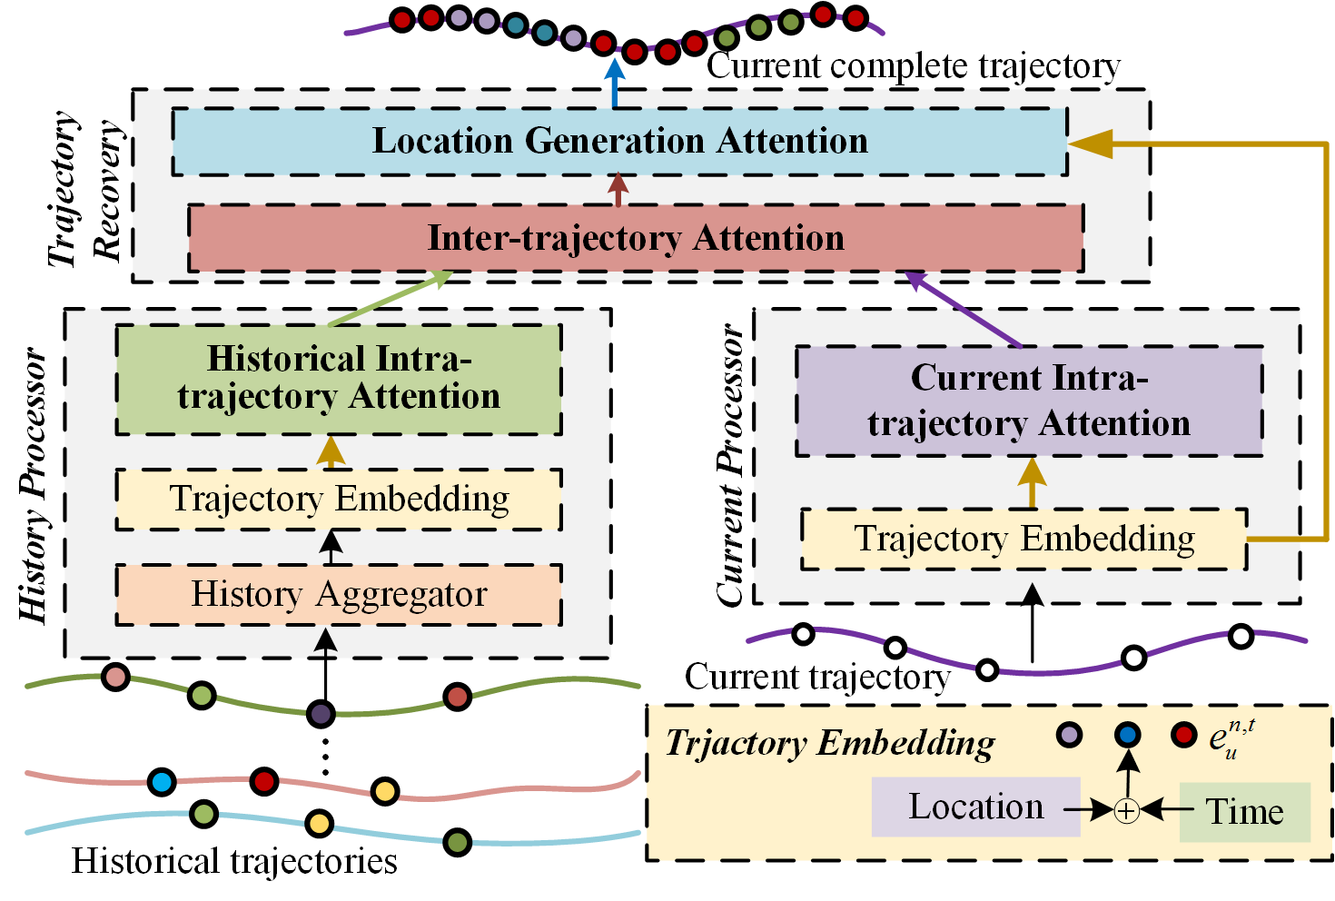
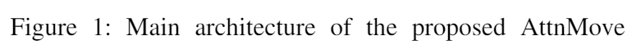
Solution
Challenge1: sparsity
Intra-trajectory attention
Challenge2: Noisy history
Max aggregation and attentional smoothing
Challenge3: Varied history importance
Inter-trajectory attention
https://arxiv.org/submit/3541766
Notes:
To achieve this goal, we propose a novel model which harness the power of attention mechanism to well tackle the challenges of this problem.

Slide 5
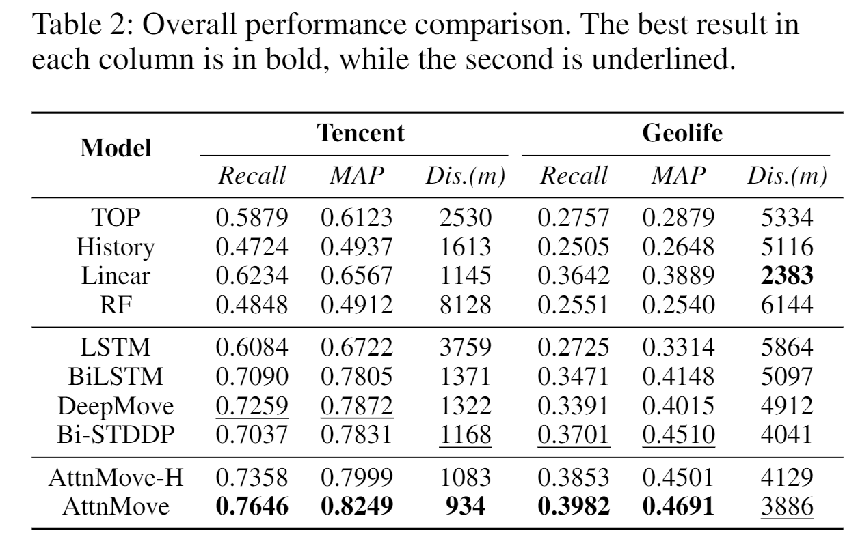
Results
4.0%~7.6% performance gain compare to SOTA
Superiority of Attentional Network
Better utilization of history
Notes:
Experiments on real world datasets demonstrate the superiority of our model. By densifying the trajectory, our model paves the way for various mobility-related downstream applications.

Slide 6

Tong Xia
https://xtxiatong.github.io/
Code and data: https://github.com/XTxiatong/AttnMove

