Slide 1
SAFE EMMA

Slide 2
SAFE EMMA
ANITA
BENNY
MANUEL
PASCAL
SUKI

Slide 3
#1 PROBLEM

Slide 4




MARKET RESEARCH
„I FEEL UNSAFE“
„I FEEL SAFE“

Slide 5
MARKET RESEARCH
„I FEEL SAFE“
BUT I HAVE A WIFE
AND I HAVE KIDS.
AND I AM AFRAID
SOMETHING COULD HAPPEN TO THEM
„I FEEL SAFE“

Slide 6
MARKET RESEARCH
2.802.189
KIDS IN ELEMENTARY SCHOOL
80%
OF PARENTS ARE SCARED
90%
OF ACCIDENTS WHILE ROAD CROSSING
20%
OF KIDS GET TO SCHOOL BY „ELTERNTAXI“
37%
WALK TO SCHOOL
Notes:
*scared when their elementary school kids walks to school alone

Slide 7

PROBLEM:
PARENTS ARE SCARED, TO LET THEIR KIDS WALK ALONE TO SCHOOL.

Slide 8
#2 SOLUTION
WE PROVIDE AN APP THAT HELPS
KIDS TO GET AROUND SAFE.

Slide 9
#3 SAFE EMMA

Slide 10
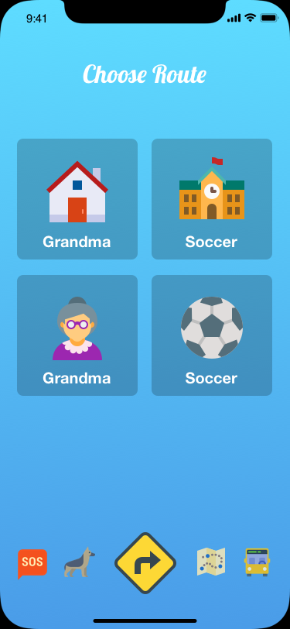
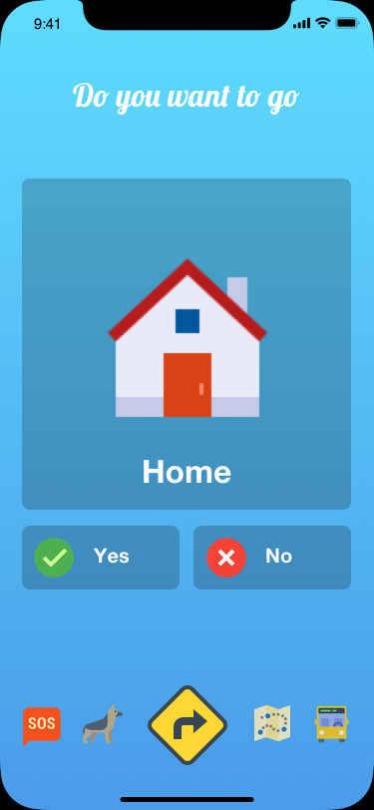
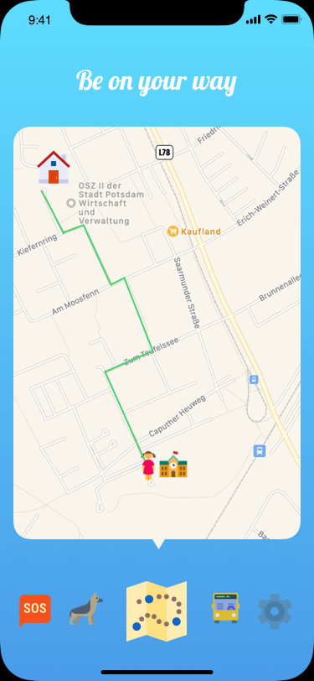
Notes:
*scared when their elementary school kids walks to school alone

Slide 11
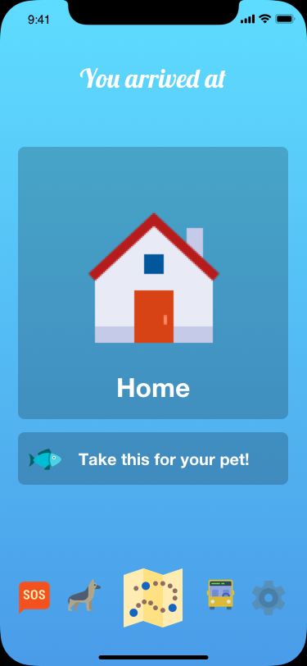
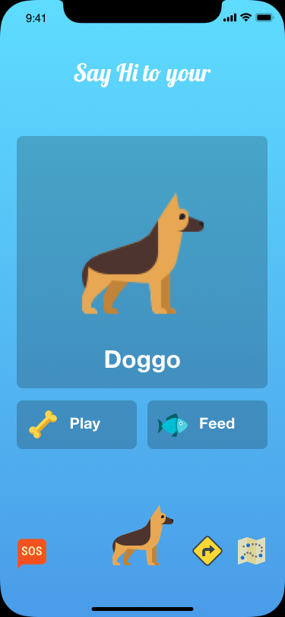
Notes:
*scared when their elementary school kids walks to school alone

Slide 12
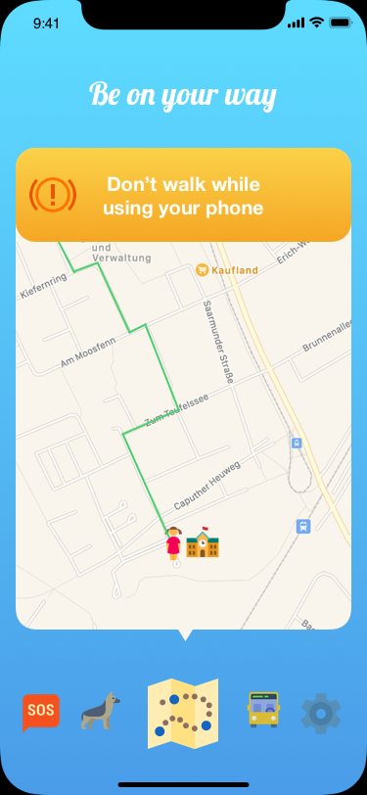
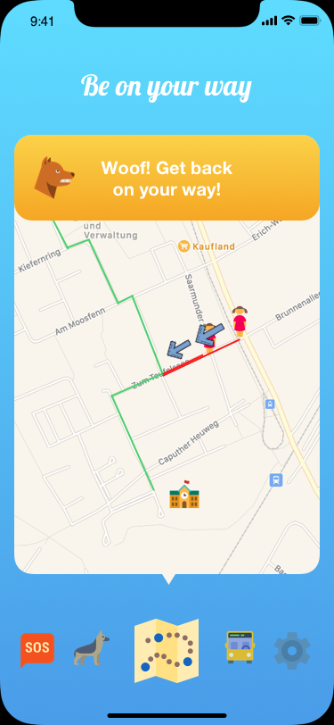
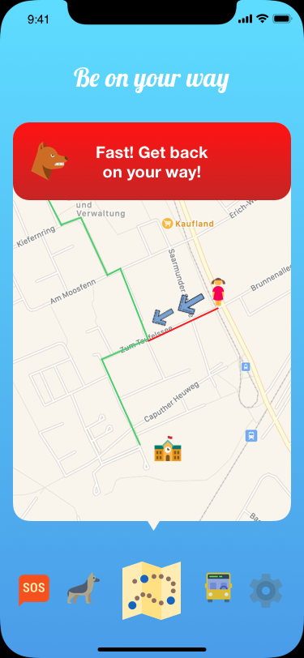
Notes:
*scared when their elementary school kids walks to school alone

Slide 13

PROOF OF CONCEPT
Live demo
Notes:
*scared when their elementary school kids walks to school alone

Slide 14

CA$H. LOTS OF CASH
Abonnement Model: Only 2 SafeSpots available (School & Home), but more cost money (soccer practise)
Buy new pets (can only be done by parents)
I‘d like to put bank notes on the screens to directly talk about monetization while explaining the features.
Dont use slide
Notes:
*scared when their elementary school kids walks to school alone

Slide 15
#4 COMPETITORS

Slide 16

COMPETITORS
SPYZIE
GOOGLE FAMILY LINK
TOTAL PRIVACY INVASION
HELICOPTER PARENTS
SPYERA
MOBISTEALTH
MSPY
.....
Notes:
*scared when their elementary school kids walks to school alone

Slide 17
#5 RESUME

Slide 18
RESUME
EASY 2 USE INTERFACE FOR KIDS.
NO HELICOPTER PARENTING. NO PRIVACY INVASION.
NO ELTERNTAXI: SAVE UP TO 42 BILLION KG OF CO2 PER YEAR.
SAVE OF 2250€ PER FAMILY FOR FUEL.
A LOT OF POTENTIAL USERS (GROW YEARLY).
MONEY VIA GAMIFICATION AND ABO MODEL.
NICE FUTURE PLANS.
Notes:
0.212 kg of co2 per 1km drive
*2 twice a day
*200 times a year
*500000 families (20% of 2.8 MIO)
5-6cent pro Kilometer

Slide 19
BOOOOOM.

Slide 20
BOOOOOM.

Slide 21
FUTURE PLANS
Bus
Wristband
Parental thingy
Tracking
More gamification
Learn traffic sign stuff
Notes:
0.212 kg of co2 per 1km drive
*2 twice a day
*200 times a year
*500000 families (20% of 2.8 MIO)
5-6cent pro Kilometer

