Slide 1
SAFE EMMA

Slide 2


SAFE EMMA
ANITA
BENNY
MANUEL
PASCAL
SUKI

Slide 3
#1 PROBLEM

Slide 4


MARKET RESEARCH
„I FEEL UNSAFE“
„I FEEL SAFE“

Slide 5
MARKET RESEARCH
„I FEEL SAFE“
BUT I HAVE A WIFE
AND I HAVE KIDS.
AND I AM AFRAID
SOMETHING COULD HAPPEN TO THEM
„I FEEL SAFE“

Slide 6
MARKET RESEARCH
2.802.189
KIDS IN ELEMENTARY SCHOOL
80%
OF PARENTS ARE SCARED
90%
OF ACCIDENTS WHILE ROAD CROSSING
20%
OF KIDS GET TO SCHOOL BY „ELTERNTAXI“
37%
WALK TO SCHOOL
Notes:
*scared when their elementary school kids walks to school alone

Slide 7

PROBLEM:
PARENTS ARE SCARED, TO LET THEIR KIDS WALK ALONE TO SCHOOL.

Slide 8
#2 SOLUTION
WE PROVIDE AN APP THAT HELPS
KIDS TO GET AROUND SAFE.

Slide 9
#3 SAFE EMMA

Slide 10

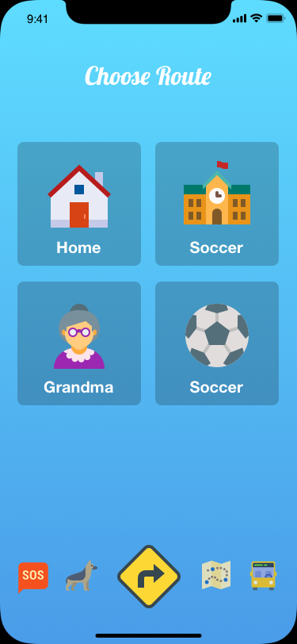
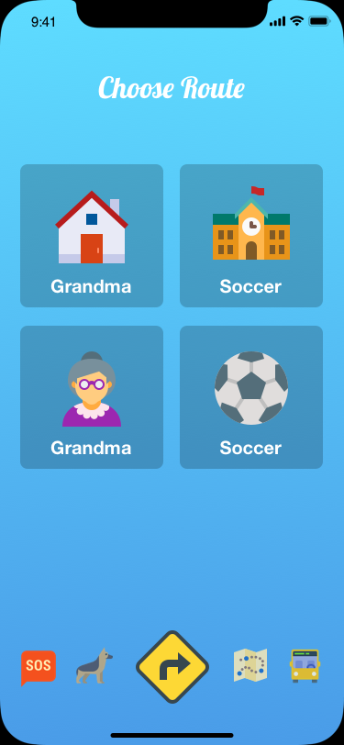
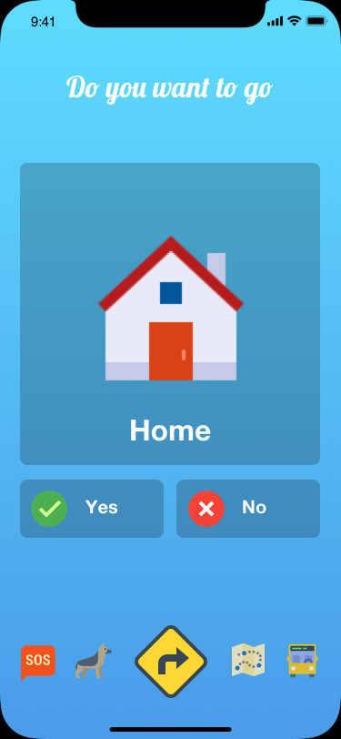
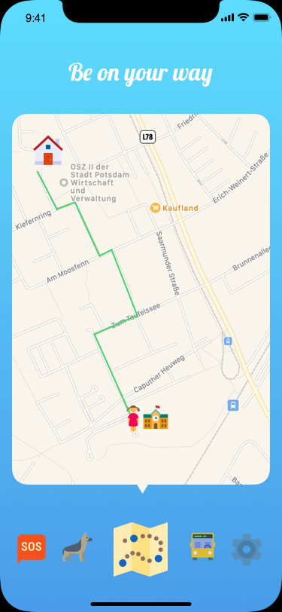

Notes:
*scared when their elementary school kids walks to school alone

Slide 11
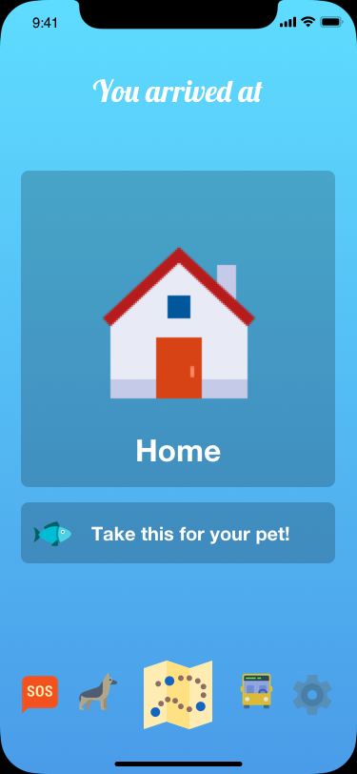
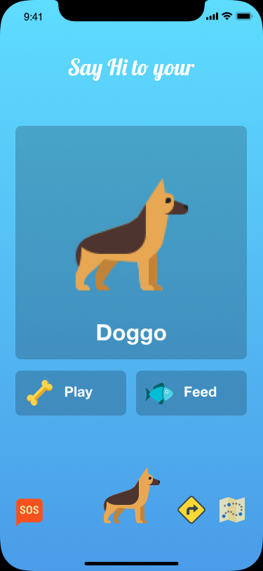
Notes:
*scared when their elementary school kids walks to school alone

Slide 12
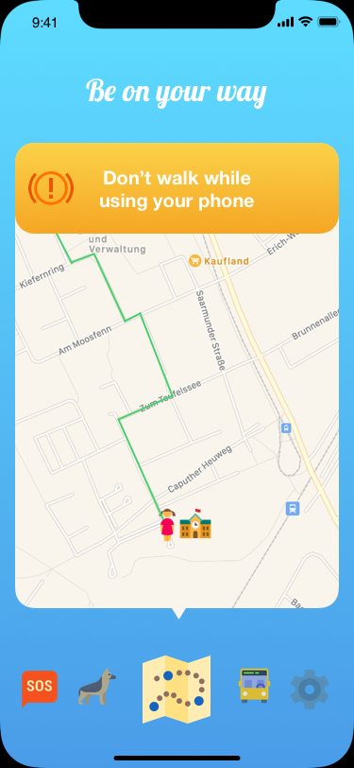
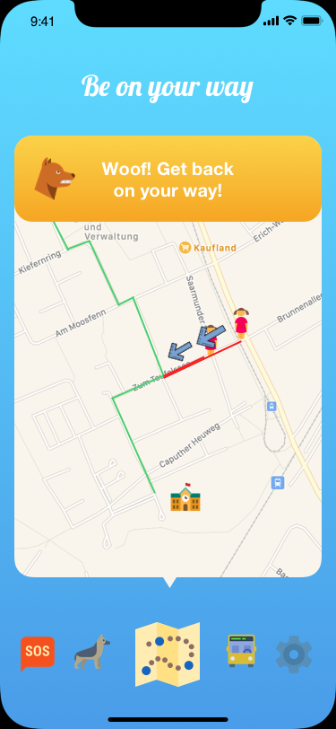
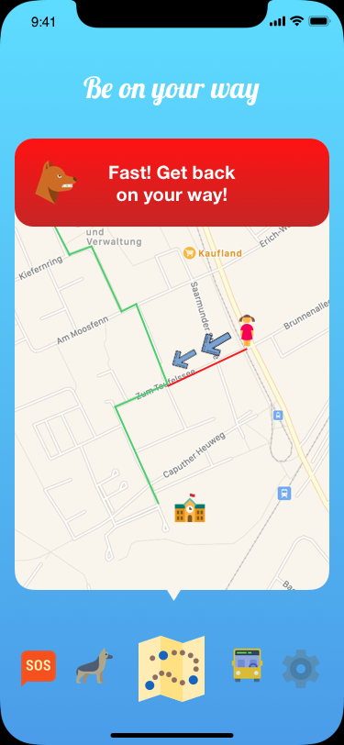
Notes:
*scared when their elementary school kids walks to school alone

Slide 13

PROOF OF CONCEPT
LIVE DEMO!
Notes:
*scared when their elementary school kids walks to school alone

Slide 14
#4 COMPETITORS

Slide 15

COMPETITORS
SPYZIE
GOOGLE FAMILY LINK
TOTAL PRIVACY INVASION
HELICOPTER PARENTS
SPYERA
MOBISTEALTH
MSPY
.....
Notes:
*scared when their elementary school kids walks to school alone

Slide 16
#5 RESUME

Slide 17
RESUME
EASY 2 USE INTERFACE FOR KIDS.
NO HELICOPTER PARENTING. NO PRIVACY INVASION.
NO ELTERNTAXI: SAVE UP TO 42 BILLION KG OF CO2 PER YEAR.
SAVE OF 2250€ PER FAMILY FOR FUEL.
A LOT OF POTENTIAL USERS (GROW YEARLY).
MONEY VIA GAMIFICATION AND ABO MODEL.
NICE FUTURE PLANS!
Notes:
0.212 kg of co2 per 1km drive
*2 twice a day
*200 times a year
*500000 families (20% of 2.8 MIO)
5-6cent pro Kilometer

Slide 18
BOOOOOM.

Slide 19
FUTURE PLANS
Integration of Bus Feature
Safety Wristband
Parental Setup App
Even more Gamification
Learning Feature: Signs and Road-Rules
Notes:
0.212 kg of co2 per 1km drive
*2 twice a day
*200 times a year
*500000 families (20% of 2.8 MIO)
5-6cent pro Kilometer

