Slide 1


Hash or Merge?
Adaptive GPU Acceleration for SpGEMM
XXF.exe: Yizhou Xue, Tengfei Xia, Zhihua Fan
State Key Laboratory of Processors, Institute of Computing Technology, CAS
University of Chinese Academy of Sciences

Slide 3

Background
Mainstream SpGEMM methods mainly adopt Merge-Based or Hash-Based accumulation
Stage-Profiling
Merge-Based
Hash-Based
ASPLOS 21/PACT 25
PPoPP 20/ISCA 24/HPCA 25
Partial Products: (column, value)
Partial Products: (column,value)
(1,2)
(4,3)
(2,5)
(1,7)
(4,1)
(3,6)
(1,2)
(4,3)
(2,5)
(4,1)
(1,7)
(3,6)
Hash Accumulator
Merge Accumulator
Hash Table (key: column ID)
insert (1,2) → slot 1
insert (4,3) → slot 2
insert (2,5) → slot 3
accumulate key 1 → 2+7=9
accumulate key 4 → 3+1=4
insert (3,6) → slot 4
slot
0
1
2
3
4
...
Compare Column IDs
...
key
—
1
4
2
3
value
—
9
4
5
6
...
Sum Duplicates
Output
Output
(1,9)
(4,4)
(2,5)
(3,6)
(1,2+7)
(2,5)
(3,6)
(4,4)
Sort
(1,9)
(2,5)
(3,6)
(4,4)

Slide 4
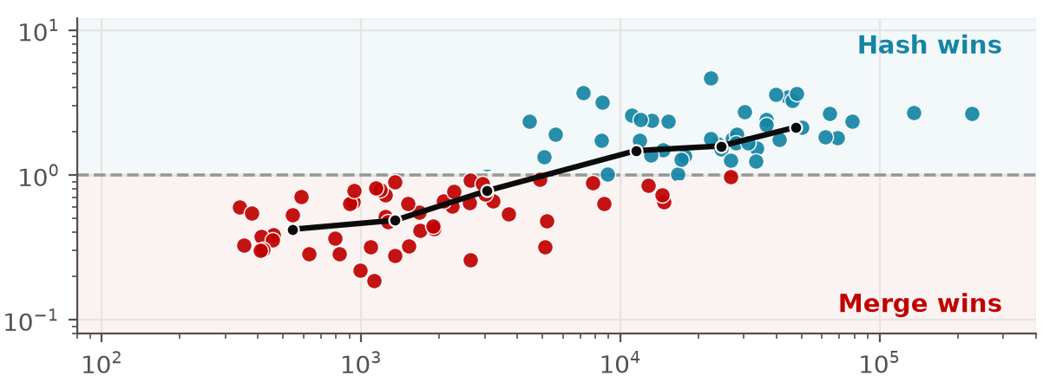
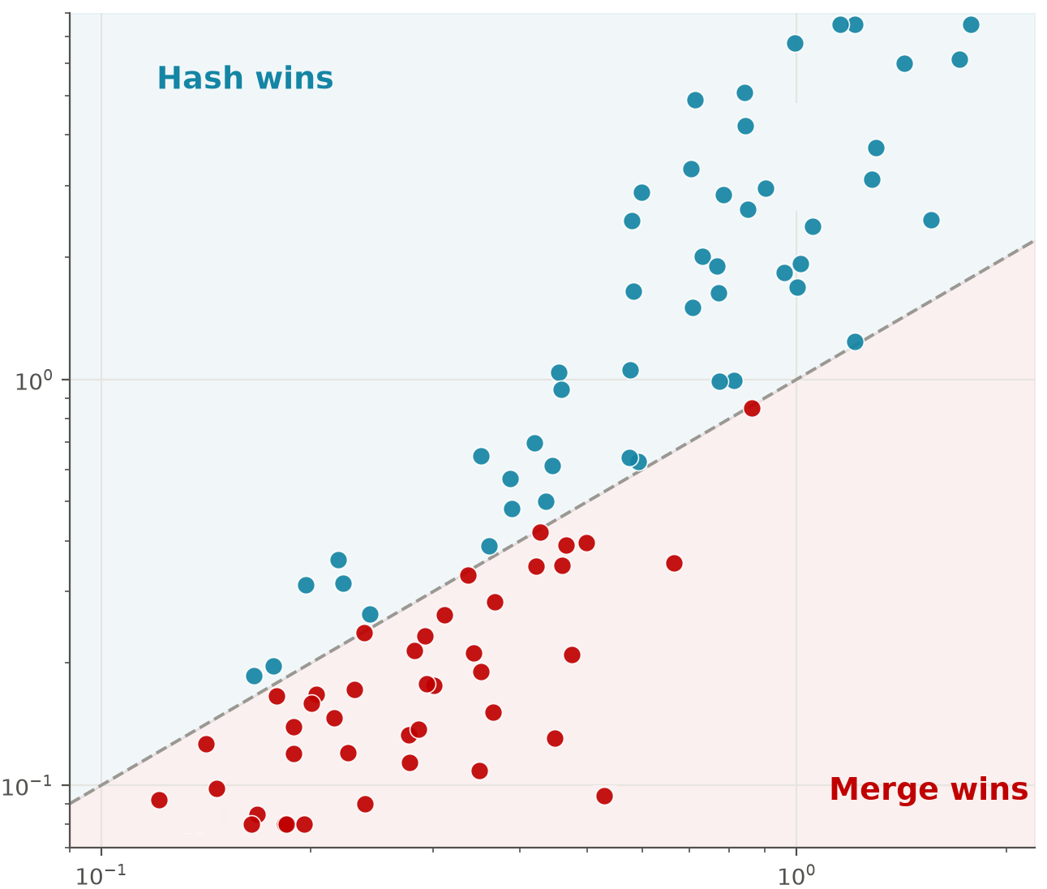
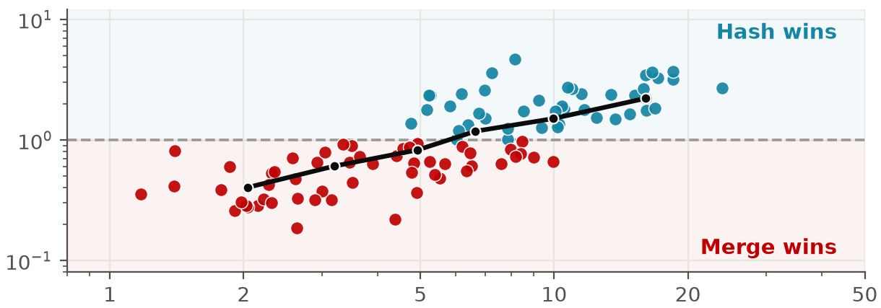
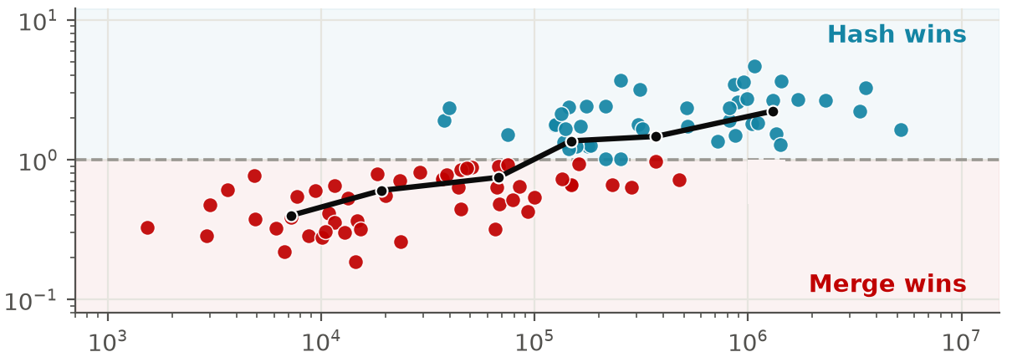




Core Insight
Neither merge nor hash consistently wins
Potential Contributing Factors
Profiling Results
$$Rows N$$
Large $N→$ Hash wins
Merge-based runtime (ms)
$$T_{merge}{\backslash T}_{hash}$$
$$σ=\frac{r_{max}}{r_{average}}$$
Large $σ→$
Hash wins
$$f=\frac{A_{nnz}^{2}}{N}$$
Large $f→$
Hash wins
Hash-based runtime (ms)

Slide 5



Overall: Adaptive Merge–Hash Workflow Dispatch
CPU dispatcher uses learned thresholds to choose Merge or Hash with negligible overhead
$$Use Hash ⇔ (N>α) ⋀ ( (σ > β) ⋁ (f > γ))$$
◆ Offline Threshold Choosing
❖ CPU-side Online Dispatcher
⬥ Overhead Hiding via Overlap
Input sparse matrix
training matrices
(disjoint from test set)
CPU
dispatch
workload
selection
CPU Dispatch Module
before accumulation
Feature extraction
N: matrix row length
$σ$: row imbalance degree
f: intermediate products estimation
H2D
transfer
data
transfer
Profiling &
threshold search
No
Yes
GPU
compute
GPU compute
Chosen thresholds: α, β, γ
N > α
$σ$ > β
OR
f > γ
Yes
Time
Merge
No
Thresholds are learned offline from 1000 matrices unrelated to the 100 test matrices
CPU-side selection overlaps with transfer,hiding dispatch. GPU compute dominates afterward.
Merge
Hash

Slide 6
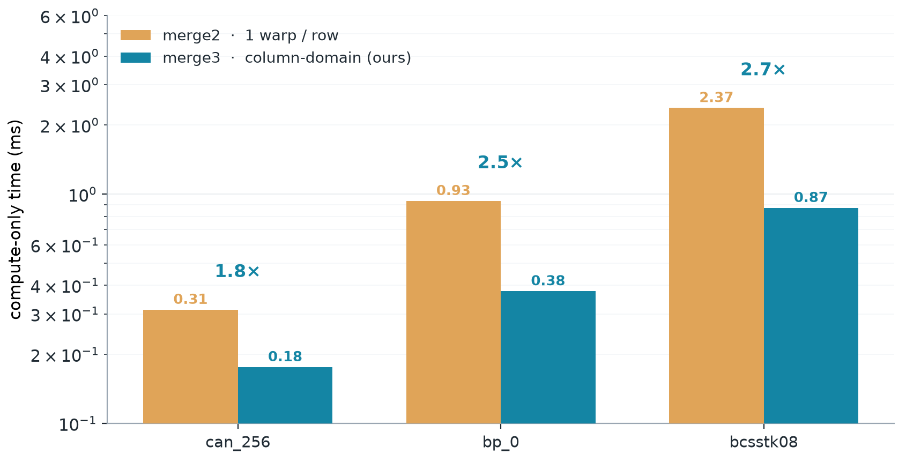







Design2: Column-Domain Parallel Merge
Motivation: Prior Merge
Ours: Disjoint column buckets
$${Bucket}_{0}$$
$${Bucket}_{1}$$
$${Bucket}_{2}$$
Compare
Compact
9
1
9
$$K_{0}$$
$$K_{0}$$
1
9
8
0
3
8
$$K_{1}$$
$$K_{1}$$
0
3
8
6
2
6
9
$$K_{2}$$
$$K_{2}$$
2
6
9
Serial Select
6
0
1
2
3
column-sorted CSR
warp-shfl
warp-shfl
warp-shfl
Serial dependency & Heavy rows are stragglers
That is why fast GPU SpGEMMs abandoned merge for hash
9
Add
0
1
2
3
6
8
9
Speedup:
Concatenate Buckets
$$C_{[i, ;]}$$
0
1
2
3
6
8
9
parallel axis:rows + K-chains + column domain
- Disjoint buckets concatenate to a column-sorted row - Both parallel and order-preserving
- No global sort
- Directly produces C[i,:] in sorted order

Slide 7
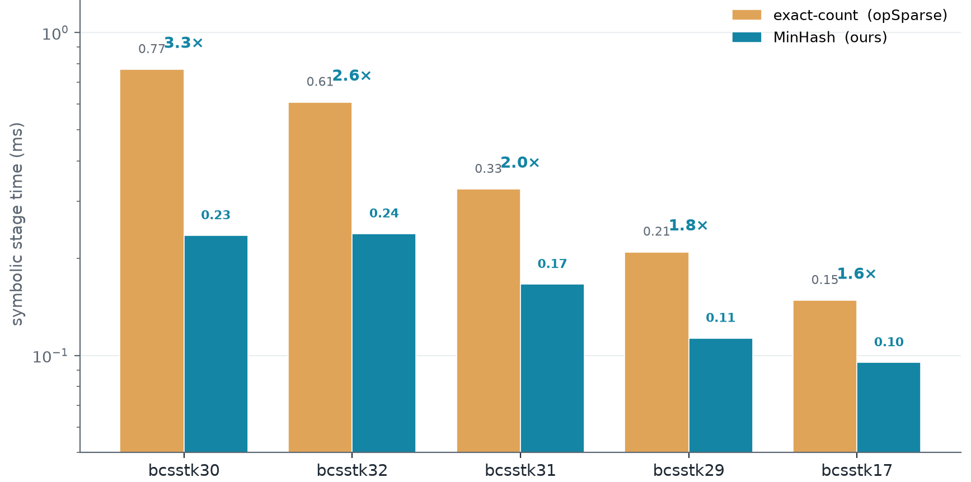



Design3: Light-Symbolic MinHash
Stage-Profiling
else cost 21%
Motivation Prior C[i] nnz Count
Ours: Light Symbolic Sizing
$$A[i, ;]$$
A(operand)
A(operand)
MurmurHash
Partition By Low 7-bits
0
2
8
$$Row_{1}$$
$$B_{0}$$
$$B_{1}$$
$$B_{2}$$
1
5
8
h(5) = 0x3FC9BA20
0x3FC9BA20
∅
0x9C44AB21
$${Sk}_{0}$$
3
3
5
7
9
$$Row_{3}$$
h(8) = 0x9C44AB21
atomicMin
2
12
h(12) = 0x4E193E58
0x1E3C6C20
0x4E193E58
$${Sk}_{1}$$
6
0
4
8
$$Row_{6}$$
h(2) = 0x1E3C6C20
$${Sk}_{2}$$
4
$$Row_{8}$$
9
h(9) = 0xAD44AC32
∅
∅
0xAD44AC32
8
2
9
Expand 1.5x to avoid overflow
Sketch of C[i , ;]
$${Sk}_{0}$$
$${Sk}_{1}$$
$${Sk}_{2}$$
0
2
4
8
9
0x1E3C6C20
∅
0x1E3C6C20
0x3FC9BA20
$$B_{0}$$
Distinct
Count
8
9
$$C_{i}nnz≈\sum_{j}{\frac{2^{32}}{min_{j}}}−m$$
0
2
3
4
5
7
0x4E193E58
∅
0x4E193E58
∅
$$B_{1}$$
0
2
3
4
5
7
8
9
0x9C44AB21
0xAD44AC32
∅
0x9C44AB21
$$B_{2}$$
$$nnz(C[i,;])=\left|\bigcup_{k}{\{}p | A[k,p]≠0\}\right|$$
$$where k∈\{k|A[i,k]≠0\}$$
Take Minimum in Bucket
- Skips exact symbolic counting
- Significantly reduces the time cost (1.4x~3.3x)
- Time Complexity: O(nnz)
- Enumerates all intermediate products
- Duplicates the hash computation
- Time Complexity: O(flops)

Slide 8

Design 4: Tail-Balanced workload partitioning for AA^{T}
Insight: upper-triangle computation reduces arithmetic work, but the actual speedup is limited.
Challenge: Upper-Triangle is Not Enough
Our solution: Tail-Balanced Workload Partitioning
1) Calculate row workload (offline or CPU-side)
Compute only the upper triangle and mirror it to the lower triangle, theoretically reducing the computational workload by nearly 50%.
Row workload = number of generated
upper-triangle partial products
$$w_{i}^{∆}=\sum_{k∈supp\left(A_{i,:}\right)}{|\{j≥i | A_{j,k} ≠ 0\}|}$$
A
A^{T}
1
0
2
1
0
4
5
0
14
0
3
0
✖
0
3
0
0
9
0
2) Reshape row tasks
4
0
5
2
0
5
14
0
41
original row tasks
balanced tasks
GPU execution
across SMs
Upper-triangle workloads are imbalanced
Row 0
SM0
SM1
SM2
Row 1
long-tail bottleneck
Row 2
......
......
Row n-1
heavy rows still dominate GPU runtime
Row n
split heavy rows and fuse light rows → balanced GPU tasks

Slide 9
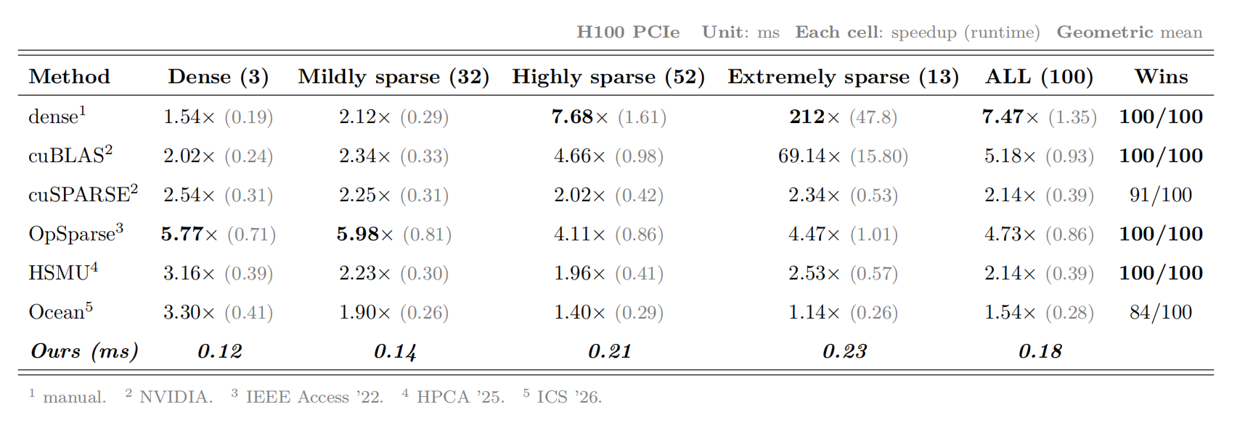
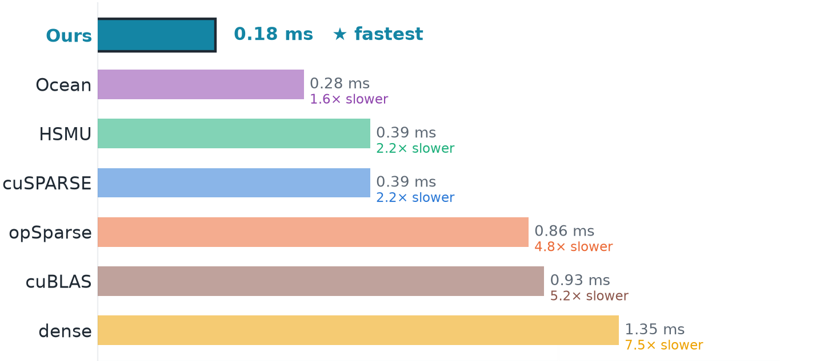


Evaluation
Result vs dense $A×A$ : Average x(up to x) $A×A^{T}$: Average x(up to x)
$$C=A×A$$
$$C=A×A^{T}$$

Slide 10
Conclusion
OVERALL · ADAPTIVE DISPATCH
matrix features
MERGE
Matrix-aware selection
INPUT A
HASH
Merge or Hash
MERGE path
HASH path
AAT path
DESIGN 1 · Column-Domain Parallel Merge
DESIGN 2 · Light-Symbolic MinHash
DESIGN 4 · Tail-Balanced AAT
K0
B0
B1
B2
balanced tasks
K1
SM0
SM1
SM2
K2
concatenate
atomicMin
C[i,;]
sketch
column-sorted C[i,:]
OVERALL RESULT

Slide 11

Engineering Optimizations
Pinned-Memory Pool for h2d/d2h
Kernel-Fusion
h2d
download A
symbolic/
sizing
accumulate
extract/
sort
d2h
upload A
Before: many separate kernels:
$$launch_{0}$$
$$launch_{1}$$
$$launch_{2}$$
$$launch_{3}$$
$$launch_{4}$$
$$launch_{5}$$
cudaMallocHost +
cudaFreeHost (lock&unlock)
Prior
cudaMallocHost
(pin page)
hostbuf
(pagebale)
PCIe Transfer
GPU
cudaFreeHost
(unpin page)
6 launches → 3 launches
repeats $×$ N transfers
$$launch_{0}$$
$$launch_{1}$$
$$launch_{2}$$
Every h2d/d2h pays a page-lock syscall
After: Fused kernels
Ours
- Fewer launches & syncs Less fixed overheard
- No regression in large cases
bp* matrices runtime reduces ~0.1ms
Pinned Pool(Init Allocate & Page Lock ONCE)
pool.get()
O(1) bump
pinned buf
(lock)
GPU
pool.return()
(no-op)
Expand Range Tightening
PCIe Transfer
async
EXPAND is the safety factor on the hash-table size estimate; tightening it from 2.0× to 1.5× cuts over-allocation 3.14×→2.29× and saves 0.32 ms in compact+sort
- Zero page-lock syscalls in the transfer loop
- DMA direct over PCle
58.7 - 9.2 ms (bcsstk30) 9.4 - 1.9 ms (bcsstk17) 1.84 - 0.91 ms (bcsstk11)

Slide 12
Scalability & Cost Trade-off Analysis
Cost Analysis
Scalability Analysis

