Slide 1
OODP CA
FT Team#2

Slide 2
Design Issue
Currently the VMCS only allows customer to pay coins.
If new requirement comes that it should support different approach of payments such as pay by EZ-Link card.
How to design the system to satisfy that needs.

Slide 3
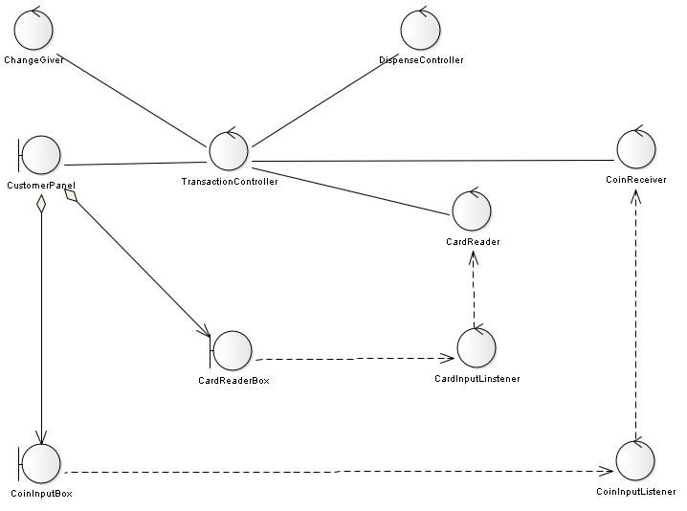
Brute Force Design – Class Diagram

Slide 4
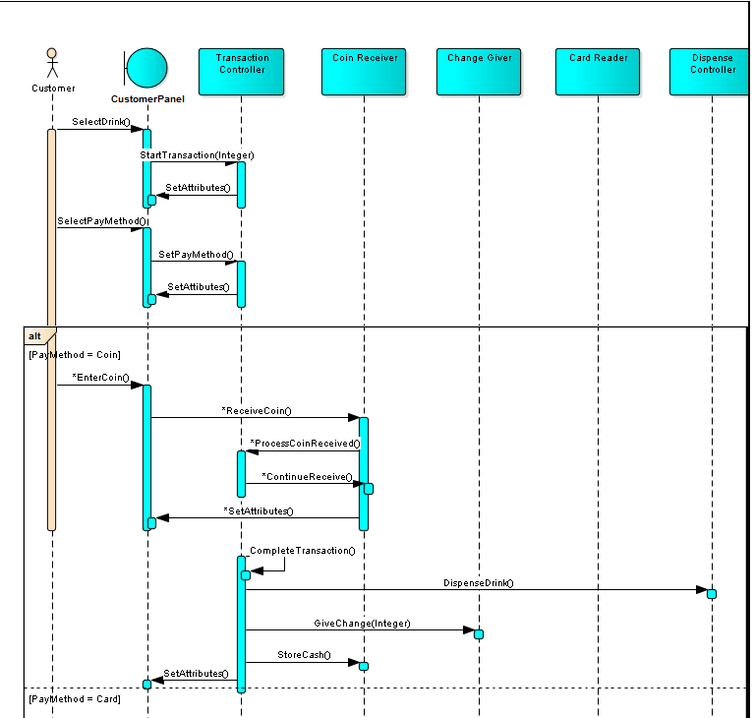
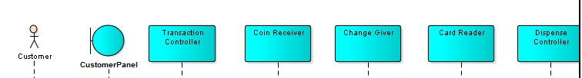
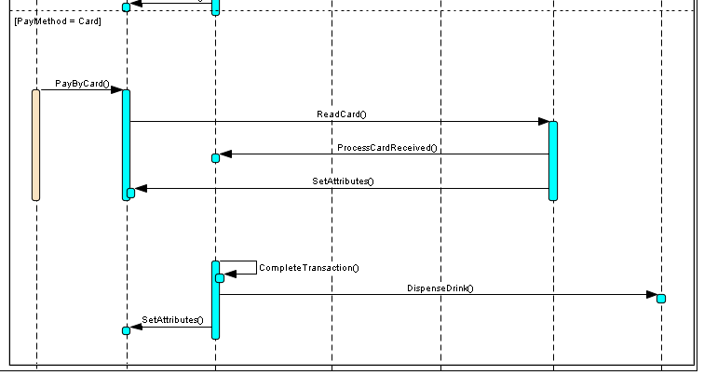
Brute Force Design – Sequence Diagram

Slide 5
Design problem
Needs the flexibility of add/changing the behavior of payment method conveniently.
Notes:
To support multiple payment methods, there would be many conditional branches with logic that will invoke different controllers and UI components to perform the task in the TransactionController. That makes it bigger and harder to maintain.
When it is required that to add or drop a payment method, the TransactionController has to be modified too much.

Slide 6
Candidate Pattern
Strategy
Related pattern from Cause for Redesign
Algorithmic Dependencies
Builder
Iterator
Template Method
Visitor

Slide 7
Motivation to use Strategy
Suits the applicability of Strategy pattern
Consequences of applying it solves the problem
Families of related algorithms
Alternative of subclassing
Eliminates conditional statements
Notes:
The algorithm’s structure should be more flexible and changeable considered different situations for different payment option.
For instance, the vendor should give change when we use coin to pay but in card payment the vendor don’t need to do that.

Slide 8
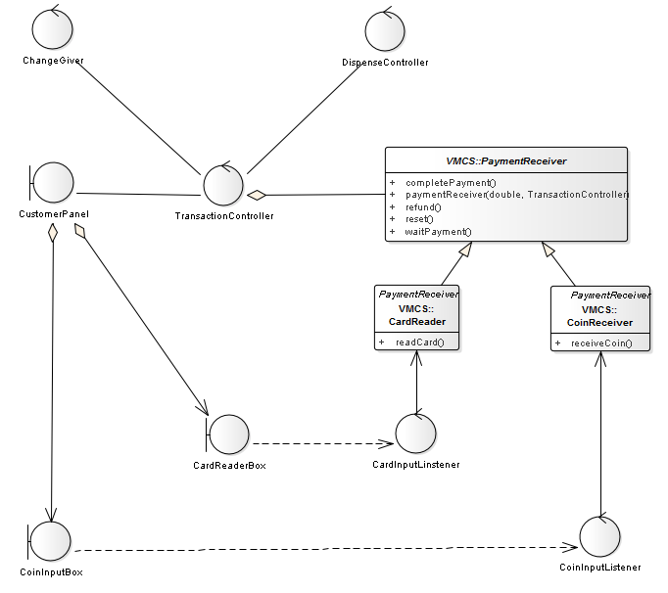
Class Diagram

Slide 9
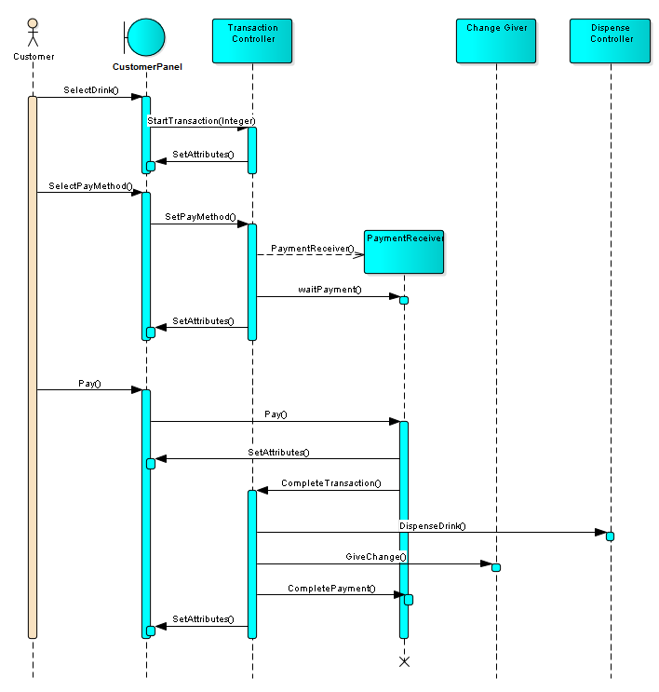
Sequence diagram

Slide 10
Implementation decisions
Define the Strategy and the Context interfaces to provide efficient access to data from each other.
Decision: Pass the context itself into Strategy and let Strategy keep it as a reference.
Rationale: 1. Strategy needs to call Context’s method to complete transaction.
2. Strategy needs to access UI components which is an attribute of Context.
Consequences: 1. Strategy can request what it needs from Context
2. Tight coupling

Slide 11
Implementation decisions
2. Strategies as template parameters.
In C++ only ,N/A in Java

Slide 12
Implementation decisions
3. Making Strategy object optional. To simplified the Context.
Applicable when Context is still meaningful without a Strategy object.
In that case, Context has to carry out default behaviors.
N/A

Slide 13
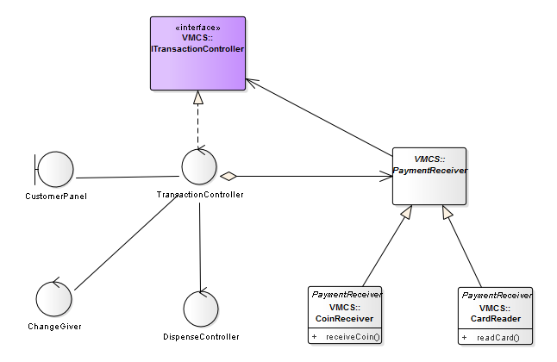
Other issue

Slide 14
QA

