Slide 1
Justifications
It provides interoperability with non-WCF clients that support the WS* stack.
It supports the WS* stack, including reliable messaging, message security, and secure transactions.
Message security is turned on by default. Transport security is also available.
It allows the service to be hosted in IIS 5.0 or IIS 6.0.
If you choose transport security, you can use certificate, Windows, or token authentication.
If you choose message security, you can use certificate, username, Windows, or issue token authentication (Windows CardSpace).

Slide 2
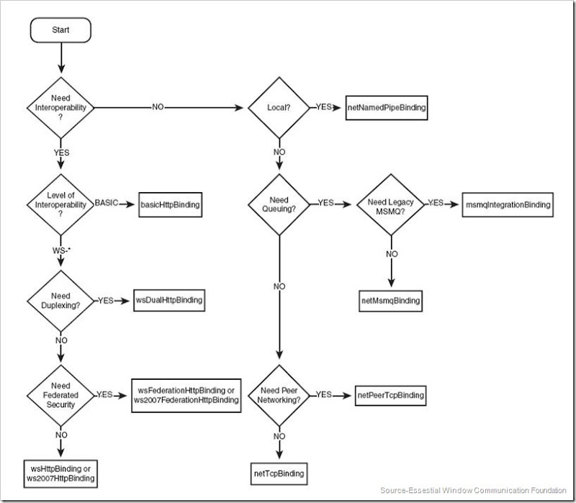
Binding Decision Tree

