Slide 1
Justifications
It provides interoperability with non-WCF clients that support the WS* stack.
It supports the WS* stack, including reliable messaging, message security, and secure transactions.
WsHttpBinding messages are encrypted by default and achieve Message security. . We can also include Transport security .
It allows the service to be hosted in IIS 5.0 or IIS 6.0.
If you choose message security, you can use certificate, username, Windows, or issue token authentication (Windows CardSpace).
If you choose transport security, you can use certificate, Windows, or token authentication.

Slide 2
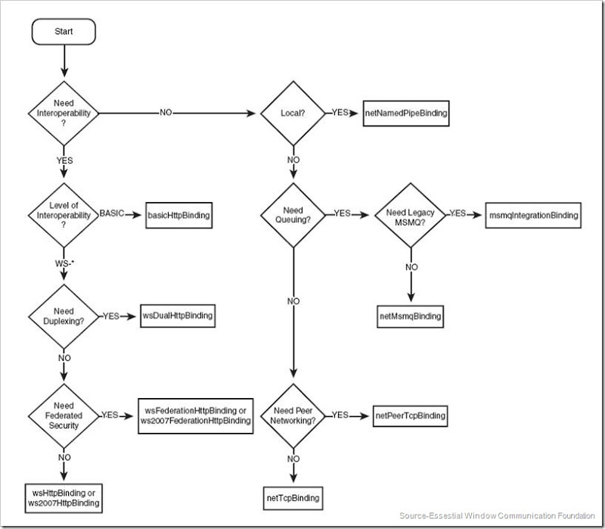
Binding Decision Tree

