Slide 1

Creating a Positive Employee Environment
建立和谐的劳资关系和组织气氛
Colleen Law 罗淑华
VP, Human Resources 人力资源副总裁
Emerson Electric Asia-Pacific 艾默生电气公司亚太区总部
November 17, 2003
2003年11月17日

Slide 2

Emerson Corporate Overview
艾 默 生 公 司 概 况
Founded in 1890
成立于1890年
Head-quartered in St Louis, Missouri, USA
总部设于美国密苏里州圣路易斯市
Global product and market leadership
全球市场和技术领导者
Record of consistent long-term performance
保持长期的优秀业绩纪录
Global sales of US$13.8b in 2002
2002年总销售額达138亿美元
More than 110,000 employees worldwide
全球员工超过十一万名
Over 60 industry-leading divisions located in
over 300 manufacturing locations in 150 countries
超过60家业界翘楚的子公司
超过300个生产基地，分布于世界150多个国
St. Louis headquarters
圣路易斯总部
Notes:
1
1
75
23
20
18

Slide 3


“2003 Fortune’s World’s Most Admired Companies”
Emerson named Global Top 50 ‘All Star’
艾默生名列 2003《财富》“全球最受讚赏的公司”全明星企业全球 50 强
Overall rank 全球排名 : #47
Industry rank 全球电子业排名: #3 global
9 rating categories 评选标准：
  social responsibility 社会责任感
  innovation 革新度
  long-term investment value 长期投资价值
  use of corporate assets 公司资产运用
  employee talent 员工素质
  financial soundness 财政状况
  quality of management 管理质量
  quality of products/services 产品和服务质量
  global business acumen 全球商务敏锐度
Global Electronics
1. GE
2. Sony
3. Emerson
US Electronics
1. GE
2. Emerson
Notes:
Feb 27, 2003
Fortune notes that Emerson’s was selected from the All-Star list by “… delivering solid products - and financial results.”
This year’s global survey polled 10,000 directors, executives, and managers in 29 industries around the world.
A technology leader, Emerson’s more than 60 divisions operate some 320 manufacturing locations worldwide in the design, manufacture and sale of engineered products, services and solutions.
International sales (incl. US exports) totaled US$5.8 billion in 2002, representing 42% of the company’s sales.
Emerson’s management model has been widely recognized:
named as one of Industry Week’s notable 100 Best-Managed Companies for 5 consecutive years.
Business Week has previously recognized Emerson as one of the top 25 best-managed companies.

Slide 4
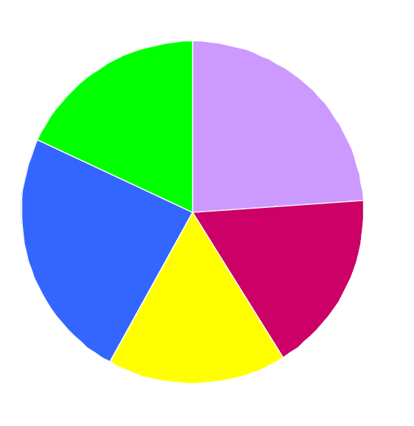
2002 Sales by Business Group
2002 年 销 售 之 业 务 范 畴 分 布
( US $13.8 Billion in Total 总 额 达 138 亿 美 元 )
Industrial Automation
工业自动化
18%
Appliance & Tools
家电和工具
24%
Process Control
过程控制
24%
HVAC
供暖、制冷及空调
17%
Electronics & Telecommunications
电子及电信
17%

Slide 5





Global Market and Technology Leadership
全 球 市 场 和 技 术 领 导 者
电子及电信
Electronics & Telecom
#1 AC & DC Power Systems
#1 OEM Embedded Power
#1 Precision Climate Systems
#1 Fiber Optic Conduit
家电及工具
Appliance & Tools
#1 Fractional Motors
#2 Appliance Components
#1 Storage Solutions
#1 Waste Disposers
#1 Plumbing Tools
过 程 控 制
Process Control
#1 Control Valves
#1 Measurement Devices
#2 Systems & Solutions
工业自动化
Industrial Automation
#1 Alternators
#1 Motors
供暖、通风及空调
H V A C
#1 Compressors

Slide 6
Emerson China Overview
艾 默 生 中 国 概 况
Started doing business in China in late 1970s
七 十 年 代 末 开 始 发 展 中 国 业 务
China is Emerson’s biggest business partner in Asia
中 国 是 艾 默 生 在 亚 洲 的 最 大 商 务 伙 伴
  Second only to U.S. in sales in ‘02
  ‘02 年 销 售 額 仅 次 于 美 国
Current Infrastructure: 基 本 设 施
  27 manufacturing operations in 10 locations
  27 家 工 厂 在 10 个 地 点
  9 joint ventures, 21 wholly-owned
  9 家 合 资 公 司， 21 家 全 资 公 司
  More than 12,000 employees
  一 万 二 千 多 名 员 工

Slide 7

Our Promise我们的承诺
Emerson is where technology and engineering come together to create solutions for the benefits of our customers, driven without compromise for a world in action
坚持不懈﹐整合科技与工程技术﹐
为客戶提供最有利的应用方案

Slide 8
ROLE OF HUMAN RESOURCES人力资源部的职责
Communications 沟通
Employee Advocacy员工沟通媒介
Accountability 问责
Emphasis on Good Supervision 强调有效的监督
Urgent Problem Response 对问题迅速作出反应
Strong Ethics Program 严格执行职业道德规范制度
Recruitment – Development – Retention 招聘 – 发 展 – 人才挽留
Legal Compliance 遵守法规
Ensure a Safe Workplace 确保工作场所的安全
Integral Part of Management Team 管理团 队 的核心组 成部分

Slide 9
Role of Human Resources人力资源部的职责
Communications 沟通
Employees can maximize their contributions to the organization only if they fully understand the business strategy plan and opportunity 员工只有在充分理解公司的商业战略计划/机遇时才能释放其最大的能量
Annual communication plan developed at each location 每个内部组织制定年度沟通計划
  Think about our key messages 重点在关键信息方面
  Decide upon communication methods 确定沟通方式
  Follow through on the scheduled communications 认真完成沟通计划

Slide 10
Role of Human Resources人力资源部的职责
Employee Advocacy
人力资源代表应该是员工沟通的媒介
“We Exist To Ensure That The Employee Point Of View Is Always Heard And Considered And That Our Personnel Policies Are Correctly Administered.”
“我们的存在目的是确保员工的想法
能被充分了解和考虑，并保证我们的
人事政策得到正确实施。”

Slide 11
“The Human Resources Balancing Act”
“平衡的艺术 ”
Human Resources and Business Planning
人力资源和业务规划
Communication 沟通
Employee Advocate Business Advocate
员工期望 业务需要
______________________________________________

Slide 12
Role of Human Resources人力资源部的职责
Accountability 问责
Human Resources and Management are accountable for how they interact with employees. This is accomplished through the use of :
在艾默生，和员工沟通是人力资源部和管理层的重要职责，我们通过以下途径来 实现上述目标：
    Annual Communication Plan 年度沟通计划
    Employee Opinion Surveys员工意见调查
    Human Resources Reviews 人力资源系统测评

Slide 13
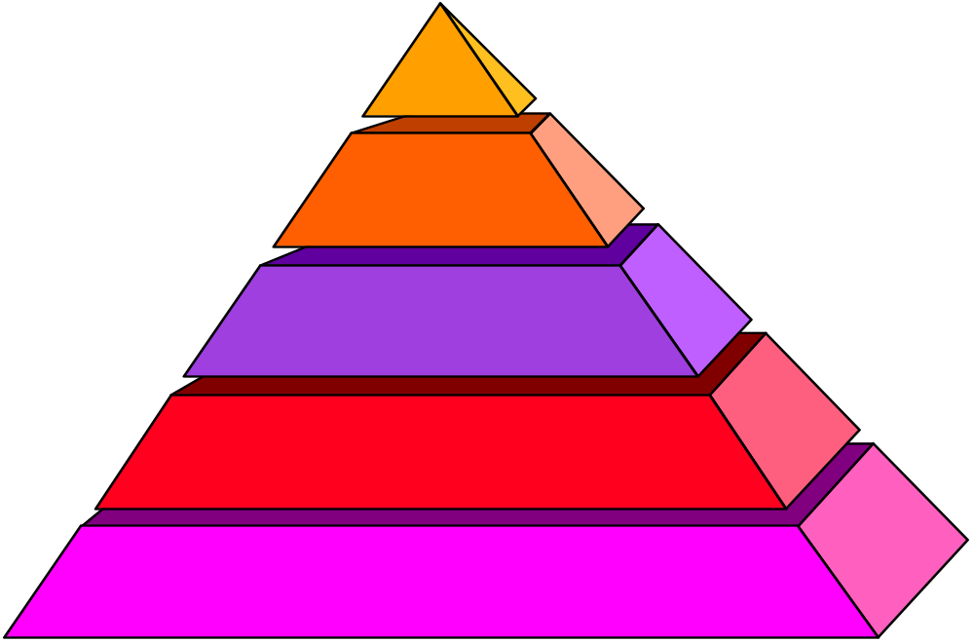
Annual Communication Plan 年度沟通计划
ACP
年度沟通计划
S-O-B Address
One (1) Per Year
每年一次年度业务
改善状况演讲 S-O-B
All Employee Meetings
季度员工会议
Departmental Meetings
周期性部门会议
Tool Box Meeting
定期小组会议
Notes:
有效的溝通及靈活的資訊交流
在推動卓越業務運籌項目時，溝通是十分重要的。公司對貨品品質和服務質素的要求要讓每一位員工清楚了解，也應提供渠道鼓勵員工多反映意見。

Slide 14
Employee Communications员工沟通
One of the Employee Communication Tools for Building the trust
其中一種有效的建立互信的沟通工具
Empoyee Opinion Survey
員工意见调查

Slide 15
The Emerson Employee Opinion Survey 艾默生员工意见调查流程
Foundation of Positive Employee Relations Since 1954 美国总公司自1954年起重视建立良好的员工关系
Critical Division and Plant Continuous Improvement Tool 它是分公司用以持续改善工作的主要工具
Jointly Analyzed by Plant / Division / Corporate ER Staff 由工厂/分公司/总公司员工关系部共同分析调查结果
The Climate Profile Score = Accountability 组织氛围评分 = 问责

Slide 16
Purpose 目的
EOS is used as a management tool for: “员工意见调查”是一种管理工具用于:
  Assessing the overall employee relations climate 评估员工关系的整体氛围
  Identifying specific major problems 识别公司内部存在的主要问题
  Evaluating success of specific programs 评估一些重大的项目工程是否成功
  Assessing training needs 评估培训需要
  Providing a quality control check on communication efforts 为沟通工作提供质量控制检查

Slide 17
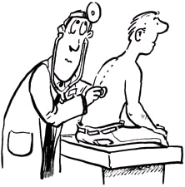
Critical Success Factors 成功要素
Don’t try to manipulate the result
切勿尝试操控结果
Focus on process but not report 应首重过程，而非报告
Signify top management’s commitment to well being of employees 体现管理层对员工所关心的问题的重视和承诺
Survey report is only a means & the starting point to improve rather the end itself 调查报告只是改进的手段及起点，而非最终目标
Segment the employees into workgroup to identify the problem area 将员工分成工作小组以确认问题所在

Slide 18

Critical Success Factors 成功要素
Terrible workload but worthwhile return
工作量极大，但会得到值得的回报
Time management of HR 人力资源部要准确估控工作量
Preparing survey result presentation for work groups 准备各小组的调查结果报告
Conducting work group feedback sessions 进行小组反馈会议
Compiling summary for feedback sessions to derive action plan 汇总反馈会议的意见，从而制定行动订计划

Slide 19

Critical Success Factors 成功要素
Employee but not management perspective
从雇员而非管理层的角度选定问题
Criteria to select optional questions 如何选定问题
Dos 宜
Select what employees dissatisfy most now 选择雇员现时最不满的
Select what make them staying with us & willing to contribute in long run 选择长远而言使他们留效并卖力工作的
Don’ts 忌
Exclude what stakeholders did not like to see 排除个别相关方不想见的
Exclude what seems to be “impossible to improve” or “unaffordable” 排除一些所谓 “不可能改善” 或 “不能承担 ” 的

Slide 20

Critical Success Factors 成功要素
Not to justify what we have done in the past but to dig what we should do in the future
应寻找未来该做的事，而非已取得的成就
When interpreting the result data 当研究原始数据时
Be action-oriented 以行动为本
Highlight the “most unfavorable” but not “most favorable” to look for opportunities to improve 著重评分 “最差” 而非 “最好” 的，以寻找改进机会
Think critically for any “unexpectedly unfavorable” to bridge the gap of perception between management & employees 认真思考 “出人意料的差” 的，以拉近管理层与雇员对该问题的认知的距离

Slide 21
Focuses 重点
Emphasize on 着重点
  Small group feedback meetings with employees 反馈会谈
  Analysis meeting and action plan development 调查分析会议及制定行动计划
  Employees communication of the action plans 与员工沟通有关行动计划
  Follow up actions execution 跟进行动计划

Slide 22
Focuses 重点
Small group feedback meetings 反馈会谈
  A small group meeting without supervisors’ participation 主管不应参与小组会谈
  LISTEN to employees’ concern and clarify if needed 只須倾听并澄清相关问题
Analysis meeting and action plan development 调查分析会议及制定行动计划
  Develop action plans and focus on unfavorable questions and low score workgroups 制定行动计划并集中在员工满意度低的方面及低分小组
  Corporate HR to review the action items to ensure employees’ concerns have been properly addressed 与总公司商讨以确保员工问题得到回应

Slide 23
Focuses 重点
Employee communication 員工沟通有关行动计划
  Address to all requests, including requests which will not or cannot be met 回应员工所有要求, 包括不会或无法滿足的要求
  Explain the action items, time schedule and the responsible persons/team 向员工解释行动项目﹐时间表和负责人员/单位
Follow Up 跟进行动计划
  Submit a follow up report to Corporate HR six months after the action plan has been confirmed 在六个月后向总公司呈交跟进行动计划报告

Slide 24
*** The End***
Thank You!

