Slide 1
Ericsson Compensation & Benefit
爱立信薪酬体系
2002年9月18日

Slide 2
Ericsson Compensation & Benefit
爱立信薪酬体系
C&B vs Company strategy & HR management
薪酬与公司管理和人力资源管理的关系
C&B system establishment, competitiveness, impact to
company finance
  薪酬体系的建立、竞争力、对公司财务管理的影响力

Slide 3
What are Ericsson’s business measurements?
爱立信业务的衡量尺度？
(它随着公司业务的转变而变化，去年可能是净销售额、客户满意度、现金流，今年则是订单数量和应收帐款等)

Slide 4
The business measurements decide the c&B strategy
业务的衡量尺度决定公司薪酬体系的战略
(如奖励机制中目标的制定直接与业务战略相关)

Slide 5
Why HR need to look at money?
人力资源为什么向“钱”看？
all HR activities can be put in money term
所有的人力资源管理活动都可以用钱来衡量
No financial mind-set & analysis, HR is blind.
没有财务分析和头脑，人力资源管理是盲目的。

Slide 6
Net sales per employee
人均净销售额
Net sales 净销售额
total no. of employees 员工总数
Notes:
excluding the hosted activities.

Slide 7
Employee cost vs OPEX
员工费用/营运费用
OPEX run rate/total turnover
营运费用/总营业额
Employee cost/OPEX run rate
员工费用/营运费用

Slide 8
How to build HR management into business process?
如何把HRM建立到业务流程？
Company financial
objectives
公司财务目标
HR reward system
HR奖励机制
Customer
satisfaction
客户满意度
Human capital index
人力资本指数

Slide 9
Key elements of HR operation
人力资源运作的关键要素
组织设置
Organizational
design\M&A
绩效评估和反馈
Performance
evaluation &feedback
人员配置、人才招聘
resource planning &
staffing
设定目标/指标量化
Setting objectives
& measurement
培训和能力发展
Training & competence
development
薪酬体系
C&B

Slide 10
Motivation characteristics of Successful Companies 成功企业激励机制的特点
support company strategy and development
配合公司战略和发展
fully align with company goals
不偏离公司目标
each motivation action has its specific objective
任何一个激励机制都有它特定的目的
flexibility, fit into individual’s desires
因人而异

Slide 11
MOTIVATION激励机制
企业运作环境
Business environment (industry, globalization,
market competitiveness)
工作，机会，工资，奖金，奖励，股票，
国外工作机会，教育，培训，管理风格，工作环境，组织结构，工作效率
品牌 brand
员工的价值
Value of staff
企业文化
Company culture

Slide 12
Compensation & Benefit
薪酬体系

Slide 13
仁者见仁，智者见智的薪酬体系
人力资源管理中技术/技巧难度最大的部分
人力资源管理的灵魂
最直白的竞争
管理的平台
直接影响公司财务运作
既灵活又抽象，
为我所用

Slide 14
C&B Program Management Cycle
薪酬体系管理流程
Organization’s Strategy 组织战略
Human Resources Strategy 人力资源战略
C & B Strategy 薪酬战略
Program Design
体系设计
Program Evaluation
体系评估
Communication
& Training
沟通与培训
Administration &
Implementation
操作执行

Slide 15
Factors to be considered in C&B Strategy 薪酬战略的考虑因素
Customer Value
客户价值
Price 价格
Quality 质量
Service 服务
Employee Value
员工价值
C&B 薪酬
Other returns 其他回报
Organization Value
组织价值
Financial Result 财务结果
Org. Performance 组织结果
C&B Strategy
薪酬战略

Slide 16
C&B Objectives 薪酬目标
Employees
员工
Company
公司
Attract 吸引
Retain 保留
Motivate 激励
Achieve Objectives
达到公司目标

Slide 17
Key Elements of C&B
薪酬福利的关键要素
IPE (International Position Evaluation) System 国际职位评估系统
C&B Package 薪酬内容
Performance Management 绩效管理

Slide 18
IPE - International Position Evaluation
IPE - 国际职位评估系统
- A Human Resource tool which measures the
impact and contribution of each position
一种人力资源的工具，用来衡量每个职位的影响和贡献
Salary survey to benchmark competitiveness 用于工资调查以衡量竞争力
Establish salary level and structure 用于建立工资水平及结构
Facilitate recruitment 用于招聘
Facilitate career planning 用于职业发展的计划
Promotion and job rotation 用于升职和工作变动时的职位评估
Organization development 用于组织发展时的职位评估

Slide 19
The Four IPE Factors
IPE 的四个要素
Factor 1: Impact 影响力
Factor 2: Communication 沟通
Factor 3: Innovation 创新精神
Factor 4: Knowledge 知识技能

Slide 20
Factor 1: Impact 影响力
Contribution 贡献
Size of organization 组织大小
Influence on it’s area of responsibility / operation 对于职责范围内的影响
Impact影响力
Organization 组织大小

Slide 21
Factor 2: Communication 沟通
Frame 架构(内部或外部)
Position’s responsibility for
communications both within and
outside the organization
职位要求的对内部及外部的沟通
Communications 沟通

Slide 22
Factor 3: Innovation 创新精神
Identify, develop and make
improvement to new ideas, techniques,
procedures, services, or products
发现、发展、改进新的想法、技术、
程序、服务或产品
Complexity 复杂性
Innovation 创新

Slide 23
Factor 4: Knowledge 知识技能
Knowledge required in job to
accomplish objective and create value
完成工作并增加价值所需的知识技能
Teams 团队
Knowledge 知识技能
Breadth宽度

Slide 24
Steps to set IPE System
设定IPE的步骤
Step 1
Establish working committee 建立工作组
Step 2
Understand IPE system and define role of each party
了解IPE系统并规定每一方的职责
Step 3
Review job description and design checklist questions
回顾工作描述并设计相关问卷
Step 4
First interview line manager 与经理第一轮面谈
Step 5
Calculate IPE score and second interview line manager 算出IPE分数并与经理第二轮面谈
Step 6
Management team review and approve
管理层审核并批准

Slide 25
C&B Package 薪酬内容
competitive in the market to attract, retain and motivate
保持市场竞争力从而吸引、保留、激励员工
Compensation薪酬
Benefits 福利
Fixed Salary 固定工资
Social Insurance 社会保险
Housing Fund 住房公积金
Supl. Housing Fund 补充住房基金
Sports allowance 运动补贴
Leave & holiday 休假
Life&Medical Insurance人寿和医疗保险
Overseas Travel Insurance 境外旅行保险
Transportation 交通
Meal allowance 饭补
Others - welfare, rewarding 其他...
Base Salary 基本工资
13 Months Salary 年底双薪
Overtime Payment加班工资
Travel Allowance 出差补贴
Variable Pay 浮动工资
Short Term incentive 短期激励奖金
Sales Incentive 销售奖金
Performance bonus 绩效奖金
Stock Option 股票期权

Slide 26
C&B Package Designing Principles
薪酬设计原则
Externally competitive 外部竞争力
Internally equitable 内部公平性
Cost Affordable & Appropriate 成本承受力及合理性
Understandable 员工及公司的认同性
Efficient to administer 便于操作

Slide 27
Externally Competitive 外部竞争力
Select competitors. 选定竞争对手
Select the appropriate type of survey 选择适当的市场调查
Determine current market position 了解目前在市场上的位置
Set target on Market positioning 设定市场定位目标 (e.g. 25P, 50P, 75P or 90P)
Adjust C&B policies accordingly 相关薪酬政策调整

Slide 28
Who are our reference?
我们和谁比较？
XX的薪酬参照物？

Slide 29
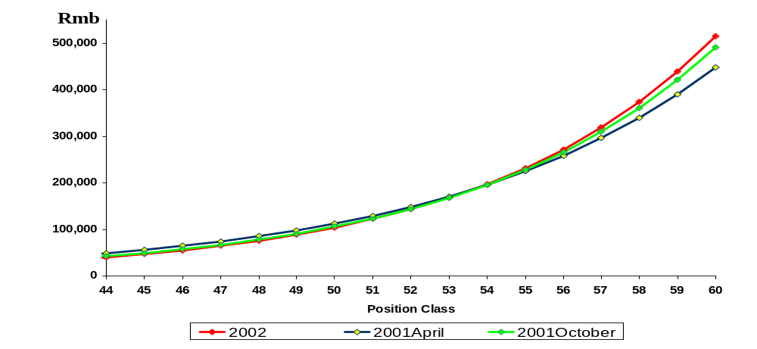
Example1：Market Survey Data Analysis
举例1：市场调查数据分析
- Market Movement市场移动
Overall Variance 总述
2002 April fixed salary is 3% and 2% higher than 2001 April and 2001 October respectively. 2002年4月市场工资比2001年4月和10月分别增长了3%和2%。
At IPE 60 Level
2002 April is 15% higher than 2001 April and 5% more than 2001 October.
IPE60的员工，2002年4月市场工资比2001年4月和10月分别增长了15%和5%。

Slide 30
Example2：Market Survey Data Analysis
举例2：市场调查数据分析
- One Company’s position in the market 公司在市场上的位置
Annual Total Cash
300000
90P
250000
200000
75P
150000
50P
25P
100000
50000
0
IPE
42
43
44
45
46
47
48
49
50
51
52
53
54
55
56
57
58
59
60

Slide 31
Internally Equitable 内部公平性
Internal equity is reflected in the following areas :
内部公平性反映在以下方面：
Base Pay - Systematic Salary Structure 基本工资 -- 系统的工资结构
Variable Pay - based on Co.’s achievement. 浮动奖金 -- 与公司业绩挂钩
Benefits - secure program for every employee 福利计划 - 为每位员工提供保障
Stock Options - to retain & motivate key contributors 股票期权 -- 保留和激励关键员工
Performance Management - Standard measurements 绩效管理 -- 统一的衡量标准

Slide 32
Cost Affordable & Appropriate 成本承受力及合理性
- Financial Analysis 费用的管理
C&B Cost Forecast - decides if it’s affordable
  薪酬费用预算 -- 决定公司是否有能力支付
OPEX Forecast - decides if it’s appropriate and acceptable by Management
  营运成本与净销售额的比值(OPEX)的预算 -- 决定薪酬是否合理，并能
  为管理层所接受

Slide 33
Understandable
员工及公司的认同性
Win-Win Principle 双赢原则
  Employees create value for Company 员工为公司创造价值
  Company provides employees competitive compensation and helps employees to achieve individual objectives. 公司为员工提供有竞争性的薪酬并帮助员工实现个人目标。
Efficient Communication 有效的沟通

Slide 34

Efficient to administer 便于操作
Negative Example :
负面例子：

Slide 35
实例1：
Base Salary Setting 基本工资设定
Salary Structure Setting 工资结构的设定
Salary revision 调薪

Slide 36
Salary Structure Setting
工资结构的设定
45000
40000
35000
30000
25000
e
Salary Policy Line
工资线
s2
d
20000
a2
c
15000
a
b
s1
c
10000
a1
5000
IPE Grades
0
a b c = Mid-Point Progression 中值变化
a1 - a2 = Range Spread 幅度范围
s1 - s2 = Range Overlap 范围重叠

Slide 37
Salary Policy Line 工资线
market data & current salaries are reference; 以市场数据和现行工资为参考
Use regressed trend line; 用回归曲线
Consistent with the C&B strategy of the organization 与公司薪酬战略保持一致

Slide 38
Midpoint-to-midpoint Differential 中值之间的差别
5-10% between grades for Adm. staff; (IPE43-49) 行政人员-每个级别差约5-10%；
8-15% between grades for professional and management (IPE50 - 57)专业技术或管理人员-每个级别差约8-15%；
30-35% between grades for executive levels (IPE58+) 高级管理人员-每个级别差约30-35%；

Slide 39
Range Spread幅度范围
Narrow range (30-50%) for adm. staff; 窄幅(30-50%)适用于行政人员；
Wider range (40-60%) for professional staff; 稍宽幅度适用于专业技术人员；
Widest range (60%-300%) for managerial & executive staff. 最宽幅度适用于管理人员

Slide 40
Range Overlap 范围重叠
A function of midpoint differentials and range spreads; 由中值差别与幅度范围决定
Overlap of five grades is common. 五个级别内的重叠为正常
Broad banding may produce substantial overlap. “宽级”会造成很大的范围重叠。

Slide 41
Factors Influence Salary Revision 影响个人工资调整的因素
Performance Rating 表现评估得分
Individual Pay Position to Salary Structure 相比工资结构，个人的工资水平
  salary exceeding the maximum: lump sum 工资超过最高值，付一笔金额，无工资增长
  salary beneath the minimum: special adjust 工资低于最低值，特殊调整
Competence and Market Value 能力与市场价值
Cost of Living 物价水平

Slide 42
实例2：
Incentive Setting 奖金设定
Incentive vs Guaranteed Pay 奖金与固定薪酬的比重
Incentive objectives setting 奖金目标的设定

Slide 43
Incentive vs Guaranteed Pay
奖金与固定薪酬的比重
- Market Movement (example) 市场移动(举例)
Admin/Sec.
100%
10%
General staff
100%
10%
Mgr.&Prof.
100%
15%
Sales general staff
100%
23%
Sales Prof.
100%
30%
Sales Mgr.
100%
28%
0%
20%
40%
60%
80%
100%
120%
140%
Guaranteed Cash
Variable Payment

Slide 44
Incentive Objectives Setting
奖金目标的设定
-Sales Incentive销售奖金
1999
2000
Turn Over(order booking, net sales) 营业额(定单，净销售额)
Market Share市场份额
Cash Flow现金流
Product Mix产品组合
Turn Over(order booking, net sales)营业额(定单，净销售额)
Market Share市场份额
Cash Flow现金流
Product Mix产品组合

Slide 45
Incentive Objectives Setting
奖金目标的设定
-Sales Incentive销售奖金
2001
2002
Max. 4 Objectives: 最多4个目标
Orders Booked (compulsory)定单量(必须)
Net Sales (compulsory) 净销售额(必须)
Market Contribution (for managers) 市场损益(针对经理)
Product Mix (strategic products & services)产品组合
Customer Satisfaction客户满意度
Account Receivable 应收帐款
MU China Net Sales (compulsory) 中国市场净销售额(必须)
MU China Cash Flow (compulsory)中国市场现金流(必须)
Customer Satisfaction客户满意度
...
(half-year evaluation & payment) (半年评估一次)

Slide 46
Incentive Objectives Setting
奖金目标的设定
-STI & Performance Bonus短期激励奖金和绩效奖金
1999
2000
Based on 5 business perspectives of financial, customer, employee, innovation, internal efficiency, Y2K 基于财务、客户、员工、创新、效率等5个方面，以及Y2K。
25% of financial objectives, 75% of KPIs with financial & non-financial 须至少有25%为财务指标
No restrictions on number of objectives 对目标的设定无数量限制。
Maximum 4 objectives 最多4个目标
At least 1 objective is financial至少一个是财
务目标
1 objective from the unit in which the
employee works 有一个员工所在部门的目标
1 objective from the unit of line manager
works 有一个员工经理所在部门的目标
Each organization decide objective weight
各组织自己决定各项目标的权重
“Grandfather” principle reinforces
objective alignment 两层经理批准以确保目标
的一致性

Slide 47
Incentive Objectives Setting
奖金目标的设定
-STI & Performance Bonus短期激励奖金和绩效奖金
2001
2002
Maximum 4 objectives 最多4个目标
Overall objectives of Net Sales/Orders Booked, Market Contribution, Quality/TQM is cascaded down; 整体目标如净销售额、定单量、市场损益、质量等由上自下设定
One of manager’s objectives should be shared by subordinates 下属须有一个目标与经理分担。
Maximum 5 objectives最多5个目标
MU China Net Sales (compulsory)中国市场净销售额(必须)
MU China Cash Flow (compulsory)中国市场现金流(必须)
Others其他
(half-year evaluation & payment) (半年评估一次)

Slide 48
C&B Program Evaluation 薪酬体系评估
Impact on organization’s performance (Customers Satisfaction, Profit, external image, etc.) 对公司业绩的影响 (客户满意度，赢利，外部形象，等)
Costs 费用
Employee turnover rate 员工离职率
Human Resources Effectiveness 人力资本指数

Slide 49

Performance Management 绩效管理
PD Discussion (Q1) 个人发展谈话
Review job description
回顾工作描述
Set Objectives Measurements
设定目标及衡量标准
Competence Profile 技能要求
Individual development plan
个人发展计划
Development Actions 发展行动
(Q1-Q4)
Training 培训
Coaching 教练
Counseling 咨询
Review 审核
Performance Appraisal (Q4) 绩效评估
Evaluate Objective achievements
Assess personal performance factors
评估目标达到情况，其结果将：
Input for next year’s PD Discussion
作为次年个人发展谈话参考
A base for salary revision 作为调薪的基础
A base for career advancement 作为事业发展的基础

Slide 50
PD Discussion
个人发展谈话

Slide 51

When To Have PD Discussion? 何时进行个人发展谈话？
First quarter of the year 每年的第一季度
6 months after new employee on board(Objective can be set once employee on board) 新员工入职后的6个月(目标设定可于员工入职后即完成)
Employee status change 员工情况变化时
  Promotion升职
  Demotion 降职
  Transfer 工作调转
  ...

Slide 52
Step 1 Review Job Description 回顾工作描述
Step 2 Set Objective/Goals - SMART 设定SMART目标
Step 3 Set Standards and Measurement设定衡量标准
Step 4 Discuss Competence Profile 讨论技能要求
Step 5 Individual Development Plan 设定个人发展计划
PD Discussion Steps 个人发展谈话步骤

Slide 53
Setting Objectives,Standards and Measurements目标及衡量标准设定
Examples 举例:
Priority Objectives/ Standards/ Rating
Weight Responsibilities Measurement (1-5)
Deliver project XXX according Delivered by 15th of Apr 02
to time plan and project spec. Increase Customer.Sat after
delivering by over 3,8.
Individual OPEX decreased by By 31st of Dec 02
Kr 25.000,-/year. Documented in the financial
system, cost center XXX
Implement Performance Measured by Dialog, Dec 01:
Management within XXX. All employees have set goals.
All employees have PD-disc.
Increased Empowerment
index by over 30%
30%.
20%.
15%.

Slide 54

The Ericsson Competence Model
爱立信技能模式
Examples 举例:
  Competencies specific for a certain function, role or task.
  3G Competence
  2.5 G Competence
  ...
Competencies relevant to interaction with people.
Managing People
Negotiating Skill
...
Technical/Professional Competence
Human Competence
Individual
Capacities
Business Competence
  Competencies related to the understanding of the business.
  Understanding of Telecom Market
  ...

Slide 55
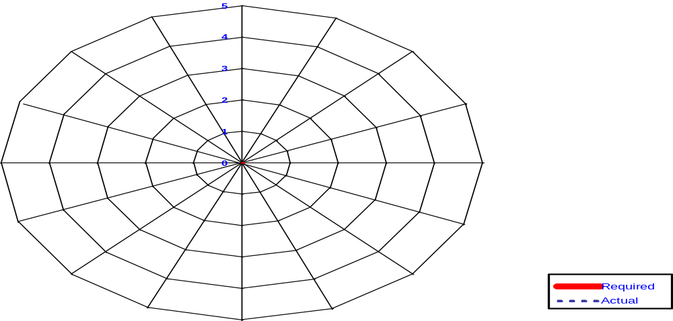
Competence Profile
综合技能评定表

Slide 56
Individual Development Plan
个人发展计划
Examples 举例:
Actions and Courses Planned Time Complete Time
行动/课程 计划时间 完成时间
Attend the LCC course June 2001 May 2002
Participate in the global project of … Feb 2001 Oct. 2001
Implement the PM program in … department May 2001 Dec. 2001
Rotate to … position to get further understanding
of business operation Jan 2002 May 2002

Slide 57
Development Actions
发展行动

Slide 58

Development Actions
发展行动
Training 培训
Coaching and Feedback 教练、反馈
Counseling咨询
Review 审核

Slide 59


Coaching & Feedback 教练、反馈
Feedback反馈
Effective feedback describes
the behaviors under specific
situation 有效的反馈是对于员工
具体情境下行为的反馈
Coaching教练
Coaching is the following up of
feedback, incl. Solving the problem
and action plan. 教练是对反馈的跟进，
包括解决问题及行动计划等。
Good Communication Skill
良好的沟通技巧
Notes:
Difficult to give negative feedback
Not willing to give recognition on good behavior

Slide 60

Feedback: The IDEAL State
给予反馈的理想状态
F = Frequent 时常
A = Accurate 准确
S = Specific明确具体
T = Timely 及时
Notes:
Ask participants to paraphrase what they think each of the elements means.
Frequent = often; this may depend on the nature of the goal or activity and the points at which progress can be assessed
Accurate = correct; multiple perspectives are helpful, but must be verified and completely understood.
Specific = detailed enough to be helpful; should give employee information that he/she can act on
Timely = close to the activity or result it relates to

Slide 61
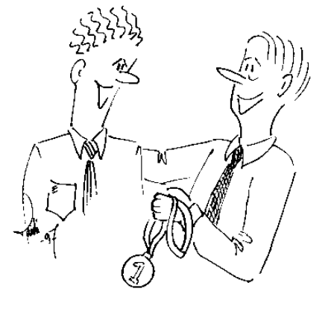
Some examples例子. . .
One approach…
  “That was a great job on the presentation you did last month. I got a few comments about how it could have been shorter, but overall you did fine. Keep up the good work!”
Preferred approach…
  “Your presentation this morning went well. You conveyed very clearly the supporting rationale. In fact, the team agreed with your recommendation and we’ll be moving ahead. One suggestion I’d make for future presentations is spending less time on the alternatives considered. That way the audience remains clear on what’s being proposed.”

Slide 62
Performance Appraisal 绩效评估

Slide 63
What to be appraised? 评估什么
Results & achievements 工作结果评估
  Objectives 目标
  Responsibilities/key results areas 职责
Performance factors 表现因素评估
  Attitude in performing 工作态度
  Competence 能力

Slide 64
Performance appraisal 绩效评估
Rating and Weighting 分值与权重
The overall rating of Performance Appraisal should derive from both rating of objectives/responsibilities and performance factors.
表现评估的最终结果来自目标/职责及表现因素的评估。
Weighting 权重：
Objectives/Responsibilities = 60% 目标/职责占60%
Performance factors = 40% 表现因素占40%

Slide 65
Performance Factors 表现因素
Examples 例如：
. Initiative 主动性
. Problem solving 解决问题能力
. Customer oriented 客户导向
. Team work 团队精神
. Communication沟通技巧

Slide 66
Five Levels of Performance 绩效的五个等级
1
2
3
4
5
UNACCEPTABLE
不合格
NEEDS
IMPROVEMENT
需改进
MEETS
REQUIREMENTS
达到要求
EXCEEDS
REQUIREMENTS
超过要求
OUTSTANDING
表现突出
Performance well below expectations 表现大大低于期望
Immediate disciplinary action required 应立即处罚
requires improvement in some areas 在某些领域需要改进
Is he/she new in the job? 是否为新员工？
Meets all objectives 达到所有目标
Minor shortfalls极少不足
Meet all objectives达到所有目标
Exceeds some objectives 超过一些目标要求
Exceed all objectives 超过各项目标
obvious at all area 在合方面都表现突出
Termination
解雇
Training
培训
Promotion
升职

Slide 67
Normal Distribution of 5 Performance Ratings
五个绩效等级的正态分布
70%
10%
10%
5%
5%
0%
Unacceptable
不合格
Acceptable
需改进
Good
达到目标
Excellent
超过要求
Outstanding
表现突出

Slide 68
Performance Appraisal Form 表现评估表
Examples 举例:
Priority Objectives/ Standards/ Rating
Weight Responsibilities Measurement
Deliver project XXX according Delivered by 15th of Apr 02
to time plan and project spec. Increase Customer.Sat after
delivering by over 3,8. Excellent
Individual OPEX decreased by By 31st of Dec 02
Kr 25.000,-/year. Documented in the financial
system, cost center XXX Outstanding
Implement Performance Measured by Dialog, Dec 01:
Management within XXX. All employees have set goals. Excellent
All employees have PD-disc.
Increased Empowerment
index by over 30%
30%.
20%.
15%.

Slide 69
Thank You 谢谢大家！

