Slide 1
Trust Building:
Methods of Strategic Culture Change
信任的建立:
战略文化改变的方法
Mark Pixley 潘士礼
General Manager 总经理
Leadership Inc
利德顺管理顾问有限公司

Slide 2
Trust in Organizations
组织机构中的信任
As an organization develops, trust becomes a measure of the strength and sustainability of the organization.
当组织机构往前发展时，信任成为组织机构是否具底蕴及持续发展力的考量
Building trust is a challenge as it requires both organizational and individual changes
信任的建立颇具挑战，因为它需要组织机构和个人二者同时进行改变
These changes will result in a new corporate culture
这些变化最终将带入新的企业文化

Slide 3
Changing Nature of Organizations
组织机构的变化本质
Hierarchical
等 级 分 明
Networked
扁 平 化后

Slide 4
Cycle of Trust
信任的循环
Cycle of Distrust
不信任的循环

Slide 5
Matching Challenge with Capabilities
用能力迎接挑战
Challenge挑
战
Stress
压力
Development
发 展
Boredom
厌倦
Capability
能 力

Slide 6
Positive Expectancy
积极的期望
Attitudes have a direct impact on the results of the organization
结果如何态度是根本
Trust based organizations involve a belief about the organization and the individuals within the organization.
对组织机构本身及对机构内个人的信任是以信任为基础的组织机构的基石

Slide 7
The Role of HR
人力资源部的作用
Change Agents (Facilitating the change process)
改变的代言人（引导改变的过程）
Guides (Helping find out what is possible and how to do it)
指导（帮助找出什么是可能的、怎样去做）
Resource Providers (Providing access to support and training as needed)
资源的提供者（为所需支持和培训提供协助）
Nurturers (Provide necessary support and understanding)哺育者（提供必要的支持和理解）

Slide 8
Key Aspects of a Trust based organization
以信任为基础组织机构的主要表现
Sharing and communicating goals (where those goals are developed by those responsible for implementing)
对欲达成的目标及时进行沟通和交流（由执行责任人负责制定目标）
Creating a learning environment (with freedom to discuss and make mistakes
营造学习交流的环境（有讨论的自由，允许犯错误）
Developing self-directed work teams (which utilize the capabilities of its members)
应用自主工作小组（旨在发挥小组成员的能力）

Slide 9
Sharing and Communicating Goals
对欲达成目标的沟通和交流
Strategy 策略
Goals 目标
Action Plans 行动计划

Slide 10
Goal Planning Process
目标的规划过程
A strategy has to be constructed and owned by those who will execute it
策略的制定需由执行者构建并拥有
The process of creating goals enhances the capacity to execute
建立目标的过程有助于提高执行的力度
Goals have to be written and involve accountability
目标须切实可行并认真记录在案

Slide 11
Creating a Common Story
演绎一个共同的故事
The process of developing, executing and achieving goals creates a common story
用发展变化的过程、实施及目标的实现演绎成一个共同的故事
Stories should be record and shared within the organization
故事应归档并在机构内广为宣传

Slide 12
Creating a Learning Environment
营造一个学习交流的环境
Reflecting
反思总结
Doing
行动
Double Loop Learning
双 环 学 习
All experiences (including mistakes) are learning experiences
所有的经验（包括犯错）均为学习到的经验

Slide 13
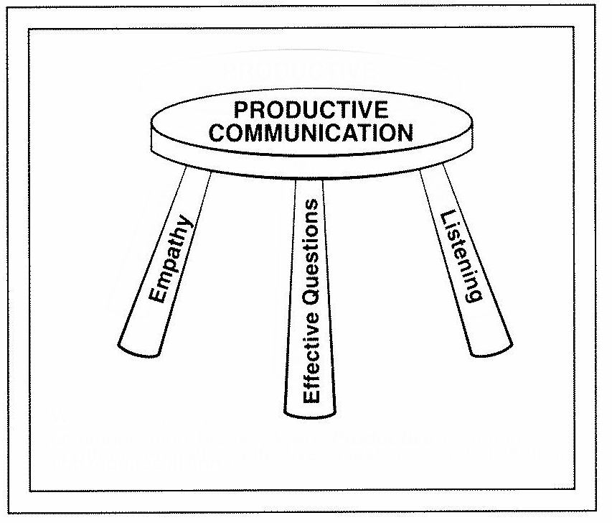
Productive Communication
具生产力的沟通
Listening: The capacity to hear and understand others
聆听：聆听和理解他人的能力
Question: The capacity to inquire into others’ understanding
发问：了解他人是否理解的能力
Empathy: The sense of what others are feeling
同理心：设身处地易位思考

Slide 14
Social Operating Mechanisms
社会运作机制
Methods to enhance communication and interaction within an organization
促进沟通和交流的办法
  Internet
  互联网
  Managerial retreats
  管理层外训
  Planning and Review session
  规划和回顾
  Team building programs
  团队建设方案
  Coaching and Mentoring
  训练和指导

Slide 15
Developing Self-Directed Work Teams
自主工作小组
Self-directed work teams are formally established work groups in which all team members undertake task and approach problems without direct involvement of management
自主工作小组系正式建立的工作小组，小组成员承担任务并发现、解决问题，管理层不必直接介入。
Given challenging goals, sufficient training and reasonable guidelines, self-directed work teams produce high quality communication and involvement
鉴于欲达成的目标很有挑战性，充足的培训、合理的指导纲要、自主工作小组将成就高质量的沟通和积极的参与
The purpose is to capitalize on the knowledge and skills of a large number of people – for the highest possible level of results
目的在于充分利用广大员工的智慧和技巧以获取高质量的成效

Slide 16
Responsibility, Diversity and Leadership
责任、多样性及领导力
The act of giving people responsibility tends to make them responsible
放权意味着让人们负起责任
Most successful teams have a range diverse members who enhance the groups capacity
大多数成功的团队之所以成功在于其成员的多样性/多面性，从而提高团队的整体能力
Leadership often shifts within a self-directed work team according to the situation
随着形势的变幻，领导力常常在自主工作小组间交替

Slide 17
Types of Teams
小组的类型
Operating teams
营运小组
Departmental teams
部门小组
Cross-functional teams
功能交叉小组
Project teams
项目小组
Ideally will be the responsibility, not an additional responsibility
理想境界，职责而非额外的责任

Slide 18
Strategic Culture Change
战略文化的改变
Trust comes first, it is the requisite of sustainable change
信任第一，它是可持续改变的先导
Culture comes last, it is the result of change
企业文化的改变最后，它是改变的结果

Slide 19
Case Study
案例分析

