Slide 1

人力资源管理体系职位评估

Slide 2
广州华路卓企业管理咨询有限公司 http://www.waljob.net

Slide 3
职位评估系统介绍
中西方文化交融的职位评估系统
具有各职位必需因素的简易应用系统
有利于启用新员工
建立薪酬结构中，职务等级工资的公正依据
评估技巧 + 点值权数 = 本系统内容

Slide 4
职位评估系统特点
采用因素点值分析法
确定若干评估因素及其子因素
配置因素点值权数与点值
以职位评估系统评估工作职位
因素点值之和确立工作职位重要度

Slide 5
职位评估的目的
◆ 依据：职位静态七大因素
◆ 方法：点值分析排列顺序
◆ 结果：确定薪酬工资等级

Slide 6
职位评估的要求
评估基础是《职位说明书》
静态评价不掺杂人为动态因素
客观、公正、不持偏见
掌握职位的责任范围、负责程度及
复杂难度

Slide 7

职 位 评 估 操 作 程 序
组建项目组
项目组培训
熟悉职位评估系统
掌握评估尺度

Slide 8
职 位 评 估 操 作 程 序（续）
熟悉《职位说明书》
选择典型试评职位
职位因素评估点值确认
建立职位职等图表

Slide 9

评估因素示意图
★ 职位评估三个主体因素
◆面临市场经济日益加剧的资源竞争、
人才资源的竞争倍加受到重视。
◆ 职位因素评估内容包括三个主体，
其关系为：
Notes:
小组讨论，分两组，每组讨论两个题目
请学员演讲，讲师用胶片总结

Slide 10
职责大小
职位越高，其职责越大，组织影响力也越大，影响程度也越深，由此对企业的战略决策有直接影响，它将决定企业命运和发展。

Slide 11
职责范围
职位管理范围越广，受控程度越小，
独立性越大，沟通能力越强，社会信誉越高，对企业的经营管理决策有直接影响，它将决定企业经营目标的最终实现。

Slide 12
工作复杂程度
职位工作复杂难度越大，知识经验的要求越高，开拓创造性越强，对企业产品开发、经营和技术管理水平有直接影响，它将决定企业产品品位质量在市场上的竞争力和占有率。

Slide 13

职位评估三个主体因素
每个主体分解为2－3个因素
每个因素分解为2－3个子因素
由此组成7大因素，16个子因素的职位评估系统
Notes:
The concept of communication:
the process of gets agreement from two sides or above.
This is a process but not a result.
Encourage each group's result. And use these points to explain other exercise.
Participants will have lots other explanations on this question.
Such as:
respect, equal level , understand each other, positive listening
explain that we will understand the question from another direction.
Ask all the paritcipants how do they explain these three principles.
Prepare some story for this slides.

Slide 14
职位评估三个主体因素
职责大小
组织影响力 人员管理
影响力 下属人数
程度 下属类别
Notes:
The concept of communication:
the process of gets agreement from two sides or above.
This is a process but not a result.
Encourage each group's result. And use these points to explain other exercise.
Participants will have lots other explanations on this question.
Such as:
respect, equal level , understand each other, positive listening
explain that we will understand the question from another direction.
Ask all the paritcipants how do they explain these three principles.
Prepare some story for this slides.

Slide 15
职位评估三个主体因素
职责范围
责任领域 沟通关系
独立性 频率
广度 技巧
知识面程度 内外用处
Notes:
The concept of communication:
the process of gets agreement from two sides or above.
This is a process but not a result.
Encourage each group's result. And use these points to explain other exercise.
Participants will have lots other explanations on this question.
Such as:
respect, equal level , understand each other, positive listening
explain that we will understand the question from another direction.
Ask all the paritcipants how do they explain these three principles.
Prepare some story for this slides.

Slide 16
职位评估三个主体因素
工作复杂程度
任职资格 解决问题难度 环境条件
学历 复杂性 风险
经验 创造性 环境
Notes:
The concept of communication:
the process of gets agreement from two sides or above.
This is a process but not a result.
Encourage each group's result. And use these points to explain other exercise.
Participants will have lots other explanations on this question.
Such as:
respect, equal level , understand each other, positive listening
explain that we will understand the question from another direction.
Ask all the paritcipants how do they explain these three principles.
Prepare some story for this slides.

Slide 17
任职资格转换示意图
经验 学历 | 1年 | 2年 | 3年 | 4年 | 5年 | 6年 | 7年
高中 | 10 | 20 | 30 | 40 | 50 | 60 | 70
中专 | 20 | 30 | 40 | 50 | 60 | 70 | 80
大专 | 30 | 40 | 50 | 60 | 70 | 80 | 90
本科 | 40 | 50 | 60 | 70 | 80 | 90 | 100
硕士 | 50 | 60 | 70 | 80 | 90 | 100 | 110
博士 | 60 | 70 | 80 | 90 | 100 | 110 | 120
Notes:
The concept of communication:
the process of gets agreement from two sides or above.
This is a process but not a result.
Encourage each group's result. And use these points to explain other exercise.
Participants will have lots other explanations on this question.
Such as:
respect, equal level , understand each other, positive listening
explain that we will understand the question from another direction.
Ask all the paritcipants how do they explain these three principles.
Prepare some story for this slides.

Slide 18
组织影响力(因素1)
影响力 程度 | 部门 员工 | 部门 骨干 | 部门 专家 | 部门 主管 | 部门 经理 | 部门 领导 | 公司 领导
微小影响
稍有影响
有限影响
一些影响
相当影响
主要影响
Notes:
The concept of communication:
the process of gets agreement from two sides or above.
This is a process but not a result.
Encourage each group's result. And use these points to explain other exercise.
Participants will have lots other explanations on this question.
Such as:
respect, equal level , understand each other, positive listening
explain that we will understand the question from another direction.
Ask all the paritcipants how do they explain these three principles.
Prepare some story for this slides.

Slide 19
监督管理(因素2)
下属类别 下属人数 （直接和间接） | 普通 员工 | 专业 人员 | 中级 管理者 | 高级 管理者
0
1------5
6-----10
11-----20
21-----30
31-----50
51--------
Notes:
The concept of communication:
the process of gets agreement from two sides or above.
This is a process but not a result.
Encourage each group's result. And use these points to explain other exercise.
Participants will have lots other explanations on this question.
Such as:
respect, equal level , understand each other, positive listening
explain that we will understand the question from another direction.
Ask all the paritcipants how do they explain these three principles.
Prepare some story for this slides.

Slide 20
责任领域(因素3)
广度 独立性 | 重复性 的活动 | 少部分 相似工作 | 担任几个 相似工作 | 同部门内担任不同工作 | 不同部门 性质工作
分工明确
一定工作限制
根据常规方法进行工作检查控制
按总原则工作
根据战略目标 控制
根据集团目标工作受目标控制
根据董事会所定目标工作控制
知识面程度： 1、 （等级 ） 2、 （等级 ） 3、 （等级 ） 4、 （等级 ）
Notes:
The concept of communication:
the process of gets agreement from two sides or above.
This is a process but not a result.
Encourage each group's result. And use these points to explain other exercise.
Participants will have lots other explanations on this question.
Such as:
respect, equal level , understand each other, positive listening
explain that we will understand the question from another direction.
Ask all the paritcipants how do they explain these three principles.
Prepare some story for this slides.

Slide 21
责任领域(因素3)续
广度 独立性 | 指导一个职务以上业务工作 | 领导两个或更多职务工作部门 | 参与一项主要活动公司领导 | 参与两项 主要活动 公司领导 | 参与三项主要活动公司领导
分工明确
一定工作限制
根据常规方法进行工作检查控制
按总原则工作
根据战略目标控制
根据集团目标工作受目标控制
根据董事会所定目标工作控制
知识面程度： 1、 （等级 ） 2、 （等级 ） 3、 （等级 ） 4、 （等级 ）
Notes:
The concept of communication:
the process of gets agreement from two sides or above.
This is a process but not a result.
Encourage each group's result. And use these points to explain other exercise.
Participants will have lots other explanations on this question.
Such as:
respect, equal level , understand each other, positive listening
explain that we will understand the question from another direction.
Ask all the paritcipants how do they explain these three principles.
Prepare some story for this slides.

Slide 22
沟通技巧(因素4)
联系频率 | 沟 通 技 巧
 | 简单 |  | 较难 |  | 复杂
偶尔
经常
频繁
 | 内部 | 外部 | 内部 | 外部 | 内部 | 外部
 | 内 外 用 处
Notes:
The concept of communication:
the process of gets agreement from two sides or above.
This is a process but not a result.
Encourage each group's result. And use these points to explain other exercise.
Participants will have lots other explanations on this question.
Such as:
respect, equal level , understand each other, positive listening
explain that we will understand the question from another direction.
Ask all the paritcipants how do they explain these three principles.
Prepare some story for this slides.

Slide 23
任职资格(因素5)
经验 学历 | 不必有 经验 | 半年 以下 | 半年--- 2年 | 2年--- 5年 | 5年--- 8年 | 8年--- 12年 | 12年--- 16年 | 16年 以上
高中 及职高
中专
大专
本科
硕士
博士
Notes:
The concept of communication:
the process of gets agreement from two sides or above.
This is a process but not a result.
Encourage each group's result. And use these points to explain other exercise.
Participants will have lots other explanations on this question.
Such as:
respect, equal level , understand each other, positive listening
explain that we will understand the question from another direction.
Ask all the paritcipants how do they explain these three principles.
Prepare some story for this slides.

Slide 24
解决问题难度(因素6)
复杂性 创造性 | 常规性质 | 有限 难度 | 有些 难度 | 难处理 | 复杂 | 较复杂 | 需要花很长时间解决复杂广泛问题
无需创造或改进
一般性改进
改进和发展现有的方法和技术
创立新方法/技术受益于企业内部经验
创立新复杂而广泛的方法和技术
确定发明性的
很科学性的发明
Notes:
The concept of communication:
the process of gets agreement from two sides or above.
This is a process but not a result.
Encourage each group's result. And use these points to explain other exercise.
Participants will have lots other explanations on this question.
Such as:
respect, equal level , understand each other, positive listening
explain that we will understand the question from another direction.
Ask all the paritcipants how do they explain these three principles.
Prepare some story for this slides.

Slide 25
环境条件(因素7)
环境 活动对身体、精神影响程度 风险 活动过程中的意外伤害
环境 风险 | 一 般 |  |  | 难 度
一 般
高 度
Notes:
The concept of communication:
the process of gets agreement from two sides or above.
This is a process but not a result.
Encourage each group's result. And use these points to explain other exercise.
Participants will have lots other explanations on this question.
Such as:
respect, equal level , understand each other, positive listening
explain that we will understand the question from another direction.
Ask all the paritcipants how do they explain these three principles.
Prepare some story for this slides.

Slide 26
因素点值汇总表
职位名称： 评估日期： 评估人：
因 素 |  | 程 度 | 点 值
1、组织影响力 | 影响力
 | 程度
2、监督管理 | 类别
 | 人数
3、责任范围 | 广度
 | 独立性
 | 知识面
Notes:
The concept of communication:
the process of gets agreement from two sides or above.
This is a process but not a result.
Encourage each group's result. And use these points to explain other exercise.
Participants will have lots other explanations on this question.
Such as:
respect, equal level , understand each other, positive listening
explain that we will understand the question from another direction.
Ask all the paritcipants how do they explain these three principles.
Prepare some story for this slides.

Slide 27
因素点值汇总表（续）
职位名称： 评估日期： 评估人：
因 素 |  | 程 度 | 点 值
4、沟通技巧 | 频率
 | 技巧
 | 内外
5、任职资格 | 学历
 | 经历
6、解决问题难度 | 创造性
 | 复杂性
7、环境条件 | 风险
 | 环境
合计
Notes:
The concept of communication:
the process of gets agreement from two sides or above.
This is a process but not a result.
Encourage each group's result. And use these points to explain other exercise.
Participants will have lots other explanations on this question.
Such as:
respect, equal level , understand each other, positive listening
explain that we will understand the question from another direction.
Ask all the paritcipants how do they explain these three principles.
Prepare some story for this slides.

Slide 28
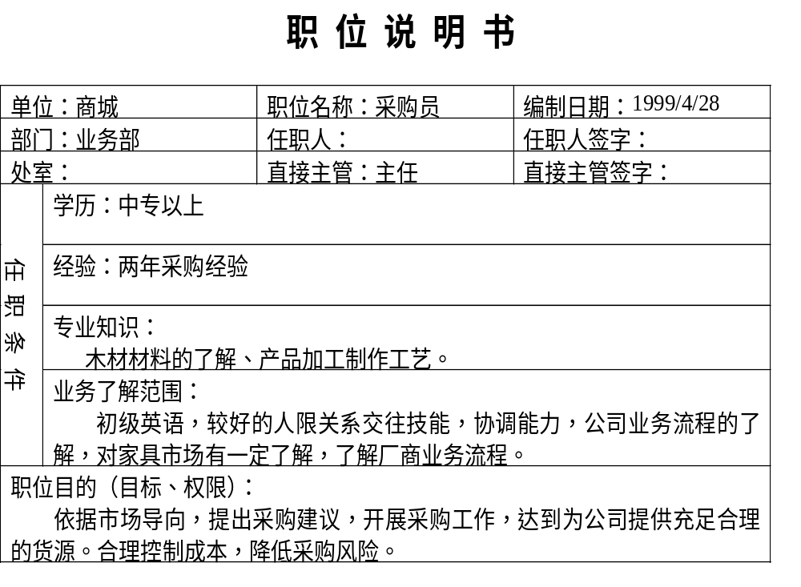

Slide 29
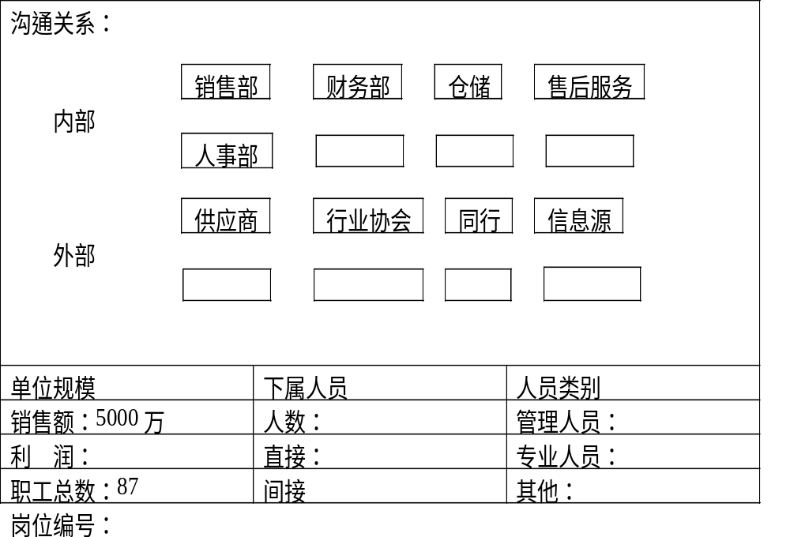
Notes:
沟通的方式有很多种，本课程只涉及面对面沟通的技巧.

Slide 30
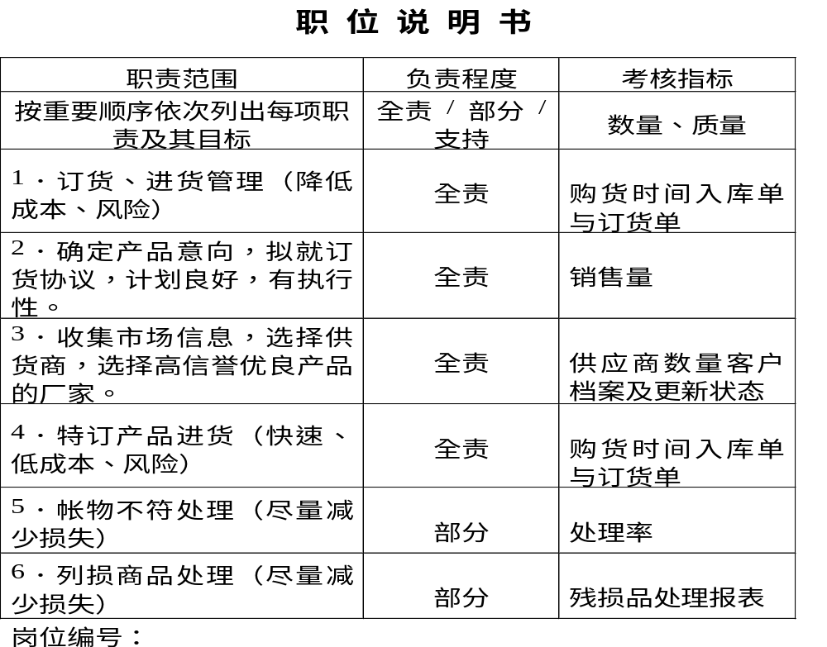
Notes:
沟通的方式有很多种，本课程只涉及面对面沟通的技巧.

Slide 31
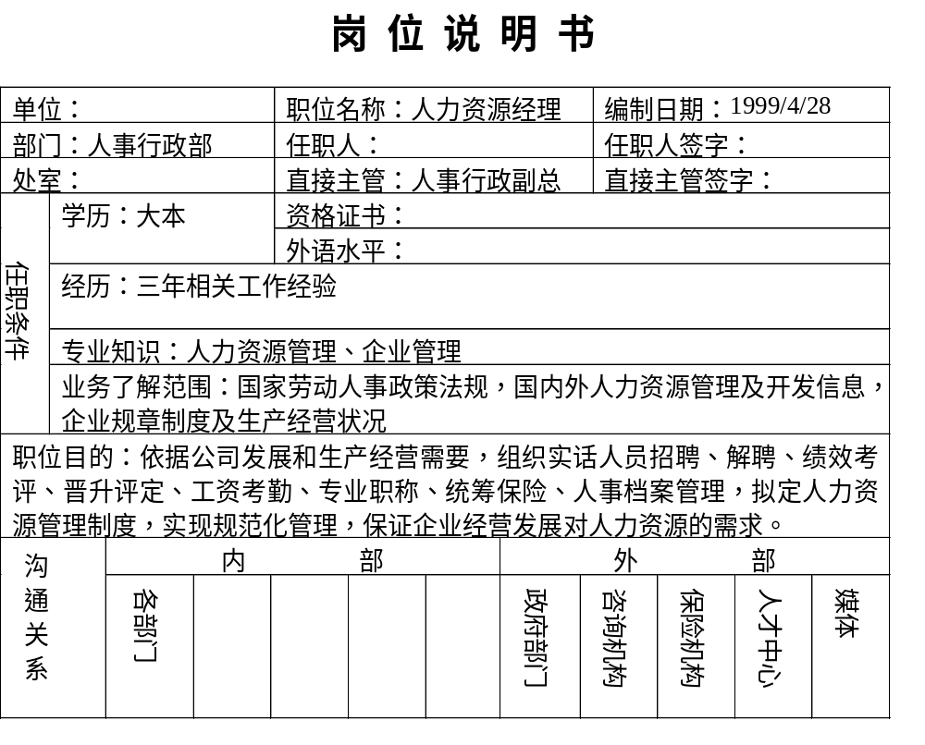
Notes:
游戏：洗衣机，问问题：你什么时候最信任别人？你在想什么？
外圈人什么情况下最容易（放松信任时）

Slide 32
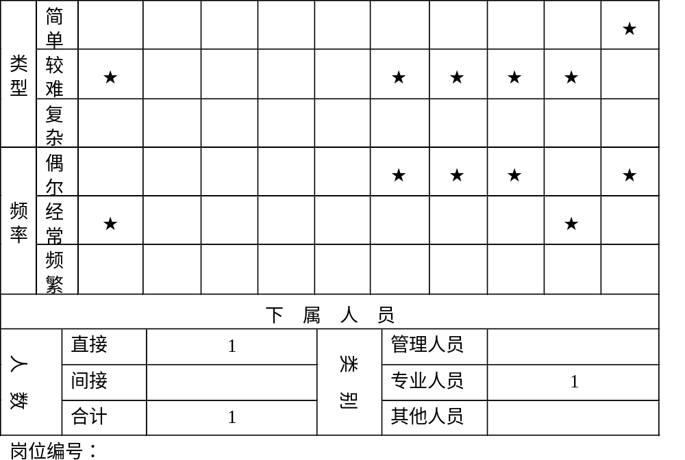
Notes:
先做采购电脑的角色演练。

Slide 33
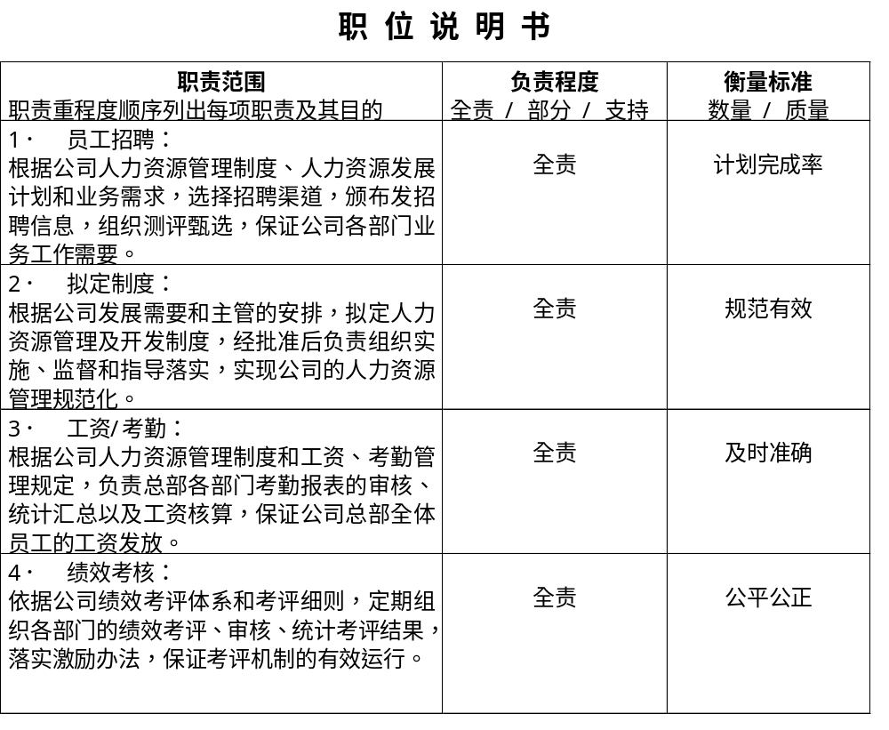
Notes:
讲解前做角色演练- 旧电脑
问学员对SWOT的了解程度：
请学员说出自己的分析情况

Slide 34
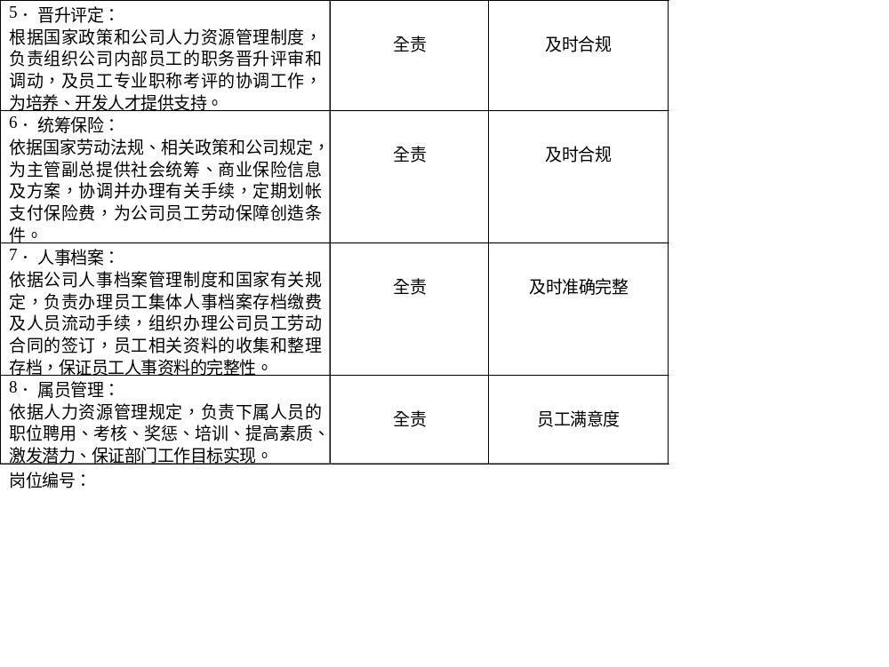
Notes:
案例讨论

Slide 35

三者关系
职位描述
·建立职位说明书
·职位评估依据
职位评估
·评估职位静态重要度
·薪酬政策依据
薪酬政策
·评价“三态”薪酬政策
·“对内具有公平性，对外具有竞争力”原则
Notes:
造成沟通的困难，看教材

Slide 36
组织影响力(因素1)
影响力 程度 | 部门 员工 | 部门 骨干 | 部门 专家 | 部门 主管 | 部门 经理 | 部门 领导 | 公司 领导
微小影响 | 5 | 5 | 5 | 5 | 5 | 5 | 5
稍有影响 | 10 | 20 | 40 | 60 | 80 | 100 | 150
有限影响 | 15 | 30 | 60 | 80 | 100 | 150 | 200
一些影响 | 20 | 40 | 80 | 100 | 150 | 200 | 250
相当影响 | 25 | 50 | 100 | 150 | 200 | 250 | 300
主要影响 | 30 | 60 | 120 | 200 | 250 | 300 | 400
Notes:
The concept of communication:
the process of gets agreement from two sides or above.
This is a process but not a result.
Encourage each group's result. And use these points to explain other exercise.
Participants will have lots other explanations on this question.
Such as:
respect, equal level , understand each other, positive listening
explain that we will understand the question from another direction.
Ask all the paritcipants how do they explain these three principles.
Prepare some story for this slides.

Slide 37
监督管理(因素2)
下属类别 下属人数 （直接和间接） | 普通 员工 | 专业 人员 | 中级 管理者 | 高级 管理者
0
1------5 | 15 | 35 | 55 | 75
6-----10 | 25 | 45 | 60 | 80
11-----20 | 35 | 55 | 80 | 90
21-----30 | 50 | 60 | 100 | 120
31-----50 | 60 | 80 | 120 | 140
51-------- | 80 | 100 | 150 | 170
Notes:
The concept of communication:
the process of gets agreement from two sides or above.
This is a process but not a result.
Encourage each group's result. And use these points to explain other exercise.
Participants will have lots other explanations on this question.
Such as:
respect, equal level , understand each other, positive listening
explain that we will understand the question from another direction.
Ask all the paritcipants how do they explain these three principles.
Prepare some story for this slides.

Slide 38
责任领域(因素3)
广度 独立性 | 重复性 的活动 | 少部分 相似工作 | 担任几个 相似工作 | 同部门内担任不同工作 | 不同部门 性质工作
分工明确 | 20 | 30 | 40 | 50 | 65
一定工作限制 | 30 | 40 | 50 | 65 | 70
根据常规方法进行工作检查控制 | 40 | 50 | 60 | 70 | 75
按总原则工作 | 50 | 60 | 70 | 75 | 90
根据战略目标 控制 | 60 | 70 | 75 | 90 | 105
根据集团目标工作受目标控制 | 70 | 75 | 90 | 105 | 120
根据董事会所定目标工作控制 | 80 | 90 | 105 | 120 | 135
知识面程度： 1、 （等级分 10 ） 2、 （等级分 20 ） 3、 （等级分 30 ） 4、 （等级分 40 ）
Notes:
The concept of communication:
the process of gets agreement from two sides or above.
This is a process but not a result.
Encourage each group's result. And use these points to explain other exercise.
Participants will have lots other explanations on this question.
Such as:
respect, equal level , understand each other, positive listening
explain that we will understand the question from another direction.
Ask all the paritcipants how do they explain these three principles.
Prepare some story for this slides.

Slide 39
责任领域(因素3)续
广度 独立性 | 指导一个职务以上业务工作 | 领导两个或更多职务工作部门 | 参与一项主要活动公司领导 | 参与两项 主要活动 公司领导 | 参与三项主要活动公司领导
分工明确 | 70 | 75 | 90 | 95 | 100
一定工作限制 | 75 | 90 | 105 | 115 | 120
根据常规方法进行工作检查控制 | 90 | 105 | 115 | 135 | 140
按总原则工作 | 105 | 115 | 135 | 150 | 160
根据战略目标控制 | 115 | 135 | 150 | 170 | 180
根据集团目标工作受目标控制 | 135 | 150 | 165 | 180 | 200
根据董事会所定目标工作控制 | 150 | 165 | 180 | 200 | 220
知识面程度： 1、 （等级分 10 ） 2、 （等级分 20 ） 3、 （等级分 30 ） 4、 （等级分 40 ）
Notes:
The concept of communication:
the process of gets agreement from two sides or above.
This is a process but not a result.
Encourage each group's result. And use these points to explain other exercise.
Participants will have lots other explanations on this question.
Such as:
respect, equal level , understand each other, positive listening
explain that we will understand the question from another direction.
Ask all the paritcipants how do they explain these three principles.
Prepare some story for this slides.

Slide 40
沟通技巧(因素4)
联系频率 | 沟 通 技 巧
 | 简单 |  | 较难 |  | 复杂
偶 尔 | 20 | 45 | 50 | 70 | 75 | 95
经 常 | 30 | 55 | 60 | 80 | 85 | 100
频 繁 | 40 | 65 | 70 | 90 | 95 | 105
 | 内 部 | 外 部 | 内 部 | 外 部 | 内 部 | 外 部
 | 内 外 用 处
Notes:
The concept of communication:
the process of gets agreement from two sides or above.
This is a process but not a result.
Encourage each group's result. And use these points to explain other exercise.
Participants will have lots other explanations on this question.
Such as:
respect, equal level , understand each other, positive listening
explain that we will understand the question from another direction.
Ask all the paritcipants how do they explain these three principles.
Prepare some story for this slides.

Slide 41
任职资格(因素5)
经验 学历 | 不必有 经验 | 半年 以下 | 半年--- 2年 | 2年--- 5年 | 5年--- 8年 | 8年--- 12年 | 12年--- 16年 | 16年 以上
高中 及职高 | 20 | 40 | 50 | 60 | 70 | 80 | 90 | 100
中专 | 30 | 50 | 60 | 70 | 80 | 90 | 100 | 110
大专 | 40 | 60 | 70 | 80 | 90 | 100 | 110 | 120
本科 | 50 | 70 | 80 | 90 | 100 | 110 | 120 | 130
硕士 | 60 | 80 | 90 | 100 | 110 | 120 | 130 | 150
博士 | 70 | 90 | 100 | 110 | 120 | 130 | 140 | 160
Notes:
The concept of communication:
the process of gets agreement from two sides or above.
This is a process but not a result.
Encourage each group's result. And use these points to explain other exercise.
Participants will have lots other explanations on this question.
Such as:
respect, equal level , understand each other, positive listening
explain that we will understand the question from another direction.
Ask all the paritcipants how do they explain these three principles.
Prepare some story for this slides.

Slide 42
解决问题难度(因素6)
复杂性 创造性 | 常规性质 | 有限 难度 | 有些 难度 | 难处理 | 复杂 | 较复杂 | 需要花很长时间解决复杂广泛问题
无需创造或改进 | 10 | 20 | 30 | 45 | 60 | 80 | 100
一般性改进 | 20 | 30 | 45 | 60 | 80 | 100 | 120
改进和发展现有的方法和技术 | 30 | 45 | 60 | 80 | 100 | 120 | 140
创立新方法/技术受益于企业内部经验 | 45 | 60 | 80 | 100 | 120 | 140 | 160
创立新复杂而广泛的方法和技术 | 60 | 80 | 100 | 120 | 140 | 160 | 180
确定发明性的 | 80 | 100 | 120 | 140 | 160 | 180 | 200
很科学性的发明 | 100 | 120 | 140 | 160 | 180 | 200 | 220
Notes:
The concept of communication:
the process of gets agreement from two sides or above.
This is a process but not a result.
Encourage each group's result. And use these points to explain other exercise.
Participants will have lots other explanations on this question.
Such as:
respect, equal level , understand each other, positive listening
explain that we will understand the question from another direction.
Ask all the paritcipants how do they explain these three principles.
Prepare some story for this slides.

Slide 43
环境条件(因素7)
环境 活动对身体、精神影响程度 风险 活动过程中的意外伤害
环境 风险 | 一 般 |  |  | 难 度
一 般 | 30 | 60
高 度 | 50 | 80
Notes:
The concept of communication:
the process of gets agreement from two sides or above.
This is a process but not a result.
Encourage each group's result. And use these points to explain other exercise.
Participants will have lots other explanations on this question.
Such as:
respect, equal level , understand each other, positive listening
explain that we will understand the question from another direction.
Ask all the paritcipants how do they explain these three principles.
Prepare some story for this slides.

Slide 44
因素点值汇总表
职位名称： 采购员 评估日期：1999年4月29日 评估人：
因 素 |  | 程 度 | 点 值
1、组织影响力 | 影响力 | 部门骨干 | 40
 | 程度 | 一些影响
2、监督管理 | 类别
 | 人数
3、责任范围 | 广度 | 同部门内担任不同工作 | 70
 | 独立性 | 根据常规工作，检查控制
 | 知识面 | 3
Notes:
The concept of communication:
the process of gets agreement from two sides or above.
This is a process but not a result.
Encourage each group's result. And use these points to explain other exercise.
Participants will have lots other explanations on this question.
Such as:
respect, equal level , understand each other, positive listening
explain that we will understand the question from another direction.
Ask all the paritcipants how do they explain these three principles.
Prepare some story for this slides.

Slide 45
因素点值汇总表（续）
职位名称： 采购员 评估日期：1999年4月29日 评估人：
因 素 |  | 程 度 | 点 值
4、沟通技巧 | 频率 | 频繁 | 90
 | 技巧 | 较难
 | 内外 | 外部
5、任职资格 | 学历 | 中专 | 70
 | 经历 | 2年
6、解决问题难度 | 创造性 | 改进现有方法 | 60
 | 复杂性 | 有些难度
7、环境条件 | 风险 | 高度 | 50
 | 环境 | 一般
合计 |  |  | 410
Notes:
The concept of communication:
the process of gets agreement from two sides or above.
This is a process but not a result.
Encourage each group's result. And use these points to explain other exercise.
Participants will have lots other explanations on this question.
Such as:
respect, equal level , understand each other, positive listening
explain that we will understand the question from another direction.
Ask all the paritcipants how do they explain these three principles.
Prepare some story for this slides.

Slide 46
因素点值汇总表
职位名称：人力资源经理 评估日期：2001年5月18日 评估人：职位评估项目组
因 素 |  | 程 度 | 点 值
1、组织影响力 | 影响力 | 部门经理 | 175
 | 程度 | 一些影响 / 相当影响
2、监督管理 | 类别 | 专业人员 | 35
 | 人数 | 1人
3、责任范围 | 广度 | 领导二个以上活动部门工作 | 170
 | 独立性 | 根据目标工作控制
 | 知识面 | 国内和国际知识面
Notes:
The concept of communication:
the process of gets agreement from two sides or above.
This is a process but not a result.
Encourage each group's result. And use these points to explain other exercise.
Participants will have lots other explanations on this question.
Such as:
respect, equal level , understand each other, positive listening
explain that we will understand the question from another direction.
Ask all the paritcipants how do they explain these three principles.
Prepare some story for this slides.

Slide 47
因素点值汇总表（续）
职位名称： 评估日期： 评估人：
因 素 |  | 程 度 | 点 值
4、沟通技巧 | 频率 | 经常 | 80
 | 技巧 | 较难
 | 内外 | 外部
5、任职资格 | 学历 | 本科 | 90
 | 经历 | 三年
6、解决问题难度 | 创造性 | 复杂 | 140
 | 复杂性 | 创立新的复杂广泛方法技术
7、环境条件 | 风险 | 一般 | 30
 | 环境 | 一般
合计 |  |  | 720
Notes:
The concept of communication:
the process of gets agreement from two sides or above.
This is a process but not a result.
Encourage each group's result. And use these points to explain other exercise.
Participants will have lots other explanations on this question.
Such as:
respect, equal level , understand each other, positive listening
explain that we will understand the question from another direction.
Ask all the paritcipants how do they explain these three principles.
Prepare some story for this slides.

Slide 48
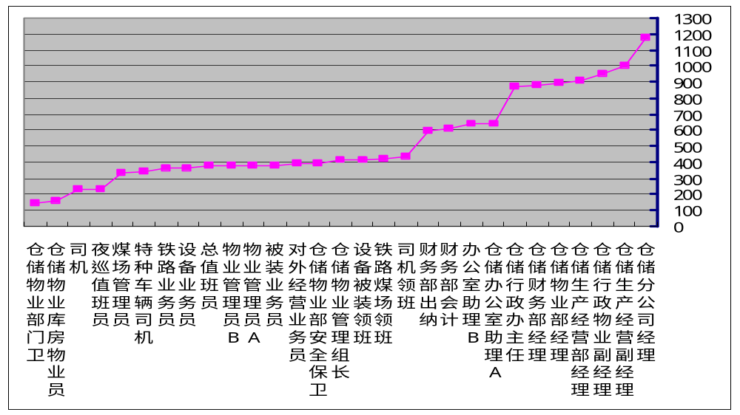
职位评估点值曲线示意图
Notes:
开始用开放式的问题一定很容易，例如：天气
The open question at the beginning must be very easy. Such as: weather.

Slide 49
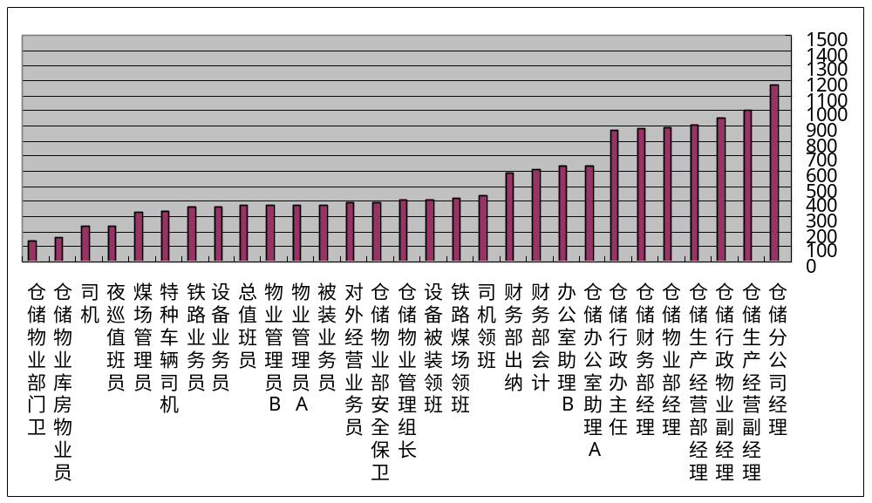
职位评估点值柱形示意图
Notes:
开始用开放式的问题一定很容易，例如：天气
The open question at the beginning must be very easy. Such as: weather.

Slide 50
评估因素权重参照数
组织影响 | 38%左右
监督管理 | 7%左右
责任领域 | 18%左右
沟通技巧 | 8%左右
任职资格 | 8%左右
问题难度 | 18%左右
环境条件 | 3%左右

Slide 51
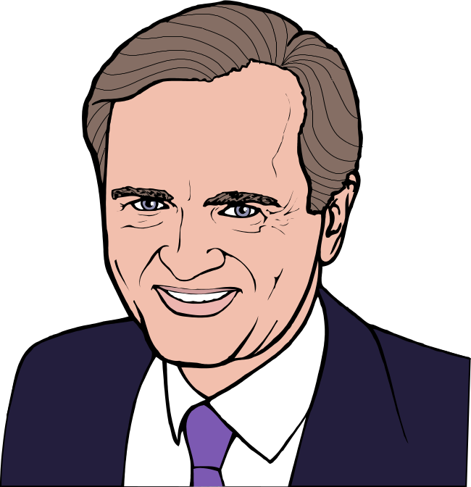
祝 你 成 功

