Slide 1
Fixed bins

Slide 2
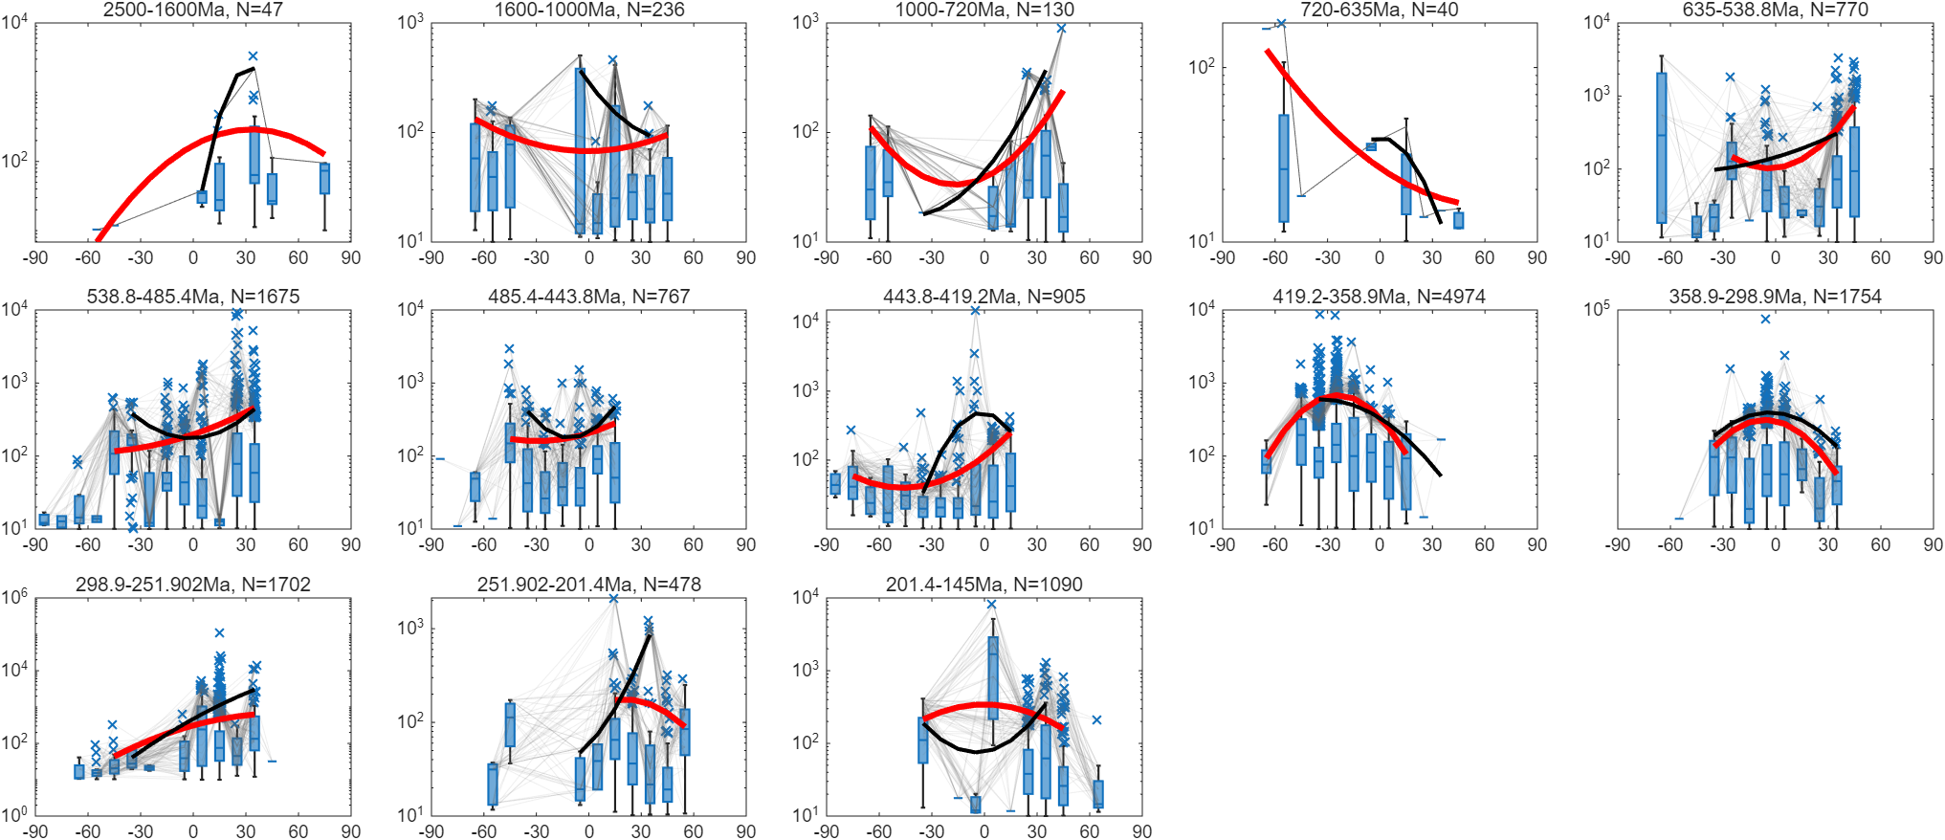
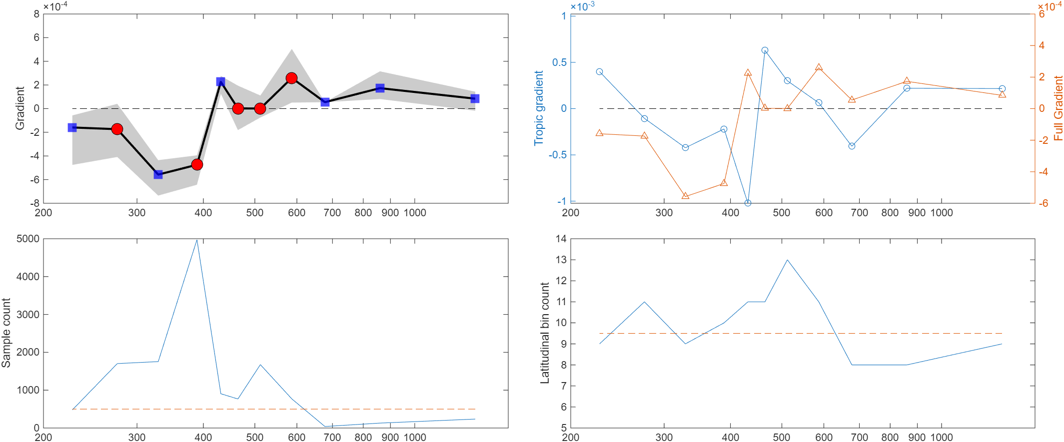
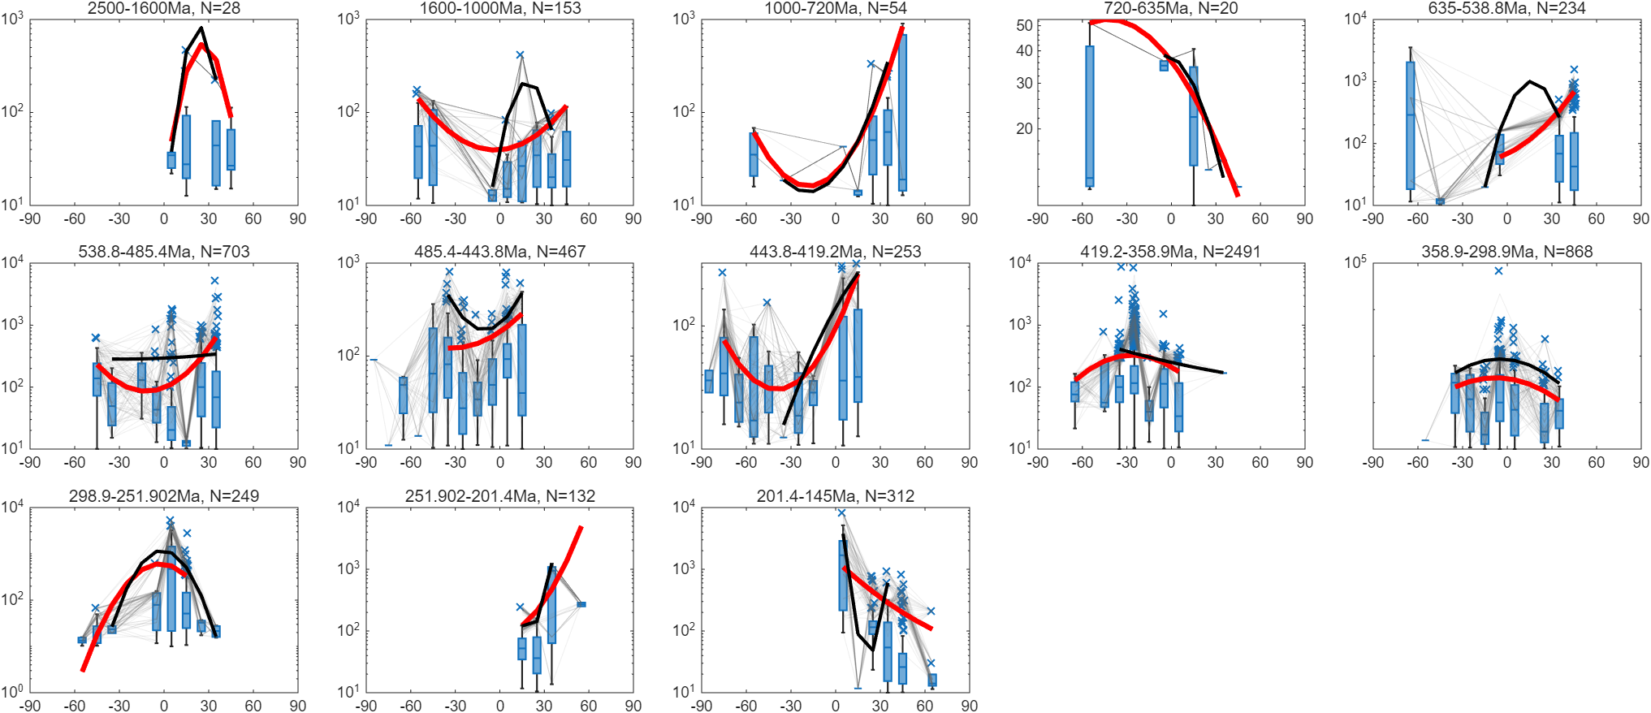
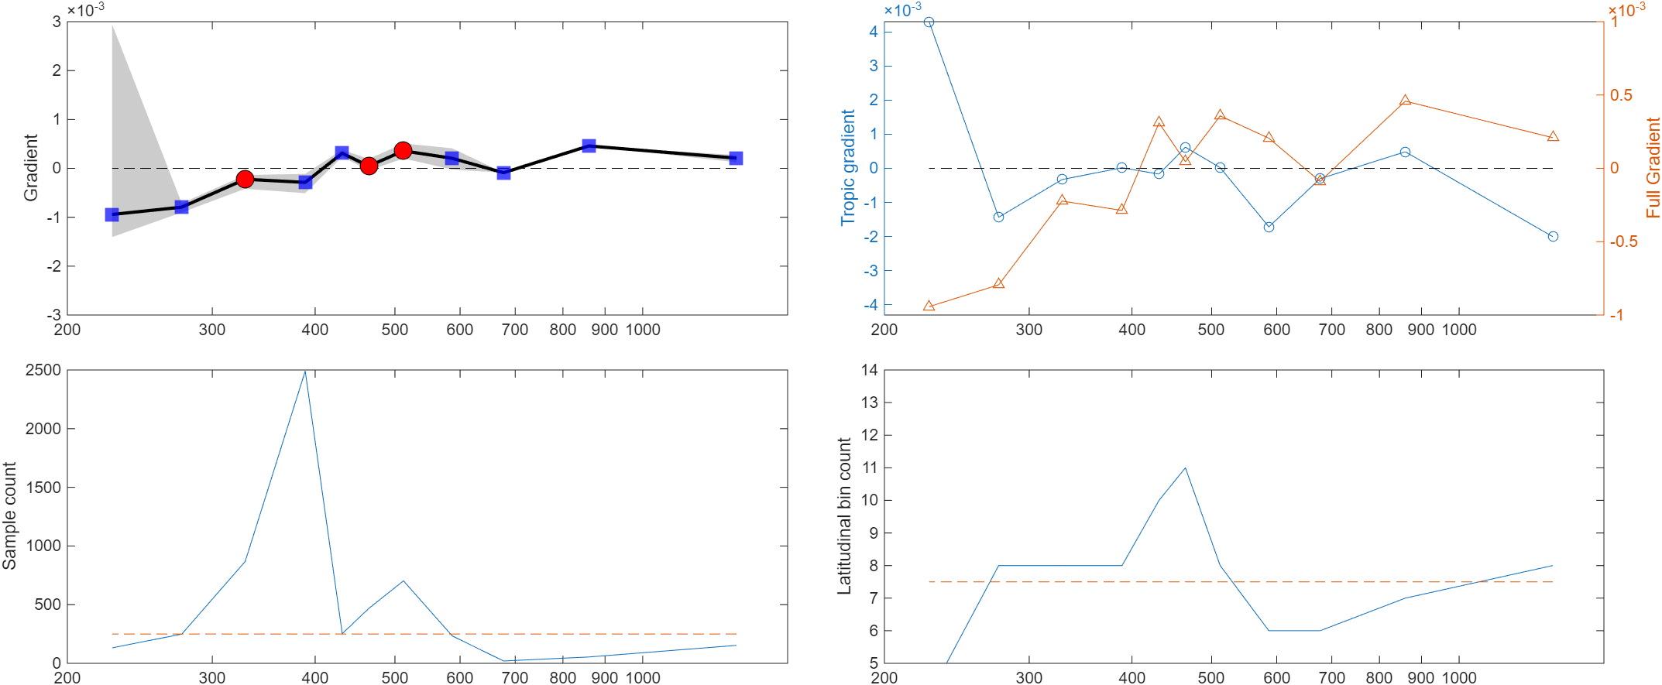
All samples
Shales
Fixed bins, 95th
MoEF, lower_boundary=10, bootstrap: 5% of total or 50 points

Slide 3
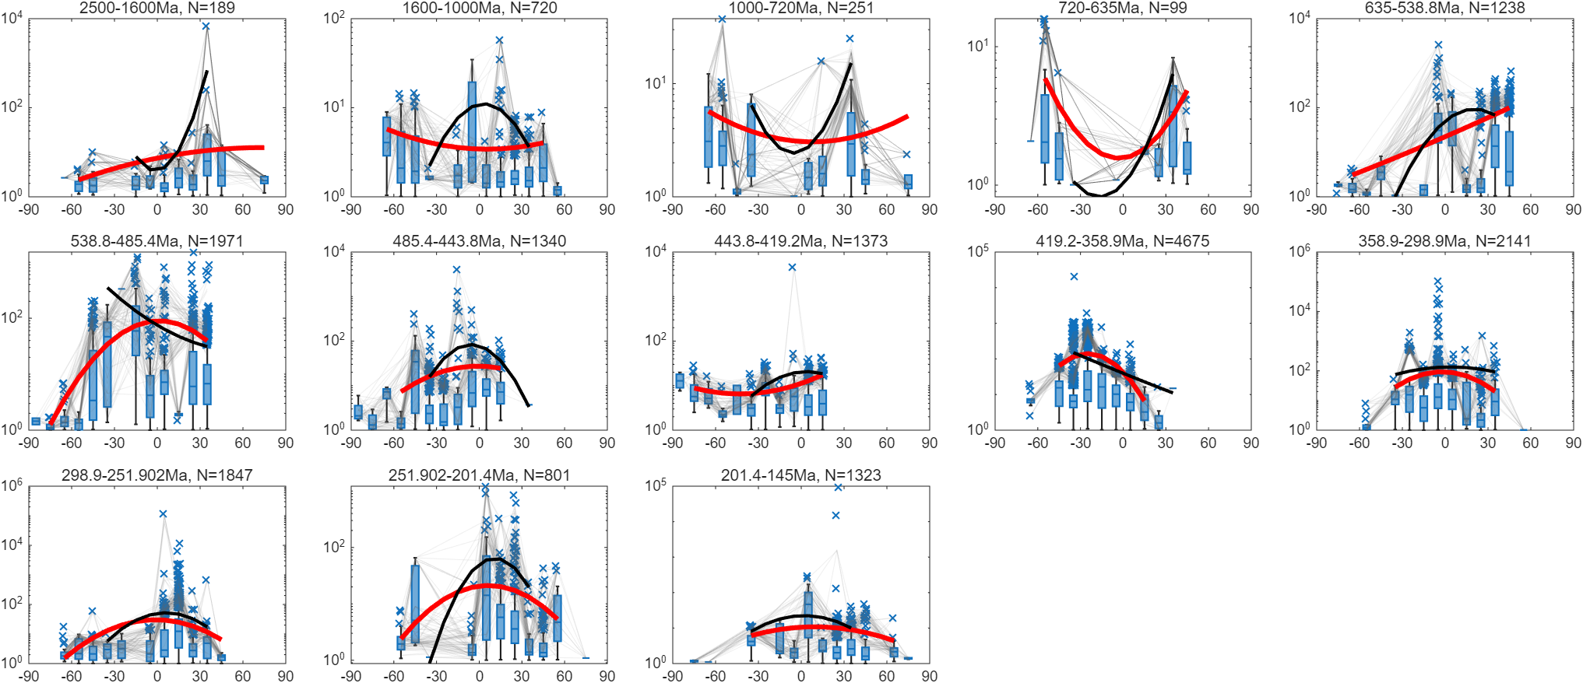
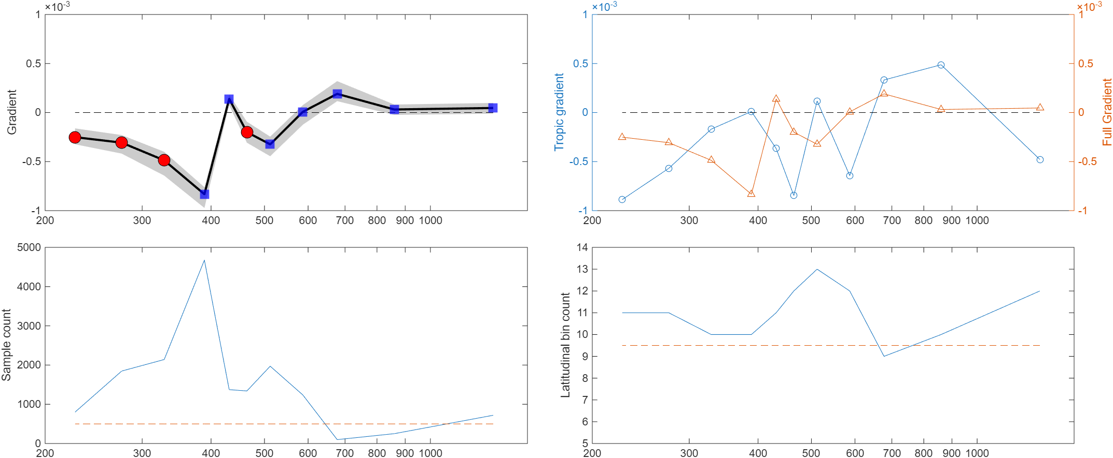
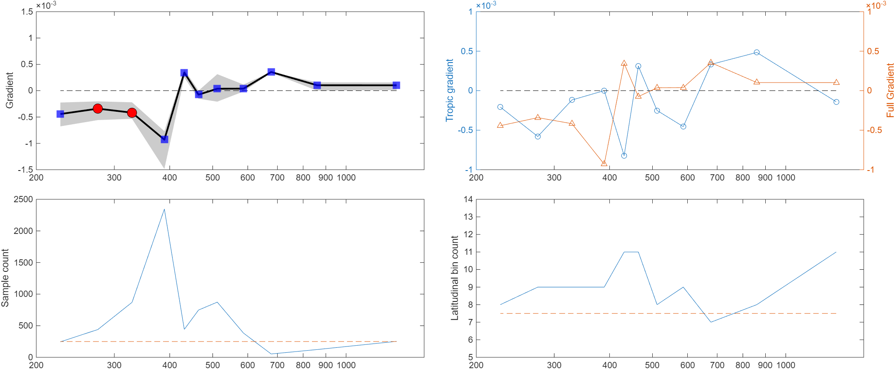
All samples
Shales
Fixed bins, 95th
UEF, lower_boundary=1, bootstrap: 5% of total or 50 points

Slide 4
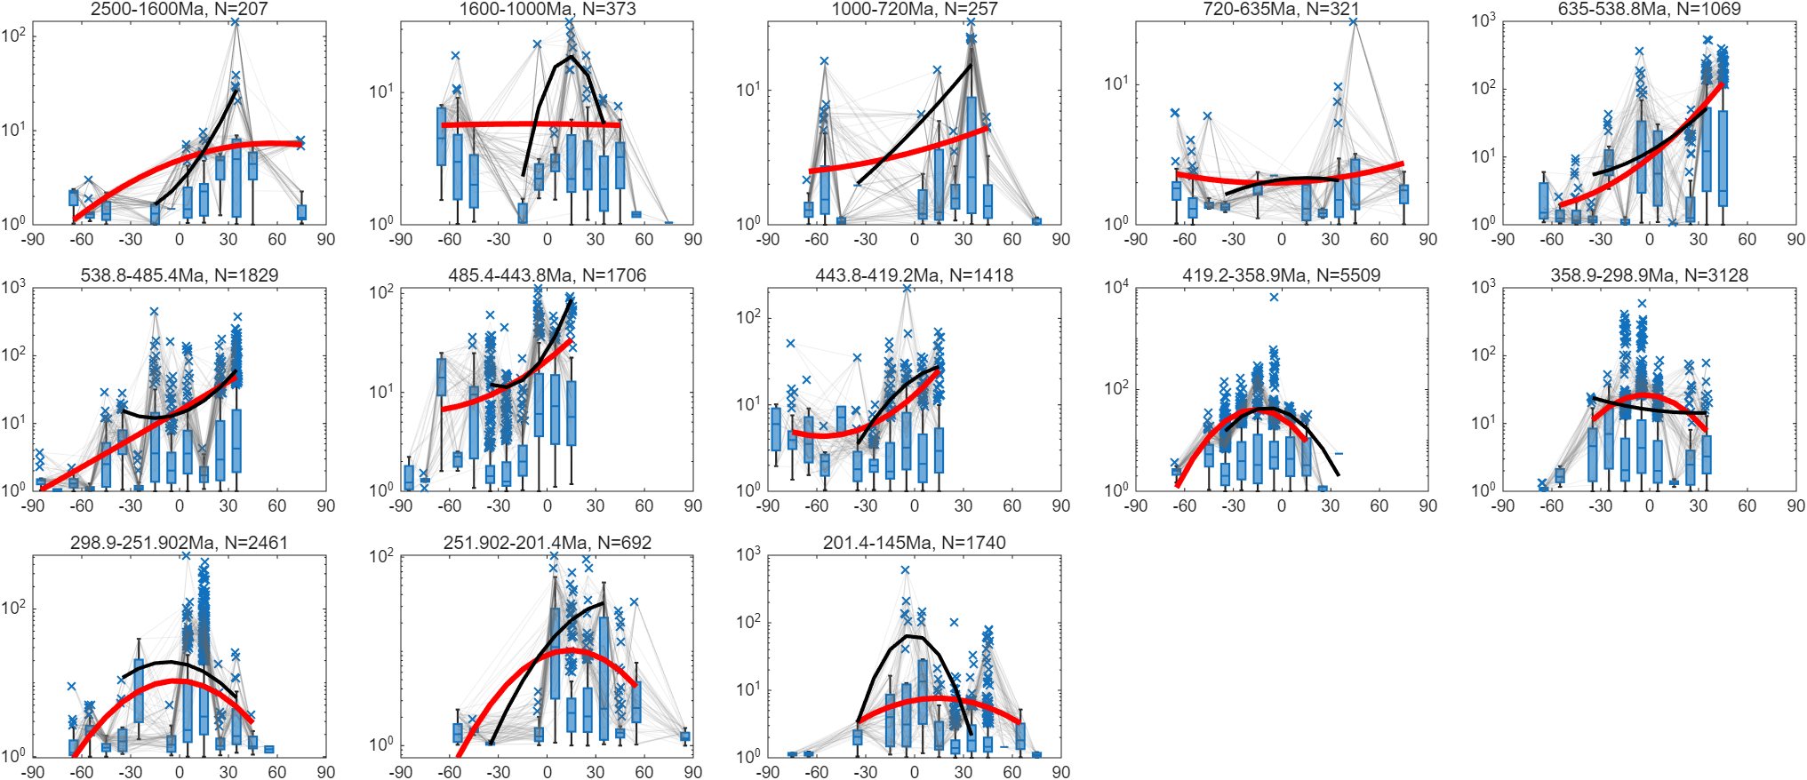
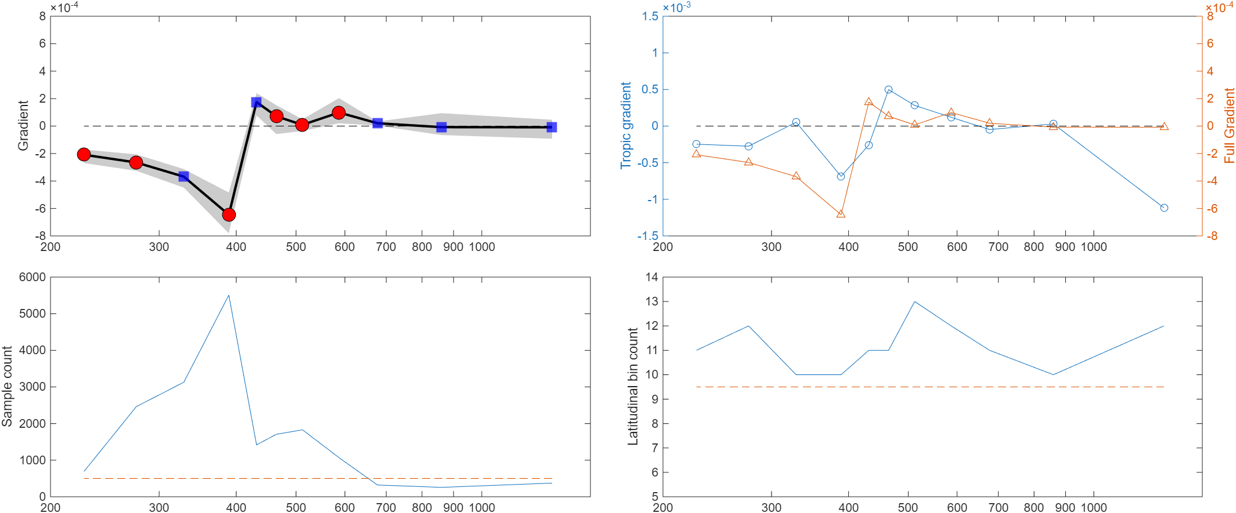
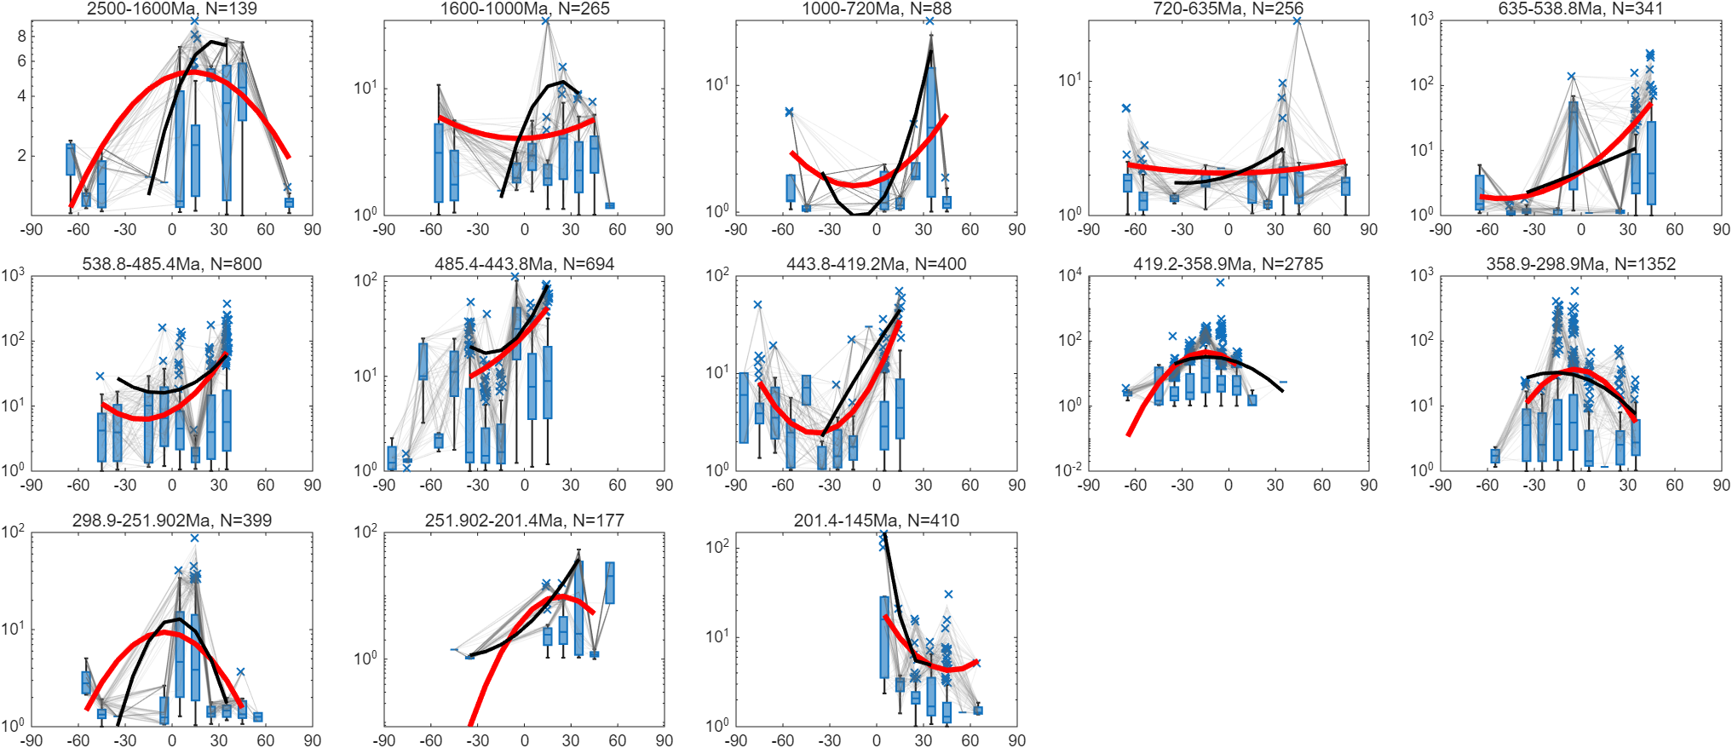
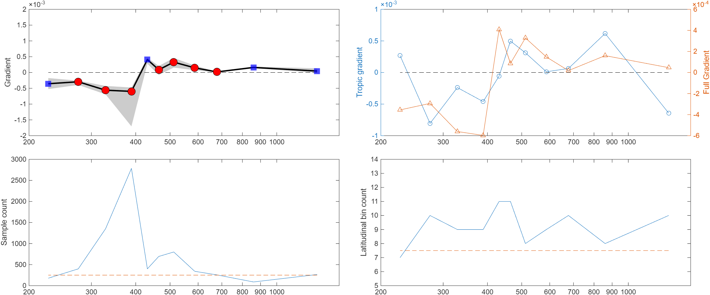
All samples
Shales
Fixed bins, 95th
VEF, lower_boundary=1, bootstrap: 5% of total or 50 points

Slide 5
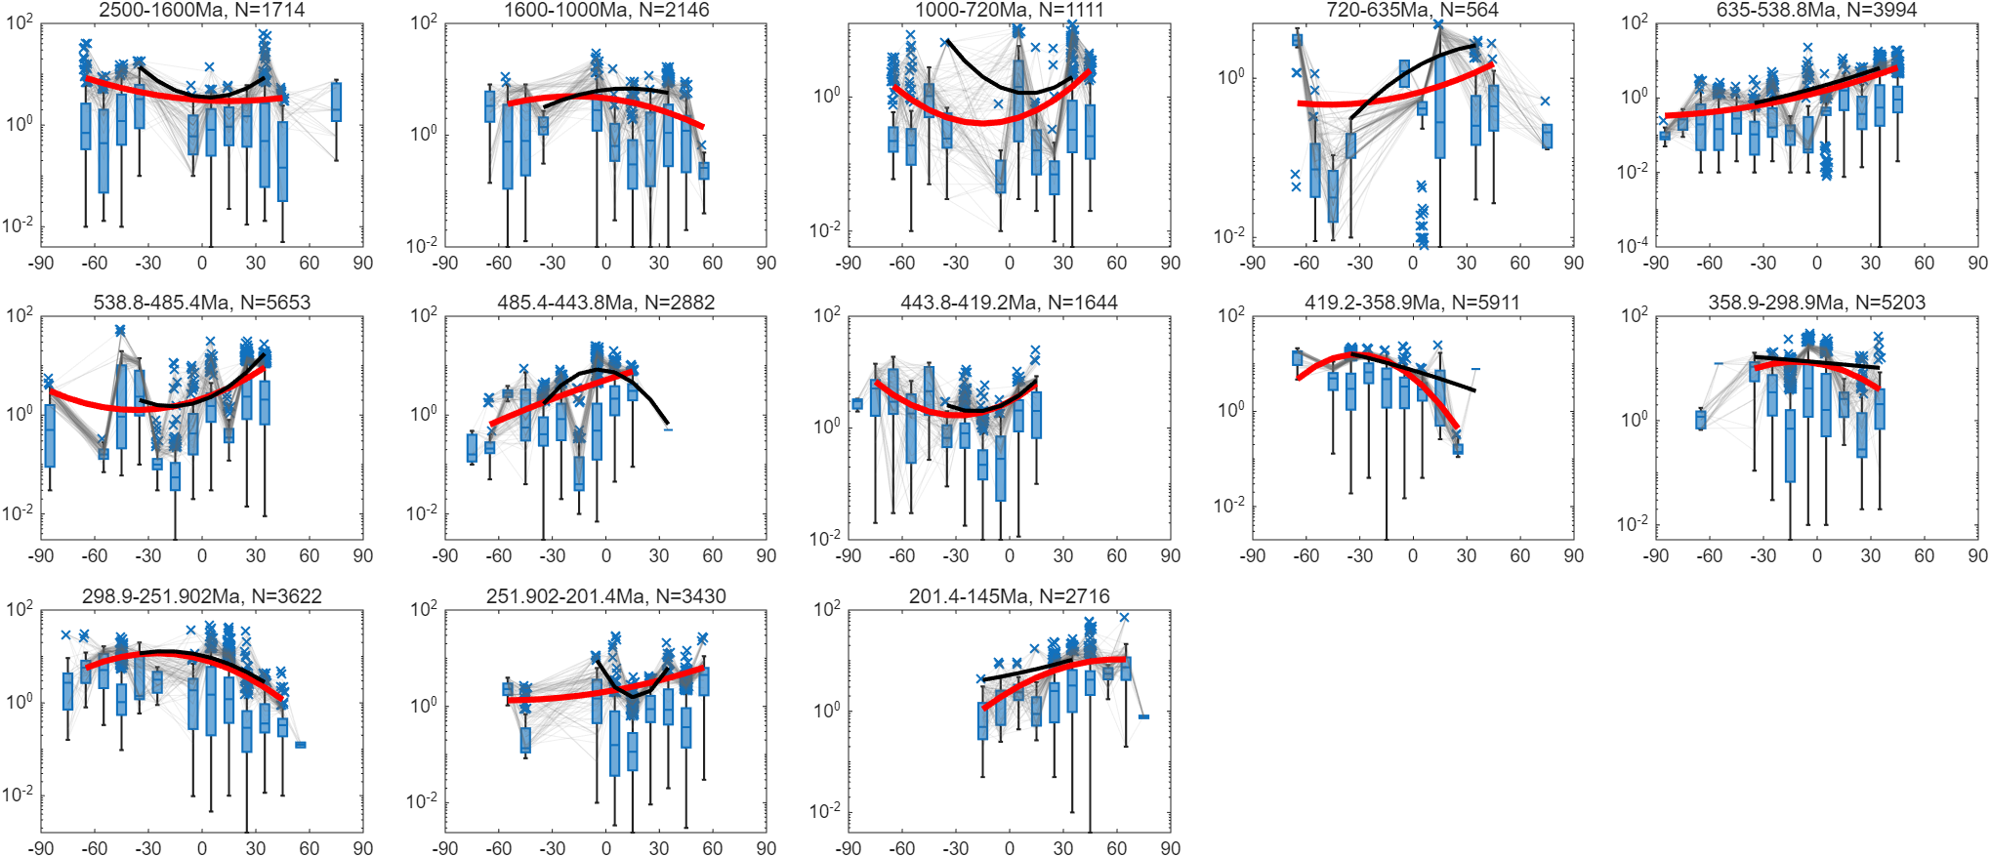
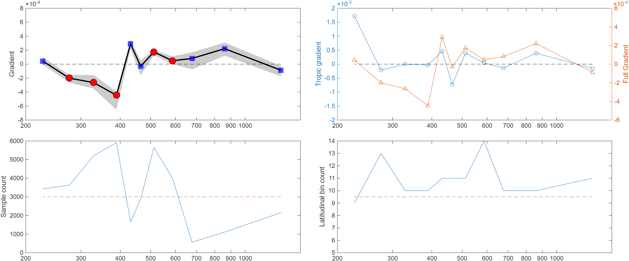
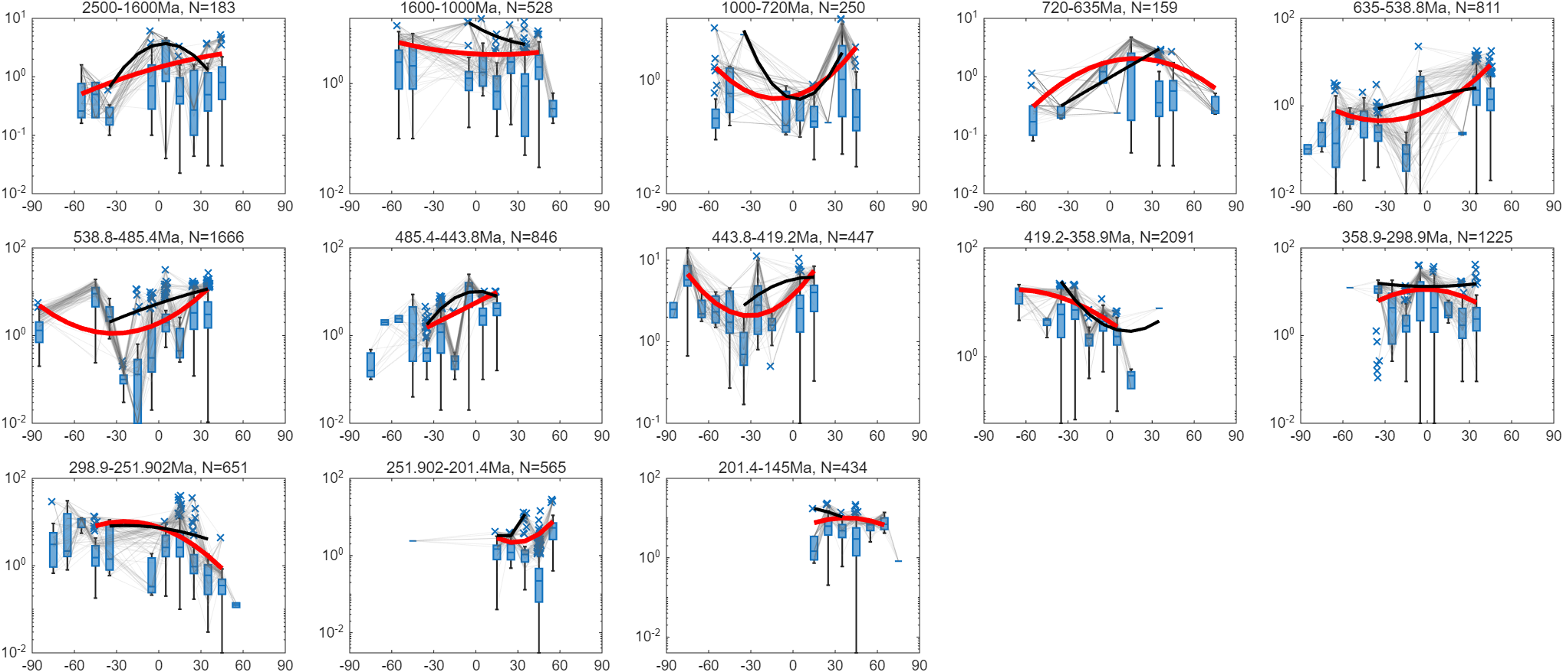
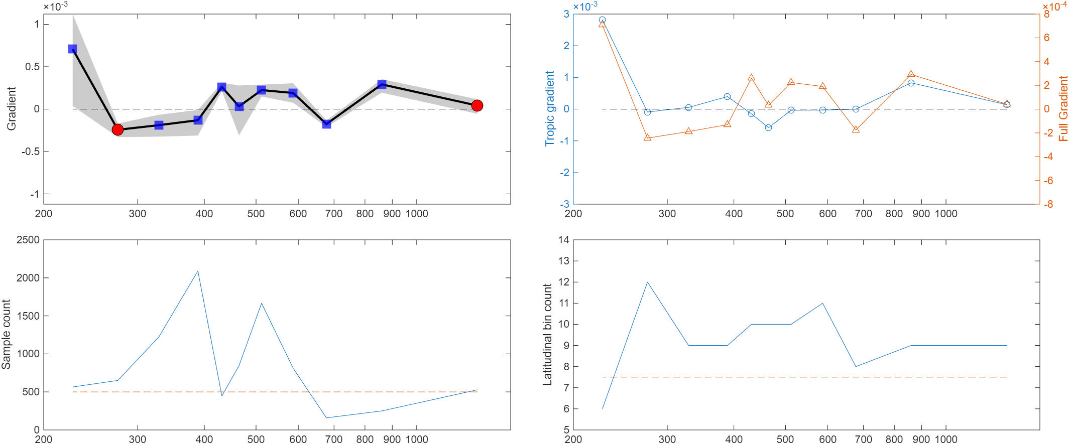
All samples
Shales
Fixed bins, 95th
TOC, lower_boundary=0, bootstrap: 5% of total or 50 points

Slide 6
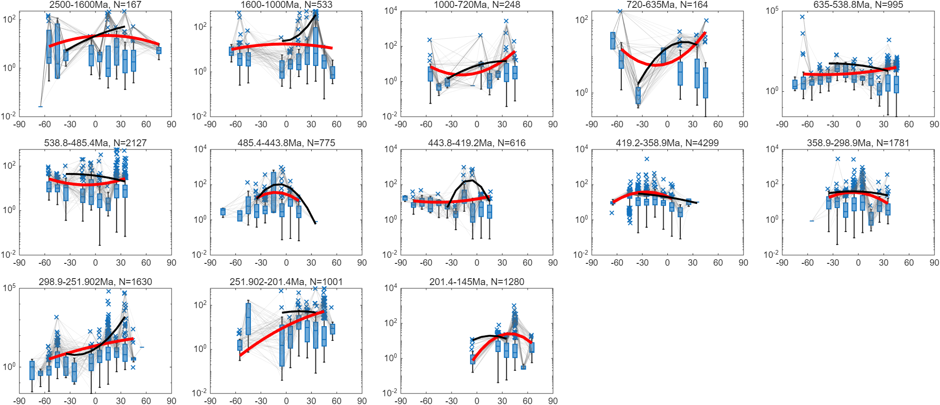
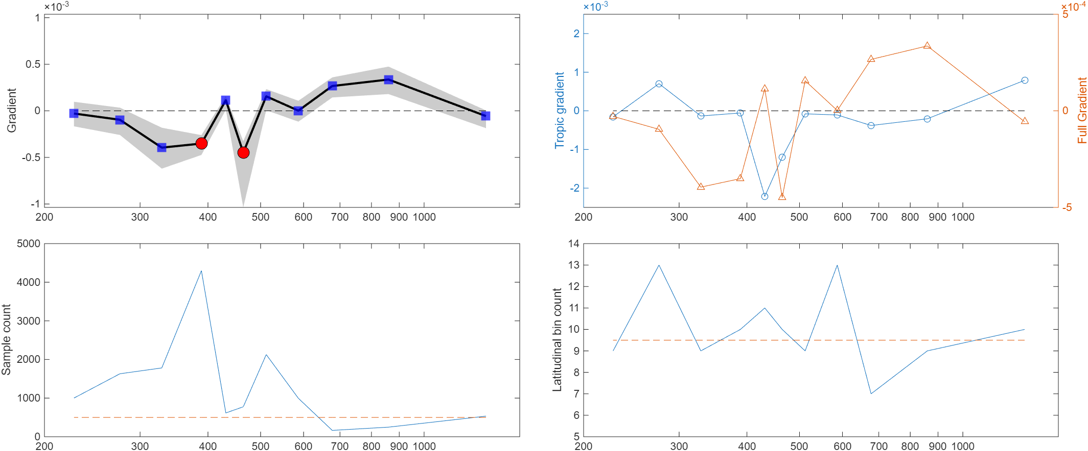
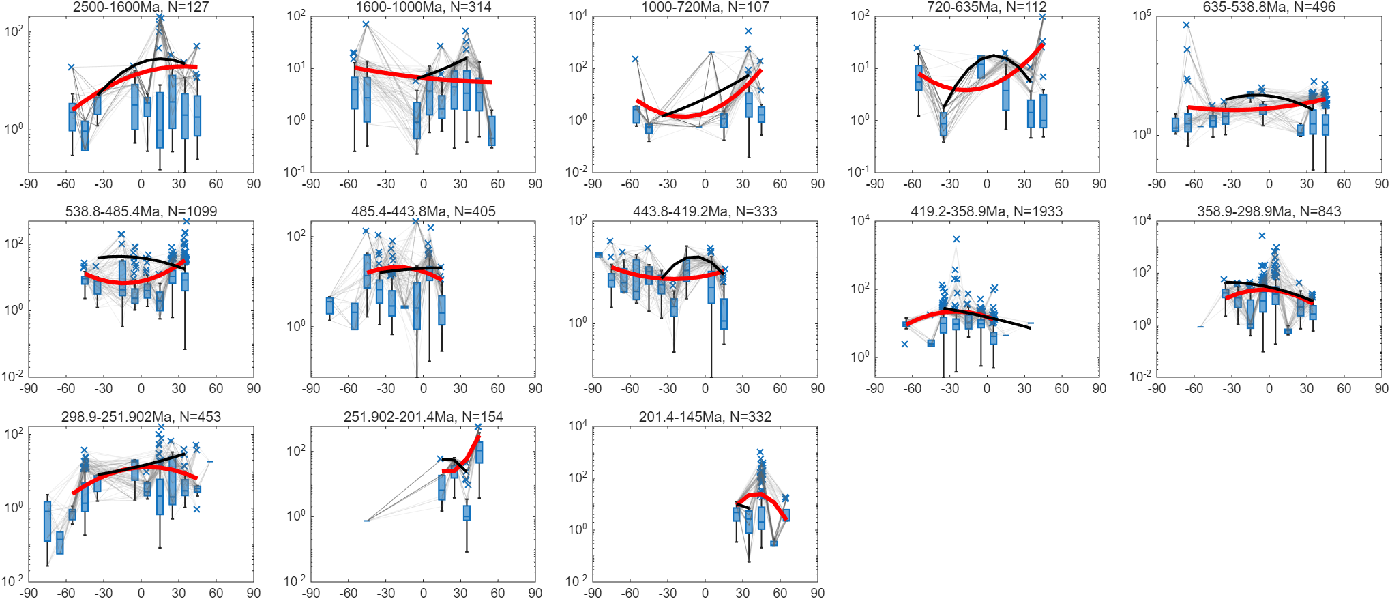
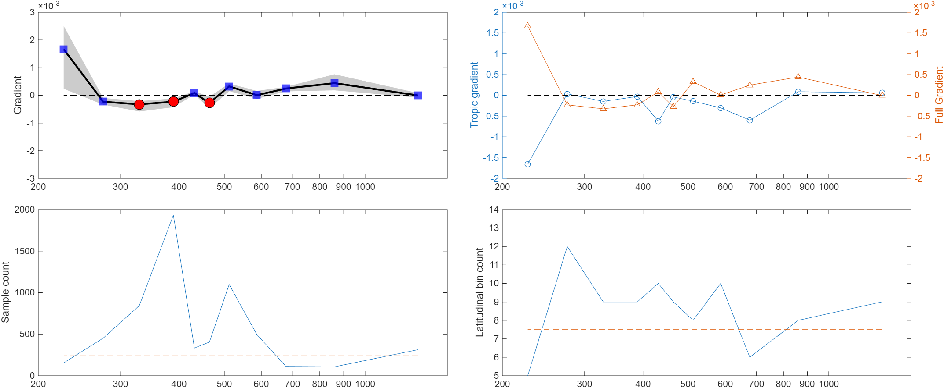
All samples
Shales
Fixed bins, 95th
Mo/TOC, lower_boundary=0, bootstrap: 5% of total or 50 points

Slide 7
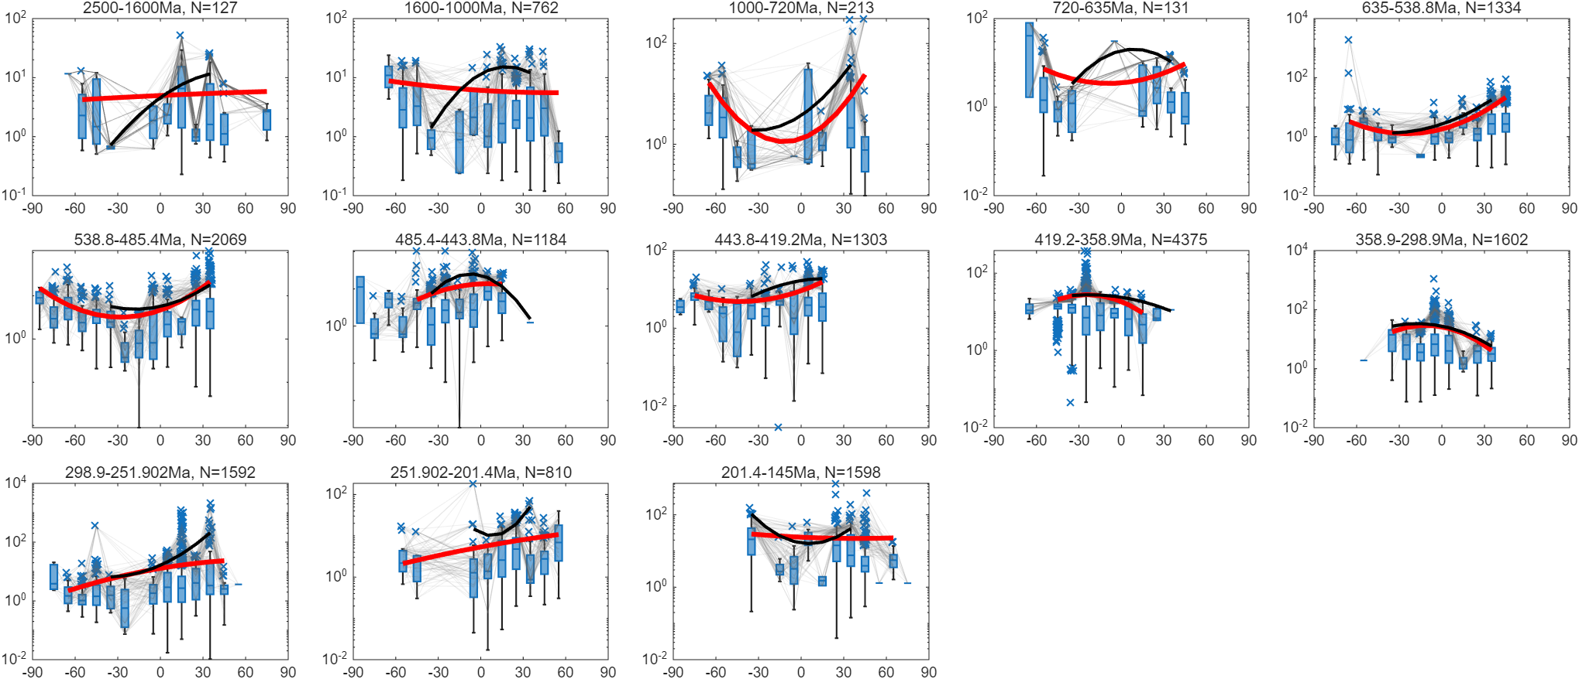
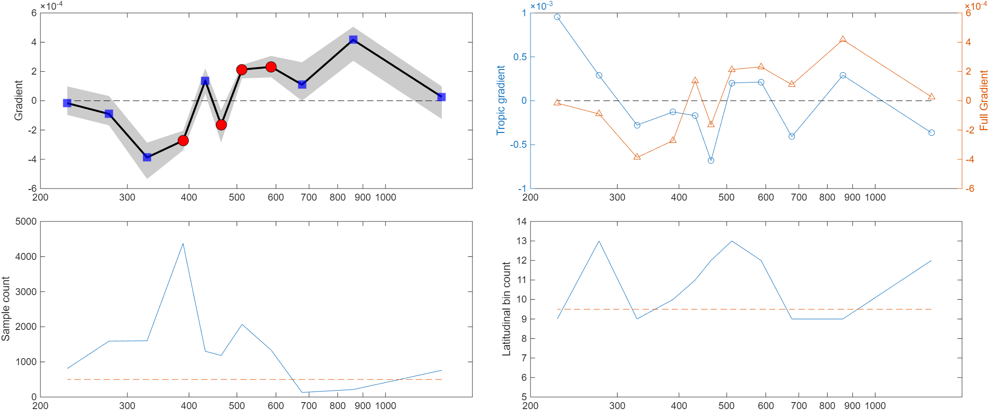
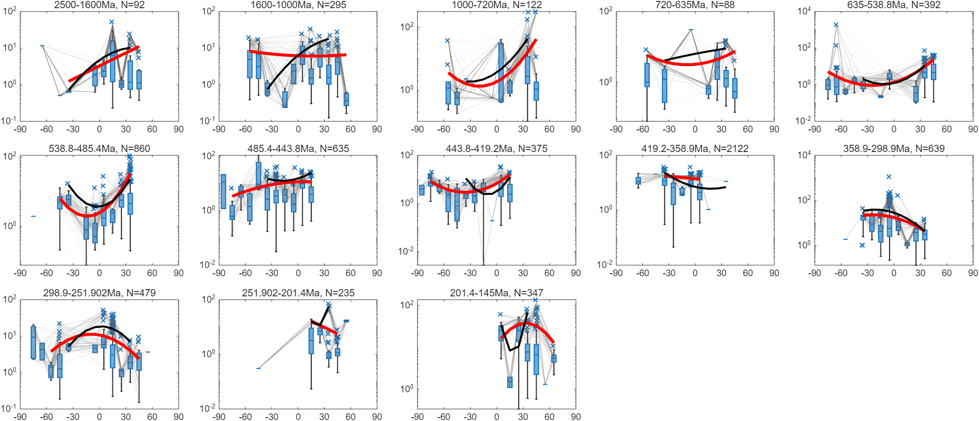
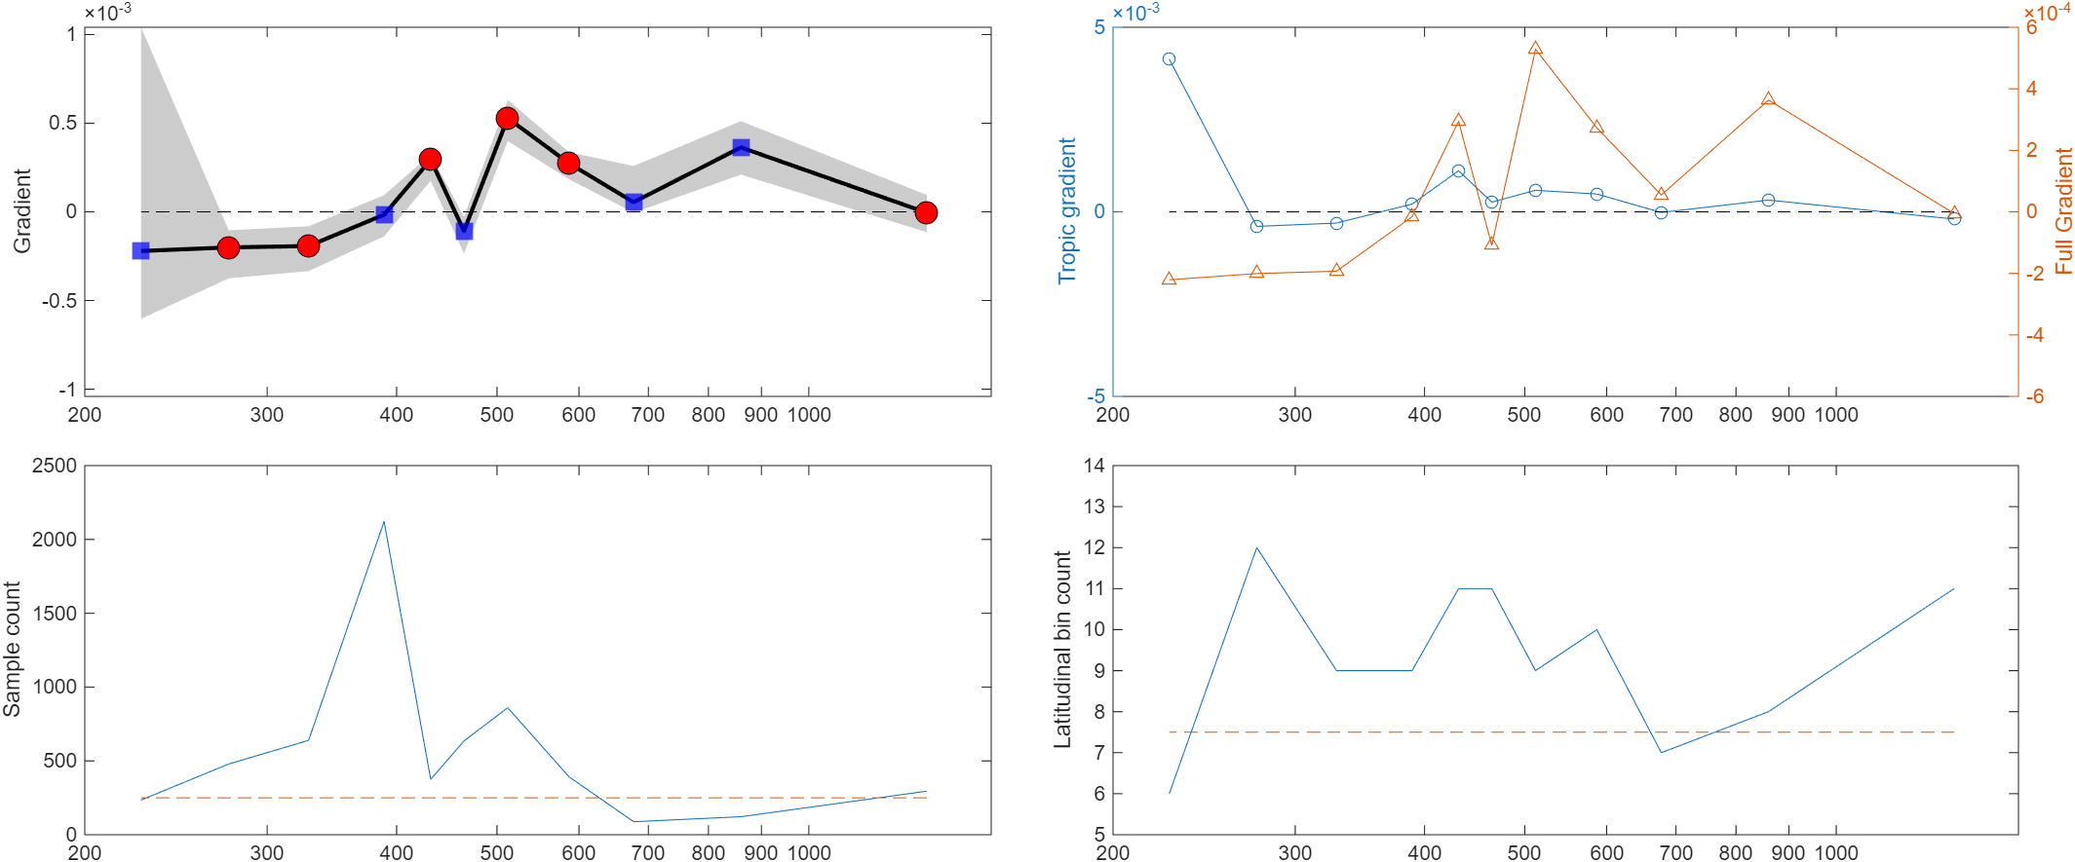
All samples
Shales
Fixed bins, 95th
MoEF/UEF, lower_boundary=0, bootstrap: 5% of total or 50 points

Slide 8
Adaptive bins

Slide 9
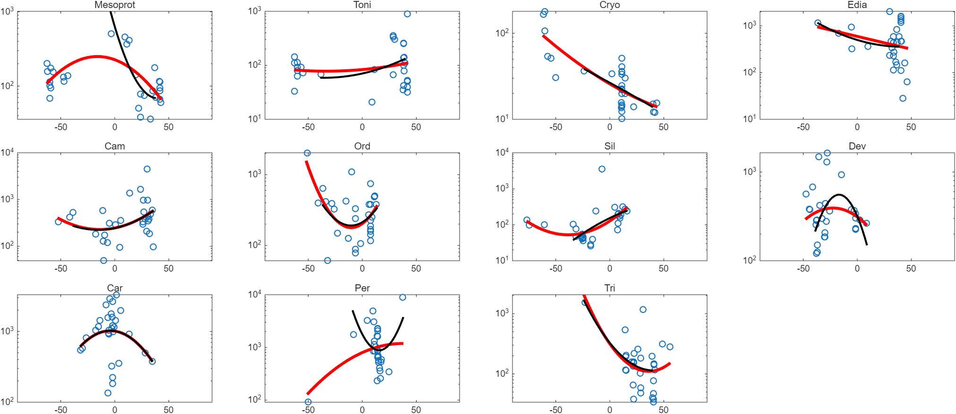
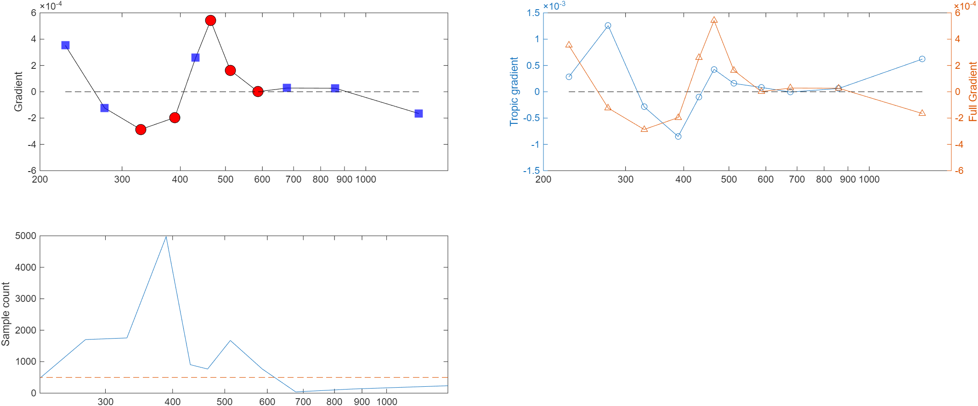
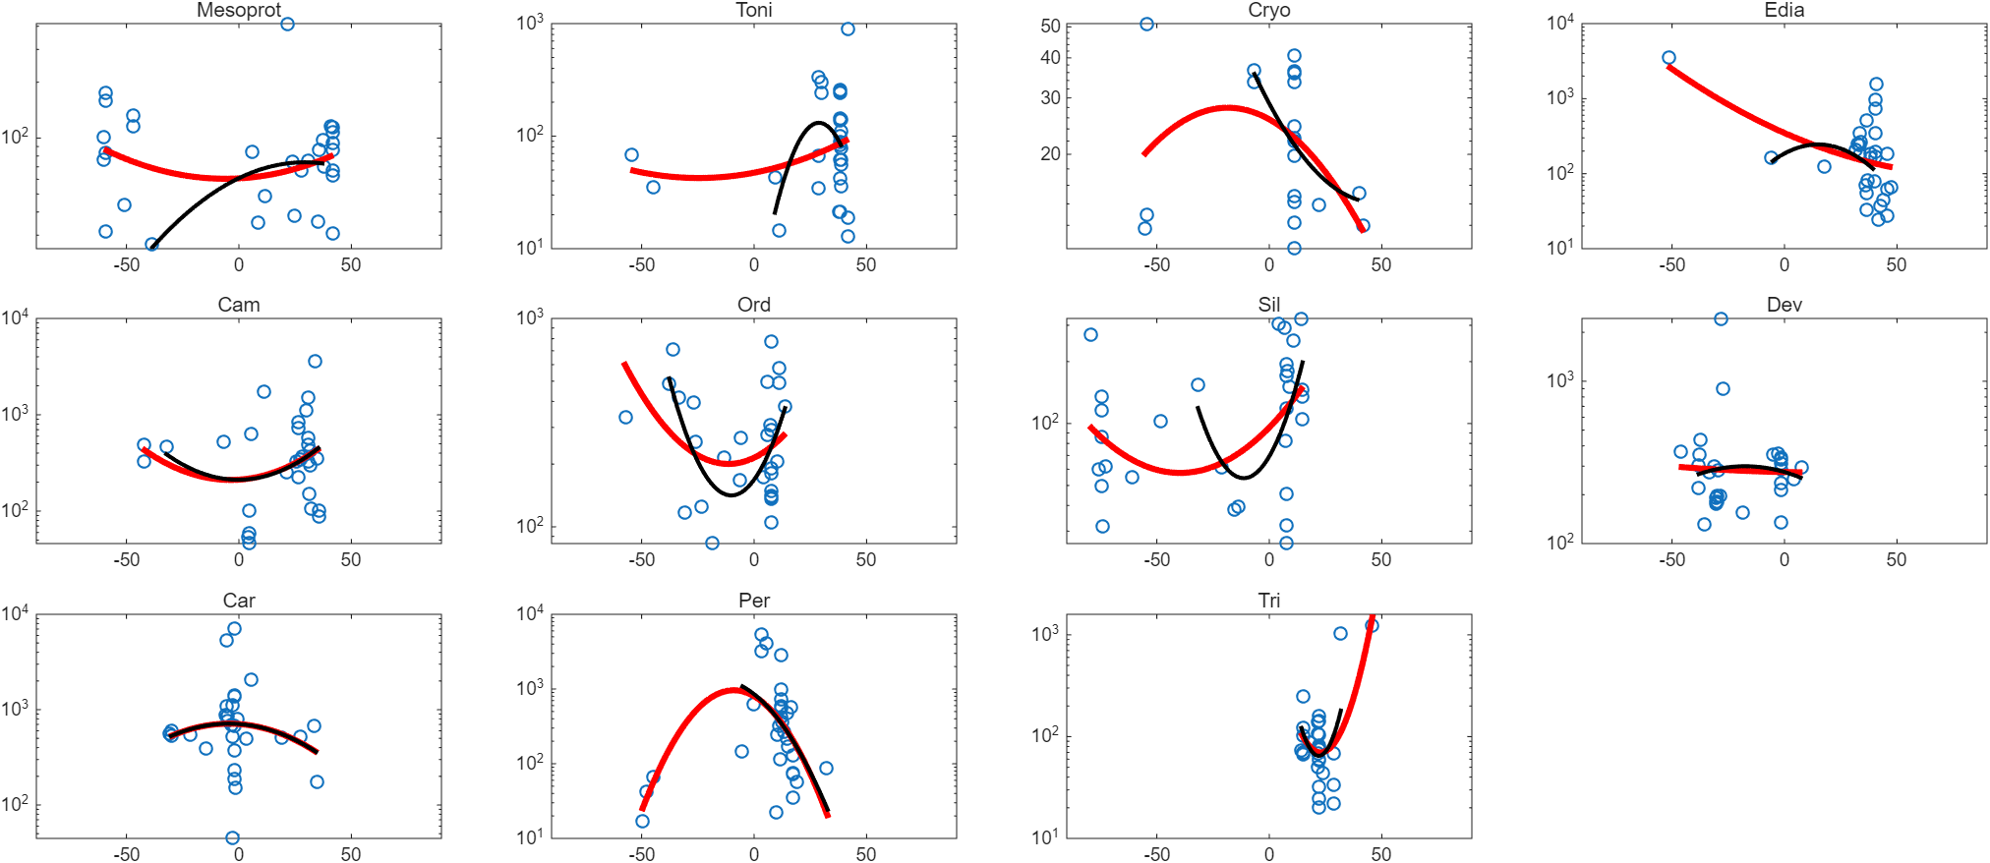
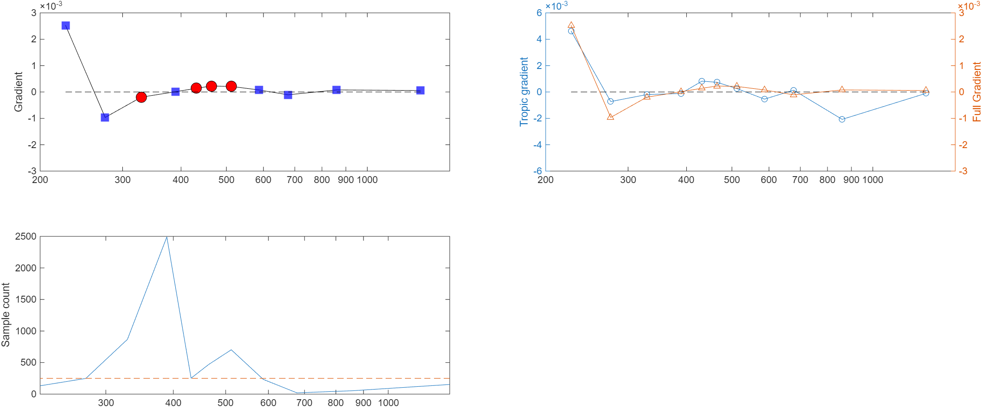
All samples
Shales
Adaptive, 95th
MoEF, lower_boundary=10

Slide 10
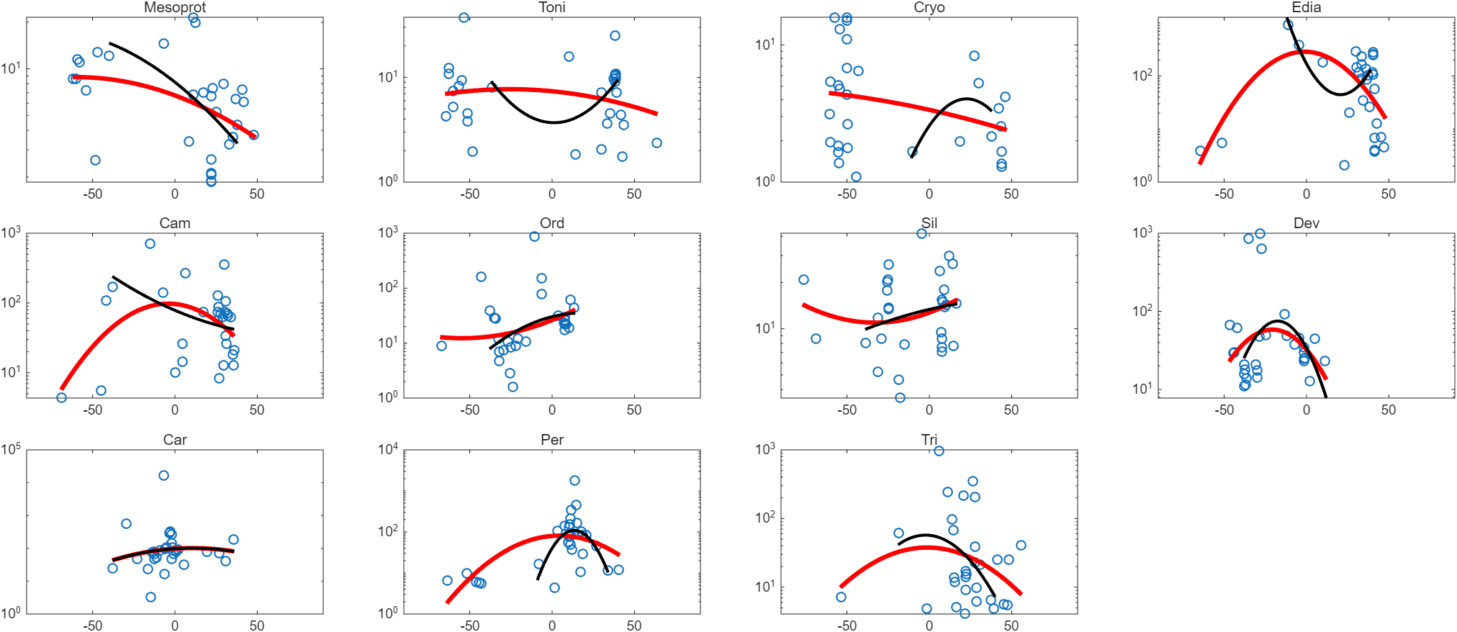
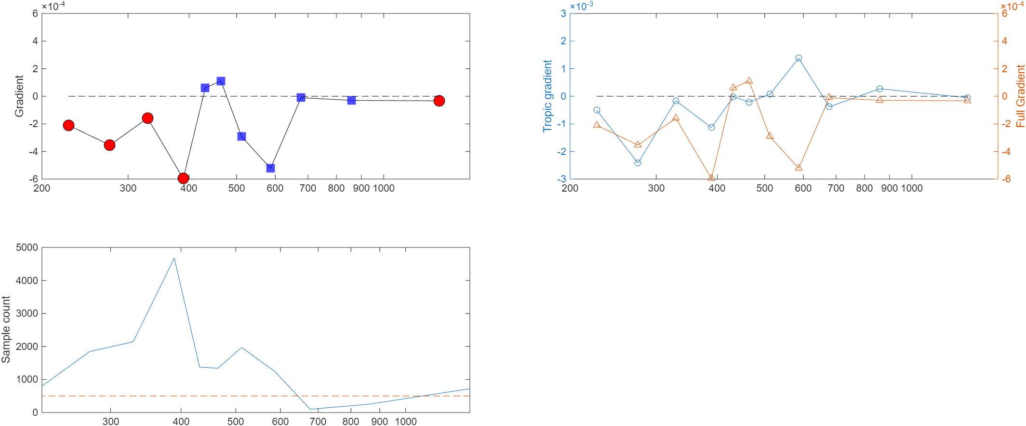
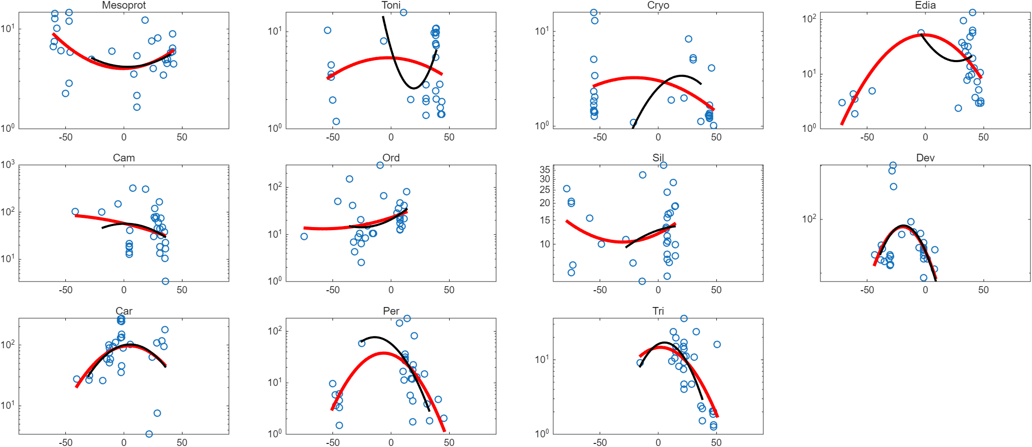
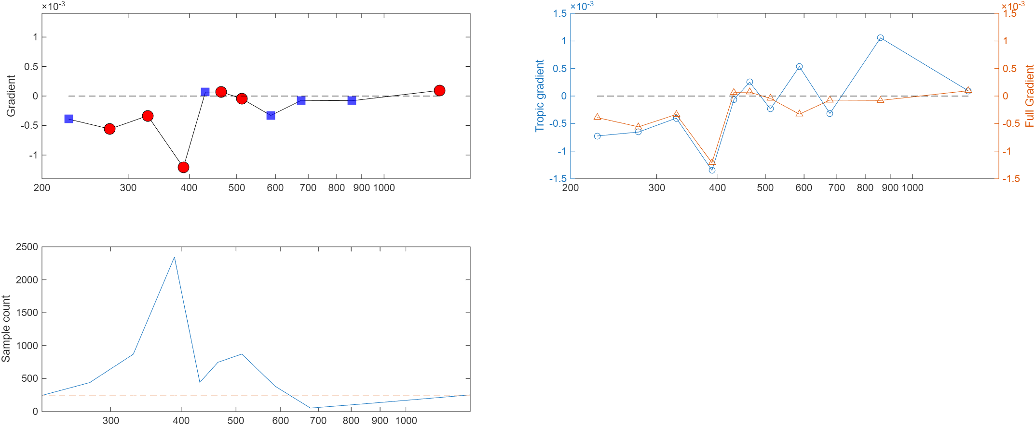
All samples
Shales
Adaptive, 95th
UEF, lower_boundary=1

Slide 11
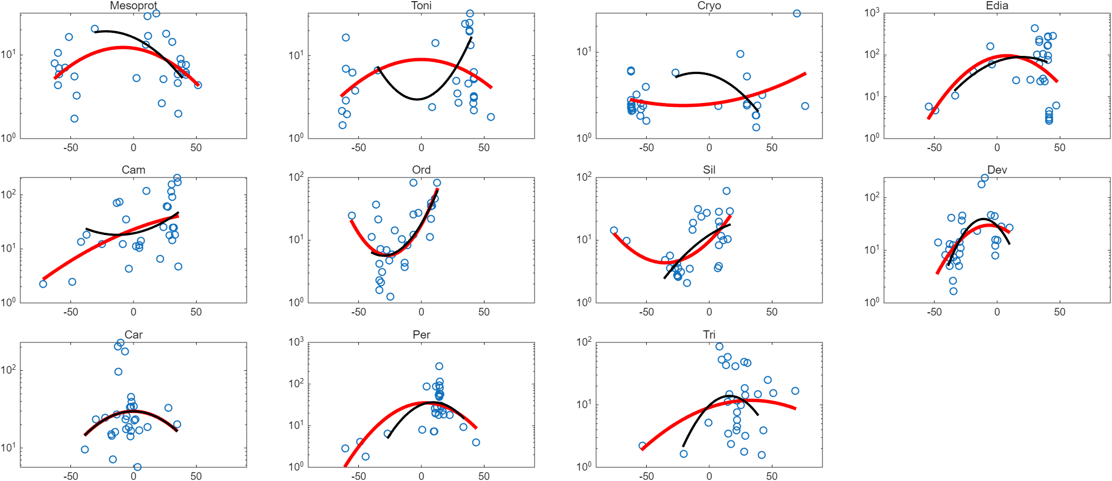
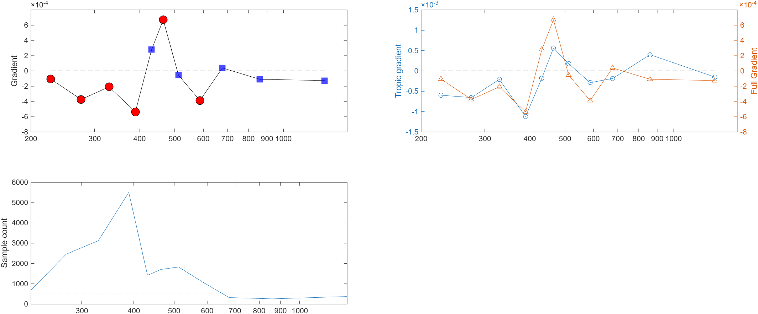
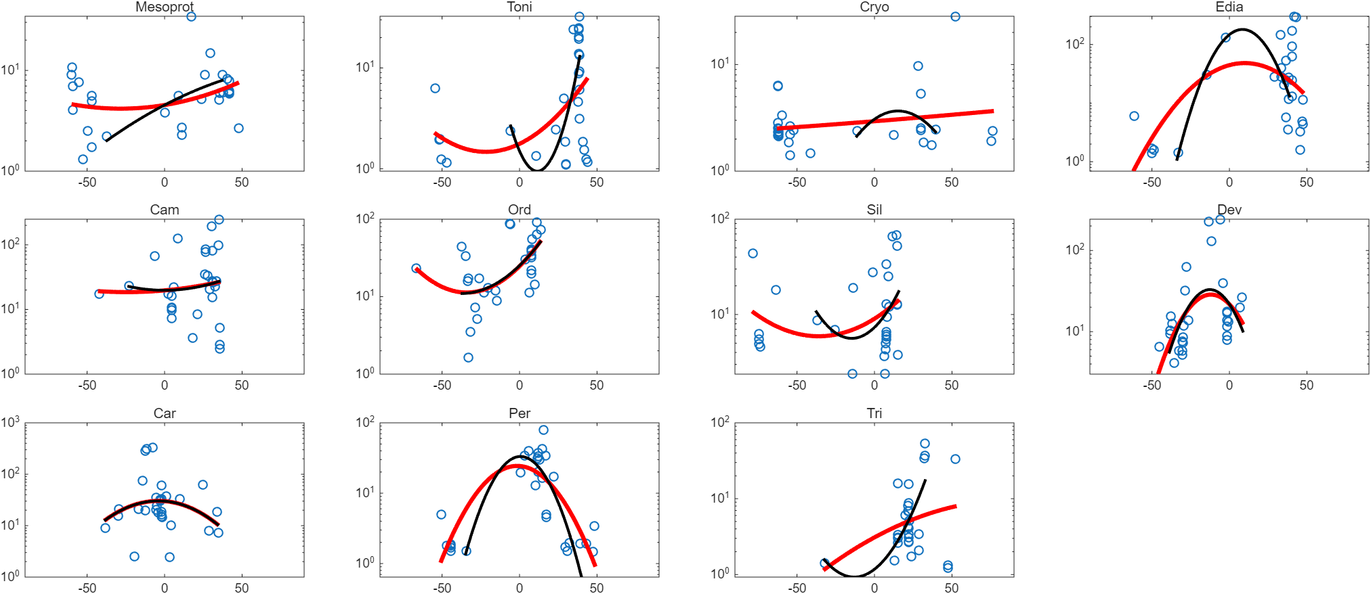
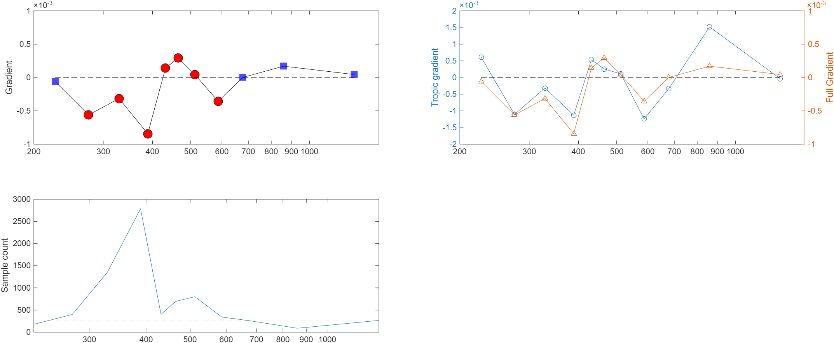
All samples
Shales
Adaptive, 95th
VEF, lower_boundary=1

Slide 12
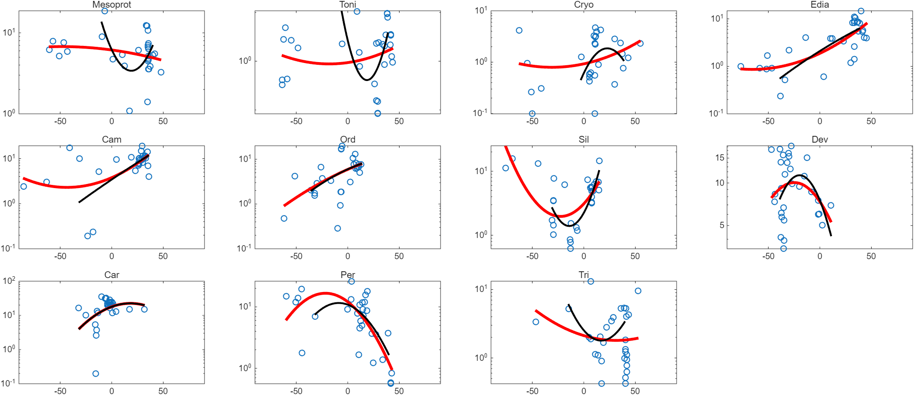
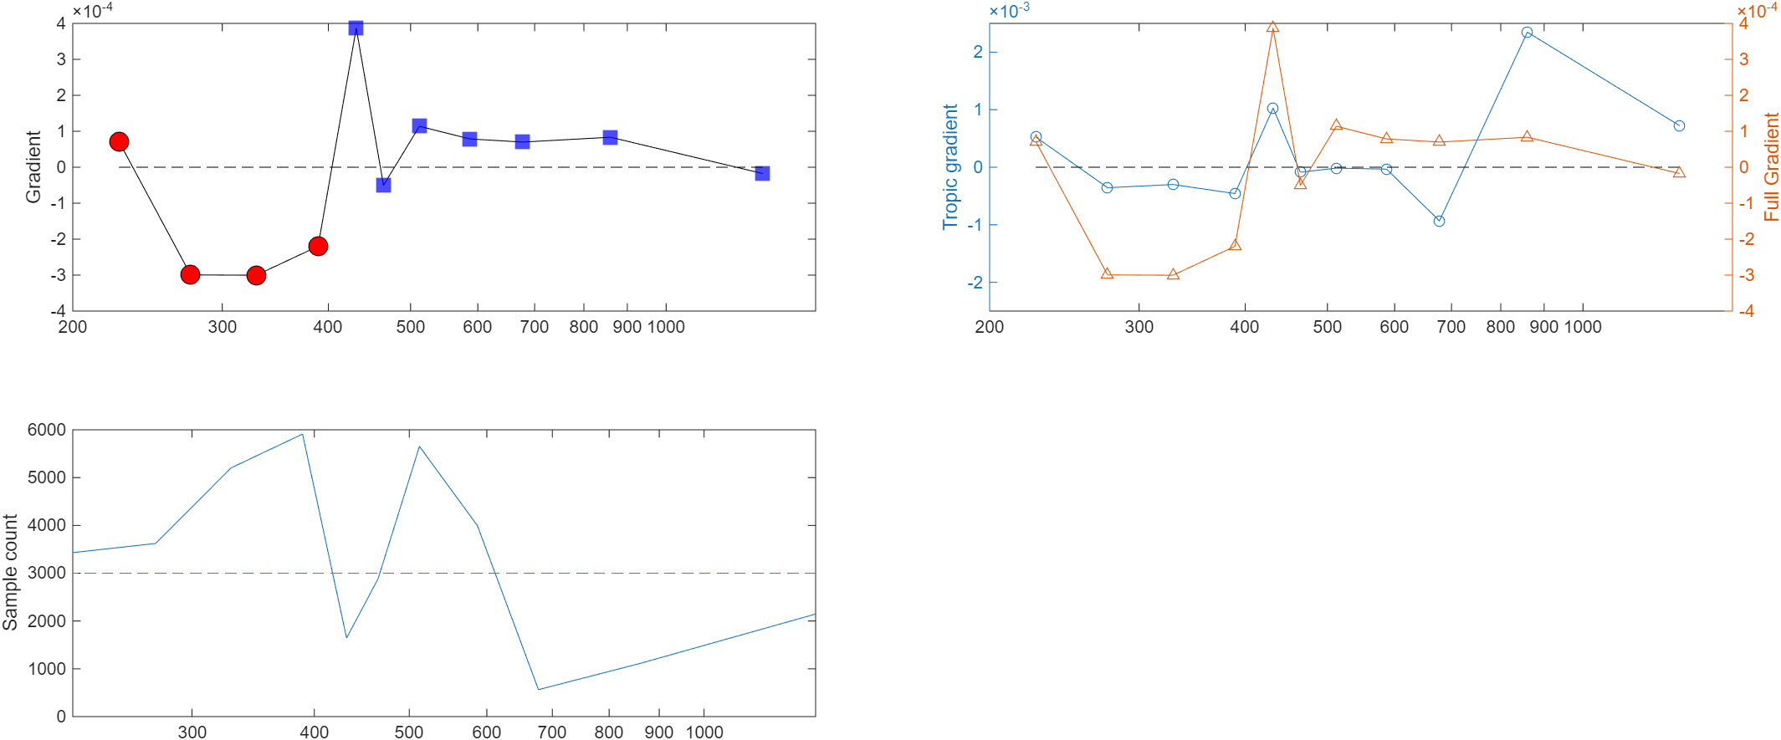
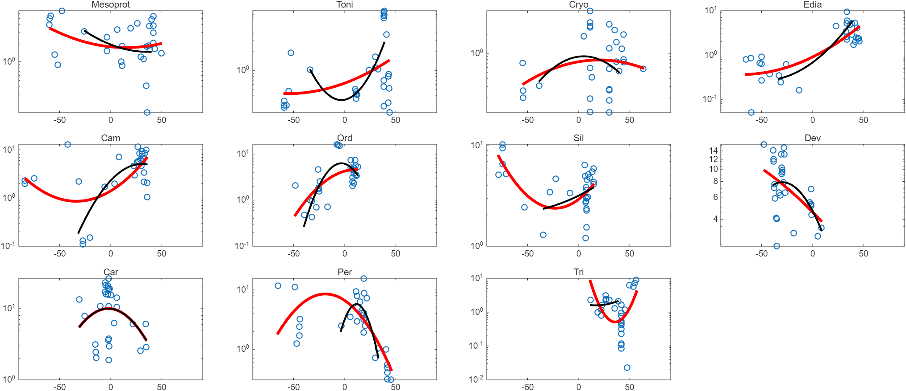
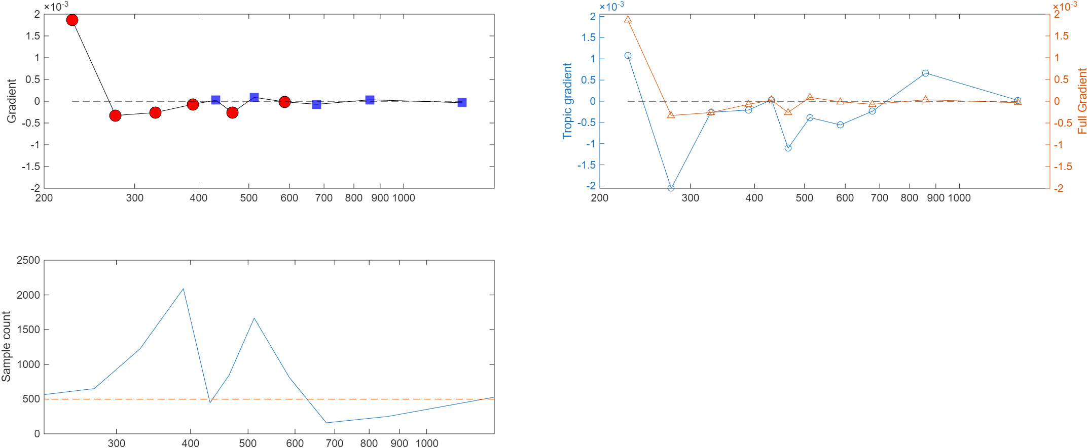
All samples
Shales
Adaptive, 95th
TOC, lower_boundary=0

Slide 13
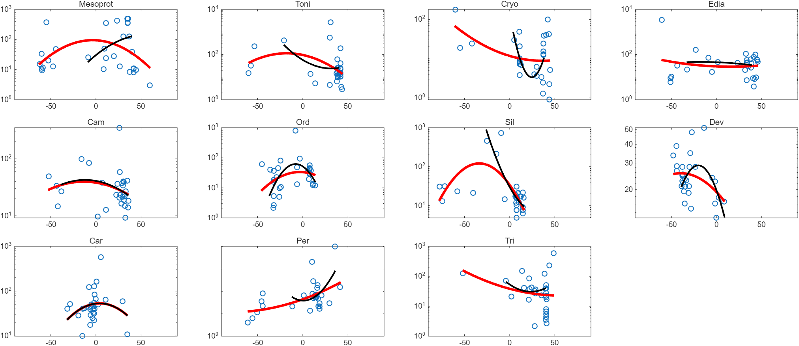
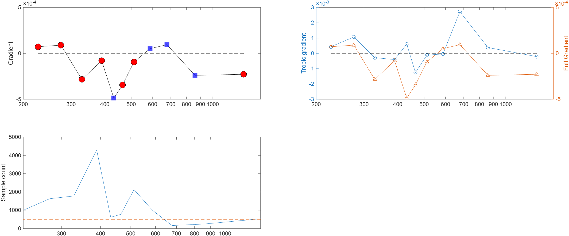
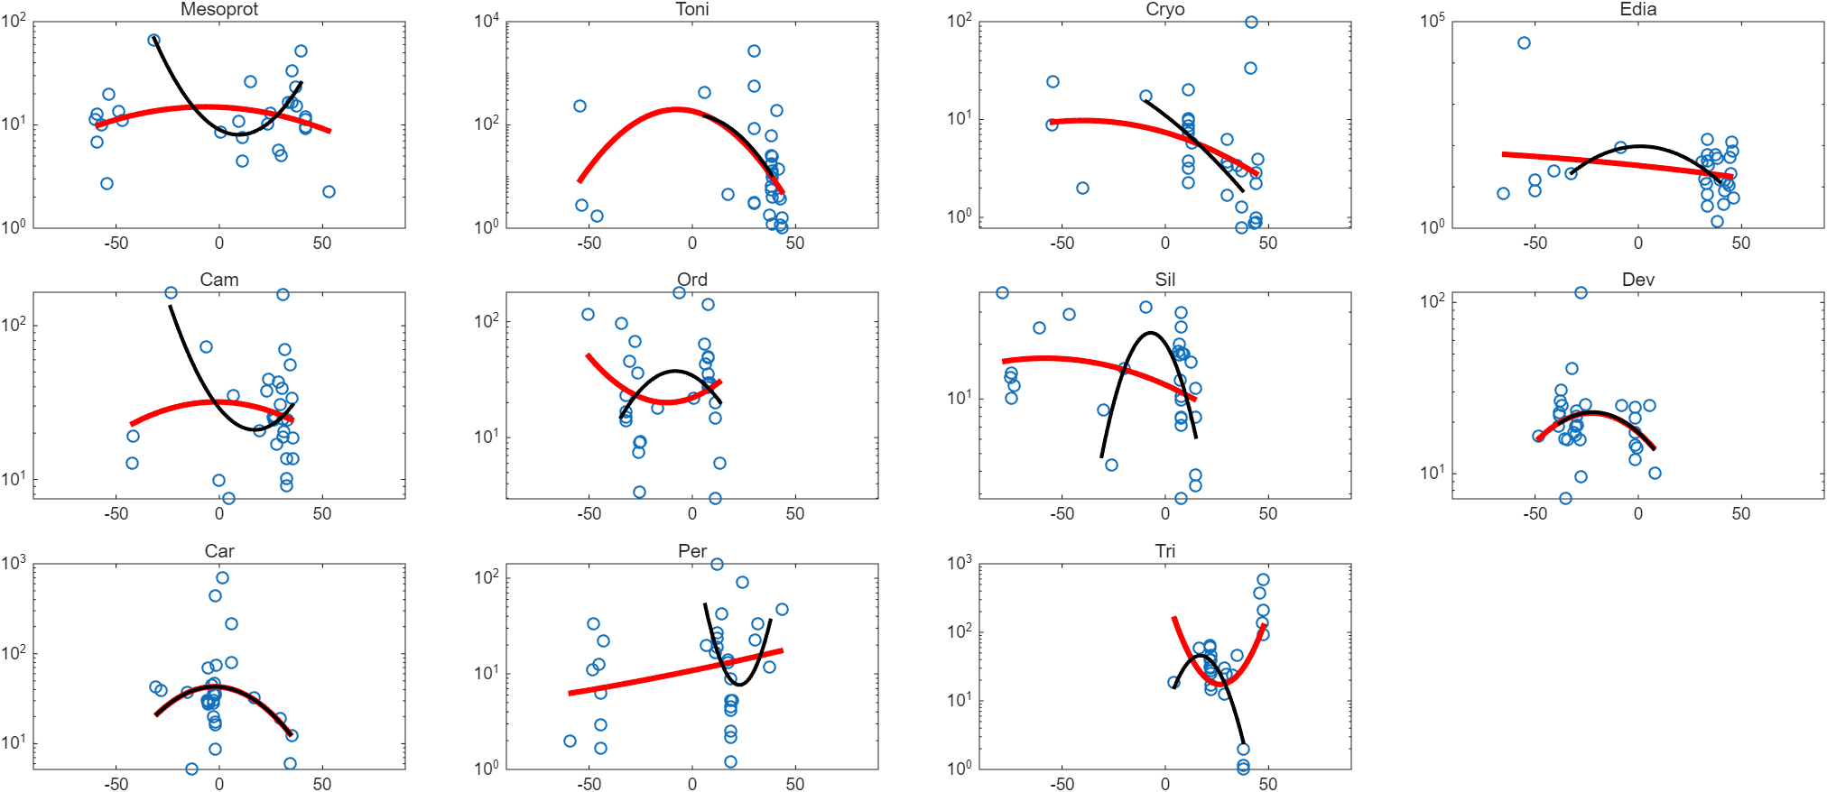
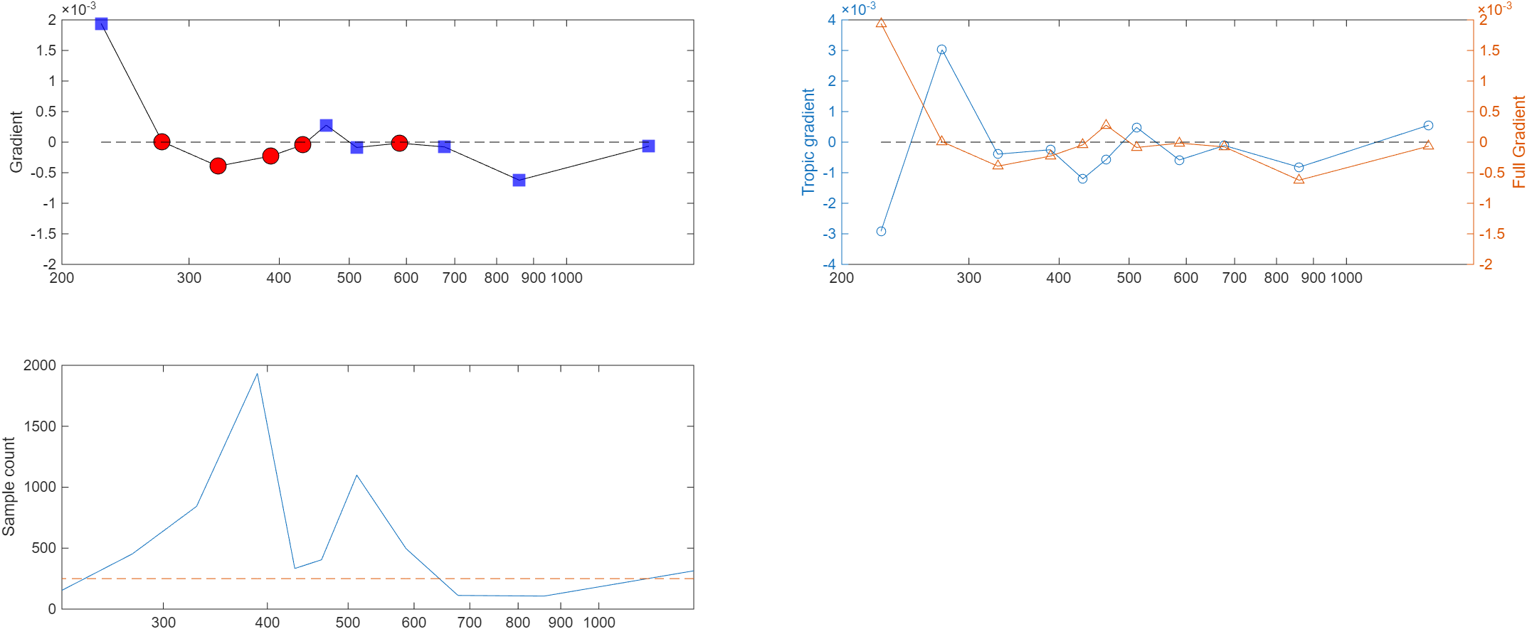
All samples
Shales
Adaptive, 95th
Mo/TOC, lower_boundary=0

Slide 14
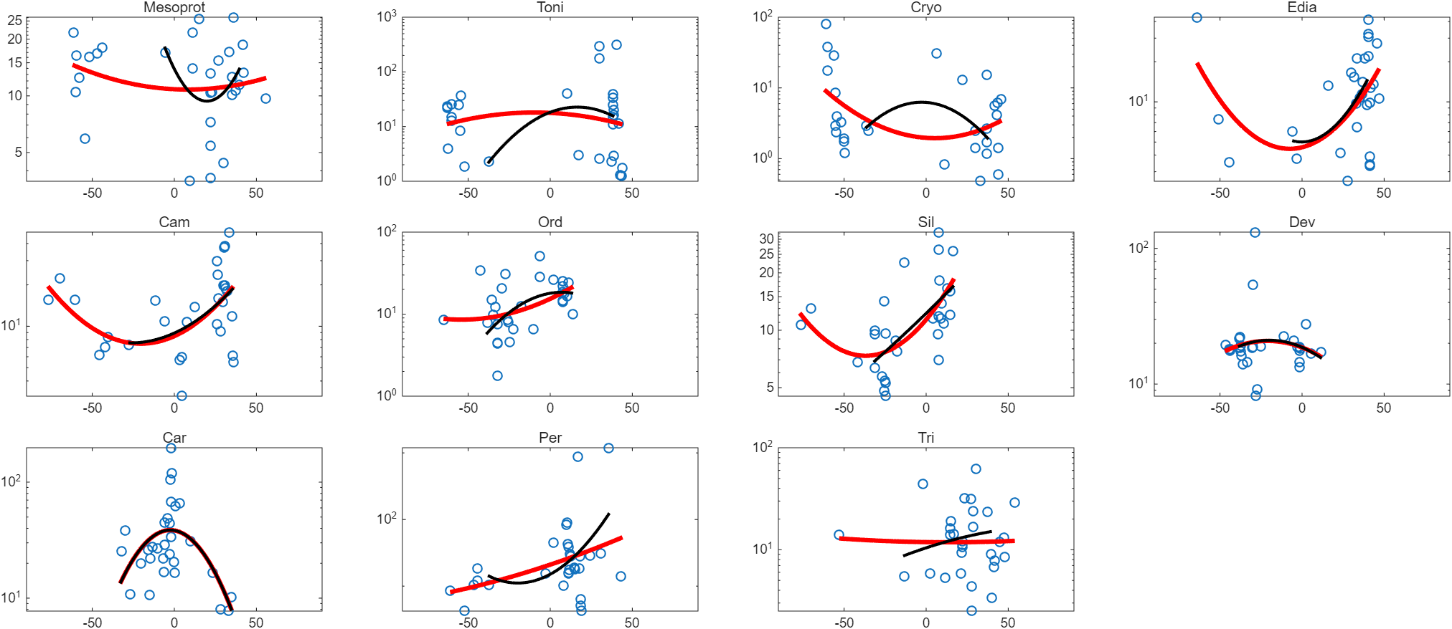
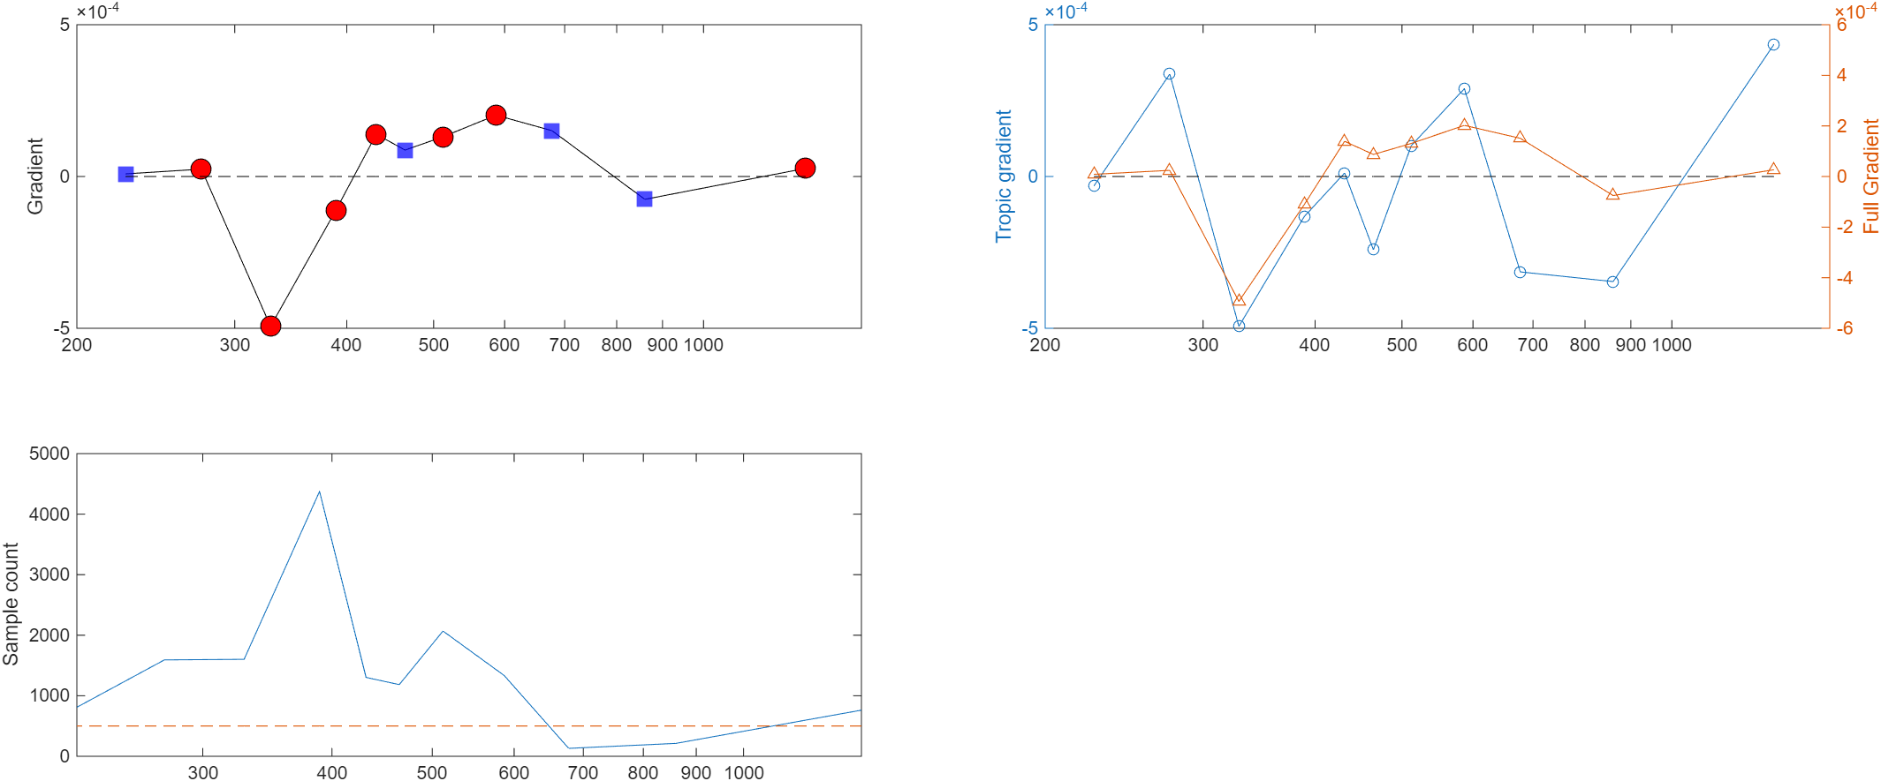
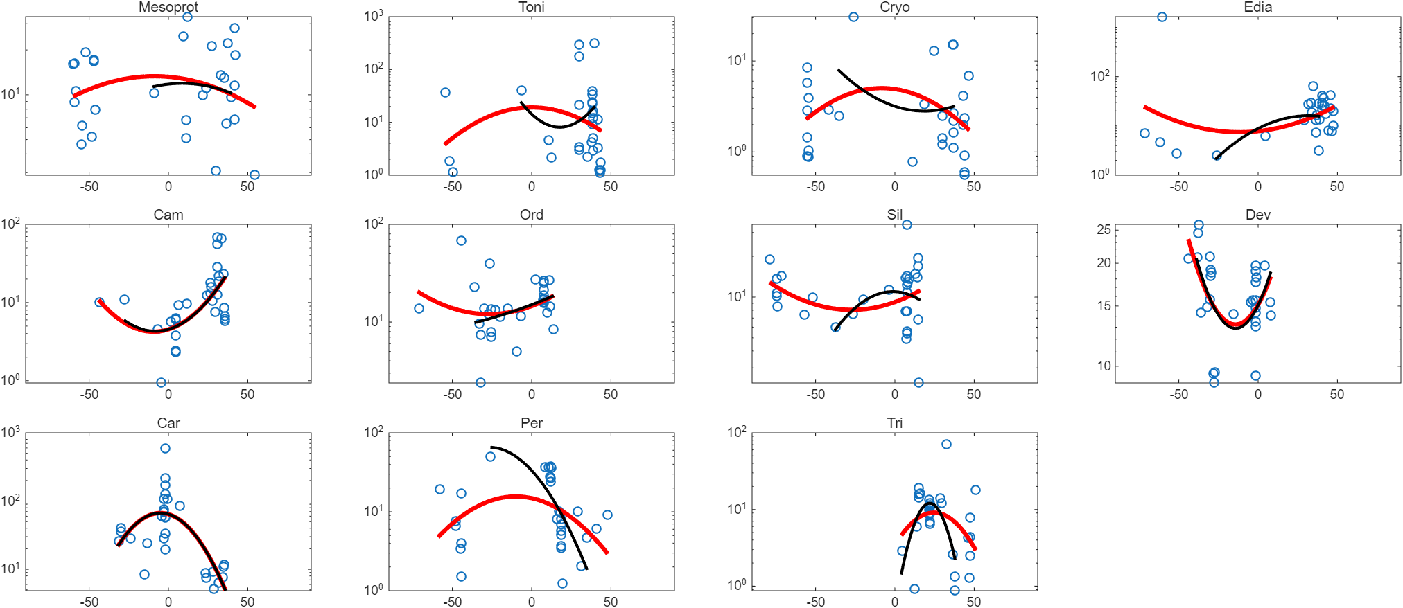
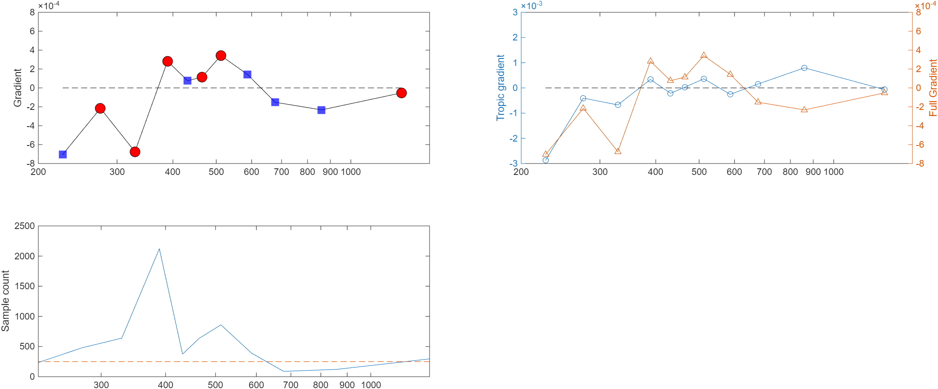
All samples
Shales
Adaptive, 95th
MoEF/UEF, lower_boundary=0

Slide 15
ISEA

Slide 16
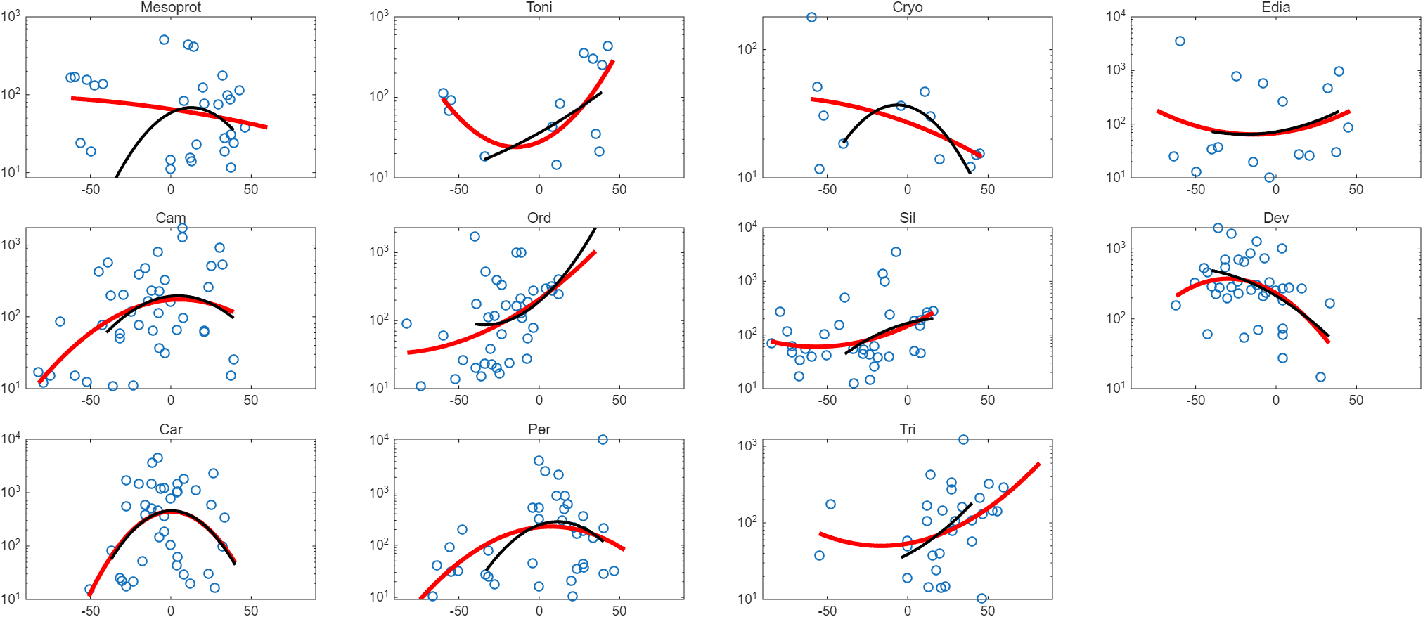
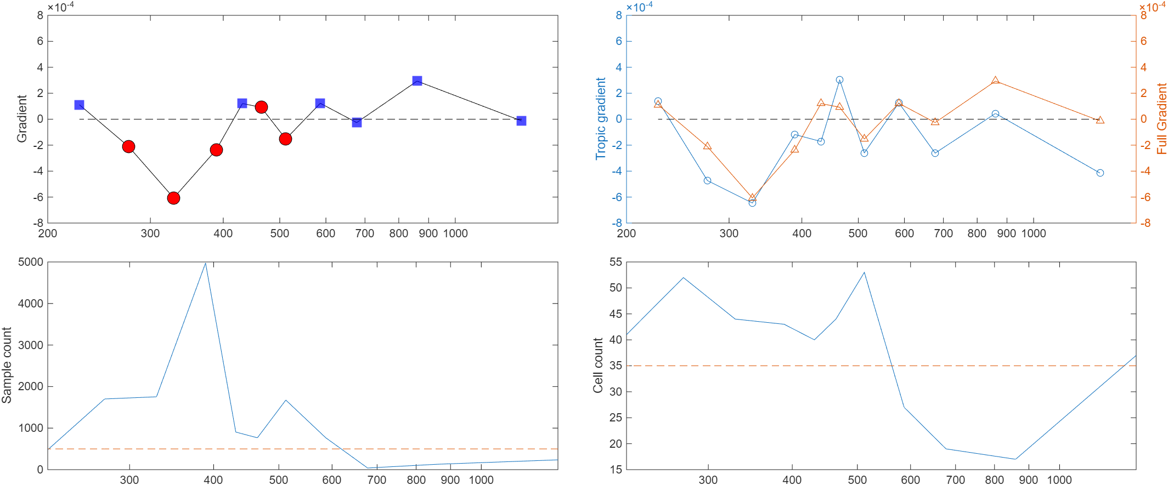
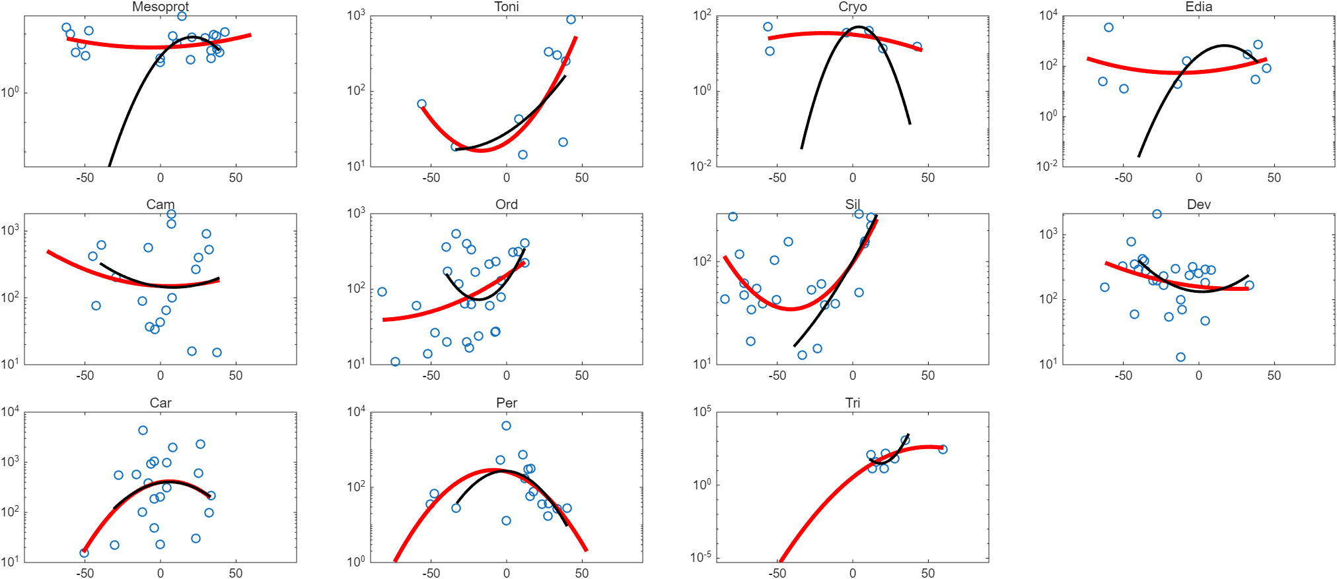

All samples
Shales
ISEA, 95th
MoEF, lower_boundary=10

Slide 17




All samples
Shales
ISEA, 95th
UEF, lower_boundary=1

Slide 18




All samples
Shales
ISEA, 95th
VEF, lower_boundary=1

Slide 19




All samples
Shales
ISEA, 95th
TOC, lower_boundary=0

Slide 20




All samples
Shales
ISEA, 95th
Mo/TOC, lower_boundary=0

Slide 21




All samples
Shales
ISEA, 95th
MoEF/UEF, lower_boundary=0

