Slide 1

Data Science Tools
This presentation explores essential data science tools. We'll cover version control, programming, platforms, and collaboration.

Slide 2

Content
0. GitHub
1. Google Colab
2. Kaggle
3. VSCode
4. Python and Pandas

Slide 3

GitHub: Version Control
1
Version Control
2
Collaboration
Track changes, revert to earlier versions. Collaborate effectively on projects.
Manage contributions from multiple team members. Streamline the development process.
3
Open Source
Access a vast library of projects. Contribute to the open-source community.
p/s: Can try GitLab as well

Slide 4
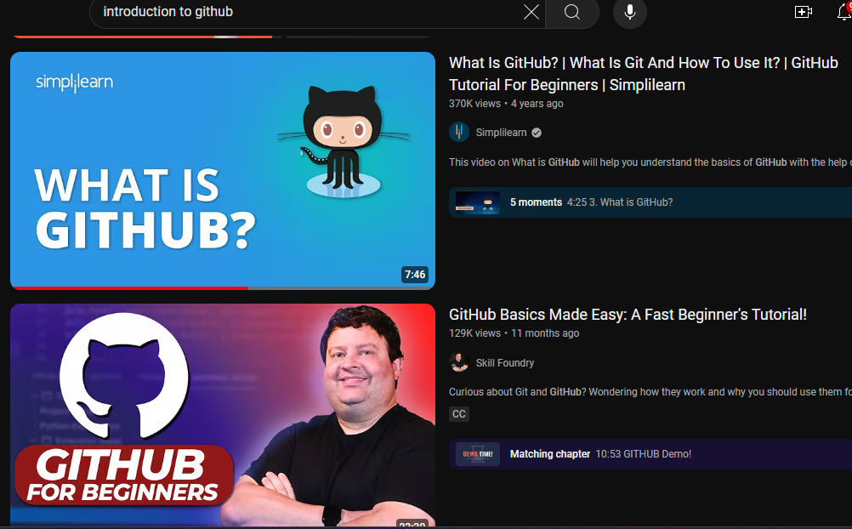
Pay attention to the dates.
Tech get outdated super fast!

Slide 5
GitHub: Your Task
1
Create a GitHub
account
2
Create a new repo from
GitHub
3
Push Google Colab Notebook to GitHub
4
Advance: Push repo from your local machine
To GitHub (using Terminal)

Slide 6
Kaggle: Competitive Platform
Competitions
Datasets
Community
Participate in challenges. Test your skills against others.
Access public datasets. Explore real-world data.
Connect with other data scientists. Learn from experts.

Slide 7
Kaggle: Your task
1. Create an account/log in
2. Explore Datasets
3. Explore Notebooks
4. Explore Competitions

Slide 8
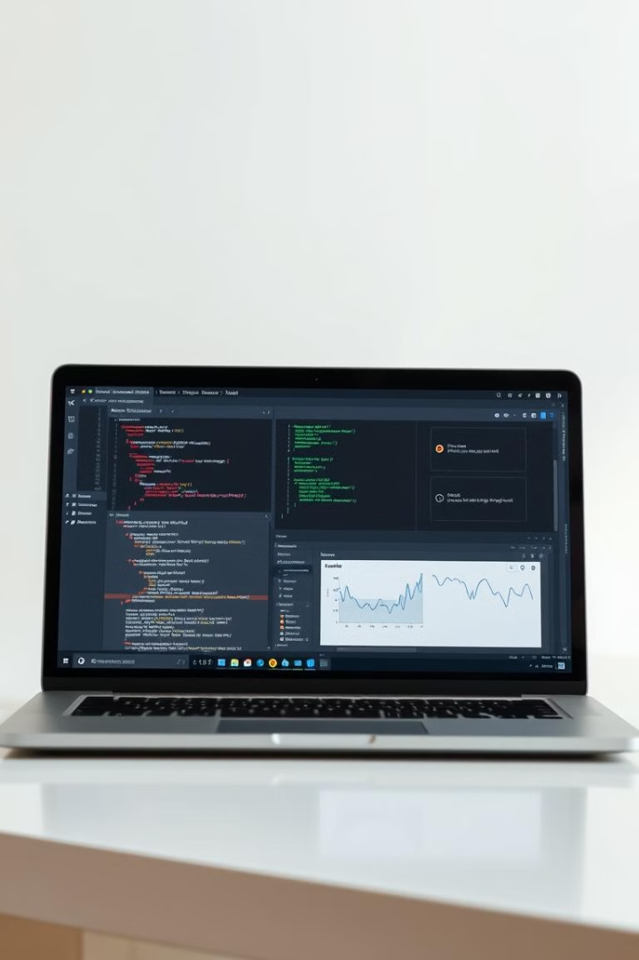



Google Colab: Collaboration
Cloud-Based
Access powerful computing resources. No local setup needed.
Collaboration
Share notebooks with others. Work together seamlessly.
Free Access
Free to use. Great for learning and experimentation.

Slide 9
Python: Data Science Backbone
Libraries
Flexibility
NumPy for numerical computation. Pandas for data manipulation.
Versatile language for various tasks. Easy to learn and use.
Community
Large community support. Abundant resources and tutorials.

Slide 10
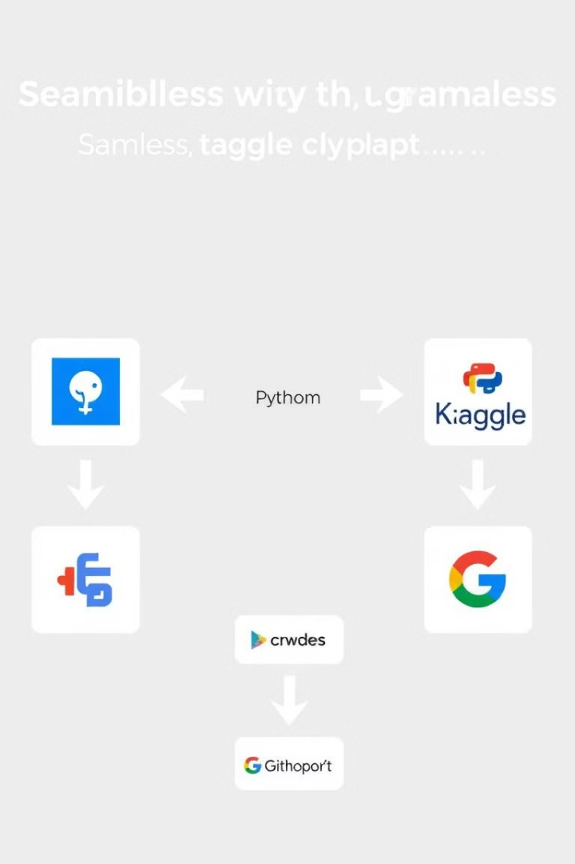
Integrating Data Science Tools
1
Version Control
Use GitHub to manage code versions. Collaborate effectively.
2
Coding
Use Python for data analysis and modeling. Leverage Colab.
3
Deployment
Deploy models and share results. Use Kaggle for competition.

Slide 11

Project Success
Tool
Benefit
GitHub
Version control, collaboration
Python
Analysis, modeling, flexibility
Kaggle
Competition, datasets, community
Colab
Collaboration, cloud computing

Slide 12
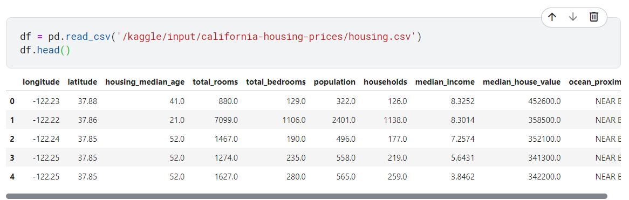
How to understand a dataset

Slide 13
How to understand a dataset

