Slide 1
Attention based recurrent neural networks for keyword spotting
Nicolò Dal Fabbro
Davide Masiero

Slide 2
Index
Introduction
Dataset and Preprocessing
Models
CNN
RNN
Attention Mechanism
Results
Application

Slide 3
Introduction
GOAL:
Design a model for the Keyword Spotting task
HOW:
Exploring an attention-based CNN/RNN architecture

Slide 4
Dataset And Preprocessing
Dataset:
Google Keyword Spotting Dataset V2 (http://download.tensorflow.org/data/speech_commands_v0.02.tar.gz)
35 classes
Length of the recordings: 1sec
Sampling rate: 16000Hz

Slide 5
Dataset And Preprocessing
Preprocessing and feature vectors:
Zero padding
80 band mel scale
1024 Discrete Fourier Transform points
Window length: 0.02s
Hop size: 0.01s

Slide 6
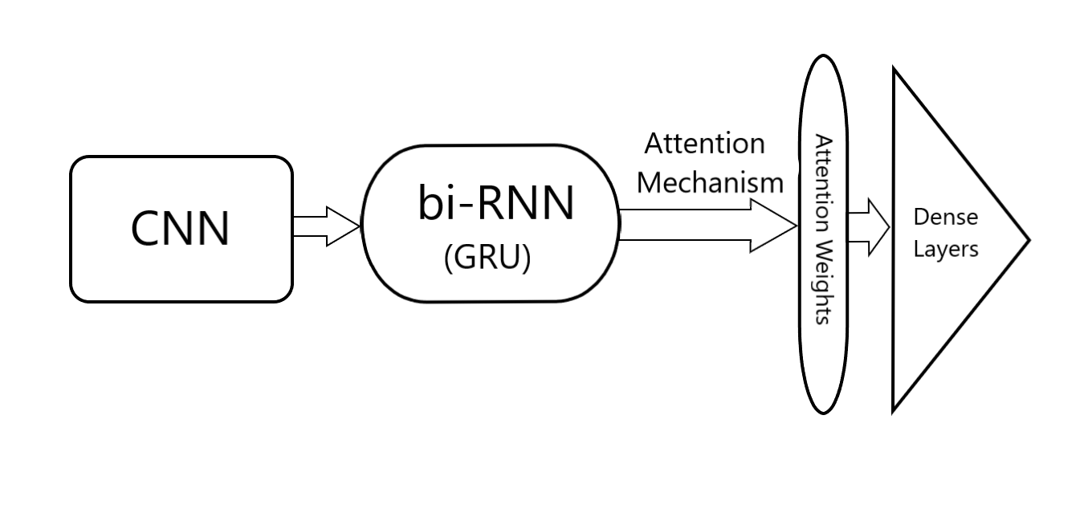
Model

Slide 7
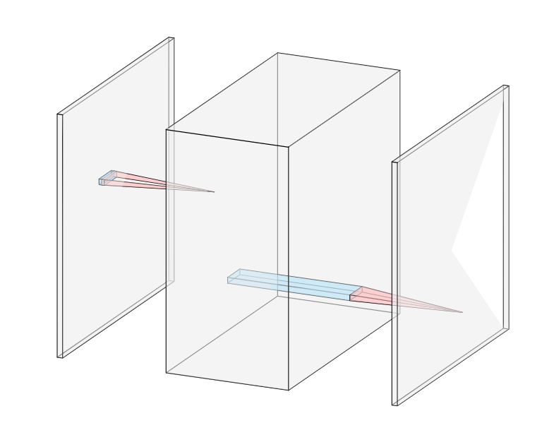
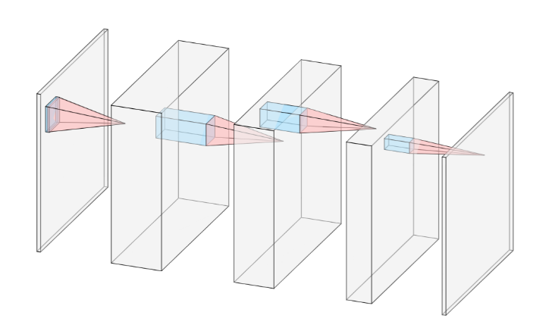
CNN

Slide 8
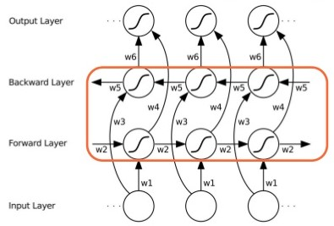
RNN
We try different configurations of Bi-RNN:
GRU/LSTM
One or two Bidirectional RNN
Different number of units (32, 48, 64)
Passing or not the
state between them

Slide 9
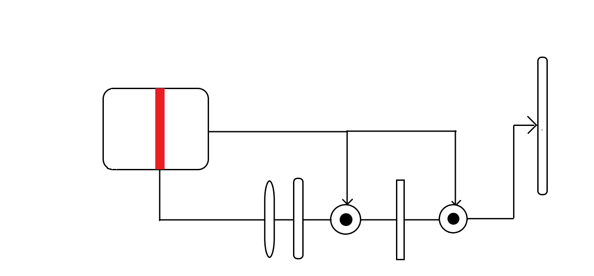
Attention Mechanism
Attention mechanism is used to train the network to understand which part of the signal is more important for the generation of the output.

Slide 10
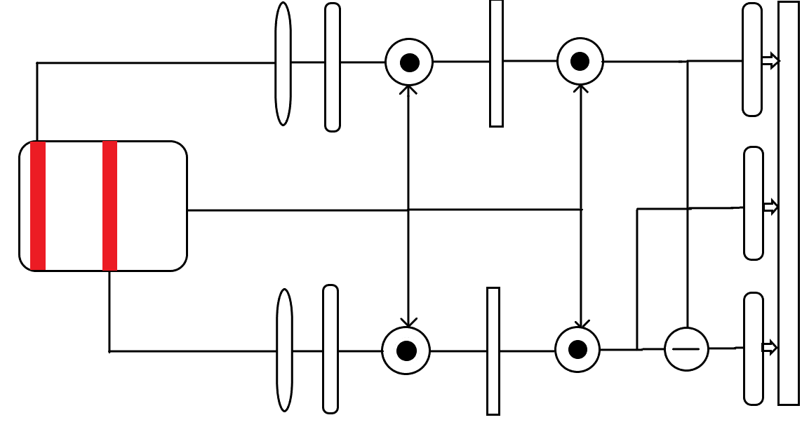
Attention Mechanism

Slide 11
Results
Model | Test Accuracy
CNNRNNAttState | 92.55
CNNRNNAttDouglas | 92.62
CNNRNNStatefulAttDouglas | 92.54
PCNNRNNStatefulAttDouglas | 88.26
MultiAttention | 93.11
MultiAttentionDouglas | 92.50
MultiAttentionDiff | 94.10
Douglas (paper) | 93.90
Douglas (by us) | 92.71

Slide 12
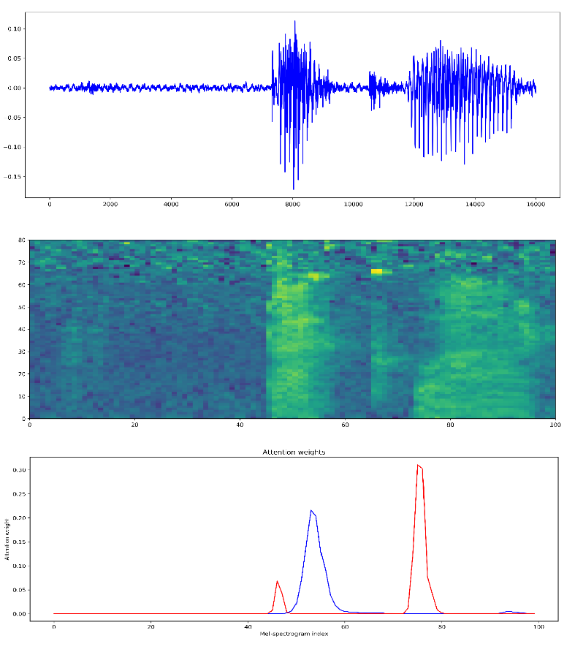
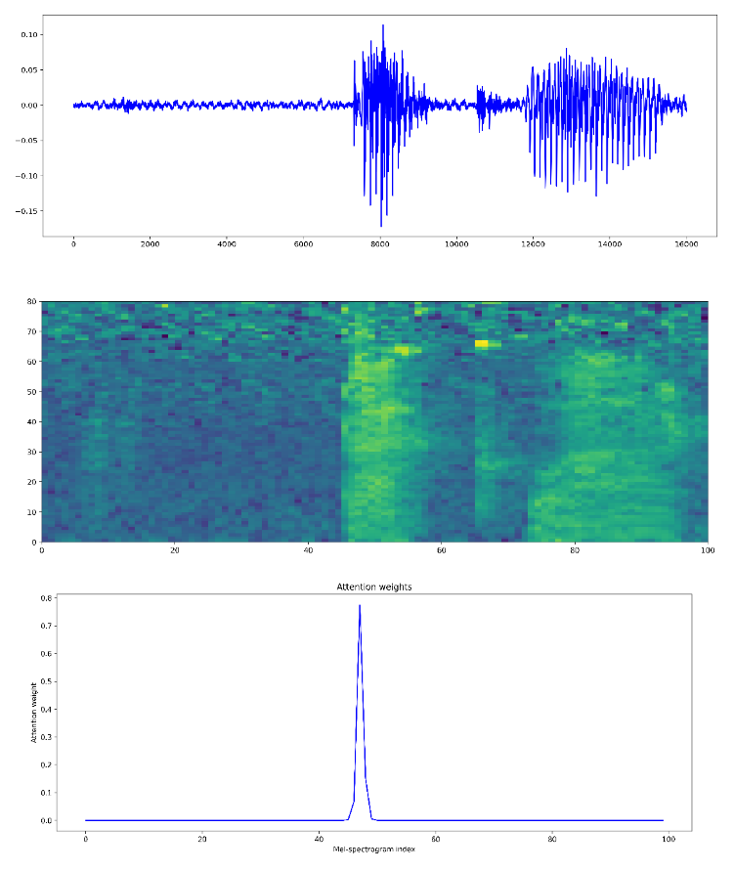
Results

Slide 13
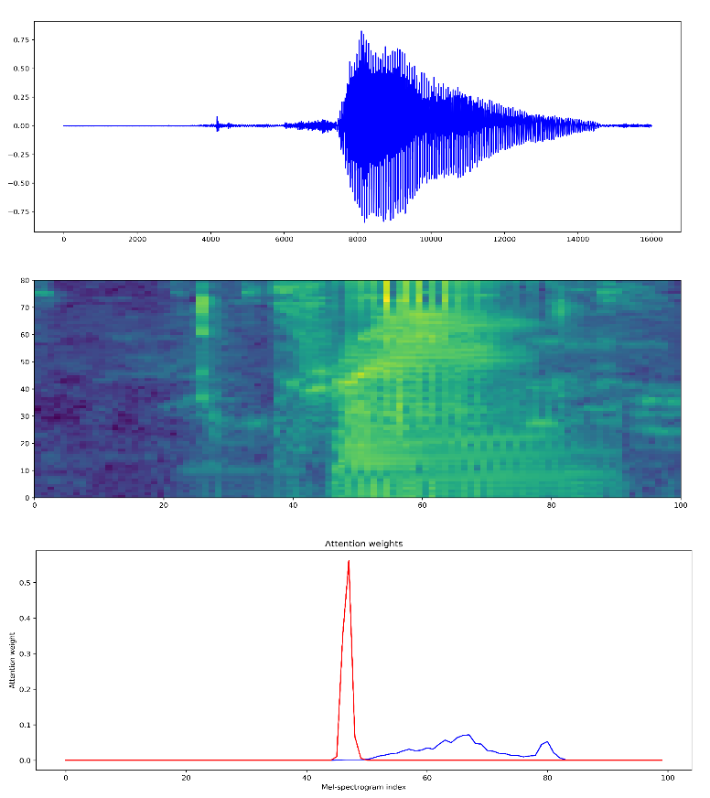
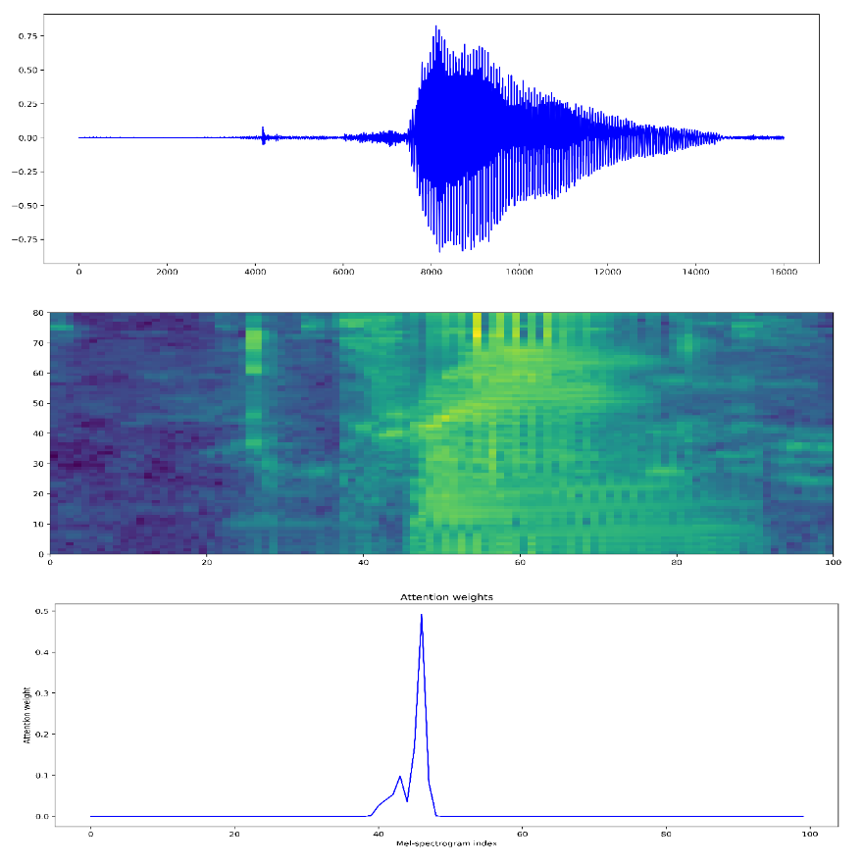
Results

Slide 14
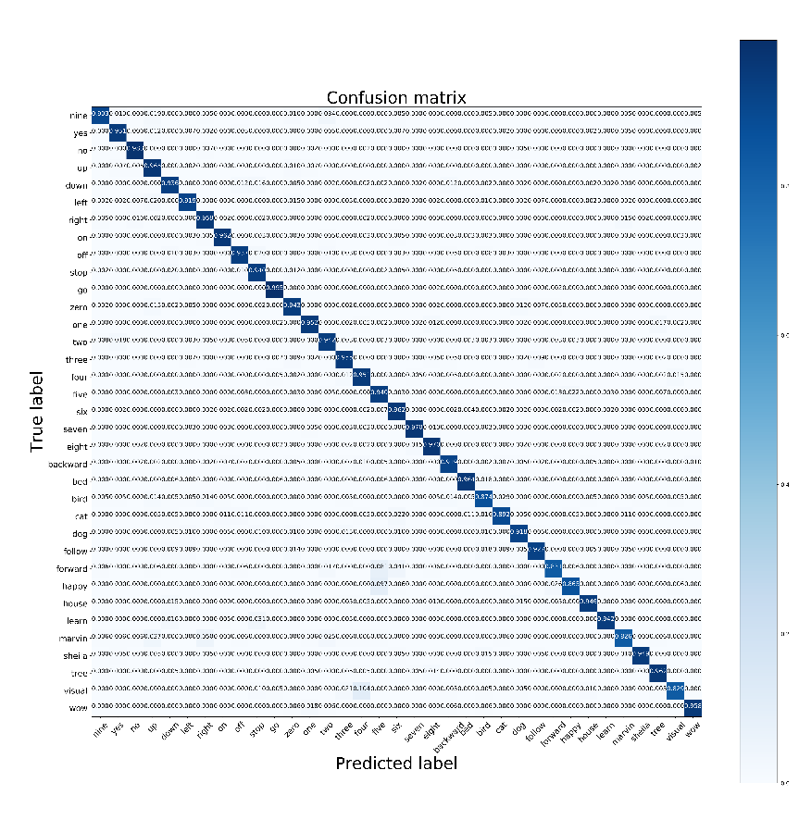
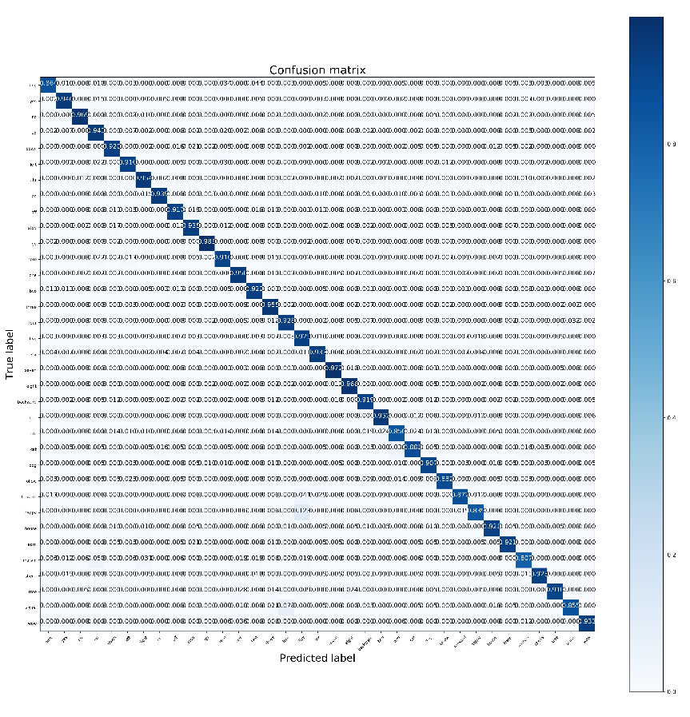
Results

Slide 15
Application
Our application predicts words spoken by a user in a real time context.
We re-train our best model in a dataset with noisy samples.

Slide 16
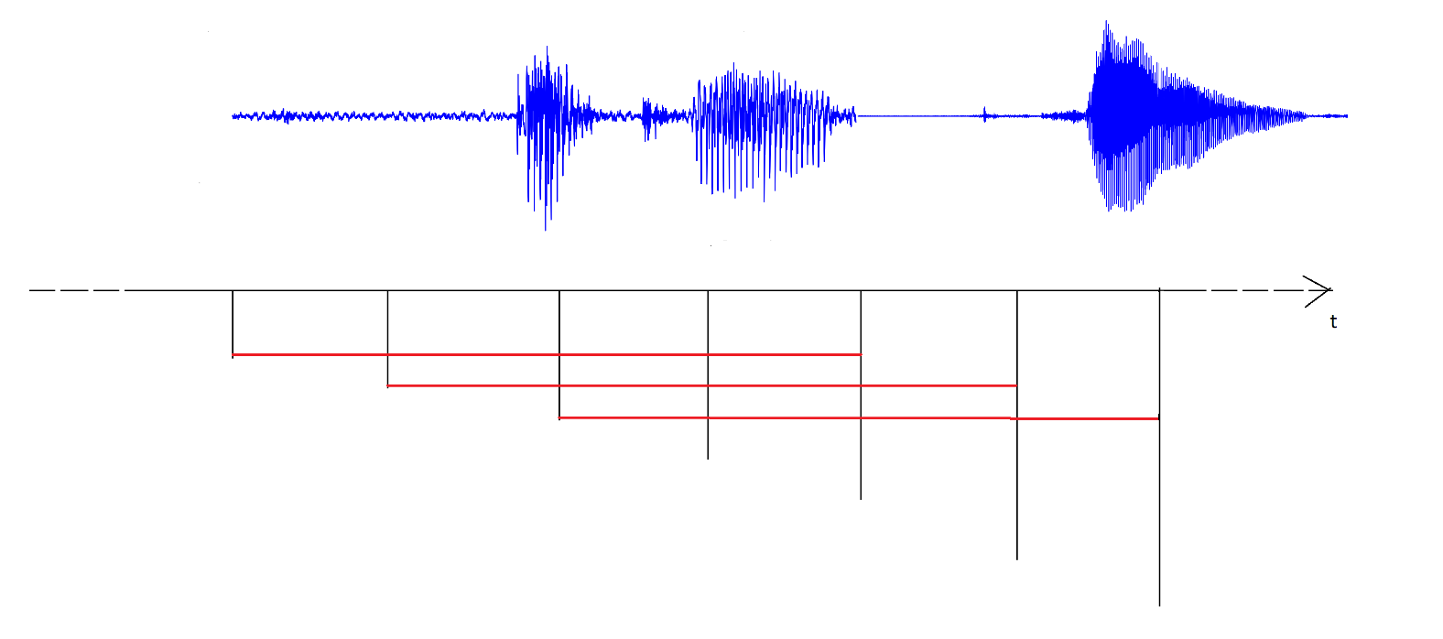
Application

Slide 17
Application
To classify the words said by the user:
The prediction in a sequence of 3 windows must be the same
A threshold is applied to the score of the prediction (80%).

Slide 18
THE END ENJOY THE DEMO

