Slide 1

ROBOTICS AND INTELLIGENT
SYSTEM

Slide 2
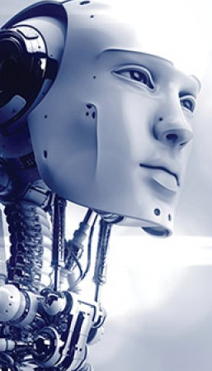
Introduction
The word ‘robot’ came from Czech word “robata” which means forced or slave laborer
1921 : Karel Capek
Robot is a machine look-wise similar to a human being

Slide 3
Definitions
Oxford English Dictionary
  robot is a machine capable of carrying out a complex series of actions automatically, especially one programmable by a computer
  This is nothing but an automatic machine.
International Organization for Standardization(ISO)
  robot is an automatically controlled, reprogrammable, multifunctional manipulator, programmable in three or more axes, which can be either fixed in place or mobile for use in industrial automation applications.

Slide 4
Definitions
RIA(Robot Institute of America)
  A reprogrammable multi-functional manipulator designed to move materials, parts, tools or specialized devices through variable programmed motions for the performance of a variety of tasks.

Slide 5
Robot is a programmable mechanical device that can perform tasks and interact with the environment without the aid of a human

Slide 6
ROBOTICS
Robotics is a science, which deals with the issues related to design, development, applications of robots to perform a variety of tasks.
Use the fundamentals of different subjects : physics, mathematics, mechanical engineering, electrical and electronics engineering, computer science

Slide 7
3H
Hand
  Manipulator/ mechanical hand
  Manipulator is a robot with fixed base.
  Manipulator could be either serial manipulator or parallel manipulator.
Head
  Intelligence
Heart

Slide 8
Why Robotics?
Increased productivity
Improved product quality
Reduced production cost

Slide 9
GENERATIONS OF ROBOT
First generation: The first generation robots are repeating, non-servo controlled type used for pick and place and point to point operations
Second generation: The addition of sensing devices and enabling the robot to alter its movements in response to sensory feedback marked in the second generation. These robots exhibit path control capabilities.

Slide 10
GENERATIONS OF ROBOT
Third generation: This generation is introduced in late 1970‘s have human like intelligence.
The growth in computers led to high speed processing of information, robot acquired artificial intelligence, self – learning and decision making capability by past experiences. Online computations & control, artificial vision and active force/torque interaction with the environment are the significant characteristics of these robots.

Slide 11
GENERATIONS OF ROBOT
Fourth generation: These are artificial biological robots or a super humanoid capable of producing its own clones

Slide 12
Robotics system components:
Mechanical platforms or hardware base
Sensors
Links and Joints
End-Effector/ Gripper
Controller
Wrist
Power Source
Artificial intelligence
Drive/Actuators

Slide 13
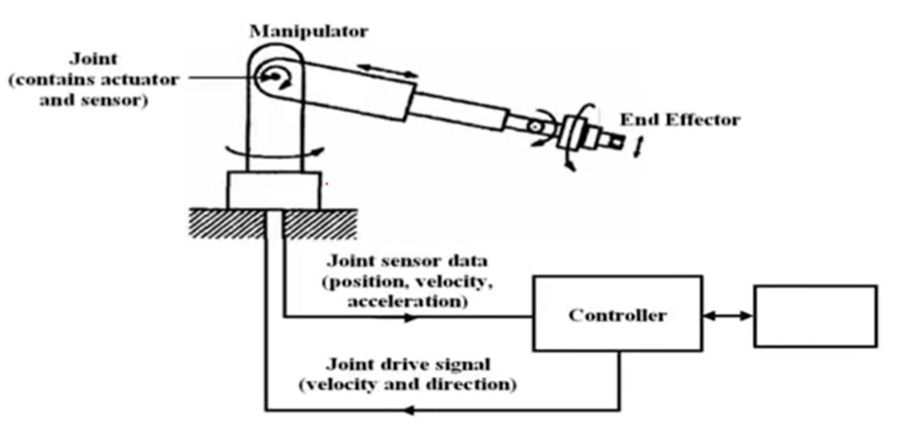
Robotics system components:
Power source

Slide 14
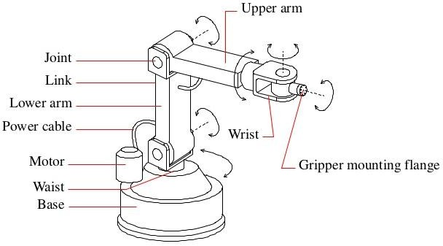

Slide 15
Manipulator (Robotic Arm)
  Just like human arm, the robot consists of what is called a manipulator having several joints and links
  A robotic arm is a type of mechanical arm, usually programmable, with similar functions to a human arm
  The arm may be the sum total of the mechanism or may be part of a more complex robot.
  The links of such a manipulator are connected by joints allowing either rotational motion (such as in an articulated robot) or translational (linear) displacement.
  The links of the manipulator can be considered to form a kinematic chain.
  The terminus of the kinematic chain of the manipulator is called the end effector and it is analogous to the human hand

Slide 16
Mechanical platforms or hardware base
  Mechanical device such as a wheeled platform, arm, fixed frame or other construction capable of interacting with its environment and other mechanisms
End effector /Gripper
  Attached to the free end of the manipulator
  End effector is expected to perform tasks that are normally performed by the palm and finger arrangement of a human arm.

Slide 17
Actuators
  Mechanism that generates a force / torque given electrical signals
  Mechanism to activate a certain process
    pneumatic (air pressure)
    hydraulic (fluid pressure)
    electric.

Slide 18
Actuators
Pneumatic Actuators
  use compressed air or pressurized gas to create a controlled movement.
  simple to use and are a safe alternative to both electric and hydraulic actuators since they do not require ignition or electricity to operate.
  disadvantage of the pneumatic actuator is that a compressor must continuously run to maintain operating pressure whether the device is in use or not.

Slide 19
Actuators
Hydraulic Actuators
  use fluid pressure to facilitate mechanical movement.
  hydraulic actuators are useful when high-powered energy is needed
Electric Actuators
  convert energy from an electrical power source into mechanical energy.
  easy to maintain
  offer a high level of precision.

Slide 20
Controller
  A digital computer
  Functions in a manner analogous to the human brain
  With the help of this controller robot is able to carry out the assigned task
  Directs and controls the movement of manipulator and end effector.

Slide 21
Sensors
  Collect the information of the environment
  Information is processed to take a meaningful decision.
  Provide the knowledge of real time information on the task environment
  Different types of sensors are attached in the robot

Slide 22
2 types
  Physical Sensors
  Logical Sensors

Slide 23
Joints and links
  Links are used to transmit the mechanical power
  Joint connects two links
    Robotic joints can be basically of two types
      Linear joint
        Either prismatic or sliding joint
      Rotary joint

Slide 24
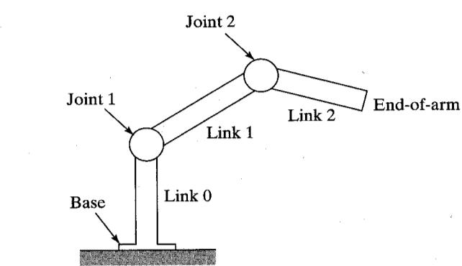

Slide 25
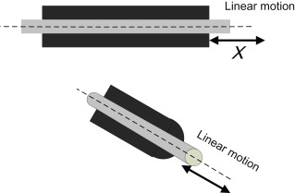
Prismatic Joint (Linear Joint)
  L Joint
  A prismatic joint is one that allows translation along a line
  Two links should be parallel for achieving the linear movement
  https://www.youtube.com/watch?v=SMcqUjQ2Swo
  1.06

Slide 26
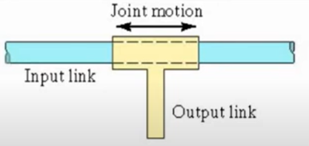
Orthogonal joint
  O-type joint
  Similar to linear joint but difference is that the input and output links will be moving at right angle
  https://www.youtube.com/watch?v=SMcqUjQ2Swo
  2.50

Slide 27
Rotary Joint
  revolute joint
  twisting joint

Slide 28
Active and Passive Joints
Active joint
  The coordinate of an active joint is controlled by an actuator. Active joints are usually prismatic or revolute
Passive joint
  A passive joint does not have any actuator. Passive joints are also called inactive or free joints.

Slide 29
There are six different lower pair joints:
  Revolute
  Prismatic
  Cylindrical
  Screw
  Spherical
  planar.
Revolute and prismatic joints are the most common joints that are utilized in serial robotic manipulators.

Slide 30
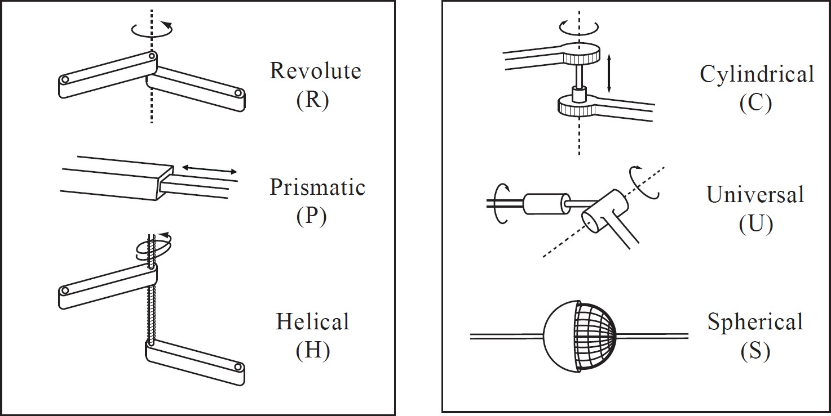

Slide 31
Degrees of Freedom
Kinematics
How many variables are required to determine the position of a mechanism in space.
Possible number of independent motion available for a system.

Slide 32
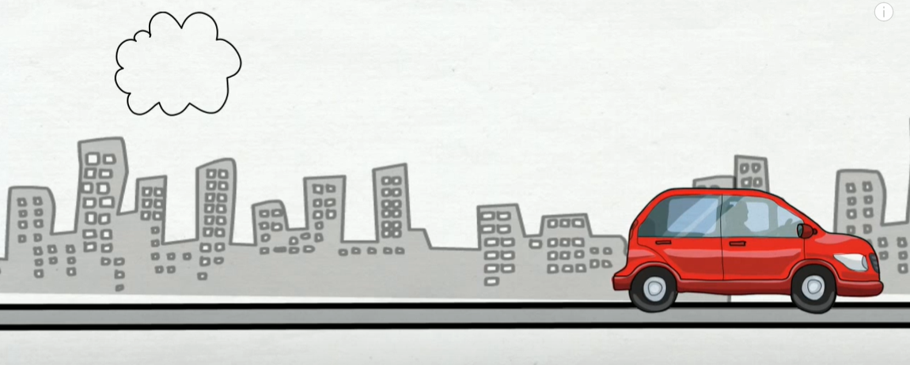
Eg: Car moving in a straight road.

Slide 33
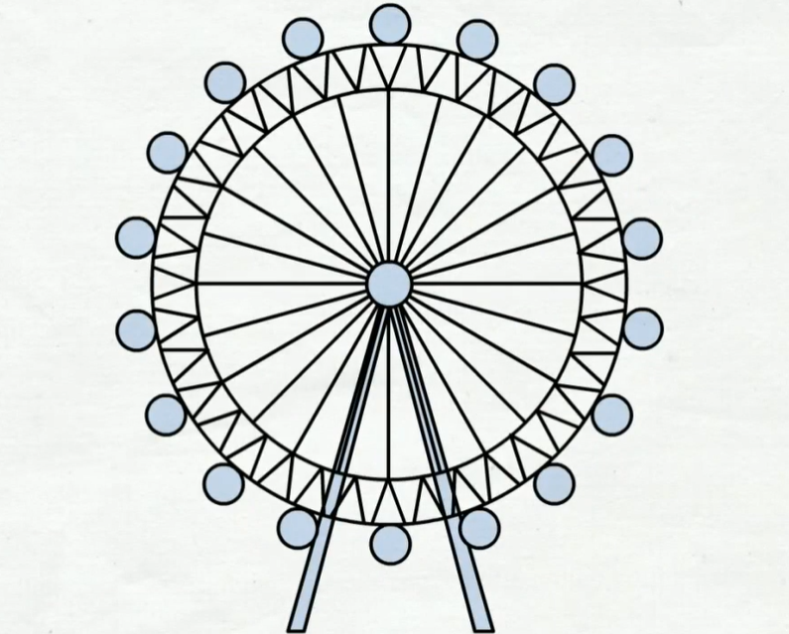
Giant Wheel rotating about its axis
The wheel is rotated by degree Θ

Slide 34
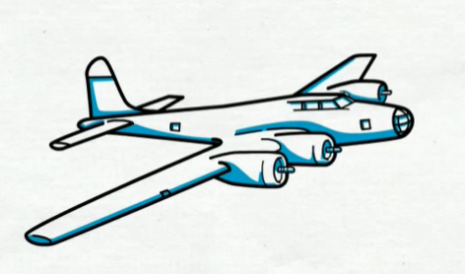
  Any object in air can have 3 translational movements and 3 rotational movements.
  https://youtube.com/clip/UgkxBalCkGIZlRzHG0EQcv1_saIOZOqPMYXY?si=phgM6RVddPMfUZf1

Slide 35
An unconstrained rigid body in space can have six independent motion and therefore 6 degrees of freedom.

Slide 36
z
x
y

Slide 37
Kutzback’s Criterion
As each independent link have maximum 6 degrees of freedom, therefore there should be 6*N degrees of freedom for N link mechanism.
But in a mechanism, one link needs to be fixed, so it get reduced to 6* (N-1)

Slide 38
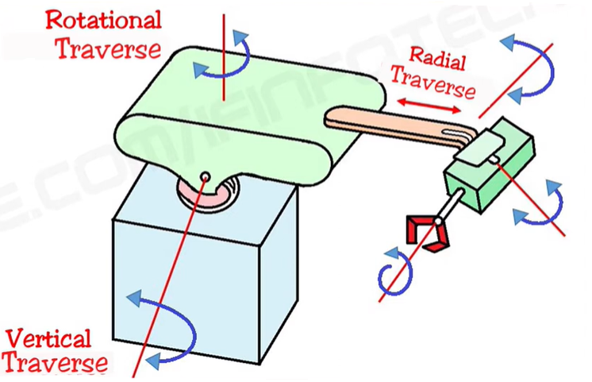
Degrees of freedom in Robots
Wrist
Body
Arm
End Effector
3 motions of arm and body
3 motions of wrist

Slide 39
Degrees of freedom in Robots
6 degrees of freedom
  Vertical Traverse
    Provides the up and down motion to arm with the help of linkage
  Rotational Traverse
    Provides rotation to body about vertical axis
  Radial Traverse
    Provides extension or retraction movement to arm
  Pitching
    Provides the up and down motion to wrist
  Yawing
    Provides right or left motion to wrist
  Rolling
    Provides rotation to end effector

Slide 40
Robot Workspace
Depending on the configuration and size of the links and wrist joints, robots can reach a collection of points around them that constitute a workspace.
Shape of the workspace for each robot is uniquely related to its design.

Slide 41
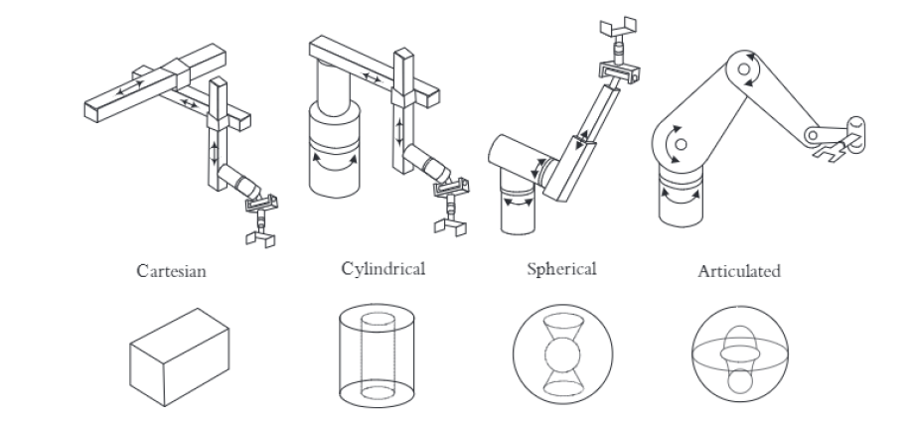

Slide 42
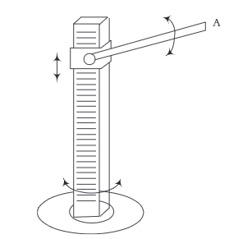
Problems
Draw the approximate workspace for the following robot. Assume the dimensions of the base and other parts of the structure of the robot are as shown.

Slide 43
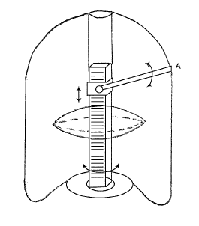

Slide 44
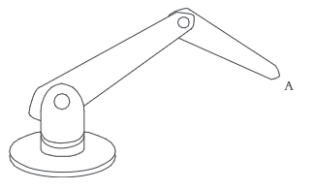
Draw the approximate workspace for the following robot. Assume the dimensions of the base and other parts of the structure of the robot are as shown.

Slide 45
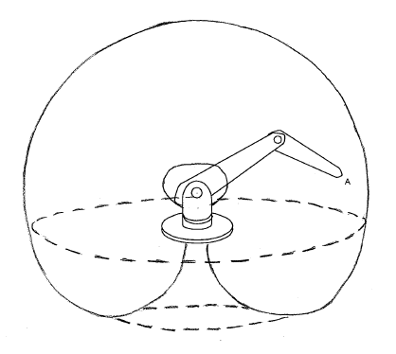

Slide 46
Robot Classification
According to Japanese Industrial Robot Association
  6 classes
Class 1 : Manual Handling device
  A device with multiple degrees of freedom actuated by an operator
Class 2 : Fixed Sequence Robot
  Device that performs the successive stages of a task according to a predetermined unchanging method .
  Hard to modify

Slide 47
Robot Classification
Class 3 Variable Sequence Robot
  Same as class 2
  Easy to modify
Class 4 Playback Robot
  Human operator performs the task manually by leading the robot which records the motions for later payback.
  Robot repeats the same motions according to the recorded information

Slide 48
Robot Classification
Class 5 Numerical control robot
  Operator supplies the robot with a movement program rather than teaching it the task manually
Class 6
  A robot with the means to understand its environment and ability to successfully complete a task despite changes in the surrounding conditions under which it is to be performed

Slide 49
Robot Classification
Robotics Institute of America(RIA)
  Classes from 3-6 only considers as robots
Association Francaise de Robotique (AFR)

Slide 50
Types of Robots
Manipulators (Robotic Arm)
Mobile Robots
Aerial Robots

Slide 51
Manipulators (Robotic Arm)
A robotic arm is a type of mechanical arm, usually programmable, with similar functions to a human arm
The arm may be the sum total of the mechanism or may be part of a more complex robot.
The links of such a manipulator are connected by joints allowing either rotational motion (such as in an articulated robot) or translational (linear) displacement.
The links of the manipulator can be considered to form a kinematic chain.
The terminus of the kinematic chain of the manipulator is called the end effector and it is analogous to the human hand

Slide 52
Manipulators (Robotic Arm)

Slide 53
Mobile Robots
Mobile robots have the capability to move around in their environment and are not fixed to one physical location.
Mobile robots can be "autonomous" (AMR - autonomous mobile robot) which means they are capable of navigating an uncontrolled environment without the need for physical or electro-mechanical guidance devices.
mobile robots can rely on guidance devices that allow them to travel a pre-defined navigation route in relatively controlled space (AGV - autonomous guided vehicle).

Slide 54
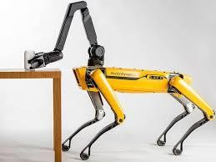
Mobile Robots
Legged robots are a type of mobile robot, which use articulated limbs, such as leg mechanisms, to provide locomotion.
They are more versatile than wheeled robots and can traverse many different terrains, though these advantages require increased complexity and power consumption.
Legged robots often imitate legged animals, such as humans or insects

Slide 55
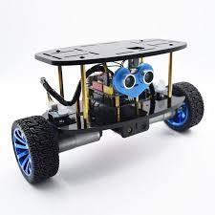
Mobile Robots
Wheeled robots are robots that navigate around the ground using motorized wheels to propel themselves.
This design is simpler than using treads or legs and by using wheels they are easier to design, build, and program for movement in flat, not-so-rugged terrain.
They are also more well controlled than other types of robots. Disadvantages of wheeled robots are that they can not navigate well over obstacles, such as rocky terrain, sharp declines, or areas with low friction.
Wheeled robots are most popular among the consumer market, their differential steering provides low cost and simplicity. Robots can have any number of wheels, but three wheels are sufficient for static and dynamic balance.
Additional wheels can add to balance; however, additional mechanisms will be required to keep all the wheels in the ground, when the terrain is not flat.

Slide 56
Aerial Robots
It‟s also called as Unmanned Aerial Vehicle (UAV).
An unmanned aerial vehicle (UAV) (or drone) is an aircraft without a human pilot on board and a type of unmanned vehicle.
UAVs are a component of an unmanned aircraft system (UAS); which include a UAV, a ground-based controller, and a system of communications between the two.
The flight of UAVs may operate with various degrees of autonomy: either under remote control by a human operator, autonomously by onboard computers or piloted by an autonomous robot.

Slide 57
Underwater Robots
An autonomous underwater vehicle (AUV) is a robot that travels underwater without requiring continuous input from an operator.
AUVs constitute part of a larger group of undersea systems known as unmanned underwater vehicles, a classification that includes non-autonomous remotely operated underwater vehicles (ROVs) – controlled and powered from the surface by an operator/pilot via an umbilical or using remote control.

Slide 58
Controller
The controller or control unit includes the processor and software.
It has three roles.
  Information role, which consists of collecting and processing the information provided by the robot‟s sensors.
  Decision role, which consists of planning the geometric motion of the robot structure.
  Communication role, which consists of organizing the information between the robot and its environment.

Slide 59
Robot Configuration
Based on movements of joints and link arrangements
  Cartesian Co-ordinate Configuration (PPP)
  Cylindrical Configuration (RPP)
  Spherical Configuration (RRP)
  Articulated Configuration (RRR)
  SCARA Configuration (Selective Compliant Articulated Robot for Assembly) (RRP)

Slide 60
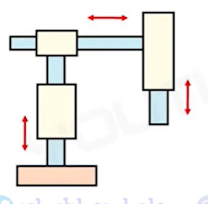
Cartesian Co-ordinate Configuration
A Cartesian Robot is an automated industrial system that can also be referred to as a Gantry Robot or a Linear Robot or XYZ Robot.
Simple configuration

Slide 61
Cartesian Co-ordinate Configuration
Move in linear paths creating a three dimensional cubic envelope of space it can work within.
3 prismatic joints
These links allow 3 linear motions along its axis.
https://www.youtube.com/watch?v=ci_mpRERMog
https://www.youtube.com/watch?v=UDGmYM2Tb5Y

Slide 62
Cartesian Co-ordinate Configuration
Applications
  Carrying high payloads
  Pick and place
  Material handling
  Used in sealing
  3D printing

Slide 63
Cartesian Co-ordinate Configuration
Advantages
  High accuracy and operating speed
  Less cost
  Simple operating Procedure
Disadvantages
  Required large space to operate

Slide 64
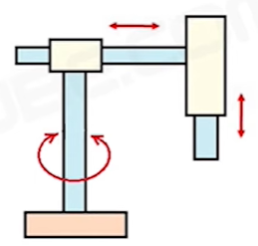
Cylindrical Configuration
Consists of two prismatic joints perpendicular to each other and one revolute joint
The vertical column carries the arm assembly that move up and down

Slide 65
Cylindrical Configuration
Applications
  Material handling
  Small assembly tasks
  Machine loading and unloading

Slide 66
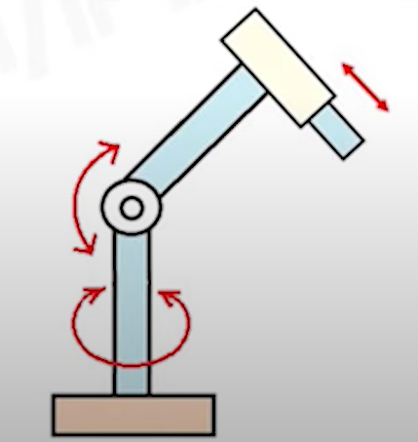
Spherical Configuration
Also known as polar configuration
Consists of one prismatic joint and two revolute joints

Slide 67
Spherical Configuration
First rotary movement occurs about a vertical base axis while second rotary movement is about horizontal axis
Prismatic joint moves in and out
This allows the robot to move in spherical work volume.

Slide 68
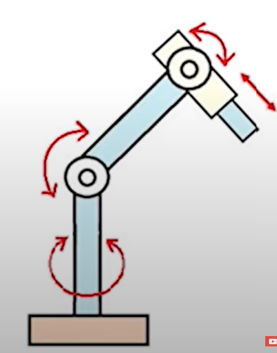
Articulated configuration
Consists of 3 revolute joints and one prismatic joint
Also called joint arm configuration
Applications
  Flat glass handling
  Manufacturing of steel bridges
  Cutting steel

Slide 69
Articulated configuration
Advantages
  High Speed
  Large working envelop

Slide 70
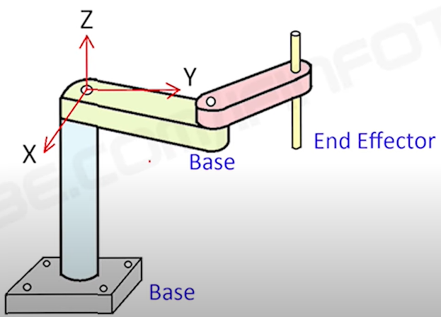
SCARA Configuration
Commonly used configuration

Slide 71
SCARA Configuration
Applications
  Assembly
  Packaging
  Machine Loading
Advantages
  High Speed
Disadvantages
  Robot requires dedicated robot controller

Slide 72
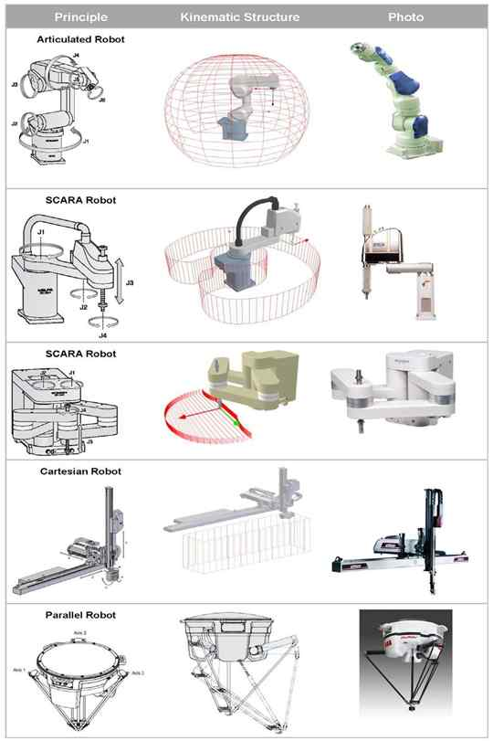

Slide 73
Dynamic characteristics
Speed of motion
The speed determines how quickly the robot can accomplish a given work cycle.
It is desirable in production to minimize the cycle time of a given task.
Nearly all robots have some means by which adjustments in the speed can be made.

Slide 74
Speed of motion
Most desirable speed determination depends on
  The accuracy with which the wrist (end effector) must be positioned
  The weight of the object being manipulated
  The distances to be moved

Slide 75
Speed of motion
As the required accuracy is increased, the robot needs more time to reduce the location errors in its various joints to achieve the desired final position.
Heavier objects mean greater inertia and momentum, and the robot must be operated more slowly to safely deal with these factors.
Because of acceleration and deceleration problems, a robot is capable of traveling long distances in less time than a sequence of short distances

Slide 76
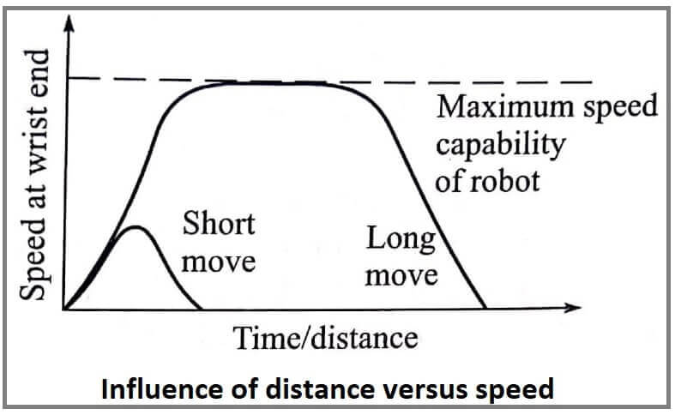
Speed of motion

Slide 77
Load Carrying Capacity
The load that can be carried by the robot depends on its physical size, construction and its capability to transmit force and torque to the end effector in the wrist.
Generally for light robots this comes to around 1.5 kg. For heavier class robots this may go up to 1000Kg.

Slide 78
Work envelope
Its the envelope or space within which the robot can manipulate the end of the wrist.
It depends on the number of joints, physical size of the joints and links and the ranges of various joints.

Slide 79
Repeatability
It is the measure of the robots ability to position an object at a previously taught point in the work envelope.

Slide 80
Control resolution
It relates to the systems capability to divide the range of the total movement into closely spaced points that can be identified.
Thus , it would represent the minimum noticeable movement achievable.

Slide 81
Spatial resolution
Whereas control resolution only concerns one joint or one link, spatial resolution combines the control resolution of all motions and also considers the mechanical errors in the points and associated links.

Slide 82
Stability
It relates to the amount of overshoot and oscillations in robot motion as it is about to reach a certain location

Slide 83
Accuracy
It is the measure of the ability of robot to position the end of the wrist at the desired location in the work envelope.

Slide 84
END EFFECTORS

Slide 85
Robot end effector is a device attached to the wrist of a manipulator for the purpose of holding materials, parts, tools to perform a specific task
Eg: Grippers
  welding equipment

Slide 86
Types
Electric Grippers — Electric grippers use motor-driven fingers, which allow for easy control of position and speed.
Many applications use adaptive electric end effectors, including machine tending, handling, and bin picking, among others.

Slide 87
Pneumatic Grippers — These grippers use air to function, normally by forcing compressed air through a piston.
Pneumatic grippers allow for angular or parallel movement.

Slide 88
Suction Cups — Suction cups use a vacuum to pick up parts.
Their simple design offers ample flexibility for material handling, along with cost-effectiveness.
They are unable to handle perforated materials.

Slide 89
Magnetic Grippers — These grippers feature a design that’s similar to suction cups, but they’re used specifically for handling ferrous material.
Eliminate the risk of dropping materials during power outages or air loss, and they don’t come with air costs.
Their simple design also requires minimal maintenance.

Slide 90
Mechanical Grippers — Non-powered mechanical grippers normally feature designs for specific types of parts.
These grippers may include forks, hooks, or complex fingers that allow operators to clamp and rotate them

Slide 91
Adhesive Gripper
  An adhesion gripper is a robot end effector that grasps objects by literally sticking to them.
  In its most primitive form, this type of gripper consists of a rod, sphere, or other solid object covered with two-sided tape.

Slide 92
Active and Passive Grippers
Active Grippers
  Active grippers has feedback sensors
  Sensors may be on the wrist or on the fingers
  They work on the closed loop system
  Also called adaptable grippers
  Have many degree of freedom
  Costly
  Complicated design

Slide 93
Passive grippers
  Most of the industrial grippers are passive
  They work on open loop systems
  Have fixed degree of freedom
  Cheaper and widely used
  Simple designs

Slide 94
Ethics
Isaac Asimov's "Three Laws of Robotics"
  A robot may not injure a human being
  A robot must obey orders given it by human beings except where such orders would conflict with the First Law.
  A robot must protect its own existence as long as such protection does not conflict with the First or Second Law.

