Slide 1
Computer Programming Final Project
Presenters:
林冠諺、林柏叡、吳聲定、邱名祺

Slide 2

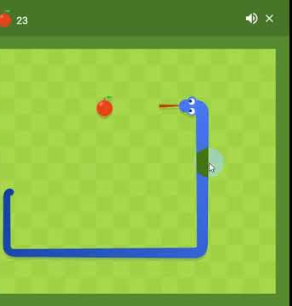
What we are going to do
We will make a project base on the well known game “Snake”, aside from the original materials in the game, we will add some new things

Slide 3
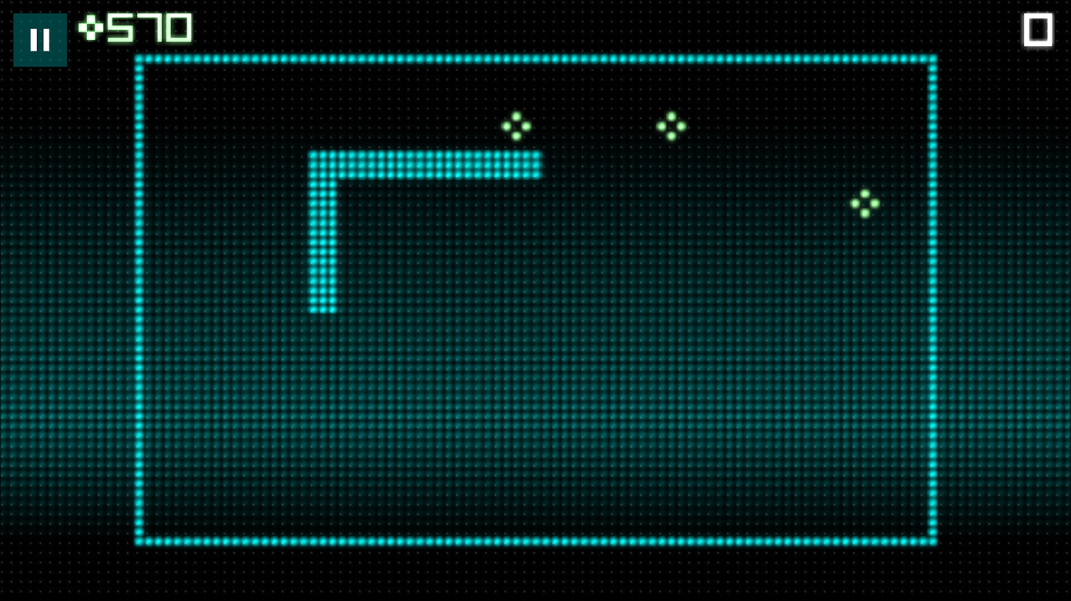
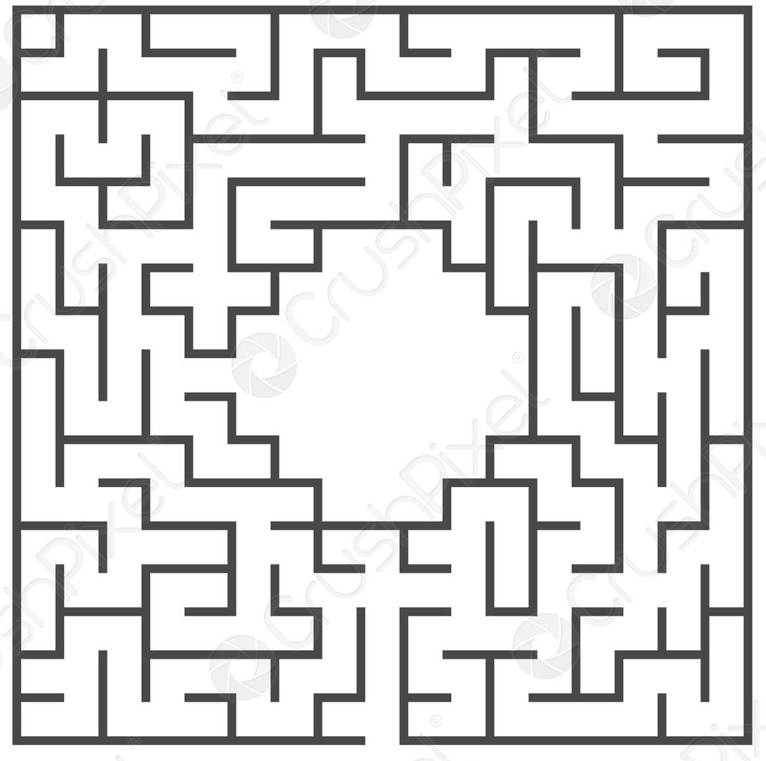
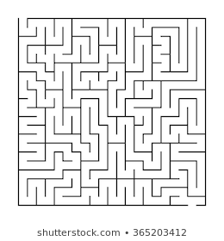
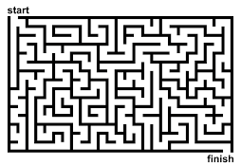
Game Map Design
40
We will design a confined space for the snake, which is measured 30 x 40 units.
We will design a few types of mazes to implement different stages, every map will be selected randomly.
30

Slide 4

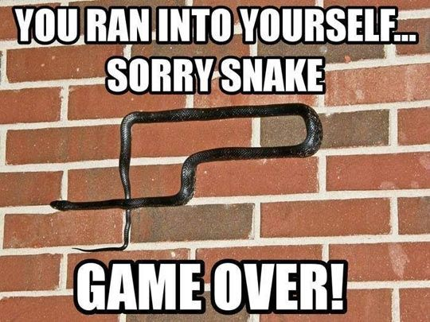
Game Restrictions
The counter will be countdowning; once the time reaches 0. The game will stop.
Players cannot touch the wall and themselves; once violated. The game will stop.

Slide 5

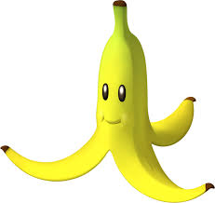

Grading
There are different objects in the map, you have to collect them to gain scores or time.
Default:
Apple: +1 Point (Or other fruits)
Banana: Self length become half
Orange: Randomly add time

Slide 6

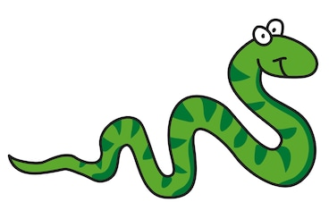
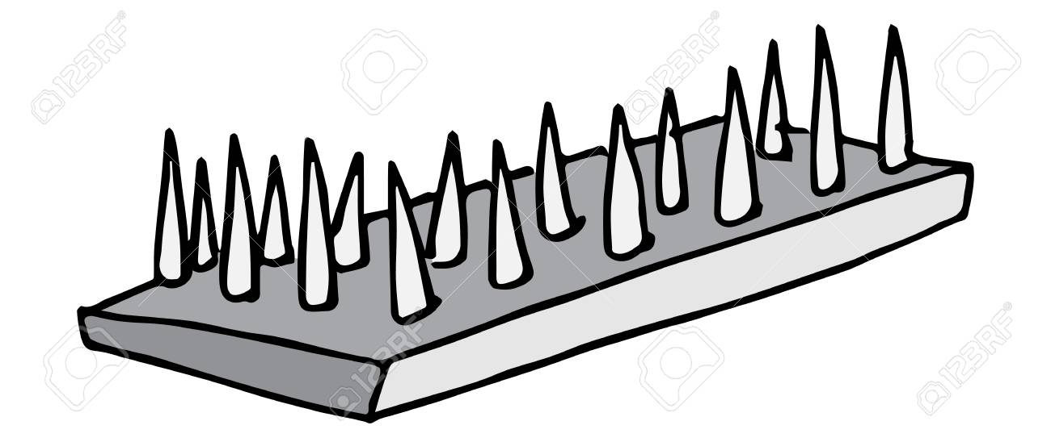
Enemies and Mechanisms
However, there are also something in the game obstructing you.
Bomb: Once collected ends the game
Other Snake Bots: Do not run in into them.
Spikes: Switching on and off in a certain place (10 seconds)

Slide 7
Modified Points
In the game, the objects will move in the following description:
Bomb: Lurking in different places in every 30 seconds
Other Snake Bots: Will randomly wandering on the map
Good items (Apple Banana Orange etc.):
Move in either ↑↓←→ direction 1 unit every 10 seconds.

Slide 8
End of Presentation
Thanks for your attention

