Slide 1
Create an 8-slide AI strategy dec...
Generated by the Python smart layer
Audience: Executives and decision makers
Scenario: General presentation
Tone: Professional and concise
Notes:
This title slide was generated by the Python mock planner.
Sources:
[1] sample-source-brief.md | /app/examples/inputs/sample-source-brief.md

Slide 2
Agenda
Create an 8-slide AI strategy dec...
Set the presentation storyline
1. Background and goals
2. Current challenges
3. Approach
4. Execution plan
5. Risks and next steps
2
Notes:
Sources:
[1] sample-source-brief.md | /app/examples/inputs/sample-source-brief.md

Slide 3
Background and goals
Create an 8-slide AI strategy dec...
Explain why this presentation matters now
Translate the request "Create an 8-slide AI strategy deck for executives" into a slide-ready storyline
Turn fragmented ideas into a concise business narrative
Keep each slide presentation-friendly instead of document-like
Reserve placeholders where live data is still missing
Visual Suggestions
Add one market context visual
Add one operating model diagram
3
Notes:
Sources:
[1] sample-source-brief.md | /app/examples/inputs/sample-source-brief.md

Slide 4
Current state and challenges
Create an 8-slide AI strategy dec...
Separate current state from blockers
Left
Right
Inputs may be incomplete or scattered
Users often provide only topic and style
Supporting material is rarely mapped to slide structure
The flow must clarify missing constraints
Each slide needs controlled information density
Natural language must become stable structured JSON
4
Notes:
Sources:
[1] sample-source-brief.md | /app/examples/inputs/sample-source-brief.md

Slide 5
Python smart layer workflow
Create an 8-slide AI strategy dec...
Show how Python and JS split responsibilities
1
2
3
4
Understand request and sources in Python
Plan or revise validated deck JSON
Persist deck artifacts for inspection
Call the JS renderer for final PPTX output
5
Notes:
Sources:
[1] sample-source-brief.md | /app/examples/inputs/sample-source-brief.md

Slide 6
Execution timeline
Create an 8-slide AI strategy dec...
Break delivery into trackable phases
Phase 1
Phase 2
Phase 3
Phase 4
Capture intent
Load trusted materials
Draft slide storyline
Render deck
6
Notes:
Sources:
[1] sample-source-brief.md | /app/examples/inputs/sample-source-brief.md

Slide 7
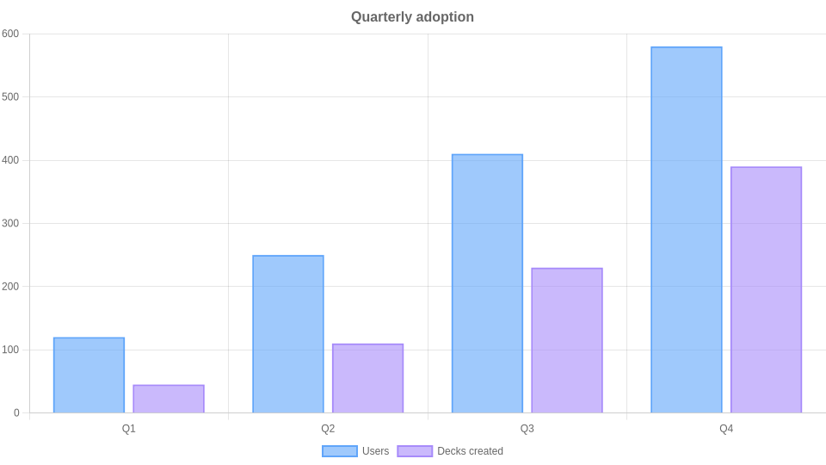
Adoption metrics
Create an 8-slide AI strategy dec...
Visualize key adoption data
Takeaways
Steady growth across all quarters
Deck creation closely tracks user adoption
7
Notes:
Sources:
[1] sample-source-brief.md | /app/examples/inputs/sample-source-brief.md

Slide 8
Key recommendations
Questions and discussion
Keep the JS layer focused on rendering only
Use 1 trusted context item(s) to improve the storyline before adding broader search
Preserve deck JSON as the stable cross-language contract
Notes:
Sources:
[1] sample-source-brief.md | /app/examples/inputs/sample-source-brief.md

