Slide 1


SMART INDIA HACKATHON 2025
Problem Statement ID – SIH25097
Problem Statement Title - an autonomous small precision focused machine for planting crops or weeding
Theme - Smart Education
PS Category - Software
Team ID - <Neiaoo>
Team Name - Neiaoo

Slide 2
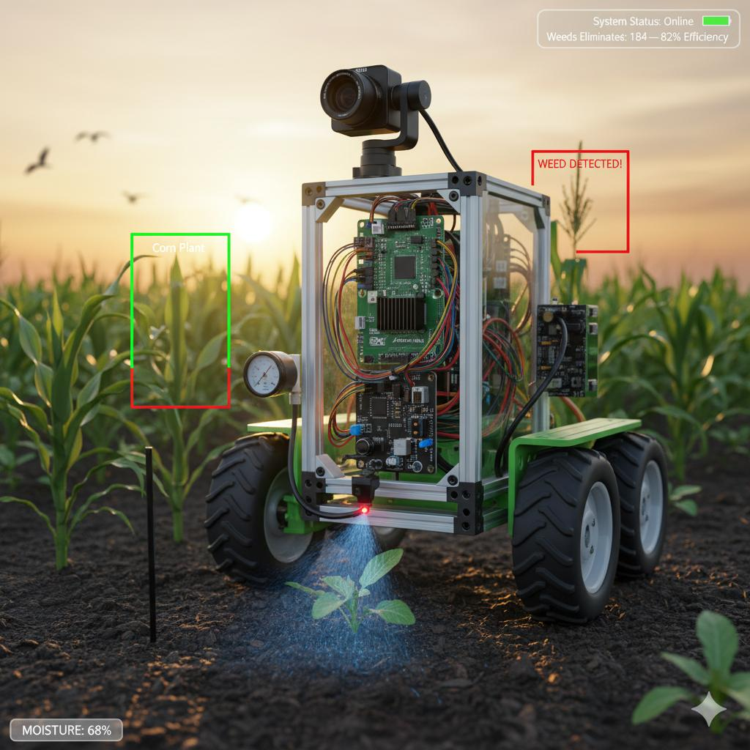
Autonomous small precision focused machine for planting crops or weeding
Neiaoo
Proposed Solution :- We propose developing a compact, autonomous robot designed for precision planting and targeted weeding in small to medium-sized farms. The robot uses trained ML model to identify between crops and weeds. It will be equipped with interchangeable moduler attachments for seed planting, micro-irrigation based weeding.
It addresses :-
It addresses :-
Reduces farmers’ dependency on manual labor, which is often expensive and scarce.
Increases accuracy in planting.
Eliminates weeds without harmful chemicals, reducing environmental impact.
Provides an affordable, scalable solution for small farmers compared to heavy agricultural machinery
Innovation and uniqueness :-
Modular Design – The same robot can switch between planting, weeding, and irrigation tasks.
Eco-friendly

Slide 3
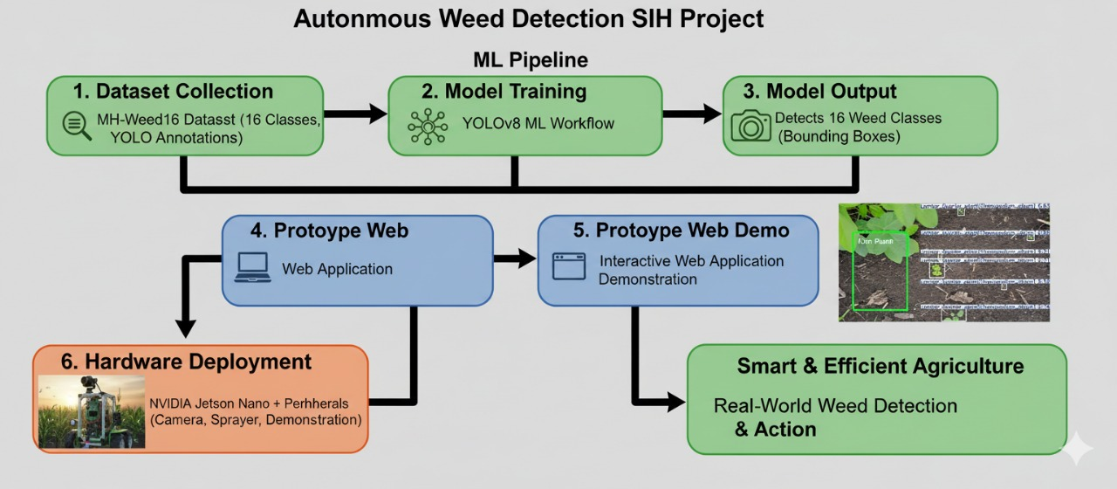

TECHNICAL APPROACH
Neiaoo
Software Aspects :-
Jupyter Notebbok
MH-Weed16: Indian Agricultural Weed Dataset :- https://data.mendeley.com/datasets/d3n3mgjjbv/1

Slide 4
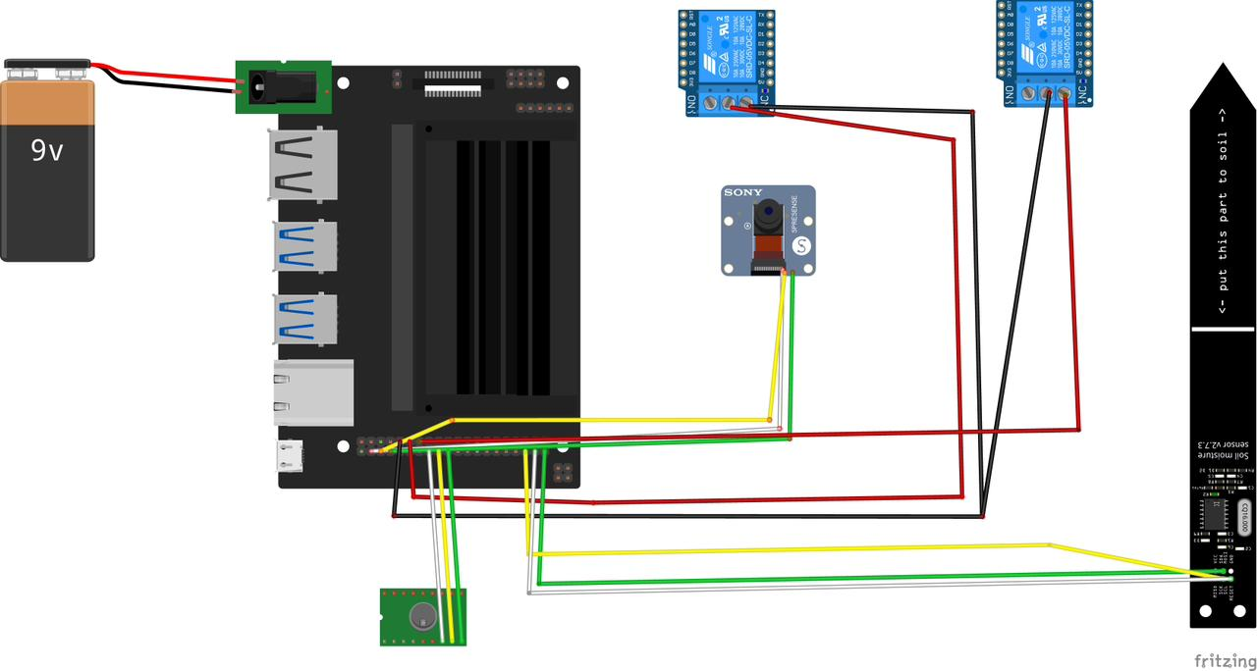
TECHNICAL APPROACH
Neiaoo
Hardware Aspects :-
MH-Weed16: Indian Agricultural Weed Dataset :- https://data.mendeley.com/datasets/d3n3mgjjbv/1

Slide 5
FEASIBILITY AND VIABILITY
Neiaoo
Analysis of the feasibility of the idea :-
    Technical Feasible
    Economically
    Viability
Potential challenges and risks :-
    Data limitation
    Environmental variations
    Hardware-software integration issues
    Farmer adoption
Strategies for overcoming these challenges:-
    Use diverse datasets
    Image Augmentation
    Lightweight Model
    Farmer-Friendly Design

Slide 6
IMPACT AND BENEFITS
Neiaoo
Potential impact on the target audience :-
1.Small and marginal farmers gain affordable access to precision farming.
2.Reduces dependency on manual labor, especially during peak seasons.
3.Improves accuracy in planning and helps make better decision while planting and wedding.
Benefits of the solution :-
Social Benefits :
It reduces stress and workload of the farmers.
Economic Benefits :
Lowers cost of labor, water, seeds which also leads to productivity and profitability.
Environmental Benefits :
Minimizes chemical herbicide usage, protecting soil health and biodiversity.

Slide 7
RESEARCH AND REFERENCES
Neiaoo
Gebbers, R., & Adamchuk, V. I. (2010). Precision agriculture and food security. Science, 327(5967), 828–831.
Bechar, A., & Vigneault, C. (2016). Agricultural robots for field operations: Concepts and components. Biosystems Engineering, 149, 94–111.
Dos Santos Ferreira, A., et al. (2017). Weed detection in soybean crops using ConvNets. Computers and Electronics in Agriculture, 143, 314–324.
Griepentrog, H. W., et al. (2006). Development of autonomous robots for precision weeding. Precision Agriculture, 7(6), 459–468.
Slaughter, D. C., Giles, D. K., & Downey, D. (2008). Autonomous robotic weed control systems: A review. Computers and Electronics in Agriculture, 61(1), 63–78.
Young, S. L. (2012). True integrated weed management. Weed Technology, 26(4), 829–833.
Olsen, A., et al. (2019). DeepWeeds: A multiclass weed species image dataset for deep learning. Scientific Reports, 9, 2058.
Bac, C. W., et al. (2014). Harvesting robots for high-value crops: State-of-the-art review and challenges ahead. Journal of Field Robotics, 31(6), 888–911.
MH-Weed16: Indian Agricultural Weed Dataset :- https://data.mendeley.com/datasets/d3n3mgjjbv/1

