Slide 2
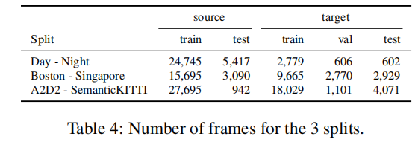
Nuscenes Dataset Domain Splits
Two Source-Target pairs
(Usa, Singapore) & (Day, Night)
Two splits on source
Source_train & Source_test
Three splits on target
Target_train, Target_test & Target_val
All of the experiments (results shown in tables) up to now are carried on these splits!
Source_train
Source_test
Target_train
Target_test
Target_val

Slide 3
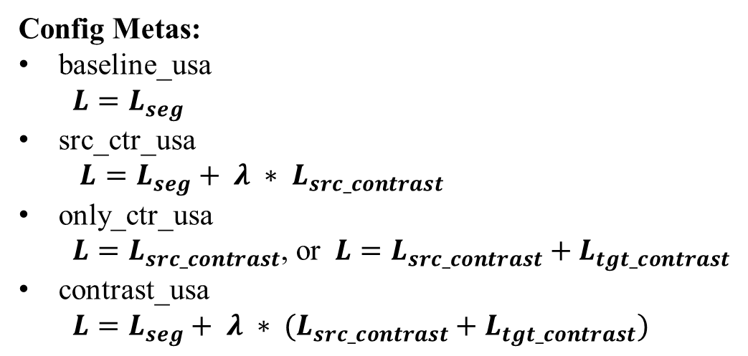
Config Metas:
baseline_usa
$$L=L_{seg}$$
src_ctr_usa
$L=L_{seg}+ λ ∗ L_{src_contrast}$
only_ctr_usa
$L=L_{src_contrast}$, or $L=L_{src_contrast}+L_{tgt_contrast}$
contrast_usa
$L=L_{seg}+ λ ∗ (L_{src_contrast}+L_{tgt_contrast})$

Slide 4
03/28/2021
src_ctr_usa_v3/v4

Slide 5
03/25/2021
src_ctr_usa_v1/v2
only_ctr_usa_v0/v1 (still running)

Slide 6
contrastive loss ablation study on single source domain
Configs | Source_test (mIOU) | Target_test (mIOU)
src_ctr_usa_v0 | 68.42 | 61.14
src_ctr_usa_v1 | 68.80 | 59.90
src_ctr_usa_v2 | 65.55 | 52.04
src_ctr_usa_v3 | 66.44 | 54.68
src_ctr_usa_v4 | 63.66 | 52.85
baseline_usa_v1 | 68.01 | 63.74

Slide 7
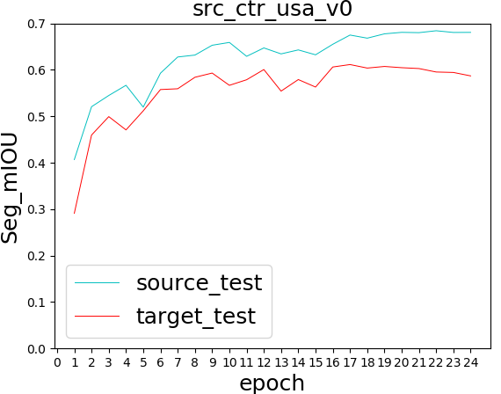
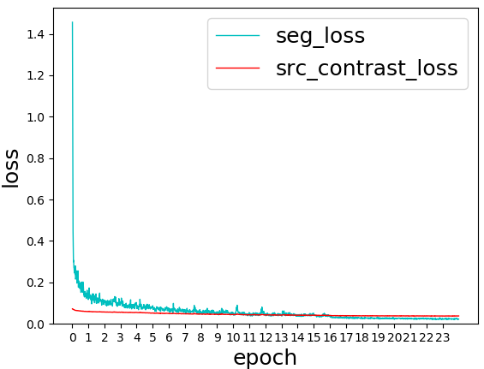
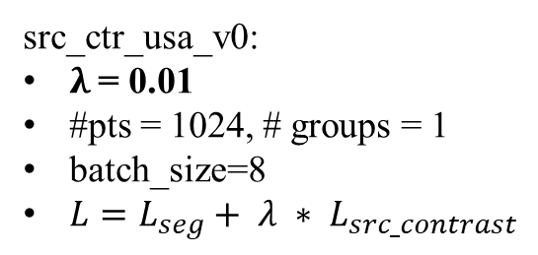
src_ctr_usa_v0:
$λ$= 0.01
#pts = 1024, # groups = 1
batch_size=8
$L=L_{seg}+ λ ∗ L_{src_contrast}$

Slide 8
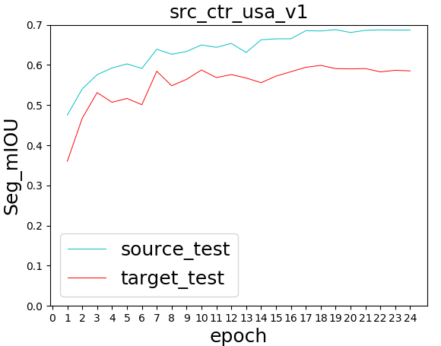
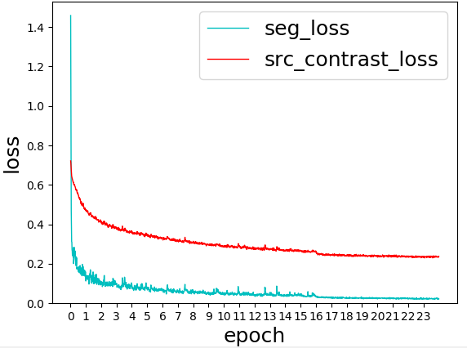
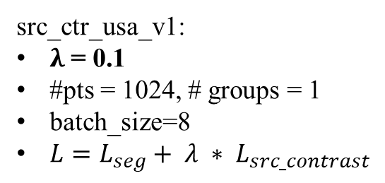
src_ctr_usa_v1:
$λ \text{= 0.1}$
#pts = 1024, # groups = 1
batch_size=8
$L=L_{seg}+ λ ∗ L_{src_contrast}$

Slide 9
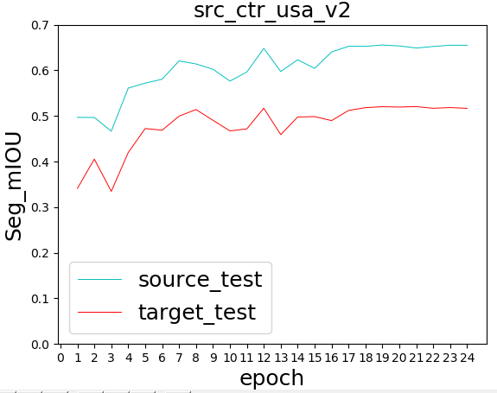
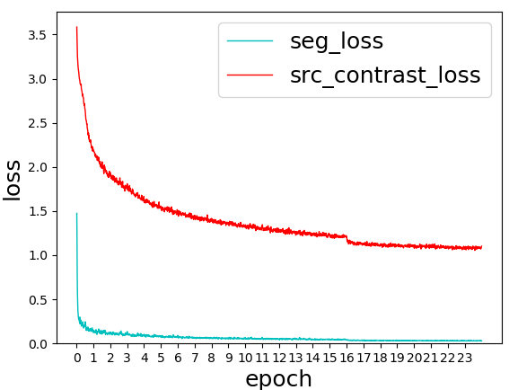
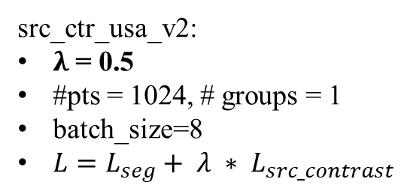
src_ctr_usa_v2:
$λ \text{= 0.}\text{5}$
#pts = 1024, # groups = 1
batch_size=8
$L=L_{seg}+ λ ∗ L_{src_contrast}$

Slide 10
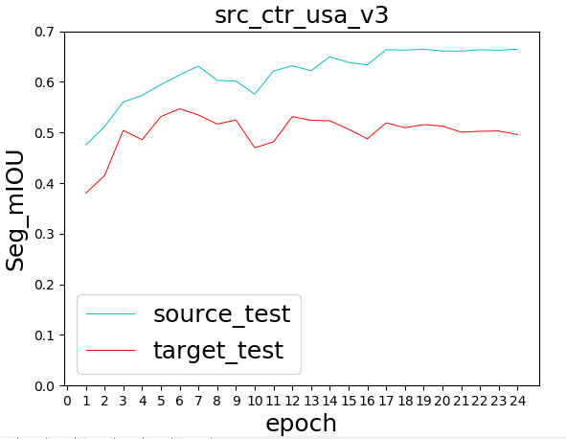
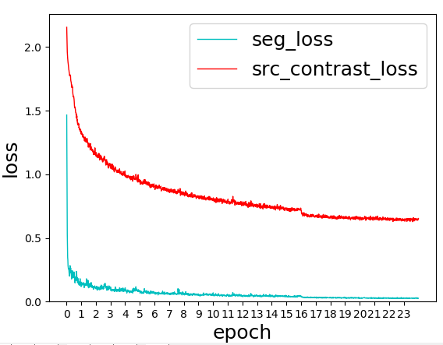
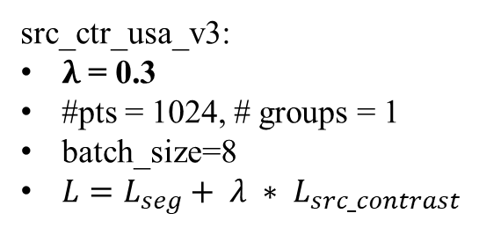
src_ctr_usa_v3:
$λ \text{= 0.}\text{3}$
#pts = 1024, # groups = 1
batch_size=8
$L=L_{seg}+ λ ∗ L_{src_contrast}$

Slide 11
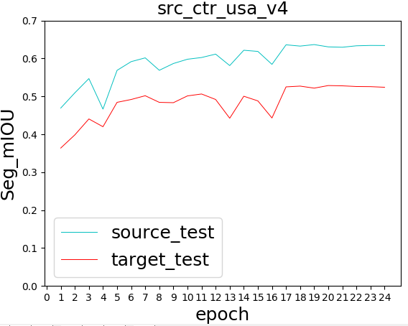
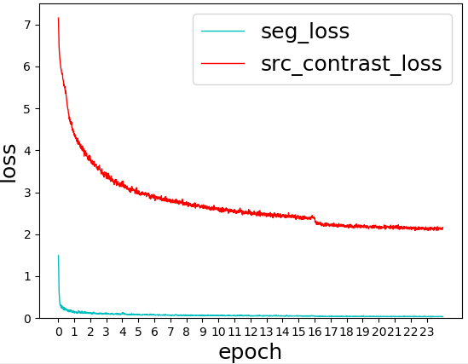
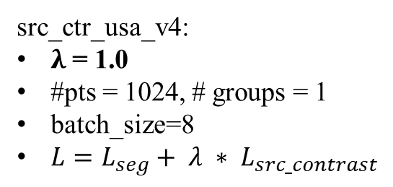
src_ctr_usa_v4:
$λ \text{= }\text{1.0}$
#pts = 1024, # groups = 1
batch_size=8
$L=L_{seg}+ λ ∗ L_{src_contrast}$

Slide 12
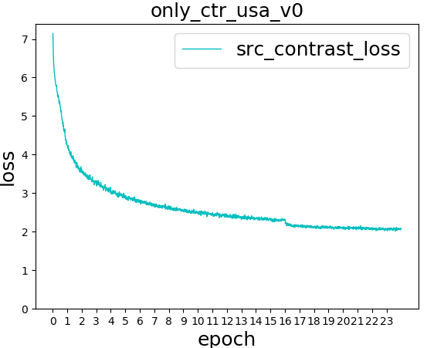

Slide 13
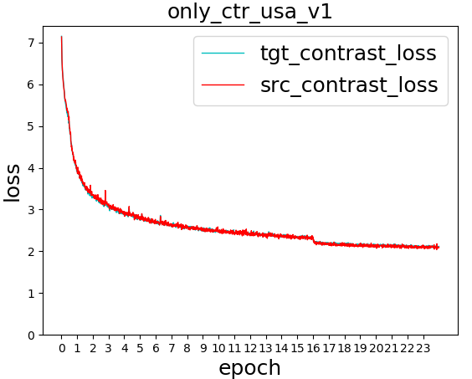
tgt_contrast_loss & src_contrast_loss
nearly coincide

Slide 14
03/24/2021
contrast_usa_v3/v4
src_contrast_usa_v0

Slide 15
03/20/2021
baseline_usa_v1(baseline2_usa)
contrast_usa_v1

Slide 16
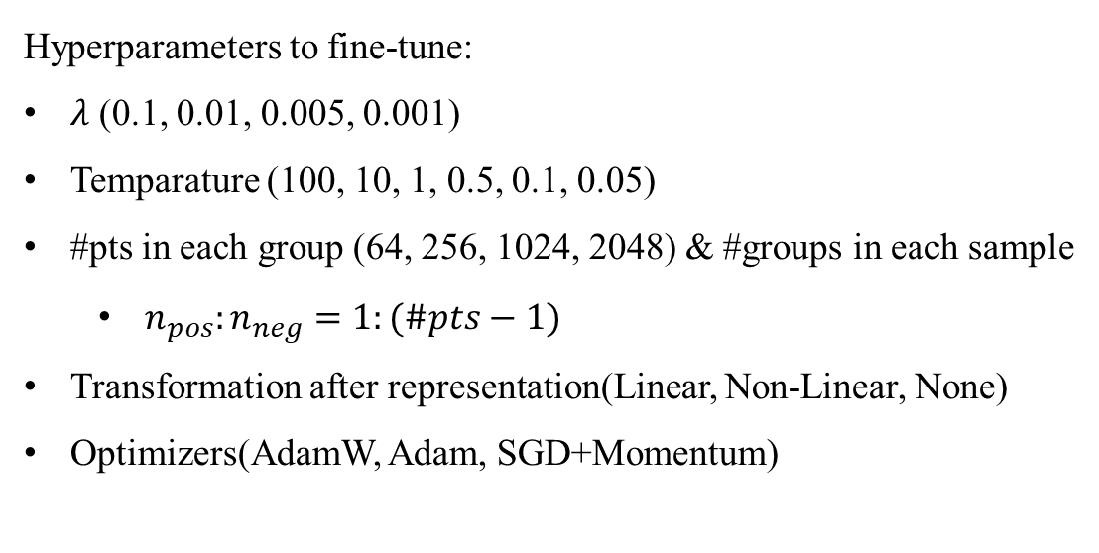
Usa-Sng
 | Config | Target_test (mIOU)
xMUDA | dual head + KL_div 2D+3D | 62.53
xMUDA baseline | single head 2D+3D | 62.10
Vanilla fusion baseline | baseline_usa_v0 (B=4) | 61.57
 | baseline_usa_v1 (B=8) | 63.74
Contrastive loss on both source_train & target_train | contrast_usa_v0 | 52.67
 | contrast_usa_v1 | 61.69
 | contrast_usa_v3 | < 60.00
 | contrast_usa_v4 | < 60.00
Hyperparameters to fine-tune:
$λ$ (0.1, 0.01, 0.005, 0.001)
Temparature (100, 10, 1, 0.5, 0.1, 0.05)
#pts in each group (64, 256, 1024, 2048) & #groups in each sample
$n_{pos}:n_{neg}=1:(\#pts−1)$
Transformation after representation(Linear, Non-Linear, None)
Optimizers(AdamW, Adam, SGD+Momentum)

Slide 17
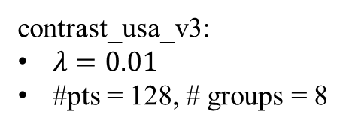
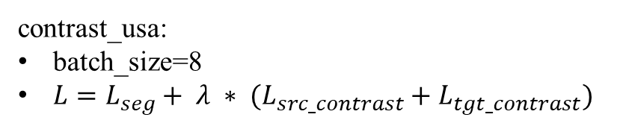
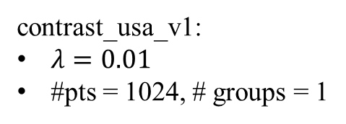
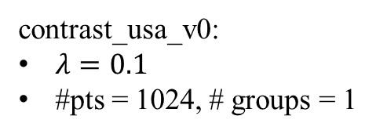
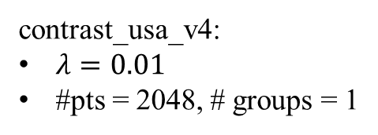
Meta Config:
contrast_usa:
batch_size=8
$L=L_{seg}+ λ ∗ (L_{src_contrast}+L_{tgt_contrast})$
Sub Configs:
contrast_usa_v0:
$λ=0.1$
#pts = 1024, # groups = 1
contrast_usa_v1:
$λ=0.01$
#pts = 1024, # groups = 1
contrast_usa_v3:
$λ=0.01$
#pts = 128, # groups = 8
contrast_usa_v4:
$λ=0.01$
#pts = 2048, # groups = 1

Slide 18
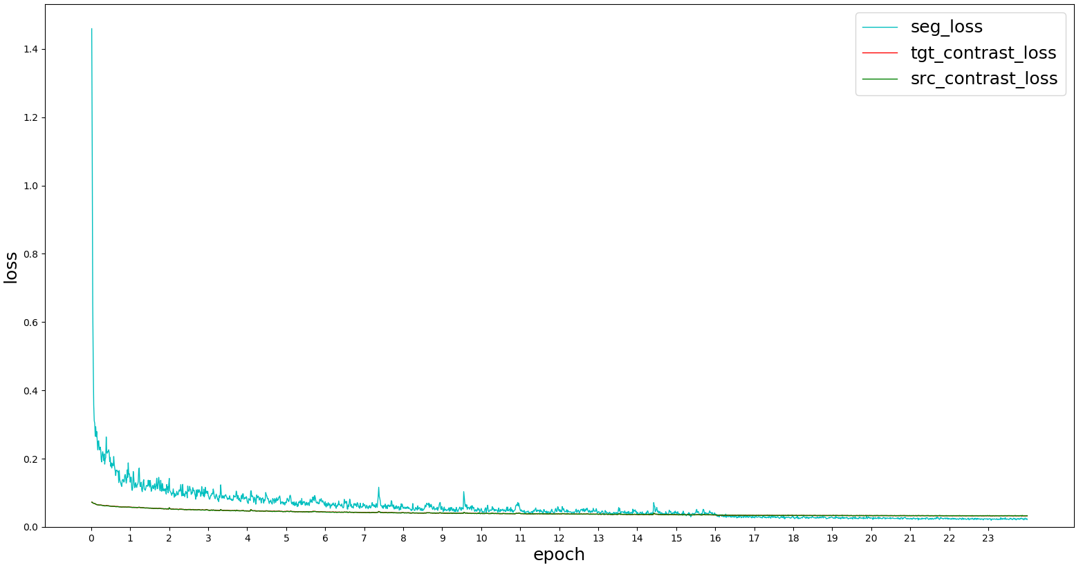
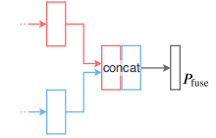
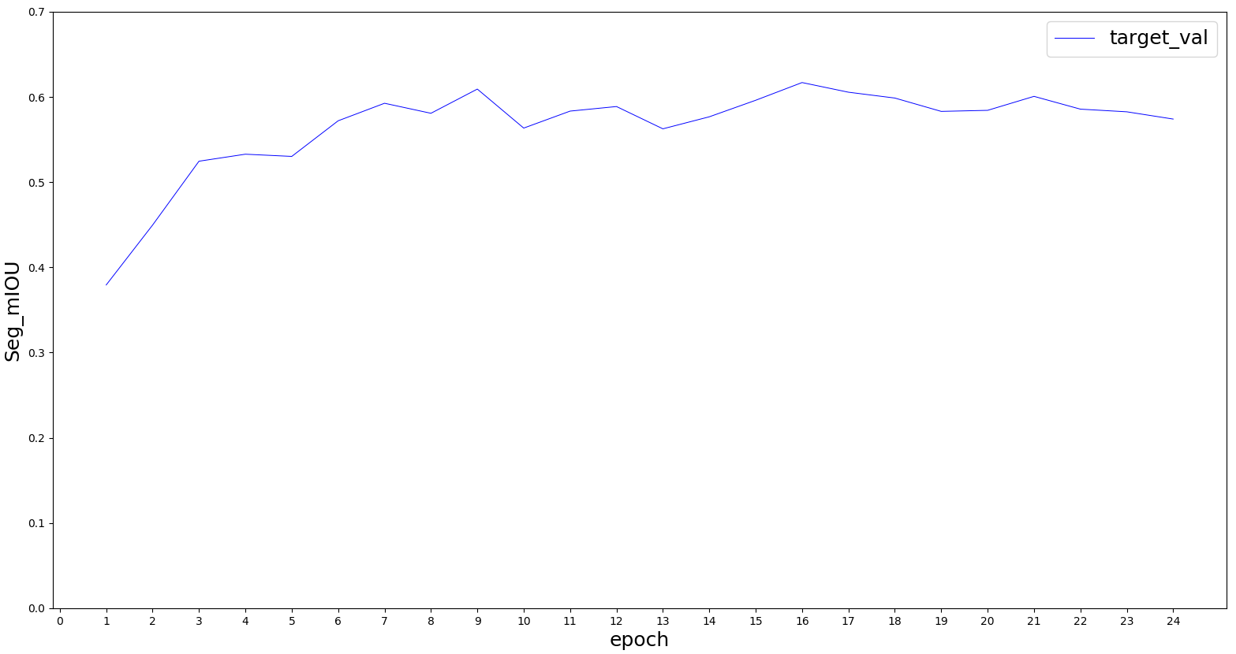
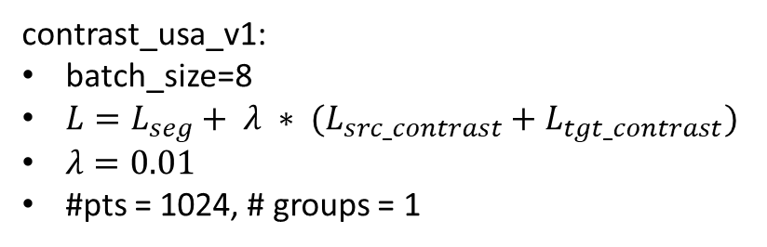
MLP(64, 16)
contrastive_loss
UNetResNet34
(N, 64+16)
(N, 64)
seg_loss
tgt_contrast_loss & src_contrast_loss nearly coincide
UNetSCN
MLP(16, 16)
(N, 16)
contrast_usa_v1:
batch_size=8
$L=L_{seg}+ λ ∗ (L_{src_contrast}+L_{tgt_contrast})$
$λ=0.01$
#pts = 1024, # groups = 1

Slide 19
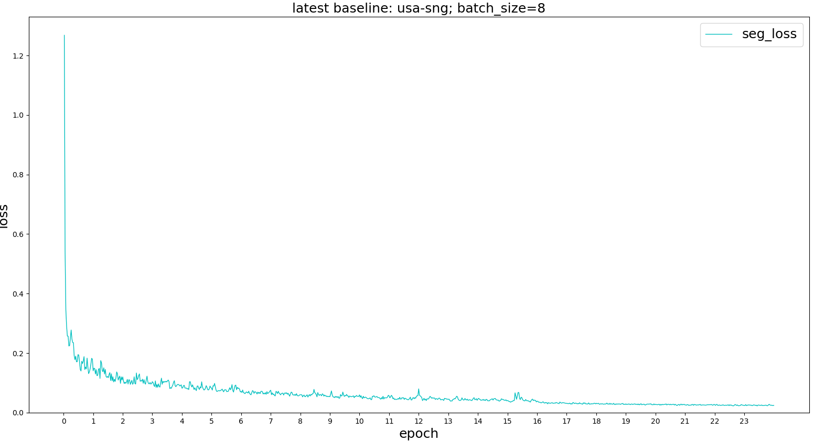
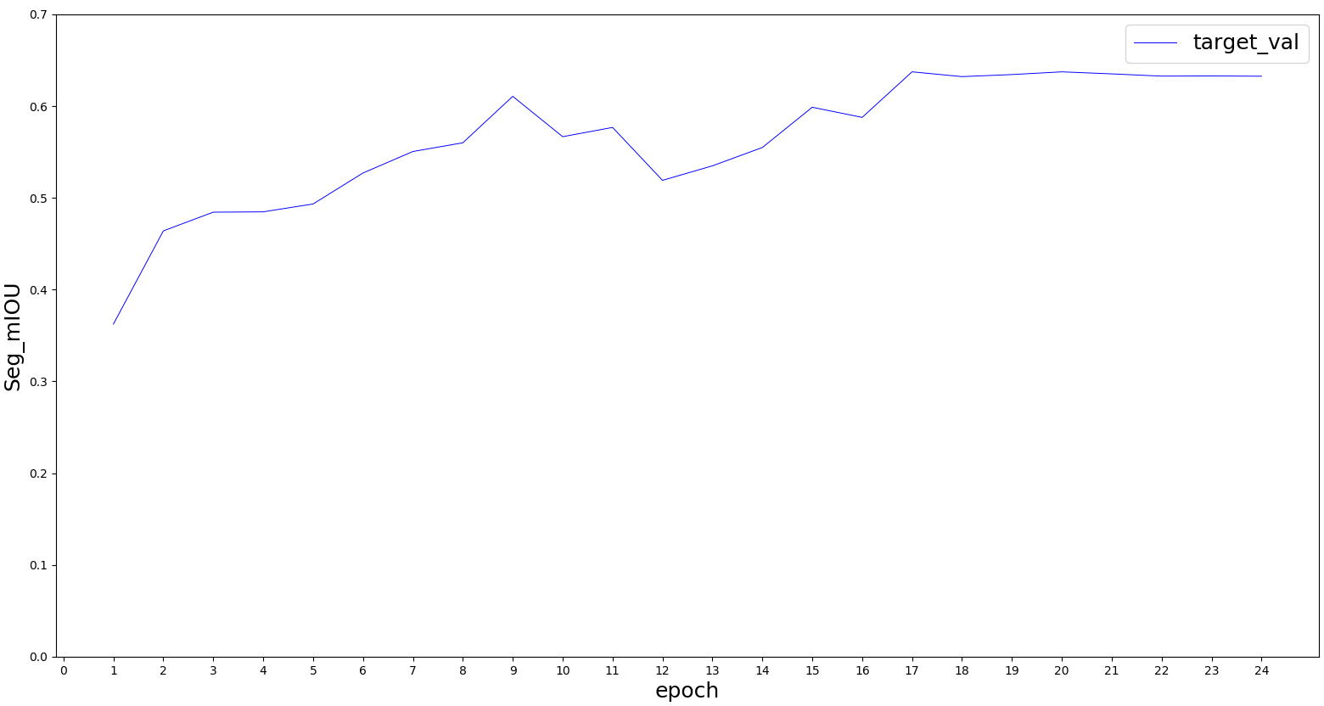
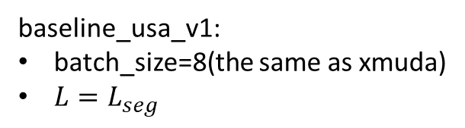
UNetResNet34
(N, 64)
(N, 64+16)
UNetSCN
(N, 16)
Vanilla Fusion(Baseline)
baseline_usa_v1:
batch_size=8(the same as xmuda)
$L=L_{seg}$

Slide 20
03/19/2021
Baseline_usa_v0(baseline1_usa)
Contrast_usa_v0

Slide 21
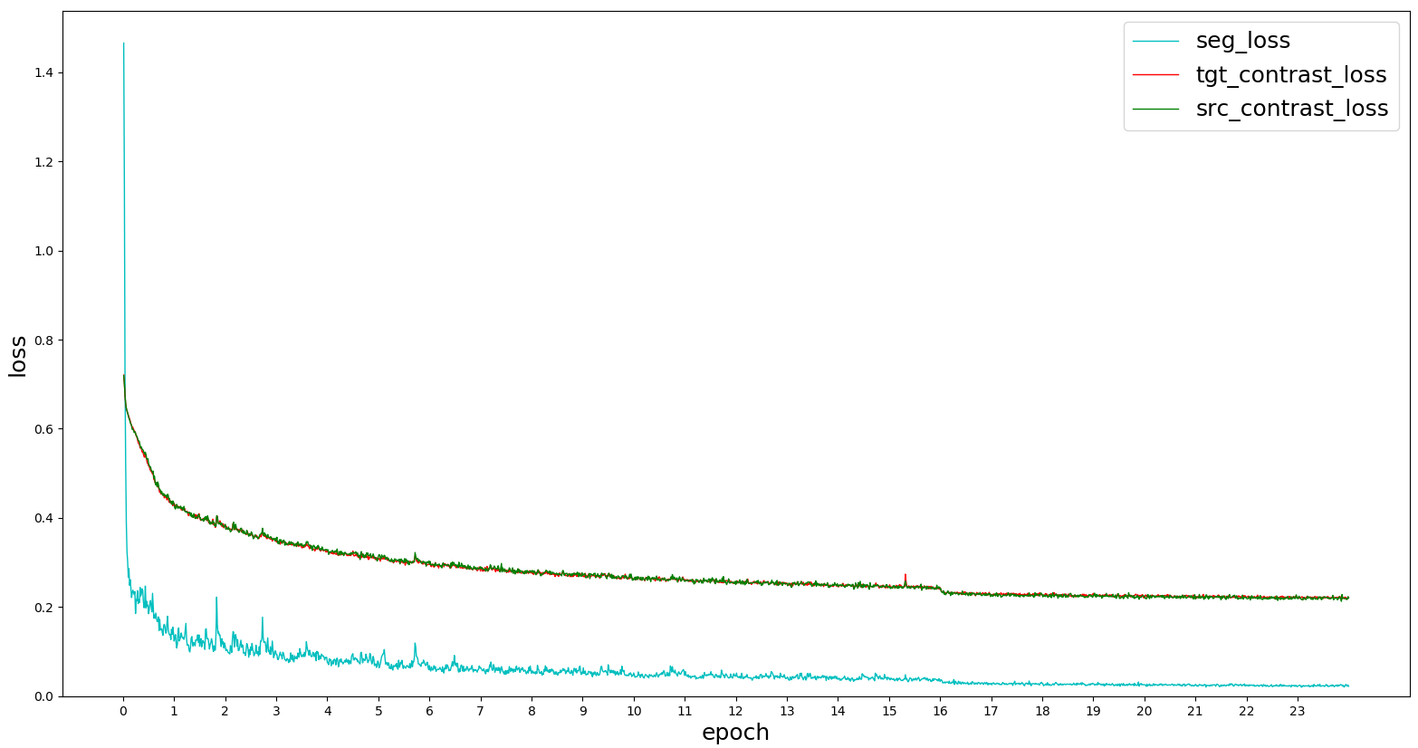
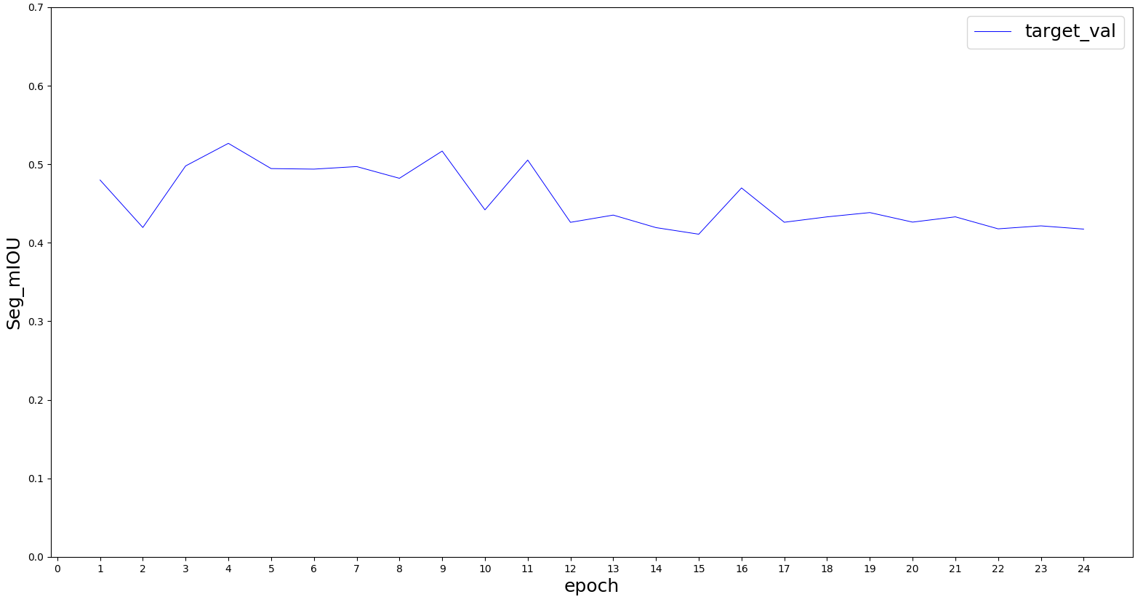
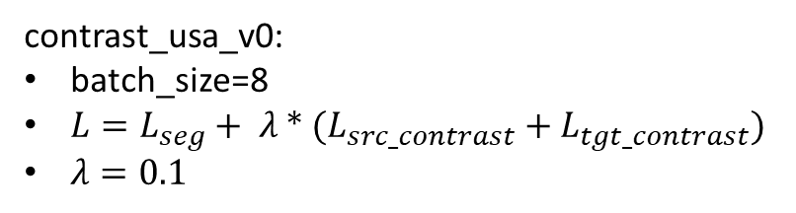
MLP(64, 16)
contrastive_loss
UNetResNet34
(N, 64+16)
tgt_contrast_loss & src_contrast_loss nearly coincide
(N, 64)
seg_loss
UNetSCN
MLP(16, 16)
(N, 16)
contrast_usa_v0:
batch_size=8
$L=L_{seg}+ λ ∗ (L_{src_contrast}+L_{tgt_contrast})$
$λ=0.1$

Slide 22
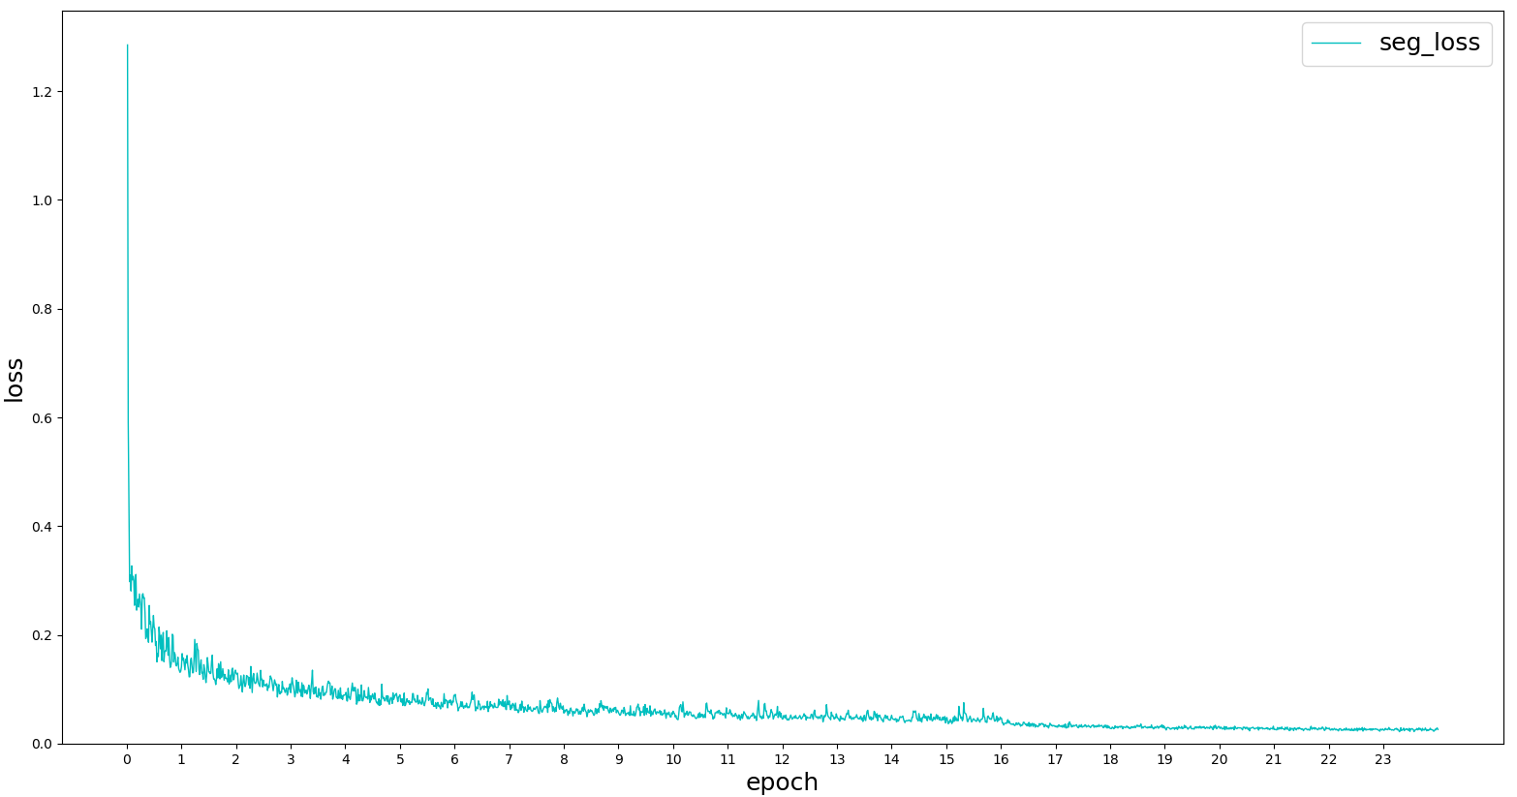
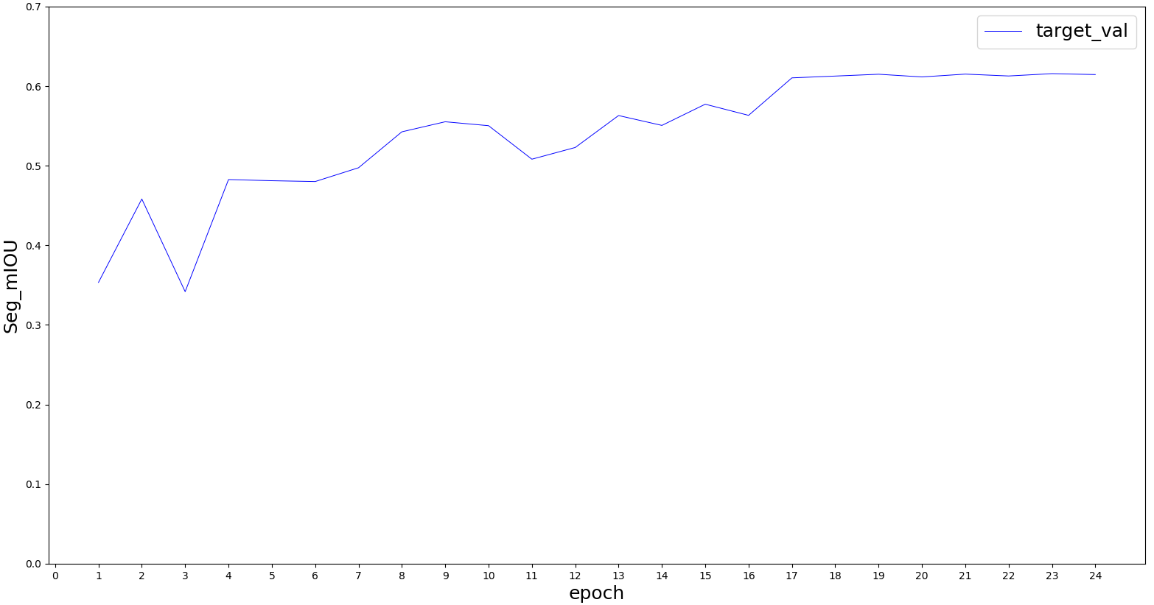
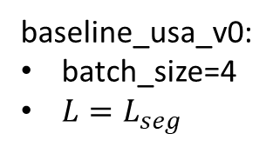
UNetResNet34
(N, 64)
(N, 64+16)
UNetSCN
(N, 16)
Vanilla Fusion(Baseline)
baseline_usa_v0:
batch_size=4
$L=L_{seg}$

Slide 23
03/16/2021
Xmuda new baseline (trained with new seg labels)
“Multi-modal Multi-Task fusion Ver2” baseline
Move xMuda network structure to our framework; train vanilla fusion

Slide 24
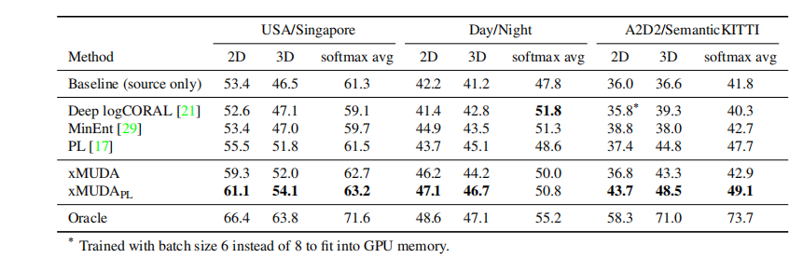
Xmuda, reproduce results using new seg labels
Train/test | Usa/Sng | Usa/Sng |  | Day/night
Segmentation(mIoU) | Xmuda (dual head, KL_div) | Baseline (train on source) | Oracle (train on target) | Xmuda | Baseline | Oracle
2D | 57.04 | 54.03 | 70.83 | 49.62 | 38.81 | 39.30
3D | 53.57 | 48.41 | 65.55 | 45.55 | 43.75 | 46.84
2D+3D | 62.53 | 62.10 | 75.40 | 52.99 | 48.63 | 43.39

Slide 25
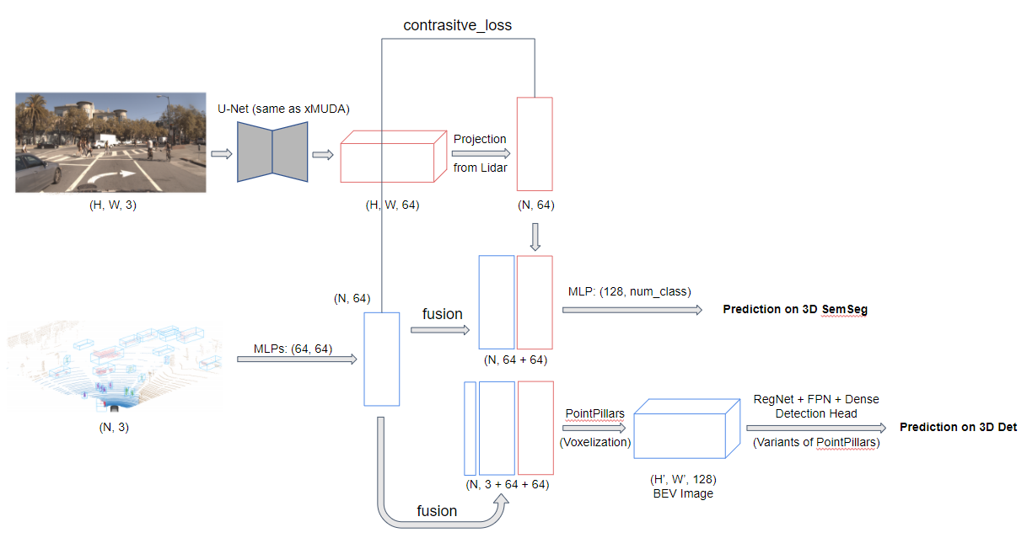
Train/test: Usa/Sng | Ver1 (separate encoders for points) | Multi-modal Multi-Task fusion Ver2 (shared encoder for points)
 | Baseline | Baseline (train on source) | Task_loss + lambda * Contrast_loss (tried a few hyperparameters)
 |  |  | Train from scratch | Resume from baseline model
Segmentation (mIoU) | 60.69 | 62.48 | 48.80 | 57.63
Detection (mAP) | 51.29 | 45.02 | 37.15 | 41.59
Xmuda, new seg labels
Train/test Usa/Sng | Xmuda (dual head， KL_div) | Baseline (separate two streams) | Vanilla fusion
2D | 57.04 | 54.03
3D | 53.57 | 48.41
2D+3D | 62.53 | 62.10 | 63.74
baseline2_usa
UNetResNet34
Multi-modal Multi-Task fusion Ver2
(N, 64)
(N, 64+16)
UNetSCN
(N, 16)
Vanilla Fusion(Baseline)

