Slide 1
So far, we have discarded 3D object detection and only remain 3D Semantic Segmentation (lidar segmentation).
Domain adaptation is still preserved; We train our model with both labeled source data and unlabeled target data and test our model on target_test.
We adopt nearly the same architecture as xMUDA, except for the head part, where xMUDA introduces “Dual Head” but we only use “Vinilla Fusion”. The backbones are the same: UNet for 2D images and SparseConvNet for 3D lidar points.
The segmentation labels we use are released after xMuda. So we have rerun xMUDA with the new labels. See the results.
We have run baseline for our “Vanilla Fusion”. Though seemingly strange, but it has outperformed xMUDA. See the results.

Slide 2
We have tried to add contrastive losses on both source and target training data. But it doesn’t give us a better result on target_test. This corresponds to config meta “contrast_usa”. See the results.
So at this point we return to contrastive loss on a single domain to check its effectiveness on source_test. This corresponds to config meta “src_ctr_usa”. See the results.

Slide 3
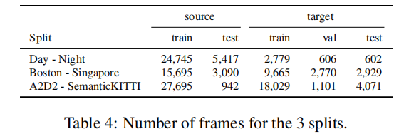
Nuscenes Dataset Domain Splits
Two Source-Target pairs
(USA, Singapore) & (Day, Night)
Two splits on source
Source_train & Source_test
Three splits on target
Target_train, Target_test & Target_val
All of the experiments (results shown in tables) up to now are carried on these splits!
Source_train
Source_test
Target_train
Target_test
Target_val

Slide 4
nuScenes-lidarseg dataset 32 classes
foreground 23; background 9; altogether 32
Foreground classes (23) |  |  |  | Background classes (9)
1 | animal | 13 | static_object.bicycle_rack | 24 | flat.driveable_surface
2 | human.pedestrian.adult | 14 | vehicle.bicycle | 25 | flat.other
3 | human.pedestrian.child | 15 | vehicle.bus.bendy | 26 | flat.sidewalk
4 | human.pedestrian.construction_worker | 16 | vehicle.bus.rigid | 27 | flat.terrain
5 | human.pedestrian.personal_mobility | 17 | vehicle.car | 28 | static.manmade
6 | human.pedestrian.police_officer | 18 | vehicle.construction | 29 | static.other
7 | human.pedestrian.stroller | 19 | vehicle.emergency.ambulance | 30 | static.vegetation
8 | human.pedestrian.wheelchair | 20 | vehicle.emergency.police | 31 | vehicle.ego
9 | movable_object.barrier | 21 | vehicle.motorcycle | 0 | noise
10 | movable_object.debris | 22 | vehicle.trailer
11 | movable_object.pushable_pullable | 23 | vehicle.truck
12 | movable_object.trafficcone

Slide 5
nuScenes Lidar Segmentation Challenge 16 classes
10 object classes + 6 background classes + 1 ignore
Lidarseg_class | General_class | Lidarseg_class | General_class | Lidarseg_class | General_class
0/ignore | animal(1) | 1/barrier | movable_object.barrier(9) | 9/trailer | vehicle.trailer(22)
 | human.pedestrian.personal_mobility(5) | 2/bicycle | vehicle.bicycle(14) | 10/truck | vehicle.truck(23)
 | human.pedestrian.stroller(7) | 3/bus | vehicle.bus.bendy(15) | 11/driveable_surface | flat.driveable_surface(24)
 | human.pedestrian.wheelchair(8) |  | vehicle.bus.rigid(16) | 12/other_flat | flat.other(25)
 | movable_object.debris(10) | 4/car | vehicle.car(17) | 13/sidewalk | flat.sidewalk(26)
 | movable_object.pushable_pullable(11) | 5/construction_vehicle | vehicle.construction(18) | 14/terrain | flat.terrain(27)
 | static_object.bicycle_rack(13) | 6/motorcycle | vehicle.motorcycle(21) | 15/manmade | static.manmade(28)
 | vehicle.emergency.ambulance(19) | 7/pedestrian | human.pedestrian.adult(2) | 16/vegetation | static.vegetation(30)
 | vehicle.emergency.police(20) |  | human.pedestrian.child(3)
 | noise(0) |  | human.pedestrian.construction_worker(4)
 | static.other(29) |  | human.pedestrian.police_officer(6)
 | vehicle.ego(31) | 8/traffic_cone | movable_object.trafficcone(12)

Slide 6
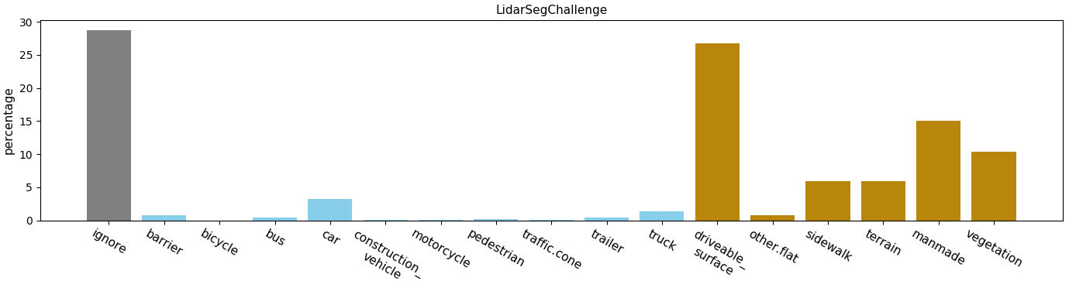
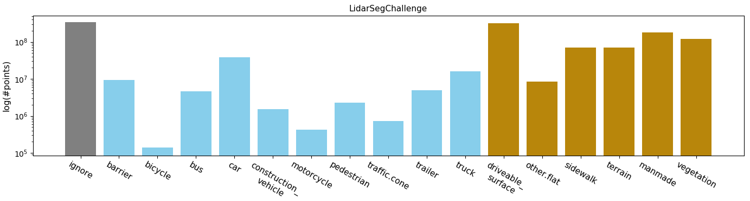
Percentage(%)
Logarithm

Slide 7
Previous 10 classes + background
0. car
1. truck
2. bus
3. trailer
4. construction_vehicle
5. pedestrian 10. background
6. motorcycle
7. bicycle
8. traffic_cone
9. barrier
Lidarseg_class | General_class | Lidarseg_class | General_class | Lidarseg_class | General_class
10/background | animal(1) | 9/barrier | movable_object.barrier(9) | 3/trailer | vehicle.trailer(22)
 | human.pedestrian.personal_mobility(5) | 7/bicycle | vehicle.bicycle(14) | 1/truck | vehicle.truck(23)
 | human.pedestrian.stroller(7) | 2/bus | vehicle.bus.bendy(15) | 10/background | flat.driveable_surface(24)
 | human.pedestrian.wheelchair(8) |  | vehicle.bus.rigid(16) |  | flat.other(25)
 | movable_object.debris(10) | 0/car | vehicle.car(17) |  | flat.sidewalk(26)
 | movable_object.pushable_pullable(11) | 4/construction_vehicle | vehicle.construction(18) |  | flat.terrain(27)
 | static_object.bicycle_rack(13) | 6/motorcycle | vehicle.motorcycle(21) |  | static.manmade(28)
 | vehicle.emergency.ambulance(19) | 5/pedestrian | human.pedestrian.adult(2) |  | static.vegetation(30)
 | vehicle.emergency.police(20) |  | human.pedestrian.child(3)
 | noise(0) |  | human.pedestrian.construction_worker(4)
 | static.other(29) |  | human.pedestrian.police_officer(6)
 | vehicle.ego(31) | 8/traffic_cone | movable_object.trafficcone(12)

Slide 8
xMuda 4 classes + background
0. vehicle
1. pedestrian
2. bike
3. traffic_boundary
4. background
Lidarseg_class | General_class | Lidarseg_class | General_class | Lidarseg_class | General_class
4/background | animal(1) | 3/traffic_boundary | movable_object.barrier(9) | 0/vehicle | vehicle.trailer(22)
 | human.pedestrian.personal_mobility(5) | 2/bike | vehicle.bicycle(14) | 1/truck | vehicle.truck(23)
 | human.pedestrian.stroller(7) | 0/vehicle | vehicle.bus.bendy(15) | 4/background | flat.driveable_surface(24)
 | human.pedestrian.wheelchair(8) |  | vehicle.bus.rigid(16) |  | flat.other(25)
 | movable_object.debris(10) | 0/car | vehicle.car(17) |  | flat.sidewalk(26)
 | movable_object.pushable_pullable(11) | 4/construction_vehicle | vehicle.construction(18) |  | flat.terrain(27)
 | static_object.bicycle_rack(13) | 2/bike | vehicle.motorcycle(21) |  | static.manmade(28)
 | vehicle.emergency.ambulance(19) | 1/pedestrian | human.pedestrian.adult(2) |  | static.vegetation(30)
 | vehicle.emergency.police(20) |  | human.pedestrian.child(3)
 | noise(0) |  | human.pedestrian.construction_worker(4)
 | static.other(29) |  | human.pedestrian.police_officer(6)
 | vehicle.ego(31) | 3/traffic_boundary | movable_object.trafficcone(12)

Slide 9
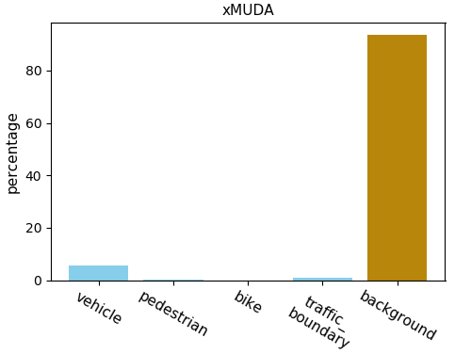
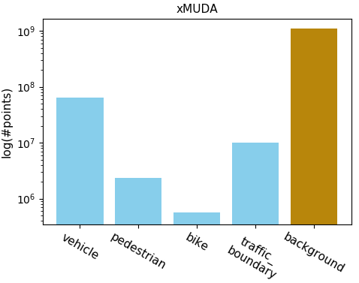
Percentage(%)
Logarithm

Slide 11
Contrastive learning 10 classes + background
0. vehicle
1. pedestrian
2. bike
3. traffic_boundary
4. driveable_surface
5. other_flat 10. ignore
6. sidewalk
7. terrain
8. manmade
9. vegetation
Lidarseg_class | General_class | Lidarseg_class | General_class | Lidarseg_class | General_class
10/ignore | animal(1) | 3/traffic_boundary | movable_object.barrier(9) | 0/vehicle | vehicle.trailer(22)
 | human.pedestrian.personal_mobility(5) | 2/bike | vehicle.bicycle(14) | 1/truck | vehicle.truck(23)
 | human.pedestrian.stroller(7) | 0/vehicle | vehicle.bus.bendy(15) | 4/driveable_surface | flat.driveable_surface(24)
 | human.pedestrian.wheelchair(8) |  | vehicle.bus.rigid(16) | 5/other_flat | flat.other(25)
 | movable_object.debris(10) | 0/car | vehicle.car(17) | 6/sidewalk | flat.sidewalk(26)
 | movable_object.pushable_pullable(11) | 4/construction_vehicle | vehicle.construction(18) | 7/terrain | flat.terrain(27)
 | static_object.bicycle_rack(13) | 2/bike | vehicle.motorcycle(21) | 8/manmade | static.manmade(28)
 | vehicle.emergency.ambulance(19) | 1/pedestrian | human.pedestrian.adult(2) | 9/vegetation | static.vegetation(30)
 | vehicle.emergency.police(20) |  | human.pedestrian.child(3)
 | noise(0) |  | human.pedestrian.construction_worker(4)
 | static.other(29) |  | human.pedestrian.police_officer(6)
 | vehicle.ego(31) | 3/traffic_boundary | movable_object.trafficcone(12)

Slide 12
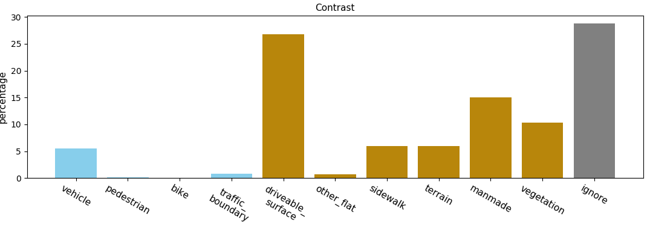
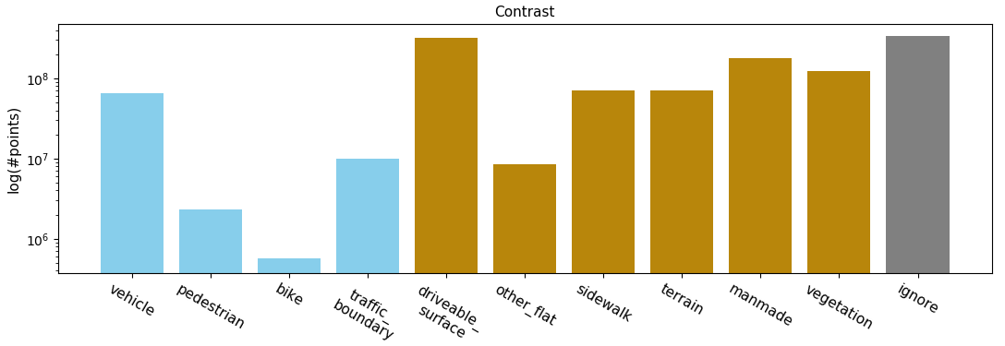
Percentage(%)
Logarithm

Slide 13
Merge

Slide 14
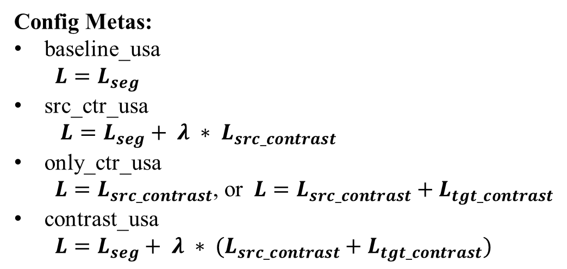
Config Metas:
baseline_usa
$$L=L_{seg}$$
src_ctr_usa
$L=L_{seg}+ λ ∗ L_{src_contrast}$
only_ctr_usa
$L=L_{src_contrast}$, or $L=L_{src_contrast}+L_{tgt_contrast}$
contrast_usa
$L=L_{seg}+ λ ∗ (L_{src_contrast}+L_{tgt_contrast})$

Slide 15
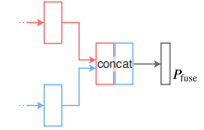
Architectures(ours)
Sample img feats
(N, 64)
MLP(64, 16)
UNetResNet34
contrastive_loss
UNetResNet34
(N, 64+16)
(N, 64+16)
UNetSCN
(N, 64)
seg_loss
Lidar feats
(N, 16)
Vanilla Fusion(Baseline)
UNetSCN
MLP(16, 16)
(N, 16)
Vanilla Fusion with contrastive loss

Slide 16
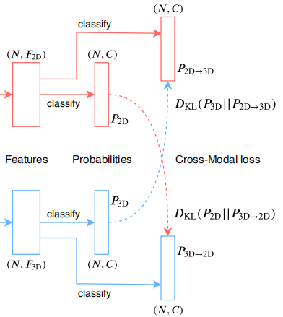
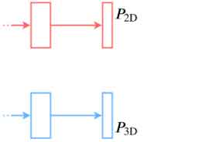
Architectures(xMuda)
(N, 64)
UNetResNet34
UNetResNet34
(N, 16)
UNetSCN
UNetSCN
Single Head without KL Divergence
Dual Head with KL Divergence

Slide 17
04/10~13/2021
xMuda class set / new class set pre-train & fine-tune
04/15/2021
new10_contra/contra_usa_v0
new10_contra/usa_finetune_v1
more epochs
contrast head; temperature (0.01 0.1 1 10 100)
fusion
3D backbone
GPUs 512 V100

Slide 18
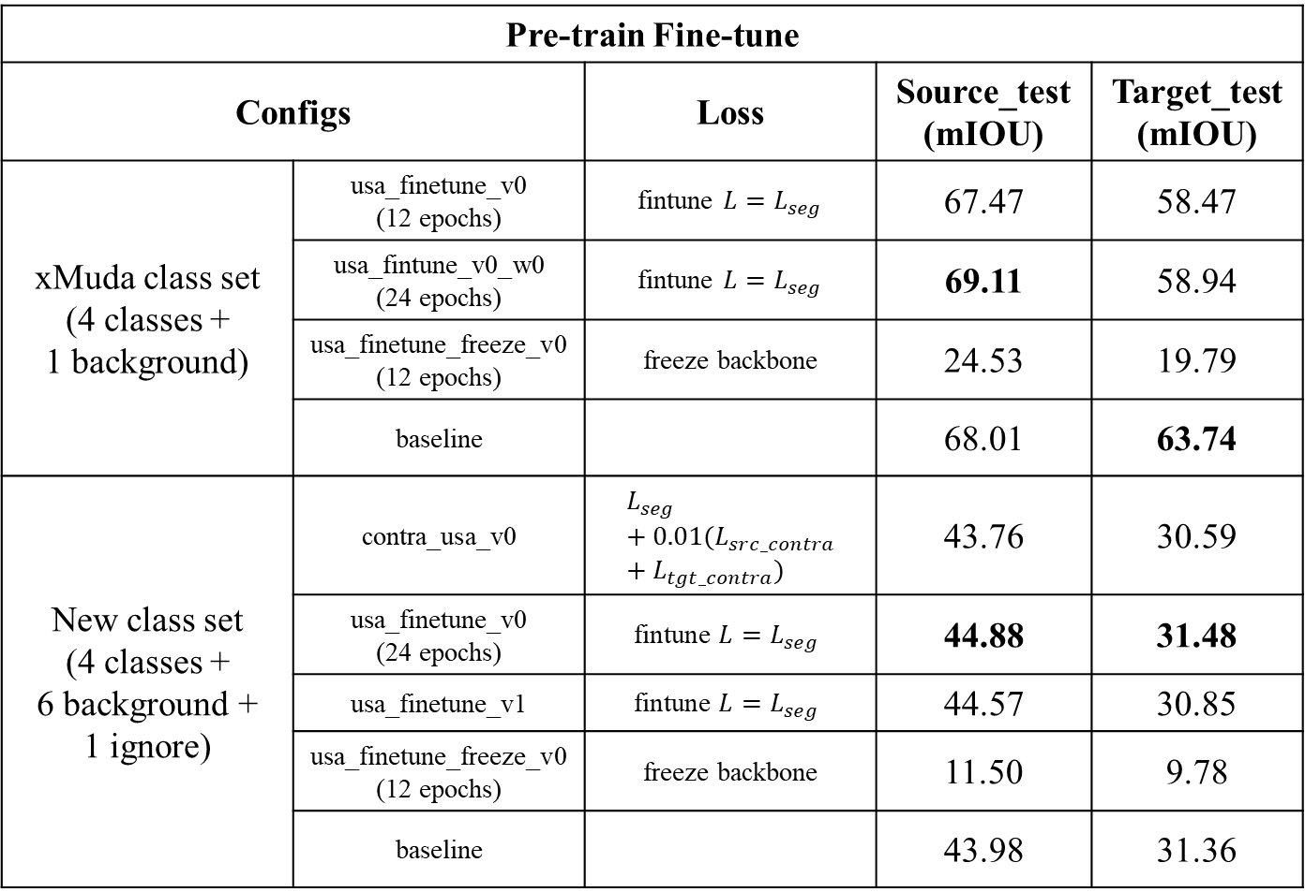
Pre-train Fine-tune | contrastive loss ablation study on single source domain
Configs | Configs | Loss | Source_test (mIOU) | Target_test (mIOU)
xMuda class set (4 classes + 1 background) | usa_finetune_v0 (12 epochs) | fintune $L=L_{seg}$ | 67.47 | 58.47
 | usa_fintune_v0_w0 (24 epochs) | fintune $L=L_{seg}$ | 69.11 | 58.94
 | usa_finetune_freeze_v0 (12 epochs) | freeze backbone | 24.53 | 19.79
 | baseline |  | 68.01 | 63.74
New class set (4 classes + 6 background + 1 ignore) | contra_usa_v0 | $$L_{seg}+0.01(L_{src_contra}+L_{tgt_contra})$$ | 43.76 | 30.59
New class set (4 classes + 6 background + 1 ignore) | usa_finetune_v0 (24 epochs) | $$\text{fintune} L=L_{seg}$$ | 44.88 | 31.48
 | usa_finetune_v1 | $$\text{fintune} L=L_{seg}$$ | 44.57 | 30.85
 | usa_finetune_freeze_v0 (12 epochs) | freeze backbone | 11.50 | 9.78
 | baseline |  | 43.98 | 31.36

Slide 19
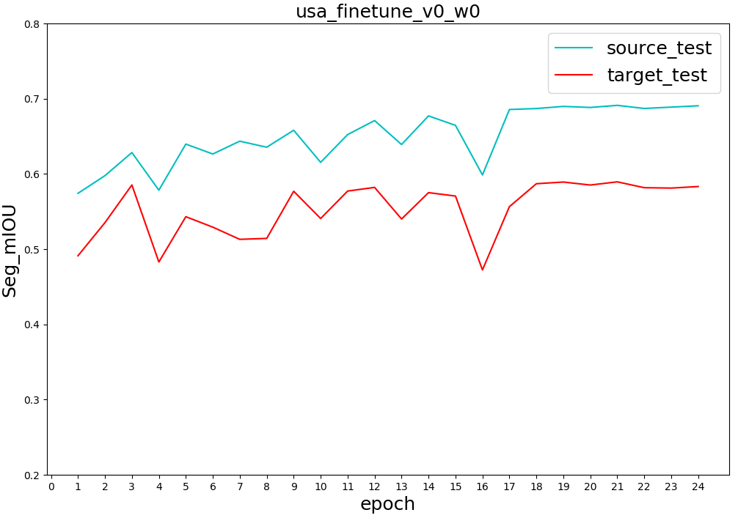
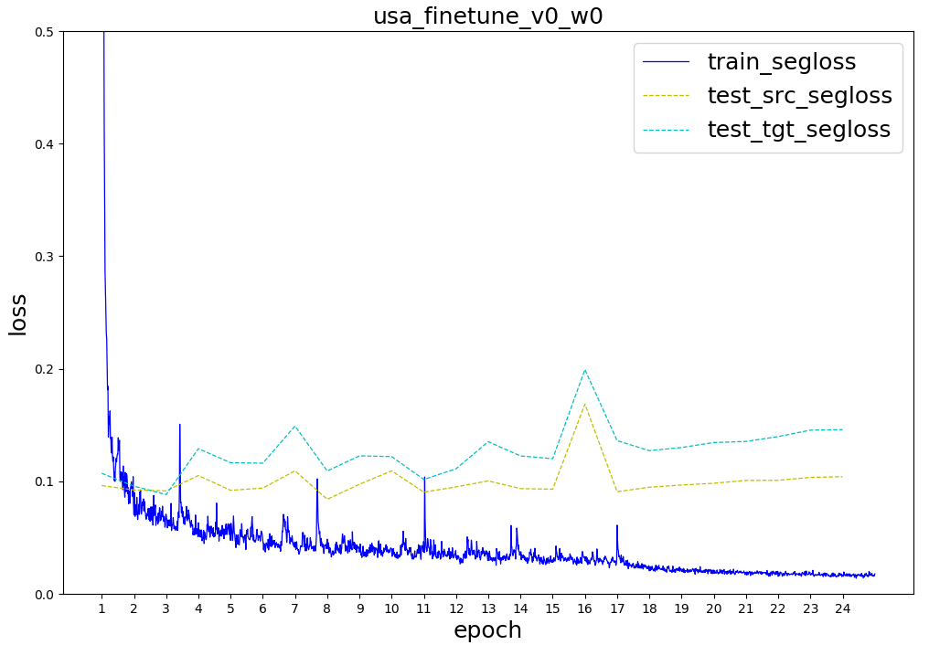
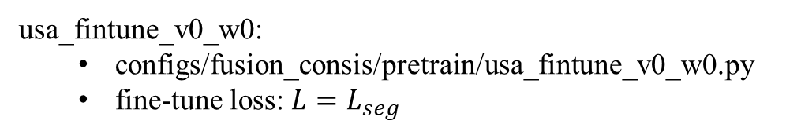
usa_fintune_v0_w0:
configs/fusion_consis/pretrain/usa_fintune_v0_w0.py
fine-tune loss: $L=L_{seg}$
xMuda class set

Slide 20
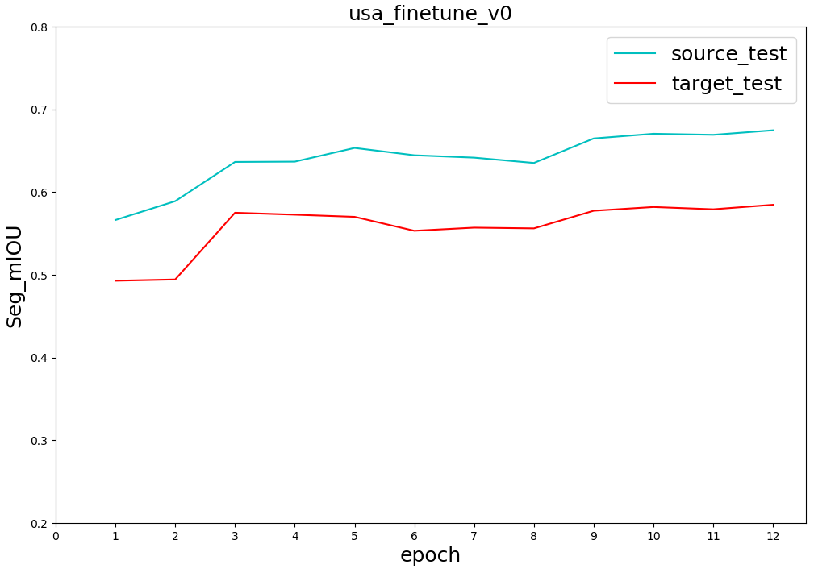
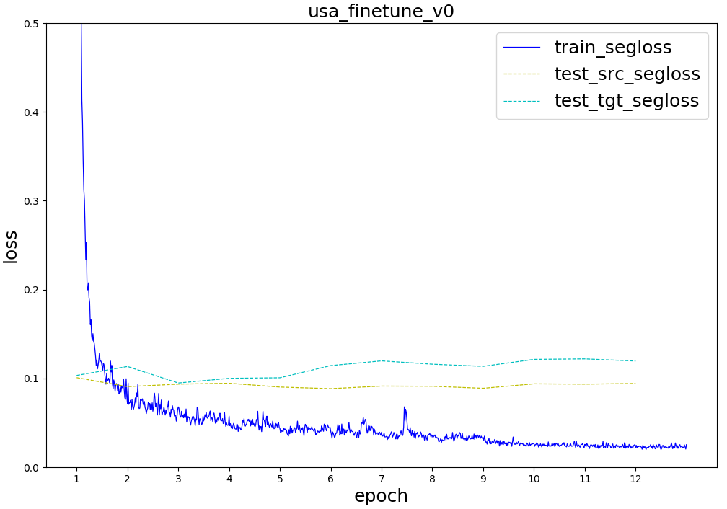
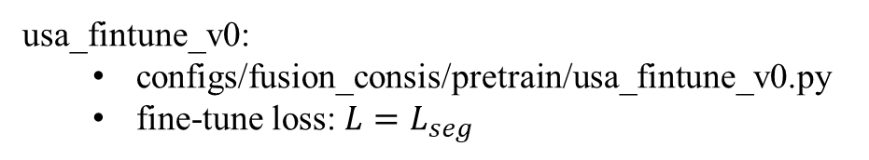
xMuda class set(5 classes)
usa_fintune_v0:
configs/fusion_consis/pretrain/usa_fintune_v0.py
fine-tune loss: $L=L_{seg}$

Slide 21
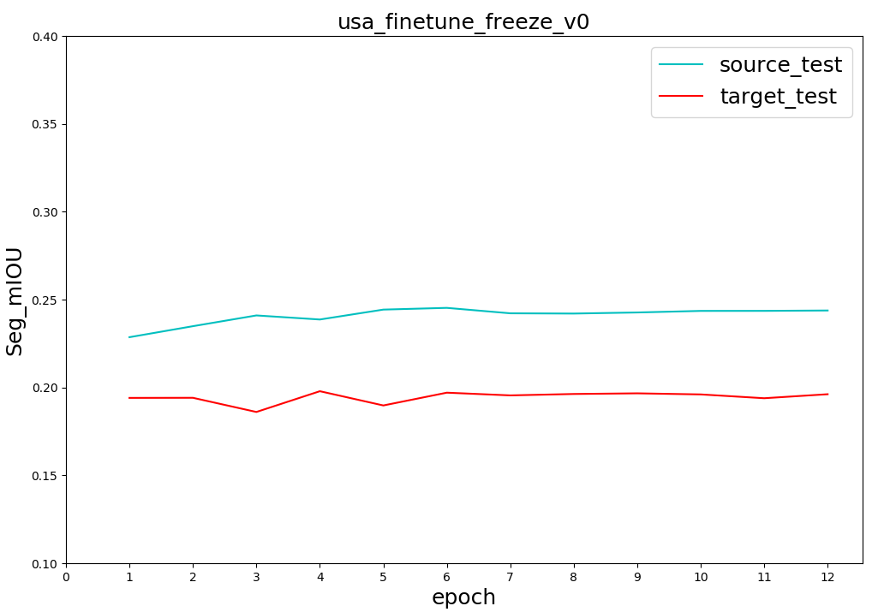
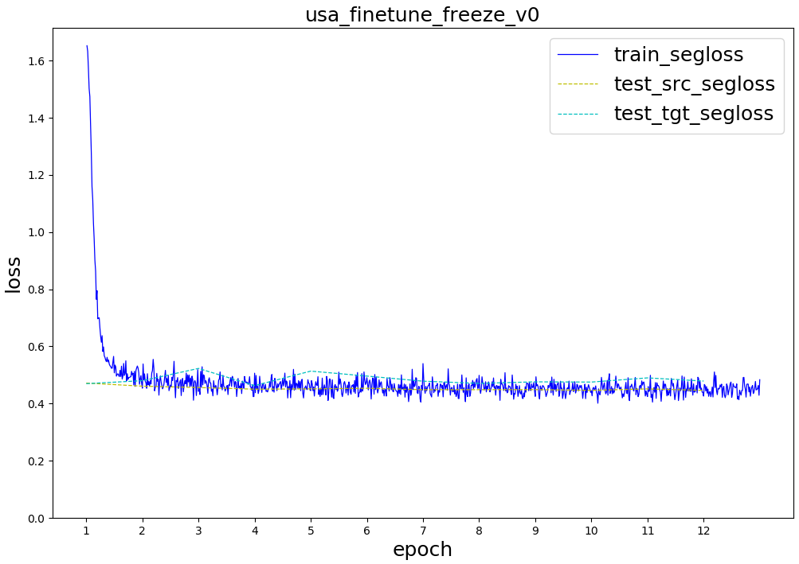
xMuda class set(5 classes)
usa_fintune_freeze_v0:
configs/fusion_consis/pretrain/usa_fintune_freeze_v0.py
freeze backbone when fine-tune; only train fc head

Slide 22
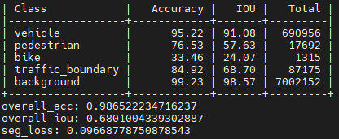
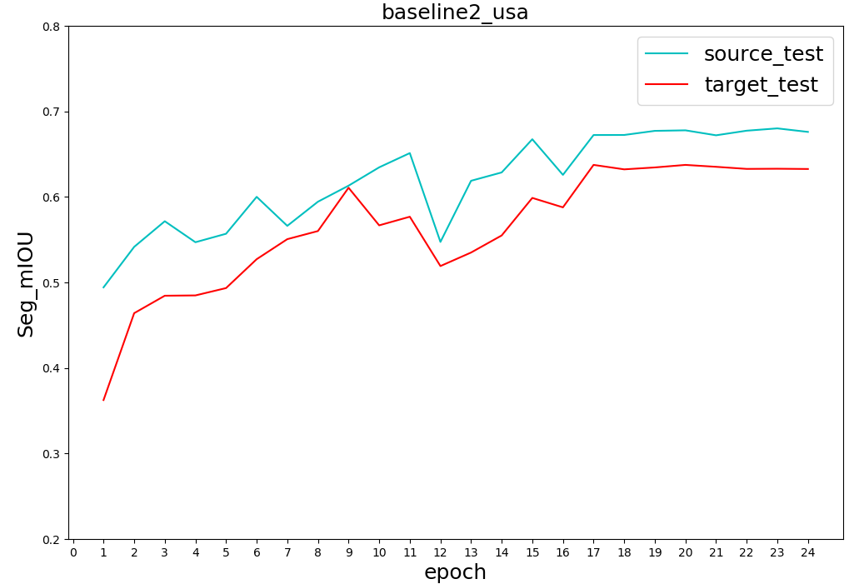
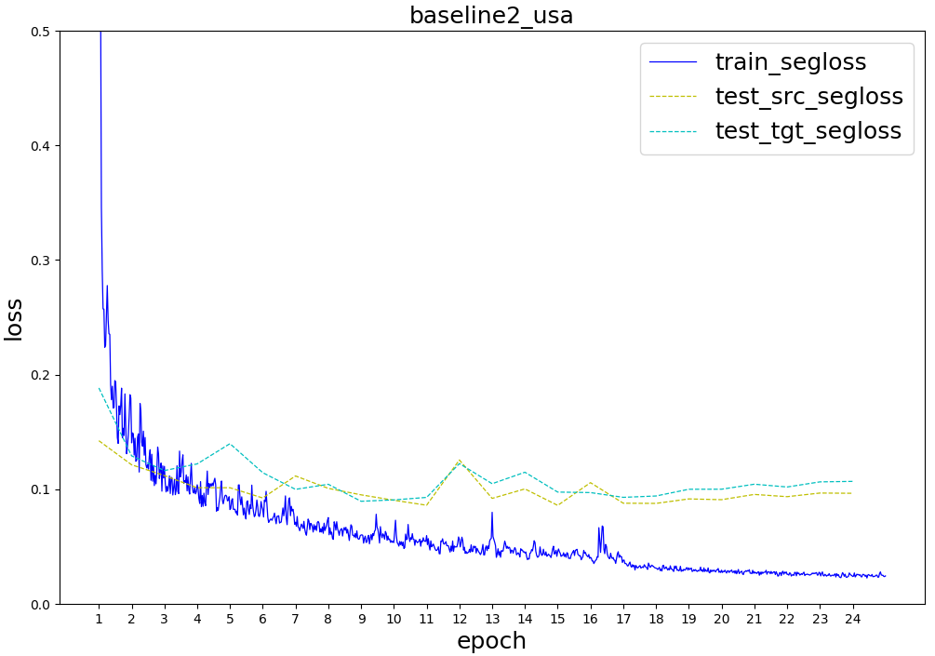
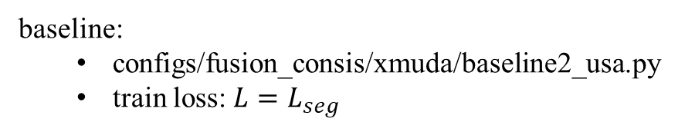
xMuda class set(5 classes)
baseline:
configs/fusion_consis/xmuda/baseline2_usa.py
train loss: $L=L_{seg}$

Slide 24
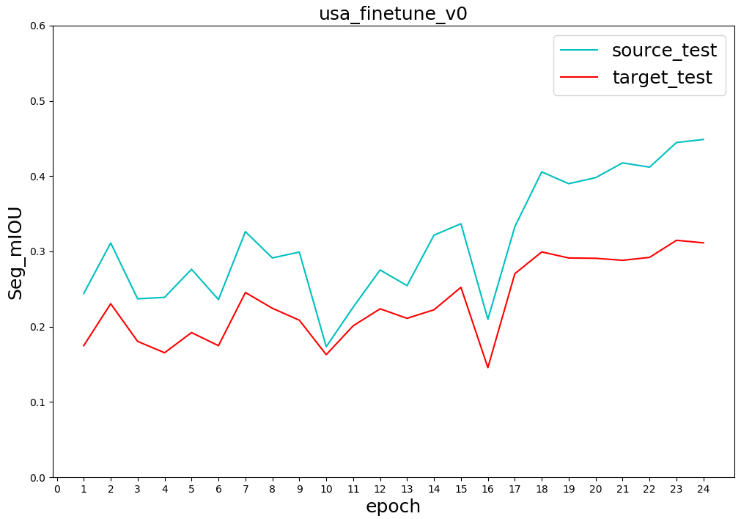
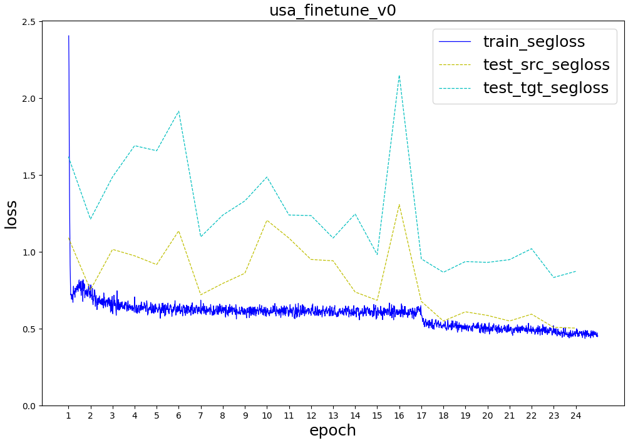
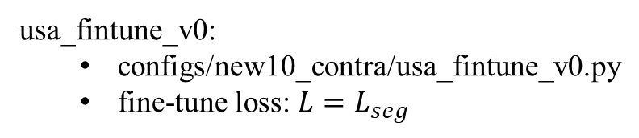
new class set(11 classes)
usa_fintune_v0:
configs/new10_contra/usa_fintune_v0.py
fine-tune loss: $L=L_{seg}$

Slide 25
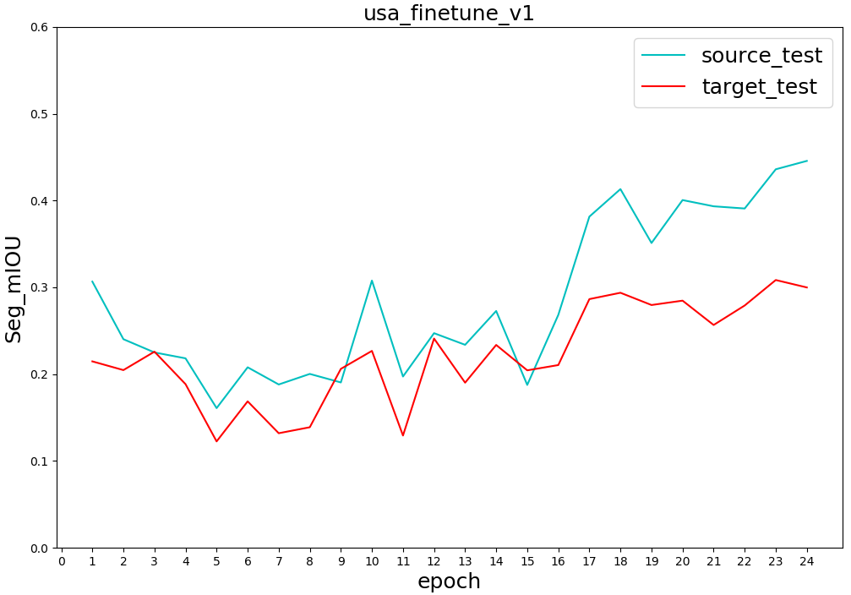
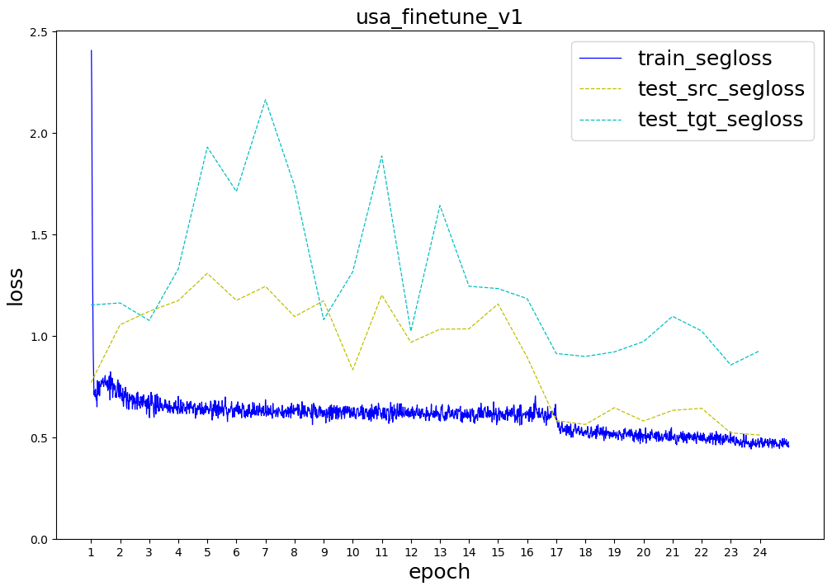
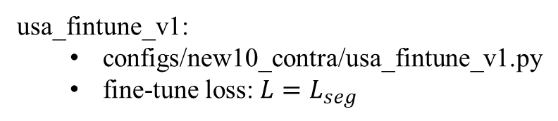
new class set(11 classes)
usa_fintune_v1:
configs/new10_contra/usa_fintune_v1.py
fine-tune loss: $L=L_{seg}$

Slide 26
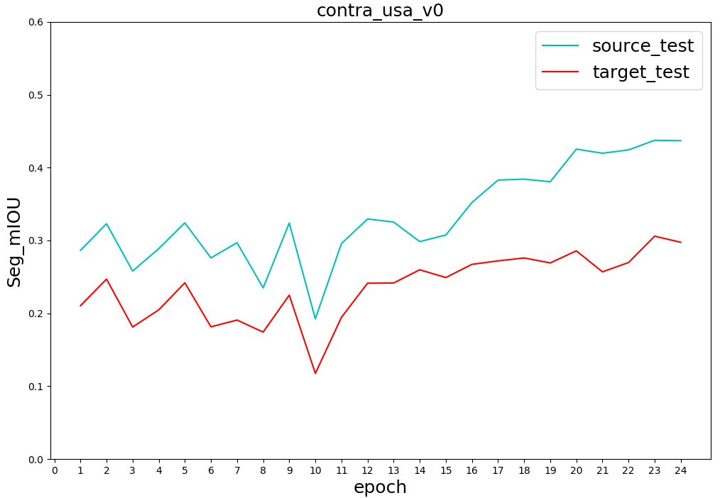
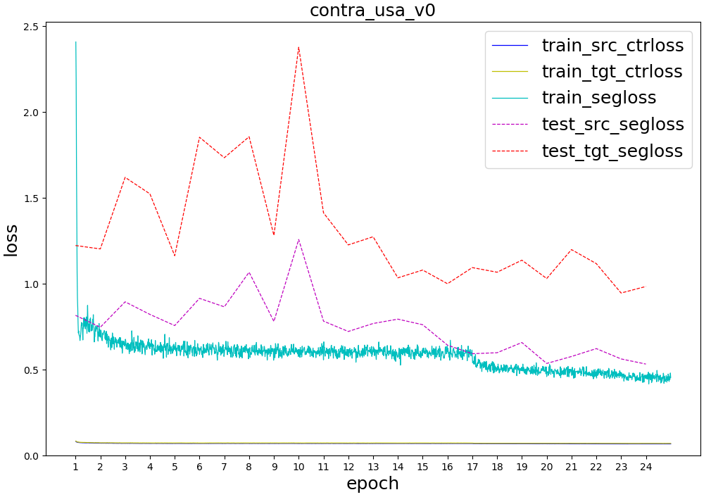
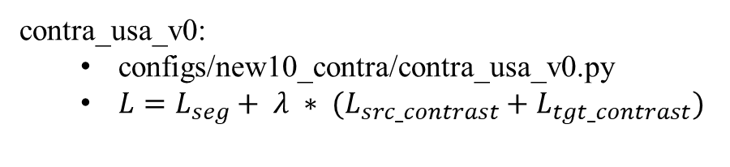
new class set(11 classes)
contra_usa_v0:
configs/new10_contra/contra_usa_v0.py
$L=L_{seg}+ λ ∗ (L_{src_contrast}+L_{tgt_contrast})$

Slide 27
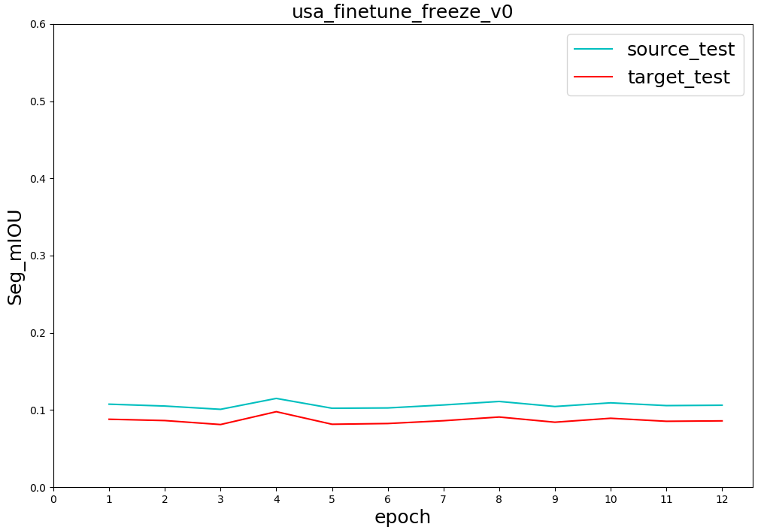
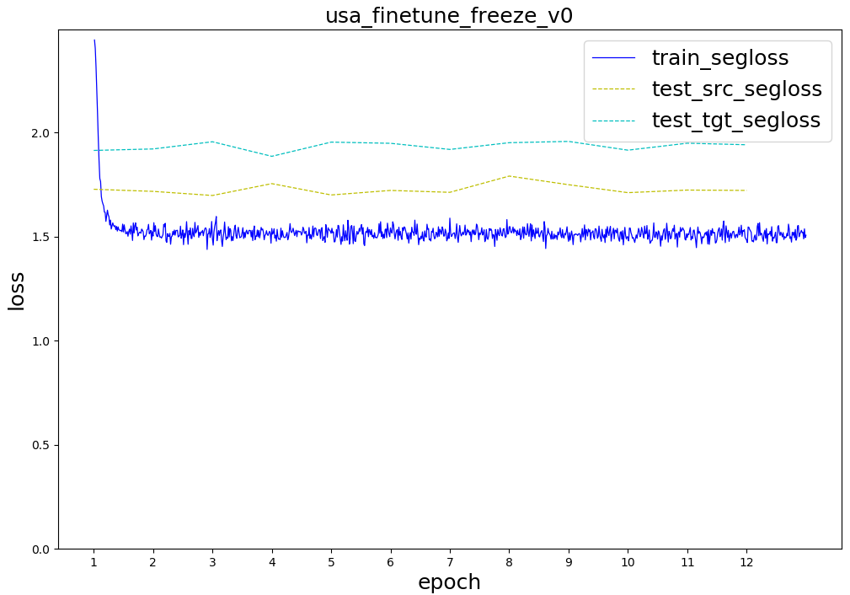
new class set(11 classes)
usa_fintune_freeze_v0:
configs/new10_contra/usa_fintune_freeze_v0.py
freeze backbone when fine-tune; only train fc head

Slide 28
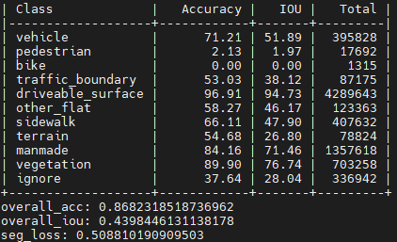
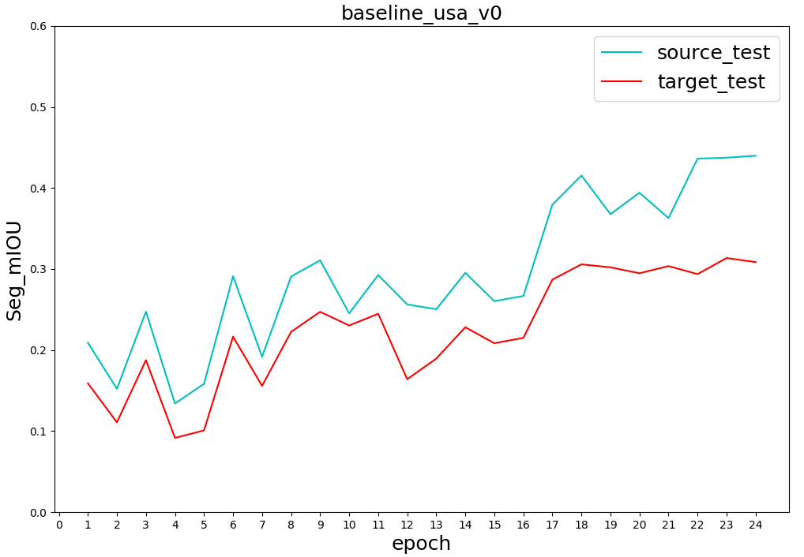
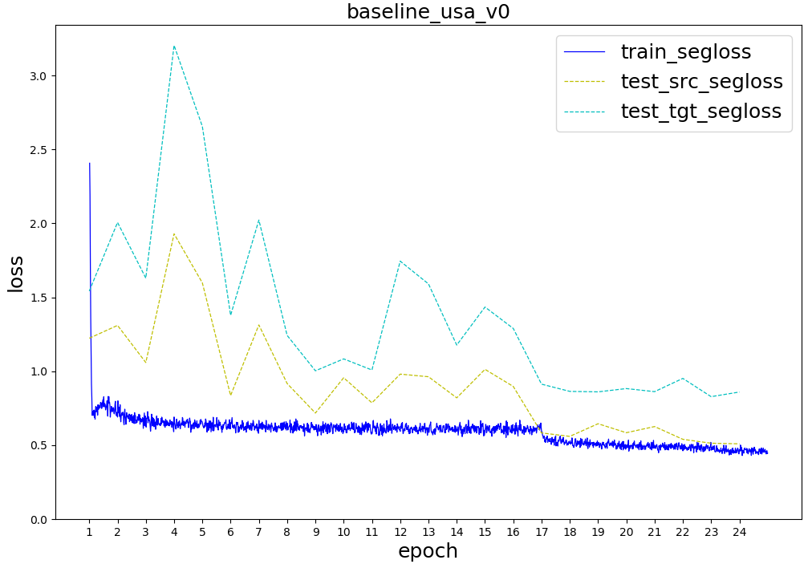
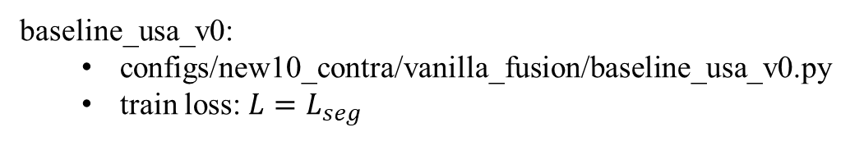
new class set(11 classes)
baseline_usa_v0:
configs/new10_contra/vanilla_fusion/baseline_usa_v0.py
train loss: $L=L_{seg}$

Slide 29
Potential problems with contrastive learning
Class imbalance still exists on the new class set(11 classes)
nuScenes Lidar scan with segmentation labels are sparse
~ 3000 labeled points in each sample
Object points are sparse: only ~10 points for a car
What about ScanNet?
Uncertain issues:
Contrast between img_feat and pts_feat
Contrastive learning helps domain adaptation?
 | vehicle | pedestrian | bike | traffic_ boundary | driveable_ surface | other_flat | sidewalk | terrain | manmade | vegetation | ignore
Sample 1 | 8 | 0 | 0 | 0 | 2013 | 0 | 76 | 0 | 812 | 0 | 0
Sample 2 | 0 | 0 | 0 | 0 | 1756 | 0 | 225 | 76 | 352 | 613 | 9
Sample 3 | 4 | 0 | 4 | 0 | 1757 | 0 | 190 | 4 | 660 | 687 | 0
Sample 4 | 5 | 8 | 0 | 5 | 1864 | 0 | 162 | 39 | 487 | 439 | 7

Slide 30
04/05/2021
contrast_usa_v0/v1 train/val loss curve
04/08/2021
classes histogram

Slide 31
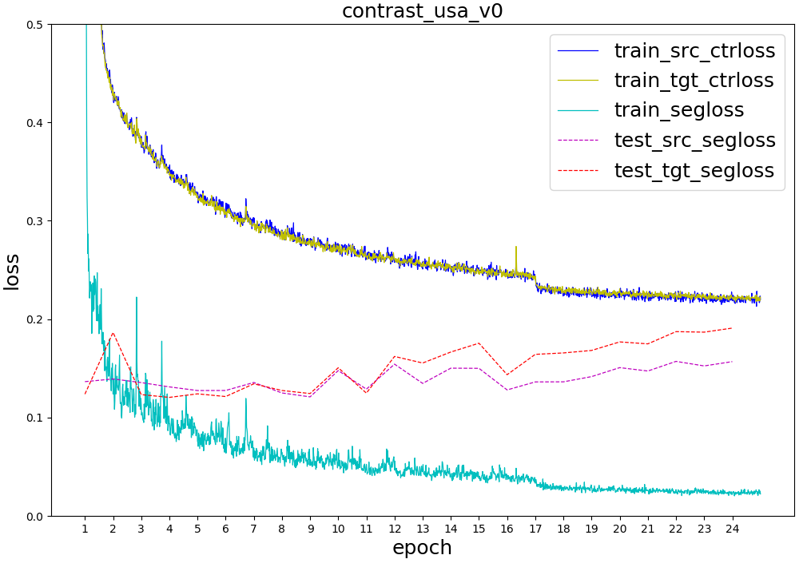
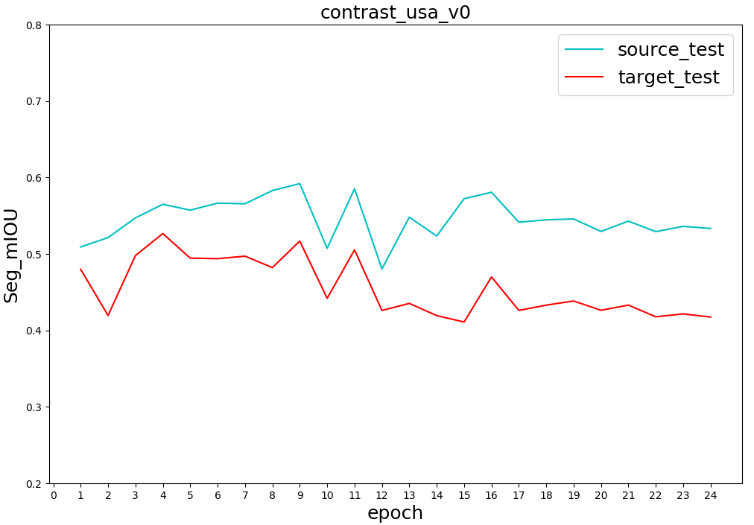
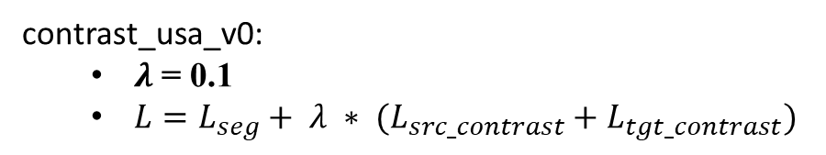
contrast_usa_v0:
$λ$ = 0.1
$L=L_{seg}+ λ ∗ (L_{src_contrast}+L_{tgt_contrast})$
train/val losses
validation mIOU

Slide 32
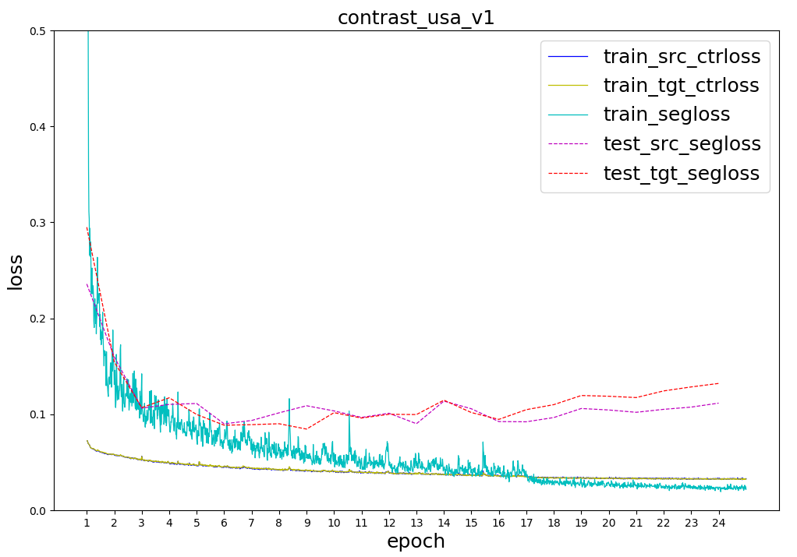
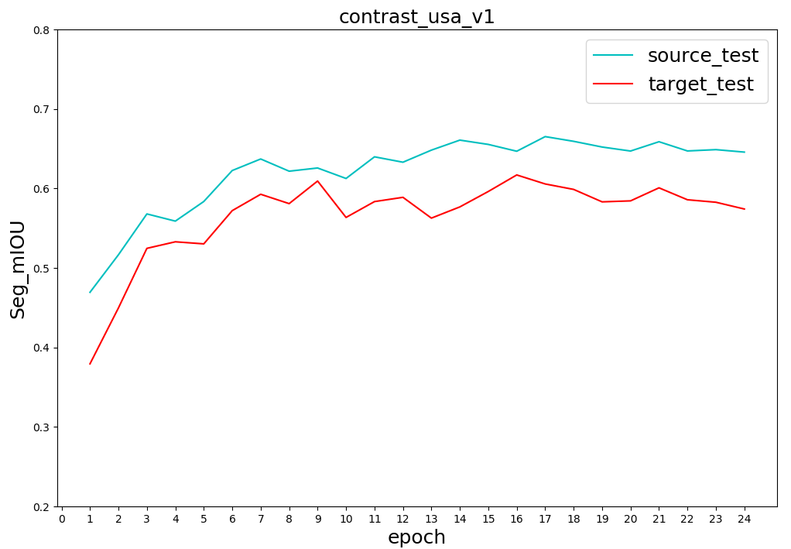
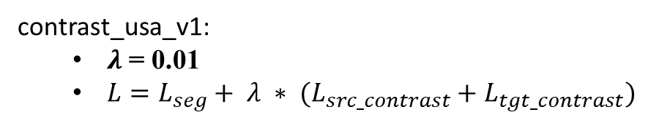
contrast_usa_v1:
$λ$ = 0.01
$L=L_{seg}+ λ ∗ (L_{src_contrast}+L_{tgt_contrast})$
train/val losses
validation mIOU

Slide 33
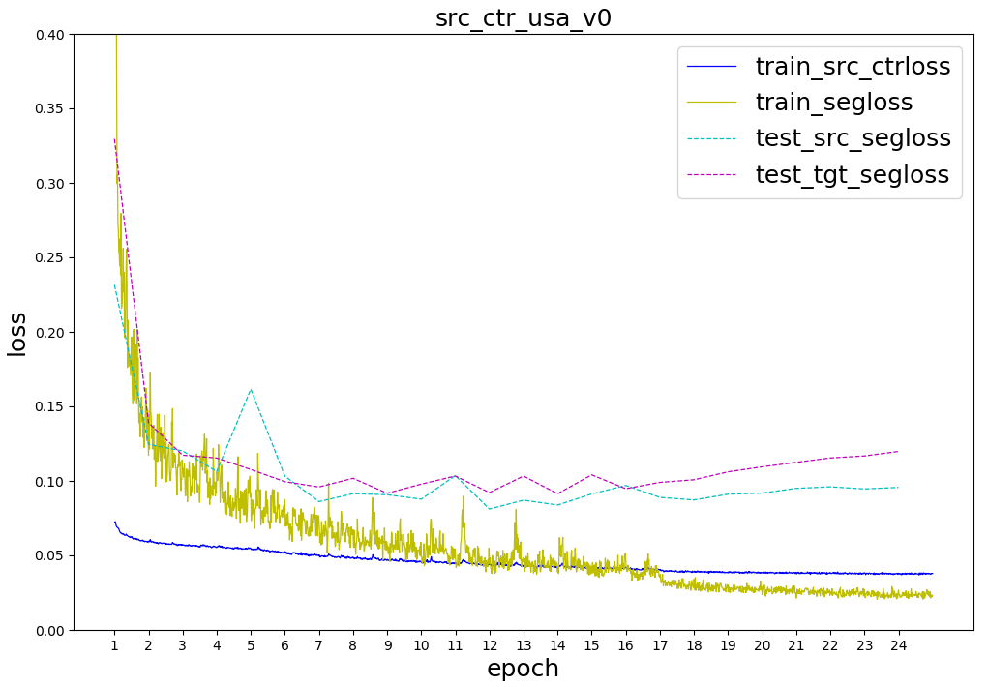
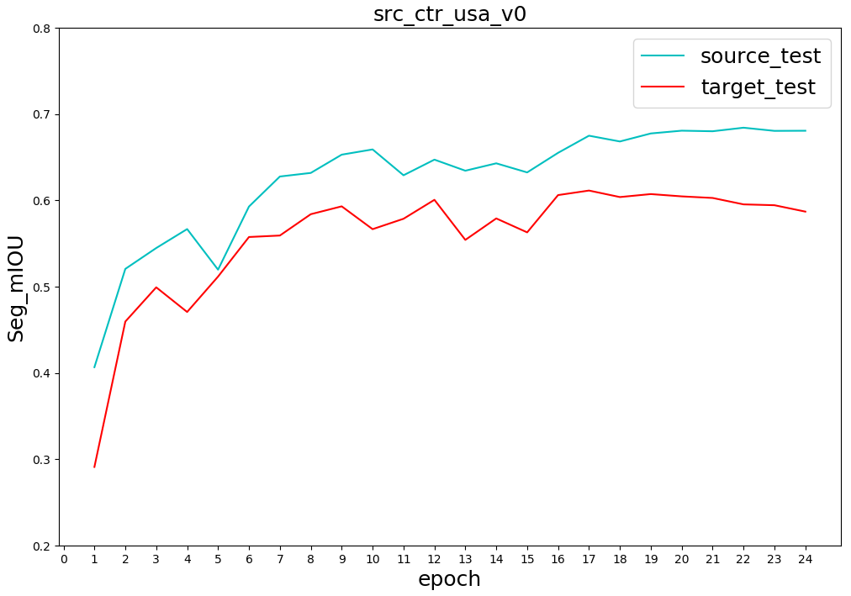
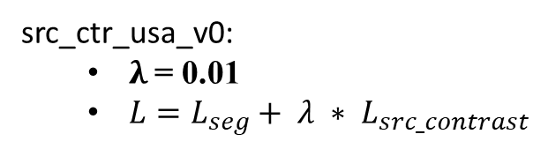
src_ctr_usa_v0:
$λ$= 0.01
$L=L_{seg}+ λ ∗ L_{src_contrast}$
train/val losses
validation mIOU

Slide 34
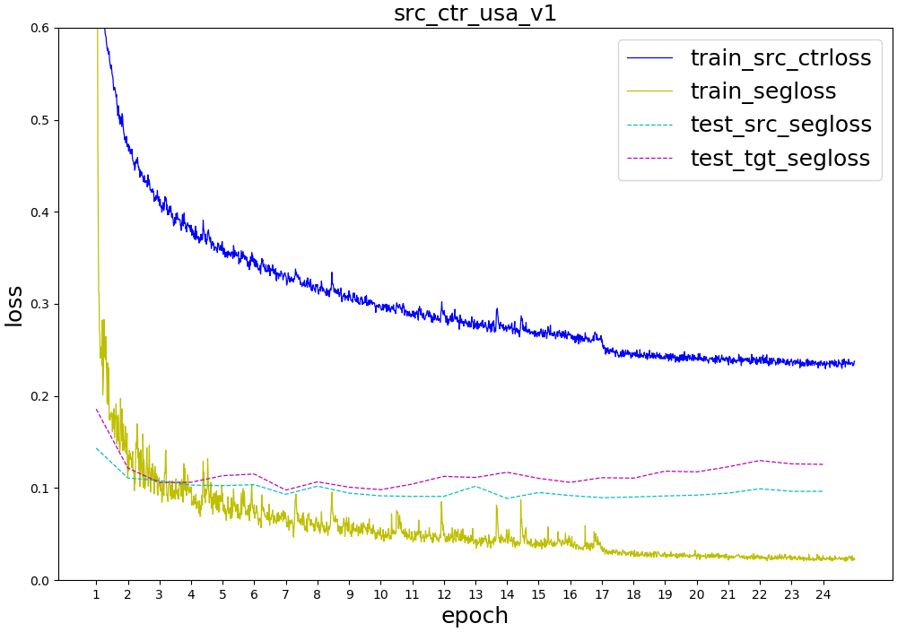
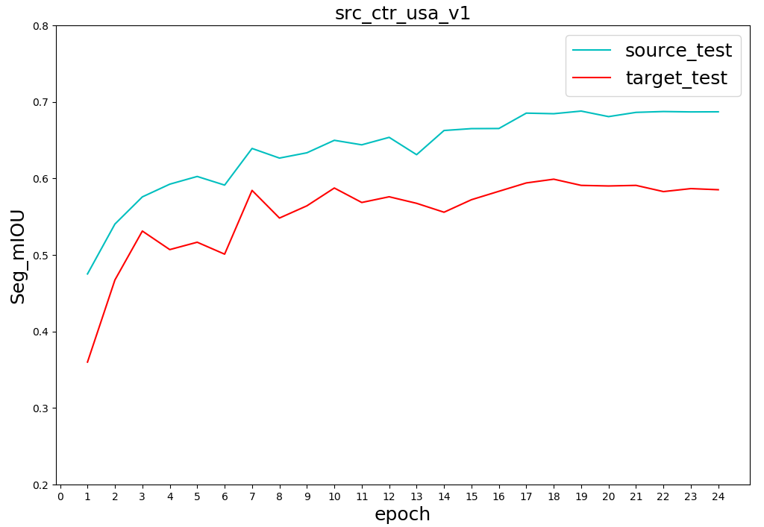

src_ctr_usa_v1:
$λ$= 0.1
$L=L_{seg}+ λ ∗ L_{src_contrast}$
train/val losses
validation mIOU

Slide 35



Vanilla Fusion/baseline_usa_v1/baseline2_usa:
batch_size=8 (the same as xmuda)
$L=L_{seg}$
train/val losses
validation mIOU

Slide 36
03/28/2021
src_ctr_usa_v3/v4
03/25/2021
src_ctr_usa_v1/v2
only_ctr_usa_v0/v1

Slide 37
contrastive loss ablation study on single source domain
Configs | Source_test (mIOU) | Target_test (mIOU)
src_ctr_usa_v0 (0.01) | 68.42 | 61.14
src_ctr_usa_v1 (0.1) | 68.80 | 59.90
src_ctr_usa_v2 (0.5) | 65.55 | 52.04
src_ctr_usa_v3 (0.3) | 66.44 | 54.68
src_ctr_usa_v4 (1.0) | 63.66 | 52.85
baseline_usa_v1 | 68.01 | 63.74

Slide 38



src_ctr_usa_v0:
$λ$= 0.01
#pts = 1024, # groups = 1
batch_size=8
$L=L_{seg}+ λ ∗ L_{src_contrast}$

Slide 39



src_ctr_usa_v1:
$λ \text{= 0.1}$
#pts = 1024, # groups = 1
batch_size=8
$L=L_{seg}+ λ ∗ L_{src_contrast}$

Slide 40



src_ctr_usa_v2:
$λ \text{= 0.}\text{5}$
#pts = 1024, # groups = 1
batch_size=8
$L=L_{seg}+ λ ∗ L_{src_contrast}$

Slide 41



src_ctr_usa_v3:
$λ \text{= 0.}\text{3}$
#pts = 1024, # groups = 1
batch_size=8
$L=L_{seg}+ λ ∗ L_{src_contrast}$

Slide 42



src_ctr_usa_v4:
$λ \text{= }\text{1.0}$
#pts = 1024, # groups = 1
batch_size=8
$L=L_{seg}+ λ ∗ L_{src_contrast}$

Slide 43


Slide 44

tgt_contrast_loss & src_contrast_loss
nearly coincide

Slide 45
03/24/2021
contrast_usa_v3/v4
src_contrast_usa_v0
03/20/2021
baseline_usa_v1(baseline2_usa)
contrast_usa_v1
03/19/2021
baseline_usa_v0(baseline1_usa)
bontrast_usa_v0

Slide 46

USA/Singapore
 | Config | Target_test (mIOU)
xMUDA | dual head + KL_div 2D+3D | 62.53
xMUDA baseline | single head 2D+3D | 62.10
Vanilla fusion baseline | baseline_usa_v0 (B=4) | 61.57
 | baseline_usa_v1 (B=8) | 63.74
Contrastive loss on both source_train & target_train | contrast_usa_v0 | 52.67
 | contrast_usa_v1 | 61.69
 | contrast_usa_v3 | < 60.00
 | contrast_usa_v4 | < 60.00
Hyperparameters to fine-tune:
$λ$ (0.1, 0.01, 0.005, 0.001)
Temparature (100, 10, 1, 0.5, 0.1, 0.05)
#pts in each group (64, 256, 1024, 2048) & #groups in each sample
$n_{pos}:n_{neg}=1:(\#pts−1)$
Transformation after representation(Linear, Non-Linear, None)
Optimizers(AdamW, Adam, SGD+Momentum)

Slide 47





Meta Config:
contrast_usa:
batch_size=8
$L=L_{seg}+ λ ∗ (L_{src_contrast}+L_{tgt_contrast})$
Sub Configs:
contrast_usa_v0:
$λ=0.1$
#pts = 1024, # groups = 1
contrast_usa_v1:
$λ=0.01$
#pts = 1024, # groups = 1
contrast_usa_v3:
$λ=0.01$
#pts = 128, # groups = 8
contrast_usa_v4:
$λ=0.01$
#pts = 2048, # groups = 1

Slide 48



baseline_usa_v1:
batch_size=8(the same as xmuda)
$L=L_{seg}$

Slide 49



UNetResNet34
(N, 64)
(N, 64+16)
UNetSCN
(N, 16)
Vanilla Fusion(Baseline)
baseline_usa_v0:
batch_size=4
$L=L_{seg}$

Slide 50



MLP(64, 16)
contrastive_loss
UNetResNet34
(N, 64+16)
tgt_contrast_loss & src_contrast_loss nearly coincide
(N, 64)
seg_loss
UNetSCN
MLP(16, 16)
(N, 16)
contrast_usa_v0:
$λ$ = 0.1
batch_size=8
$L=L_{seg}+ λ ∗ (L_{src_contrast}+L_{tgt_contrast})$

Slide 51



tgt_contrast_loss & src_contrast_loss nearly coincide
contrast_usa_v1:
$λ\text{ = 0.}\text{0}\text{1}$
batch_size=8
$L=L_{seg}+ λ ∗ (L_{src_contrast}+L_{tgt_contrast})$

Slide 52
03/16/2021
Xmuda new baseline (trained with new seg labels)
“Multi-modal Multi-Task fusion Ver2” baseline
Move xMuda network structure to our framework; train vanilla fusion

Slide 53

xMuda, reproduce results with new seg labels
Train/test | USA/Singapore | Usa/Sng |  | Day/night
Segmentation(mIoU) | Xmuda (dual head, KL_div) | Baseline (train on source) | Oracle (train on target) | Xmuda | Baseline | Oracle
2D | 57.04 | 54.03 | 70.83 | 49.62 | 38.81 | 39.30
3D | 53.57 | 48.41 | 65.55 | 45.55 | 43.75 | 46.84
2D+3D | 62.53 | 62.10 | 75.40 | 52.99 | 48.63 | 43.39
xMuda, old results showed in paper
(seg label obtained by marking points in bounding boxes)

Slide 54

Train/test: Usa/Sng | Ver1 (separate encoders for points) | Multi-modal Multi-Task fusion Ver2 (shared encoder for points)
 | Baseline | Baseline (train on source) | Task_loss + lambda * Contrast_loss (tried a few hyperparameters)
 |  |  | Train from scratch | Resume from baseline model
Segmentation (mIoU) | 60.69 | 62.48 | 48.80 | 57.63
Detection (mAP) | 51.29 | 45.02 | 37.15 | 41.59
Xmuda, new seg labels
Train/test Usa/Sng | Xmuda (dual head， KL_div) | Baseline (separate two streams) | Vanilla fusion
2D | 57.04 | 54.03
3D | 53.57 | 48.41
2D+3D | 62.53 | 62.10 | 63.74
baseline2_usa
UNetResNet34
Multi-modal Multi-Task fusion Ver2
(N, 64)
(N, 64+16)
UNetSCN
(N, 16)
Vanilla Fusion(Baseline)

