Slide 1

Prediction Challenge
Xinyu Meng
Xm73
April 18th

Slide 2
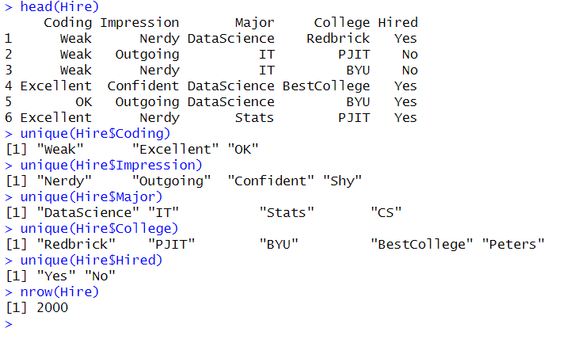
Hire dataset structure: The Hire dataset contains 5 categorical attributes

Slide 3
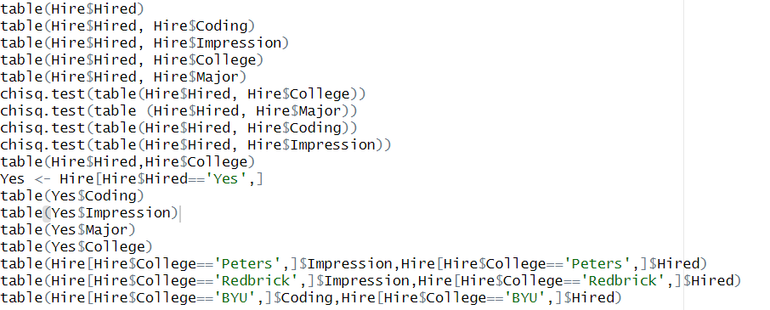
Method:
By executing several queries on the Hire dataset, I detected many combination that could lead to a successful prediction.
I categorize the data using subframes and visualized the difference of hire and no hire using bar plots.

Slide 4
Classification of Hiring result for students with excellent coding and outgoing impressions:
In the barplot, we can see a significant difference in the hiring result.
Even though there are still a few students who are not hired, the vast majority of students with these attributes are hired.
So I can add the above rule to the binary prediction model

