Slide 1

Prediction Challenge
Xinyu Meng
Xm73
April 18th

Slide 2
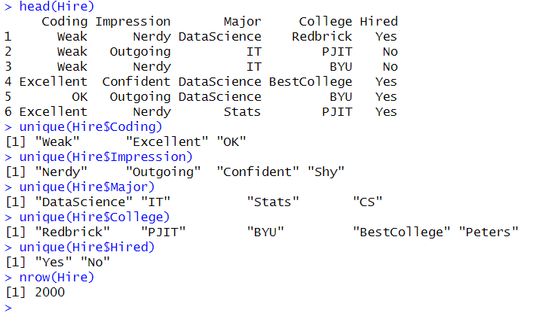
Hire dataset structure: The Hire dataset contains 5 categorical attributes

Slide 3
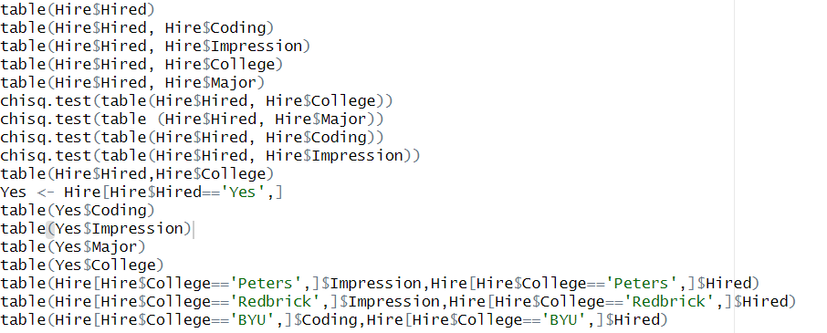
Method:
By executing several queries on the Hire dataset, I detected many combination that could lead to a successful prediction.
I categorize the data using subframes and visualized the difference of hire and no hire using bar plots.

Slide 4
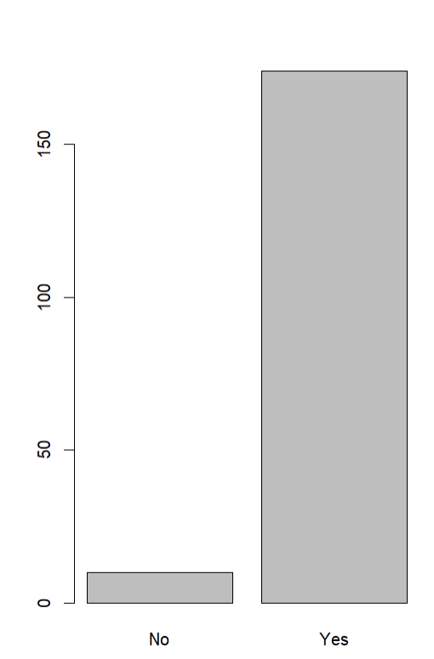
Classification of Hiring result for students with excellent coding and outgoing impressions:
In the barplot, we can see a significant difference in the hiring result.
Even though there are still a few students who are not hired, the vast majority of students with these attributes are hired.
So I can add the above rule to the binary prediction model

Slide 5
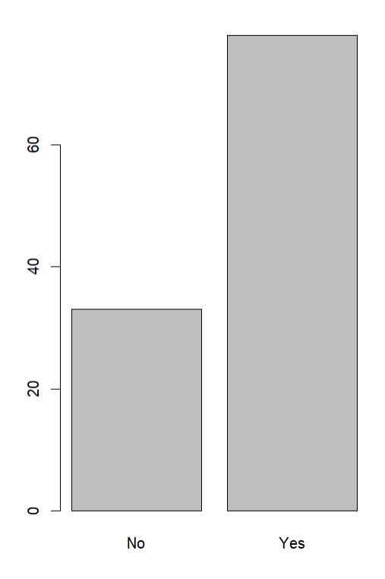
Classification of Hiring result for students from Redbrick college majoring in Computer Science
In the barplot, we can see a significant difference in the hiring result.
Even though there are still a few students who are not hired, the vast majority of students with these attributes are hired.
So I can add the above rule to the binary prediction model

Slide 6
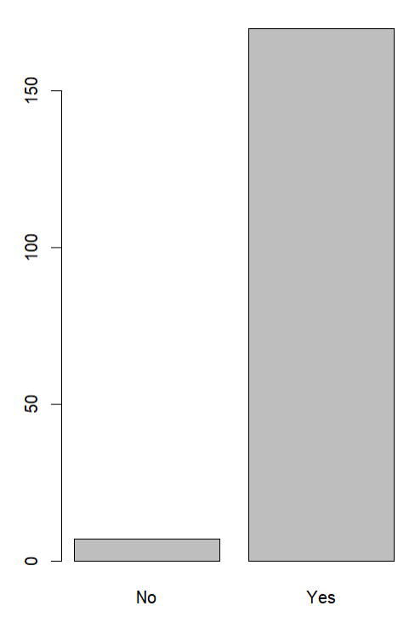
Classification of Hiring result for students with excellent coding skills and also shows their confidence
In the barplot, we can see a significant difference in the hiring result.
Even though there are still a few students who are not hired, the vast majority of students with these attributes are hired.
So I can add the above rule to the binary prediction model

Slide 7
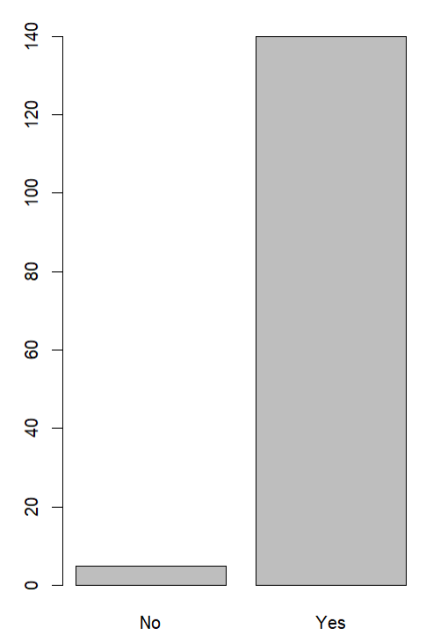
Classification of Hiring result for students with excellent coding skills but showing shy impressions to their employeers
In the barplot, we can see a significant difference in the hiring result.
Even though there are still a few students who are not hired, the vast majority of students with these attributes are hired.
So I can add the above rule to the binary prediction model

Slide 8
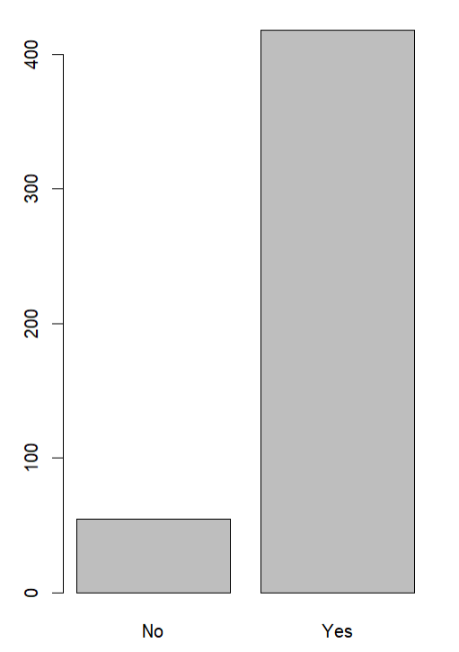
Classification of Hiring result for students with ok coding skills having non-nerdy impressions
In the barplot, we can see a significant difference in the hiring result.
Even though there are still a few students who are not hired, the vast majority of students with these attributes are hired.
So I can add the above rule to the binary prediction model

Slide 9
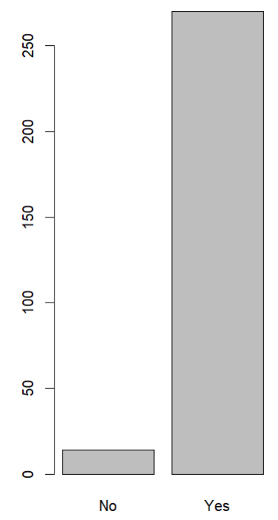
Classification of Hiring result for students from Redbrick college with ok to excellent coding skills
In the barplot, we can see a significant difference in the hiring result.
Even though there are still a few students who are not hired, the vast majority of students with these attributes are hired.
So I can add the above rule to the binary prediction model

Slide 10
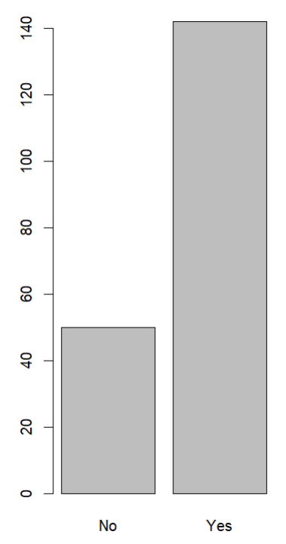
Classification of Hiring result for students from Peters college with Nerdy or outgoing impression
In the barplot, we can see a significant difference in the hiring result.
Even though there are still a few students who are not hired, the vast majority of students with these attributes are hired.
So I can add the above rule to the binary prediction model

Slide 11
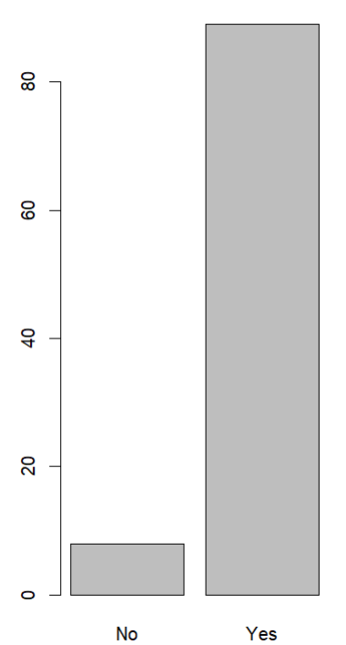
Classification of Hiring result for Nerdy students from Redbrick college
In the barplot, we can see a significant difference in the hiring result.
Seems Redbrick college is the most reputated college among our dataset.
Even though there are still a few students who are not hired, the vast majority of students with these attributes are hired.
So I can add the above rule to the binary prediction model

Slide 12
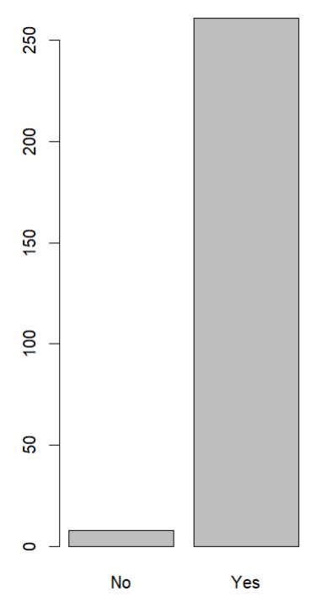
Classification of Hiring result for students from Peters college with coding skills better than weak
In the barplot, we can see a significant difference in the hiring result.
Peter college has also a pretty good reputation compared to others, also, seems like weak coding skills are largely disliked by most employers.
Even though there are still a few students who are not hired, the vast majority of students with these attributes are hired.
So I can add the above rule to the binary prediction model

Slide 13
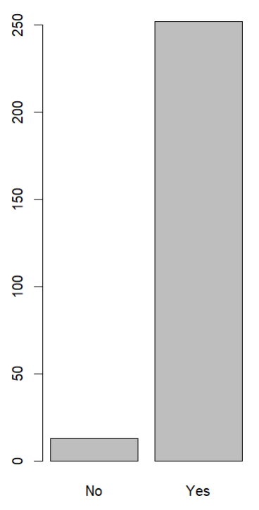
Classification of Hiring result for students from BYU college with coding skills better than weak
In the barplot, we can see a significant difference in the hiring result.
Even though there are still a few students who are not hired, the vast majority of students with these attributes are hired.
So I can add the above rule to the binary prediction model

Slide 14

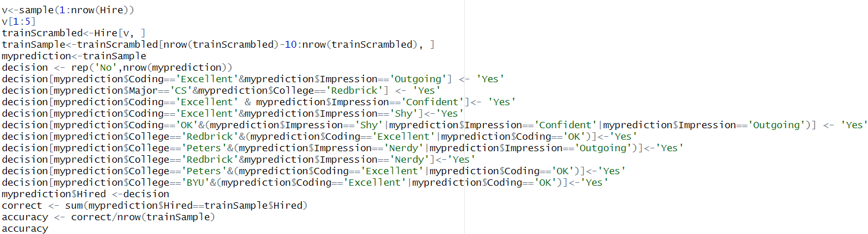
Cross Validation:
To conduct Cross Validation, I first created an random sample dataset and an empty decision vector.
I initialize the vector for No, and add each positive prediction to the vector.
After running the prediction model several times, the precision is able to reach above 85%.

Slide 15
Conclusion:
Student’s coding skills being weak or non-weak seems the most significant attribute on deciding the hiring result. In general, almost all companies do not like students with weak programming skills.
Overall, confident and outgoing impressions are more likely to attract the attention of employers and eventually lead to hiring.
In terms of colleges, the majority of students at BestCollege are not employed, while RedBrick college is the most popular college.
In contrast, the difference between the four majors of the students is minor.

Slide 16
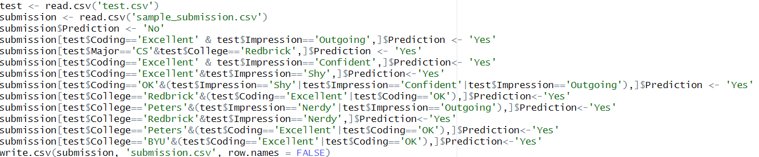
Code for generating submission dataset:

Slide 17
Thank You!

