Slide 1
How to get a good grade in Professor Moody’s class?
Xinyu Meng
xm73

Slide 2
Introduction
How to get a good grade in Prof Moody’s class?
Data from past will help us understand which attributes matter in getting a better grade.
The following slides will help to do analysis on subsets of particular attributes in the dataset.
It will help analyze certain patterns such as texting vs grades , participation in class vs score.

Slide 3
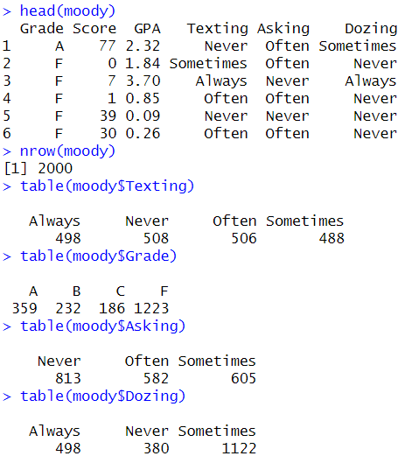
An Overview of the Data
Number of students: 2000
Number of attributes: 6(2 numerical+4 categorical)
Number of values per categorical attribute: 4(grade), 4(texting), 3(asking), 3(dozing)

Slide 4
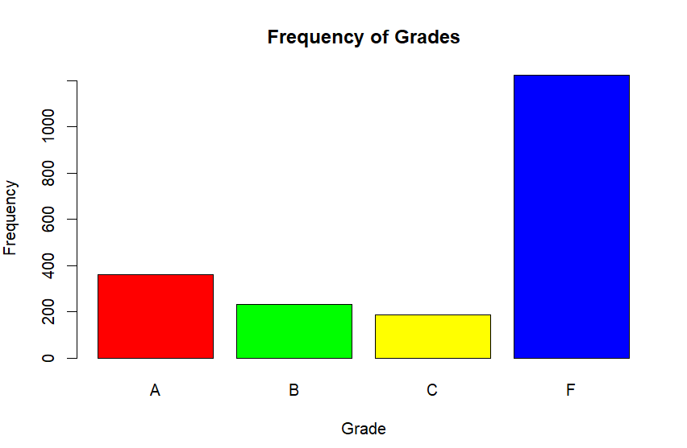
Distribution of Grades
Let’s start with a simple graph: frequency of letter grades.
There are much more F grades than other three grades.
However, this isn’t very helpful.

Slide 5
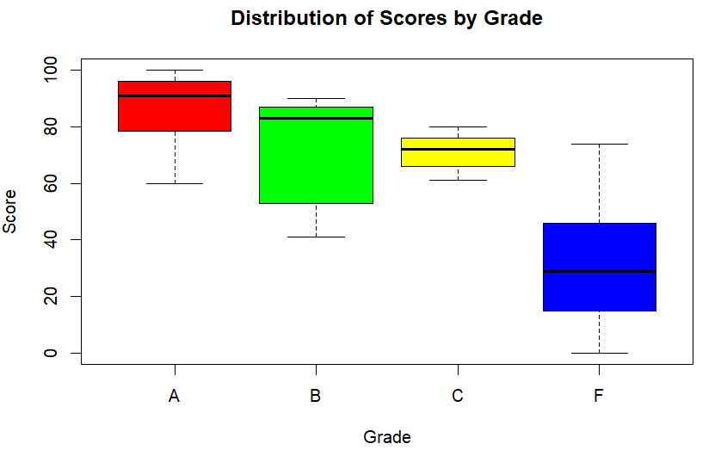
Distribution of Scores by Grade
Let’s see how scores are distributed by each letter grade.
Apparently, there’s a lot of overlap, meaning a student who scores an 78 can get an A or B, or F.
That means Prof. Moody is not assigning grades purely based on number scores.

Slide 6
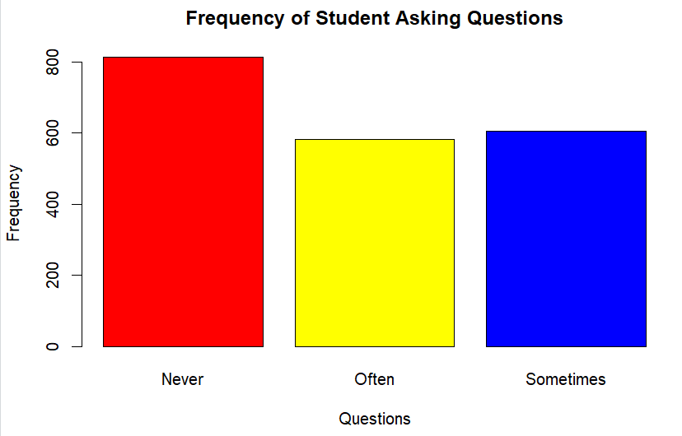
Splitting Up by questions Attribute
Let’s see if we can find any patterns by splitting the data up around the attribute of dozing.
First, let’s examine the frequency of questions

Slide 7
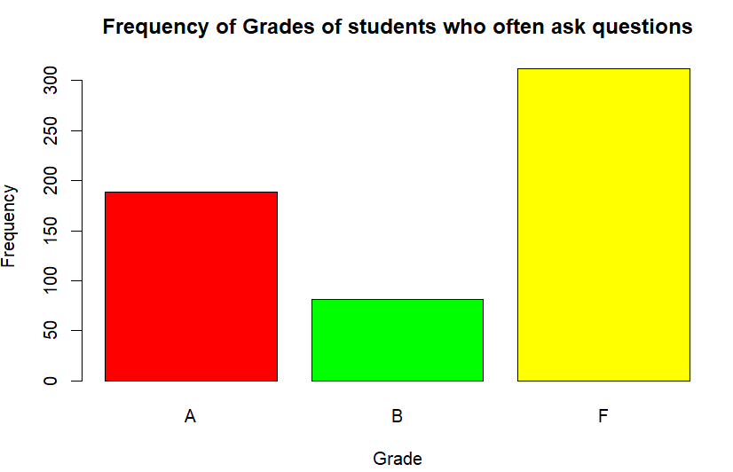
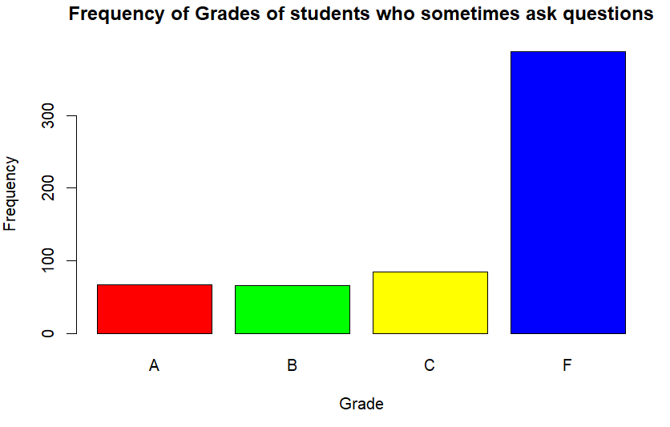
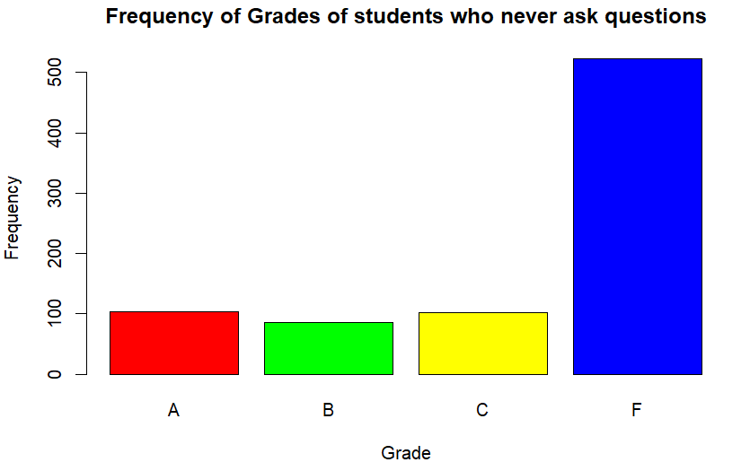
Splitting Up by questions Attribute
All kinds of students have more F grades.
Students often ask questions get much more As and Bs than other while they never get Cs.
Students who never ask questions have more As than students who sometimes ask questions.

Slide 8
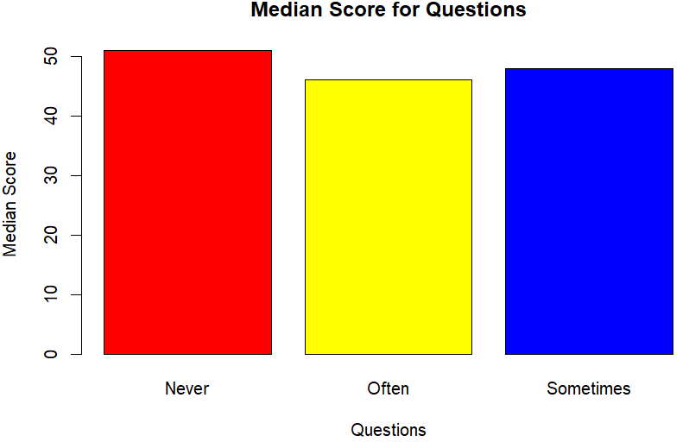
Splitting Up by questions Attribute
Students who never ask questions have better score than other students while receiving lower grades.
Students who often ask questions have less score than other students while receiving higher grades.

Slide 9
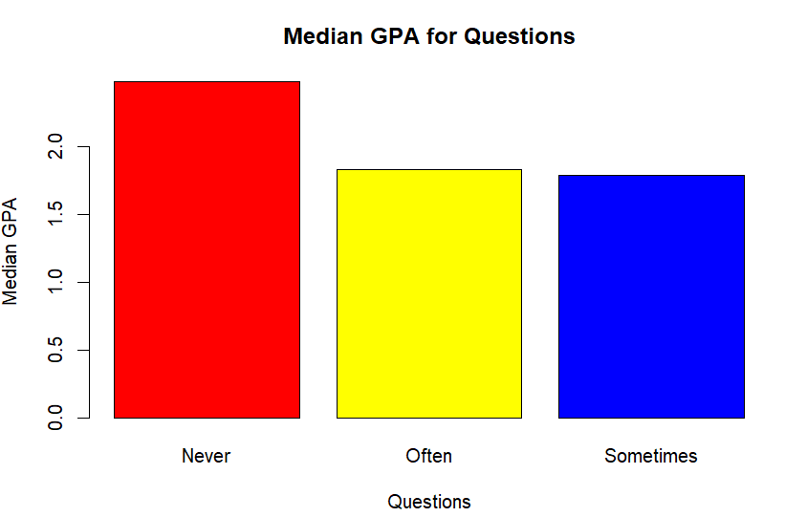
Splitting Up by questions Attribute
Students who ask more questions have lower GPA while receiving higher grades.
Students who ask less questions have higher GPA while receiving lower grades.

Slide 10
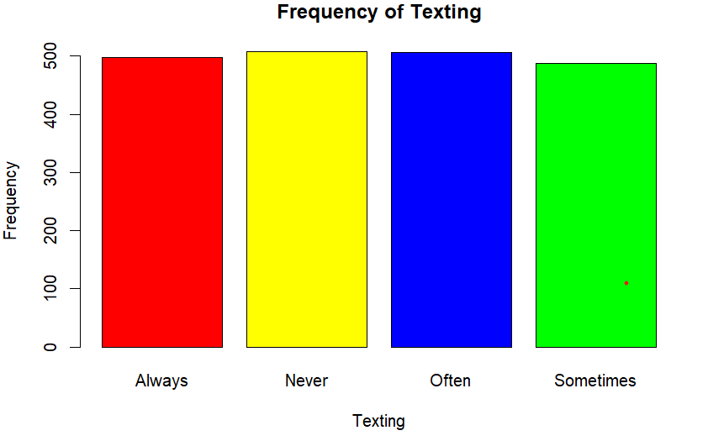
Splitting Up by texting Attribute
Let’s see if we can find any patterns by splitting the data up around the attribute of texting.
First, let’s examine the frequency of texting levels.

Slide 11
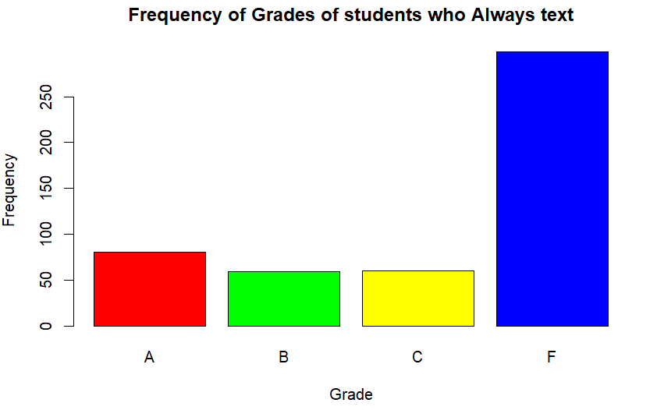
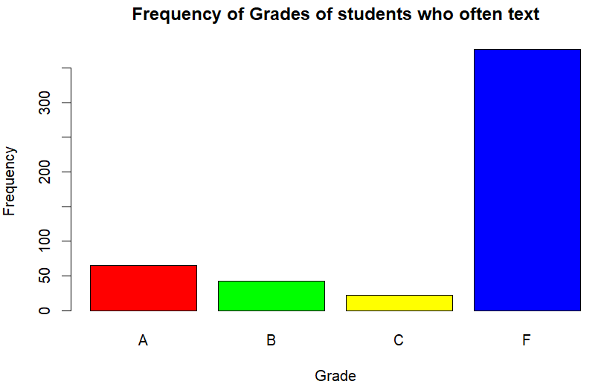
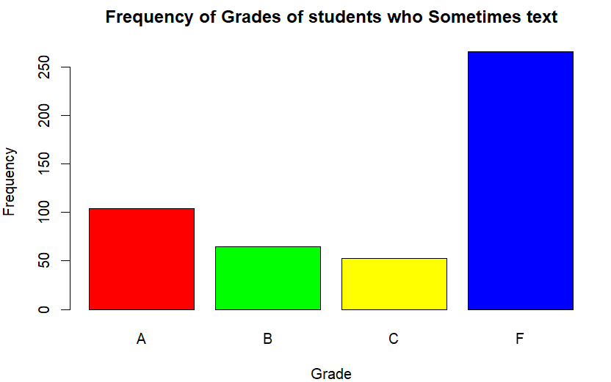
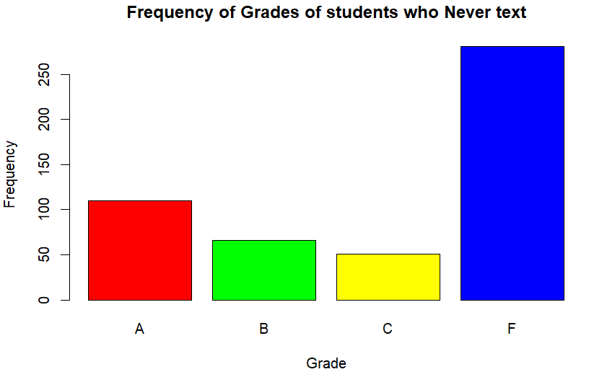
Splitting Up by texting Attribute
Students who always text have more Fs.
Students who often text have more Fs while much less A,B and Cs.
Students who sometimes text have more As and less Fs.
Students who never text tends to have the best grades compared to other students.

Slide 12
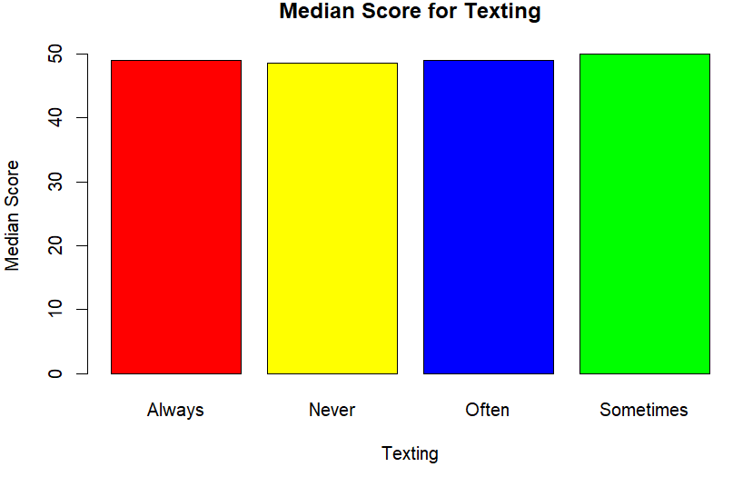
Splitting Up by texting Attribute
Students who text less have lower score while receiving higher grade.
Students who text more have higher score while receiving lower grade.

Slide 13
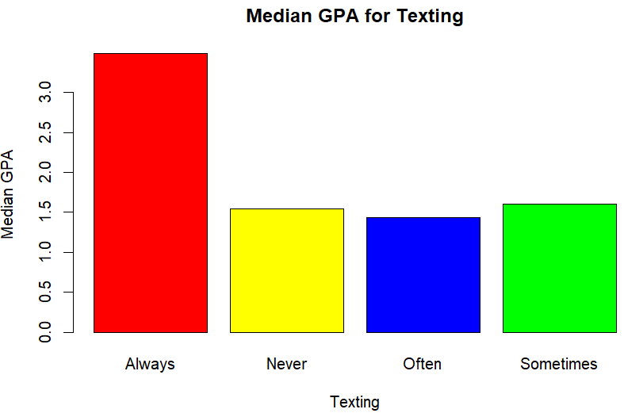
Splitting Up by texting Attribute
Students who text less have lower GPA while receiving higher grade.
Students who text more have higher GPA while receiving lower grade.

Slide 14
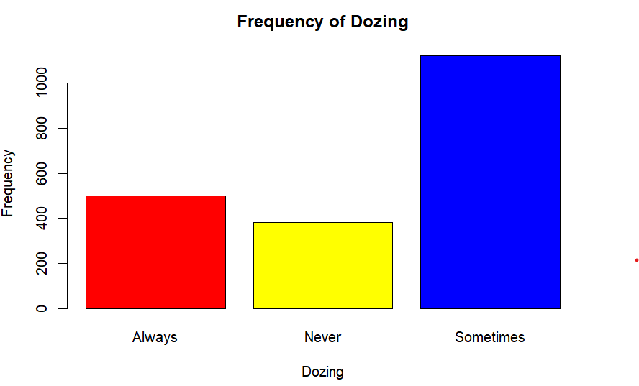
Splitting Up by dozing Attribute
First let’s see if we can find any pattern related to Dozing and students’ Grade and GPA.
Observing the frequency of dozing.

Slide 15
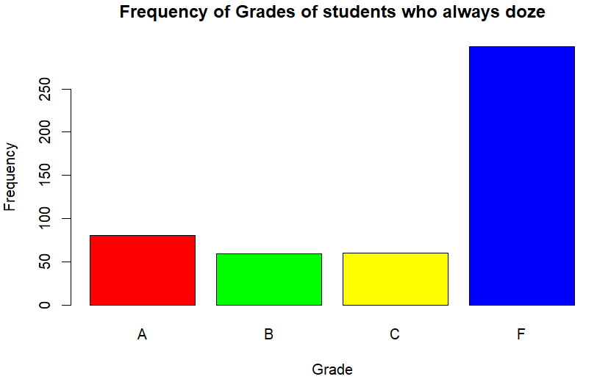
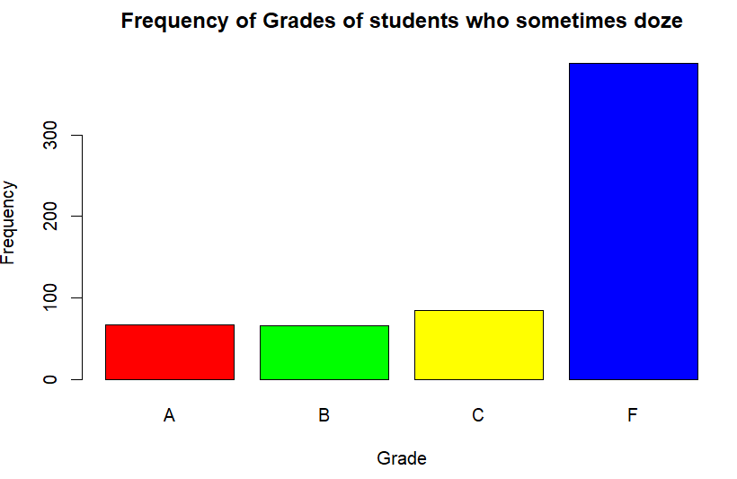
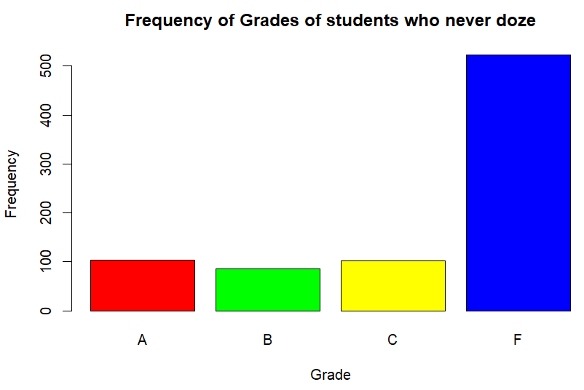
Splitting Up by dozing Attribute
Students who always doze have more Fs.
Students who sometimes doze have more Cs and Fs.
Students who never doze tends to have the best grades compared to other students.

Slide 16
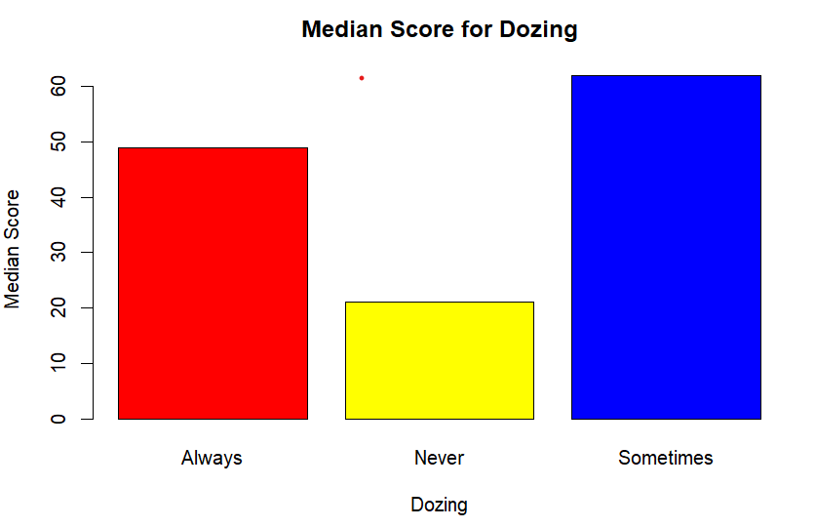
Splitting Up by dozing Attribute
Students who doze less have lower score while receiving higher grade.
Students who doze more have higher score while receiving lower grade.

Slide 17
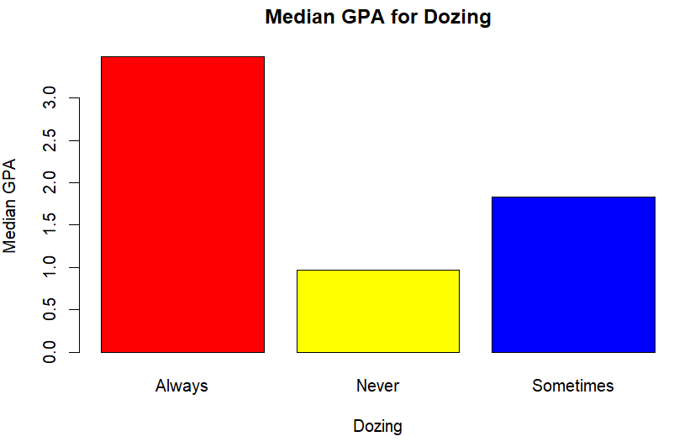
Splitting Up by dozing Attribute
Students who doze less have lower GPA while receiving higher grade.
Students who doze more have higher GPA while receiving lower grade.

Slide 18
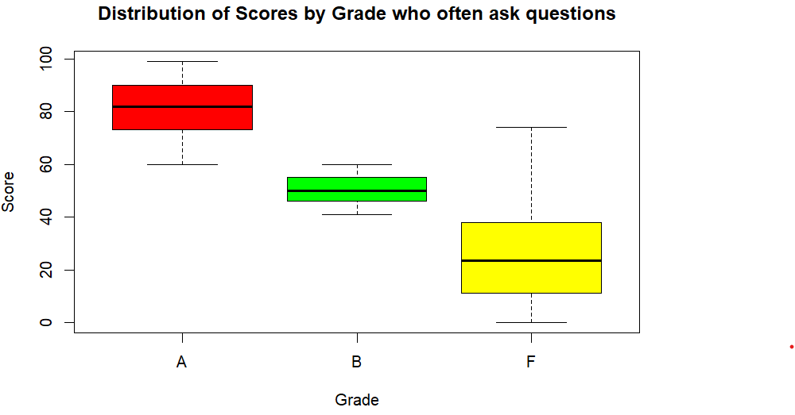
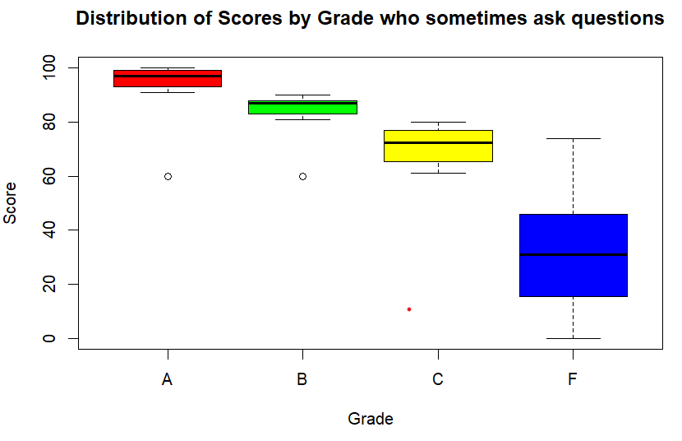
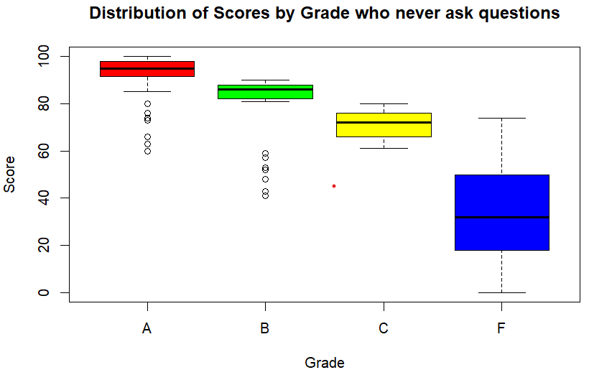
Distribution of Scores by Grade with asking

Slide 19
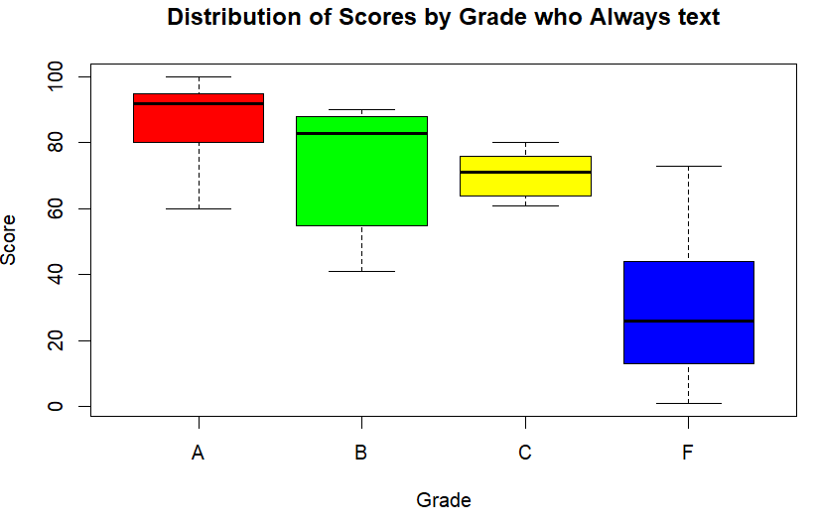
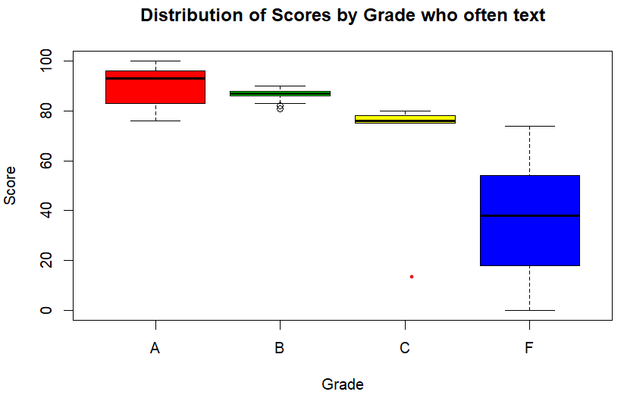
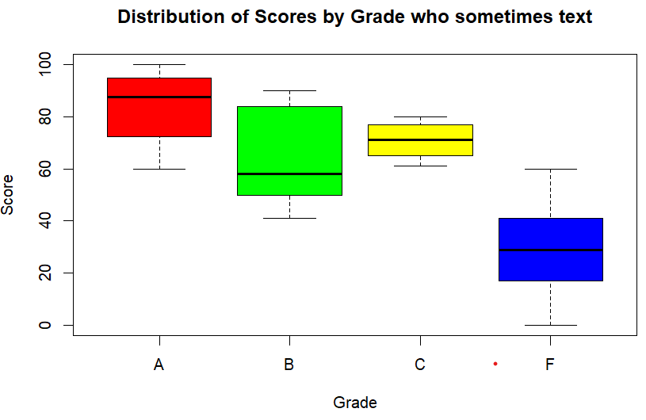
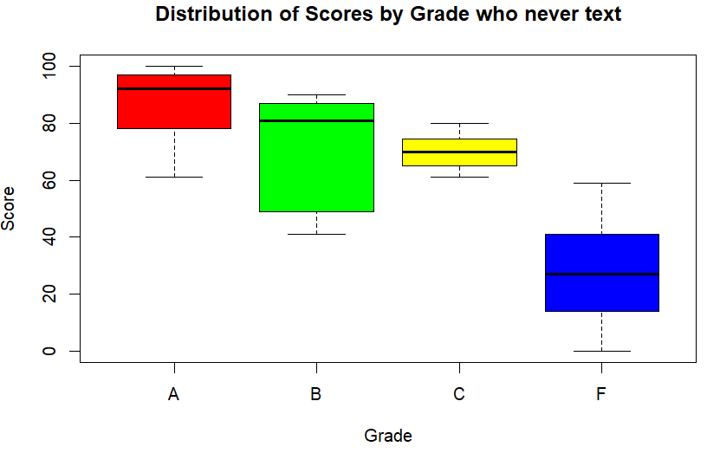
Distribution of Scores by Grade with texting

Slide 20
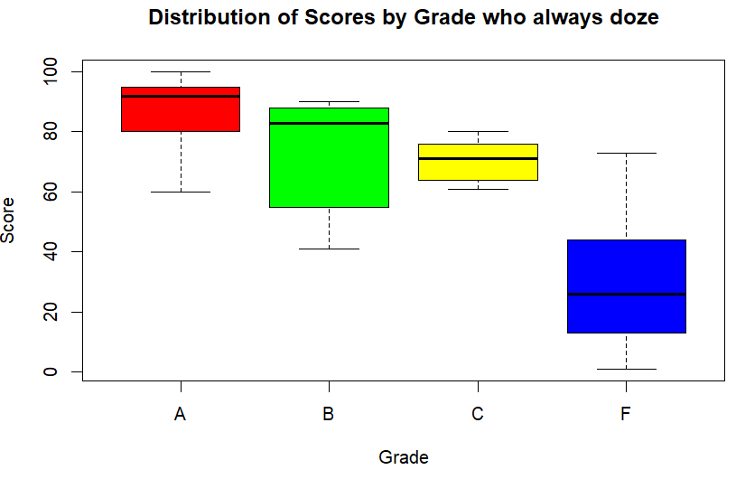
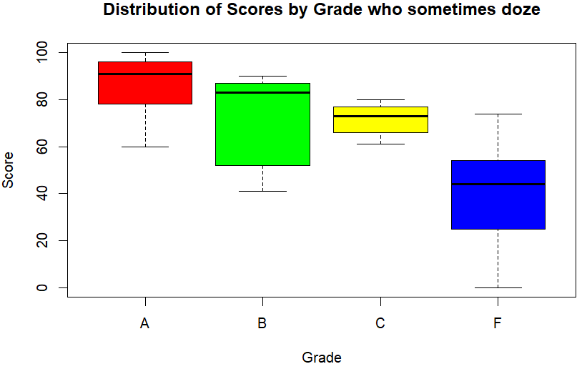
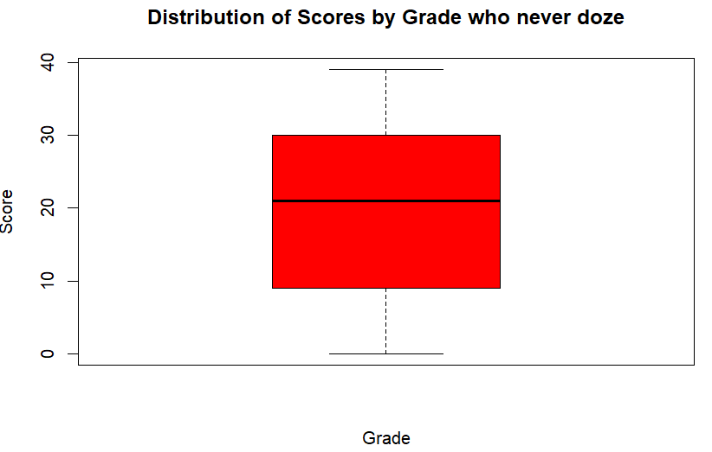
Distribution of Scores by Grade with dozing

Slide 21
Conclusion
As a student in Professor moody’s class you need to:
Doze less
Text less
Ask more questions
While exam scores and GPAs seems important, they are less impactful as compared to other activities.

