Slide 1

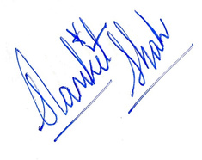




CONCEPT
SIMPLIFIED
EXPERIENCE LETTER
DATE: {{DATE}}
ID : {{ID}}
Dear {{NAME}},
This is to certify that {{NAME}} (Employee ID: {{ID}}) has worked with Concept Simplified as {{ROLE}} from {{JOIN_DATE}} to {{RELIEVE_DATE}}, a period of {{DURATION}}.
During their tenure, {{NAME}} demonstrated exceptional professionalism, dedication, and a strong work ethic. They consistently delivered high-quality results and made meaningful contributions to their role and to the broader team.
We found {{NAME}} to be sincere, responsible, and a collaborative team player who approached every task with enthusiasm and integrity.
We wish {{NAME}} all the very best in their future endeavours and have no hesitation in recommending them for any opportunities they pursue.
Yours Sincerely,
Samkit Shah
Founder, Concept Simplified
+91 8591220422
www.collegesimplified.in

