Slide 1

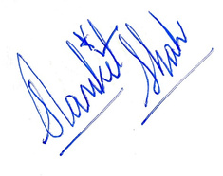




CONCEPT
SIMPLIFIED
LETTER OF RECOMMENDATION
DATE: {{DATE}}
ID : {{ID}}
To Whomsoever It May Concern,
I am writing to highly recommend {{NAME}}.
{{NAME}} has been associated with Concept Simplified as {{ROLE}}. During this period, they consistently demonstrated exceptional skills, a growth mindset, and the ability to deliver outstanding results.
{{NAME}} was a valued member of our team who demonstrated consistent dedication, strong work ethic, and a collaborative attitude throughout their tenure at Concept Simplified. Their contributions were meaningful and impactful, and they approached every responsibility with professionalism and integrity. We have observed their professional and personal growth over this period and are fully confident in their capabilities. We believe Test will be a valuable asset to any organisation or academic programme they choose to pursue
I wholeheartedly endorse {{NAME}} and am confident they will bring the same level of excellence and commitment to your organisation. Please feel free to reach out for any further information.
Yours Sincerely,
Samkit Shah
Founder, Concept Simplified
+91 8591220422
www.collegesimplified.in

