Slide 1
UnionLabs: new agent, features, physical layers
First Author · Second Author · Third Author
Institution
ACM MobiCom '26 Demo · Austin, TX · October 2026

Slide 2
The problem: everything around the algorithm
A learning-over-radio experiment is easy to state and expensive to run — the algorithm is a page of code; what surrounds it is not.
Platforms removed the hardware barrier, open stacks the waveform barrier …
… but users still hand-link algorithms to the physical layer: hundreds of lines, days of debugging.
The wiring lives in operators' heads and shell history — retyped per machine, and the retypings disagree.
UnionLabs separates what an algorithm does from how the experiment is wired.

Slide 3
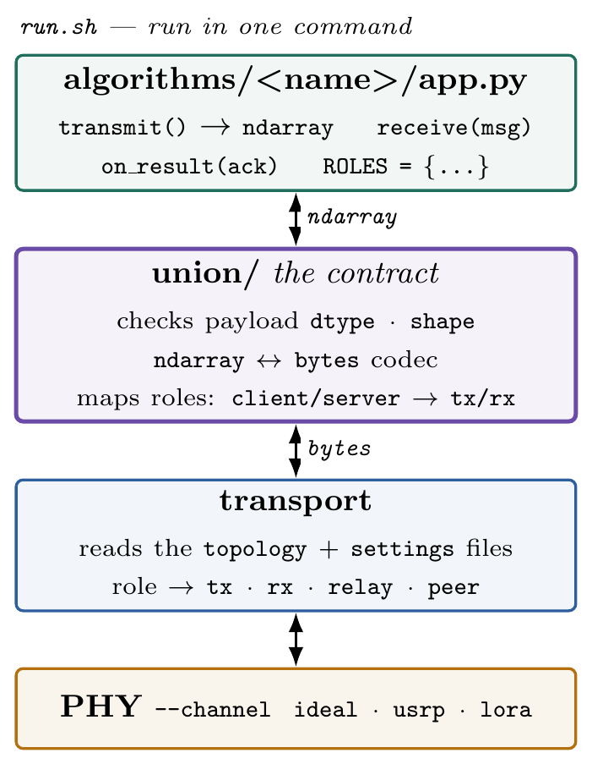
Four designed parts
The Agent — any machine becomes a managed edge node
The shared workspace — one account's state, across testbeds
The algorithm contract — transmit() / receive(msg), nothing else
The PHY codes — a modem whose every stage is selectable

Slide 4
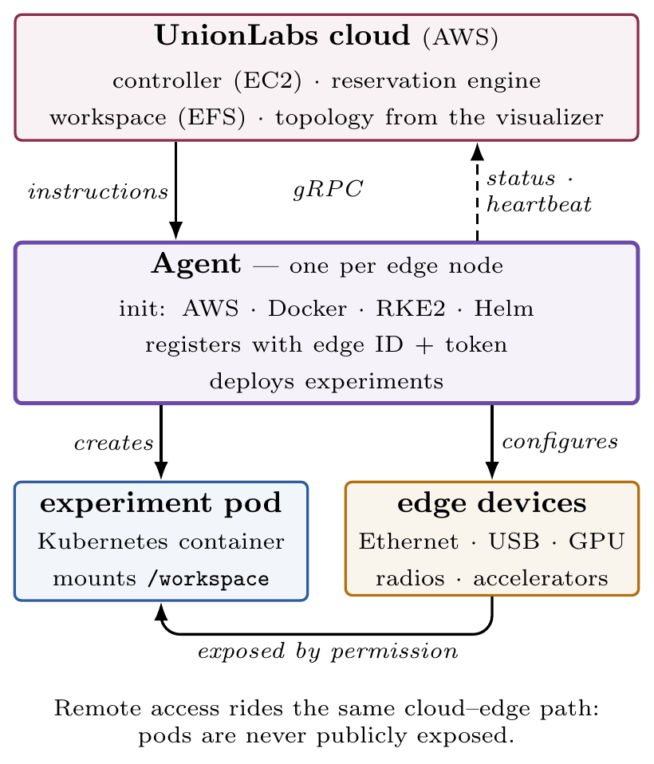
The UnionLabs Agent
One agent per edge node — server, workstation, or laptop.
Install: prepares AWS, Docker, RKE2, Helm; registers with a unique edge ID + token.
gRPC with the cloud: instructions down, status + heartbeats up.
Owner uploads the topology via the visualizer; reservation allocates from it — live nodes only.
Experiments become Kubernetes pods; devices exposed only by the owner's permission.
Remote access rides the cloud–edge path: pods never publicly exposed.

Slide 5
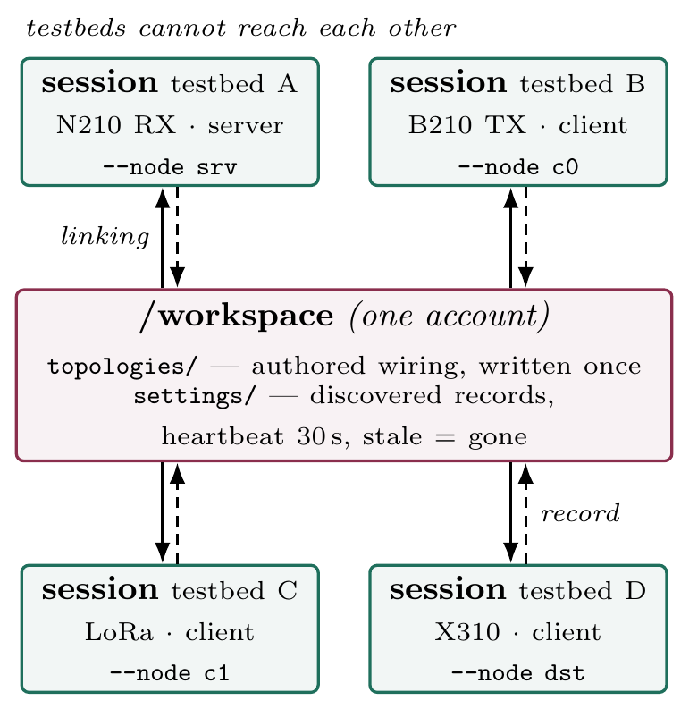
One workspace across testbeds
Every session of an account mounts the same /workspace — even when the testbeds cannot reach each other.
topologies/: authored wiring, written once.
settings/: each session's own record — 30 s heartbeat, dropped when stale.
Two kinds of state, two lifecycles: the shared file system never carries a fact that can go stale.

Slide 6
The algorithm contract — run.sh, one command
The algorithm writes transmit() and receive(msg) — and imports nothing from any radio driver.
The union layer validates payloads, converts ndarray ↔ bytes, maps role names.
The transport reads the topology + settings files; the node becomes tx · rx · relay · peer.
--channel selects the PHY: ideal · usrp · lora.
Same path, both directions — change the physical layer with one flag, no code change.

Slide 7
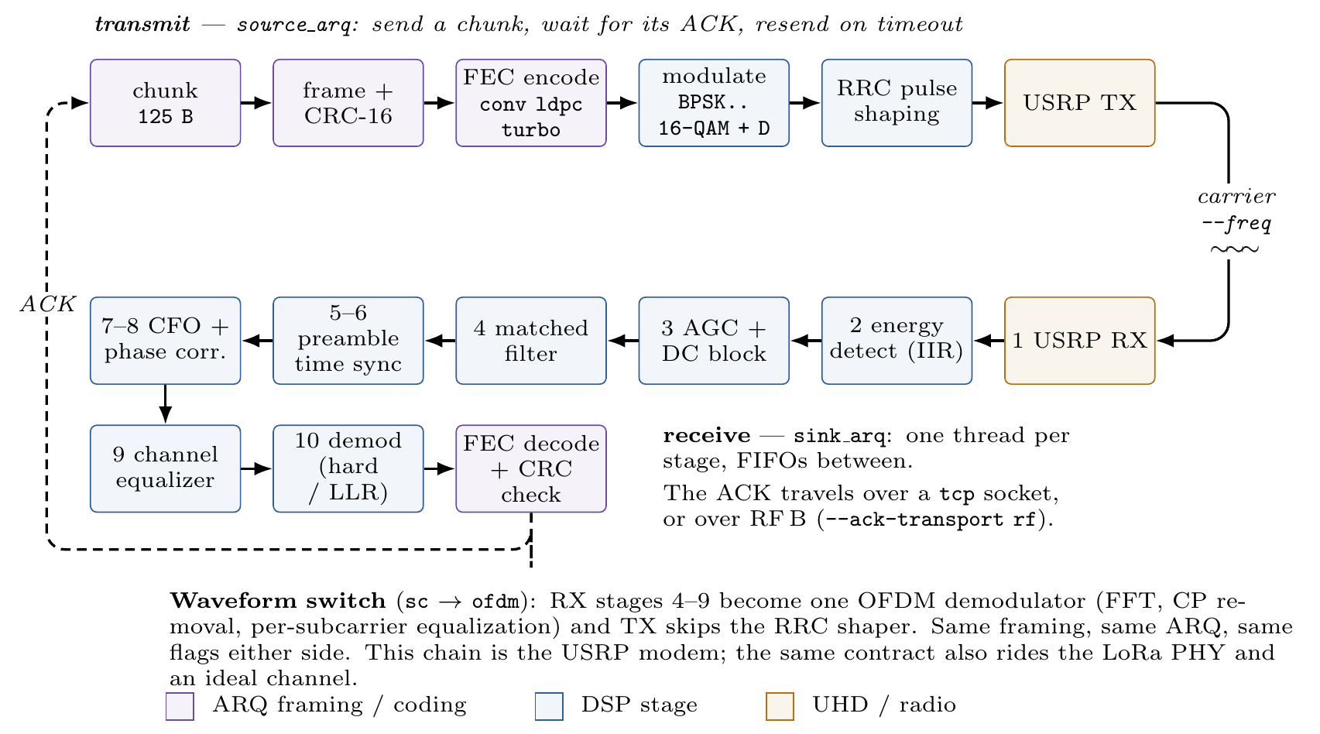
The PHY codes
Modulation, coding, synchronization, waveform, gains, carrier — all selectable per experiment.
Stop-and-wait ARQ end to end; the ACK over TCP or a second RF path.

Slide 8
Wiring as a file
A topology names each node, its role, its radio, its ports, and the links between nodes — every node launches from the same file.
Per-link, per-direction media: one hop over the air, the next over Ethernet; the reply may return over TCP/IP.
A wiring that cannot run is refused when it is read, naming the node at fault — not minutes later, from the wrong layer.
One command walks 44 flags and 82 topology settings from typed text to the object each configures.

Slide 9
Demonstration: each part, working
1. Onboarding (Agent) — a machine enrolled on the spot; heartbeat appears; the visitor opens the container's remote desktop.
2. One workspace — edit a wiring file here, see it from a session on a remote testbed.
3. One algorithm, different PHYs — radio-free, then real radios by one flag; delivery, retransmissions, airtime on screen.
4. Rewiring, and refusal — a multi-hop experiment changes medium by one field; an impossible wiring is refused by name.

Slide 10
Write the experiment once.
Run it over any PHY, topology, and testbed.
./run.sh --algo <yours> --topology <wiring> --node <me>
One command · one wiring file · one contract
Come run it at the table.

