Slide 1
End-to-End SDR Communication System
A configurable single-carrier & OFDM modem on USRP B210 (C++/UHD)
Modulation · Synchronization · Equalization · FEC · ARQ · Visualization
Hardware-validated over the air @ 915 MHz

Slide 2
What Was Built
2
● A complete, real-time digital communications link between two USRP B210 radios
– Two interchangeable waveforms — single-carrier (RRC) and OFDM
– 14 modulation schemes: BPSK → 256-QAM, differential PSK, APSK
– Full receiver chain: energy detection, frame/timing/carrier sync, equalization, demod
– Reliability layer: forward error correction + CRC + stop-and-wait ARQ
– Built-in visualization: time / spectrum / constellation + EVM readout
● Every DSP block validated in simulation, then on hardware over the air
– Fully documented: 19-page reference (math + figures) and ready-to-run command sets

Slide 3
Signal-Chain Architecture
3
TX message → chunks → CRC-16 → [FEC encode] → symbols (modulator, +preamble)
├─ single-carrier: RRC pulse-shaping → USRP TX
└─ OFDM: subcarrier map → IFFT + cyclic prefix → USRP TX
RX USRP RX → energy detector → AGC
├─ single-carrier: matched filter → ACQ sync → CFO → phase → [eq] → demod
└─ OFDM: Schmidl-Cox sync + CFO → FFT → 1-tap eq → pilot CPE → demod
→ [FEC decode] → CRC-16 check → (ARQ: ACK if OK) → reassemble message
Single-carrier timing is done by ACQ preamble correlation (not a Gardner loop). OFDM's sync / CFO / equalization / pilots all live inside its demodulator.

Slide 4
TX Chain — What Each Block Does
4
Block | Full name | What it does
CRC-16 | Cyclic Redundancy Check (16-bit) | appends a checksum so the RX can detect any bit error in a chunk
FEC | Forward Error Correction | rate-1/2 K=7 convolutional encoder — adds redundancy to fix bit errors
Modulator | bit-to-symbol mapper | maps groups of bits to complex constellation points (QPSK … 256-QAM)
Preamble | known training sequence | prepended to each burst so the RX can detect and synchronize to it
RRC | Root-Raised-Cosine filter | pulse-shaping: band-limited spectrum, zero inter-symbol interference
IFFT + CP | Inverse FFT + Cyclic Prefix | OFDM: subcarrier symbols → time samples; CP absorbs channel multipath
USRP | Universal Software Radio Peripheral | the SDR hardware — up-converts baseband to 915 MHz RF and transmits

Slide 5
RX Chain — What Each Block Does
5
Block | Full name | What it does
Energy detector | — | finds where each burst begins by watching received power
AGC | Automatic Gain Control | normalizes the captured burst to a fixed amplitude
Matched filter | RRC at the receiver | maximizes SNR and removes ISI (pairs with the TX pulse shaper)
ACQ | Acquisition (preamble correlation) | joint frame + symbol timing from the known preamble
CFO | Carrier Frequency Offset correction | removes the two radios' oscillator frequency offset
Phase / PLL | carrier phase correction | removes residual constellation rotation before decisions
Equalizer | — | inverts channel distortion (SC: off by default; OFDM: 1 tap/subcarrier)
Schmidl-Cox | OFDM frame synchronizer | frame timing + CFO from a repeated-half preamble symbol
FFT | Fast Fourier Transform | OFDM: time samples → per-subcarrier symbols
CPE | Common Phase Error tracking | OFDM pilots track residual per-symbol phase drift
Demodulator | symbol-to-bit decision | nearest-constellation-point decision: symbols → bits
ARQ | Automatic Repeat reQuest | CRC-verify each chunk; ACK the good ones, retransmit the failed ones

Slide 6
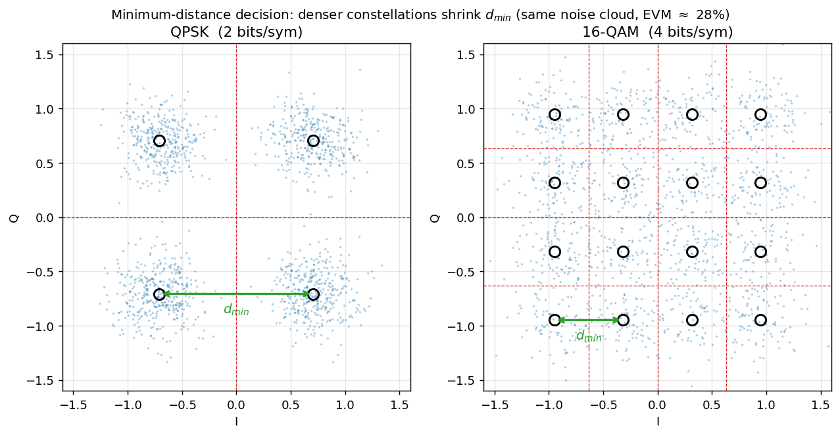
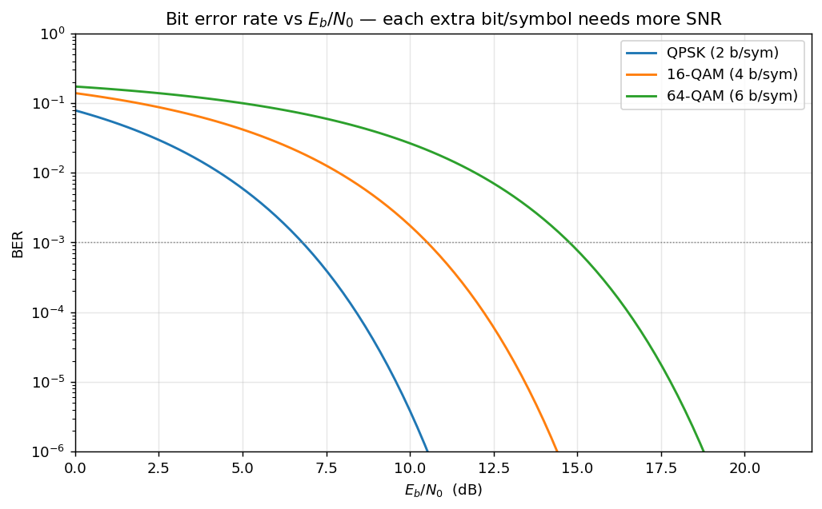
Modulation Schemes
6
Family | Schemes | bits/sym
PSK | BPSK, QPSK, 8-PSK | 1–3
QAM | 16 / 32 / 64 / 128 / 256-QAM | 4–8
Differential | DBPSK, DQPSK, 8-DPSK, π/4-QPSK | 1–3
APSK | 16-APSK, 32-APSK | 4–5
● Minimum-distance decision; ŝ = argmin |y − c|
– Denser constellations shrink d_min → need lower EVM
– EVM ≲ 35% QPSK · ≲ 12% 16-QAM · ≲ 6% 64-QAM
– Differential: info in phase change → no PLL needed
– Gray coding → 1 symbol error ≈ 1 bit error
Same 28% EVM: clean on QPSK, bleeds across 16-QAM boundaries

Slide 7
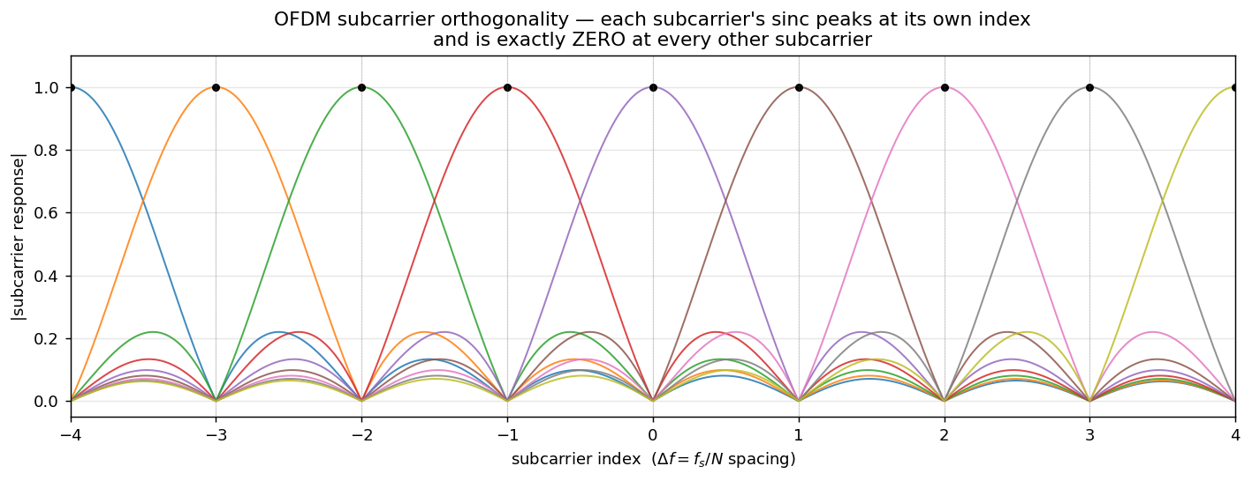
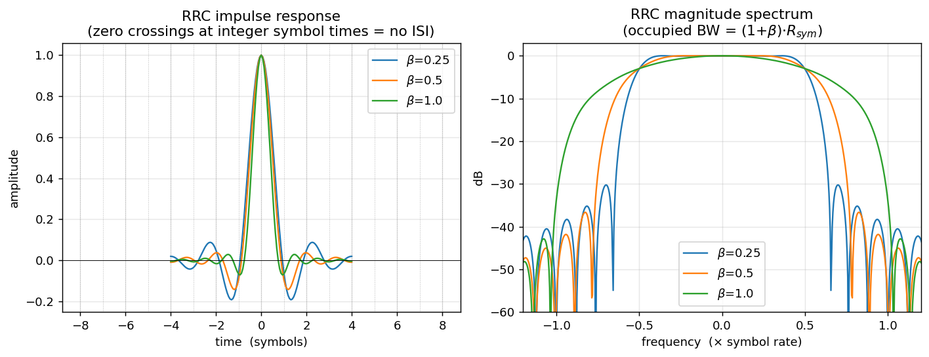
Two Waveforms: Single-Carrier vs OFDM
7
● Single-carrier + RRC pulse shaping
– Root-raised-cosine → zero-ISI at symbol instants (Nyquist)
– Matched filter at RX maximizes SNR
● OFDM (64 subcarriers, cyclic prefix)
– IFFT + CP → channel becomes 1 complex tap per subcarrier
– One-tap equalization — no FIR needed under multipath
– Scattered pilots + common-phase-error tracking
– Best for dense QAM on frequency-selective channels
OFDM orthogonality: each subcarrier peaks where others are zero
RRC pulse: zero crossings at neighbouring symbols → no ISI

Slide 8
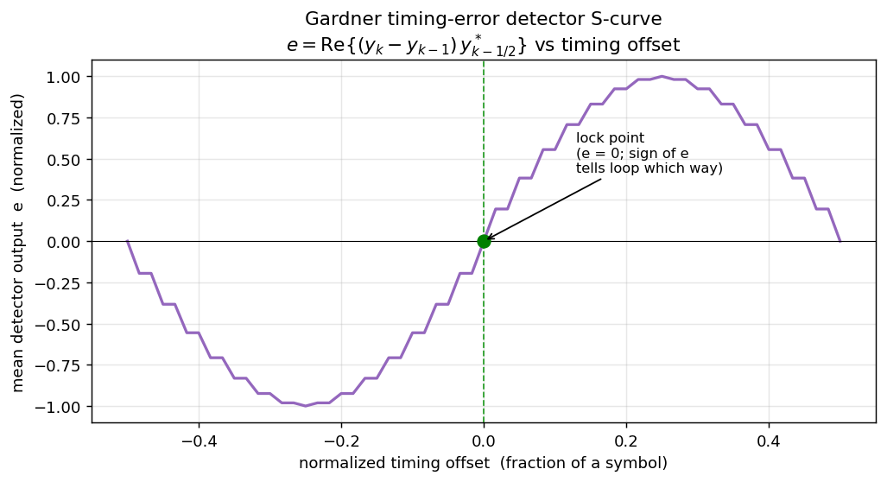
Synchronization & Timing Recovery
8
● Received signal carries 4 impairments: gain, CFO, phase, timing
– Recovery order: frame + timing → CFO → phase
● Energy detection — IIR hypothesis test gates each burst
● Frame + symbol timing — ACQ preamble correlation
– m-sequence or Zadoff-Chu (CAZAC) preamble
– Feedforward: one timing phase per burst — robust for packets
● Gardner TED loop — the available tracking alternative
– for a continuous stream (implemented, not active); S-curve →
Gardner S-curve (available tracking loop): error → 0 at correct timing

Slide 9
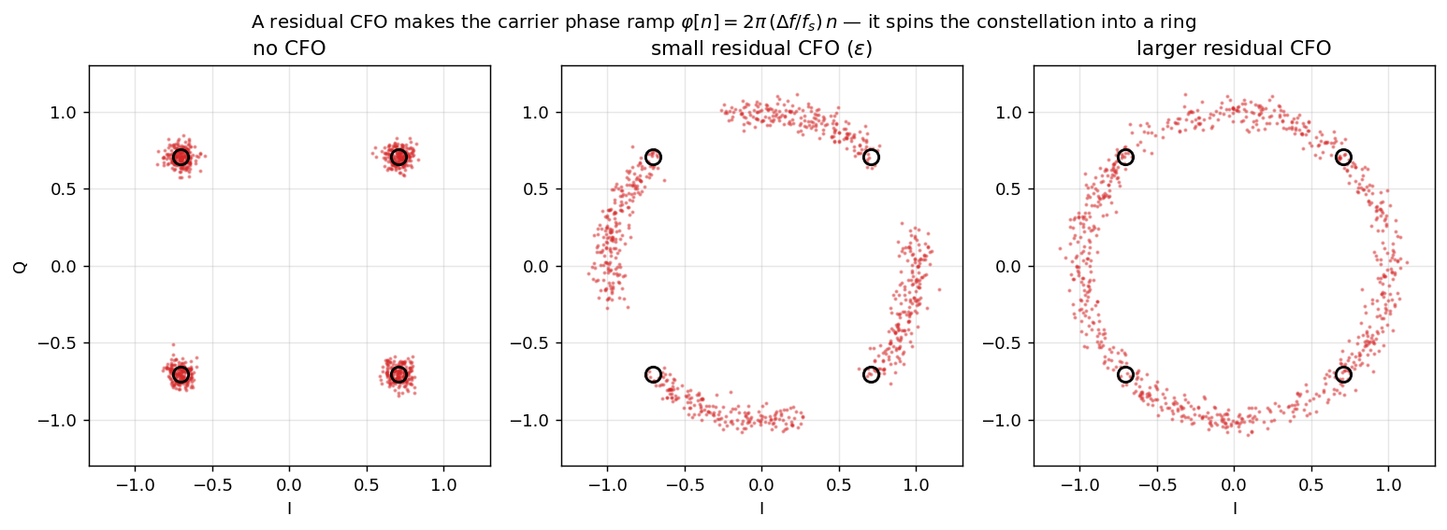
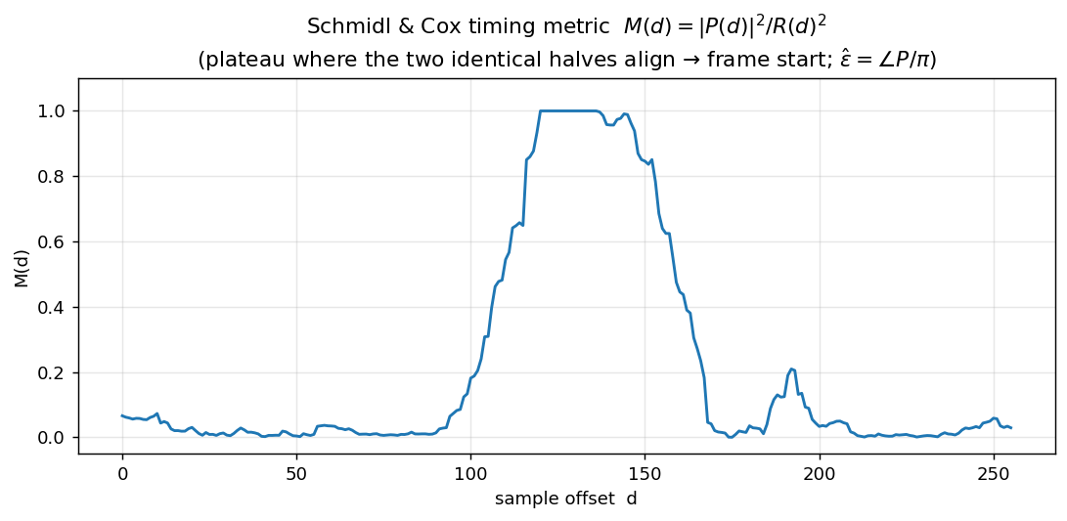
Carrier Recovery: Frequency & Phase Offset
9
● CFO spins the constellation at 2π·Δf/fs rad/sample
– Estimated data-aided from the preamble, then corrected
– Pilot-aided phase-slope estimator
– Autocorrelation (Moose / Schmidl-Cox) estimator
● Phase offset — 2nd-order digital PLL
– Tracks static offset AND residual-CFO ramp
● OFDM: Schmidl-Cox joint timing + CFO; pilots track drift
Uncorrected CFO spins clusters into arcs, then a full ring
Schmidl-Cox timing metric: plateau marks the OFDM frame start

Slide 10
Reliability: FEC + CRC + ARQ
10
● Forward Error Correction (optional, --fec)
– Rate-1/2, constraint-length-7 convolutional code (NASA/802.11a)
– Maximum-likelihood Viterbi decoder, d_free = 10
– ~100% error-free up to ~2% raw bit-error rate
● Error detection — CRC-16-CCITT per chunk
– Catches all 1–2 bit, all odd, and ≤16-bit burst errors
● Automatic Repeat reQuest — stop-and-wait
– ACK only verified chunks; retransmit on timeout; auto-terminate
– ACK over TCP (default) or a reverse RF path

Slide 11
Key Engineering Contributions
11
Problem | Method / Fix | Result
Wrong demod (front-end) | Rebuilt matched filter + ACQ joint timing | BER → 0 (verified)
OFDM dense-QAM smeared | MRC-weighted pilot CPE (robust to fades) | EVM 67% → 37%, decodes
Higher-order length mismatch | Fixed bits↔symbol partial-group packing | 8-PSK/16-QAM+ align
Differential never decoded OTA | Last-preamble reference + bypass PLL | DBPSK/DQPSK/8-DPSK work
Flaky burst detection | Continuous noise-floor tracking | Reliable gating
Equalizer 'divergence' | LS training + center-tap delay comp. | BER 0 through multipath
Each fix validated in simulation, then confirmed on hardware.

Slide 12
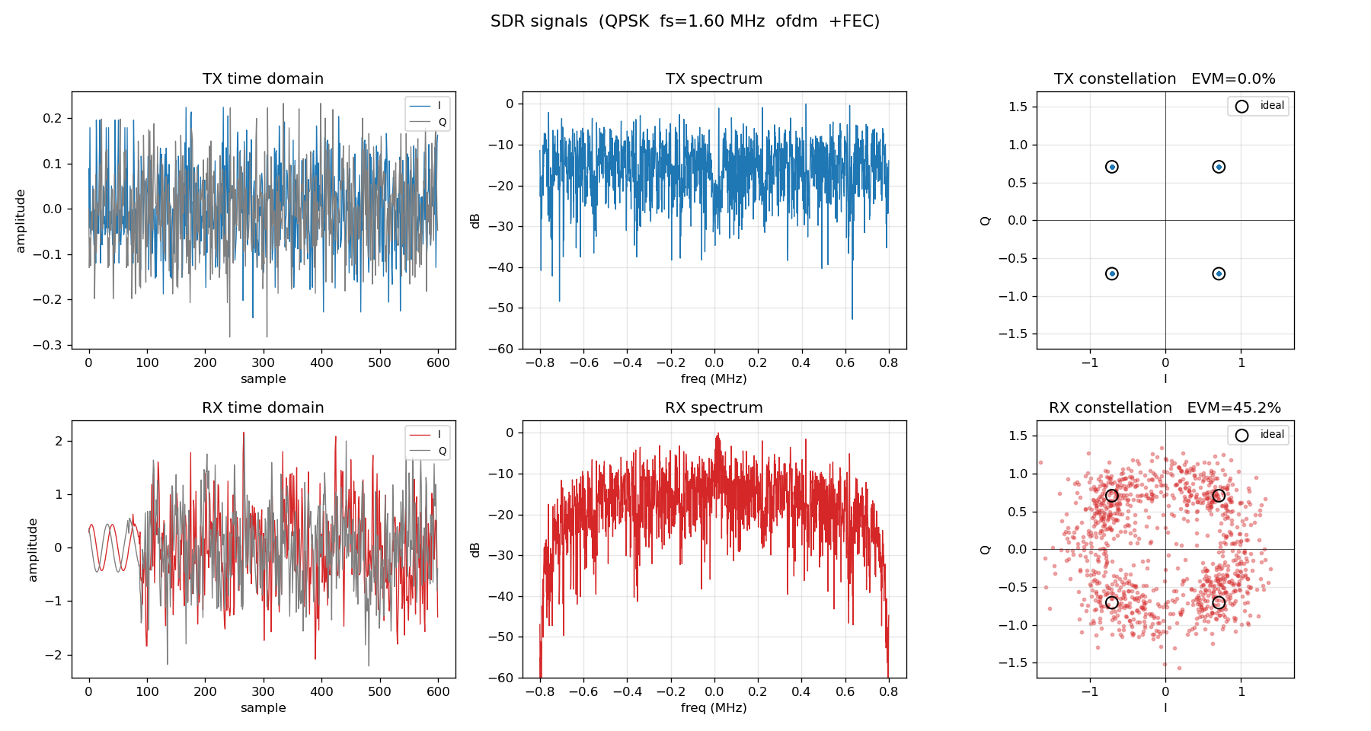
Visualization & EVM — Proof of Correctness
12
● Every run auto-captures TX & RX signals
– Time domain, spectrum (FFT), constellation
– Ideal points overlaid + measured EVM %
– Per-modulation folders; figure saved on exit
– Tool to resolve individual OFDM subcarriers
● Turns 'it works' into a visual, quantitative claim
Over-the-air QPSK OFDM: TX ideal points → RX four clean recovered clusters

Slide 13
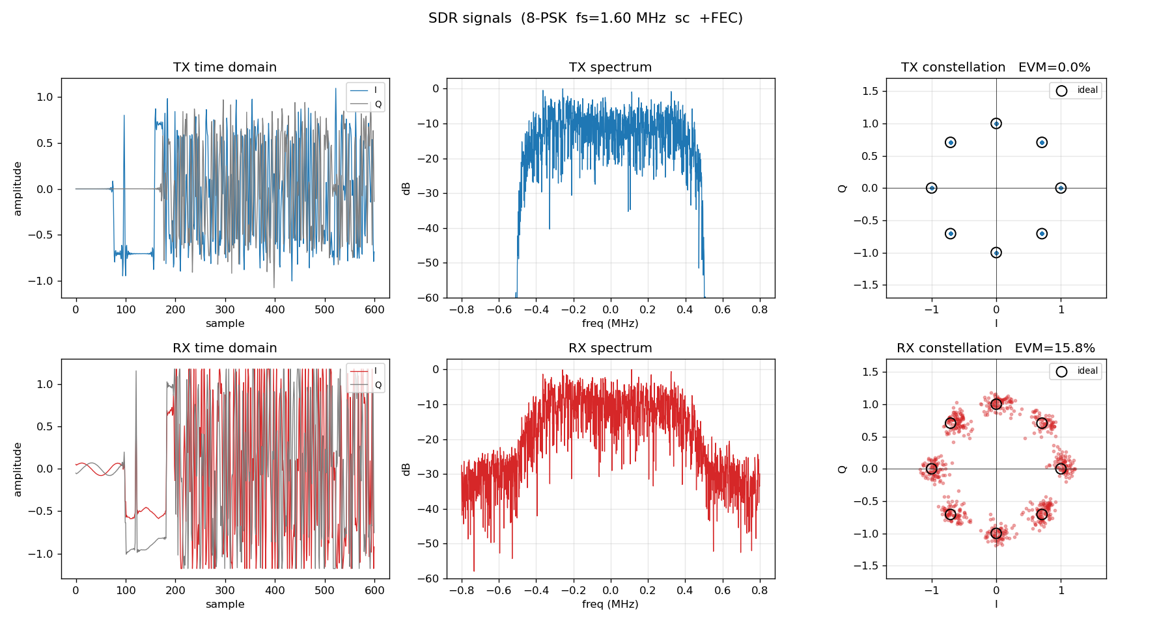
Hardware Results — Over the Air @ 915 MHz
13
Scheme | Waveform | Status | EVM
BPSK / QPSK | SC & OFDM | Solid (5/5 chunks) | ~28%
8-PSK | SC | Usable (ARQ completes) | ~16% (tuned)
DBPSK / DQPSK / 8-DPSK | SC | Solid (differential) | —
16-QAM and higher | SC & OFDM | Blocked OTA / cable | > ~30%
● Full stack delivered error-free OTA
– FEC + stop-and-wait ARQ, auto-terminating
– Key lever: TX power drives EVM down
– (76→86 dB halved 8-PSK EVM: 28→16%)
– Link EVM floor ≈ 28–31%
8-PSK OTA at tuned gains: 8 clean clusters, EVM 16%

Slide 14
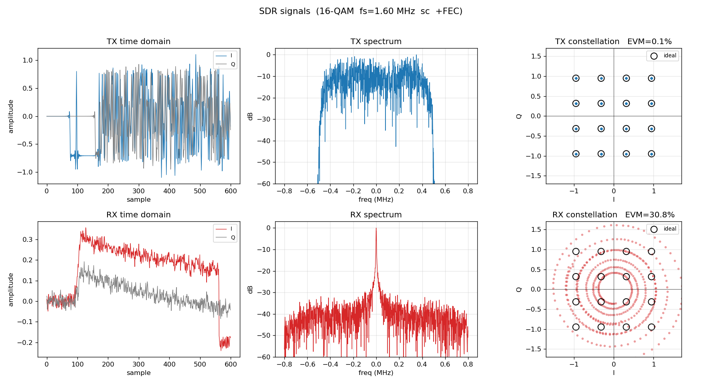
Investigation: Why 16-QAM+ Is Blocked
14
● Cable link SNR is excellent — QPSK decodes cleanly
● But 16-QAM fails on BOTH waveforms
● Root cause: two free-running oscillators
– Independent TCXOs → real CFO (±1200 Hz jitter)
– TX carrier leakage beats at the CFO (near-DC tone)
– → rotates constellation (SC) / dominates AGC (OFDM)
● Tried: DC removal, DC-block filter, TX LO-null
– None sufficient — leakage is a drifting tone, not static DC
Cable 16-QAM: amplitude perfect (rings) but phase rotates → fails

Slide 15
The Fix & Portability
15
● Solution: a shared 10 MHz reference clock
– One reference into both radios' REF IN (--ref external)
– CFO → ~0; leakage becomes removable static DC
– → 16-QAM / 64-QAM / 256-QAM decode
– Same as WiFi: per-packet sync + pilots + clean TX
● Portable across USRP models — DSP is device-independent
– N210 / X310 / X410: only args, subdev, antenna, gain change
– Front-panel REF IN (+ GPSDO option) → dense QAM ready
– Command templates provided for all four models

Slide 16
Summary
16
● Delivered a complete, documented SDR modem on USRP B210
– SC + OFDM, 14 modulations, full sync/eq/demod chain
– Convolutional-Viterbi FEC + CRC + stop-and-wait ARQ
● Hardware-validated: error-free QPSK / 8-PSK OTA, both waveforms
– Coherent AND differential schemes working end-to-end
● Diagnosed the dense-QAM limit to its root cause
– Free-running clocks → shared 10 MHz reference is the fix
● Reproducible: 19-page reference w/ math & figures, command sets, tests
● Next step: add a 10 MHz reference → unlock 16-QAM and above

Slide 17
Live Demo — Run Commands
17
QPSK single-carrier + FEC + stop-and-wait ARQ. Start the SINK (RX) first, then the SOURCE (TX).
# TERMINAL 1 — Sink / RX (auto-stops when all chunks verified; saves the figure)
./sdr_system --role sink_arq --rx-args serial=30CD3F7 --tx-args serial=30CD3F7 \
--rx-subdev A:A --rx-ant RX2 --rx-freq 915e6 --rx-rate 1.6e6 --rx-gain 20 \
--scheme QPSK --fec true --ack-transport tcp --ack-port 5599 --det-mult 3
# TERMINAL 2 — Source / TX (retransmits until every chunk is ACKed)
./sdr_system --role source_arq --tx-args serial=30CD424 --rx-args serial=30CD424 \
--tx-subdev A:A --tx-ant TX/RX --tx-freq 915e6 --tx-rate 1.6e6 --tx-gain 78 \
--scheme QPSK --fec true --ack-transport tcp --ack-host 127.0.0.1 \
--ack-port 5599 --timeout 3000
● Other schemes: swap --scheme (BPSK · 8-PSK · DBPSK · DQPSK)
● OFDM: add --waveform ofdm --ofdm-fft 64 --ofdm-cp 16 --ofdm-tx-peak 0.5
● 8-PSK needs more TX power: --rx-gain 16 --tx-gain 86
● Live output: per-chunk CRC-OK, then the auto-saved constellation figure

Slide 18
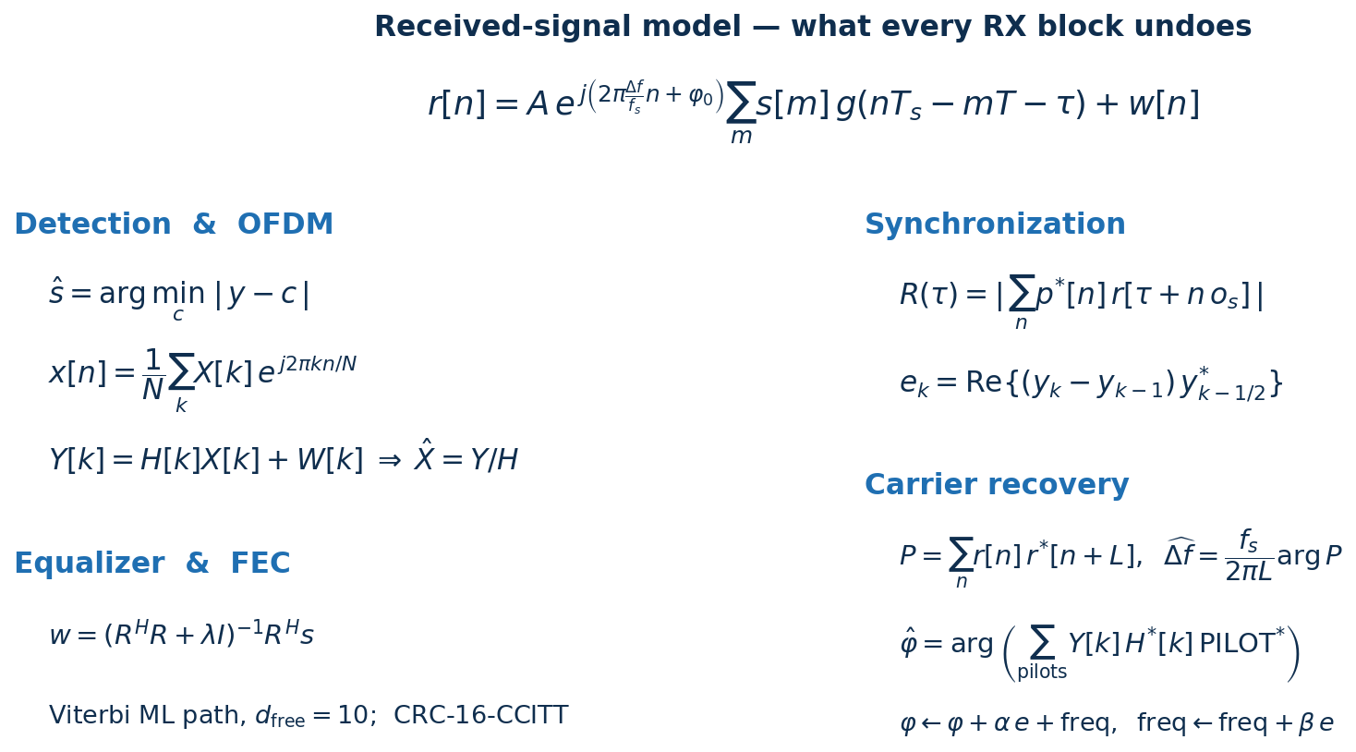
Appendix — Key Equations
18

