Slide 1
Unit- II
Constructor & Destructor
Dr. Amit J. Chinchawade

Slide 2
Constructor
A constructor is a special member function of a class that is used to initialize the objects of that class.
It is automatically called when an object is created.
The main purpose of a constructor is to give initial values to the data members of an object.
A constructor has the same name as the class.
A constructor does not have a return type, not even void.
This makes a constructor different from an ordinary member function.
An ordinary function may have a return type, but a constructor never has one.
For example, if the class name is Student, the constructor must also be named Student.

Slide 3
Syntax
class ClassName
{
public:
ClassName()
{
// initialization
}
};

Slide 4
#include <iostream>
using namespace std;
class Student
{
public:
int rollNo;
Student()
{
rollNo = 101;
}
void display()
{
cout << "Roll No = " << rollNo << endl;
}
};
int main()
{
Student s1;
s1.display();
return 0;
}
Output
Roll No = 101

Slide 5
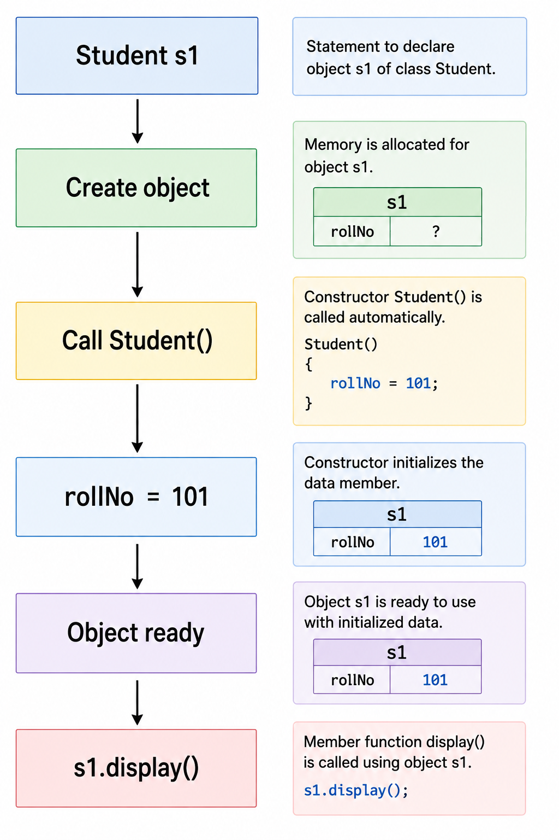

Slide 6
Basis | Constructor | Member Function
Purpose | Used to initialize an object | Used to perform operations on an object
Name | Must have the same name as the class | Can have any valid name
Return type | Has no return type, not even void | May have a return type such as int, float, string, or void
Calling | Called automatically when an object is created | Usually called explicitly using the object
Execution | At the time of object creation | Whenever the programmer calls it
Invocation/Call | Student s1; automatically calls Student() | s1.display(); explicitly calls display()
Return value | Cannot return a value | Can return a value
Example | Student() | display()

Slide 7
Rules for Writing a Constructor
Rule 1: Constructor name must be the same as the class name
If the class is:
class Student
Not:
the constructor must be:
Student()
student()
createStudent()

Slide 8
Rule 2: Constructor does not have a return type
A constructor is written as:
Not:
Student()
void Student()
int Student()
class Student
{
public:
Student()
{
cout << "Constructor";
}
};

Slide 9
Rule 3: Constructor is automatically called when an object is created
When we write:
Student s1;
C++ automatically calls:
We don't write:
Student()
s1.Student();

Slide 10
Rule 4: Constructor is usually placed in the public section
class Student
{
public:
Student()
{
// constructor
}
};
This allows objects to be created normally.

Slide 11
#include <iostream>
using namespace std;
class Student
{
public:
int rollNo;
string name;
Student()
{
rollNo = 101;
name = "Rohan";
}
void display()
{
cout << "Roll No = " << rollNo << endl;
cout << "Name = " << name << endl;
}
};
int main()
{
Student s1;
s1.display();
return 0;
}

Slide 12
Output
Roll No = 101
Name = Rohan

Slide 13
#include <iostream>
using namespace std;
class Student
{
public:
int rollNo;
string name;
Student()
{
cout << "Enter Roll No: ";
cin >> rollNo;
cout << "Enter Name: ";
cin >> name;
}
void display()
{
cout << "\nRoll No = " << rollNo << endl;
cout << "Name = " << name << endl;
}
};
int main()
{
Student s1;
s1.display();
return 0;
}

Slide 14
Output
Enter Roll No: 101
Enter Name: Rohan
Roll No = 101
Name = Rohan

Slide 15
#include <iostream>
using namespace std;
class Employee
{
int empId;
string name;
float salary;
public:
Employee()
{
empId = 1001;
name = "Rahul";
salary = 35000;
}
void display()
{
cout << "Employee ID: " << empId << endl;
cout << "Name: " << name << endl;
cout << "Salary: " << salary << endl;
}
};
int main()
{
Employee e1;
e1.display();
return 0;
}

Slide 16
Output
Employee ID: 1001
Name: Rahul
Salary: 35000

Slide 17
#include <iostream>
using namespace std;
class Rectangle
{
float length;
float width;
public:
Rectangle()
{
length = 10;
width = 5;
}
void area()
{
cout << "Area = " << length * width << endl;
}
};
int main()
{
Rectangle r1;
r1.area();
return 0;
}
Output
Area = 50

Slide 18
Types of Constructors
1. Default Constructor
A default constructor is a constructor that does not take any arguments.
It is used to initialize an object with predefined or default values.
When an object is created without passing any values, the default constructor is automatically called.

Slide 19
#include <iostream>
using namespace std;
class Student
{
int rollNo;
public:
Student()
{
rollNo = 101;
}
void display()
{
cout << "Roll No: " << rollNo;
}
};
int main()
{
Student s1;
s1.display();
return 0;
}
Output
Roll No: 101

Slide 20
Here,
Student() is the default constructor.
When Student s1;
is executed, the constructor is automatically called and rollNo is initialized to 101.
A default constructor takes no arguments.

Slide 21
2. Parameterized Constructor
A parameterized constructor is a constructor that accepts one or more arguments.
It is used when we want to initialize different objects with different values.
The values are passed at the time of object creation.

Slide 22
#include <iostream>
using namespace std;
class Student
{
int rollNo;
string name;
public:
Student(int r, string n)
{
rollNo = r;
name = n;
}
void display()
{
cout << "Roll No: " << rollNo << endl;
cout << "Name: " << name << endl;
}
};
int main()
{
Student s1(101, “Raj");
Student s2(102, "Rahul");
s1.display();
s2.display();
return 0;
}

Slide 23
Here,
Student(int r, string n) is a parameterized constructor.
The statement Student s1(101, “Raj"); passes 101 and “Raj" to the constructor.
Similarly, Student s2(102, "Rahul"); initializes the second object with different values.
A parameterized constructor takes one or more arguments.
Roll No: 101
Name: Raj
Roll No: 102
Name: Rahul
Output

Slide 24
#include <iostream>
using namespace std;
class Mobile
{
string brand;
string model;
float price;
public:
// Parameterized Constructor
Mobile(string b, string m, float p)
{
brand = b;
model = m;
price = p;
}
void display()
{
cout << "Brand: " << brand << endl;
cout << "Model: " << model << endl;
cout << "Price: Rs. " << price << endl;
}
};

Slide 25
int main()
{
Mobile m1("OnePlus", "Nord CE5", 24999);
Mobile m2("Samsung", "Galaxy M56", 23999);
cout << "Mobile 1:" << endl;
m1.display();
cout << "\nMobile 2:" << endl;
m2.display();
return 0;
}
Output
Mobile 1:
Brand: OnePlus
Model: Nord CE5
Price: Rs. 24999
Mobile 2:
Brand: Samsung
Model: Galaxy M56
Price: Rs. 23999

Slide 26
#include <iostream>
using namespace std;
class BankAccount
{
int accountNo;
string name;
float balance;
public:
// Parameterized Constructor
BankAccount(int acc, string n, float b)
{
accountNo = acc;
name = n;
balance = b;
}
void display()
{
cout << "Account No: " << accountNo << endl;
cout << "Account Holder: " << name << endl;
cout << "Balance: Rs. " << balance << endl;
}
};
int main()
{
BankAccount b1(1001, “Ram", 25000);
b1.display();
return 0;
}

Slide 27
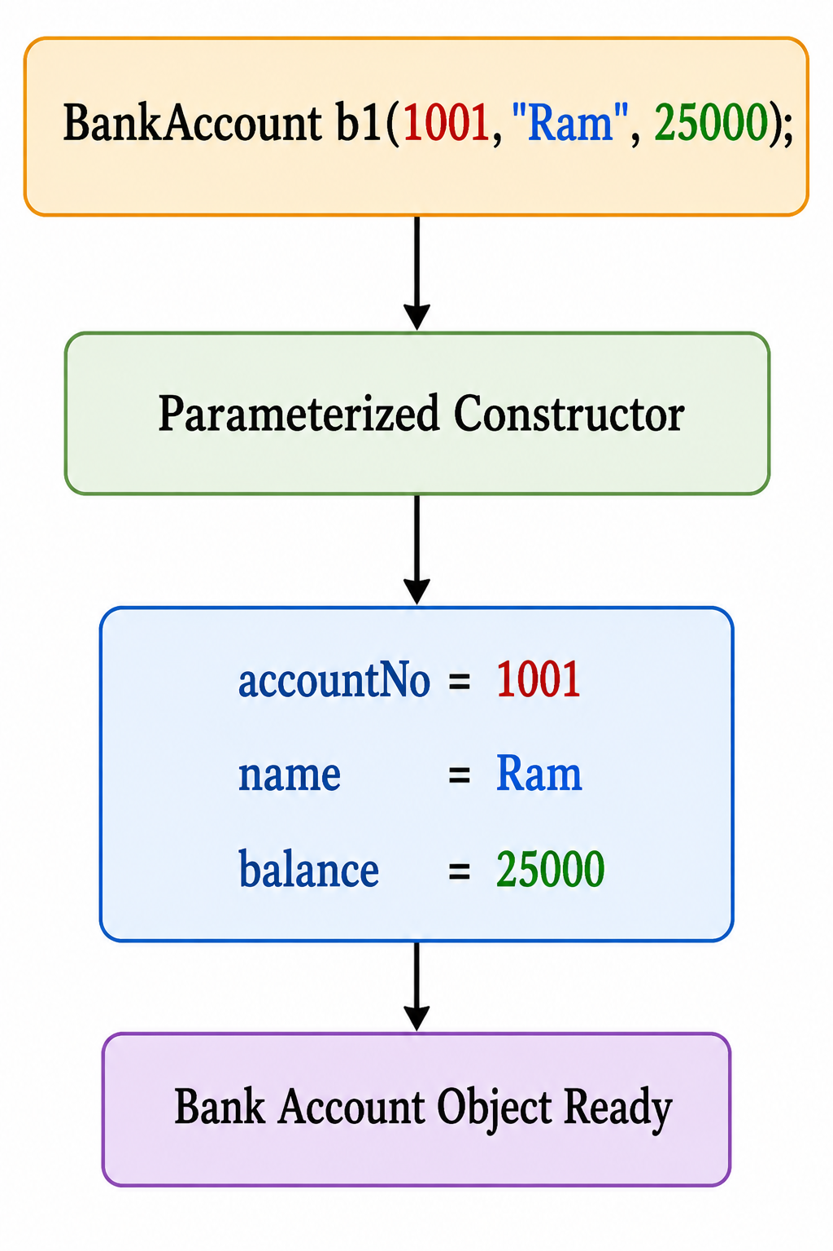
Output
Account No: 1001
Account Holder: Ram
Balance: Rs. 25000

Slide 28
#include <iostream>
using namespace std;
class Book
{
int bookId;
string title;
string author;
float price;
public:
// Parameterized Constructor
Book(int id, string t, string a, float p)
{
bookId = id;
title = t;
author = a;
price = p;
}
void display()
{
cout << "Book ID: " << bookId << endl;
cout << "Title: " << title << endl;
cout << "Author: " << author << endl;
cout << "Price: Rs. " << price << endl;
}
};
int main()
{
Book b1(101, "C++ Programming", "Balguruswamy", 450);
b1.display();
return 0;
}

Slide 29
Output
Book ID: 101
Title: C++ Programming
Author: Balguruswamy
Price: Rs. 450

Slide 30
Experiment No.- 4
1.Explain Constructor with Syntax.
2.Explain Default and Parameterized Constructor with Example.
3.Create Default and Parameterized Constructor Constructors for Employee Class

Slide 31
#include <iostream>
using namespace std;
class Employee
{
int empId;
string name;
float salary;
public:
// Default Constructor
Employee()
{
empId = 1001;
name = "Rahul";
salary = 35000;
}
Default Constructor – Employee Class
void display()
{
cout << "Employee ID: " << empId << endl;
cout << "Name: " << name << endl;
cout << "Salary: Rs. " << salary << endl;
}
};
int main()
{
Employee e1;
e1.display();
return 0;
}

Slide 32
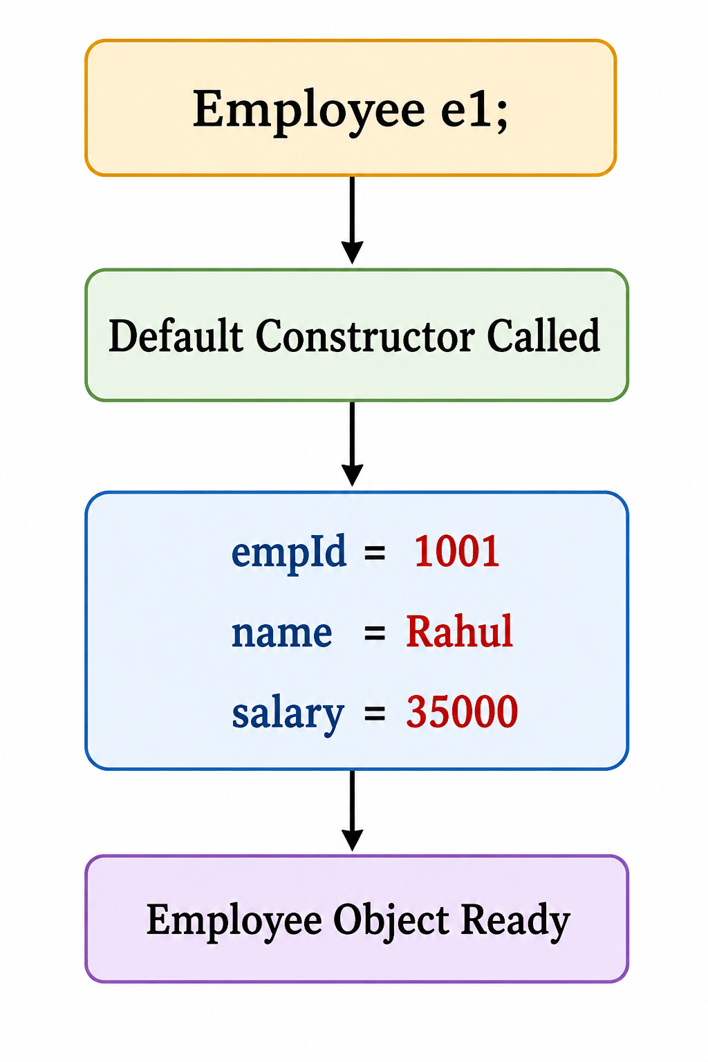
Output
Employee ID: 1001
Name: Rahul
Salary: Rs. 35000

Slide 33
#include <iostream>
using namespace std;
class Employee
{
int empId;
string name;
float salary;
public:
// Parameterized Constructor
Employee(int id, string n, float s)
{
empId = id;
name = n;
salary = s;
}
Parameterized Constructor – Employee Class
void display()
{
cout << "Employee ID: " << empId << endl;
cout << "Name: " << name << endl;
cout << "Salary: Rs. " << salary << endl;
}
};
int main()
{
Employee e1(1001, "Rahul", 35000);
e1.display();
return 0;
}

Slide 34
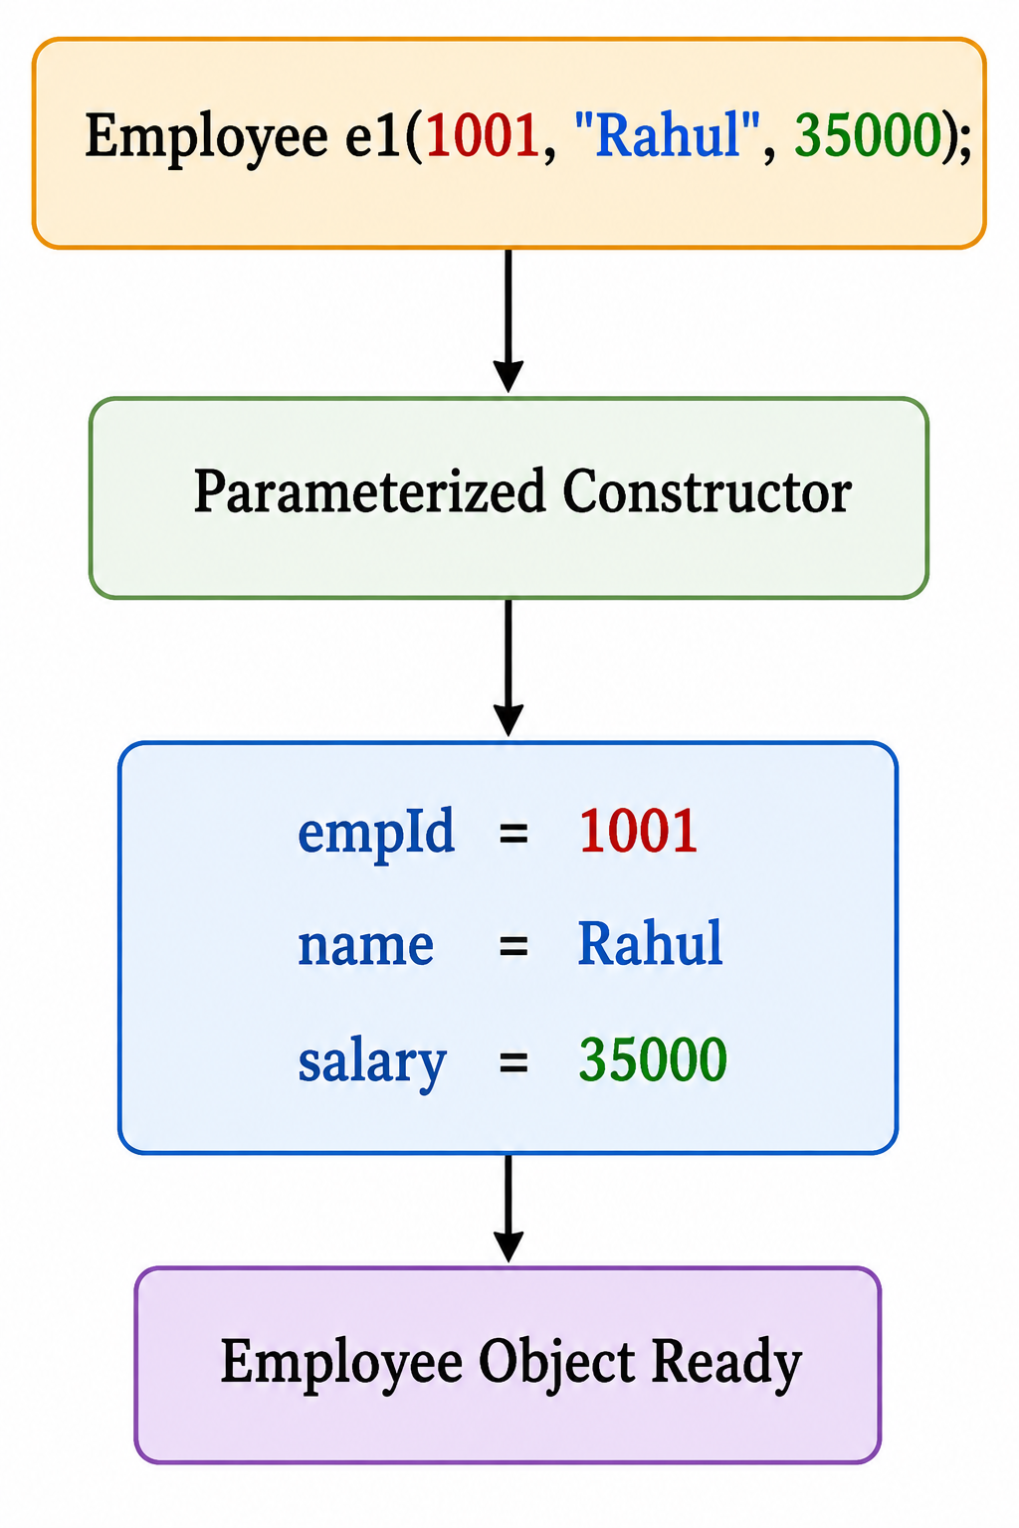
Output
Employee ID: 1001
Name: Rahul
Salary: Rs. 35000

Slide 35
3. Copy Constructor
A copy constructor is a special constructor used to create a new object by copying the values of an existing object of the same class.
It is called when a new object is created from an existing object.
It copies the data members of the existing object into the new object.
If we do not write a copy constructor, the compiler provides one automatically.
The compiler-provided copy constructor performs member-wise copying.

Slide 36
Student s2(s1);

Slide 37
I. Default / Implicit Copy Constructor
An implicit copy constructor is a copy constructor that is automatically provided by the C++ compiler when the programmer does not explicitly define a copy constructor.
It is used to create a new object by copying the data members of an existing object of the same class

Slide 38
#include <iostream>
using namespace std;
class Student
{
public:
int rollNo;
};
int main()
{
// Creating an s1 object
Student s1;
s1. rollNo = 10;
cout << “s1- rollNo = " << s1. rollNo << endl;
// Creating another object using s1
Student s2(s1);
cout << “s2- rollNo = " << s2. rollNo << endl;
return 0;
}
Output
s1- rollNo = 10
s2- rollNo = 10

Slide 39
#include <iostream>
#include <string>
using namespace std;
class Student
{
public:
int rollNo;
string name;
float marks;
};
int main()
{
Student s1;
s1.rollNo = 101;
s1.name = "Rahul";
s1.marks = 88.5;
Student s2(s1);
cout << "Original Student" << endl;
cout << "Roll No = " << s1.rollNo << endl;
cout << "Name = " << s1.name << endl;
cout << "Marks = " << s1.marks << endl;

Slide 40
cout << "\nCopied Student" << endl;
cout << "Roll No = " << s2.rollNo << endl;
cout << "Name = " << s2.name << endl;
cout << "Marks = " << s2.marks << endl;
return 0;
}
Output
Original Student
Roll No = 101
Name = Rahul
Marks = 88.5
Copied Student
Roll No = 101
Name = Rahul
Marks = 88.5

Slide 41
II. User Defined / explicit Copy Constructor
An explicit copy constructor is a copy constructor that is defined explicitly by the programmer inside the class.
It is used to create a new object by copying the data of an existing object of the same class.
It takes a reference to an object of the same class as its argument.
syntax
ClassName(const ClassName &object)
{
// copy values
}

Slide 42
#include <iostream>
using namespace std;
class Student
{
public:
int rollNo;
// Default constructor
Student()
{
}
// Explicit copy constructor
Student(const Student &s)
{
rollNo = s.rollNo;
}
};
int main()
{
// Creating the first object
Student s1;
s1.rollNo = 10;
cout << "s1 rollNo = " << s1.rollNo << endl;
// Creating s2 by copying s1
Student s2(s1);
cout << "s2 rollNo = " << s2.rollNo << endl;
return 0;
}

Slide 43
#include <iostream>
using namespace std;
class Student
{
int rollNo;
public:
Student(int r)
{
rollNo = r;
}
Student(const Student &s)
{
rollNo = s.rollNo;
}
void display()
{
cout << "Roll No: " << rollNo << endl;
}
};
int main()
{
Student s1(101);
Student s2(s1);
s1.display();
s2.display();
return 0;
}

Slide 44
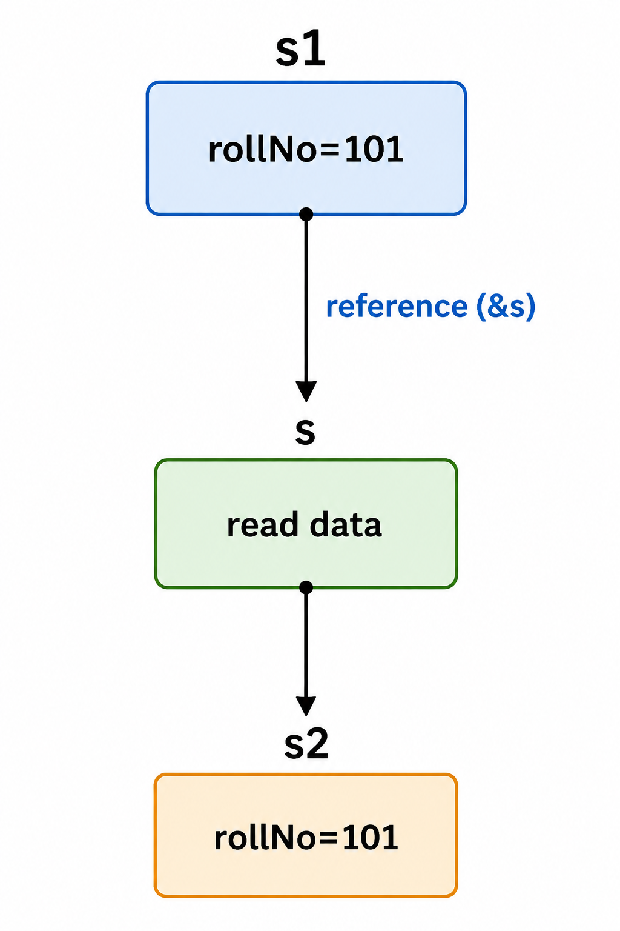
Output
Roll No: 101
Roll No: 101

Slide 45
Student(const Student &s)
const ensures that the original object cannot be modified through s.
The copy constructor is supposed to read/copy the original object's data, not change it.
&s means reference- A reference does not create another copy of the object.
It simply provides another name/reference to the existing object.
Student(const Student &s)
First Student → Constructor name
Second Student → Object's class/type
const → Original object cannot be modified
& → Passes the original object by reference, avoiding another copy.
s → Reference name

Slide 46
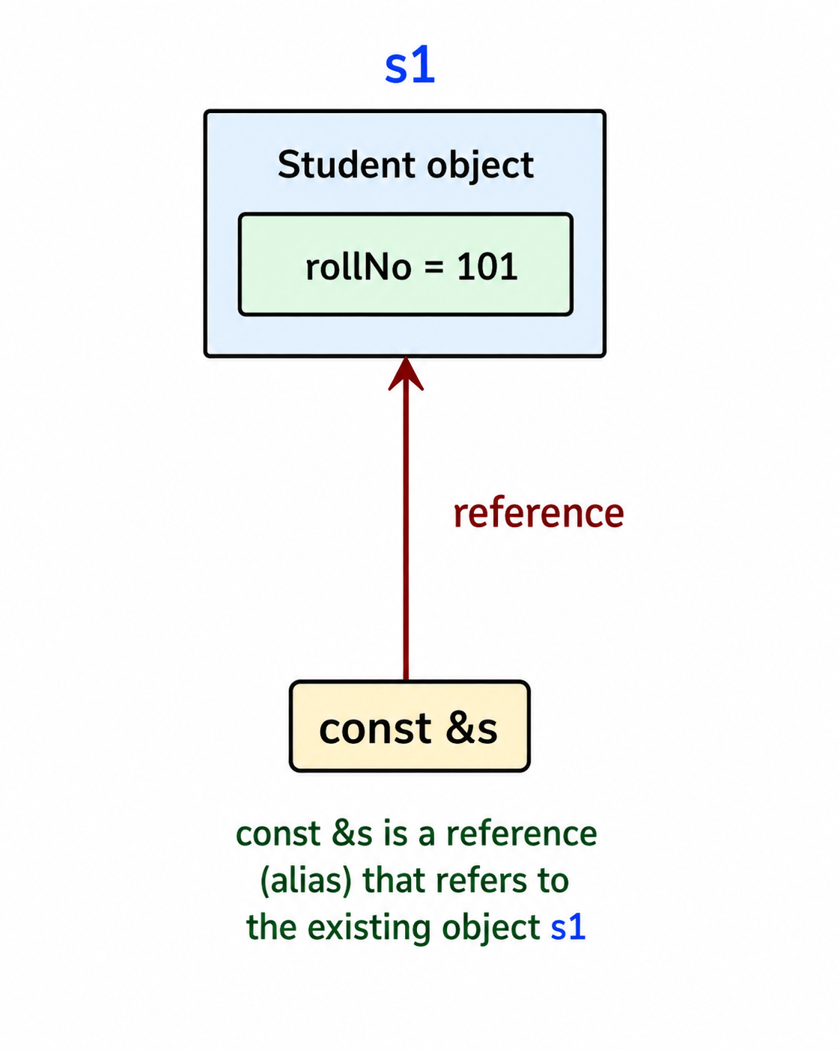

Slide 47
Here,
Student s2(s1);
creates s2 by copying the value of s1.
Therefore, both objects contain the same roll number.
A copy constructor creates a new object by copying an existing object.
Output
Roll No: 101
Roll No: 101

Slide 48
#include <iostream>
using namespace std;
class Book
{
string title;
float price;
public:
// Parameterized Constructor
Book(string t, float p)
{
title = t;
price = p;
}
// Copy Constructor
Book(const Book &b)
{
title = b.title;
price = b.price;
}
void display()
{
cout << "Book Title: " << title << endl;
cout << "Price: Rs. " << price << endl;
}
};

Slide 49
int main()
{
Book b1("C++ Programming", 450);
// Copy Constructor
Book b2(b1);
cout << "Original Book:" << endl;
b1.display();
cout << "\nCopied Book:" << endl;
b2.display();
return 0;
}
Output
Original Book:
Book Title: C++ Programming
Price: Rs. 450
Copied Book:
Book Title: C++ Programming
Price: Rs. 450

Slide 50
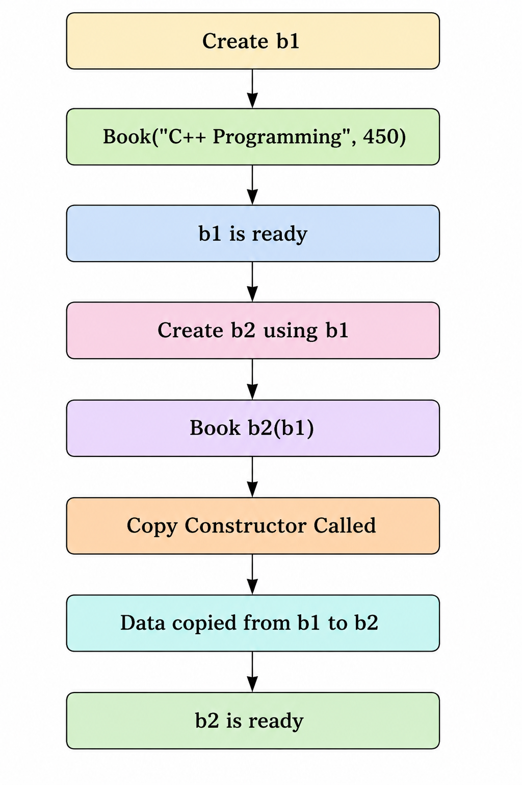

Slide 51
#include <iostream>
using namespace std;
class BankAccount
{
private:
int accountNo;
string name;
float balance;
public:
// Parameterized Constructor
BankAccount(int no, string n, float b)
{
accountNo = no;
name = n;
balance = b;
}
// Copy Constructor
BankAccount(const BankAccount &account)
{
accountNo = account.accountNo;
name = account.name;
balance = account.balance;
}
// Display Function
void display()
{
cout << "Account Number: " << accountNo << endl;
cout << "Customer Name: " << name << endl;
cout << "Balance: Rs. " << balance << endl;
}
};

Slide 52
int main()
{
// Original Bank Account
BankAccount account1(1001, "Rahul", 25000);
// Copy of account1
BankAccount account2 (account1);
cout << "Original Account:" << endl;
account1.display();
cout << "\nCopied Account:" << endl;
account2.display();
return 0;
}
Output
Original Account:
Account Number: 1001
Customer Name: Rahul
Balance: Rs. 25000
Copied Account:
Account Number: 1001
Customer Name: Rahul
Balance: Rs. 25000

Slide 53
#include <iostream>
using namespace std;
class Patient
{
private:
int patientId;
string name;
int age;
string disease;
public:
Patient(int id, string n, int a, string d)
{
patientId = id;
name = n;
age = a;
disease = d;
}
// Copy Constructor
Patient(const Patient &p)
{
patientId = p.patientId;
name = p.name;
age = p.age;
disease = p.disease;
}
// Display Function
void display()
{
cout << "Patient ID: " << patientId << endl;
cout << "Name: " << name << endl;
cout << "Age: " << age << endl;
cout << "Disease: " << disease << endl;
}
};

Slide 54
int main()
{
// Original Patient Record
Patient p1(501, “Ramesh", 45, "Diabetes");
// Copy patient record
Patient p2 = p1;
cout << "Original Patient Record:" << endl;
p1.display();
cout << "\nCopied Patient Record:" << endl;
p2.display();
return 0;
}
Output
Original Patient Record:
Patient ID: 501
Name: Ramesh
Age: 45
Disease: Diabetes
Copied Patient Record:
Patient ID: 501
Name: Ramesh
Age: 45
Disease: Diabetes

Slide 55
4. Constructor with Default Arguments
A constructor can also have default arguments.
A default argument is a value automatically used when the caller does not provide a value.

Slide 56
#include <iostream>
using namespace std;
class Student
{
int rollNo;
string name;
public:
Student(int r = 101, string n = "Unknown")
{
rollNo = r;
name = n;
}
void display()
{
cout << "Roll No: " << rollNo << endl;
cout << "Name: " << name << endl;
}
};
int main()
{
Student s1;
Student s2(102);
Student s3(103, "Rahul");
s1.display();
s2.display();
s3.display();
return 0;
}

Slide 57
Here, if no values are provided, 101 and "Unknown" are used.
If only the roll number is provided, the default name "Unknown" is used.
If both values are provided, those values are used.
Default arguments allow a constructor to work with different numbers of supplied arguments.
Roll No: 101
Name: Unknown
Roll No: 102
Name: Unknown
Roll No: 103
Name: Rahul
Output

Slide 58
#include <iostream>
using namespace std;
class Car
{
string brand;
string color;
int price;
public:
// Constructor with Default Arguments
Car(string b = "Toyota", string c = "White", int p = 1500000)
{
brand = b;
color = c;
price = p;
}

Slide 59
void display()
{
cout << "Brand: " << brand << endl;
cout << "Color: " << color << endl;
cout << "Price: Rs. " << price << endl;
}
};
int main()
{
Car c1;
Car c2("Honda");
Car c3("Hyundai", "Black");
Car c4("Tata", "Blue", 1200000);
cout << "Car 1:" << endl;
c1.display();
cout << "\nCar 2:" << endl;
c2.display();
cout << "\nCar 3:" << endl;
c3.display();
cout << "\nCar 4:" << endl;
c4.display();
return 0;
}

Slide 60
Car 1:
Brand: Toyota
Color: White
Price: Rs. 1500000
Car 2:
Brand: Honda
Color: White
Price: Rs. 1500000
Car 3:
Brand: Hyundai
Color: Black
Price: Rs. 1500000
Car 4:
Brand: Tata
Color: Blue
Price: Rs. 1200000
Output

Slide 61
Overloaded Constructor
An overloaded constructor is a class that contains more than one constructor with different parameter lists.
In other words, constructor overloading is a form of compile-time polymorphism in which a class can have multiple constructors, but each constructor must have a different number, type, or order of parameters.
The compiler determines which constructor to call based on the arguments supplied when an object is created.

Slide 62
#include <iostream>
using namespace std;
class Employee
{
private:
int empId;
string name;
float salary;
public:
// Default Constructor
Employee()
{
empId = 0;
name = "Unknown";
salary = 0;
}
// Constructor with one parameter
Employee(int id)
{
empId = id;
name = "Unknown";
salary = 0;
}

Slide 63
// Constructor with three parameters
Employee(int id, string n, float s)
{
empId = id;
name = n;
salary = s;
}
void display()
{
cout << "Employee ID: " << empId << endl;
cout << "Name: " << name << endl;
cout << "Salary: " << salary << endl;
}
};
int main()
{
Employee e1;
Employee e2(1001);
Employee e3(1002, "Rahul", 35000);
cout << "Employee 1:" << endl;
e1.display();
cout << "\nEmployee 2:" << endl;
e2.display();
cout << "\nEmployee 3:" << endl;
e3.display();
return 0;
}

Slide 64
Output
Employee 1:
Employee ID: 0
Name: Unknown
Salary: 0
Employee 2:
Employee ID: 1001
Name: Unknown
Salary: 0
Employee 3:
Employee ID: 1002
Name: Rahul
Salary: 35000

Slide 65
Destructor
A destructor is a special member function of a class that is automatically called when an object is destroyed.
Its main purpose is to release resources acquired by the object, such as memory, files, network connections, database connections, etc.

Slide 66
Syntax
class ClassName
{
public:
~ClassName ()
{
// initialization
}
};
Characteristics of a Destructor
    Its name is the same as the class name preceded by a ~ (tilde).
    It has no return type (not even void).
    It takes no parameters.
    Only one destructor can exist in a class (cannot be overloaded).
    It is called automatically when an object goes out of scope or is deleted.

Slide 67
#include <iostream>
using namespace std;
class Test {
public:
Test()
{
cout << "Constructor called" << endl;
}
~Test()
{
cout << "Destructor called" << endl;
}
};
int main() {
Test obj;
cout << "Object is being used" << endl;
return 0;
}

Slide 68
Output
Constructor called
Object is being used
Destructor called
The destructor is automatically called when obj goes out of scope.

Slide 69
#include <iostream>
using namespace std;
class Test
{
private:
int* ptr;
public:
Test()
{
ptr = new int(10);
cout << "Memory allocated" << endl;
}
~Test()
{
delete ptr;
cout << "Memory released" << endl;
}
};
int main() {
Test obj;
return 0;
}
Output
Memory allocated
Memory released

Slide 70
int* ptr;
ptr is a pointer variable that can store the address of an integer.
ptr = new int(10);
new int(10) :-
Dynamically allocates memory for one int.
Initializes that integer with the value 10.
Returns the address of that memory.
That address is stored in ptr.
ptr = 1000
suppose the allocated memory is at address 1000.

Slide 71
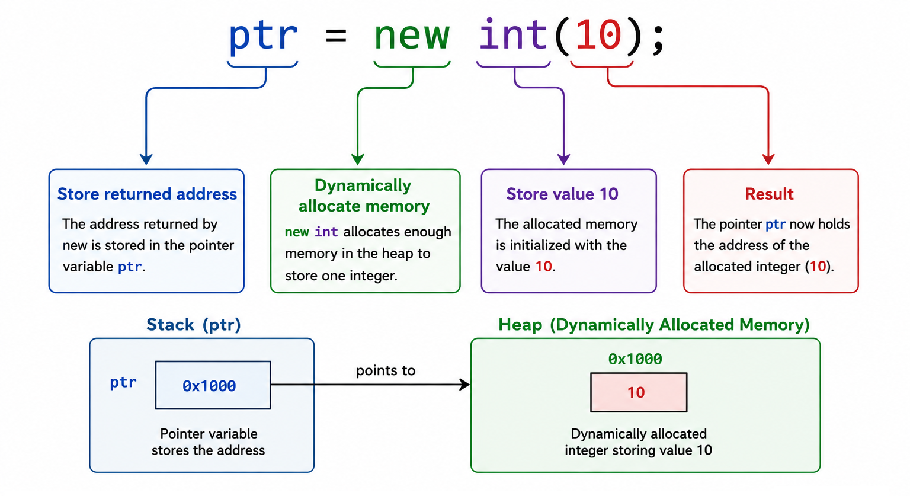

Slide 72
delete ptr;
this releases the dynamically allocated memory that was obtained using:
new int(10);
Without the destructor, the dynamically allocated memory would not be freed, causing a memory leak.
A memory leak occurs when a program dynamically allocates memory but fails to release it after the memory is no longer needed.

Slide 73
#include <iostream>
using namespace std;
class Test
{
private:
int* ptr;
public:
Test()
{
ptr = new int(10);
cout << "Value = " << *ptr << endl;
cout << "Memory allocated" << endl;
}
~Test()
{
delete ptr;
cout << "Memory released" << endl;
}
};
int main()
{
Test obj;
return 0;
}

Slide 74
Output
Value = 10
Memory allocated
Memory released

Slide 75
Experiment No.- 5
Write a program to demonstrate the automatic execution of constructor and destructor when objects are created and destroyed respectively.

Slide 76
#include <iostream>
using namespace std;
class Demo
{
public:
// Constructor
Demo()
{
cout << "Constructor is executed." << endl;
}
// Destructor
~Demo()
{
cout << "Destructor is executed." << endl;
}
};
int main()
{
cout << "Creating object..." << endl;
Demo obj;
cout << "Object is being used." << endl;
cout << "End of main()." << endl;
return 0;
}

Slide 77
Output
Creating object...
Constructor is executed.
Object is being used.
End of main().
Destructor is executed.

