Slide 1

Comparison between optimizers
Zhitong Xu(zx581)

Slide 2
Goal: Compare between Mini-Batch SGD, SGD with momentum, Adagrad, RMSProp, and Adam to see which optimizer will perform the best with given hyperparameters(Learning rate, hyperparameter for optimizers). -Running time -Coefficient variance
Value and benefit: To see if Adaptive optimizers have high generalization gap.
Approach:
Theoretical comparison between optimizers weight update equation and see which one should perform the best on what scenario.
By giving specific hyperparameter values, compare if theoretical analysis holds.
Generalize result.

Slide 3
Motivation:
All neural network need a optimizer and concept of optimizer is simple. Either change learning rate or gradient.
Except momentum, all those optimizers are created within last decades.
Not much information about how to choose optimizers on internet.(People just recommend Adam in most post )
New studies shown to oppose use of adaptive methods.

Slide 4
Technical Challenges:
Need to build a CNN that have a high validation accuracy(98%) on dataset.
Grid search to optimize hyperparameters for SGD.
Compare how well each optimizer generalize.

Slide 5
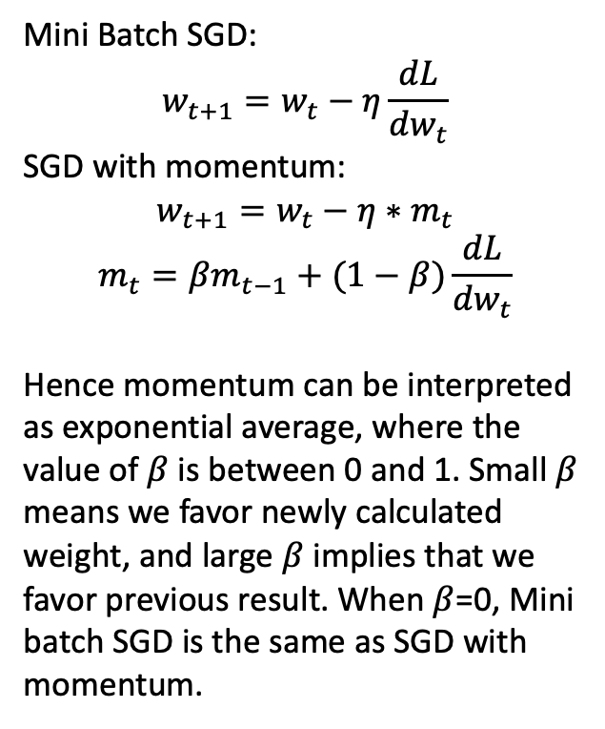
Approach-theoretical analysis:
Mini Batch SGD:
$$w_{t+1}=w_{t}−η\frac{dL}{dw_{t}}$$
SGD with momentum:
$$w_{t+1}=w_{t}−η∗m_{t}$$
$$m_{t}=βm_{t−1}+(1−β)\frac{dL}{dw_{t}}$$
Hence momentum can be interpreted as exponential average, where the value of $β$ is between 0 and 1. Small $β$ means we favor newly calculated weight, and large $β$ implies that we favor previous result. When $β$=0, Mini batch SGD is the same as SGD with momentum.
Advantage and potential problem with momentum:
By taking exponential average, every weight update will take consideration of several previous weight update. Hence, we can move quickly on direction with small but consistent gradient, and slow on inconsistent gradient. (This can be looked as decreasing the noise cause by stochasticity.)
But the potential problem is when loss function is reaching global minimum. Since there is no prior knowledge to inform optimizer that we are reaching global minimum, and the momentum is large, it is likely that we pass it. (This scenario will be more likely to occur when learning rate is large.)

Slide 6
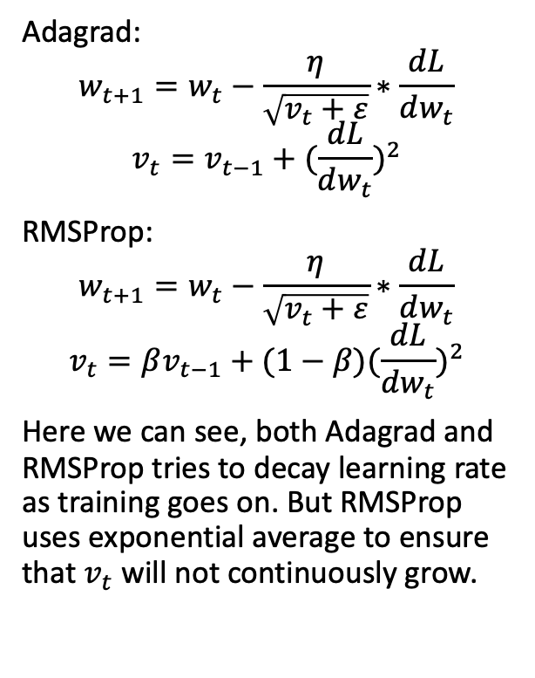
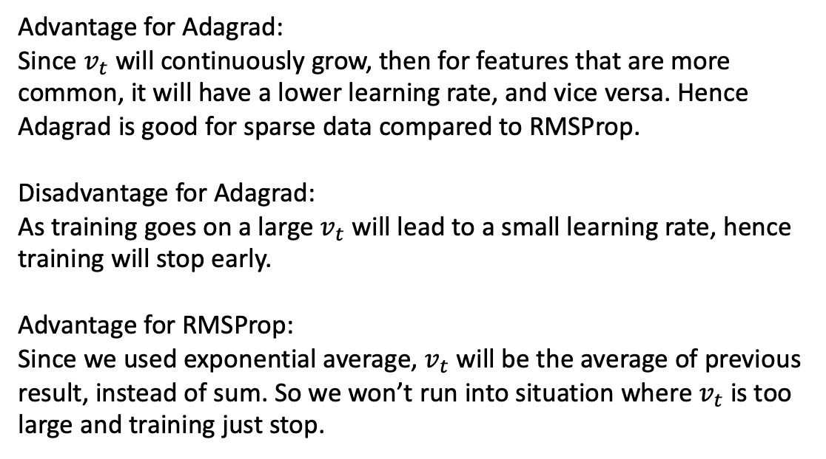
Approach-theoretical analysis:
Adagrad:
$$w_{t+1}=w_{t}−\frac{η}{\sqrt{v_{t}+ε}}∗\frac{dL}{dw_{t}}$$
$$v_{t}=v_{t−1}+{(\frac{dL}{dw_{t}})}^{2}$$
RMSProp:
$$w_{t+1}=w_{t}−\frac{η}{\sqrt{v_{t}+ε}}∗\frac{dL}{dw_{t}}$$
$$v_{t}=βv_{t−1}+{(1−β)(\frac{dL}{dw_{t}})}^{2}$$
Here we can see, both Adagrad and RMSProp tries to decay learning rate as training goes on. But RMSProp uses exponential average to ensure that $v_{t}$ will not continuously grow.
Advantage for Adagrad:
Since $v_{t}$ will continuously grow, then for features that are more common, it will have a lower learning rate, and vice versa. Hence Adagrad is good for sparse data compared to RMSProp.
Disadvantage for Adagrad:
As training goes on a large $v_{t}$ will lead to a small learning rate, hence training will stop early.
Advantage for RMSProp:
Since we used exponential average, $v_{t}$ will be the average of previous result, instead of sum. So we won’t run into situation where $v_{t}$ is too large and training just stop.

Slide 7
Implementation details:
Dataset: Fashion MNINST
CNN architecture: 2 Convolution layers with Maxpool and one fully connect layer
Run on HPC with RTX8000
Default learning rate is 0.01, momentum is 0.8, batch size is 64.

Slide 8
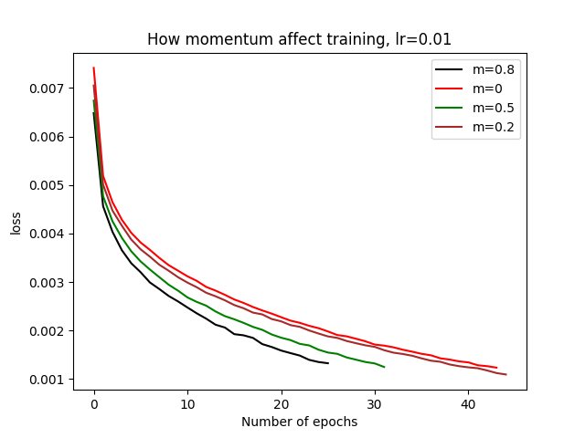
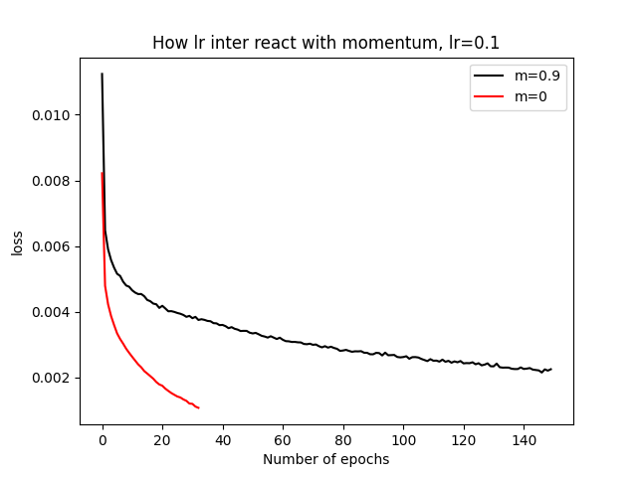
Experiment evaluation
SGD vs Momentum:
From upper graph, we can see that a large beta value will result to a faster convergence. This is due to initial gradient change is always large, hence if we take exponential average of previous gradient, it will accelerate training.
Bottom graph shows if learning rate increase to 0.1, a high momentum will get stuck around global minimum. But SGD will perform better.

Slide 9
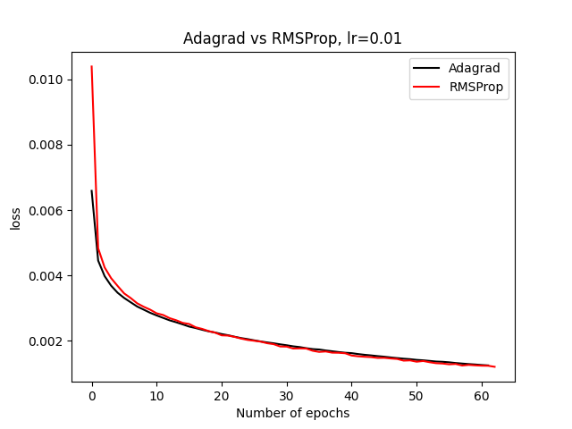
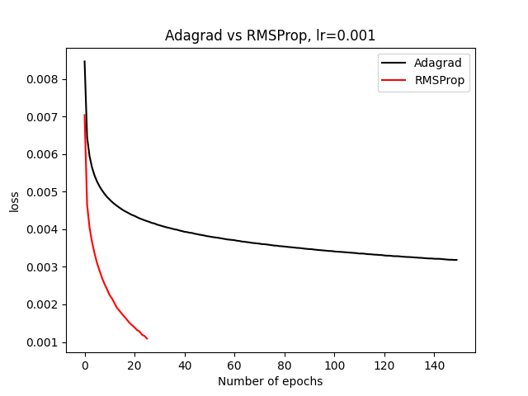
Experiment evaluation
Adagrad vs RMSProp:
As stated before Adagrad and RMSProp are similar, but Adagrad will potentially stop early. As we change learning rate from 0.01 to 0.001, RMSProp perform better, but Adagrad just completely stop learning.

Slide 10
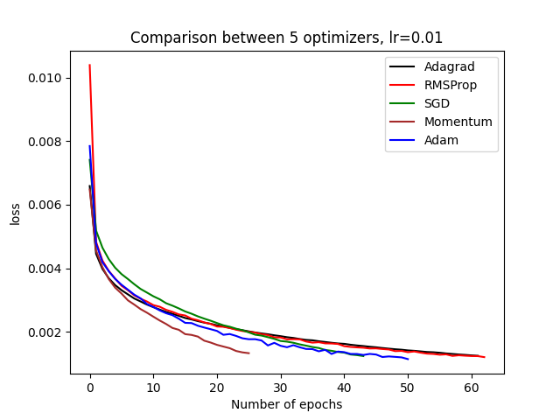
Experiment evaluation
Here we showed when learning rate is at 0.01, all those optimizers will reaches 98% validation accuracy.
optimizer | TTA(98%) | Coeff var
SGD | 1058 | 12.59%
Momentum | 615 | 10.98%
Adagrad | 1268 | 13.87%
RMSProp | 1317 | 15.11%
Adam | 855 | 16.04%

Slide 11
Conclusion and Application
Choice of initial learning rate is more important than optimizer.(In hyperparameter optimization, we should consider fix learning rate first during grid search)
If learning rate is not clear, use Adam, since it used exponential moving average on both gradient and learning rate.(More freedom)
Avoid Adagrad unless dataset has sparse features.
If confident about learning rate, then use SGD with momentum.
Some new paper shows SGD with lr schedule is better, and advise people to stay away from adaptive learning rate.(Similar to result shown)

Slide 12
Github:
https://github.com/XZT008/CSCI-GA-3033/tree/main/project

