Slide 1

University of Padua
Presentation of the Master’s Degree Thesis
Department of Information Engineering
DEVELOPMENT OF
A POINTING-ACQUISITION-TRACKING SYSTEM
FOR FREE-SPACE QUANTUM COMMUNICATION
Author: Federico Berra
Supervisor: Prof. Giuseppe Vallone
Co-Supervisor: Dr. Francesco Vedovato
07/09/2020

Slide 2
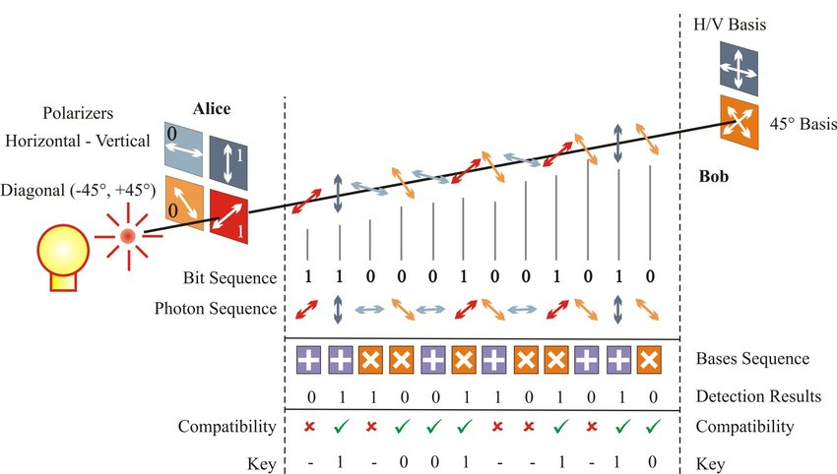



WHAT IS QKD
SECRET RANDOM KEY
Eve
1/9

Slide 3
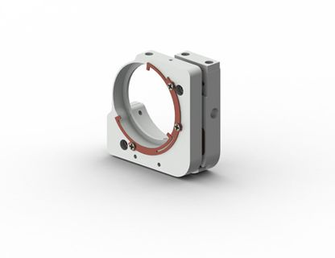
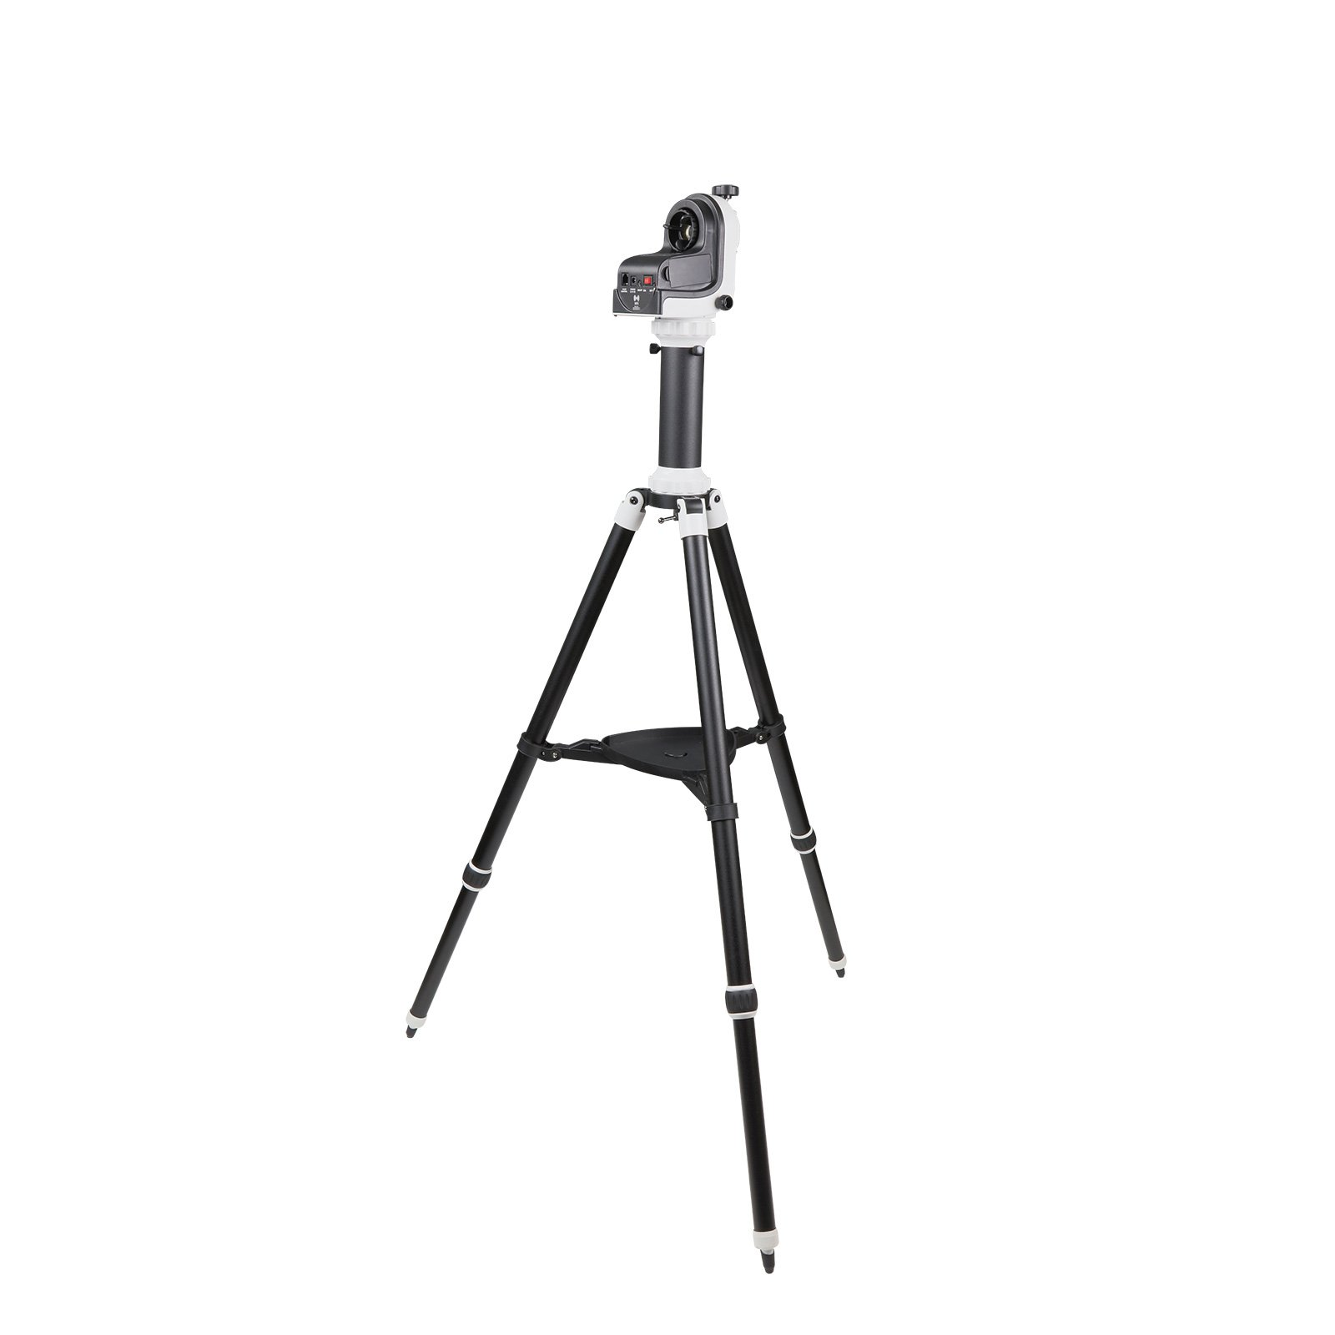

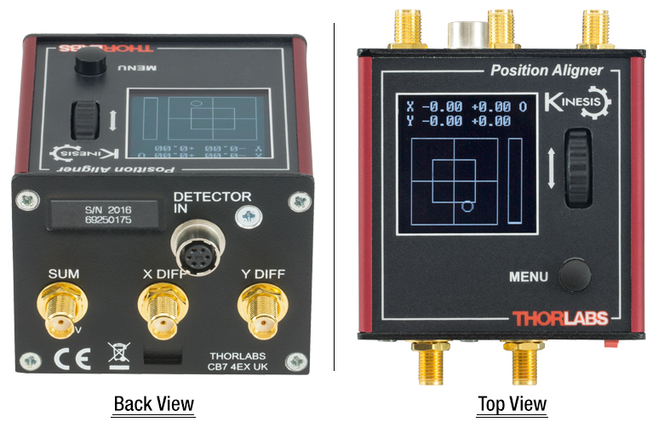
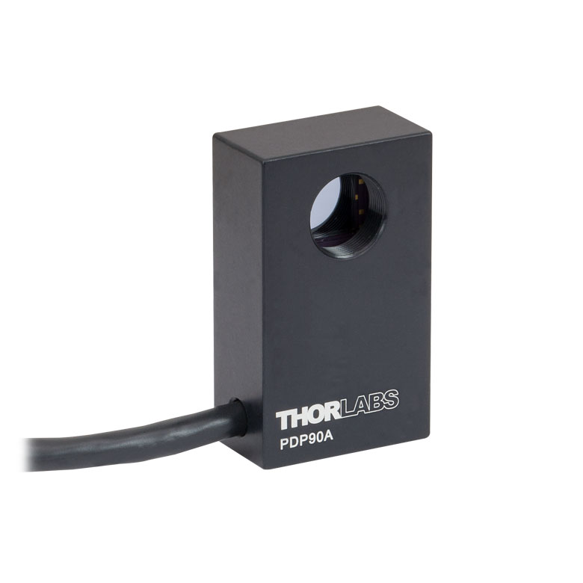
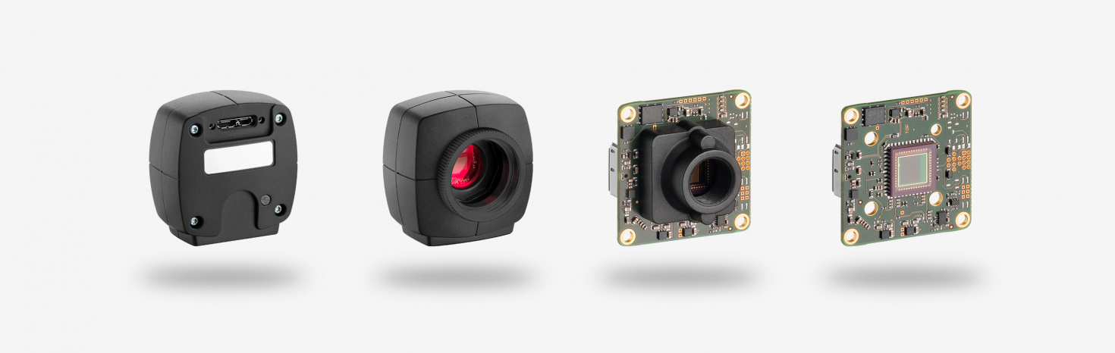
WHAT IS PAT
Pointing-Acquisition-Tracking system
2/9

Slide 4

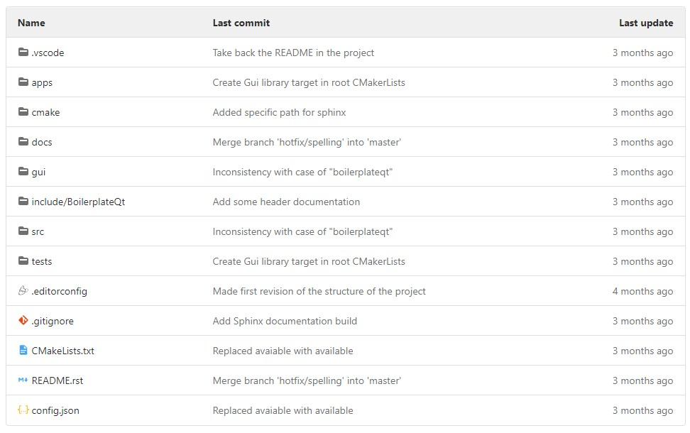



QKD Software
Boilerplate
3/9

Slide 5
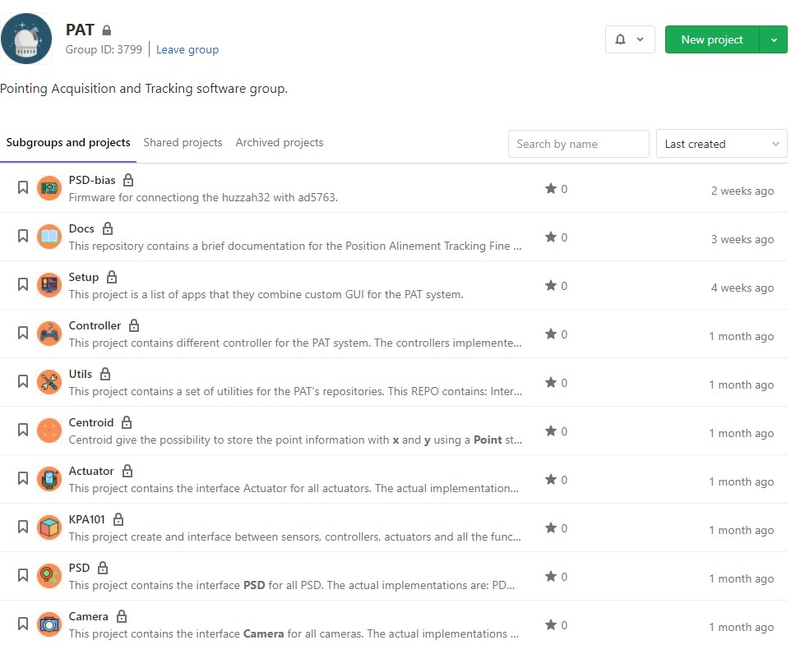
WHAT IS QKD
PAT Software
4/9

Slide 6
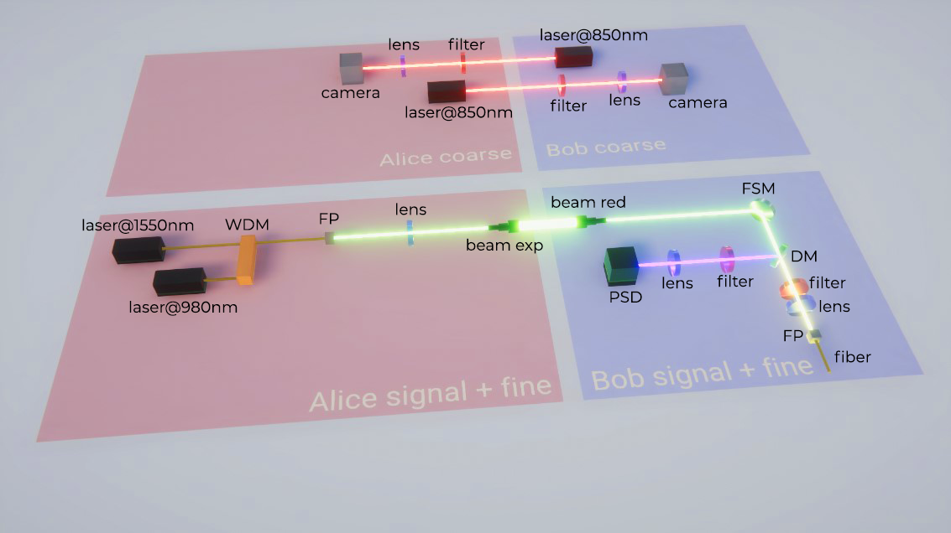
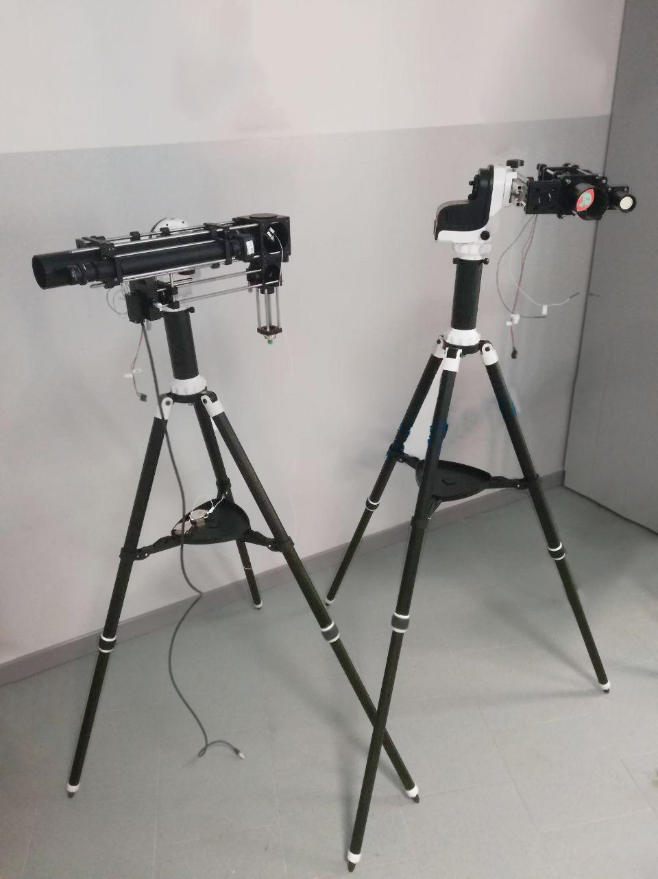
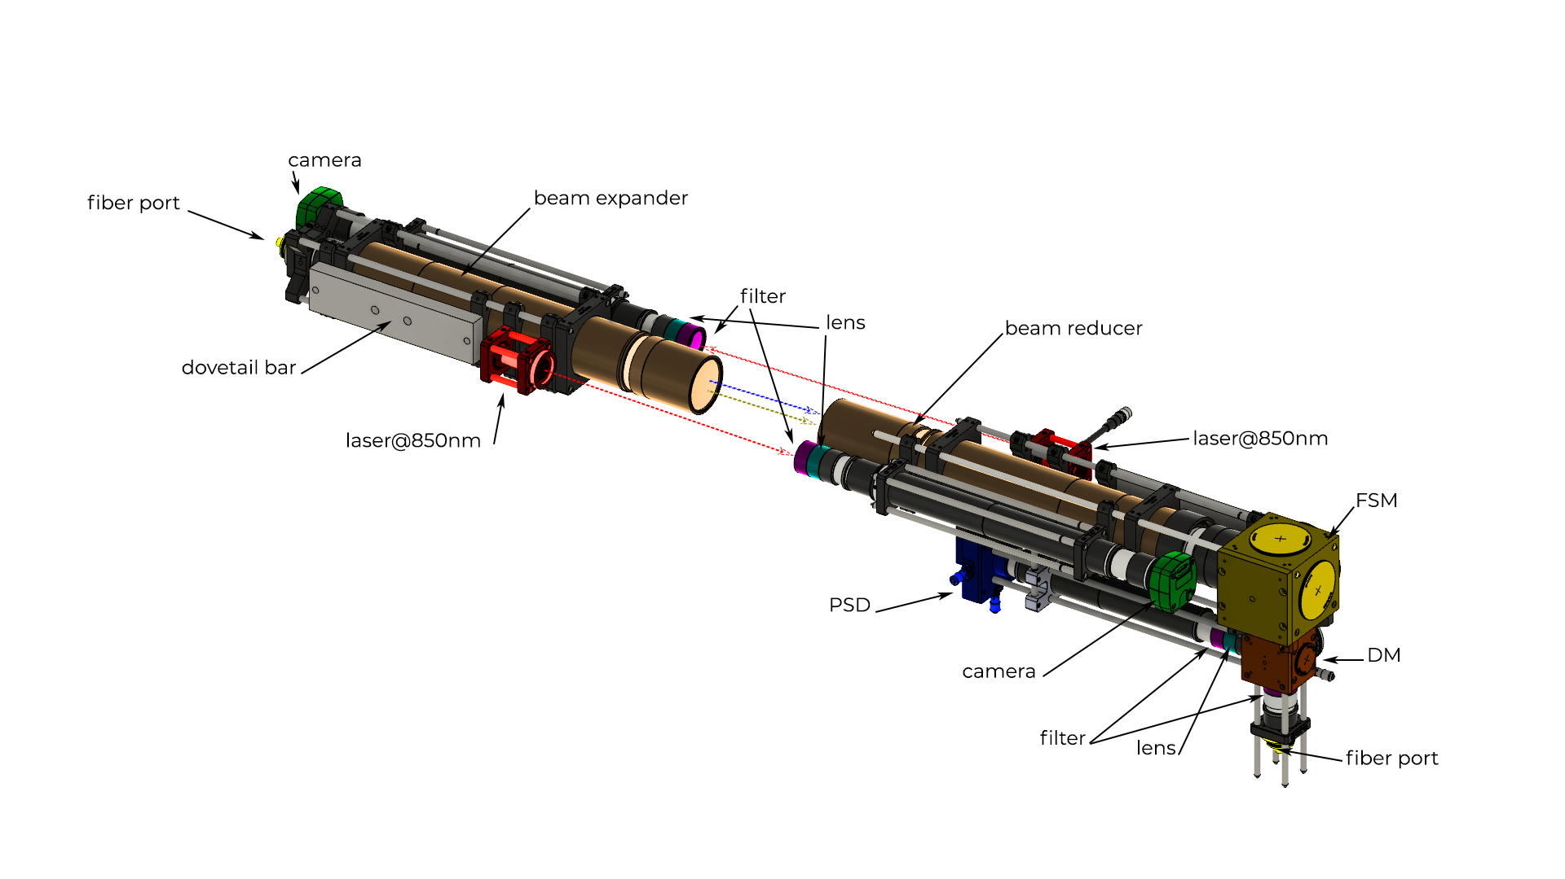
PATLIC
PATLIC experiment
5/9

Slide 7
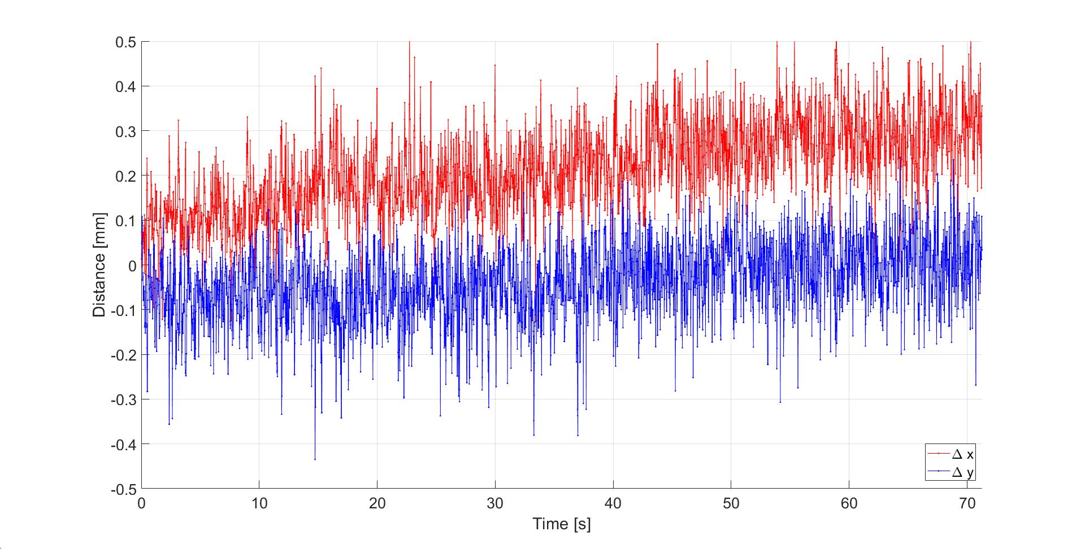
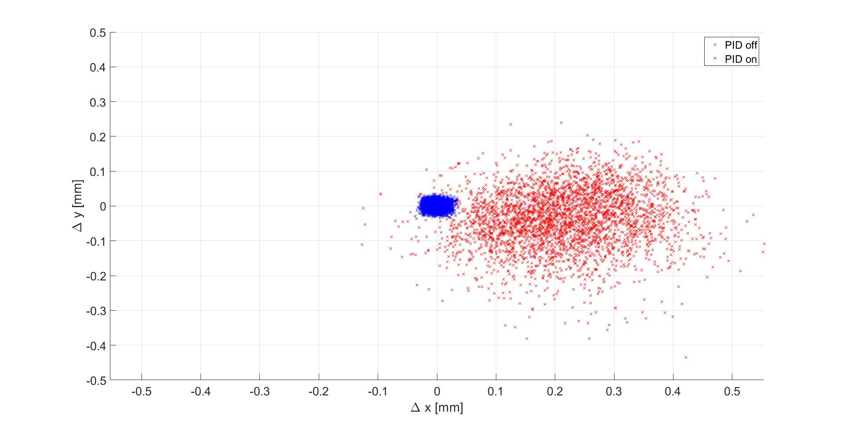
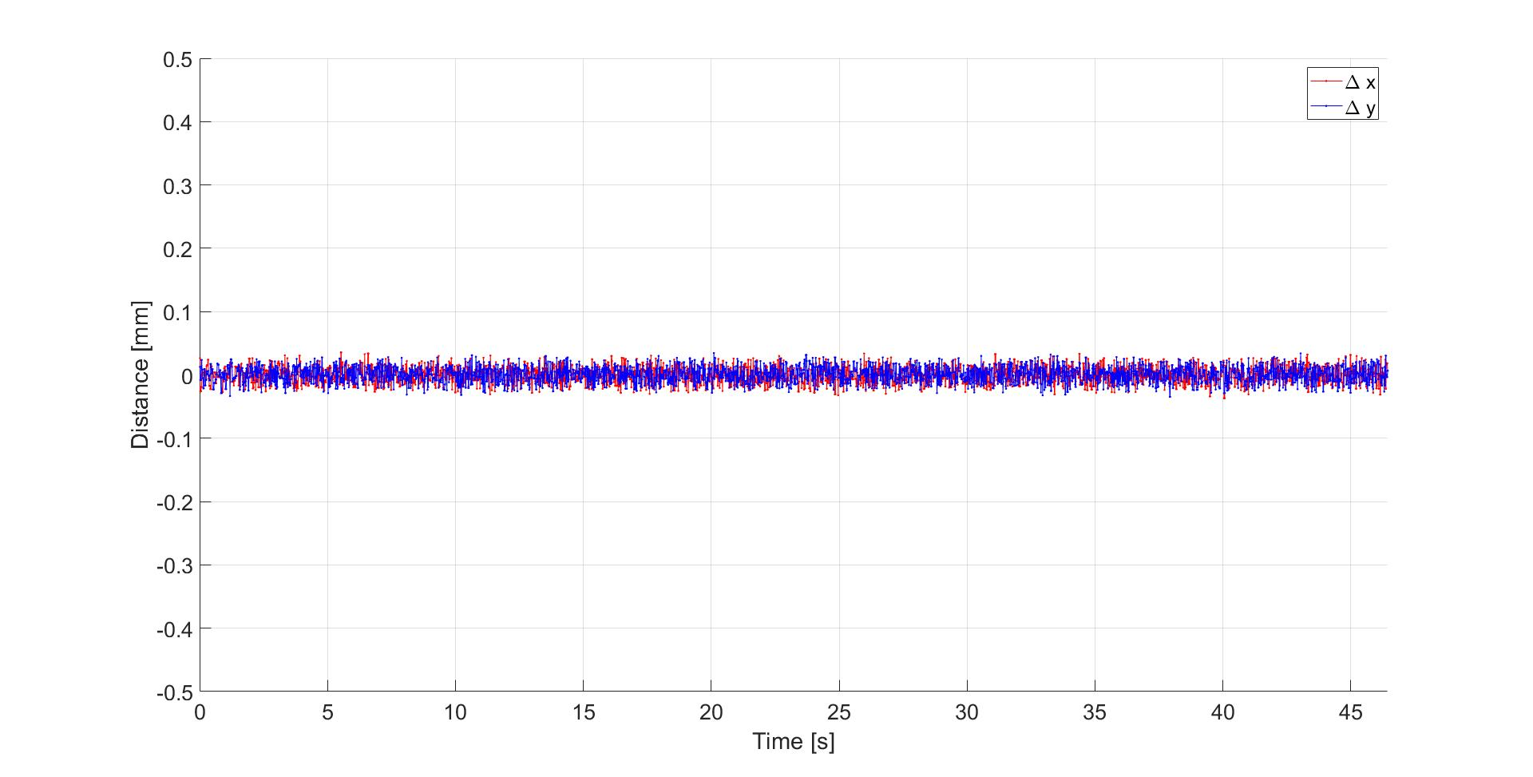
Heat – PIDKPA101 – Fine
PATLIC heat turbolence PIDKPA101
6/9

Slide 8
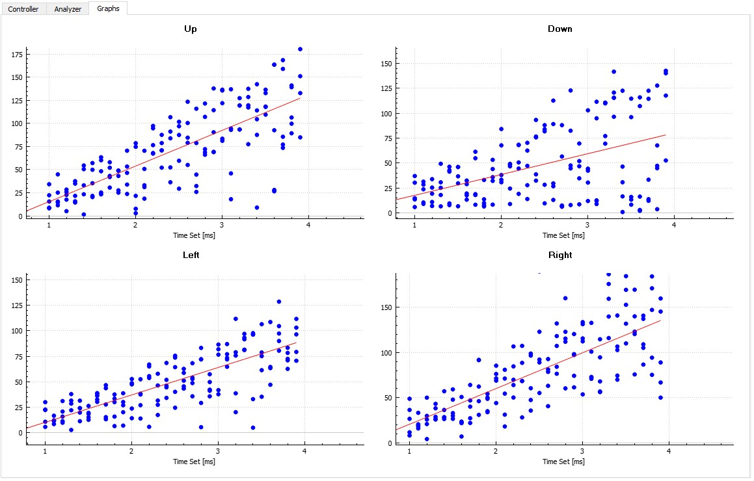
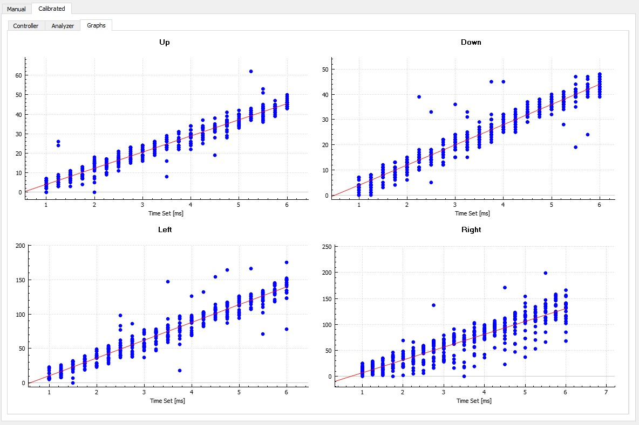
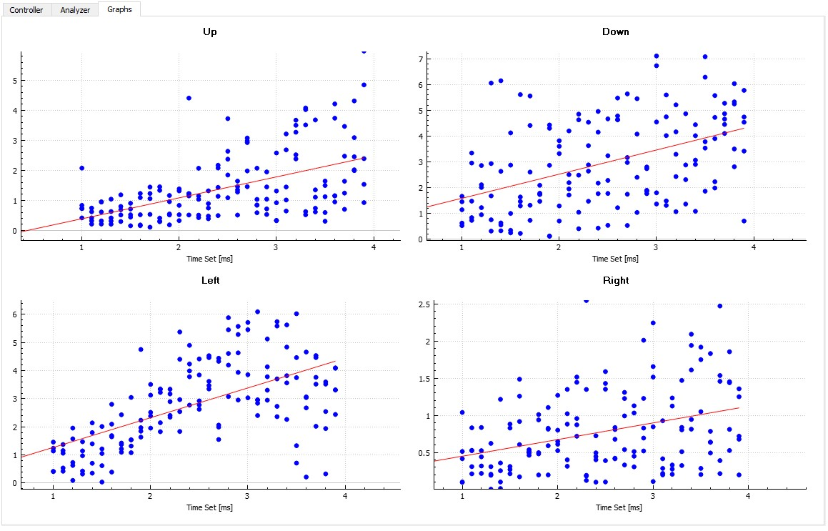
Calibration One shot
PATLIC Calibration
All: 1V
Top: 2V, Bottom: 2V, Left: 3V, Right: 3.5V
All: 4V
7/9

Slide 9
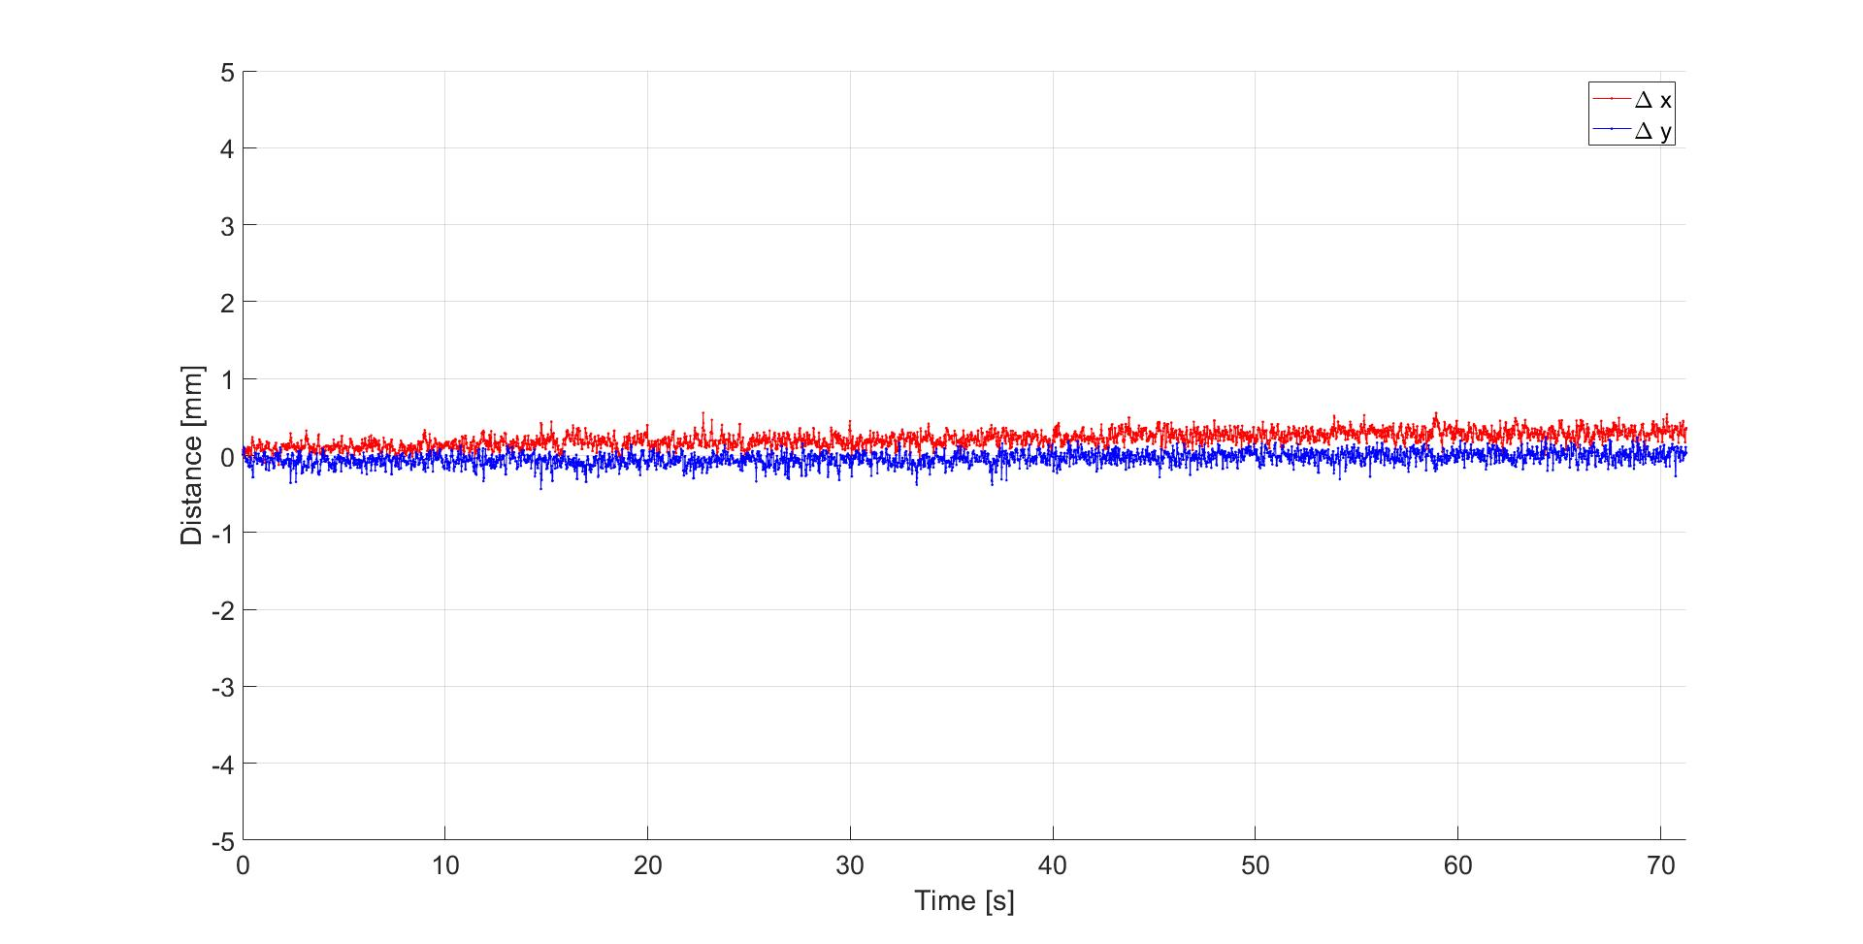
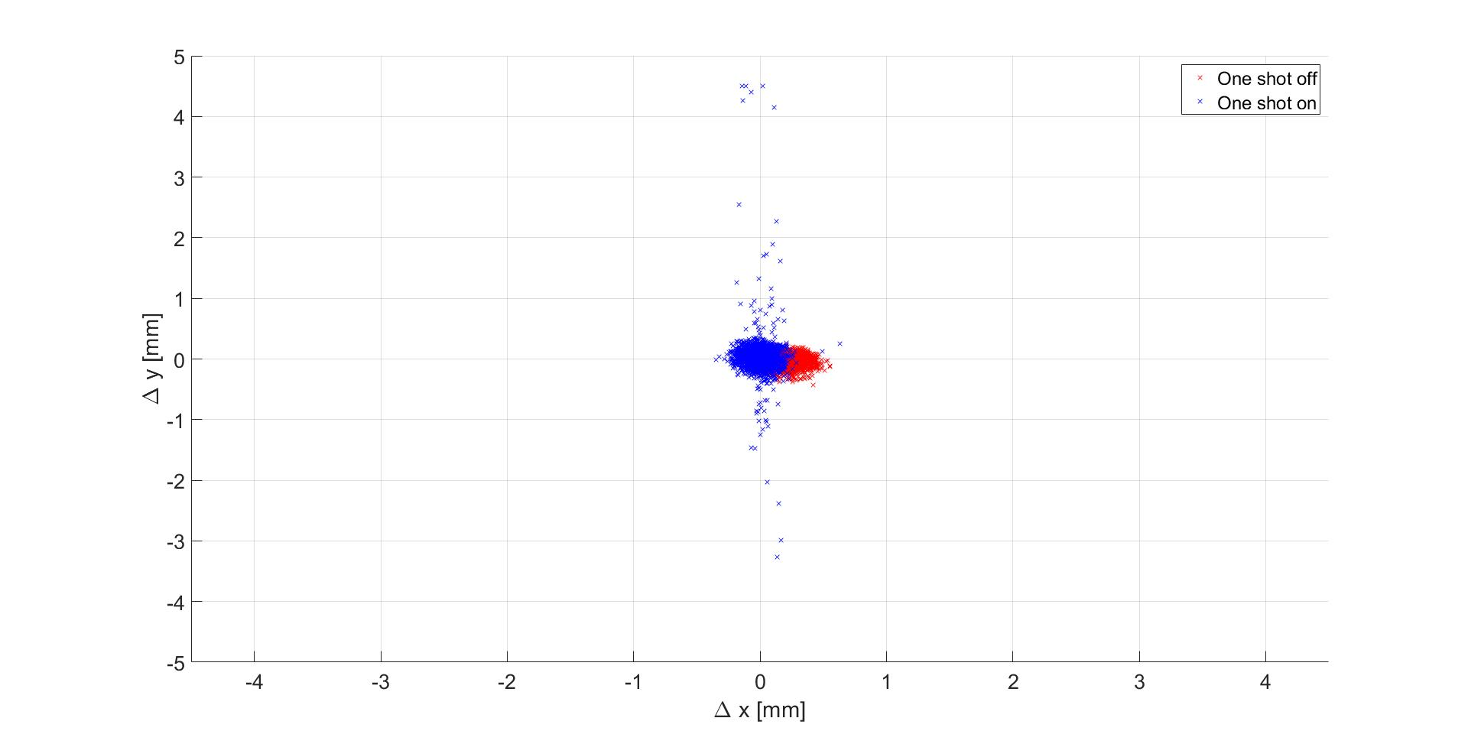
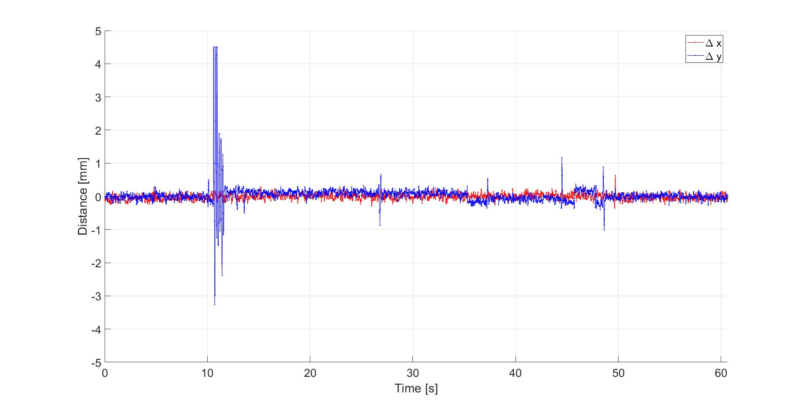
Heat – One shot – Fine
PATLIC heat trubolence One shot
8/9

Slide 10
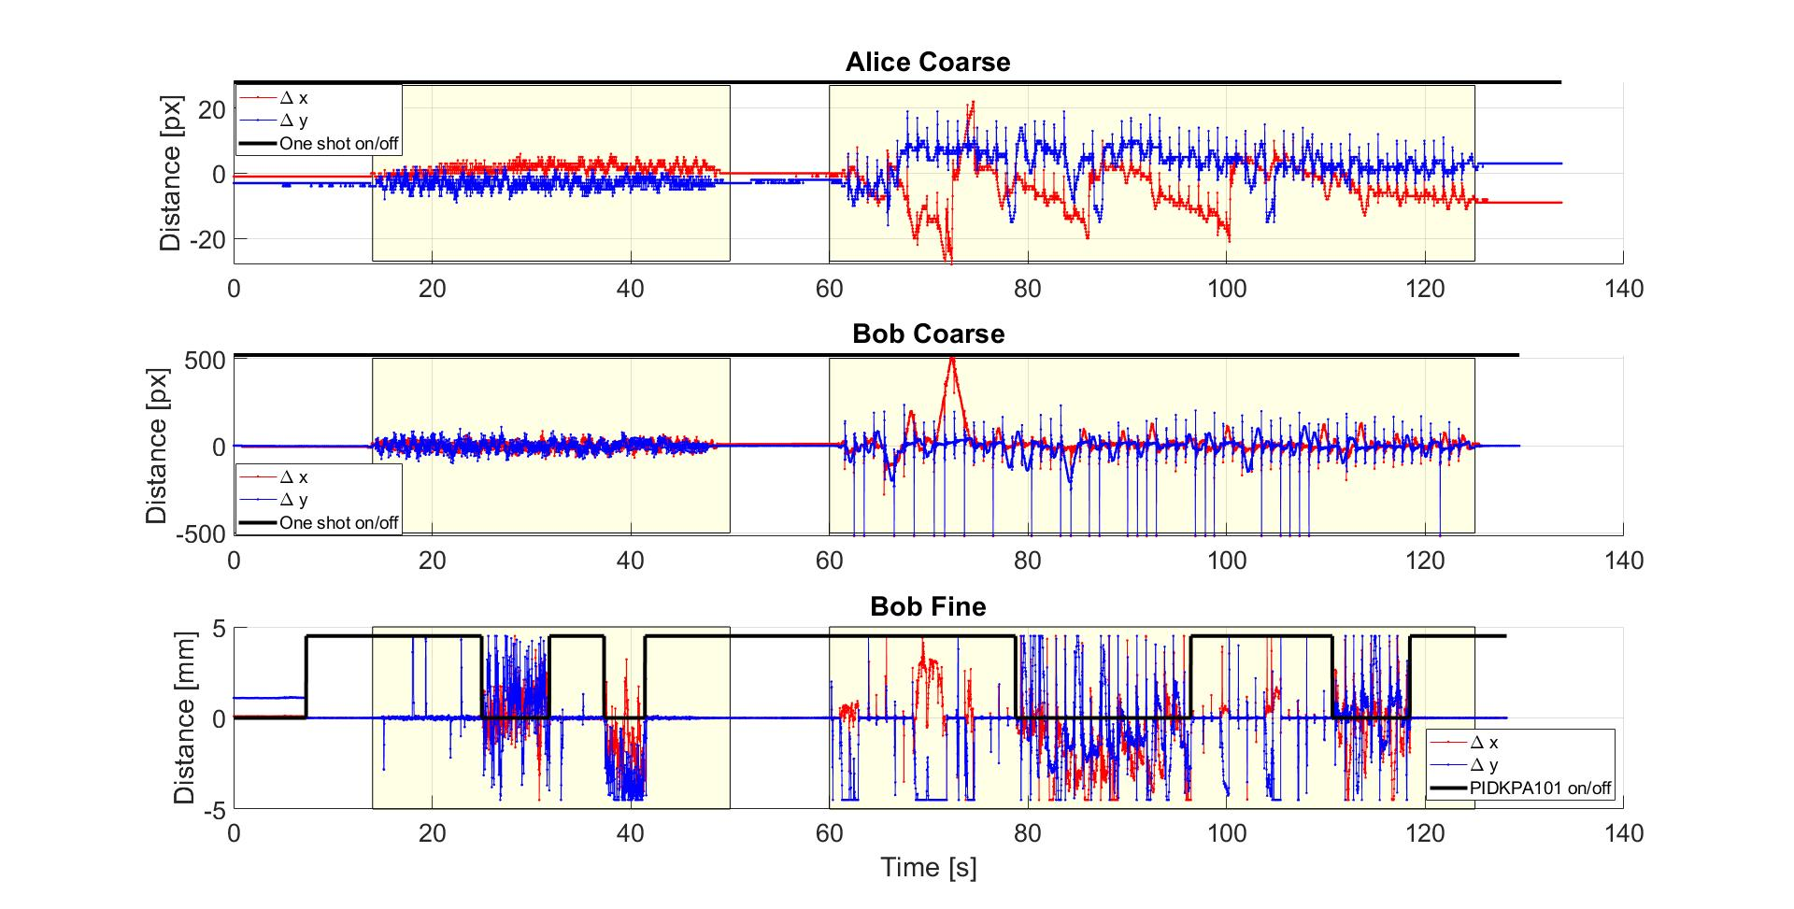
Hammer – Coarse + Fine
PATLIC hammer impulse sequence
9/9

Slide 11
THANKS YOU FOR THE ATTENTION
Q&A

Slide 12
DEVELOPMENT OF A POINTING-ACQUISITION-TRACKING SYSTEM FOR FREE-SPACE QUANTUM COMMUNICATION
Presentation of the Master’s Degree Thesis
07/09/2020

Slide 13
INDEX
INDEX
Who I am
Why I chose PhD
Why choose me
My proposal
1/5

