Slide 1
Comp 472 Mini Project 1
DONOVAN UPSDELL - 40133717
JULIEN PICARD - 40158060
XAAVIAN ALI - 40082861

Slide 2
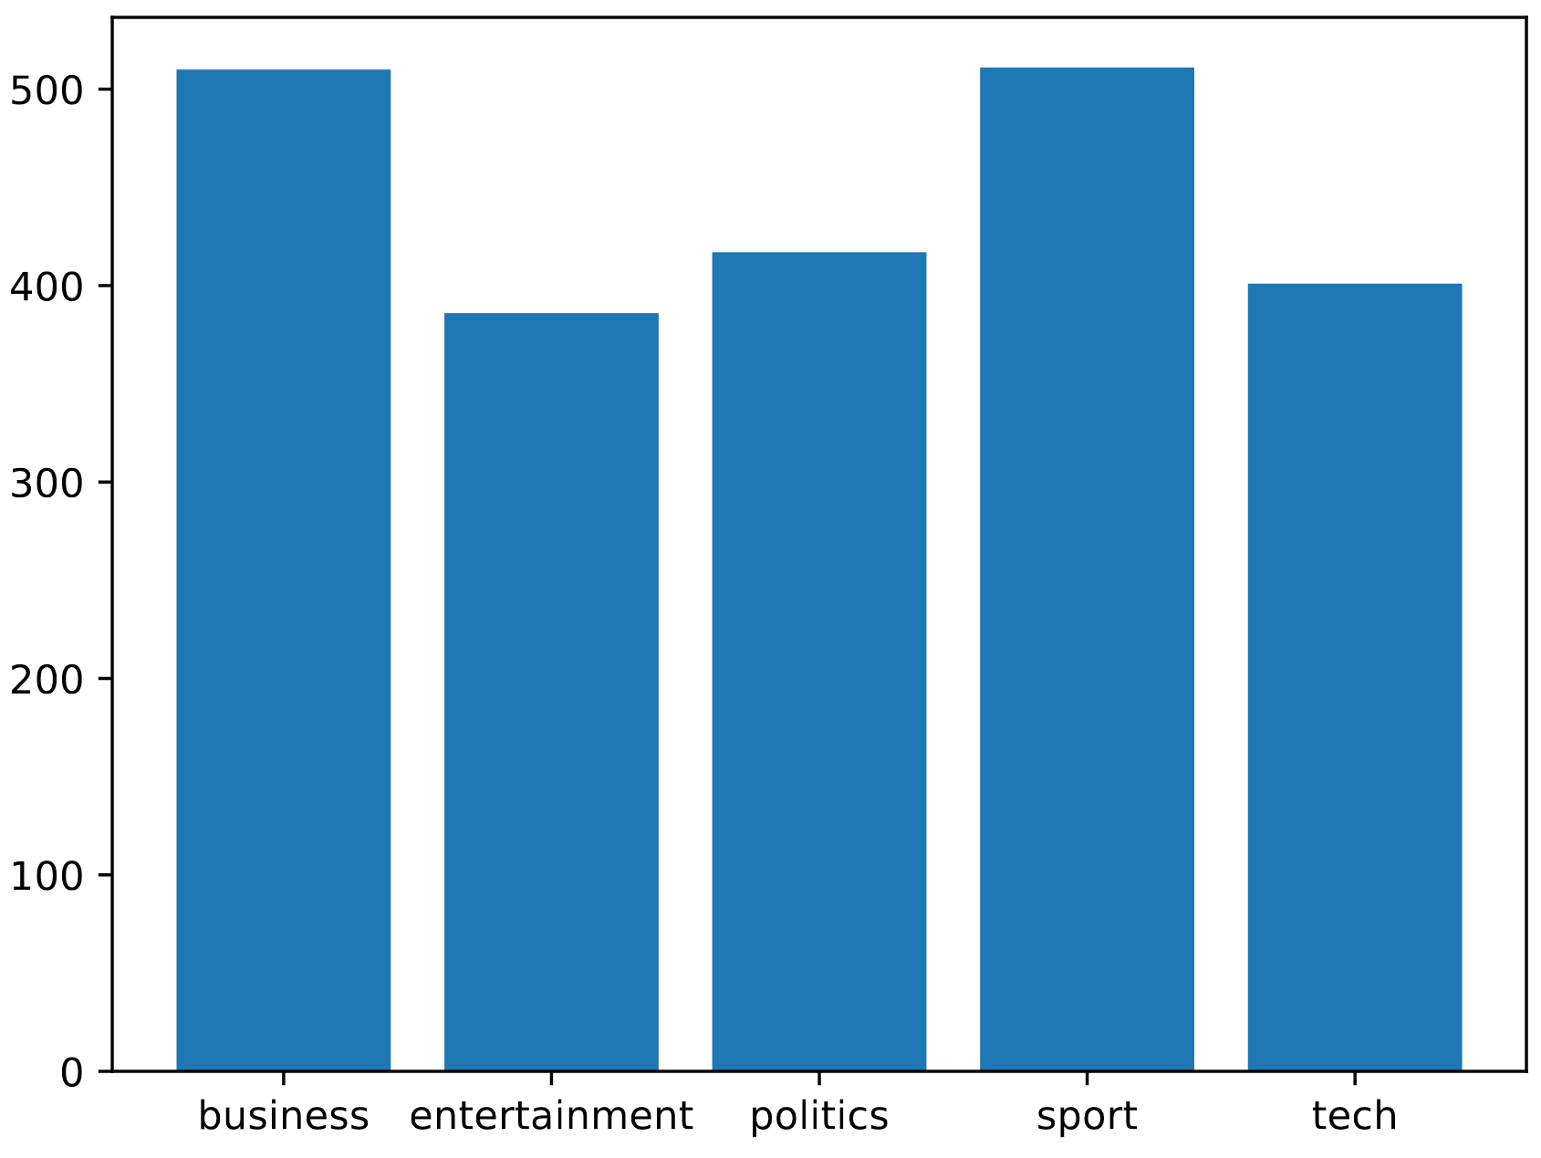
BBC Article Data Distribution
While the data classes are roughly balanced, they aren’t perfectly so.
There is roughly 20-30% more sport and business articles compared to tech, politics, or entertainment.
This means that we could see a considerable dip in accuracy if there is not ‘enough’ training data for something like entertainment compared to sport.
Accuracy is a good measure for performance, though precision and recall are also important, and neither is more critical for this purpose.

Slide 3
Multinomial Naïve Bayes: Default Values, Try 1 & 2
 | precision | recall | f1 | support
Business | 0.96 | 0.98 | 0.97 | 101
Entertainment | 1.00 | 0.85 | 0.92 | 67
Politics | 0.91 | 0.96 | 0.93 | 82
Sports | 0.95 | 1.00 | 0.97 | 104
Tech | 0.97 | 0.93 | 0.95 | 91
Accuracy |  |  | 0.95 | 445
Macro avg | 0.96 | 0.95 | 0.95 | 445
Weighted avg | 0.95 | 0.95 | 0.95 | 445
Try 1 and 2 were identical.
Same data split means the model would be expected to perform the same as there’s nothing random about Naïve Bayes other than the split. The scores would be the same both times.
Overall, fairly effective classification across the board.
Business and sports performed slightly better than the other three, suggesting they might have performed better with some more training data.

Slide 4
Multinomial Naïve Bayes: Smoothing 0.0001
 | precision | recall | f1 | support
Business | 0.99 | 0.94 | 0.96 | 101
Entertainment | 0.98 | 0.91 | 0.95 | 67
Politics | 0.95 | 1.00 | 0.98 | 82
Sports | 1.00 | 1.00 | 1.00 | 104
Tech | 0.92 | 0.98 | 0.95 | 91
Accuracy |  |  | 0.97 | 445
Macro avg | 0.96 | 0.97 | 0.97 | 445
Weighted avg | 0.97 | 0.97 | 0.97 | 445
A considerable increase in accuracy, as well as individual precision, recall, and f1 with the addition of a small amount of smoothing overall.
There was however a dip in Business in particular.
Avery small number for smoothing can greatly improve performance
Would more smoothing perform better, or worse?

Slide 5
Multinomial Naïve Bayes: Smoothing 0.9
 | precision | Recall | f1 | support
Business | 0.98 | 0.98 | 0.98 | 101
Entertainment | 1.00 | 0.87 | 0.93 | 67
Politics | 0.92 | 0.99 | 0.95 | 82
Sports | 0.95 | 1.00 | 0.97 | 104
Tech | 0.97 | 0.93 | 0.95 | 91
Accuracy |  |  | 0.96 | 445
Macro avg | 0.96 | 0.96 | 0.96 | 445
Weighted avg | 0.96 | 0.96 | 0.96 | 445
A small improvement over the performance of our classifier with default values but…
Worse performance overall than the run we did with 0.0001 smoothing.
There likely is still too much smoothing.

Slide 6
Word Frequency: Smoothing and Performance
 | Total Occurrences | Percentage Occurrences
Freq. of 1 in entire Corpus | 10005 | 34.01%
Freq. 0 in business | 17538 | 59.61%
Freq. 0 in entertainment | 17746 | 60.32%
Freq. 0 in politics | 18201 | 61.86%
Freq. 0 in sport | 18850 | 64.07%
Freq. 0 in tech | 17323 | 58.88%
The decrease in performance we saw in the model with 0.9 smoothing likely has something to do with assigning too much probability to words which never occurred in the vocabulary of a specific type of article.
34% of words only occur once in the entire corpus, meanwhile roughly 60% of words don’t occur at all within the vocabulary of a particular class of article.
There may be a middle-ground which performs better still, but clearly 0.9 is still too much.

Slide 7
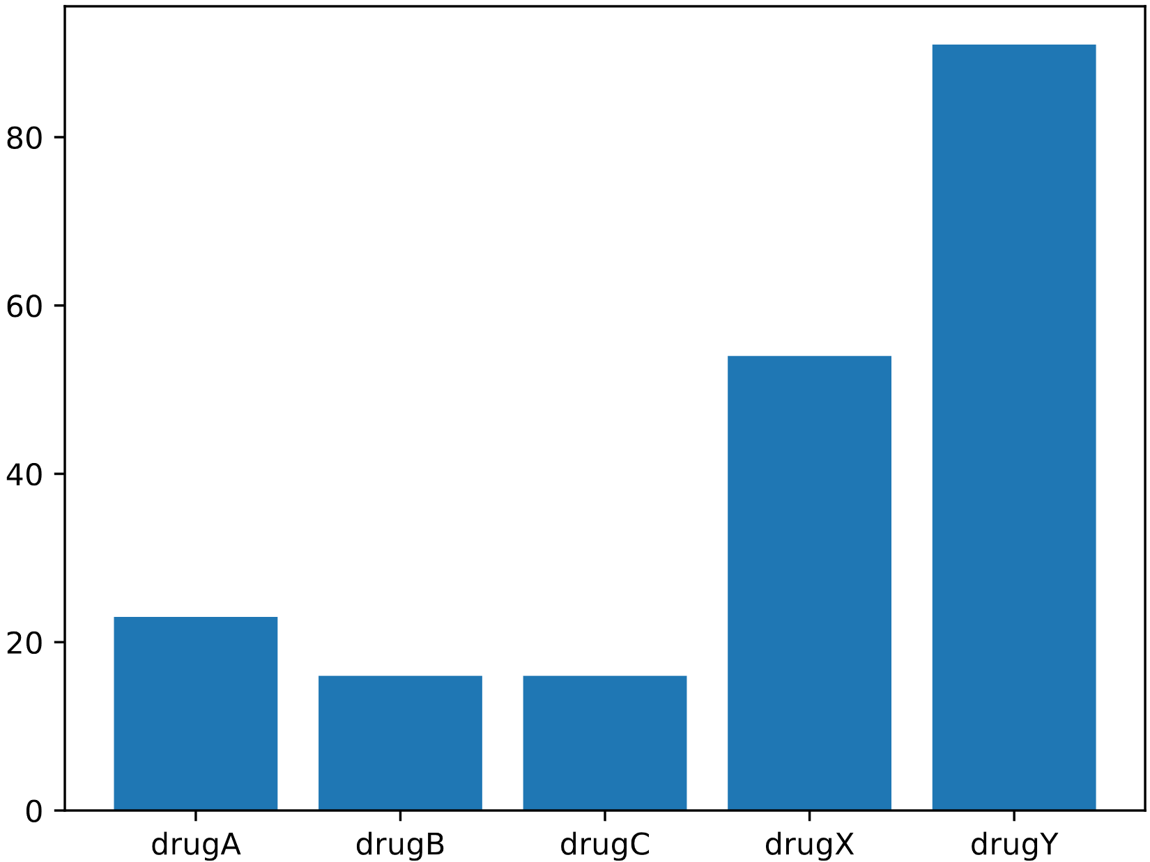
Drugs Data Distribution
The data set is not balanced at all.
DrugY is vastly more represented in our data than the other drugs. A little less than 2x DrugX and 4-5x Drug A, B, or C.
Accuracy would be a bad gauge of whether or not the system is performing well at prescribing the correct drug. We will want to rely more on the F1 measures to ensure nothing is missed.
We would expect to see greater performance when it comes to drugX or drugY if there’s insufficient training data when it comes to drugs A, B, or C.

Slide 8
Gaussian Naïve Bayes: Performance Metrics
Drug Type | precision | recall | f1 | support
A | 0.18 | 0.40 | 0.25 | 5
B | 0.12 | 0.33 | 0.18 | 3
C | 0.43 | 1.00 | 0.60 | 3
X | 0.62 | 1.00 | 0.77 | 15
Y | 1.00 | 0.00 | 0.00 | 24
Accuracy |  |  | 0.42 | 50
Macro avg | 0.47 | 0.55 | 0.36 | 50
Weighted avg | 0.72 | 0.42 | 0.30 | 50
Our predictions from initial analysis of the data set appear to be conflicting, as drugX with a lot of samples performed comparatively well to the others, while drugY did not.

Slide 9
Gaussian Naïve Bayes: Confusion Matrix
 | A | B | C | X | Y
A | 2 | 3 | 0 | 0 | 0
B | 2 | 1 | 0 | 0 | 0
C | 0 | 0 | 3 | 0 | 0
X | 0 | 0 | 0 | 15 | 0
Y | 7 | 4 | 4 | 9 | 0
All the instances of drugY were incorrectly classified as A, B, C, X
The other drugs performed fairly well in comparison.

Slide 10
Base Decision Tree: Performance Metrics
Drug Type | precision | recall | f1 | support
A | 0.14 | 0.20 | 0.17 | 5
B | 1.00 | 0.00 | 0.00 | 3
C | 0.43 | 1.00 | 0.60 | 3
X | 0.59 | 0.67 | 0.62 | 15
Y | 0.42 | 0.33 | 0.37 | 24
Accuracy |  |  | 0.44 | 50
Macro avg | 0.52 | 0.44 | 0.35 | 50
Weighted avg | 0.48 | 0.44 | 0.42 | 50
Here, we can note that drugB performed poorly with a recall of 0, while drugX performed the best overall with the highest recall and precision.

Slide 11
Base Decision Tree: Confusion Matrix
 | A | B | C | X | Y
A | 1 | 0 | 0 | 0 | 4
B | 1 | 0 | 0 | 0 | 2
C | 0 | 0 | 3 | 0 | 0
X | 0 | 0 | 0 | 10 | 5
Y | 5 | 0 | 4 | 7 | 8
We can see here that almost all of drugA was classified under drugY, and that drugY was once again all over the place.

Slide 12
Top Decision Tree: Performance Metrics
Drug Type | precision | recall | f1 | support
A | 0.14 | 0.20 | 0.17 | 5
B | 1.00 | 0.00 | 0.00 | 3
C | 0.43 | 1.00 | 0.60 | 3
X | 0.62 | 1.00 | 0.77 | 15
Y | 0.50 | 0.25 | 0.33 | 24
Accuracy |  |  | 0.50 | 50
Macro avg | 0.54 | 0.49 | 0.35 | 50
Weighted avg | 0.53 | 0.50 | 0.44 | 50
We can see that the top decision tree has outperformed the base model by looking at the averages.
The parameters used were "max_depth":[40,50], "min_samples_split":[30,40,50], "criterion":["gini","entropy"]

Slide 13
Top Decision Tree: Confusion Matrix
 | A | B | C | X | Y
A | 1 | 0 | 0 | 0 | 4
B | 1 | 0 | 0 | 0 | 2
C | 0 | 0 | 3 | 0 | 0
X | 0 | 0 | 0 | 15 | 0
Y | 5 | 0 | 4 | 9 | 6
Here, all 15 of drugX and drugC were classified correctly, while drugA was mostly classified as drugY again and drugY was all over the place

Slide 14
Perceptron: Performance Metrics
Drug Type | precision | recall | f1 | support
A | 1.00 | 0.00 | 0.00 | 5
B | 0.14 | 1.00 | 0.24 | 3
C | 0.43 | 1.00 | 0.60 | 3
X | 0.25 | 0.07 | 0.11 | 15
Y | 0.29 | 0.21 | 0.24 | 24
Accuracy |  |  | 0.24 | 50
Macro avg | 0.42 | 0.46 | 0.24 | 50
Weighted avg | 0.35 | 0.24 | 0.20 | 50
Here we can note that drugB and C have recall values of 1 which is very good, but low precision which indicates that many other drugs were also classified incorrectly in those categories

Slide 15
Perceptron: Confusion Matrix
 | A | B | C | X | Y
A | 0 | 5 | 0 | 0 | 0
B | 0 | 3 | 0 | 0 | 0
C | 0 | 0 | 3 | 0 | 0
X | 0 | 2 | 0 | 1 | 12
Y | 0 | 12 | 4 | 3 | 5
While all of drugB and C were classified correctly, the others did not fare very well

Slide 16
Base Multi-Layered Perceptron: Performance Metrics
Drug Type | precision | recall | f1 | support
A | 1.00 | 0.00 | 0.00 | 5
B | 1.00 | 0.00 | 0.00 | 3
C | 1.00 | 0.00 | 0.00 | 3
X | 1.00 | 0.00 | 0.00 | 15
Y | 0.48 | 1.00 | 0.65 | 24
Accuracy |  |  | 0.48 | 50
Macro avg | 0.90 | 0.20 | 0.13 | 50
Weighted avg | 0.75 | 0.48 | 0.31 | 50
Here, every drugA, B, C, and X all have recalls of 0, which indicates that none of them were classified correctly during this test

Slide 17
Base Multi-Layered Perceptron: Confusion Matrix
 | A | B | C | X | Y
A | 0 | 0 | 0 | 0 | 5
B | 0 | 0 | 0 | 0 | 3
C | 0 | 0 | 0 | 0 | 3
X | 0 | 0 | 0 | 0 | 15
Y | 0 | 0 | 0 | 0 | 24
In this case every drug was reported to be drug Y

Slide 18
Top Multi-Layered Perceptron: Performance Metrics
Drug Type | precision | recall | f1 | support
A | 0.14 | 0.20 | 0.17 | 5
B | 1.00 | 0.00 | 0.00 | 3
C | 0.40 | 0.67 | 0.50 | 3
X | 0.64 | 0.60 | 0.62 | 15
Y | 0.46 | 0.46 | 0.46 | 24
Accuracy |  |  | 0.46 | 50
Macro avg | 0.53 | 0.39 | 0.35 | 50
Weighted avg | 0.51 | 0.46 | 0.45 | 50
By comparing the averages against its base version, we can conclude that this version performed better
The parameters used were "activation":["identity","logistic","tanh","relu"],"solver":["adam","sgd"], "hidden_layer_sizes":[(30,50),(10,10,10)]

Slide 19
Top Multi-Layered Perceptron: Confusion Matrix
 | A | B | C | X | Y
A | 1 | 0 | 0 | 0 | 4
B | 1 | 0 | 0 | 0 | 2
C | 0 | 0 | 2 | 0 | 1
X | 0 | 0 | 0 | 9 | 6
Y | 5 | 0 | 3 | 5 | 11
In this confusion matrix, we can see that drugA and B performed the worst, while drugX and Y appear to be more accurate than the previous models during this run

Slide 20
Average of 10 runs of Each:
Average: | NB | Base DT | Top DT | Perceptron | Base Multi-Layered Perceptron | Top Multi-Layered Perceptron
Accuracy | 42.4 | 46.4 | 47.2 | 45.8 | 44.8 | 46.2
Macro - Average | 36.9 | 35.5 | 37.9 | 28.2 | 12.4 | 30.6
Weighted Average | 31.1 | 43.4 | 44.9 | 38.3 | 25.6 | 41.3
Accuracy σ | 0.445 | 0.445 | 0.421 | 0.569 | 0.457 | 0.442
Macro - Average F1 σ | 0.566 | 0.571 | 0.561 | 0.945 | 0.08 | 0.806
Weighted Average F1 σ | 0.522 | 0.422 | 0.401 | 0.482 | 0.478 | 0.713
As we can see, the Top DT performed the best overall leading in all averaged categories., while the Base MLP performed the worst when comparing the it to the other averages. Something interesting to note is that each “Top” model outperformed its “Base” counterpart. Low averages can be attributed to a low number of samples compared to task 1.

Slide 21
Breakdown of Workload
Donovan:
Data Distribution Graphs for task 1 and 2
Word Counting sections of task 1
Julien:
Naïve Bayes Classifiers for Task 1
Performance Doc for Task 1
Xaavian:
All 6 Classifiers of Task 2
Performance Doc for Task 2

