Slide 1
FLOWDESK
AI-Powered Workplace Productivity Assistant
CAPACITI AI Skills Acceleration Programme | Prepared by Xabiso Memani
1

Slide 2
Problem Statement
Professionals spend significant time each week on repetitive tasks such as drafting emails, planning their workload and researching information. This slows down productivity and takes focus away from higher value work.
Email drafting
Cover letters, follow ups and client emails take time to get right
Task overload
As a software development intern juggling client projects, internship deliverables and an active job search, this problem is personal, not theoretical. Flowdesk was built to directly reduce that daily overhead.
Internship, client work and job applications compete for the same hours
Information overload
Job postings, briefs and articles need fast, accurate summarising
Flowdesk | CAPACITI AI Skills Acceleration Programme
2

Slide 3
Solution Overview
Flowdesk is a browser based productivity assistant that uses generative AI to automate three everyday professional tasks. It is designed as a real tool for real use, not just a class exercise.
Smart Email Generator
AI Task Planner
AI Research Assistant
Generates professional emails based on purpose, audience and tone, ready to send or edit
Turns a raw list of tasks and deadlines into a prioritised, structured plan
Summarises articles, job posts or notes into key insights in seconds
Flowdesk | CAPACITI AI Skills Acceleration Programme
3

Slide 4
Design Direction
Styled after modern SaaS interfaces on Framer and Mobbin, warm and light by default, with a dark mode toggle for user preference.
Light by default
Warm accent colour
Soft neutral stone background, not a dark landing page
Burnt orange used sparingly for buttons and highlights
Light / dark toggle
Soft, modern shapes
User can switch to a warm charcoal dark mode anytime
Rounded corners and subtle shadows instead of hard borders
Flowdesk | CAPACITI AI Skills Acceleration Programme
4

Slide 5
Tools Used
Lovable
GPT / Gemini API
AI app builder used to generate and deploy the front end from natural language prompts
Language model powering the email, planning and summarising features
React + Tailwind CSS
GitHub
Front end framework and styling used under the hood by Lovable
Version control, hosted via Lovable's two way GitHub sync
Flowdesk | CAPACITI AI Skills Acceleration Programme
5

Slide 6
Sample Prompts
Example prompt structures used to generate each feature's output
Email Generator
"Write a formal follow up email to a recruiter after a technical assessment, thanking them and asking for a timeline on next steps."
Task Planner
"Given these five tasks and deadlines, return a prioritised daily plan ordered by urgency and importance, with a one line reason for each position."
Research Assistant
"Summarise this job posting into three key requirements and one recommendation on how to tailor my application."
Flowdesk | CAPACITI AI Skills Acceleration Programme
6

Slide 7
Responsible AI
Flowdesk is built with awareness of AI's limitations. It is designed to assist, not replace, human judgement.
Human review required
Bias awareness
Every AI generated email and plan is shown as editable text before it is used, never sent automatically
Outputs are treated as a starting draft, since AI models can reflect bias in tone or phrasing
Transparency
Data handling
A clear disclaimer is shown reminding users to review AI generated content before relying on it
No personal or client data is stored by the application, all processing happens per session
Flowdesk | CAPACITI AI Skills Acceleration Programme
7

Slide 8
Challenges and Solutions
Prompt accuracy
Challenge: Early outputs were too generic
Solution: Refined prompts to include specific context like tone and audience, improving relevance
Scope control
Challenge: Five possible features risked spreading the build too thin
Solution: Focused on three features that map to a real daily workflow instead of building all five
Responsible use
Challenge: Risk of users trusting AI output blindly
Solution: Added an editable preview and disclaimer before any content is used
Flowdesk | CAPACITI AI Skills Acceleration Programme
8

Slide 9
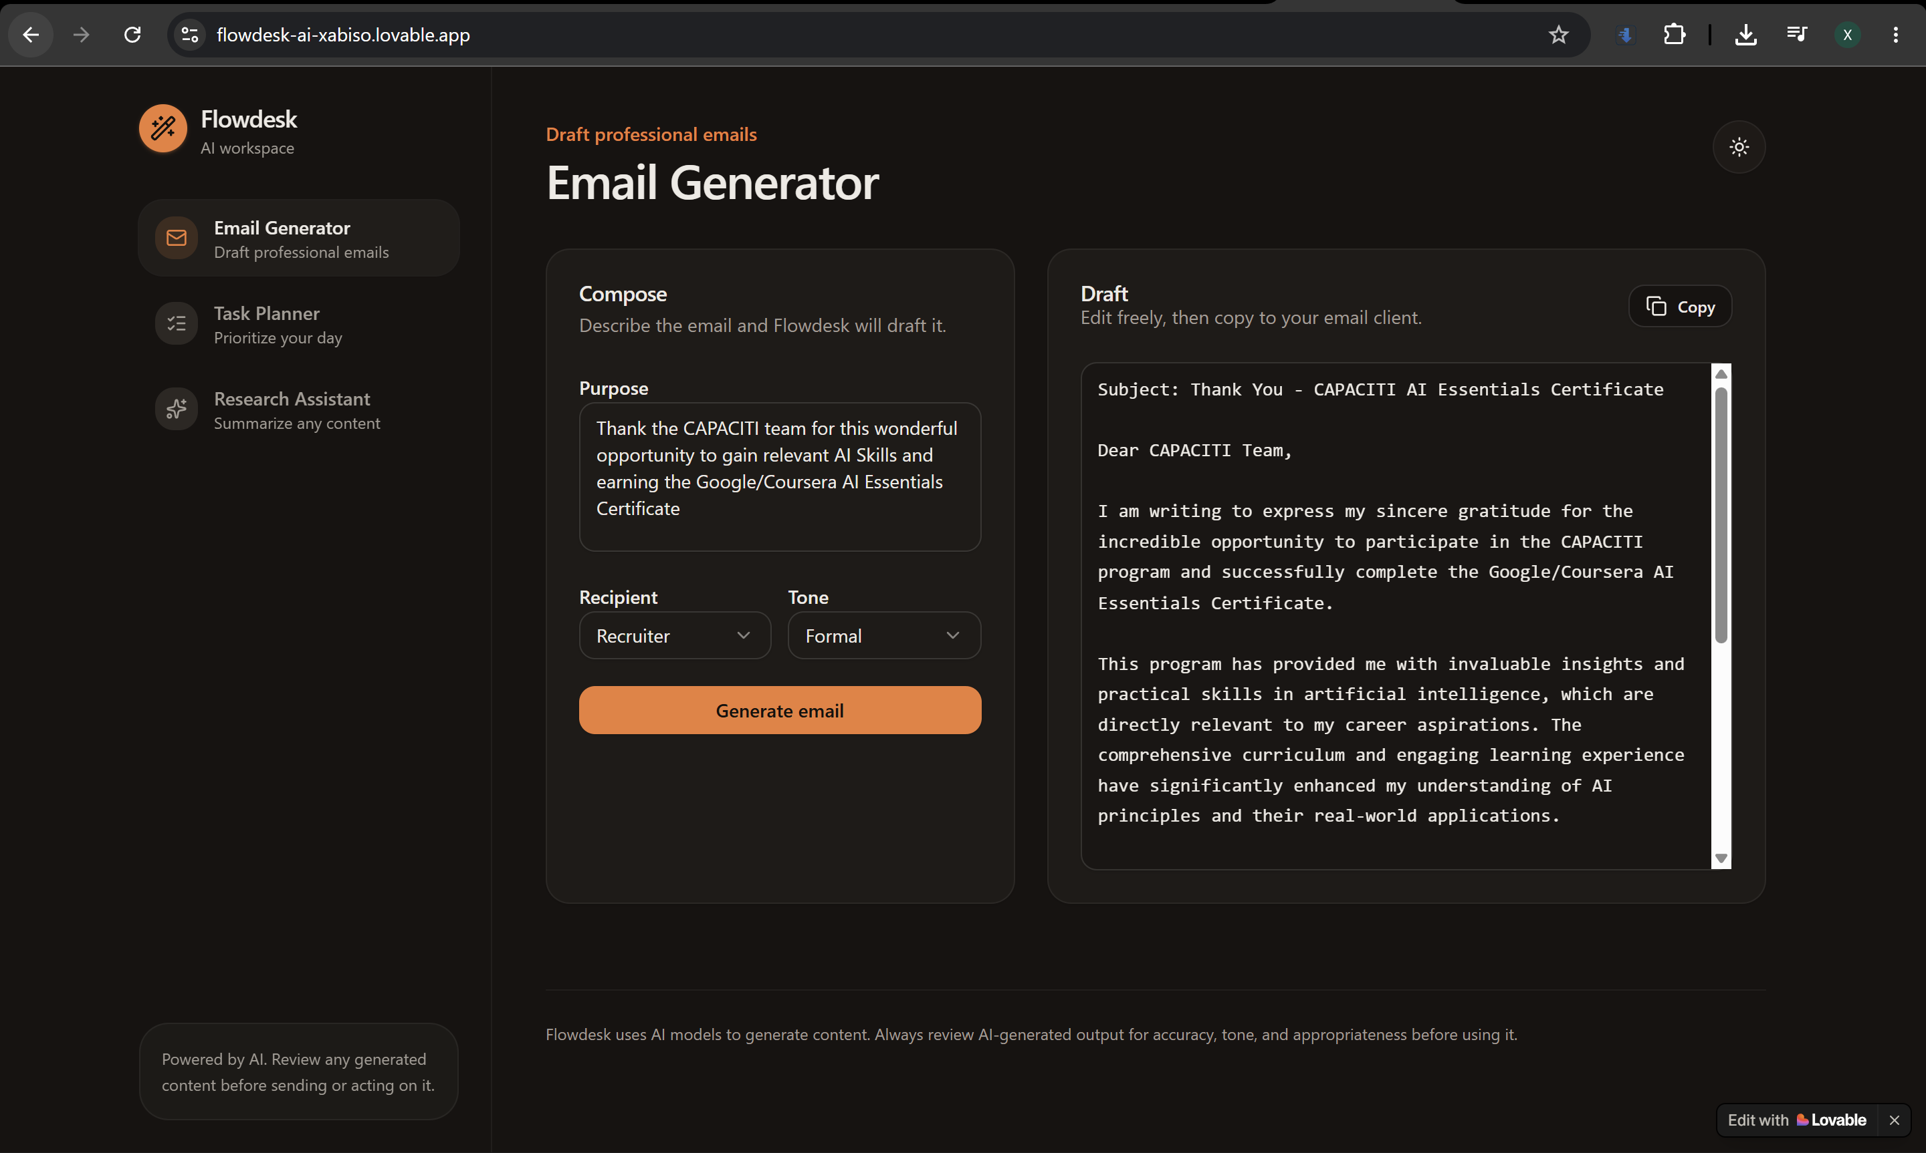
Live Demo
GitHub: https://github.com/XabisoMemani/flowdesk-ai-assistant | Live app: https://flowdesk-ai-xabiso.lovable.app/
Flowdesk | CAPACITI AI Skills Acceleration Programme
9

