Slide 1

OPERATING SYSTEM
Chapter 1 Introduction
2023-2024 –Fall Semester

Slide 2
0
0
LEARNING OBJECTIVES
Upon completion of this material, you should be able to understand:
What Operating Systems Do
Computer-System Organization
Computer-System Architecture
Operating-System Operations
Resource Management.
Computing Environments

Slide 3
0
1
Objectives
Describe the general organization of a computer system and the role of interrupts.
Describe the components in a modern, multiprocessor computer system.
Illustrate the transition from user mode to kernel mode.
Discuss how operating systems are used in various computing environments.
Provide examples of free and open-source operating systems.

Slide 4
0
1
Introduction
An operating system is software that manages a computer’s hardware.
It also provides a basis for application programs and acts as an intermediary between the computer user and the computer hardware.
An amazing aspect of operating systems is how they vary in accomplishing these tasks in a wide variety of computing environments.

Slide 5
0
1
Introduction
Operating systems are everywhere:
from cars and home appliances that include “Internet of Things” devices,
to Smart phones,
Personal computers,
Enterprise computers,
and cloud computing environments.
In order to explore the role of an operating system in a modern computing environment, it is important first to understand the organization and architecture of computer hardware.

Slide 6
0
1
Introduction
Operating system goals
Execute user programs and make solving user problems easier
Make the computer system convenient to use
Use the computer hardware in an efficient manner

Slide 7
0
2
Computer System Structure
A computer system can be divided roughly into four components:
The hardware
The operating system
The application programs
The User
Notes:
We begin our discussion by looking at the operating system’s role in the overall computer system.

Slide 8
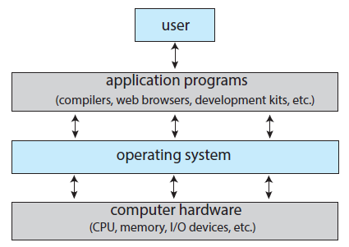
0
2
Computer System Structure
Abstract View of Components of Computer

Slide 9
0
3
What Operating Systems Do?
To understand more fully the operating system’s role, we next explore operating systems from two viewpoints: that of the user and that of the system.
User's View:
The user's experience with a computer depends on the interface being used, such as laptops or PCs with monitors, keyboards, and mice.
These systems are designed for a single user and prioritize ease of use, with some consideration for performance and security, but not resource utilization.
Mobile devices like smartphones and tablets are replacing traditional computers for some users, featuring touch screens and voice recognition interfaces.
Some computers, like embedded ones in home devices and automobiles, have minimal user interaction and are designed for autonomous operation.

Slide 10
0
3
What Operating Systems Do?
Computer's View:
From the computer's point of view, the operating system is the program most closely connected to the hardware.
The operating system serves as a resource allocator, managing CPU time, memory space, storage space, I/O devices, and more.
It must make decisions on resource allocation in the face of potentially conflicting requests to operate the computer efficiently and fairly.
Another perspective sees the operating system as a control program, managing user program execution to prevent errors and improper use of the computer, especially concerning I/O devices.
OS serve both the user's need for interaction and the computer's need for resource management and control.

Slide 11
0
4
Operating System Definition
No universally accepted definition
“Everything a vendor ships when you order an operating system” is a good approximation
But varies wildly
“The one program running at all times on the computer” is the kernel, part of the operating system
Everything else is either
A system program (ships with the operating system, but not part of the kernel) , or
An application program, all programs not associated with the operating system
Today’s OSes for general purpose and mobile computing also include middleware – a set of software frameworks that provide additional services to application developers such as databases, multimedia, graphics .

Slide 12
0
5
WHY STUDY OPERATING SYSTEMS?
Although the most computer scientists may not directly create or modify operating systems, studying them is vital.
Knowledge of operating systems is crucial for proper, efficient, effective, and secure programming.
Operating systems serve as the foundation for almost all code, making their understanding essential.
Understanding operating system fundamentals helps in comprehending their role in driving computer hardware and supporting applications.
This knowledge benefits both those who program operating systems and those who write and use programs running on them.

Slide 13
Overview of
Computer System Structure

Slide 14
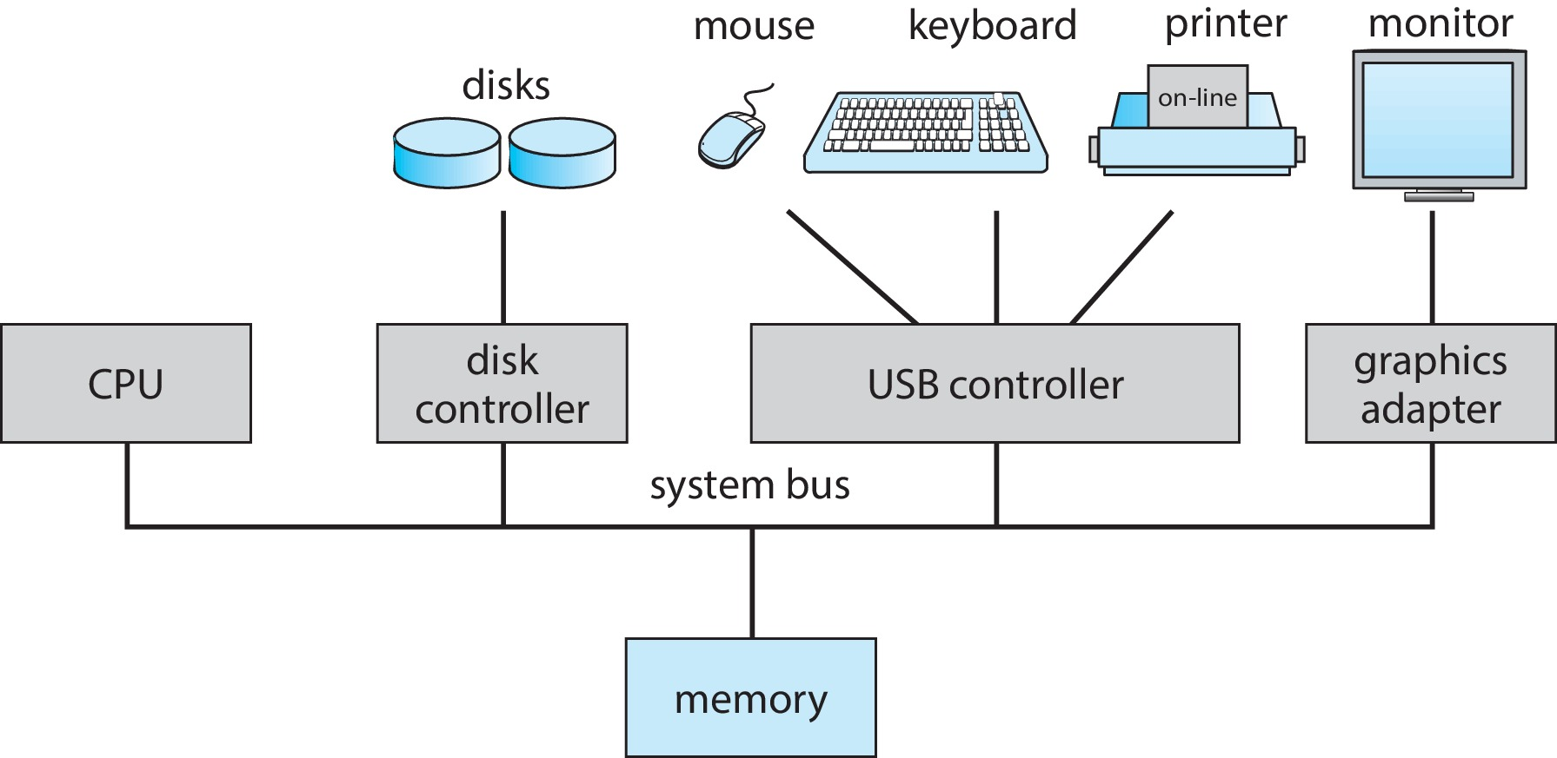
0
6
Computer System Organization
A modern general-purpose computer system consists of one or more CPUs and a number of device controllers connected through a common bus that provides access between components and shared memory.
Concurrent execution of CPUs and devices competing for memory cycles

Slide 15
0
7
Computer-System Operation
I/O devices and the CPU can execute concurrently
Each device controller is in charge of a particular device type
Each device controller has a local buffer
Each device controller type has an operating system device driver to manage it
CPU moves data from/to main memory to/from local buffers
I/O is from the device to local buffer of controller
Device controller informs CPU that it has finished its operation by causing an interrupt.

Slide 16
0
7
Computer-System Operation
Interrupts are an event that causes a program to stop and start executing another program.
Interrupts are like a phone call from some device telling the program to stop executing and execute some other code instead.
Most often, the device that generates an interrupt is the hardware device such as a keyboard, mouse, printer, hard drive, etc. The program itself can also generate interrupts.

Slide 17
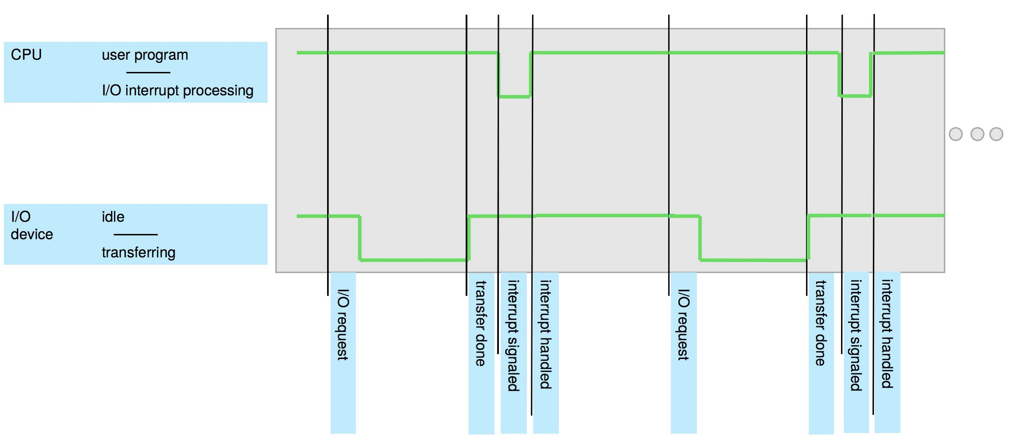
0
8
Interrupt Timeline

Slide 18
0
9
Common Functions of Interrupts
Interrupt transfers control to the interrupt service routine generally, through the interrupt vector, which contains the addresses of all the service routines
Interrupt architecture must save the address of the interrupted instruction
A trap or exception is a software-generated interrupt caused either by an error or a user request
An operating system is interrupt driven

Slide 19
0
9
Interrupt Handling
The operating system preserves the state of the CPU by storing the registers and the program counter
Determines which type of interrupt has occurred:
Separate segments of code determine what action should be taken for each type of interrupt

Slide 20
0
9
Interrupt-drive I/O Cycle

Slide 21
0
9
Types of Interrupts
Interrupts are generally categorized in two categories-
Hardware interrupts are generated by interrupt request signals from peripheral circuits. hardware interrupts happen when information like the video card’s signals need to be processed.
Software interrupts are generated by executing a dedicated instruction. software interrupts happen when the system is waiting for a certain program to finish so that it can continue running.

Slide 22
Understanding
Storage Structure

Slide 23
1
0
Storage Structure
Main memory – only large storage media that the CPU can access directly
Random access
Typically volatile
Typically random-access memory in the form of Dynamic Random-access Memory (DRAM)
Secondary storage – extension of main memory that provides large nonvolatile storage capacity

Slide 24
1
0
Storage Structure
The most common secondary-storage devices are hard-disk drives (HDDs) and nonvolatile memory (NVM) devices, which provide storage for both programs and data.
Most programs (system and application) are stored in secondary storage until they are loaded into memory.

Slide 25
1
0
Storage Hierarchy
Storage systems organized in hierarchy
Speed
Cost
Volatility
Caching – copying information into faster storage system; main memory can be viewed as a cache for secondary storage
Device Driver for each device controller to manage I/O
Provides uniform interface between controller and kernel
Notes:
Caching: storing data in a separate disk
Device Driver : a piece of software that allows your computer's operating system to communicate with a hardware device the driver is written for

Slide 26
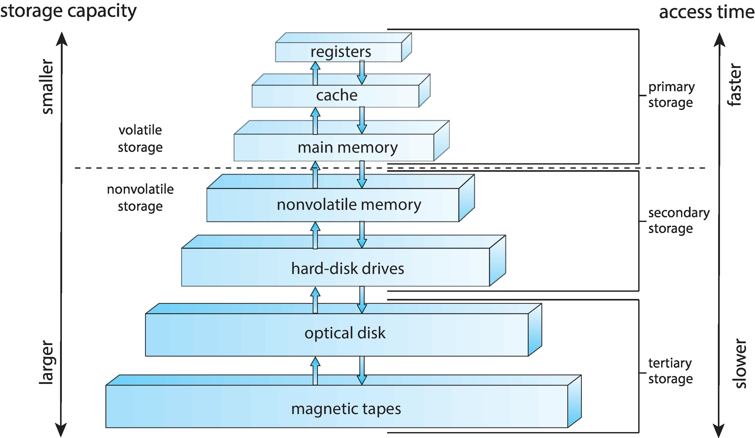
1
0
Storage-Device Hierarchy

Slide 27
1
1
Computer-System Architecture
Single-Processor Systems: also known as uniprocessor systems, are computing systems that contain only one central processing unit (CPU). This CPU executes instructions sequentially.
Performance: These systems are generally limited in terms of performance because they can only execute one instruction at a time. They may not be suitable for resource-intensive tasks that require parallel processing.
Simplicity: Single-processor systems are relatively simple in terms of hardware and software design.
Cost: They tend to be more cost-effective compared to multiprocessor systems since they require fewer hardware components.
Compatibility: Many older systems and legacy software applications were designed for single-processor architectures.
Scalability: They do not easily scale in terms of performance. To improve performance, you would need to upgrade the CPU, which may have limitations in terms of how much improvement can be achieved.
Notes:
Single-Processor Systems:
Definition: Single-processor systems, also known as uniprocessor systems, are computing systems that contain only one central processing unit (CPU). This CPU executes instructions sequentially.
Performance: These systems are generally limited in terms of performance because they can only execute one instruction at a time. They may not be suitable for resource-intensive tasks that require parallel processing.
Simplicity: Single-processor systems are relatively simple in terms of hardware and software design. They are easier to program and maintain because there is no need to manage multiple processors.
Cost: They tend to be more cost-effective compared to multiprocessor systems since they require fewer hardware components.
Compatibility: Many older systems and legacy software applications were designed for single-processor architectures. Compatibility can be an issue when trying to run such software on multiprocessor systems.
Scalability: They do not easily scale in terms of performance. To improve performance, you would need to upgrade the CPU, which may have limitations in terms of how much improvement can be achieved.

Slide 28
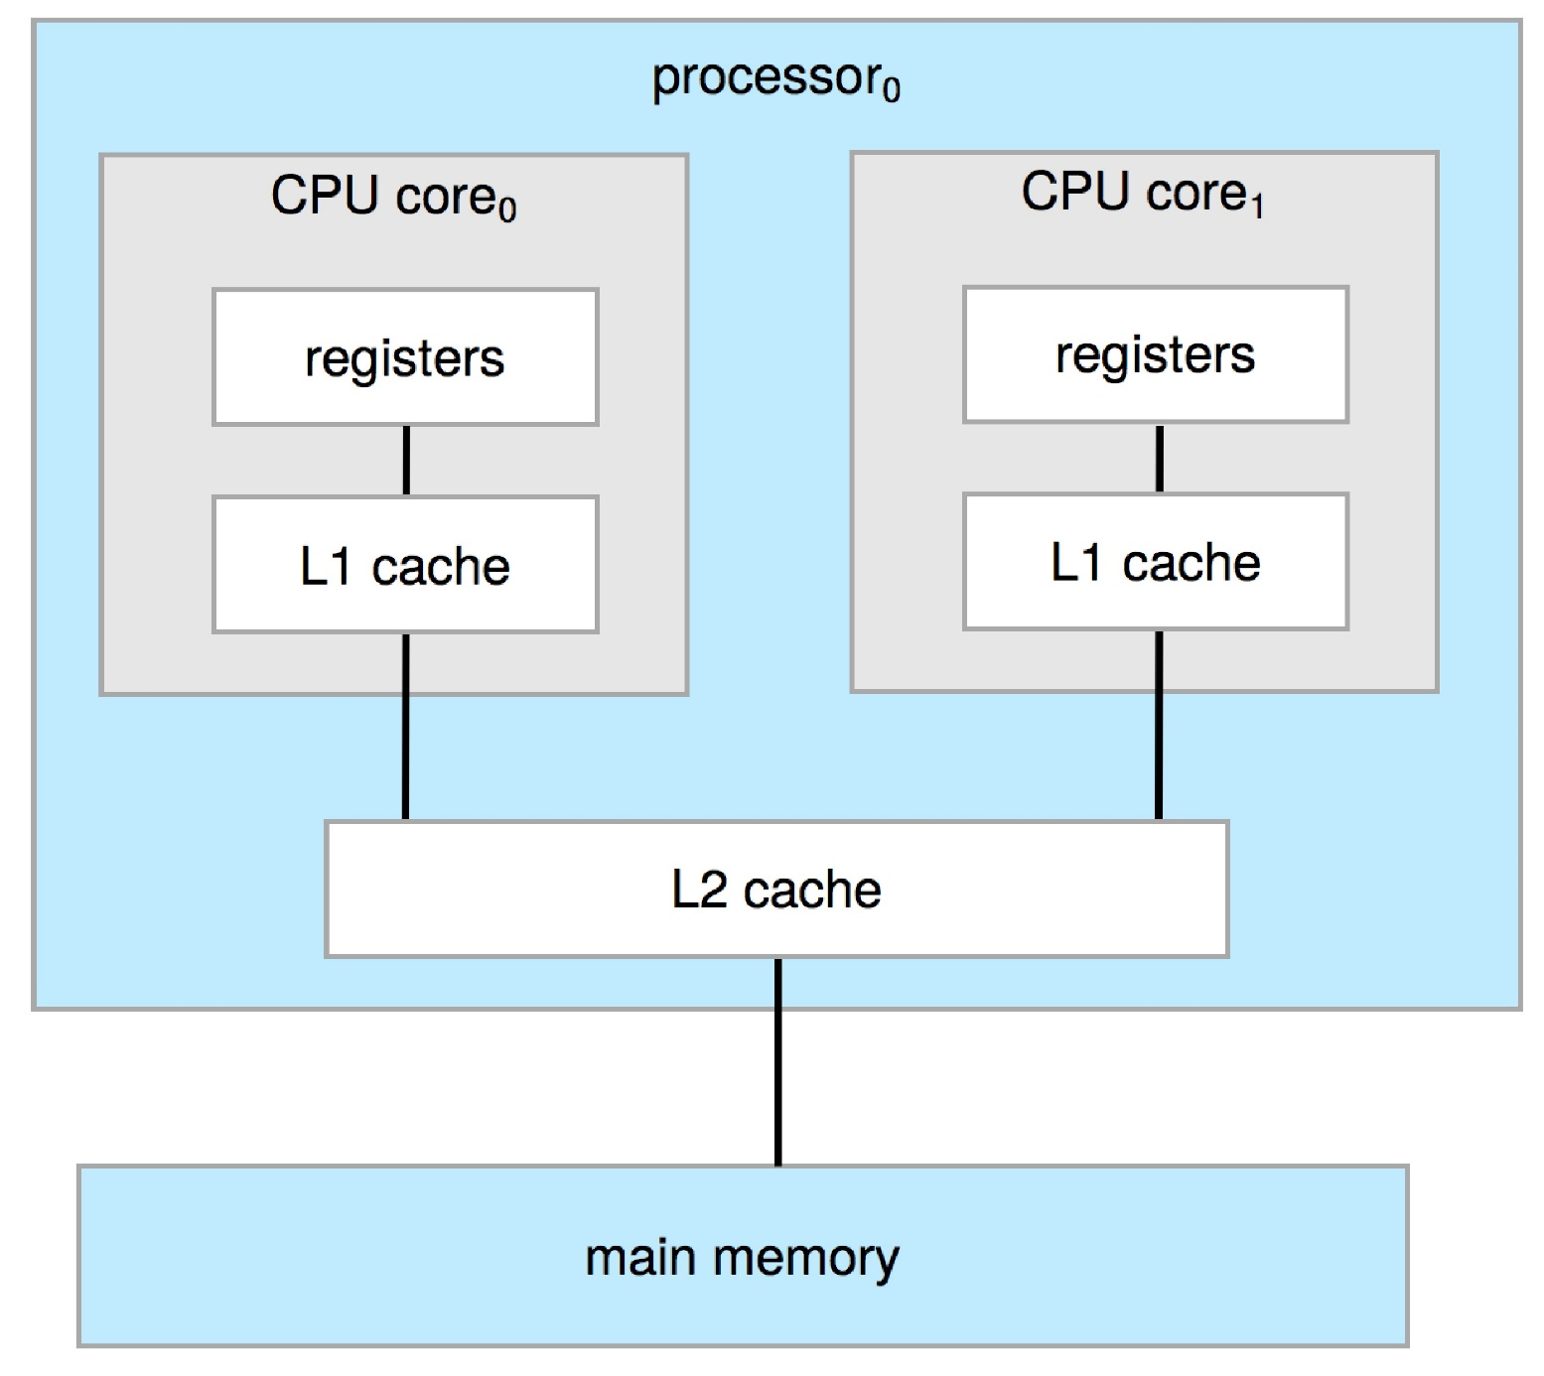
1
1
Computer-System Architecture

Slide 29
1
2
Computer-System Architecture
Multiprocessor Systems: also known as parallel processing systems, contain multiple CPUs that work together to execute instructions simultaneously. These CPUs can communicate and share resources.
Performance: Multiprocessor systems are designed to offer improved performance for tasks that can be parallelized. They can handle multiple tasks concurrently, making them suitable for tasks such as scientific simulations, video rendering, and large-scale data processing.
Complexity: Multiprocessor systems are more complex in terms of both hardware and software.
Cost: They are generally more expensive than single-processor systems due to the additional hardware and complexity involved.
Compatibility: Multiprocessor systems may have compatibility issues with software that is not designed to take advantage of multiple processors.
Scalability: They can be more easily scaled to meet increased performance demands. You can add more processors to a multiprocessor system to improve its performance, making them suitable for tasks that require scalability.

Slide 30
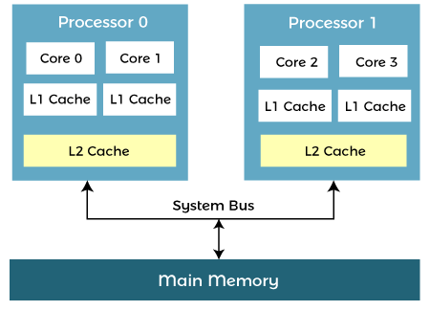
1
2
Computer-System Architecture
Multiprocessor Systems

Slide 31
1
2
Computer-System Architecture
Clustered Systems
Like multiprocessor systems, but multiple systems working together
Usually sharing storage via a storage-area network (SAN)
Provides a high-availability service which survives failures
Asymmetric clustering has one machine in hot-standby mode
Symmetric clustering has multiple nodes running applications, monitoring each other
Some clusters are for high-performance computing (HPC)
Applications must be written to use parallelization
Some have distributed lock manager (DLM) to avoid conflicting operations
Notes:
High performance computing (HPC) generally refers to processing complex calculations at high speeds across multiple servers in parallel. Those groups of servers are known as clusters and are composed of hundreds or even thousands of compute servers that have been connected through a network
A distributed lock manager (DLM) is a software component provided by your platform vendor. The DLM maintains a list of system resources and provides locking mechanisms to control allocation and modification of Oracle resources.

Slide 32
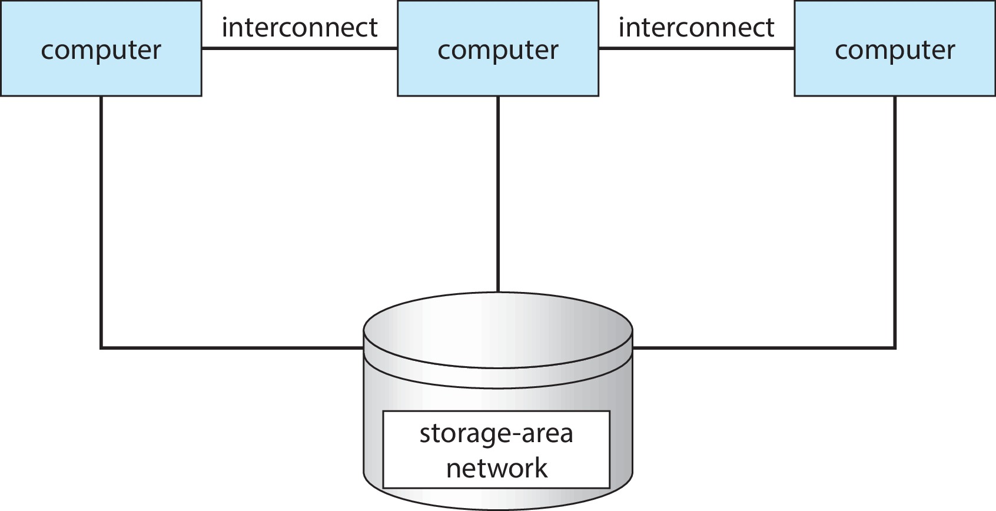
1
2
Computer-System Architecture

Slide 33
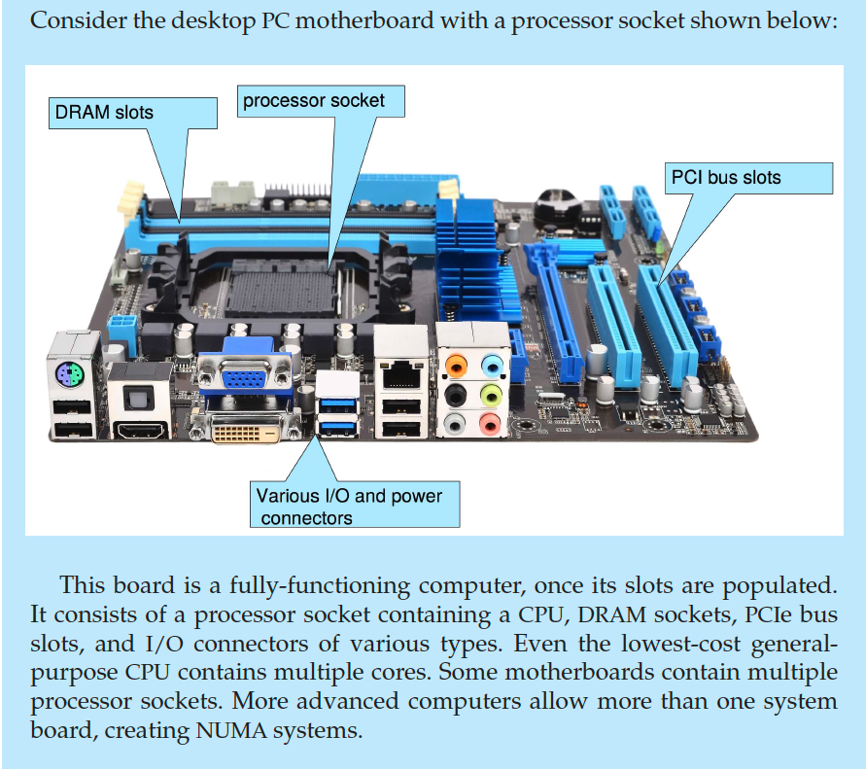
1
2
Computer-System Architecture
PC Motherboard

Slide 34
1
3
Resource Management
The operating system is a resource manager. The system’s CPU, memory space, file-storage space, and I/O devices are among the resources that the operating system must manage.
1) Process Management
A process is a program in execution. It is a unit of work within the system. Program is a passive entity; process is an active entity. Process Management Activities include:
Creating and deleting both user and system processes
Scheduling processes and threads on the CPUs
Suspending and resuming processes
Providing mechanisms for process synchronization
Providing mechanisms for process communication
Notes:
Single-threaded process has one program counter specifying location of next instruction to execute
Multi-threaded process has one program counter per thread

Slide 35
1
3
Resource Management
2) Memory Management
To execute a program all (or part) of the instructions must be in memory
All (or part) of the data that is needed by the program must be in memory
Memory management determines what is in memory and when
Optimizing CPU utilization and computer response to users
Memory management activities include:
Keeping track of which parts of memory are currently being used and by whom
Deciding which processes (or parts thereof) and data to move into and out of memory
Allocating and deallocating memory space as needed
Notes:
Memory management is the functionality of an operating system which handles or manages primary memory and moves processes back and forth between main memory and disk during execution.

Slide 36
1
3
Resource Management
3) File-system Management
OS provides uniform, logical view of information storage
Abstracts physical properties to logical storage unit - file
Each medium is controlled by device (i.e., disk drive, tape drive)
Varying properties include access speed, capacity, data-transfer rate, access method (sequential or random)
File-System management
Files usually organized into directories
Access control on most systems to determine who can access what
OS activities include
Creating and deleting files and directories
Primitives to manipulate files and directories
Mapping files onto secondary storage
Backup files onto stable (non-volatile) storage media
Notes:
File management is one of the basic and important features of operating system. Operating system is used to manage files of computer system

Slide 37
1
3
Resource Management
4) Mass-Storage Management
Usually disks used to store data that does not fit in main memory or data that must be kept for a “long” period of time
Proper management is of central importance
Entire speed of computer operation hinges on disk subsystem and its algorithms
OS activities
Mounting and unmounting
Free-space management
Storage allocation
Disk scheduling
Partitioning
Protection

Slide 38
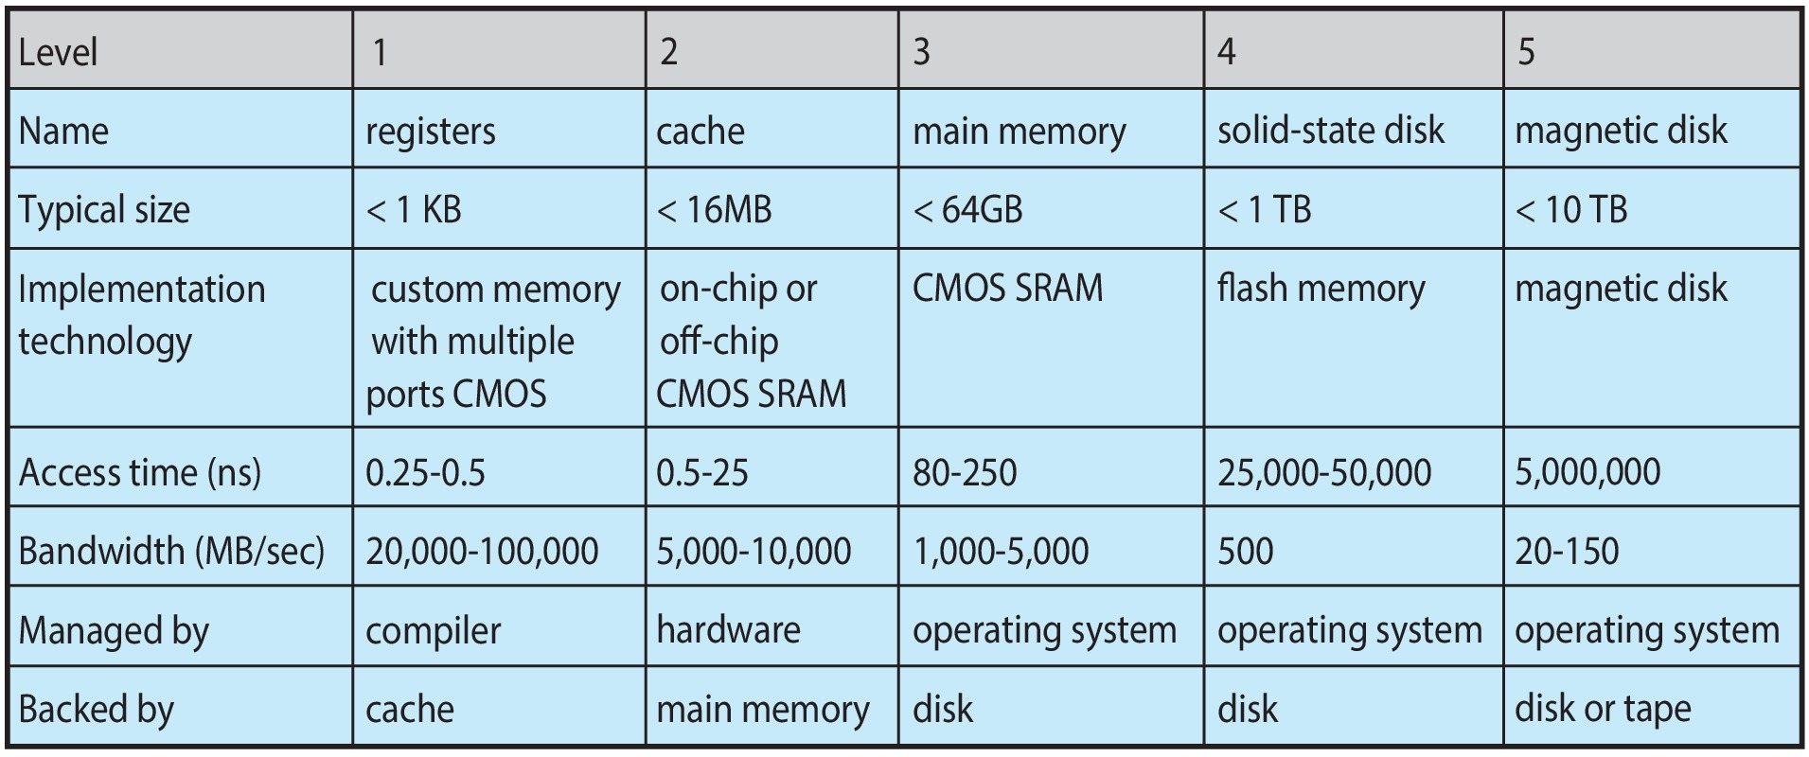
1
4
Characteristics of Various Types of Storage
Movement between levels of storage hierarchy can be explicit or implicit

Slide 39
Understanding
Computing Environments

Slide 40
1
5
Computing Environments
Traditional Computing Environment:
Refers to the conventional model of computing where software and data are primarily stored and processed on personal computers or local servers.
Typically involves standalone applications and limited connectivity to other devices or networks.
Mobile Computing Environment:
Focuses on computing devices like smartphones and tablets.
These devices are highly portable and often connected to the internet, allowing users to access a wide range of applications and services while on the move.
Leaders are Apple iOS and Google Android

Slide 41
1
5
Computing Environments
Client-Server Computing Environment:
Involves a networked architecture where multiple client devices (e.g., computers, smartphones) communicate with a central server.
Clients request and receive services or data from the server, which is responsible for processing and managing these requests.
Peer-to-Peer Computing Environment:
Relies on a decentralized network of interconnected devices, where each device can act both as a client and a server.
Participants in the network share resources and collaborate directly with one another without a central server

Slide 42
1
5
Computing Environments
Cloud Computing Environment:
Utilizes remote servers hosted on the internet (the "cloud") to store, manage, and process data and applications. Offers scalability, flexibility, and accessibility, making it a popular choice for businesses and individuals.
Amazon EC2 has thousands of servers, millions of virtual machines, petabytes of storage available across the Internet, pay based on usage.

Slide 43
1
5
Computing Environments
Cloud Computing Environment: Many types
Public cloud – available via Internet to anyone willing to pay
Private cloud – run by a company for the company’s own use
Hybrid cloud – includes both public and private cloud components
Software as a Service (SaaS) – one or more applications available via the Internet (i.e., word processor)
Platform as a Service (PaaS) – software stack ready for application use via the Internet (i.e., a database server)
Infrastructure as a Service (IaaS) – servers or storage available over Internet (i.e., storage available for backup use

Slide 44
1
5
Computing Environments
Real-Time Embedded Computing Environment:
Embedded systems are specialized computing systems integrated into other devices or products.
Real-time embedded systems perform tasks with strict timing constraints, often used in applications where immediate and predictable responses are critical (e.g., automotive control systems, medical devices).

Slide 45
0
0
Review Questions
Define these terms: A) Operating system b) Main memory c) Secondary storage d)Caching
What are the main goals of Operating systems?
A computer system can be divided roughly into four components list them.
Explain the two viewpoints about the operating system’s role.
Why do we study Operating systems?
Describe the Organization of the Modern Computer System.
What is Interrupts?
Describe two different types of Interrupts supported by Operating systems.
What are the most common secondary storage devices?
Storage systems are organized in a hierarchy according to three factors list them.
Explain the Computer-System Architecture
What is different between Asymmetric and Symmetric clustering?
List Process Management Activities
List Memory management activities
List File-System management activities
List Mass-Storage Management activities
Discuss different Computing Environments

Slide 46
END

