Slide 1
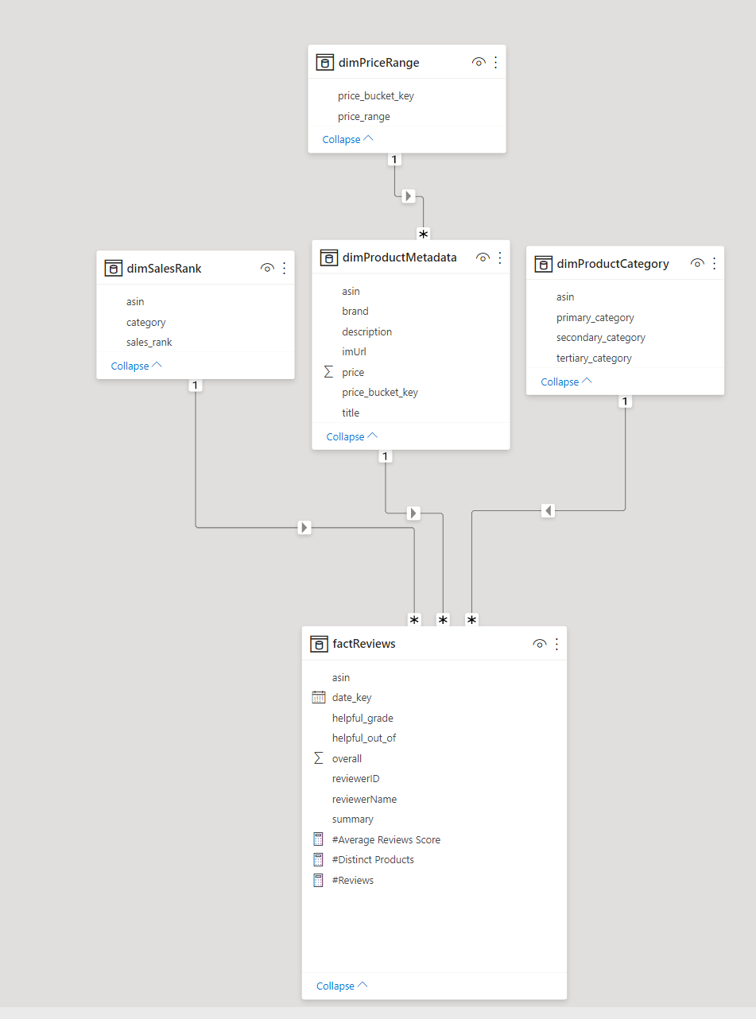
Final Model
dimPriceRange: Holds buckets for price. Key generated by passing price through log function. Prevents having to join/lookup.
dimProductCategory: Only holds details for the first category from input file. Primary/secondary/tertiary determined based on order in source dictionary.
dimSalesRank: coming from salesrank field from source.
dimProductMetadata: all flat fields from source, plus a price key for dimPriceRange
factReviews: holds the review data minus the text, since there is no value in bringing that over for now

