Slide 1

XR Simulation Learning Platform
Phase 1 · Student LMS — UI/UX Progress Review
Project Progress & Product Discussion
12 August 2026
Review 005 approved baseline · 29 Student screens defined · Decisions D-01 – D-25
Notes:
Progress review for Phase 1 of the XR Simulation Learning Platform — the Student Desktop LMS. This covers UI/UX only; software implementation has not begun. Review 005 is the approved baseline and everything shown traces back to it.

Slide 2
Where We Are Today
Status by workstream — not a single overall percentage
ADVANCED
ADVANCED
IN TRANSFER
NOT STARTED
Product Understanding & Requirements
UX / Product Definition
Visual Design
Software Development
• Phase-1 requirements analysed
• Student scope defined
• FRD traceability established
• Information architecture
• User journeys mapped
• Decisions D-01 – D-25
• 29-screen inventory
• High-fidelity Student experience created
• Design system specified
• Native Figma foundations started
• Awaiting UI/UX review and sign-off
• Implementation planning follows sign-off
FOCUS
Complete native Figma → PM review → UI/UX sign-off → development planning
XR Simulation Learning Platform · Phase 1 Student LMS · UI/UX Progress Review
2
Notes:
Four workstreams, four different states — deliberately not a single overall figure. Requirements and UX definition are advanced. Visual design exists in full in the repository and is being transferred into native Figma. Development has not started, which is intentional: UI/UX sign-off should come first.

Slide 3
Phase 1 Scope
One Student experience, two audiences, four simulation formats
Student Desktop LMS
B2B — Institutional Student
B2C — Individual Learner
ASSIGNED ACCESS
PURCHASED ACCESS
• Institutional SSO preferred
• Assigned / licensed learning
• Institution context shown
• No irrelevant purchase prompts
• Individual self-registered account
• Explore catalogue
• Module / Bundle purchase
• Checkout and entitlement
SHARED LEARNING EXPERIENCE
Home
My Learning
Courses
Modules
Learning Resources
Simulations
Assessments
Progress
Profile
SIMULATION FORMATS
WEB
VR
MR
AR
Licensed XR modules stay visible on desktop with device-specific guidance
XR Simulation Learning Platform · Phase 1 Student LMS · UI/UX Progress Review
3
Notes:
One shared learning core serves both audiences. They differ only where the experience genuinely differs — how you sign in, where entitlement comes from, and whether you see commerce. Ten divergences are documented; everything else is identical. Four simulation formats are supported and XR modules are never hidden on desktop.

Slide 4
From FRD to an Implementable Student Experience
Every stage below is complete and recorded in the repository
FRD
→
Requirements Analysis
→
Product Decisions
→
Information Architecture
→
User Flows
29-Screen Inventory
→
Wireframes
→
High-Fidelity UI
→
Accessibility Review
→
Developer Handoff
131
78
29
D-01 – D-25
Review 005
FRD requirements accounted for
Phase-1 requirements classified
Student screens defined
approved product decisions
approved baseline
Repository documentation is now the source of truth for the UI/UX baseline. Coverage indicators, not performance metrics.
XR Simulation Learning Platform · Phase 1 Student LMS · UI/UX Progress Review
4
Notes:
This is the path from the original FRD to something a development team can build. Each stage produced a reviewed artefact. The numbers are coverage indicators: every FRD requirement was accounted for, and every Student-facing one lands on a named screen. The repository — not any single tool — is the baseline.

Slide 5
Key Product Decisions Now Defined
Twenty-five confirmed decisions, grouped into what they change for the Student
1
Audience
2
Learning Structure
3
Progression
• B2B and B2C share one learning core
• Branch only where experience truly differs
• Course → Module → Resources
• → Simulation → Assessment
• Sequential gating inside a course
• A locked step always names its prerequisite
4
Standalone B2C Module
5
Commerce
6
Assessment
• Available immediately after purchase
• Internal progression still applies
• Purchasable: Module, Bundle
• A Course is not directly purchasable
• 10 MCQs · 20 minutes total
• +2 correct · +1 after hint · −1 wrong · 0 blank
• Pass 10/20 · unlimited attempts
Score floor: the displayed assessment score can never fall below 0. Negative marking still applies to each wrong answer; only the reported total is floored.
XR Simulation Learning Platform · Phase 1 Student LMS · UI/UX Progress Review
5
Notes:
Rather than walk all twenty-five decisions, these are the six groups that change what the Student actually experiences. The two worth pausing on: a Course is structural, not a product — only Modules and Bundles are sold; and the reported assessment score is floored at zero so a learner never sees a negative total.

Slide 6
Student Learning Journey
One deterministic path — the system always knows the next step
Login / SSO
→
Home
→
My Learning
→
Course
→
Module
INSIDE A MODULE — SEQUENTIAL
Required Learning Resources
→
Simulation
→
Assessment
→
Pass
→
Module Complete
→
Next Module Unlocks
REQUIRED
OPTIONAL
Optional resources never block progression.
B2C BRANCH
Standalone purchased module
→
Available immediately
→
Same internal sequence
No previous-module prerequisite
A module completes only when required resources, the simulation, and a passed assessment are all satisfied.
XR Simulation Learning Platform · Phase 1 Student LMS · UI/UX Progress Review
6
Notes:
This is the whole product in one picture. The Student signs in, lands on Home, and gets one Continue button — because gating makes the next step unambiguous. Inside a module the order is fixed: required resources, then simulation, then assessment. Passing completes the module and unlocks the next one. Optional material never blocks anyone. A separately purchased module skips the prerequisite but keeps the same internal order.

Slide 7
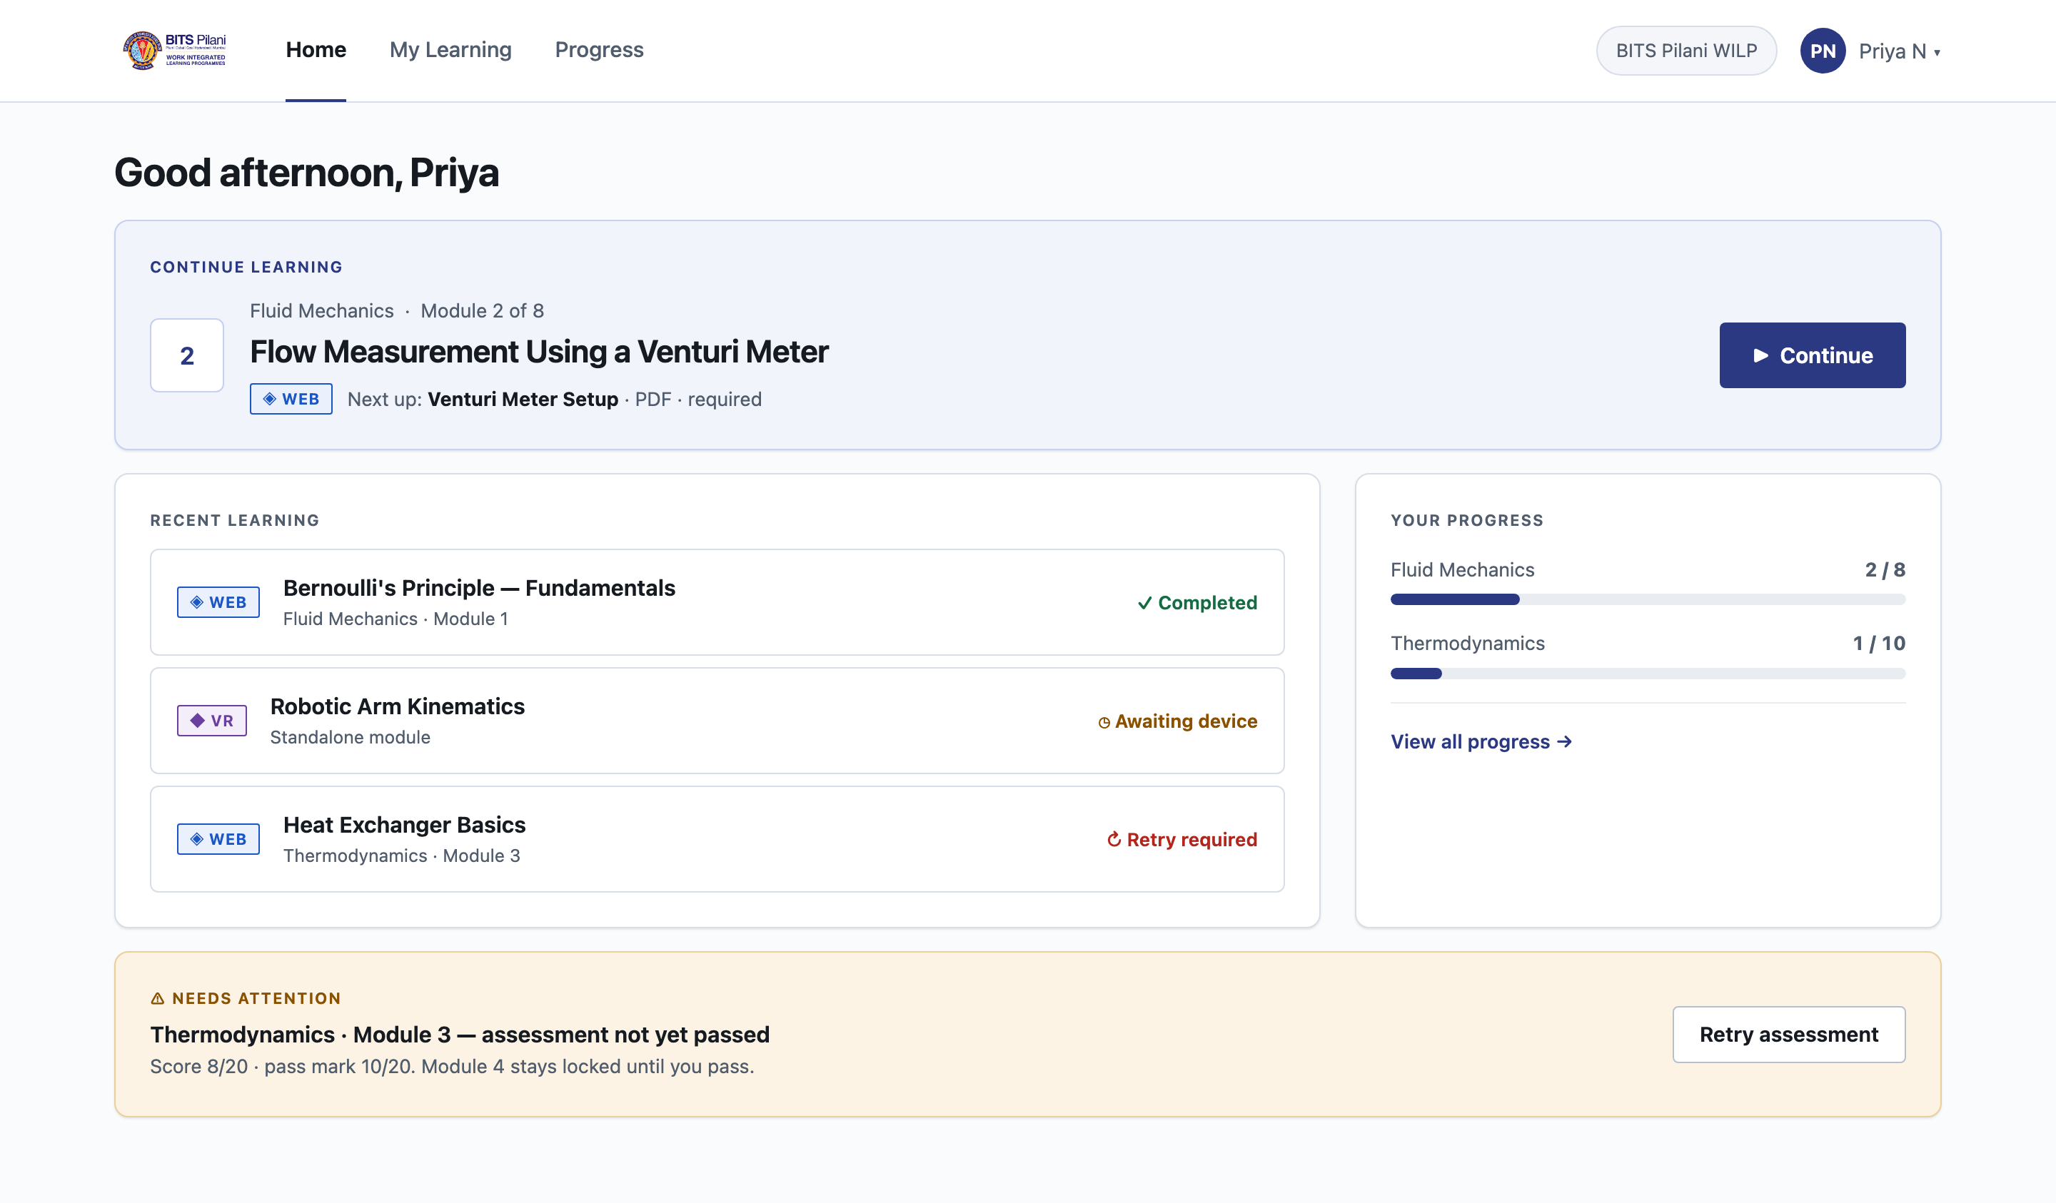
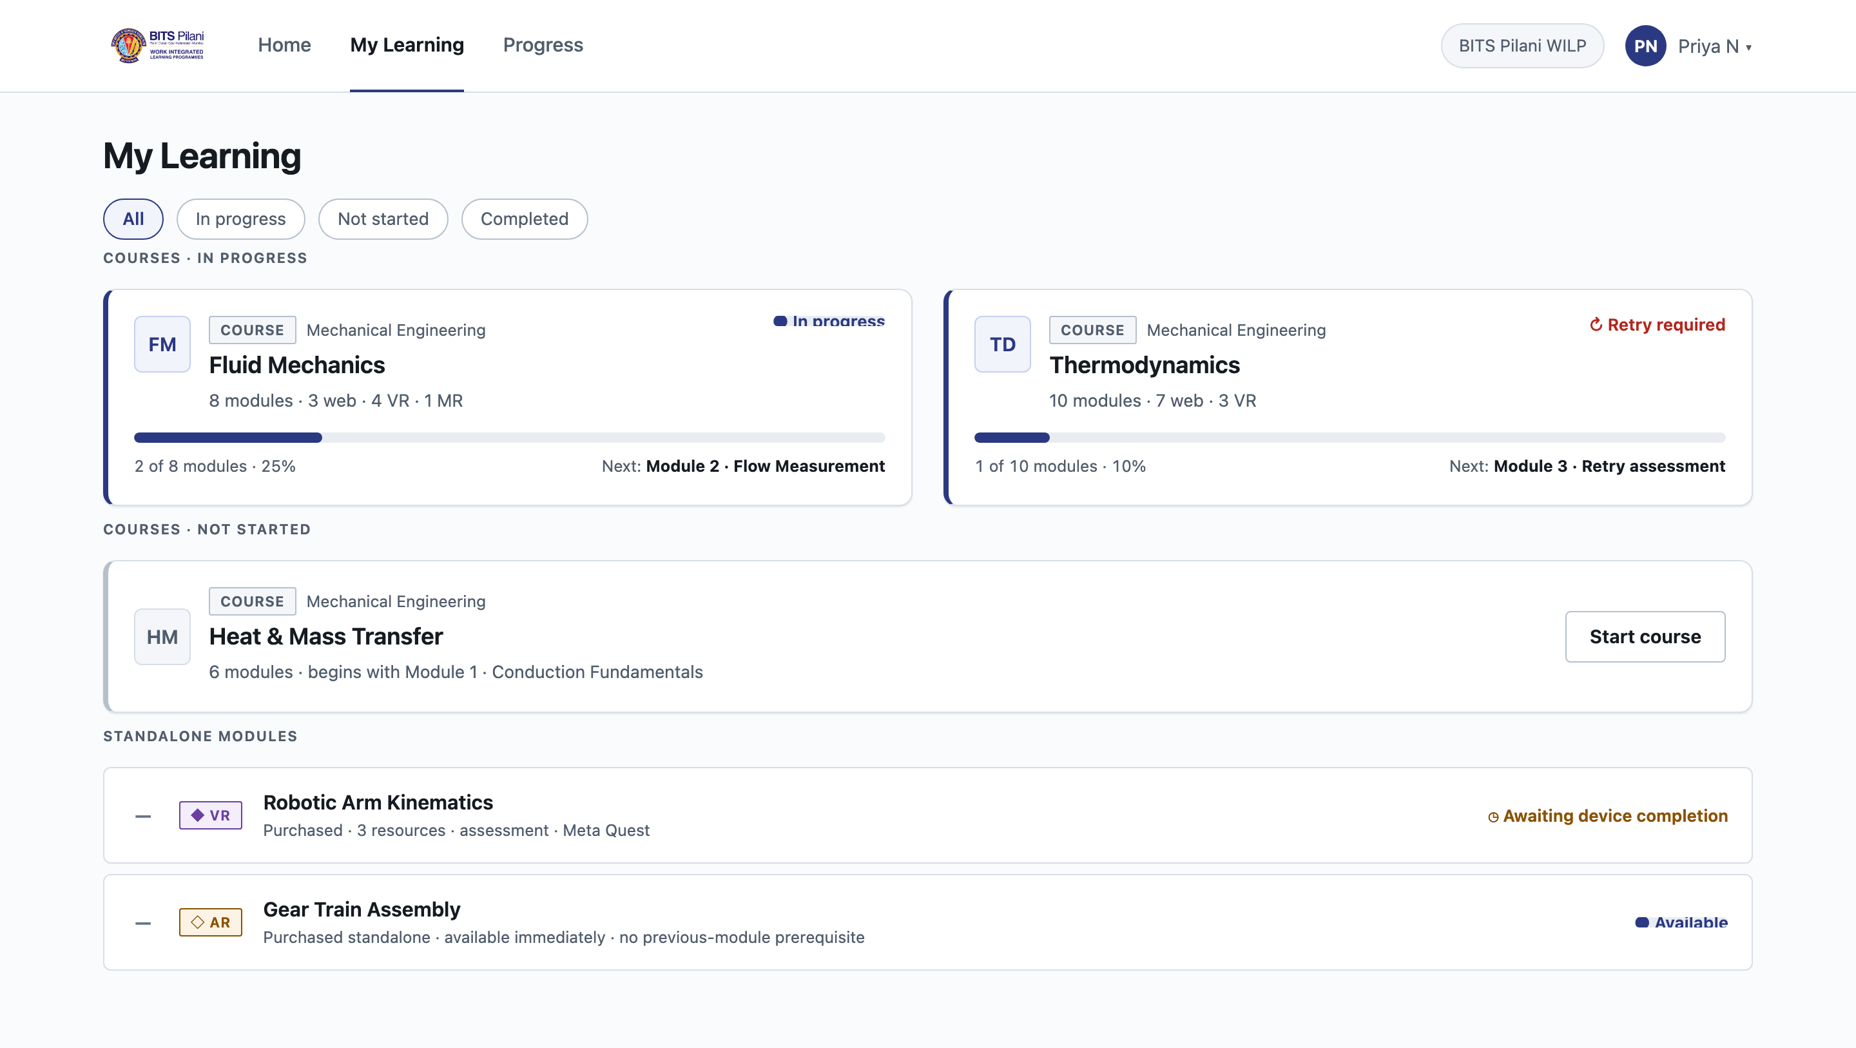
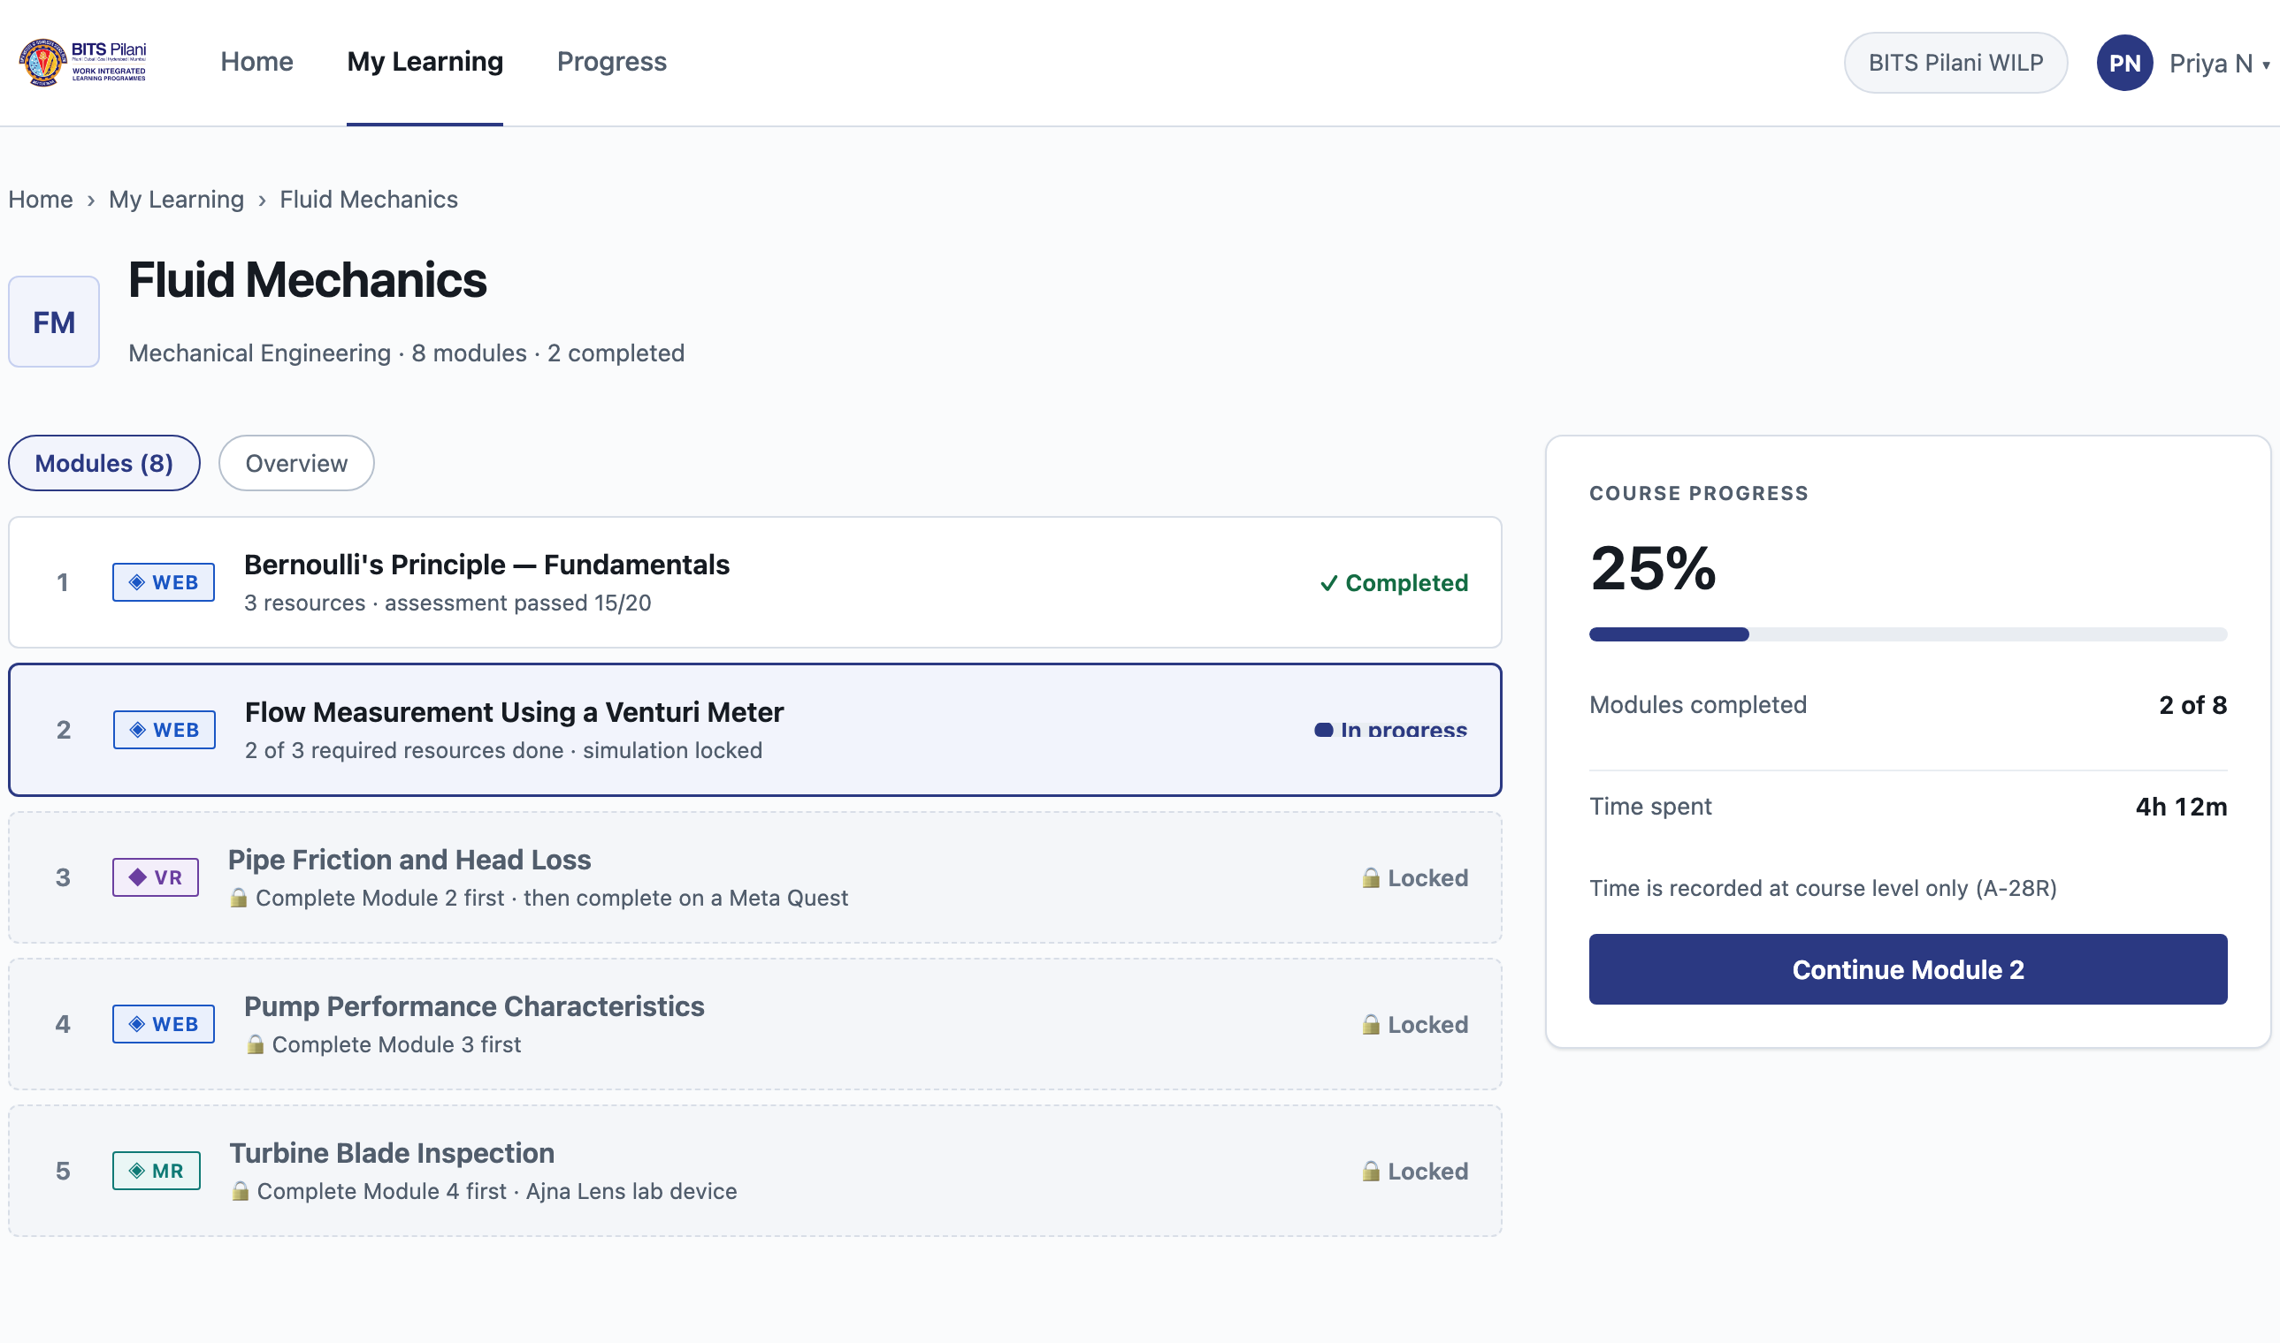
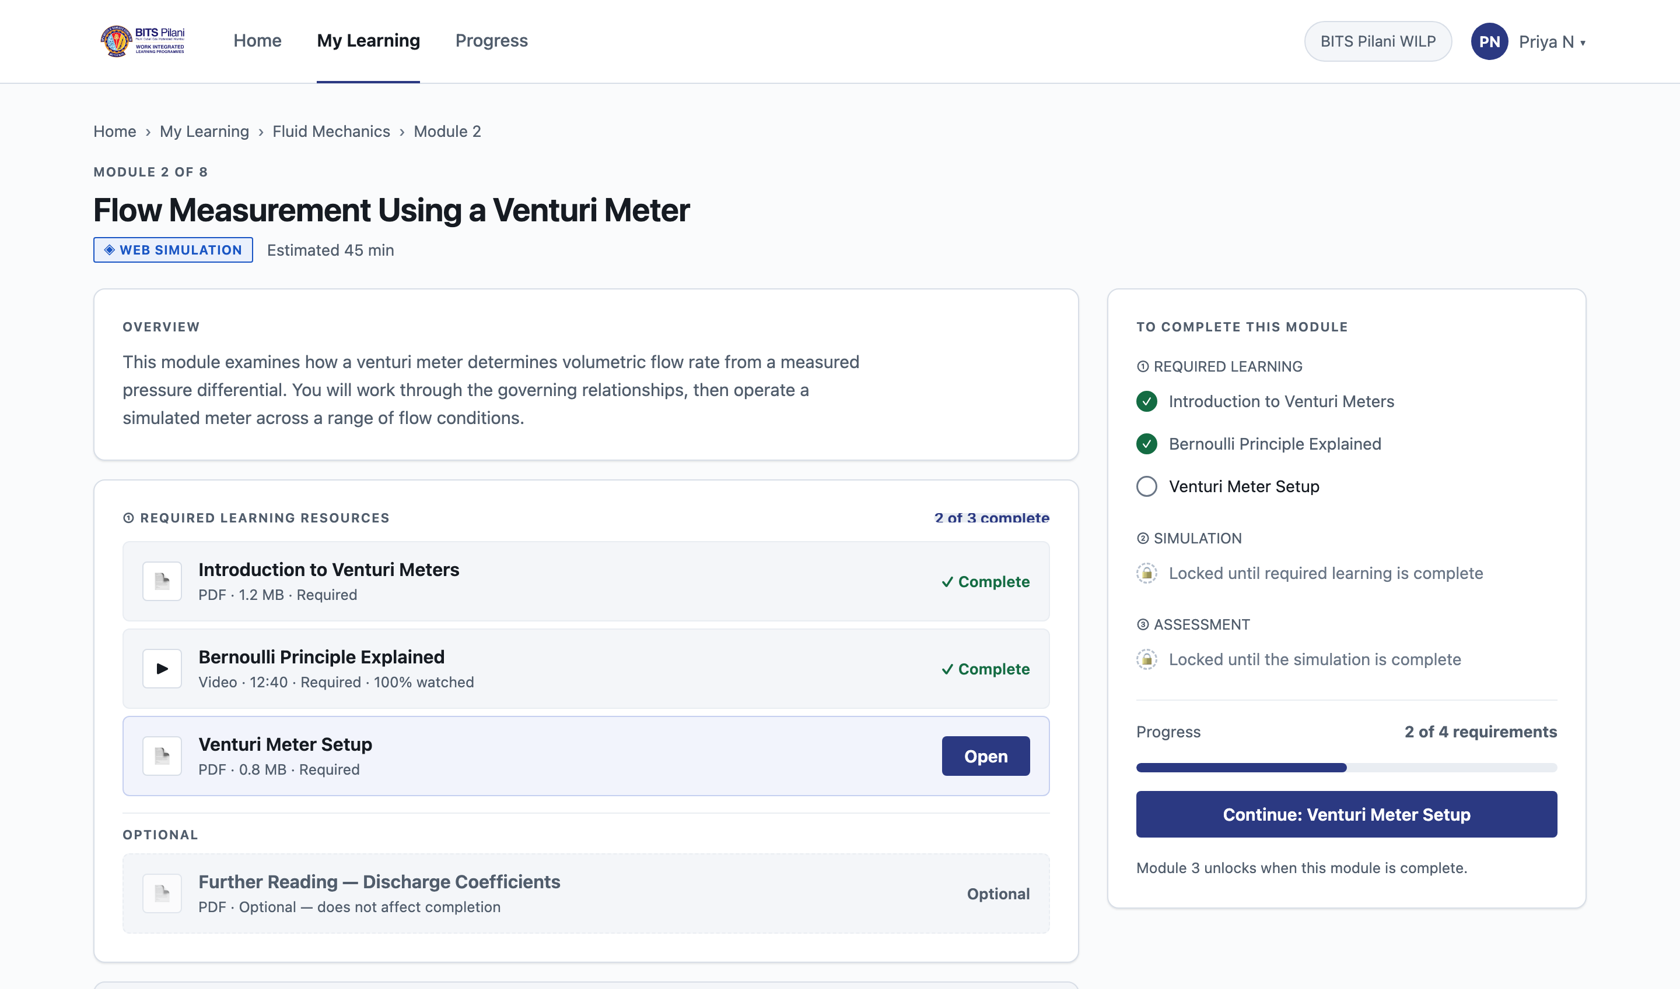
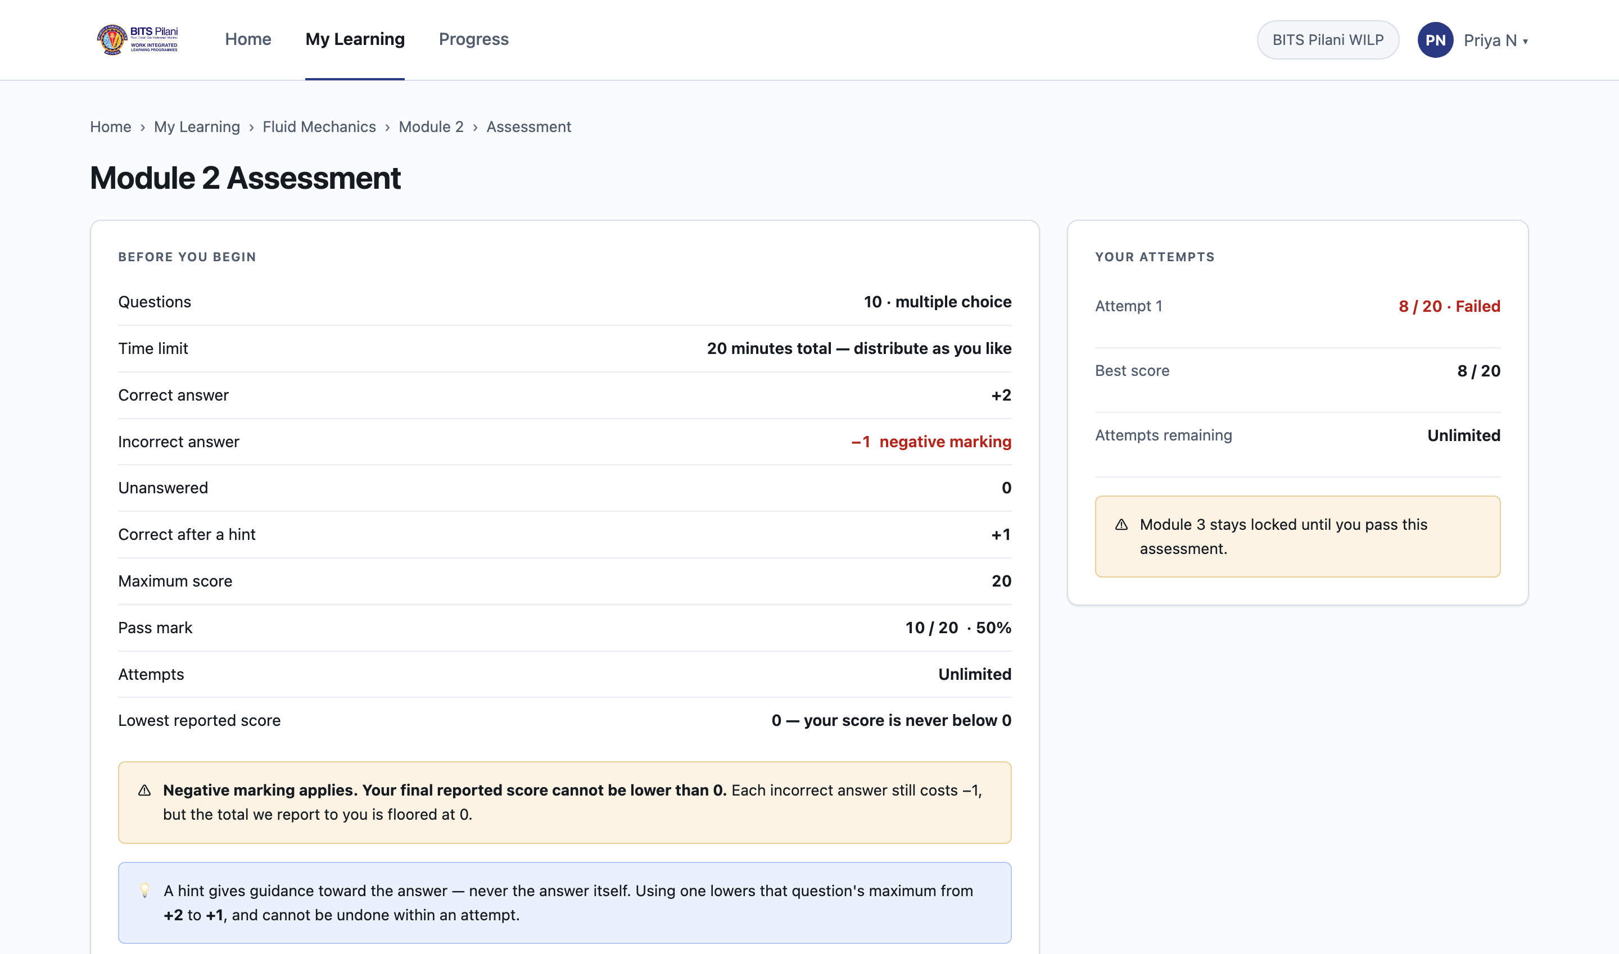
Student Experience — High-Fidelity Progress
All 29 approved screen IDs are represented in the Review-005 high-fidelity baseline
STU-02 My Learning
STU-03 Course detail
STU-01 Home — one-click resumption
SCREEN GROUPS
Authentication & onboarding
7
Student learning
14
B2C commerce
5
System states
3
STU-04 Module detail
STU-09 Assessment
XR Simulation Learning Platform · Phase 1 Student LMS · UI/UX Progress Review
7
Notes:
These are real screens rendered from the approved high-fidelity baseline, not mockups made for this deck. Home is shown large because it carries the core idea — one deterministic Continue action. Assessments, XR and commerce screens all exist too. Learner names, module titles and scores are sample content.

Slide 8
Learning Progression & Assessment Rules
How a module completes, and how an attempt is scored
MODULE COMPLETION
ASSESSMENT SCORING
Required Resources
open
Correct
+2
↓
Correct after a hint
+1
Simulation
unlocks after resources
Incorrect
−1
↓
Unanswered
0
Assessment
unlocks after simulation
Pass mark
10 / 20
↓
Pass — 10 / 20
Attempts
Unlimited
↓
• Hints guide the Student but never reveal the answer.
• After an attempt: Correct / Incorrect / Unanswered per question — never the answer key.
• Timer and unlock state are designed to be server-authoritative during implementation.
Module Completed
↓
Next Module Unlocks
A locked step never shows an active button — it states which prerequisite is outstanding, by name.
XR Simulation Learning Platform · Phase 1 Student LMS · UI/UX Progress Review
8
Notes:
Left: a module completes in a fixed order and each locked step names what is blocking it, so a Student is never guessing. Right: the scoring model. Two points worth noting for product — hints reduce the maximum for that question but never give the answer, and after an attempt we show which questions were wrong without revealing the correct answers, because attempts are unlimited. Timing and unlocking must be enforced on the server, not in the browser.

Slide 9
XR Access and B2C Commerce
How simulations reach the right device, and how individual learners buy
XR SIMULATION ACCESS
B2C PURCHASE PATH
WEB
Launch in browser
1
Explore
2
Module / Bundle
VR
Meta Quest guidance
3
Checkout
MR
Ajna Lens / institutional lab
4
Secure payment
AR
Mobile continuation
5
Entitlement
6
My Learning
Completion recorded against account
→
LMS reflects it
→
Next step unlocks
Course purchase — not part of the current model
The UX does not invent an unconfirmed cross-device pairing mechanism.
SAMPLE DESIGN DATA Prices shown in the designs are placeholders, not approved commercial values.
Licensed XR modules are never hidden on desktop — and a Course remains a structural concept, not a product.
XR Simulation Learning Platform · Phase 1 Student LMS · UI/UX Progress Review
9
Notes:
Left — every module declares its format and required device, and licensed XR modules stay visible on desktop rather than being hidden. Completion is recorded against the Student's account, so finishing on a headset unlocks the next step when they return to the laptop. We deliberately did not design a device-pairing mechanism nobody has confirmed. Right — individual learners buy a Module or a Bundle. A Course is a structural concept, not something you can buy. Prices in the designs are placeholders.

Slide 10
Quality Built Into the Design
Not only screens — interaction behaviour and implementation contracts are specified
1
Accessibility
2
Edge Cases
3
Developer Handoff
• Designed toward WCAG 2.2 AA
• Focus and keyboard behaviour specified
• 24px minimum interaction target
• Caption / transcript / audio-description slots
• Accessible assessment behaviour
• Errors never rely on colour alone
• Session expires during an assessment
• Assessment submission failure
• XR completion never received
• Licence restriction reached
• Payment result unknown
• Content withdrawn between sessions
• Assessment timing contract
• Autosave behaviour
• Video coverage vs playhead position
• Server-side module unlock
• Account-level XR completion
• Payment-state handling
Full WCAG conformance cannot yet be claimed until implemented and tested.
Each one states what happened and what the Student can do next.
Written so estimation and build can start from a defined contract.
This is not only screen design — the behaviour a static mockup cannot show is documented alongside it.
XR Simulation Learning Platform · Phase 1 Student LMS · UI/UX Progress Review
10
Notes:
Three things that reduce risk later. Accessibility was designed in from the start, though we are careful not to claim conformance before it is built and tested. The awkward cases — a session expiring mid-assessment, a payment we cannot confirm — are designed rather than left to a developer to improvise. And the contracts that must live on the server are written down, so estimation has something concrete to work from.

Slide 11
Native Figma Status & Current Constraint
Repository design is advanced; the native Figma transfer has started and continues
COMPLETE
Built in native Figma
REMAINING
Still to transfer
• Three-page file structure
• Foundations section
• Colour system
• 4 variable collections
• 187 variables
• Design System section structure
• Typography styles
• Component library
• UX / wireframe transfer
• 29 native Student screens
• Prototype connections
• Figma QA pass
CONSTRAINT
The current Figma Starter plan limits automated operations. The automated native transfer reached the available plan quota, so the remaining Figma work continues through a controlled manual / assisted workflow unless a paid workspace becomes available.
No design work is lost. The approved Review-005 repository remains the design source of truth, and Figma completion can continue manually. A paid workspace would accelerate the transfer but is not required to continue the project.
XR Simulation Learning Platform · Phase 1 Student LMS · UI/UX Progress Review
11
Notes:
The product and UX definition is already well advanced in the repository. We started transferring this into native Figma. Because the current workspace is on the free Starter tier, automated operations reached the plan quota. This doesn't block us from continuing — I will complete the remaining transfer through the manual assisted workflow. If a paid workspace becomes available, the transfer can be accelerated.

Slide 12
Decisions Needed & Next Steps
Six clarifications would remove the largest remaining unknowns
FOR PM / PRODUCT DISCUSSION
IMMEDIATE NEXT STEPS
1
Brand assets
PM DECISION
1
Complete native Figma
Is there an approved brand guide, vector or reversed logo?
2
PM UI/UX review
2
Profile data ownership
PM DECISION
Which Student fields are editable, and which stay ERP-controlled?
3
Resolve priority product questions
3
B2B / B2C identity linking
PM DECISION
4
Apply corrections
Should one person share or separate learning identities?
Descriptive assessments
5
UI/UX sign-off
4
PM DECISION
Who evaluates written answers, and how does Pass/Fail return?
6
Frontend / backend planning
5
B2C commercial rules
PM DECISION
7
Implementation
Currency, tax, payment, invoice and access-duration expectations.
6
Accessibility & responsive
PM DECISION
Current focus: Figma completion + PM review
Extended-time policy, media accessibility owner, mobile phase.
XR Simulation Learning Platform · Phase 1 Student LMS · UI/UX Progress Review
12
Notes:
These six are discussion points, not things I have answered. Brand and profile ownership block final visual and profile decisions. Identity linking matters before B2C launch because a person holding both an institutional and a personal account would not see their learning merge. Descriptive-answer grading has no owner yet, and progression is gated on passing. Commercial rules are compliance-adjacent. Accessibility needs an owner for extended time and captions. Also still open and worth a slot later: what a Student sees when certification requirements are met, and four engineering questions on timing, video tracking and XR completion recovery.

