Slide 1
Xamarin Forms MVVM with Realm and Rest
Andrew McCormack - Xamarin Certified Developer Xamarin Forms MVVM with REST and Realm mccorm79@gmail.com / https://github.com/amccorma/CodeCamp16

Slide 2
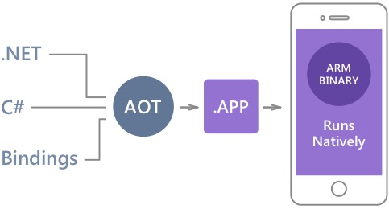
Native Performance
Xamarin.iOS does full Ahead Of Time (AOT) compilation to produce an ARM binary for Apple’s App Store.
Xamarin.Android takes advantage of Just In Time (JIT) compilation on the Android device.

Slide 3
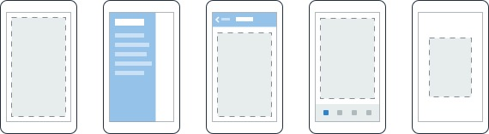
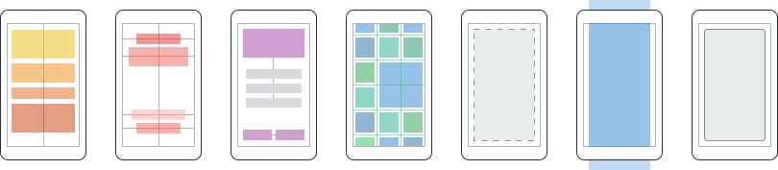
Layouts
Pages
Content
MasterDetail
Navigation
Tabbed
Carousel
Stack
Absolute
Relative
Grid
ContentView
ScrollView
Frame

Slide 4
Layouts
StackLayout organizes views in a one-dimensional line ("stack"), either horizontally or vertically. Views in a StackLayout can be sized based on the space in the layout using layout options. Positioning is determined by the order views were added to the layout and the layout options of the views.
Grid supports arranging views into rows and columns. Rows and columns can be set to have proportional sizes or absolute sizes. The Grid layout should not be confused with traditional tables and is not intended to present tabular data. Grid does not have the concept of row, column or cell formatting. Unlike HTML tables, Grid is purely intended for laying out content.

Slide 5
Controls
ActivityIndicator
BoxView
Button
DatePicker
Editor
Entry
Image
Label
ListView
Map
OpenGLView
Picker
ProgressBar
SearchBar
Slider
Stepper
TableView
TimePicker
WebView
EntryCell
ImageCell
SwitchCell
TextCell
ViewCell

Slide 6
MVVM Pattern
View
ViewModel
Model
Presentation and Presentation Logic
Business Logic and Data

Slide 7
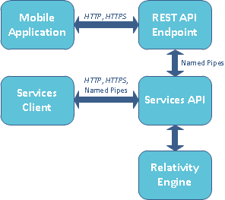
REST
RESTful applications use HTTP requests to post data (create and/or update),
read data (e.g., make queries), and
delete data.
Thus, REST uses HTTP for all four CRUD (Create/Read/Update/Delete) operations.
Presentation and Presentation Logic
Business Logic and Data

Slide 8
Realm
Mobile-first: Realm is the first database built from the ground up to run directly inside phones, tablets and wearables.
Simple: Data is directly exposed as objects and queryable by code, removing the need for ORM's riddled with performance & maintenance issues. Plus, we've worked hard to keep our API down to just 3 common classes(RealmObject, RealmResults and Realm): most of our users pick it up intuitively, getting simple apps up & running in minutes.
Modern: Realm supports relationships, generics, vectorization and modern C# idioms.
Fast: Realm is faster than even raw SQLite on common operations, while maintaining an extremely rich feature set.
https://github.com/realm/realm-dotnet
Presentation and Presentation Logic
Business Logic and Data
https://realm.io/docs/xamarin/latest/

Slide 9
The End
Let’s code
Andrew McCormack - Xamarin Certified Developer Xamarin Forms MVVM with REST and Realm mccorm79@gmail.com / https://github.com/amccorma
Presentation and Presentation Logic
Business Logic and Data

