Slide 1
Agile Testing, Test Automation & BDD
October 25, 2016
singapore
Organized by Testingmind

Slide 2
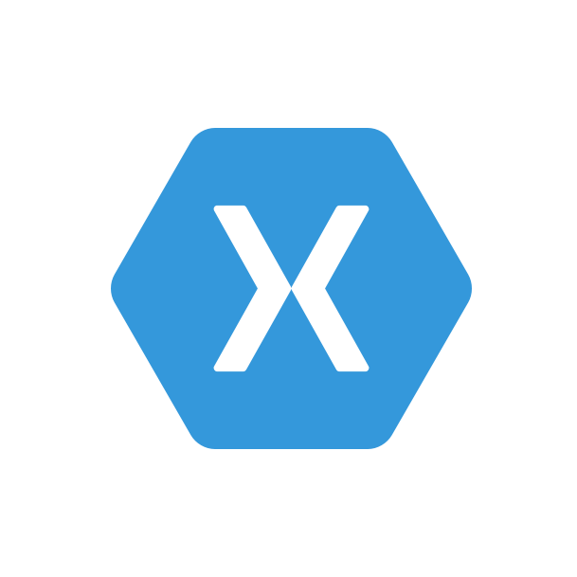



BDD + Mobile
Ben Ishiyama-Levy
Agile Technologist / .Net Pianist / Xamarin Evangelist / Driven Cucumberist
www.xamariners.com
www.meetup.com/SingaporeMobileDev
ben@xamariners.com

Slide 3
A programmer is going out for a stroll one evening.
His wife asks him to swing by the store and pick up a gallon of milk, and if they had eggs, to get a dozen.
He returned with 12 cartons of milk and said:
"They had eggs."

Slide 4



What is BDD?
“Behaviour Driven Development is a outside-in, pull-based, multiple-stakeholder, multiple-scale, high-automation, agile methodology.
It describes a cycle of interactions with well-defined outputs, resulting in the delivery of working, tested software that matters.”
It’s a bunch of tiny stories, using a particular grammatical structure.
It’s Finding places of misunderstanding, and filling it with understanding
It’s a conversation, captured.

Slide 5










Who is BDD for?
BDD is not solely beneficial to developers,
but to all stakeholders associated with the project:
Business / Clients
Users
Testers
Developers
Designers
UX Architects
Business Analysts
Scrum Masters
Project Managers
Project Owners

Slide 6
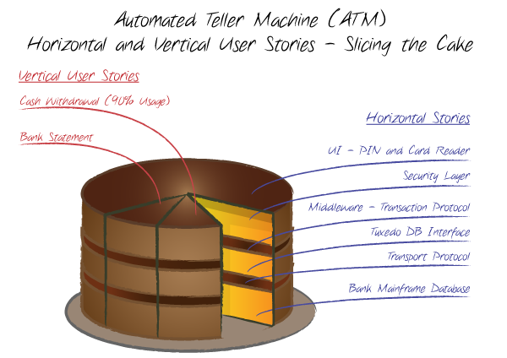
Horizontal User Stories
Build the application layers atomically.
The first demonstrable deliverable will only be ready when most layers are ready
Subsequent long iterations = risk increase
The entire cake must be baked before the customer realizes that the cake is not the one that’s wanted
In the best case, customer gets what was asked for, but not what was in mind (vanilla instead of chocolate, sponge cake instead of profiteroles)
If given the chance to sample one slice, the discrepancies would have been flagged early on

Slide 7
Horizontal User Stories
It is difficult to prioritize horizontal stories:
For example, during the initial pilot roll-out of ATM machines, most bank customers have asked for ability to:
Withdraw their money 24/7
Check their balance
Based on marketing research, withdrawing the cash would accounts for over 90% of intended usage of ATM
It could have been easily achieved with two vertical stories (epics) and delivered to the market early:
“As a user of ATM, I want to withdraw cash from my bank account”
“As a user of ATM, I want to get the current balance of my bank account”
Knowing this fact, the prudent approach would be to release the first version of ATM, only with ability to dispense the cash (and we can call it “the cash machine”). The bank would be able to release it to the market much sooner (3-6 months) rather than waiting to implement the full functionality (12-15 months)

Slide 8
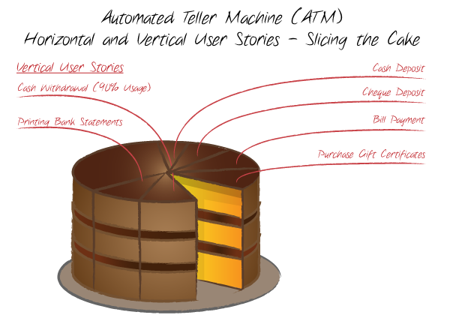
Vertical User Stories
Rather than building the system layer by layer, in which case the end user will only have a chance to experience the system when fully done,
the idea is to build it, user story by user story, where each one will cross all horizontal layers.
Vertical user story is not a scenario:
One user story may contain many positive and negative scenarios, and they should be part of acceptance criteria for that user story.
From the user story mentioned above, we can derive at least ten positive scenarios, and all of them at the end will result in satisfied user walking away from ATM with $100 cash,
And negative scenarios resulting in user being rejected withdrawal from their account.

Slide 9
Vertical User Stories
Positive Scenarios:
User enters the wrong password
User enters the amount larger than the daily withdrawal limit
User enters the amount larger than the her account balance
Similarly we can come up with five times more negative
Negative Scenarios:
Wrong bank card
Expired bank card
Customer forgot her password
Account in negative balance
ATM has no money
Vertical stories are written in a unambiguous language that is easily understood by all stakeholders of the system, and encourages the conversation between them.
All those scenarios mentioned above can be easily communicated between the product owner and the team (developer and tester), and specified as an acceptance criteria

Slide 10
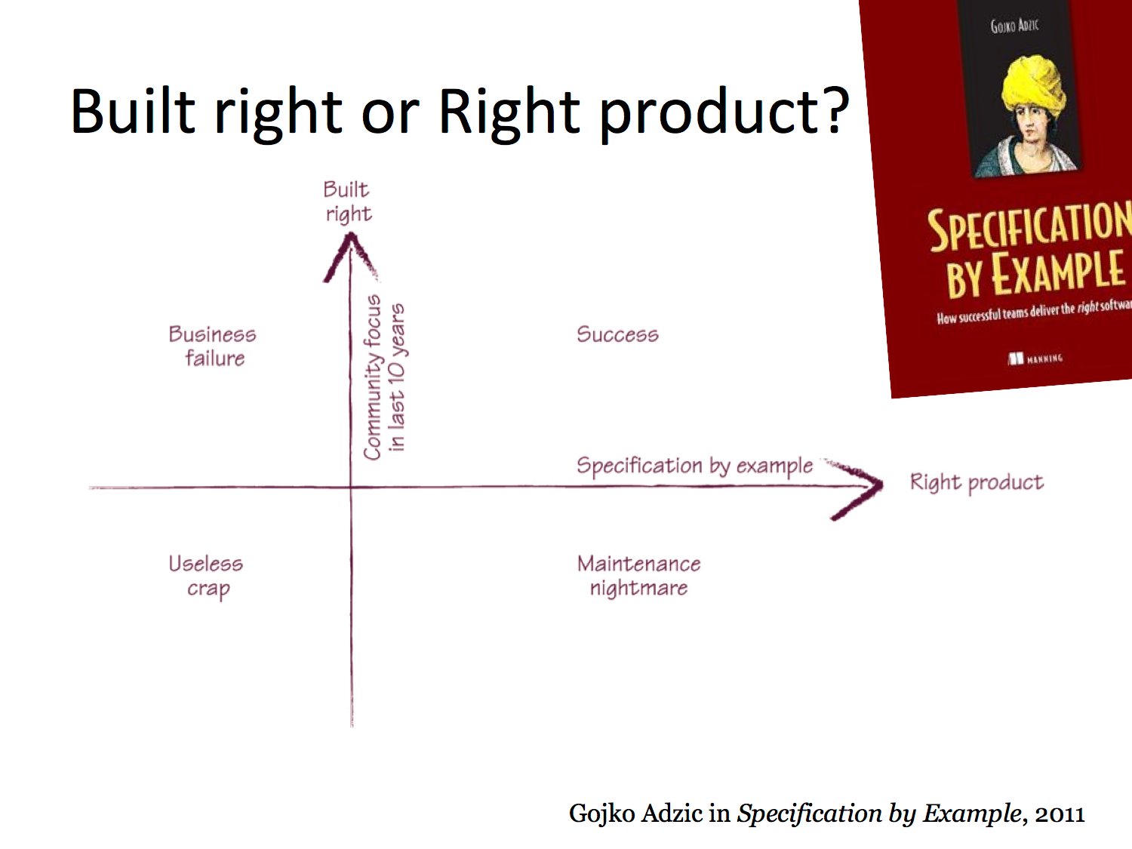

Slide 11

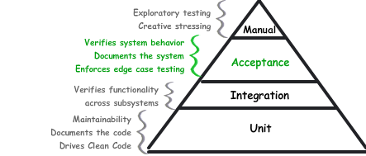
Acceptance Tests vs. Unit and Integration Tests
Unit Tests confirm that you built it right (INSIDE OUT)
Acceptance Tests confirm that you build the right thing (OUTSIDE IN)

Slide 12
From TDD to BDD
Cucumber is a software requirements and testing tool that enables a style of
Development, Behaviour Driven Development, that builds on the principles of test-driven development
Test-driven development is a core principle and practice of extreme
programming and has since been adopted by many other agile life cycles
Test-driven development is supported by a few key ideas:
No production code is written except to make a failing test pass
This test case should be written by the developer and customer together
The tests should be automated so we are encouraged to run them all
the time: they provide insight into the progress being made

Slide 13
From TDD to BDD
These tests are called acceptance tests because they document what
behaviours the customer will find acceptable in terms of the final functionality of
the system
They are different from unit tests:
• Unit tests are for developers and help you “build the thing right”
• Acceptance tests are for customers and help you “build the right thing”
• Acceptance tests are higher-level constructs that can be used to guide
developers down the path of writing unit tests that will get them to their goal
• Cucumber helps you write acceptance tests in the customer’s language
• This encourages the customer to participate in a task they might
otherwise skip

Slide 14
From TDD to BDD
Behaviour-driven development expands on test-driven development by:
• Formalizing its best practices
• In particular the perspective of working from the outside-in
• Start work with failing customer acceptance tests
• Write tests such that they serve as examples that anyone can read
• Both to understand a requirement and to understand how to
generate more requirements
• Develop a process to encourage our customers to get involved with
writing these requirements and to stay involved
• Aim to develop a shared, ubiquitous language for talking about the
system

Slide 15

Ubiquitous Language
Make sure everyone (including your customers) speak about the system, its
requirements and its implementation, in the same way:
• “The case management system tracks the cases handled by service reps”
• The whole team will now talk about “service reps” and “cases”
• Any attempt to change that to, say, “workers” and “jobs” will be rejected
• We want to see the same terms used to discuss the system to be present in the
requirements, design documents, code, tests, etc.
• Cucumber helps with this process since, as we shall see, it ties together the
tests with the actual code of the system

Slide 16

Typical Cucumber Acceptance Test
Feature: Sign up
Sign up should be quick and friendly
Scenario: Successful sign up
New users should get a confirmation e-mail and be greeted personally
Given I have chosen to sign up
When I sign up with valid details
Then I should receive a confirmation email
And I should see a personalized greeting message
• Acceptance tests refer to features
• Features are explained by scenarios
• Scenarios consist of steps
• The spec is written in natural language in a plain-text file
• BUT the spec is executable!
• Cucumber can guide us into turning the language of each step into an executable test case that calls
our systems and can then either pass or fail
• The way it does this is actually designed to get customers and developers working together

Slide 17
How Cucumber Works
Cucumber is a command line tool that processes text files that contain features
looking for scenarios that can be executed against your system
It makes use of a bunch of conventions about how the files are named and
where they live to make it easy to get started
Each scenario is a list of steps that describe the pre-conditions, actions, and
post-conditions of each scenario; if each step executes without error, the
scenario is marked as having passed
At the end of a run, Cucumber will report how many scenarios passed; if
something fails, it provides information about what failed so the developer
can make progress
Features, scenarios, and steps are written in language called Gherkin

Slide 18
How Cucumber Works
To turn natural language into executable specifications:
• Each step must be accompanied by a step definition
• Most steps will gather input and then delegate to a framework that is
specific to your application domain in order to make calls on your framework
• For instance, TestCloud is a framework for automating interactions with Mobile devices
• If your application is a mobile app, then your step definitions will most likely
delegate to TestCloud to make sure that your application is loaded and
then stepped through the scenario (“tap this button”, enter “Ben” in the “first name” field, etc.)
• Your step definitions will likely be short and easy to maintain

Slide 19
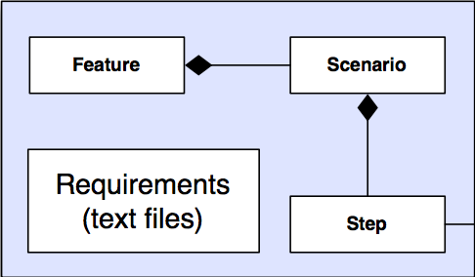
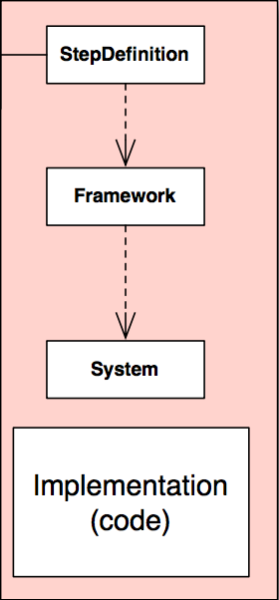
How Cucumber Works
The key to Cucumber is the mapping between steps and step definitions.
That’s “where the magic happens” and allows your non-technical customers to write specifications that will actually invoke and test the system that you are building!

Slide 20
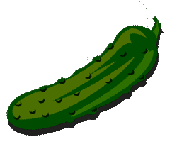

Gherkin Language
Gherkin is the language used to write features, scenarios, and steps
The purpose of the language is to help us write concrete requirements
Consider:
- Customers should be prevented from entering invalid credit card details.
Versus:
- If a customer enters a credit card number that isn’t exactly 16 digits long,
when they try to submit the form, it should be redisplayed with an error
message advising them of the correct number of digits.
The latter is much more testable; we want to remove as much ambiguity as
possible in our requirements since ambiguity is a proven source of errors
Gherkin is designed to create more concrete requirements

Slide 21
Gherkin Format and Syntax
Feature: Feedback when entering invalid credit card details
Background: (Applies to all Scenarios for that feature)
Given I have chosen an item to buy
And I am about to enter my credit card number
Scenario: Credit card number too short (Scenario Definition)
When I enter a card number that is less than 16 digits long
And all the other details are correct
And I submit the form
Then the form should be redisplayed
And I should see a message advising me of the correct number of digits
Steps

Slide 22
Feature
The feature keyword is used to group a set of tests (scenarios)
The text on the same line as the keyword is considered the name of the feature
All text between the initial line and a line that starts with Scenario,
Background, or Scenario Outline is considered part of a feature’s
description

Slide 23
Coming up with Features
Think of your Users
In order to identify features in your system, you can a “feature injection template”:
In order to <meet some goal>
As a <type of user>
I want <a feature>
The functional requirements of a system are determined by asking the
Questions:
• For each type of user
• What goals are they trying to achieve?
• What tasks must they perform to achieve those goals
• How does our system support those tasks?

Slide 24
Scenario
To express the behaviour of our system, we attach one or more scenarios with each feature
It is typical to see 5 to 20 scenarios per feature to completely specify all
the behaviours we’d like to see around a particular feature
Scenarios follow a pattern:
• Configure the system
• Have it perform a specific action
• Verify that the new state of the system is what we expected
• We start with a context, describe an action, and check the outcome

Slide 25
Scenario
Gherkin provides three keywords to describe contexts, actions, and outcomes:
• Given: establish context
• When: perform action
• Then: check outcome
Example:
Scenario: Withdraw money from account
Given I have $100 in my account
When I request $20
Then $20 should be dispensed

Slide 26
Scenario
You can add additional steps to the context, action, and outcome sections using the keywords ‘And’ and ‘But’
They allow you to specify scenarios in more detail
Scenario: Attempt withdrawal using stolen card
Given I have $100 in my account
But my card is invalid
When I request $50
Then my card should not be returned
And I should be told to contact the bank
These keywords help increase the expressiveness of the scenario

Slide 27
Scenario
In creating scenarios, a key design goal (indeed requirement)
is that they must be stateless
• “Each scenario must make sense and be able to be executed
independently of any other scenario”
• You can’t have the success condition of one scenario depend on the fact that
some other scenario executed before it
• Each scenario creates its particular context, executes one thing, and tests
the result

Slide 28
Scenario
Having stateless scenarios provides multiple benefits:
Tests are simpler and easier to understand
You can run just a subset of your scenarios and you don’t have to worry about your test set breaking
Depending on your system, you might be able to run tests in parallel, reducing the amount of time it takes to execute all of your tests

Slide 29
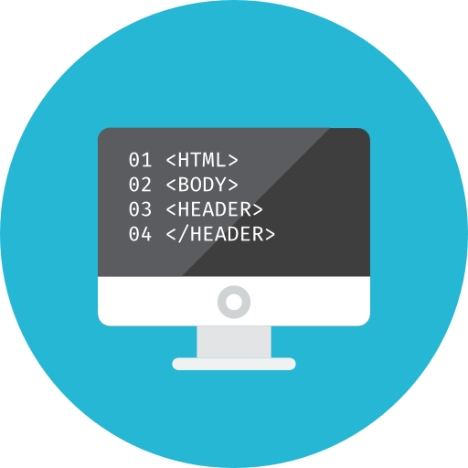
Technology Stack
IDE plugins / Scaffolding / Generator: SpecFlow
Test Frameworks: xUnit, nUnit, MSTest
Runners: Ruby, JRuby , .NET, JavaScript, - map cukes to application
UI testing framework - Watir, Watin, Selenium, Capybara (headless), anything that supports WebDriver, TestCloud …
Misc:
Open source, strong community support

Slide 30
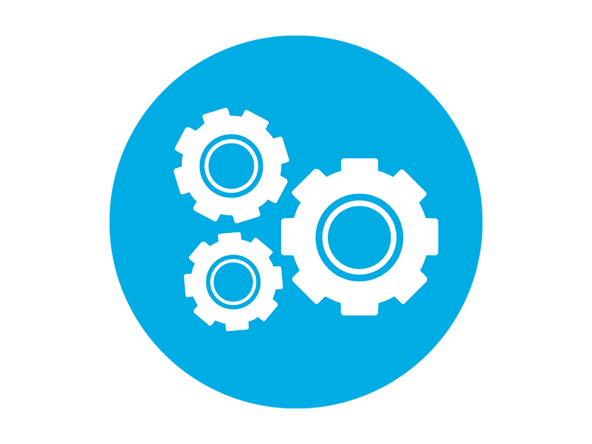
Automation
As BDD features file get transformed into an existing unit testing framework executable, they play nice with any continuous integration solution such as:
TeamCity
Team Services
Jeeves
The executable generated will provide human readable feedback, such as:
Step: ‘When I click on the login button’ failed with error ‘invalid username’

Slide 31
BDD + Mobile
BDD provides the only tests you need for your app, to achieve:
well designed app
well implemented
over-engineering free
high level test coverage
- highly maintainable codebase

Slide 32
BDD + Mobile
Mobile device fragmentation issue:
Impossible to predict how and app will behave on all the combinations of:
OS (iOS, Android, Windows phone)
OS Version (iOS 6,7,8,9 – Android jellybean, ice cream sandwich, nougat – Windows 8.1, UPW – Cyanogen Mod…)
Device screen factor (phones, phablets, tablets, eqach with their different sizes and dpi)
Device Specs (ram, cpu, sensors…)
The app needs to be tested on each combinations to ensure it runs as expected

Slide 33
BDD + Mobile
UI Tests
BDD Tests mimics the user interaction on devices in real time. All Mobile user interaction such as tap, slide, zoom, scroll, etc… are available
Tests can be recorded with the help of a Test Recorder, that will ultimately generate the interaction code (following manually the BDD specifications)
Or
The BDD specifications are execute by the test runner as such, using libraries that binds steps keywords to test runner interaction
pros: closest to the user truth
cons: expensive (long time to run, cost)

Slide 34
BDD + Mobile
Acceptance Console Tests
User interaction is abstracted to the commands it triggers on the underlying framework.
For instance, on a MVVM environment, the tests definitions would:
Execute commands (that would execute when a user taps, scrolls, navigates…)
Assert the ViewModel properties (such as the text in the username and password fields)
pros: cheap to run (fast execution)
cons: no UI layer, therefore not as close from truth

Slide 35
BDD + Mobile
Best Approach:
Write BDD specs once ( feature / scenarios / steps)
Target both UITest and ACT runners
Continuously run acceptance console tests (local / server on commit)
Run ad hoc ui tests (locally)
Run UI Tests Suite on dev complete (server on pre-merge)

Slide 36
Thank You! Questions?
Ben Ishiyama-Levy
Agile Technologist / .Net Pianist / Xamarin Evangelist / Driven Cucumberist
www.xamariners.com
www.meetup.com/SingaporeMobileDev
ben@xamariners.com

Slide 37


