Slide 1


Blazor And Xamarin #devday2018
https://github.com/Xamariners/BlazorWithXamarin
@xamariner
SSIDNAME / PASSWORD

Slide 2

Hello!
Ben Ishiyama-Levy
Microsoft & Xamarin MVP
Boss@Xamariners
Community Leader
Tech Speaker
@xamariner

Slide 3
Mobile

Slide 4
Essentials for mobile success
Beautiful & Robust Native apps

Slide 5

Xamarin Native – Traditional UI
iOS C#
Android C#
Windows C#
Shared C# Logic
3 Native User Interfaces
Shared App Logic

Slide 6
Xamarin.Forms- Cross Platform UI
Shared UI Code
Shared C# Logic
Shared Native User Interface
Shared App Logic

Slide 7

Xamarin.Forms- Now running on:

Slide 8
Demo: Xamarin Forms

Slide 9
SPA

Slide 10





Slide 11



Slide 12
Web Assembly

Slide 13

WebAssembly
http://webassembly.org/
Binary instruction format for a stack-based VM
For Browser and beyond
Portable compilation target for high-level languages like C/C++/Rust
Open Standard
Why?
Performance
Safe
https://commons.wikimedia.org/wiki/File:Web_Assembly_Logo.svg

Slide 14
Facts about WASM
Very different from .NET‘s IL
Much simpler
Linear memory
No GC
Cannot access the DOM = no UI
(…yet)
JavaScript interop exists
WASM calls JS
JS calls into WASM

Slide 15
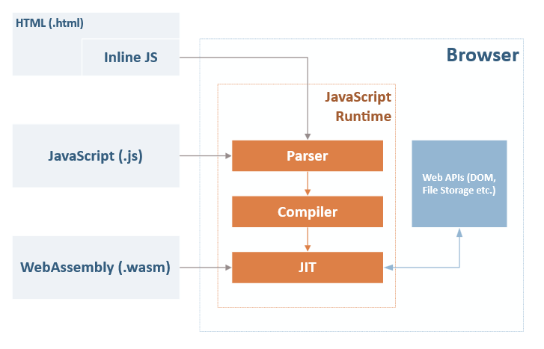
https://daveaglick.com/posts/blazor-razor-webassembly-and-mono

Slide 16

WASM and the CLR
C++ can be compiled into WASM
The .NET CLR is written in C++
Can the .NET CLR run on WASM?
Yes, it can – with mono

Slide 17
WASM Languages
.Net 🐣
AssemblyScript 🐣
Astro 🥚
Brainfuck 🐥
C 🐥
C# 🐣
C++ 🐥
D 🐣
Elixir 🥚
Faust 🥚
Forest 🥚
Forth 🐥
Go 🐣
Grain 🥚
Haskell 🥚
Java 🐣
Idris 🐣
Kotlin/Native 🐣
Kou 🥚
Lua 🐥
Ocaml 🥚
Perl 🐣
PHP 🐣
Plorth 🥚
Poetry 🐣
Python 🐣
Prolog 🐣
Rust 🐥
Scheme 🐣
Speedy.js 🐣
Turboscript
Wah 🐥
Walt 🐣
Wracket 🥚
Xlang 🥚
Zig 🥚

Slide 18
Blazor

Slide 19
Blazor
Built on the Mono WASM Runtime
ASP.NET Razor Template Syntax
The .NET Core you know and love…

Slide 20
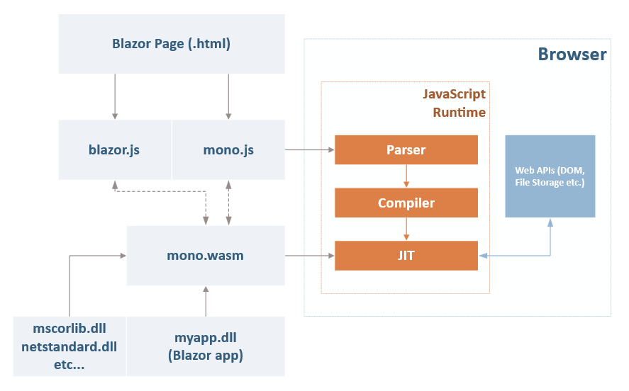
https://daveaglick.com/posts/blazor-razor-webassembly-and-mono

Slide 21
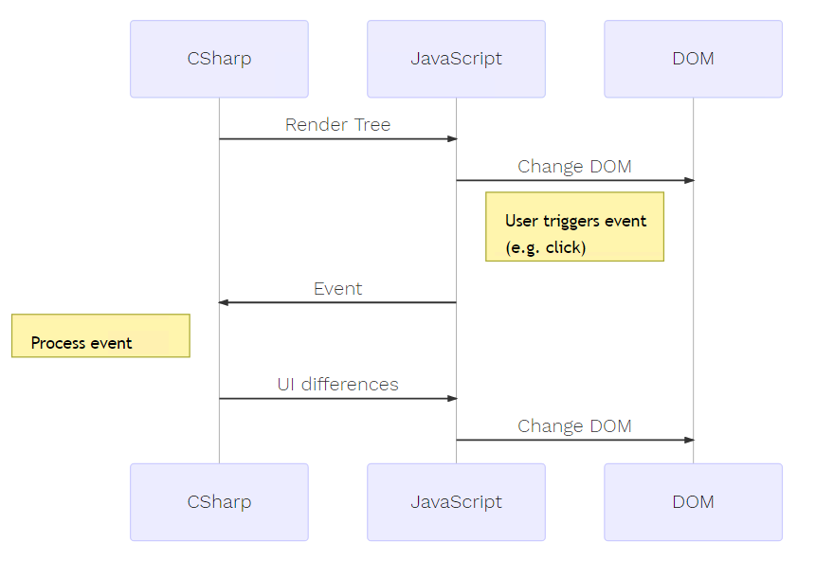
Anatomy
of a Blazor App
Rendering

Slide 22
Server-Side Hosting
Client-side
All benefits of a SPA
Restrictions because of WASM
Maturity of tooling and runtime
Larger initial download
Server-side (.net Core 3.0)
Same Blazor programming model
Full .NET environment
Smaller initial download
More server resources
SignalR support
No offline support
Browser
Server
UI Thread
dotnet
Blazor
Blazor (JS)
WS

Slide 23
Demo: Blazor

Slide 24
Blazor + Xamarin

Slide 25
Code sharing
SPA
Xamarin.Forms
Pages
Views
Components
ViewModels
SPA consumes State from Blazor Pages and Components
XF ViewModels Consumes State from ViewModel
Same Models
Same Services
Common Dependencies
Common Styles
Common Tests
Shared
Models
Services
States
Styles
Dependencies
Tests

Slide 26
Demo: Blazor + Xamarin

Slide 27
OOUI

Slide 28
Find out more!
Learn more about
Xamarin.Forms: https://docs.microsoft.com/en-us/xamarin/xamarin-forms/
Blazor: https://blazor.net/
Learn Blazor: https://learn-blazor.com
Web Assembly: https://webassembly.org
Web Assembly Languages: https://github.com/appcypher/awesome-wasm-langs
Demo Repository:https://github.com/Xamariners/BlazorWithXamarin

Slide 29
Thank you!
#devday2018
@xamariner
github.com/Xamariners/BlazorWithXamarin

