Slide 1


Prism for Xamarin.Forms
99/4A
Ben Ishiyama-Levy
Xamarin Evangelist
ben@xamariners.com
http://www.meetup.com/SingaporeMobileDev/

Slide 2
Prism : History
Started with Microsoft Patterns and Practices Team
Originally build for WPF and Silverlight
Release in open Source
Brian Lagunas (Infragistics) took over

Slide 3
Prism for Xamarin.Forms
Released Prism for Xamarin.Forms in 2016
MVVM quick recap
MVVM in Xamarin.Forms : Not really

Slide 4

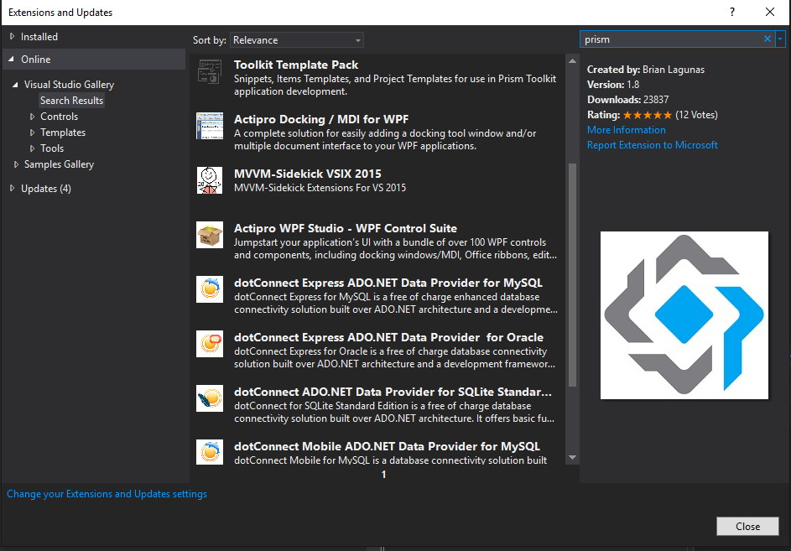
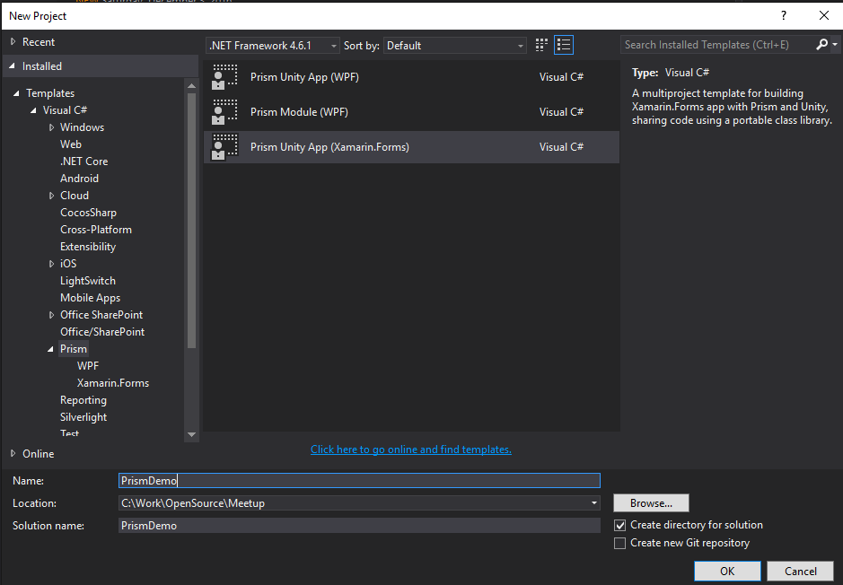
Project Setup
Visual Studio
Install Prism Template: https://marketplace.visualstudio.com/items? itemName=BrianLagunas.PrismTemplatePack
New Project with template:
Prism Unity App

Slide 5
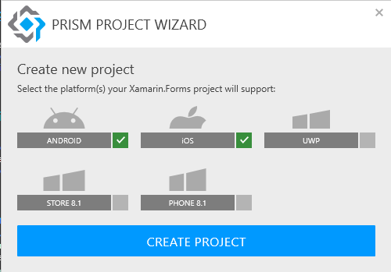
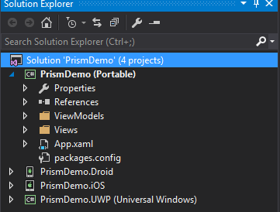
Project Setup
Visual Studio
Prism template let you select your platforms (unlike Xamarin.Forms template)
Creates a Xamarin.Forms solution with 1 project per plaftform and 1 PCL project
Created Views and ViewModels folders on PCL project

Slide 6

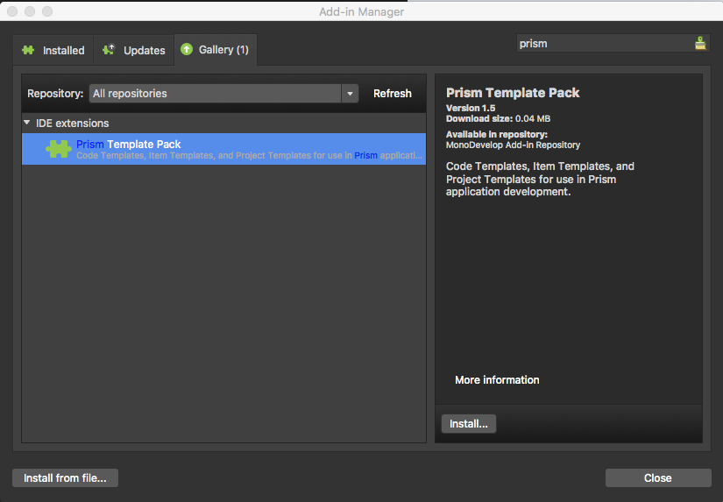
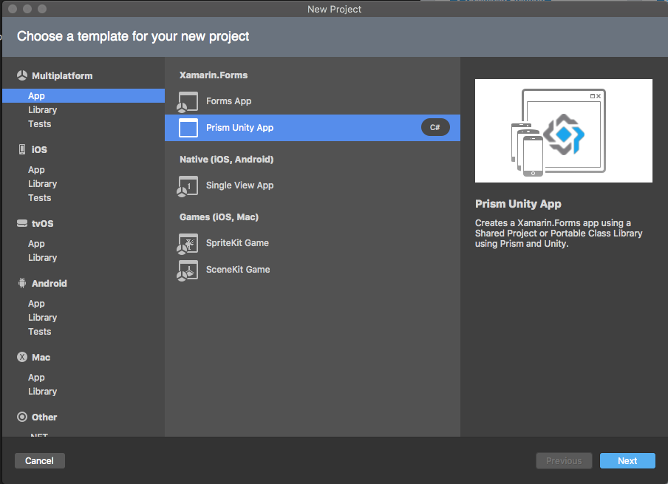
Project Setup
Xamarin Studio
Install Prism Template from add-in manager:
New Project with template:
Prism Unity App

Slide 7
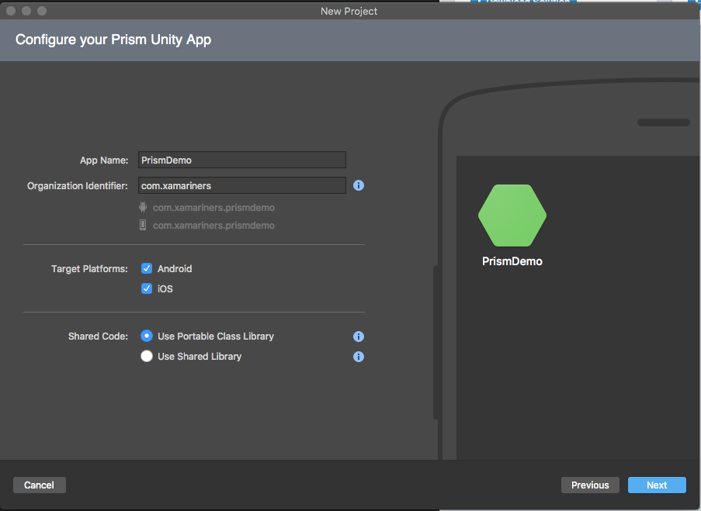
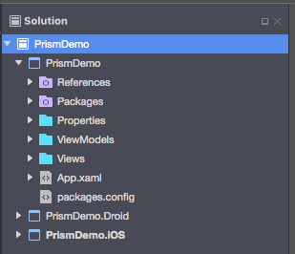
Project Setup
Xamarin Studio
Prism template let you select your platforms (unlike Xamarin.Forms template)
Creates a Xamarin.Forms solution with 1 project per plaftform and 1 PCL project
Created Views and ViewModels folders on PCL project

Slide 8
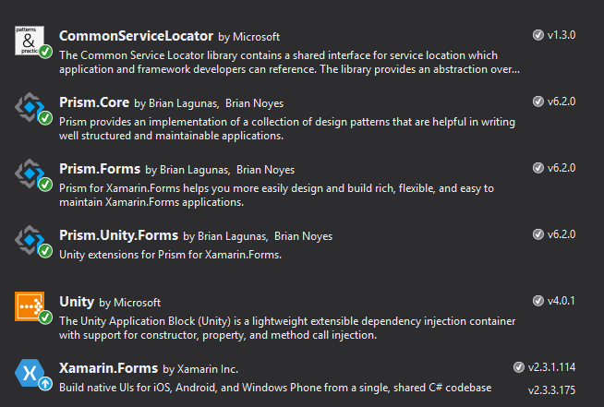
Project Setup
Added packages: Prism (Core, Forms, Unity.Forms), Unity (Unity, CommonServiceLocator), Xamarin.Forms
Unity container can be replaced by Autofac, Dryloc, Ninject

Slide 9
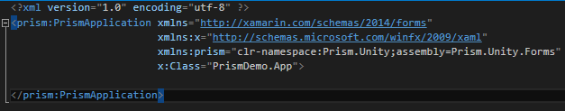
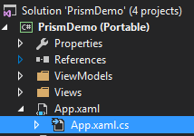
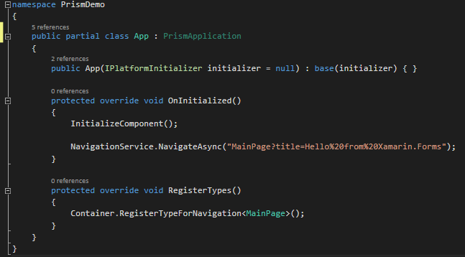
App Class
To add Prism support to Xamarin.Forms, The App class needs to inherit from PrismApplication instead of Application
App.xaml
App.xaml.cs

Slide 10
App Class
Prism adds 3 features to app class:
Ctor takes IPlatformInitializer parameter: provides a hook for platform specific Registations with DI Container
OnInitialized() override: provides Xamarin.Forms initialization and navigation to app main page
RegisterTypes() override: provides a hook for common Registations with DI Container

Slide 11
Connect Views & ViewModels
Assign ViewModel to View by Convention over Configuration:
Xaml page is in the Views folder
ViewModel is in the ViewModels folder
ViewModel name = $”{PageName}ViewModel”
Ex: MainPage.xaml ⬄ MainPageViewModel.cs

Slide 12


Connect Views & ViewModels
Register Pages with RegisterTypes() on App class with Container.RegisterTypeForNavigation<T>() where T is the page type. Prism wires the ViewModel to the View thanks to convention
You can also override conventions by using Container.RegisterTypeForNavigation<TPageType, TViewModel>()

Slide 13
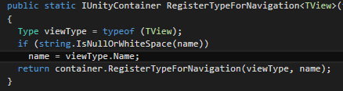


Connect Views & ViewModels
Under the hood, prism registers the view with its type name string:
Ultimately ending in Prism DI Container:
For consumption in navigation with PageNavigationService:

Slide 14
Connect Views & ViewModels
Navigation example:
Having a page type of MainPage, we use the string parameter “MainPage” as key on NavigateAsync() method to navigate to that page
The Page type name key can be overridden at registration with a custom string, hence using that custom key for navigation

Slide 15
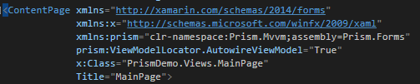
ViewModel
No changes needed to XAML page to support Prism
(for example, some MVVM frameworks require to change the ContentPage type with a custom one)
Only addition (although set to true as default so not visible unless for disabling): ViewModelLocator.AutowireViewModel on contentPage
Sets ViewModel to this Page BindingContext

Slide 16
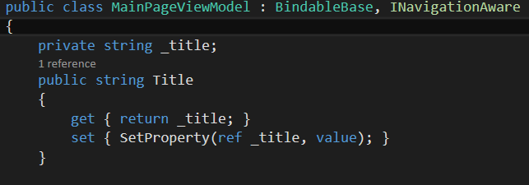
BindableBase
ViewModels need to inherit Prism BindableBase
Implements INotifyPropertyChanged
Provides SetProperty() that stores property value and send a notification to all controls bound to property

Slide 17
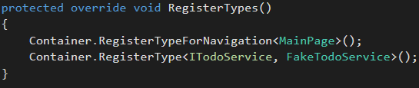
Dependency Injection
To register types such as services, use the selected DI Container:
For platform agnostic types, use RegisterTypes() on App class on PCL project
For platform specific types, use RegisterTypes() on AndroidInitializer class (Android), iOSInitializer class (iOS), UwpInitializer class (UWP)

Slide 18
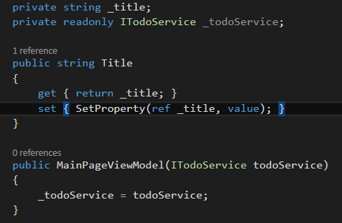
Dependency Injection
As Pages (and therefore ViewModels through auto wiring) and services are registered in the DI container, resolved registered types instances are injected in all registered dependencies Constructors (along with their resolved child dependencies)

Slide 19
Navigation LifeCycle
We want to retrieve data asynchronously
We need a hook other than the ViewModel constructor (not async)
Xamarin.Forms offers OnAppearing() and OnDisappearing() on Page code behind, but we need those hooks on the ViewModel

Slide 20
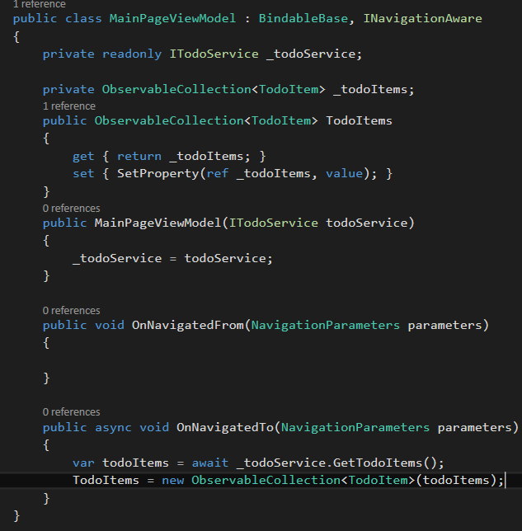
Navigation LifeCycle
ViewModels need to implement Prism INavigationAware:
OnNavigatedTo() – Initialisation (ex: fetch data)
OnNavigatedFrom() - Cleanup
Example:
OnNavigatedTo fetches data async
ObservableCollection property is initialized with the data

Slide 21
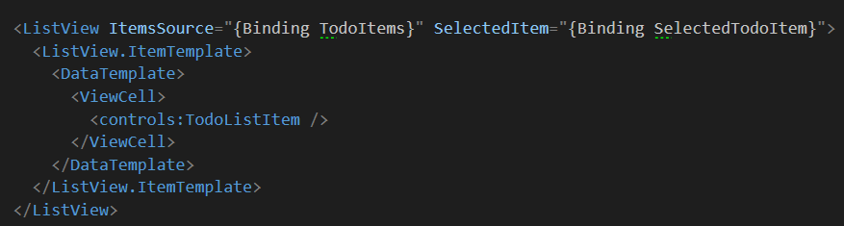
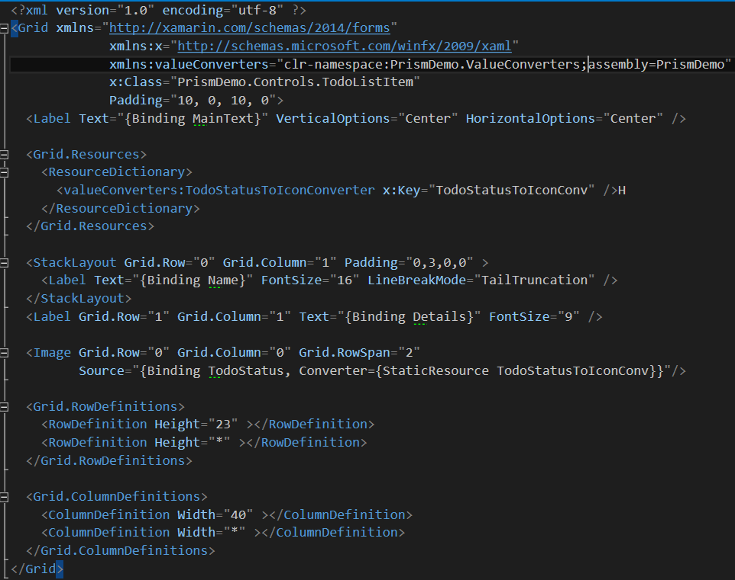
Navigation LifeCycle
The Observable collection is bound to the Page, here in a ListView:
The item properties are encapsulated in a
control for reusability and maintenance sake
Same rules applies to value converters
Any trick of the trade that makes your xaml
more readable is a good trick

Slide 22
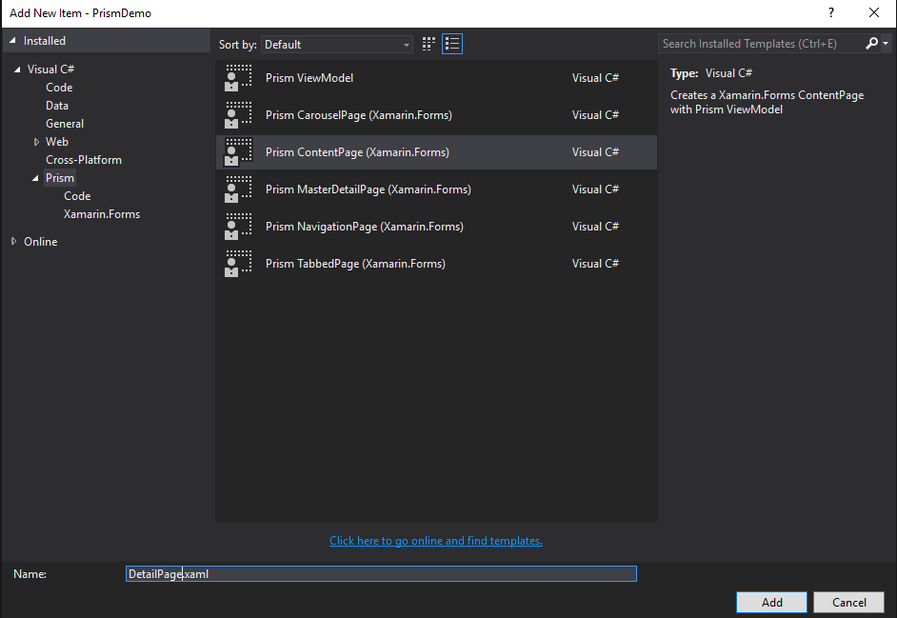
Navigation With Parameters
NavigationParameters is a Dictionary<string, object> that can be optionally provided to the NavigateAsync() method
NavigationParameters in injected in the OnNavigatedTo() and OnNavigatedFrom() methods
Add a ContentPage to the Views folder using
the Prism templates. This will create the Page,
ViewModel, and register them with the
DI Container automatically

Slide 23
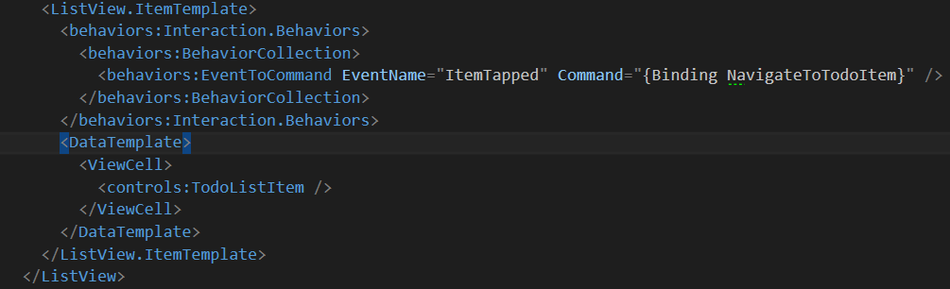
Navigation With Parameters
Add a command hook to the ItemTapped event of the ListView
this can achieved by binding the SelectedItem property of the ListView with a ViewModel property and in turn execute a command on property changed
Another way is to use Xamarin.Forms behaviors to bind a command to an event (use the nuget Corcav.Behaviors):
`

Slide 24
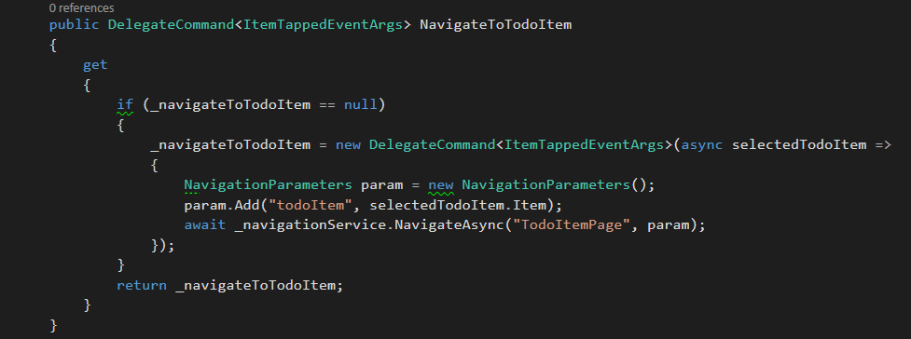
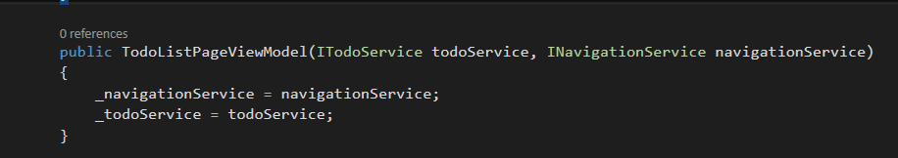
Navigation With Parameters
Add a delegate parameterized command ( saves you creating a ICommand all the time), that provides the selected item object as command parameter
Instantiate a NavigationParameters object
and add the selected item to this
Dictionary
Add the INavigation service to the Ctor
to get its resolved instance and use it
to navigate to the detail page.
`

Slide 25
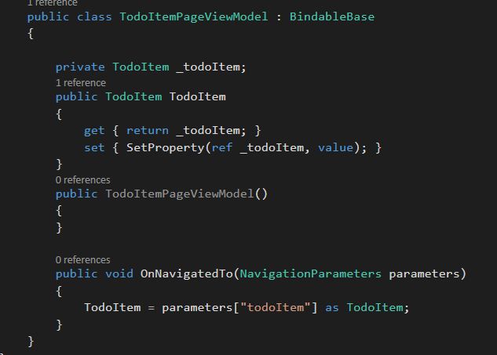
Navigation With Parameters
Retrieve the NavigationParameters on the OnNavigatedTo()
method of the detail page ViewModel
Set the data to a ViewModel bindable property
Consume that object on the detail page Xaml
`

Slide 26
Deep Linking
Prism Support complex queries as parameters of the NavigateAsync() method
Supports queries like “MainPage/DetailPage?id=1” to navigate directly to the detail page of the app and, at the same time, passing a parameter called id with value 1
Example: link a specific application page from another application, a website or a section of your app
`

Slide 27
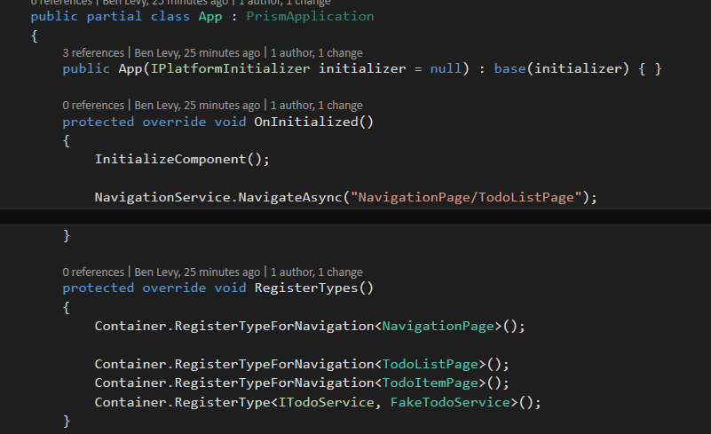
Deep Linking: Navigation Page
Register the base NavigationPage type included in Xamarin.Forms as a type for navigation in the Container
use the query “NavigationPage/MainPage” to tell to the NavigationService that we need to navigate first to the page identified by the NavigationPage key and then to the one identified by the MainPage key
As NavigationPage is just a container,
the MainPage (and every consequent page
in the navigation flow) will be embedded
into a NavigationPage
`

Slide 28
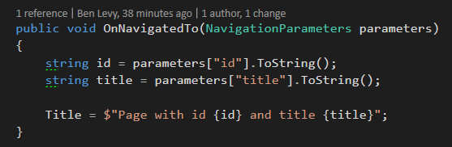
Deep Linking: NavigationParameters
Deep linking allows QueryString NavigationParameters in queries:
the destination page will receive, in the NavigationParams object of the OnNavigatedTo() method, two items:
one with key id and value 1
one with key title and value First page.
`

Slide 29
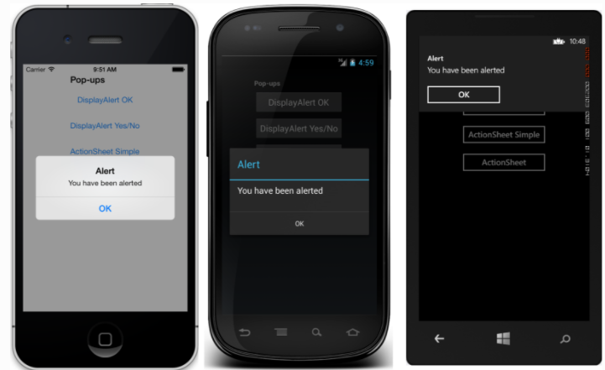
Page Dialog Services
Provides control of DisplayAlert and DisplayActionSheet from ViewModel
Get an instance of the IPageDialogService from the ViewModel constructor using DI
DisplayAlertAsync method shows a modal pop-up to alert the user or ask simple questions of them.
To display these alerts with Prism's IPageDialogService, use the DisplayAlertAsync method:
`

Slide 30
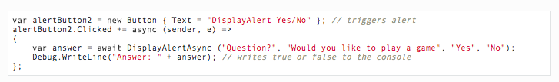
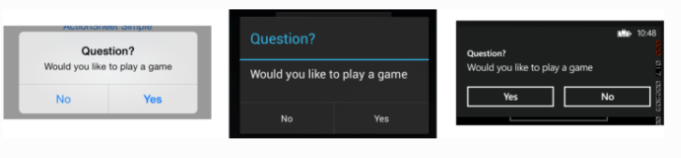
DisplayAlertAsync
To get a response from an alert, supply text for both buttons and await the method.
After the user selects one of the options the answer will be returned to your code
`

Slide 31

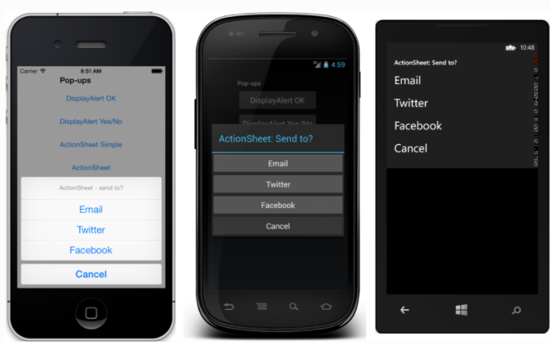
DisplayActionSheetAsync
To display an action sheet, await DisplayActionSheetAsync in any ViewModel, passing the message and button labels as strings.
The method returns the string label of the button that was clicked by the user
`

Slide 32
More Info
Prism GitHub: https://github.com/PrismLibrary/Prism
Prism Doc: http://prismlibrary.readthedocs.io/en/latest/
Prism template pack: https://marketplace.visualstudio.com/items?itemName=BrianLagunas.PrismTemplatePack
This demo repo : https://github.com/PrismLibrary/Prism
`

Slide 33
Thank You! Questions?
Ben Ishiyama-Levy
Xamarin Evangelist
ben@xamariners.com

