Slide 2


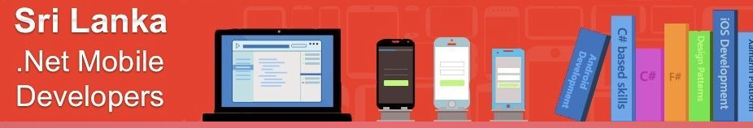


Slide 3

Intro to Blazor
Ben Ishiyama-Levy
Xamarin MVP – Microsoft MVP CEO - Xamariners

Slide 4
Software is eating the world

Slide 5
And the web is eating software
From a backend oriented world:
Server side Data consumption
Server side UI
All responsibilities Server Side
To a Services oriented world:
Client side Data consumption
Client side UI
More responsibilities client side

Slide 6
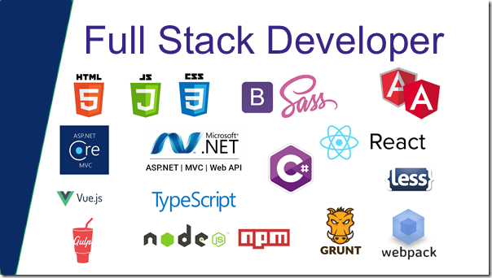

Slide 7
The Times They Are a-Changin'
Server Stack is complemented by many new client side tech
Developers have to learn and master these
Different Languages between back and front end
Desirable to achieve Full-Stack profile

Slide 8
Within Microsoft

Slide 9
ASP.net Evolution
A long time ago, Microsoft Dev = Windows Dev
ASP.net Webforms:
Reproduce Windows Dev model for Web
Hide Web Development pipes
Mostly Server Side
AJAX:
Created by MSFT for office online
ASP.net AJAX toolkit => magic client development benefits without client development
ASP.net MVC:
Embraces front end technologies
Client scripting (JavaScript) => First class citizen

Slide 10
Confusion & Antipatterns

Slide 11
Evolution of Back / Front separation
A long time ago, Microsoft Dev = Windows Dev
Difference between library and framework:
AngularJS in not a JQuery follow-up
Using a framework is a major technical decision
Strong coupling to a stack
Single Page Application:
Most front end frameworks are SPA
Not compatible with classic multipage websites
Hence duplication of server side features (views, binding, routing, etc)

Slide 12
Keeping up with frameworks trends
It isn’t straight forward to make the call that provides the right foundations
In an agile world where multi skilled developers are in demand, the boxes to tick for full stack developers is getting increasingly huge
While some developers are keeping up happily and ride the latest and greatest wave of tech
Others flee this unstable environment to go No-Framework

Slide 13
What is Blazor?

Slide 14
Web Assembly
Past: JavaScript = monopoly Client Side wen development
Now: WebAssembly
‘It is a low-level assembly-like language with a compact binary format that provides a way to run code written in multiple languages on the web at near native speed.’ - webassembly.org

Slide 15
Web Assembly and C#
JavaScript : powerful but with disadvantages
Some flaws fixed by TypeScript
C# for client side is compelling:
C# is a very robust batteries included language
Great for projects and teams of all sizes
Existing C# code can be re-used
ASP.NET Core is a powerful programming framework for server-side web development
Enabling C# on the client allows teams to use a common technology stack on server and client

Slide 16
Web Assembly and Mono
Mono is an open source implementation of Microsoft’s .NET Framework
Created by Xamarin’s Miguel De Icaza
In 2017, Mono team brought Mono to WebAssembly
At the time of writing, Mono’s C runtime is compiled into WebAssembly, and then Mono’s IL interpreter is used to run managed code.
A prototype for statically compiling managed code into one Wasm file exists and Blazor may move to that model

Slide 17
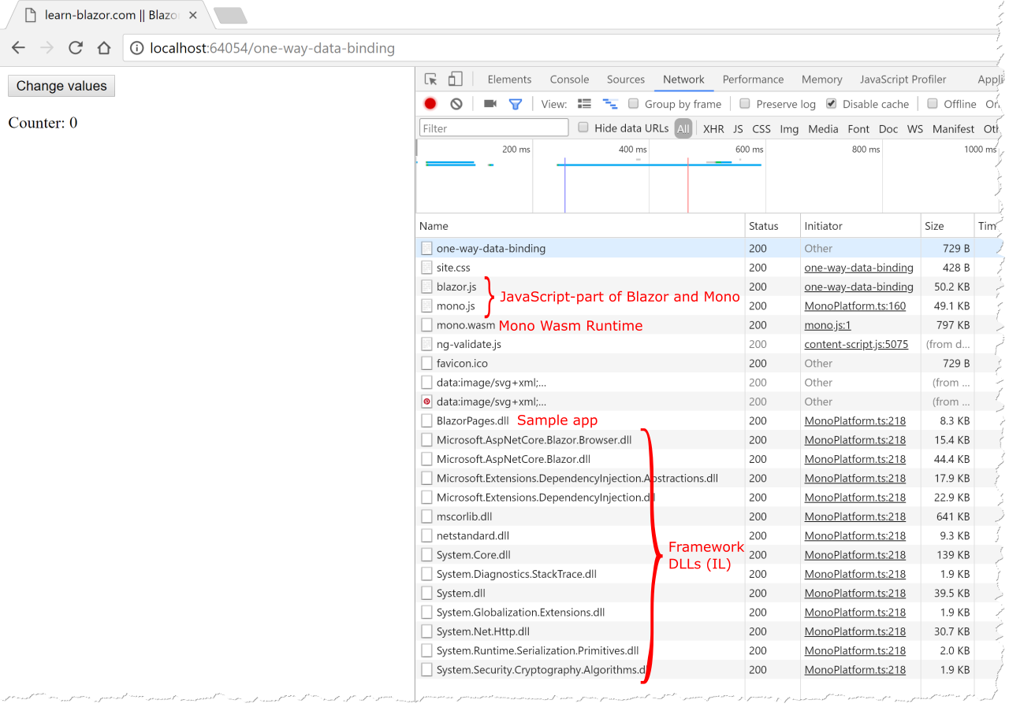
Blazor Boot Process
Notes:
The app (counter) includes Blazor’s JavaScript (blazor.js).
It uses Mono’s JavaScript library (mono.js) to bootstrap the Mono runtime (mono.wasm) in WebAssembly.
It then loads the app’s DLL (WebApplication2.dll) and the DLLs of the .NET Framework.

Slide 18
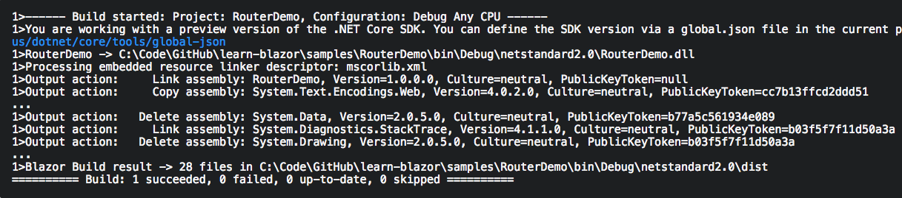
Size Matters
Blazor uses Mono’s IL Linker to reduce the size of your app
You see the IL Linker in action by looking at the Output window during build:

Slide 19
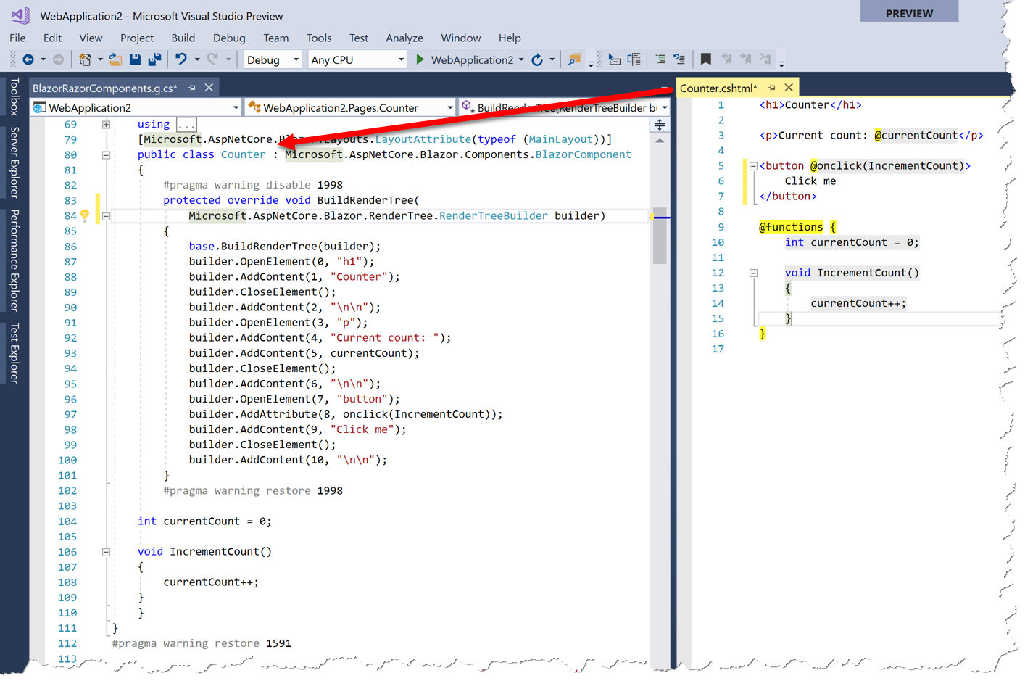
About Razor
Razor is a template engine that combines C# with HTML to create dynamic web content
Lives on the server where it is used to dynamically generate HTML
In Blazor, Razor is used on the client

Slide 20
HTML Output
Unlike former platforms like Silverlight, it does not bring its own rendering engine to paint pixels on the screen
Blazor uses the Browser’s DOM to display data
The C# code running in WebAssembly cannot access the DOM directly. It has to go through JavaScript.

Slide 21
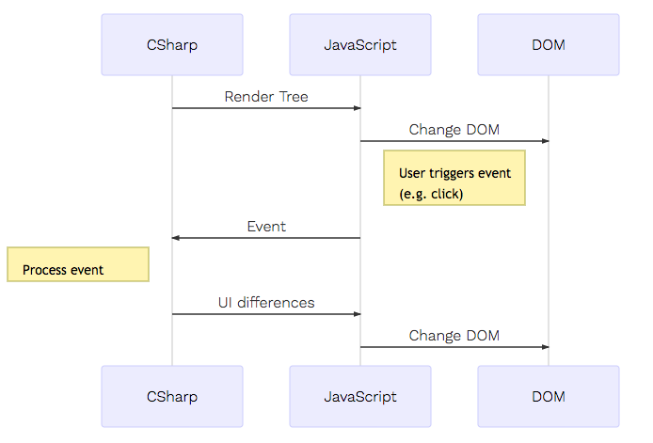
HTML Output
The C#-part of Blazor creates a Render Tree which is a tree of UI items
The render tree is passed from WebAssembly to the Rendering in the JavaScript-part of Blazor & executes the corresponding DOM changes

Slide 22
HTML Output
When the user interacts with the DOM (e.g. mouse click, enter text, etc.), the JavaScript-part of Blazor dispatches an event to C#
The event is processed by the C#-code of the web app
If the DOM changes, a Render Batch with all the UI tree differences (not the entire UI tree) is built in C# and given to a JavaScript Blazor method that applies the DOM changes.
Blazor uses the regular browser DOM: all DOM mechanisms including CSS works

Slide 23
Renderer
Blazor, renderers (classes derived from the abstract class Microsoft.AspNetCore.Blazor.Rendering.Renderer, see source on GitHub) provide mechanisms for rendering hierarchies of components (classes implementing Microsoft.AspNetCore.Blazor.Components.IComponent, see source on GitHub), dispatching events to them, and notifying when the user interface is being updated.
Provide mechanisms for :
Rendering hierarchies of components
Dispatching events to them
Notifying when the user interface is being updated.
For running in the browser, Blazor comes with a browser renderer
For unit tests, Blazor currently uses a test renderer

Slide 24
Get Blazor

Slide 25
Get Blazor Bits
Blazor, renderers (classes derived from the abstract class Microsoft.AspNetCore.Blazor.Rendering.Renderer, see source on GitHub) provide mechanisms for rendering hierarchies of components (classes implementing Microsoft.AspNetCore.Blazor.Components.IComponent, see source on GitHub), dispatching events to them, and notifying when the user interface is being updated.
Install the .NET Core 2.1 Preview 2 SDK
Install the latest preview of Visual Studio 2017 (15.7) with the ASP.NET and web development workload
Install the ASP.NET Core Blazor Language Services extension from the Visual Studio Marketplace
Or go to Blazor GitHub repository and build it yourself

Slide 26
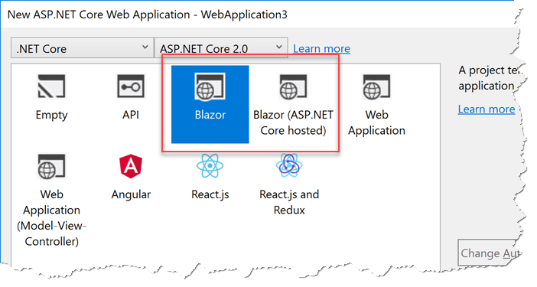
Check the Blazor bits
Blazor, renderers (classes derived from the abstract class Microsoft.AspNetCore.Blazor.Rendering.Renderer, see source on GitHub) provide mechanisms for rendering hierarchies of components (classes implementing Microsoft.AspNetCore.Blazor.Components.IComponent, see source on GitHub), dispatching events to them, and notifying when the user interface is being updated.
Create a new ASP.NET Core Web Application.
You should see Blazor templates in the New ASP.NET Core Web Application wizard:

Slide 27
Binding

Slide 28
One-Way Data Binding
<!-- Use this button to trigger changes in the source values -->
<button onclick=@(ChangeValues)>Change values</button>
<button onclick=@(() => ChangeValues(param))>Change values</button>

Slide 29
One-Way Data Binding
<!-- Simple interpolation In Angular, this would be {{ Count }} -->
<p>Counter: @Count</p>
<!-- Conditionally display content In Angular, this would be *ngIf -->
@if (ShowWarning) { <p style="background-color: red; padding: 5px">Warning!</p> }

Slide 30
One-Way Data Binding
<!-- Style binding In Angular, you would do that with [style.backgroundColor]="..." --> <p style="background-color: @Background; color=white; padding: 5px">Notification</p>
<!-- Add/remove class In Angular, you would do that with [class.highlight]="..." -->
<p class="note @((NoteIsActive ? "highlight" : ""))">This is a note</p>

Slide 31
One-Way Data Binding
<!-- Bind to a collection In Angular, you would do that with *ngFor -->
<ul>
@foreach(var number in Numbers)
{
<li>@number</li>
}
</ul>

Slide 32
One-Way Data Binding
@functions
{ private int Count { get; set; } = 0;
private bool ShowWarning { get; set; } = true;
private string Background { get; set; } = "red";
private bool NoteIsActive { get; set; } = true;
private List<int> Numbers { get; set; } = new List<int> { 1, 2, 3 };
private void ChangeValues()
{
Count++;
ShowWarning = !ShowWarning;
Background = Background == "red" ? "green" : "red";
NoteIsActive = !NoteIsActive;
Numbers.Add(Numbers.Max() + 1);
}

Slide 33
Two-Way Data Binding
Blazor, renderers (classes derived from the abstract class Microsoft.AspNetCore.Blazor.Rendering.Renderer, see source on GitHub) provide mechanisms for rendering hierarchies of components (classes implementing Microsoft.AspNetCore.Blazor.Components.IComponent, see source on GitHub), dispatching events to them, and notifying when the user interface is being updated.
Blazor supports two-way data binding using bind=...
Note that at the time of writing, Blazor supports the following types for two-way data binding:
int
string
DateTime
Enumerations
Boolean
If you need other types (e.g. decimal), you need to provide getter and setter from/to a supported type.

Slide 34
Two-Way Data Binding
<p>
What is your age? <input type="number" bind="Age" /><br />
@* Note how to pass a format for DateTime *@
What is your birthday (culture-invariant default format)?
<input type="text" bind="Birthday" /><br />
What is your birthday (German date format)?
<input type="text" bind="Birthday" format-value="dd.MM.yyyy" /><br />
@* Data binding for checkboxes with boolean properties *@ Are you an administrator?
<input type="checkbox" bind="IsAdmin" /><br />

Slide 35
Two-Way Data Binding
@* Data binding for selects with enums *@
<select id="select-box" bind="TypeOfEmployee">
<option value=@EmployeeType.Employee>@EmployeeType.Employee.ToString()</option>
<option value=@EmployeeType.Contractor>@EmployeeType.Contractor.ToString()</option>
</select>
@* The following line would not work because decimal is not supported *@
What is your salary? <input type="number" bind="Salary" /><br /> </p>

Slide 36
Two-Way Data Binding
<h2>Hello, @Name!</h2>
<p>You are @Age years old. You are born on the @Birthday. You are @TypeOfEmployee.</p>
@if (IsAdmin)
{ <p>You are an administrator!</p> }
@functions {
private enum EmployeeType { Employee, Contractor};
private EmployeeType TypeOfEmployee { get; set; } = EmployeeType.Employee;
private string Name { get; set; } = "Tom";
private bool IsAdmin { get; set; } = true;
private int Age { get; set; } = 33;
public DateTime Birthday { get; set; } = DateTime.Today;
public decimal Salary { get; set; }
}

Slide 37
Bind value to child component
Blazor, renderers (classes derived from the abstract class Microsoft.AspNetCore.Blazor.Rendering.Renderer, see source on GitHub) provide mechanisms for rendering hierarchies of components (classes implementing Microsoft.AspNetCore.Blazor.Components.IComponent, see source on GitHub), dispatching events to them, and notifying when the user interface is being updated.
You can use data binding for communication between components.
Here is an example that demonstrates how to bind a value in a parent component to a child component.
The child component uses to value to generate a list of value
(in practice this could be e.g. due to a web api response).

Slide 38
Bind value to child component (Parent)
...
<ManualRefreshChild NumberOfElements=@CurrentValue></ManualRefreshChild> ...
@functions
{
private int CurrentValue { get; set; }
...
}

Slide 39
Bind value to child component (Child)
@using System.Collections.Generic
...
<p>You requested @NumberOfElements elements. Here they are:</p>
<ul>
@foreach (var n in Numbers)
{
<li>@n</li>
}
</ul>
...
@functions {
...
public int NumberOfElements { get; set; }
private IEnumerable<int> Numbers
{
get
{
for (var i = 0; i < NumberOfElements; i++)
{
yield return i;
}
}
}
...
}

Slide 40
Manually Trigger UI Refresh
Blazor, renderers (classes derived from the abstract class Microsoft.AspNetCore.Blazor.Rendering.Renderer, see source on GitHub) provide mechanisms for rendering hierarchies of components (classes implementing Microsoft.AspNetCore.Blazor.Components.IComponent, see source on GitHub), dispatching events to them, and notifying when the user interface is being updated.
Blazor detects a necessary UI refresh automatically in many scenarios (e.g. after button click).
However, there are situations in which you want to trigger a UI refresh manually.
Use the BlazorComponent.StateHasChanged method for that.
It changes the application’s state using a timer.

Slide 41
Manually Trigger UI Refresh
<h1>@Count</h1>
<button onclick(@StartCountdown)>Start Countdown</button>
@functions {
private int Count { get; set; } = 10;
void StartCountdown()
{
var timer = new Timer(new TimerCallback(_ =>
{
if (Count > 0)
{
Count--;
// Note that the following line is necessary because otherwise
// Blazor would not recognize the state change and not refresh the UI
this.StateHasChanged();
}
}), null, 1000, 1000);
}
}

Slide 42
Event Binding
Blazor, renderers (classes derived from the abstract class Microsoft.AspNetCore.Blazor.Rendering.Renderer, see source on GitHub) provide mechanisms for rendering hierarchies of components (classes implementing Microsoft.AspNetCore.Blazor.Components.IComponent, see source on GitHub), dispatching events to them, and notifying when the user interface is being updated.
At the time or writing, event binding is quite limited in Blazor.
Just @onclick and @onchange are supported.
However, the support will increase

Slide 43
Event Binding
<!-- Note that Console.WriteLine goes to the browsers console -->
<button onclick(@Clicked)>Click me</button>
<button onclick(@() => Console.WriteLine("Hello World"))>Click me</button>
<input type="text" onchange(@newValue => Console.WriteLine(newValue)) />
<ChildComponent OnSomeEvent=@ChildEventClicked />
@functions {
private void Clicked() {
Console.WriteLine("Hello World");
}
private void ChildEventClicked() {
Console.WriteLine("Child event clicked");
}
}

Slide 44
Components

Slide 45
Dynamic Component
Blazor, renderers (classes derived from the abstract class Microsoft.AspNetCore.Blazor.Rendering.Renderer, see source on GitHub) provide mechanisms for rendering hierarchies of components (classes implementing Microsoft.AspNetCore.Blazor.Components.IComponent, see source on GitHub), dispatching events to them, and notifying when the user interface is being updated.
We can create HTML using an algorithm instead of a template (Think of a chess board In Blazor, you can ignore the template and create the component fully in C#.
The class that is used for dynamically generating content is Microsoft.AspNetCore.Blazor.RenderTree.RenderTreeBuilder
It contains methods to open elements, add attributes, add content, add components, etc.

Slide 46
Dynamic Component
using Microsoft.AspNetCore.Blazor.Components;
using Microsoft.AspNetCore.Blazor.RenderTree;
namespace BlazorPages.Pages
{
[Route("/dynamic-render-tree")]
public class DynamicRenderTree : BlazorComponent
{
protected override void BuildRenderTree(RenderTreeBuilder builder)
{
var seq = 0; builder.OpenElement(seq, "table");
builder.OpenElement(++seq, "tbody");
for (var row = 0; row < 3; row++)
{
builder.OpenElement(++seq, "tr");
for (var col = 0; col < 3; col++)
{
builder.OpenElement(++seq, "td");
builder.AddAttribute(++seq, "class", "tictactoe-cell");
builder.CloseElement();
}
builder.CloseElement();
}
builder.CloseElement();
builder.CloseElement();
}
}
}

Slide 47
Render Fragments
Blazor, renderers (classes derived from the abstract class Microsoft.AspNetCore.Blazor.Rendering.Renderer, see source on GitHub) provide mechanisms for rendering hierarchies of components (classes implementing Microsoft.AspNetCore.Blazor.Components.IComponent, see source on GitHub), dispatching events to them, and notifying when the user interface is being updated.
It is not necessary to build the entire component in C#.
You can also dynamically generate reusable fragments.
Note that the method creating the render fragment (delegate in DynamicFragment) is called whenever a rendering occurs, not just during component load.

Slide 48
Render Fragments
using Microsoft.AspNetCore.Blazor.Components;
using Microsoft.AspNetCore.Blazor.RenderTree;
namespace BlazorPages.Pages
{
[Route("/dynamic-render-tree")]
public class DynamicRenderTree : BlazorComponent
{
protected override void BuildRenderTree(RenderTreeBuilder builder)
{
var seq = 0; builder.OpenElement(seq, "table");
builder.OpenElement(++seq, "tbody");
for (var row = 0; row < 3; row++)
{
builder.OpenElement(++seq, "tr");
for (var col = 0; col < 3; col++)
{
builder.OpenElement(++seq, "td");
builder.AddAttribute(++seq, "class", "tictactoe-cell");
builder.CloseElement();
}
builder.CloseElement();
}
builder.CloseElement();
builder.CloseElement();
}
}
}

Slide 49
Layouts

Slide 50
Layouts
Blazor, renderers (classes derived from the abstract class Microsoft.AspNetCore.Blazor.Rendering.Renderer, see source on GitHub) provide mechanisms for rendering hierarchies of components (classes implementing Microsoft.AspNetCore.Blazor.Components.IComponent, see source on GitHub), dispatching events to them, and notifying when the user interface is being updated.
Blazor apps typically contain more than one page.
Certain layout elements like menus, copyright messages, logos, etc. must be present on all pages.
Copying the code of these layout elements onto all pages would not be a good solution.
The app would become hard to maintain and probably inconsistent over time.
Blazor Layouts solve this problem.

Slide 51
Layouts
Blazor, renderers (classes derived from the abstract class Microsoft.AspNetCore.Blazor.Rendering.Renderer, see source on GitHub) provide mechanisms for rendering hierarchies of components (classes implementing Microsoft.AspNetCore.Blazor.Components.IComponent, see source on GitHub), dispatching events to them, and notifying when the user interface is being updated.
The layout component contains the Razor keyword @Body. During rendering, it is replaced by the content of the layou<㾀
The layout component contains the Razor keyword @Body. During rendering, it is replaced by the content of the layout.
<─
Blazor layout is just another Blazor component.
It is defined in a Razor template or in C# code, it can contain data binding, dependency injection is supported, etc.
The layout component has to implement Microsoft.AspNetCore.Blazor.Layouts.ILayoutComponent
The layout component contains the Razor keyword @Body.
During rendering, it is replaced by the content of the layout.

Slide 52
Create Layout
@implements ILayoutComponent
<header>
<h1>ERP Master 3000</h1>
<p>Current user: @UserName</p>
</header>
<nav>
<a href="/master-data">Master Data Management</a>
<a href="/invoicing">Invoicing</a>
<a href="/accounting">Accounting</a>
</nav>
@Body
<footer>
(c) by Acme Corp
</footer>
@functions {
public string UserName { get; set; }
public RenderFragment Body { get; set; }
}

Slide 53
Consume Layout
@layout MasterLayout
@page "/master-data"
<h2>Master Data Management</h2> ...

Slide 54
Router

Slide 55
Router
Blazor, renderers (classes derived from the abstract class Microsoft.AspNetCore.Blazor.Rendering.Renderer, see source on GitHub) provide mechanisms for rendering hierarchies of components (classes implementing Microsoft.AspNetCore.Blazor.Components.IComponent, see source on GitHub), dispatching events to them, and notifying when the user interface is being updated.
Blazor comes with a client-side router (Microsoft.AspNetCore.Blazor.Routing.Router.
At the time of writing, the router is quite limited compared to e.g. Angular’s router.
However, it already contains all you need to create basic web apps that consist of multiple pages.

Slide 56
Route Templates
Blazor, renderers (classes derived from the abstract class Microsoft.AspNetCore.Blazor.Rendering.Renderer, see source on GitHub) provide mechanisms for rendering hierarchies of components (classes implementing Microsoft.AspNetCore.Blazor.Components.IComponent, see source on GitHub), dispatching events to them, and notifying when the user interface is being updated.
The layout component contains the Razor keyword @Body. During rendering, it is replaced by the content of the layou<㾀
The layout component contains the Razor keyword @Body. During rendering, it is replaced by the content of the layout.
<─
The router looks for all classes that implement Microsoft.AspNetCore.Blazor.Components.IComponent in the assembly specified in App.cshtml
Each component class has to have a Microsoft.AspNetCore.Blazor.Components.RouteAttribute that specifies the route template.
In .cshtml, the attribute is set using @page (e.g. @page "/hello-planet/{Planet}").
If you implement a component without a template in pure C#, you have to use the attribute (e.g. [RouteAttribute("/hello-planet/{Planet}")]).
Note that @page directives are turned into RouteAttribute attributes in the background by the Blazor template compiler.
It is defined in a Razor template or in C# code, it can contain data binding, dependency injection is supported, etc.

Slide 57
Router Templates
@page "/hello-universe"
<h1>Hello Universe!</h1>
@*Components can have multiple routes on which they are available. If you need that, just add multiple @page directives or RouteAttribute attributes:*@
@page "/"
@page "/Page1"
<h1>Page1</h1>

Slide 58
Router Templates Parameters
@page "/hello-planet/{Planet}"
<h1>Hello @Planet!</h1>
@functions {
public string Planet { get; set; }
protected override void OnInit() {
Console.WriteLine(Planet);
}
}

Slide 59
Links
@*Blazor comes with a helper class NavLink that can be used as an alternative. It automatically sets the active CSS class if the href matches the current URI.*@
@page "/"
<p>
<a href="/hello-universe">Hello Universe</a><br />
<a href="/hello-world">Hello World</a><br />
</p>
<p>
<NavLink href="/hello-universe">Hello Universe</NavLink><br />
</p>

Slide 60
Questions?
Ben Ishiyama-Levy
Xamarin MVP – Microsoft MVP CEO - Xamariners

