Slide 1
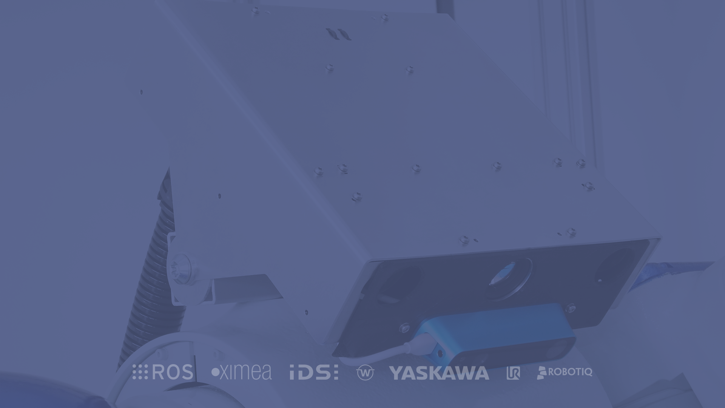


Fast and intuitive robot programming based on ROS!
Fast and intuitive robot programming based on ROS!
Dr. Andre Lemme Xamla Robotics Team

Slide 2
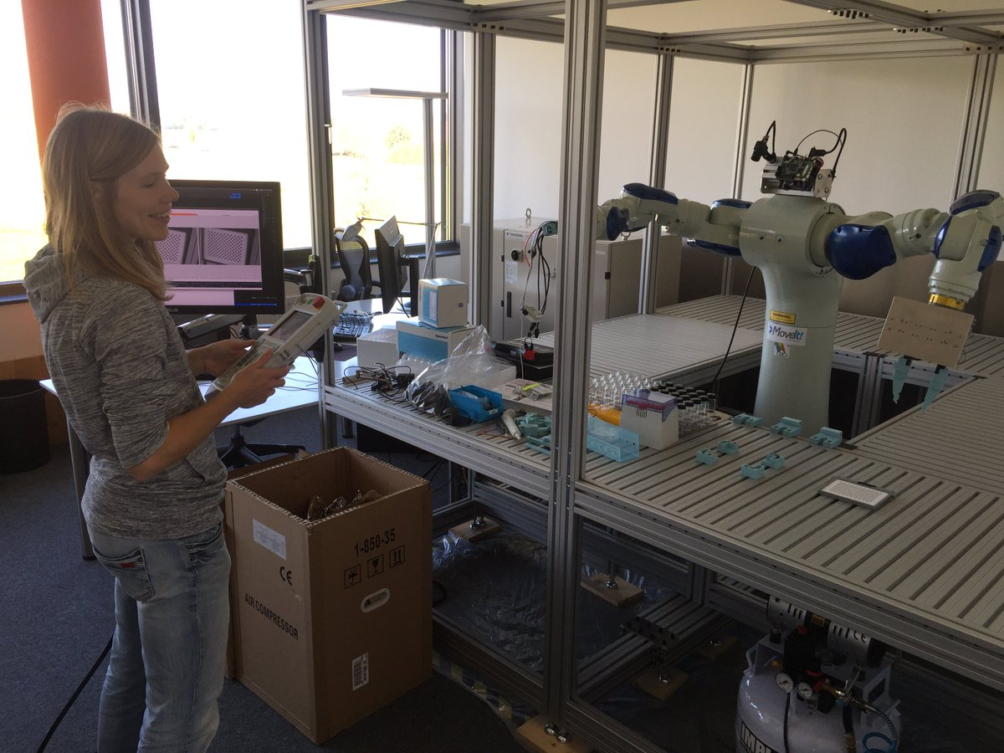


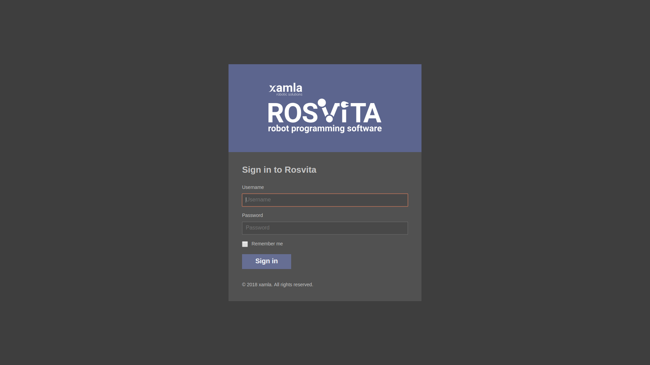
Intro of ROSVITA
1/50
Table of contents
1
Overview robotics field
6
Robot configuration
2
Introduction of ROS
7
World view
3
ROS vs. ROSVITA concepts
8
Status monitoring
Getting started with ROSVITA
4
9
Costum robot part
5
Docker as deployment tool
10
Concluding

Slide 3
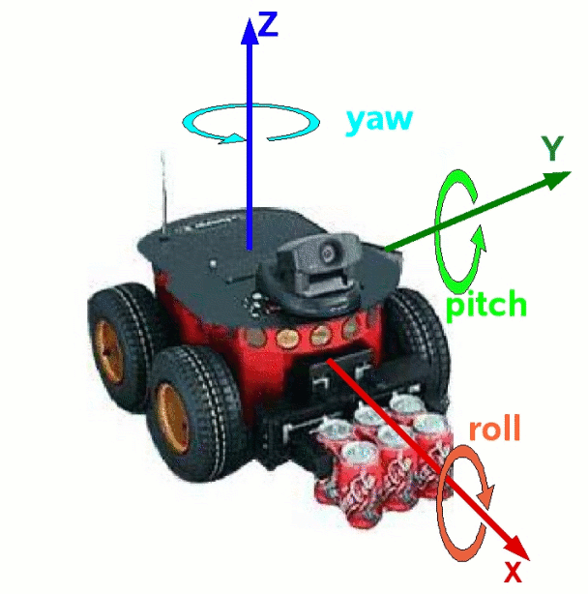
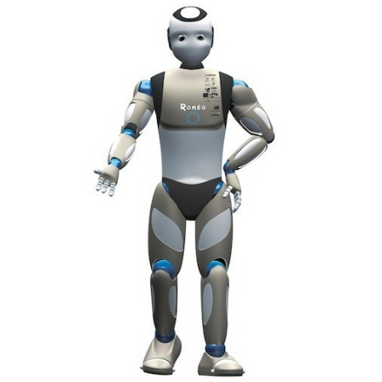
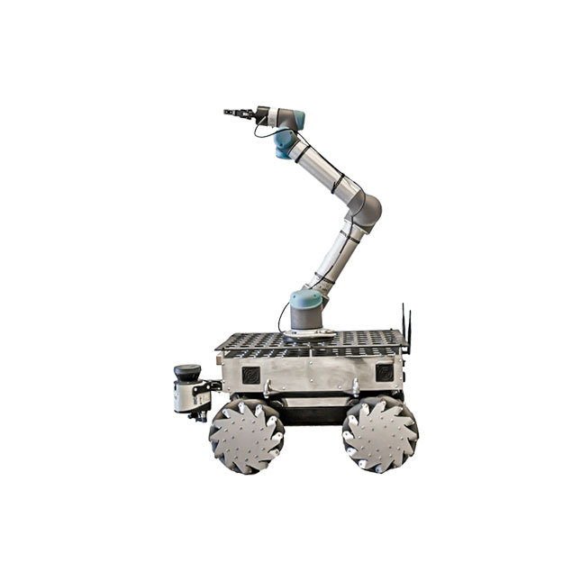
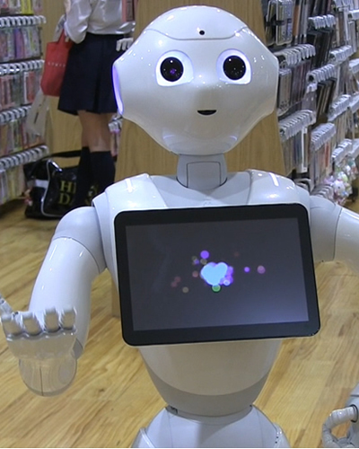
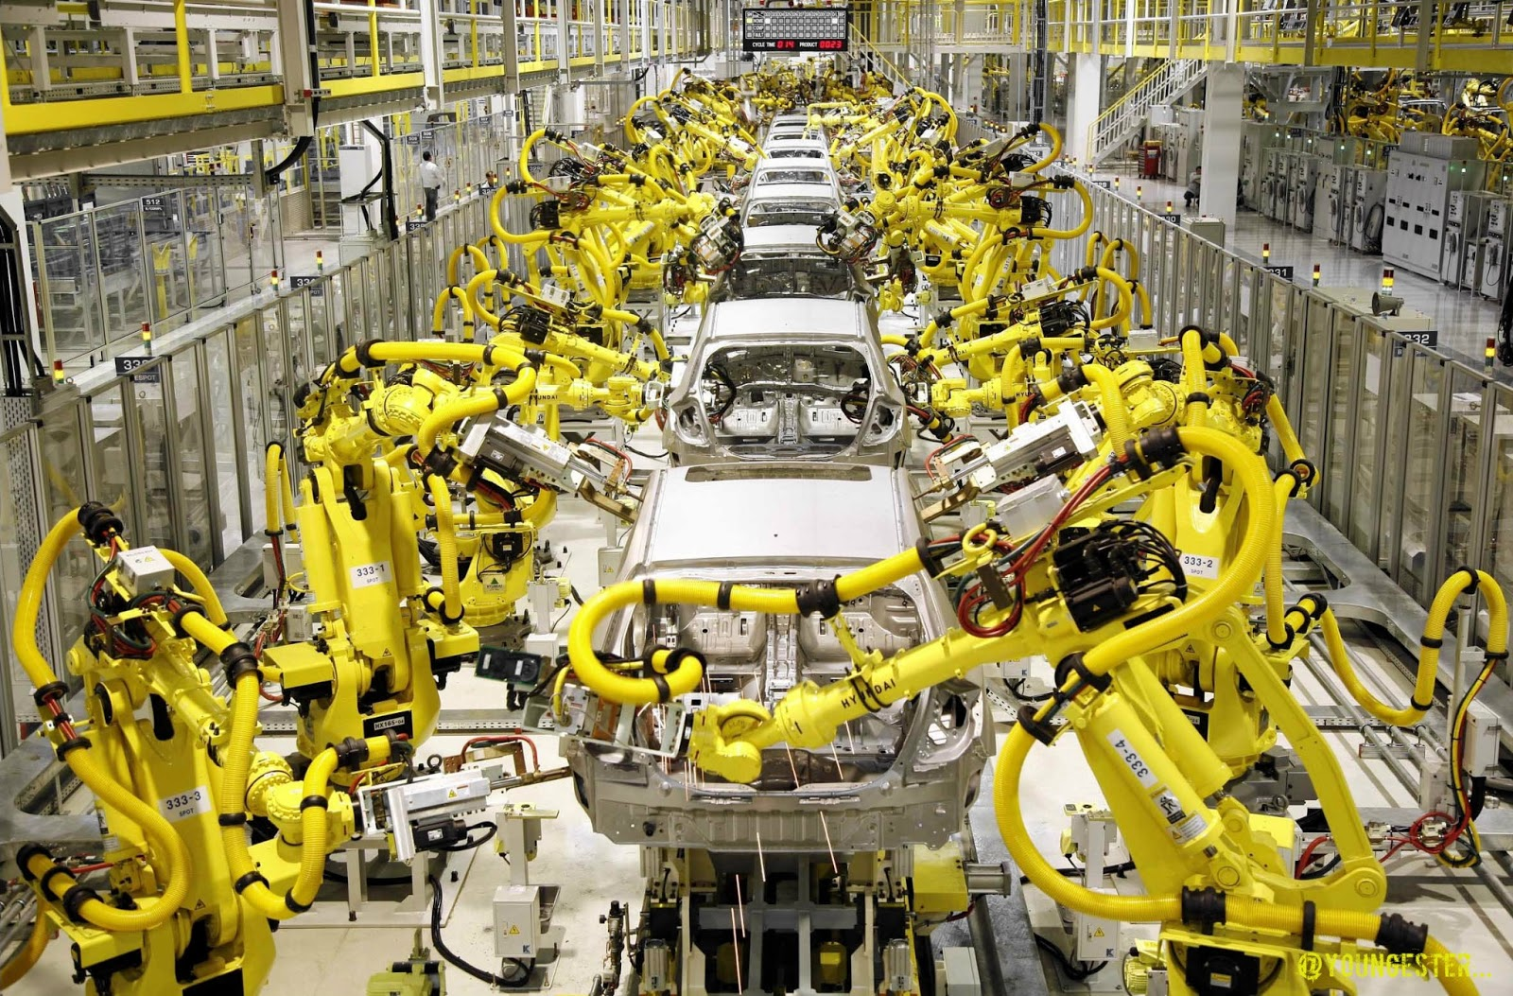
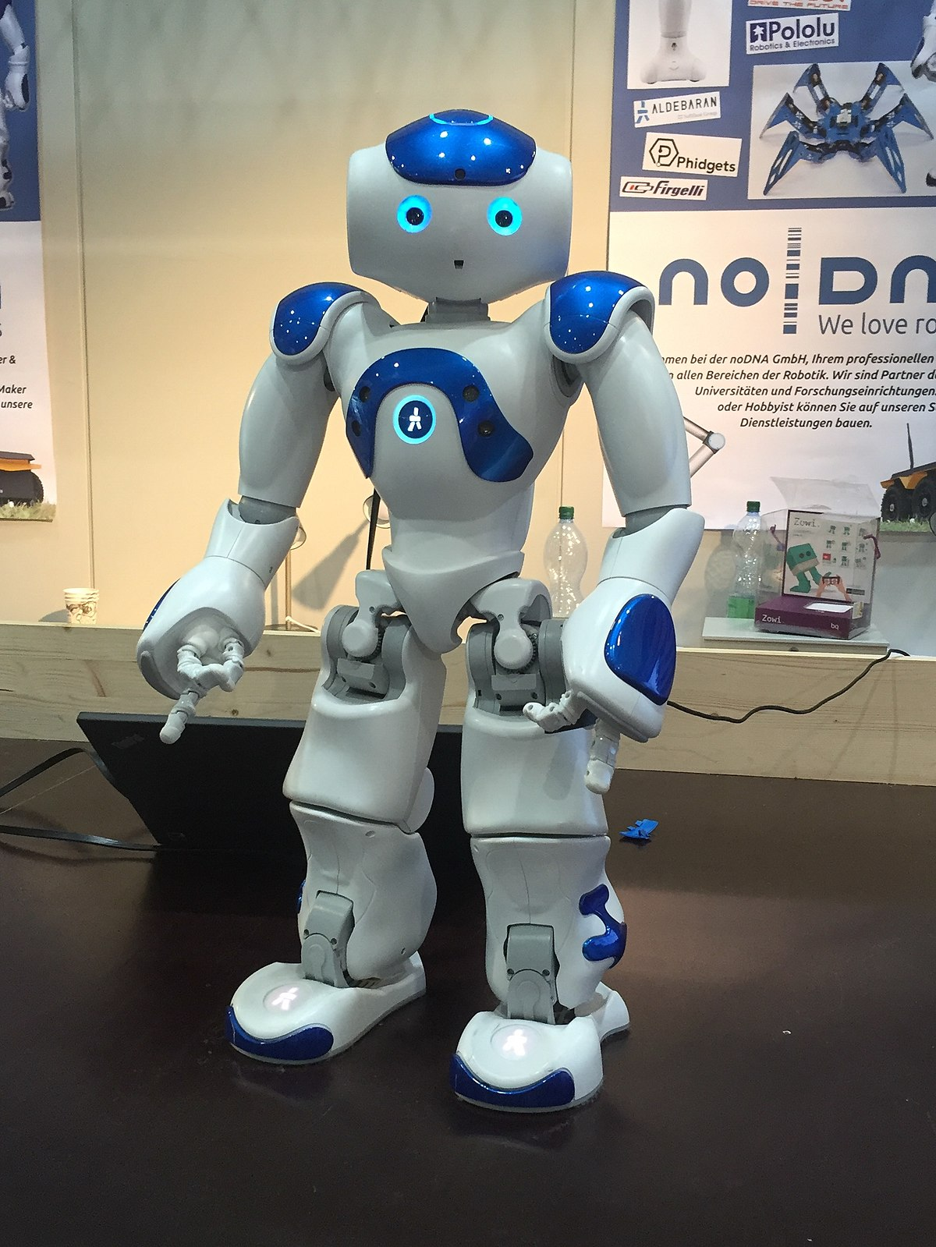
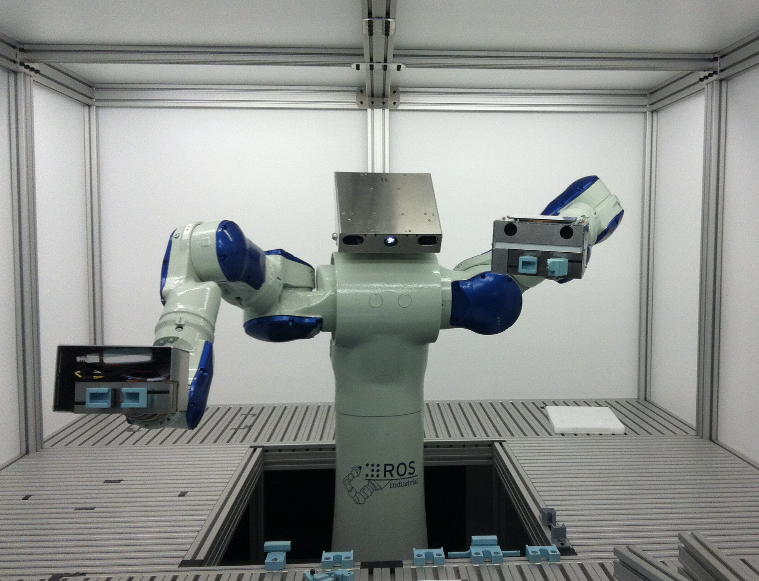

Intro of ROSVITA
2/50
1.1 Overview of Robotics
Mobile Robots
Humanoid Robots
Service Robots
Industrial Robots
Robotics is a very diverse field where restrictions and requirements come in different combinations!
How can we handle this? → Robotic-Framework

Slide 4
Intro of ROSVITA
3/50
1.2 Requirements and Tasks of a
Robotic-Framework
Integration of sensors and actuators
Software interfaces
High-Level functionality can be used on different hardware platforms!
ROS represents such a Robotic-Framework.

Slide 5
Intro of ROSVITA
4/50
2.1 Introduction of ROS
Robot Operating System (ROS)
Development started in context of the Standford-AI-Robot-Projects in 2007
Since 2009, the research institute Willow Garage took over
Since 2013, the Open Source Robotics Foundation (OSRF) is in charge
Mobile Robots
Humanoid Robots
Service Robots
Acknowledged standard in research and development

Slide 6
Intro of ROSVITA
5/50
2.1 Introduction of ROS
Robot Operating System (ROS)
  Linux, MacOS (experimental)
Open-Source Robotics-Framework
  Core parts of ROS → BSD License
  Community packages → Apache 2.0, GPL, MIT License
  e.g. MoveIt: path-planning with collision avoidance
Mobile Robots
Humanoid Robots
Service Robots
Industrial Robots
What about industrial applications?

Slide 7
Intro of ROSVITA
6/50
2.2 ROS-Industrial
started with the collaboration of
  Yaskawa Motoman Robotics,
  Southwest Research Institute
  Willow Garage
founded by Shaun Edwards (SwRI) in January 2012
Industrial Robots
Shows promising applications
Welding
Blending process
Pick and Place
Etc…
Community size?

Slide 8
Intro of ROSVITA
7/50
2.3 ROS-Industrial
Consortium Americas
(led by SwRI and located in San Antonio)
Consortium Europe
(led by Fraunhofer IPA and located in Stuttgart, Germany)
Consortium Asia Pacific
(led by Advanced Remanufacturing and Technology Center (ARTC) and Nanyang Technological Univertiy (NTU) located in Singapore)
Release cycle of ROS?

Slide 9
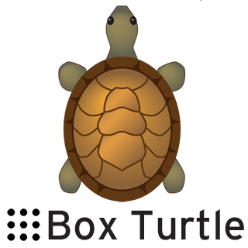




ROSVITA
8/50
2.4 ROS Distribution
ROS
Box Turtle
ROS
C Turtle
ROS
Diamondback
ROS
Fuerte Turtle
ROS
Groovy Galapagos
March 2, 2010
August 2, 2010
March 2, 2011
April 23, 2012
December 31, 2012

Slide 10


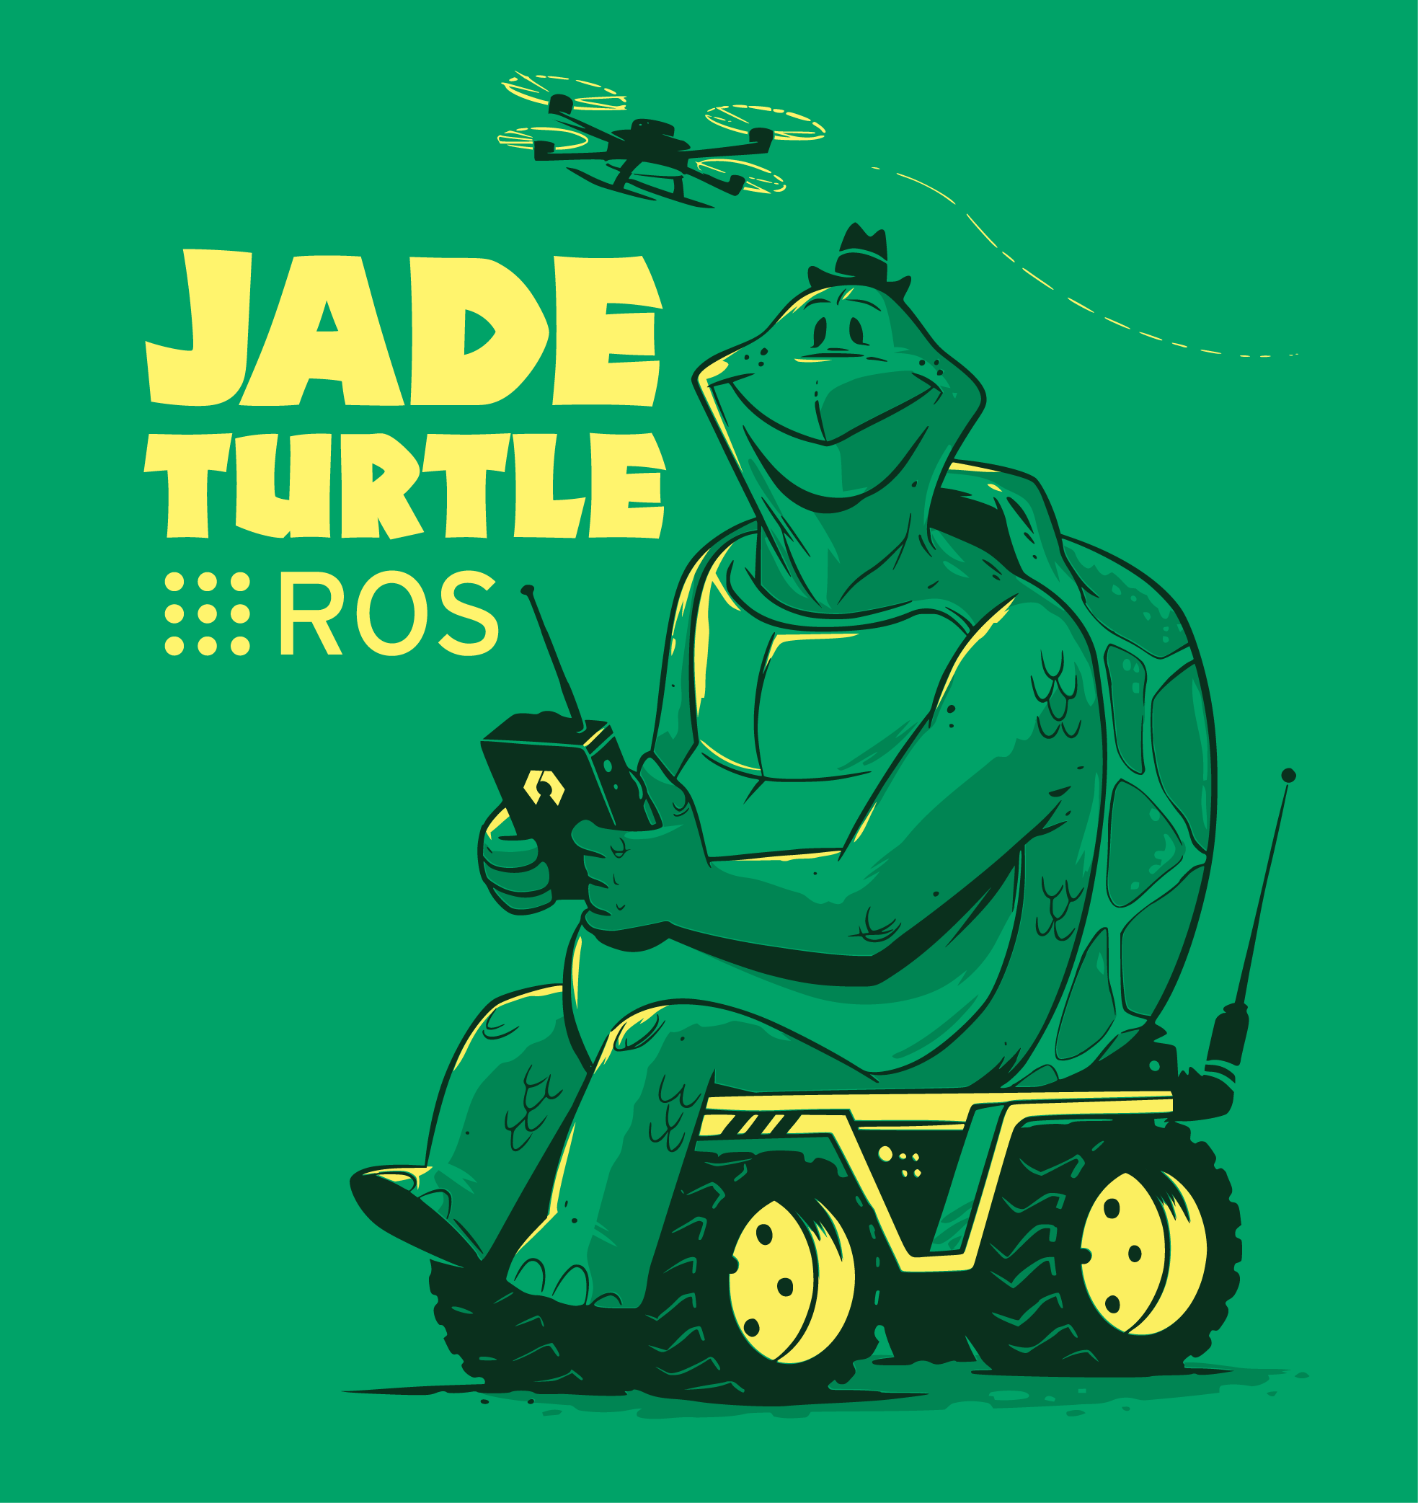

ROSVITA
9/50
2.4 ROS Distribution
ROS
Hydro Medusa
ROS
Indigo Igloo
ROS
Jade Turtle
ROS
Kinetic Kame
ROS
Lunar Loggerhead
September 4, 2013
July 22, 2014
May 23, 2015
May 23, 2016
May 23, 2017
Synced with ubuntu releases
Every two years new LTS release

Slide 11
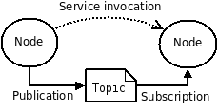
Intro of ROSVITA
10/50
2.5 ROS Concepts
Modularity
  Packages for organization
  Basic build and release item (catkin workspace)
Robot programs
  Nodes and launch-files
Communication
  Topics
  Services
  Actions
Tools
  rostopic, rosservice, rosparam, roscd, rviz
Processes
  Represented in graph architecture
Goals:
Scale-ability
Flexibility
?Robustness?
From ROS to ROSVITA

Slide 12
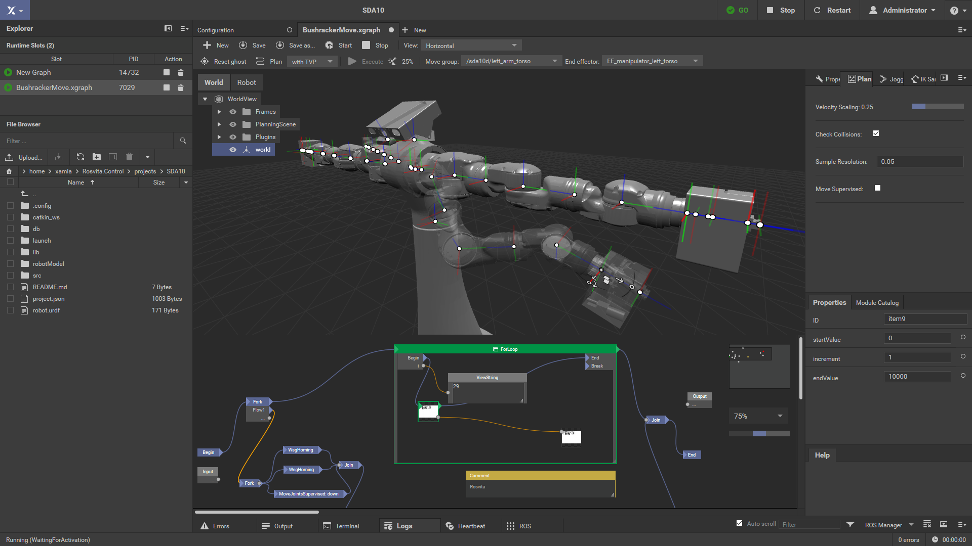
Intro of ROSVITA
11/50
3.1 ROS vs. ROSVITA concepts
Rosvita is a browser based programming IDE on top of ROS and therefore also using the ROS concepts!
  Web-Server
  RosGardener
  RosServices
  Motion planning with xamlamoveit
Rosvita

Slide 13
Intro of ROSVITA
12/50
3.2 ROSVITA
Browser based IDE on top of ROS and therefore also using the ROS concepts!
High quality 2D and 3D visualization
Ready-for-Industry robot drivers and other reliable ROS components
Visual workflow editor with an expandable module system
All features bundled in docker container for easy deployment
Rosvita

Slide 14
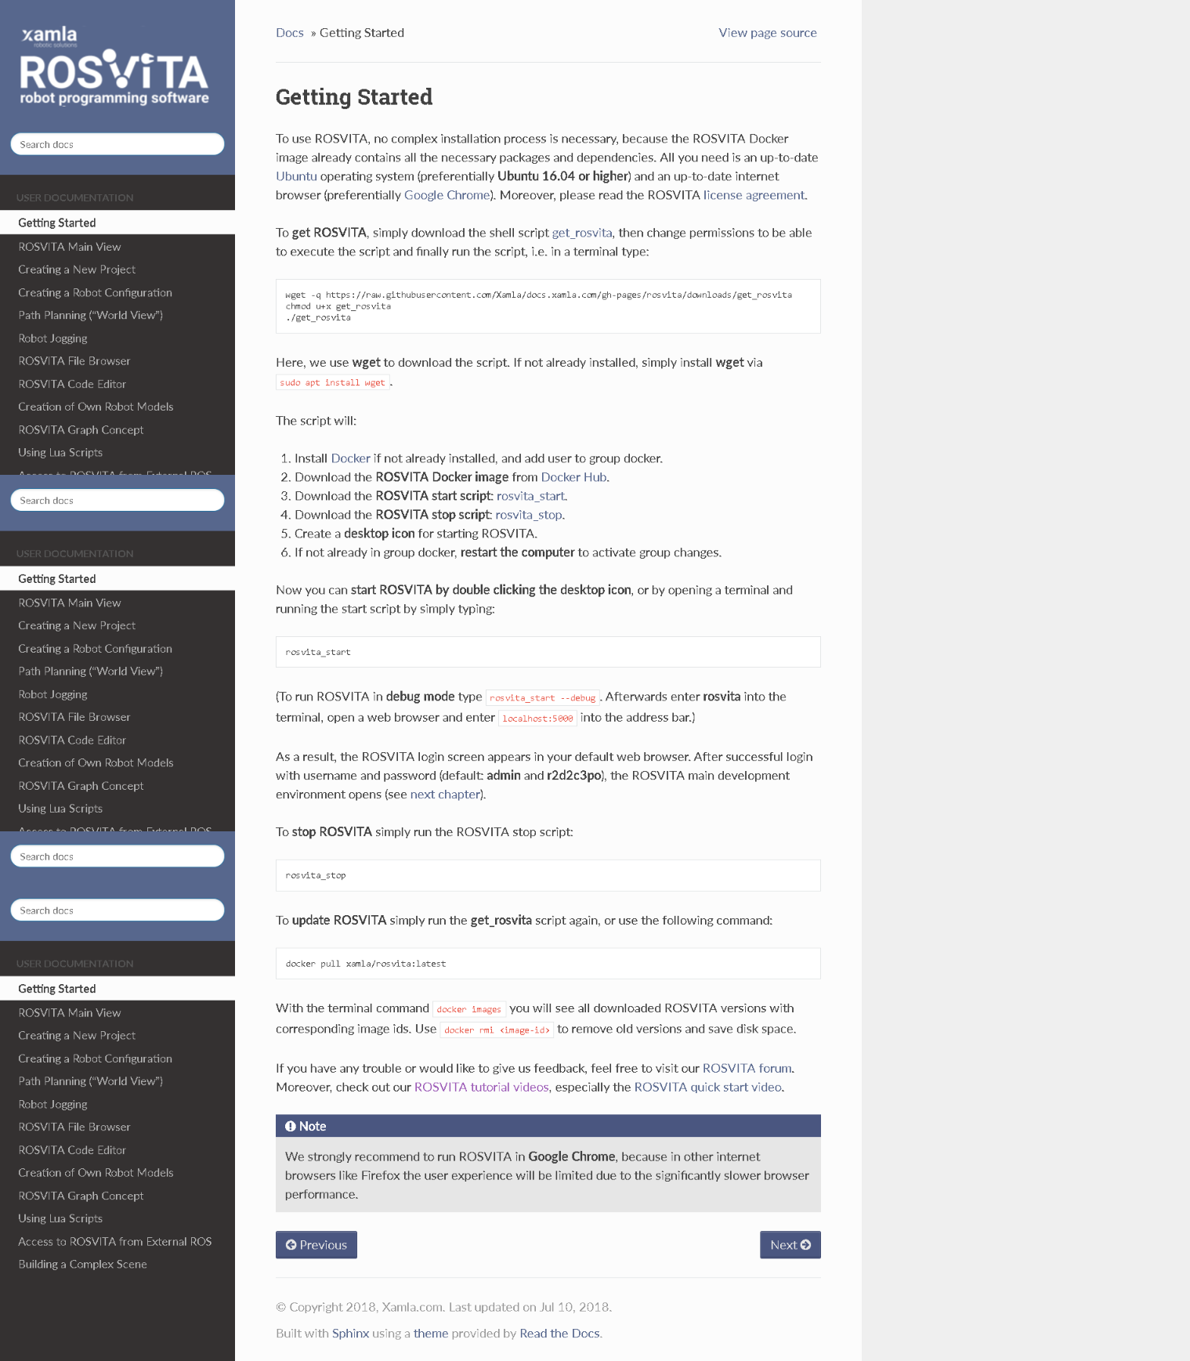
Intro of ROSVITA
13/50
4.1 Getting started with ROSVITA
VIDEO

Slide 15
Intro of ROSVITA
14/50
4.2 Docker as deployment tool
Docker image
Persistent data located in host system
  ~/Rosvita/data
  ~/Rosvita/projects
  ~/Rosvita/robot_parts
Advantages
  Available on Linux/MacOs/Windows
  Robust system → image restart
  Dependencies bundeled
“Docker – Build, Ship, and Run Any App, Anywhere. ”

Slide 16
Intro of ROSVITA
15/50
4.3 What is docker and why is it useful?
Docker image
Persistent data located in host system
Advantages
  Available on Linux/MacOs/Windows
  Robust system → image restart
  Dependencies bundeled
Disadvantages
  Difficult to connect to hardware
“Docker – Build, Ship, and Run Any App, Anywhere. ”

Slide 17
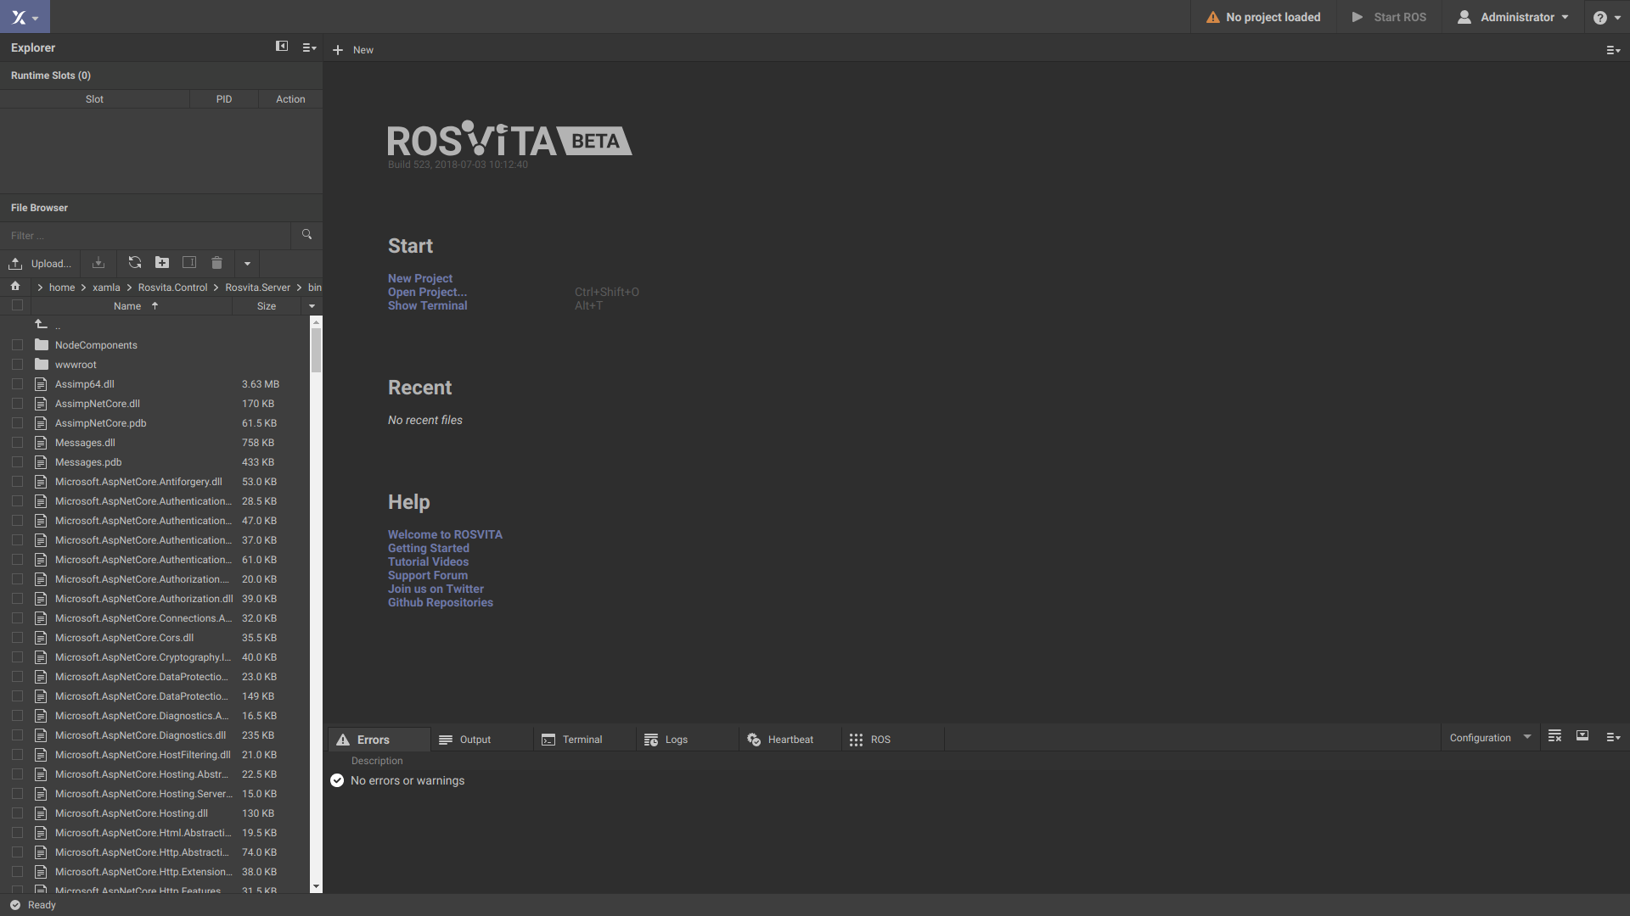
Intro of ROSVITA
16/50
5.1 Welcome to ROSVITA

Slide 18
Intro of ROSVITA
17/50
5.2 Welcome to ROSVITA

Slide 19
Intro of ROSVITA
18/50
5.2 Welcome to ROSVITA

Slide 20
Intro of ROSVITA
19/50
5.2 Welcome to ROSVITA

Slide 21
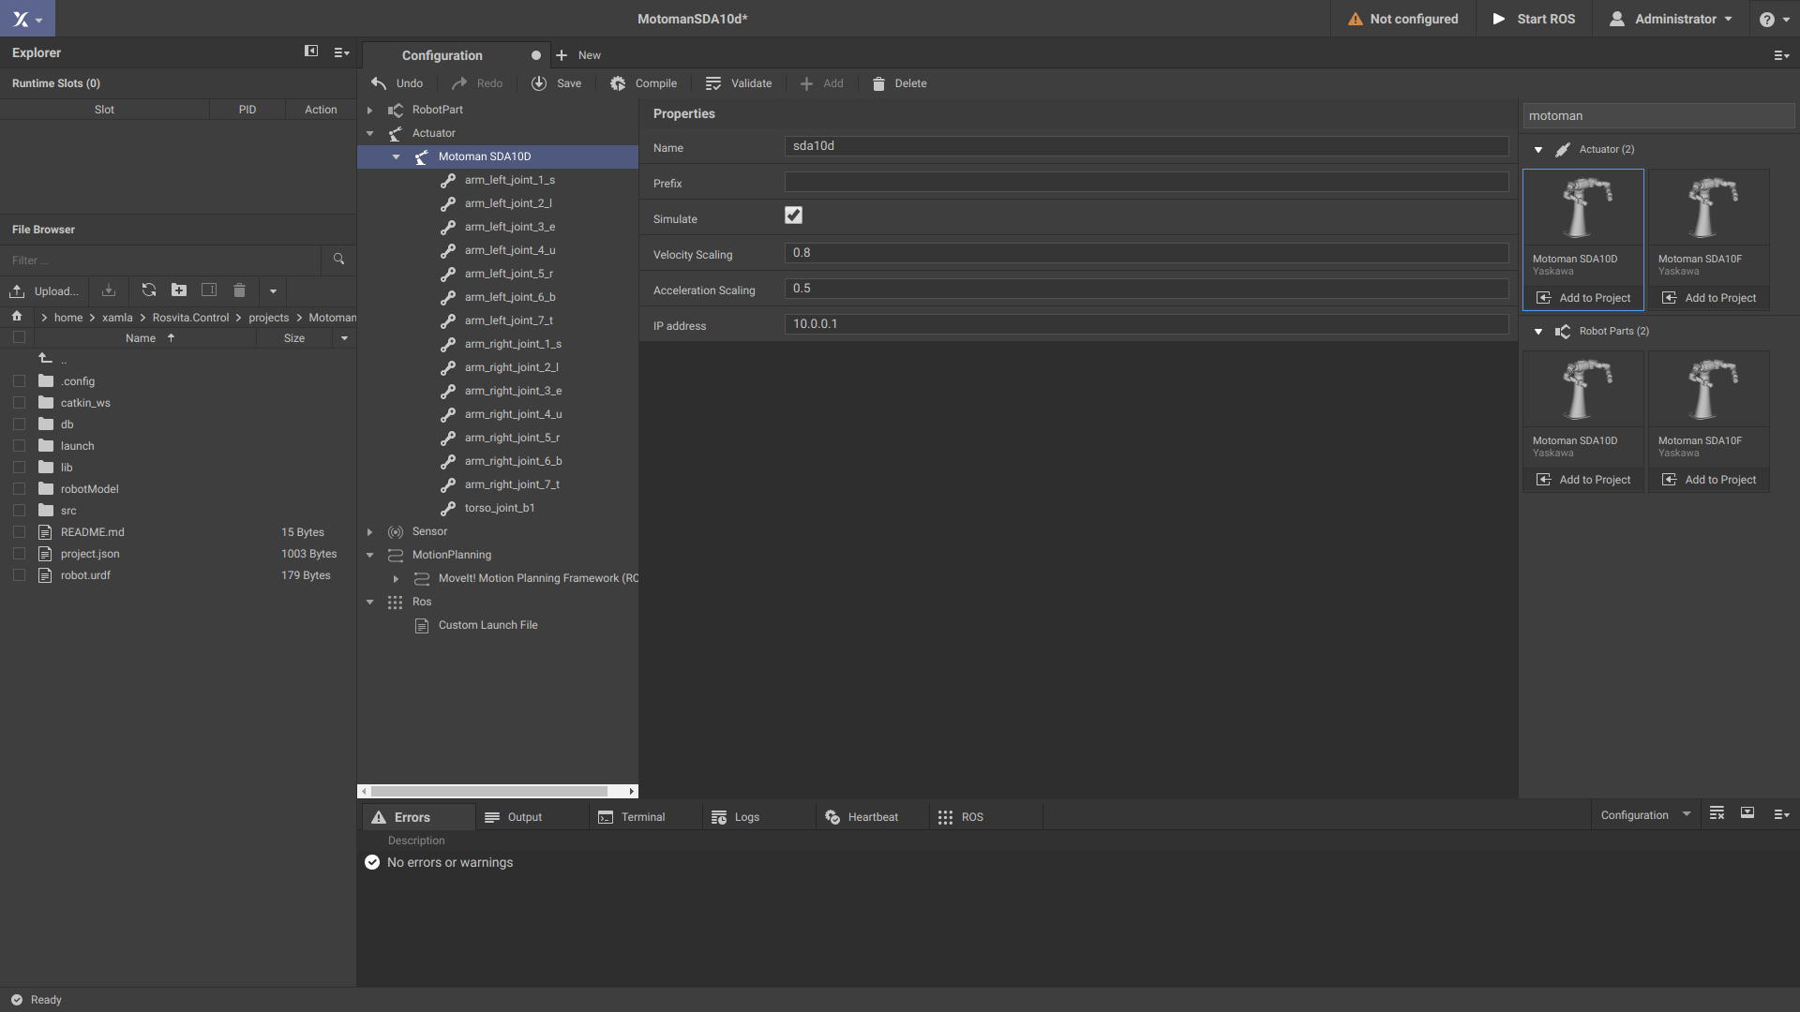
Intro of ROSVITA
20/50
6.1 Robot configuration

Slide 22
Intro of ROSVITA
21/50
6.2 Robot configuration
RobotPart
  URDF, Xacro, standard interface
Actuator
  Driver, corresponding to urdf
Sensor
  Cameras etc...
MotionPlanning
  MoveIt configuration and extras
ROS Launch File

Slide 23
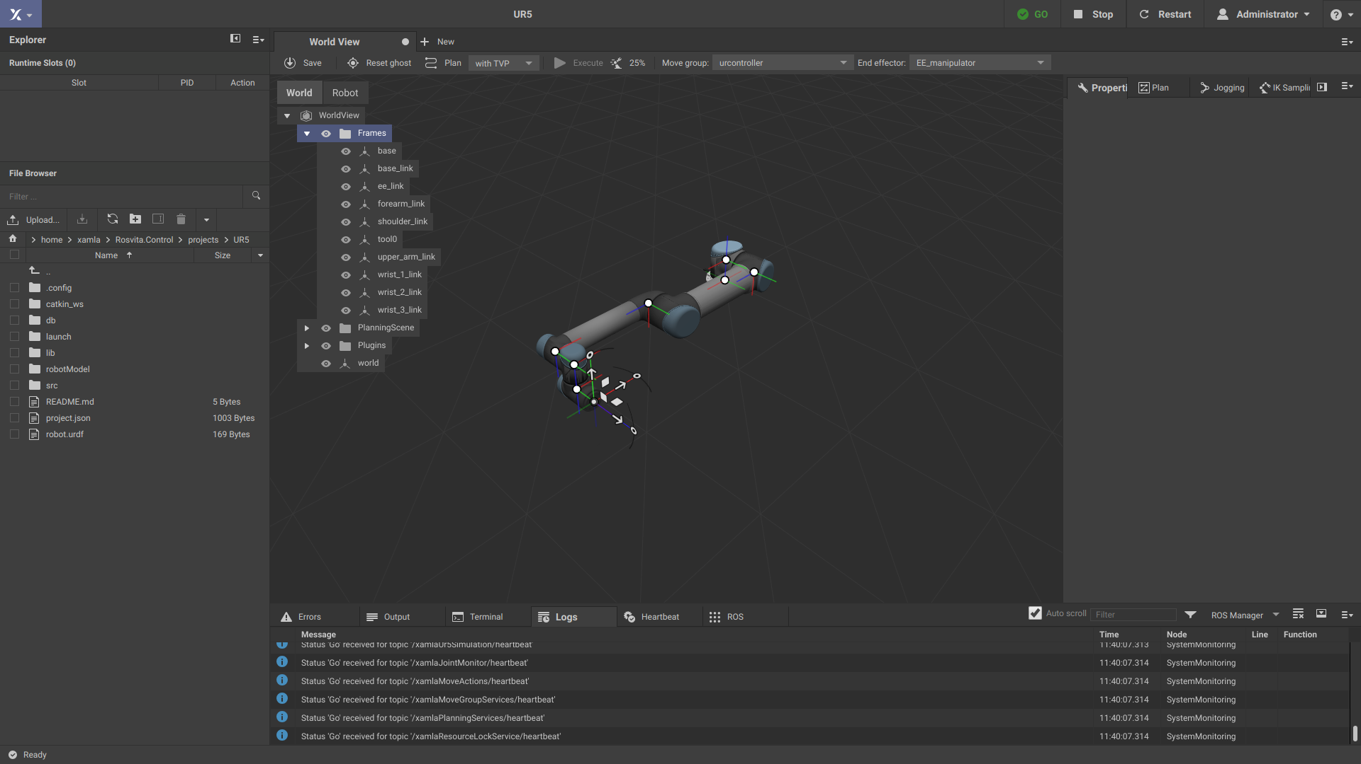
Intro of ROSVITA
22/50
7.1 World view

Slide 24
Intro of ROSVITA
23/50
7.1 World view
Frames
CollsionObjects
Plugins
Poses
JointValues

Slide 25
Intro of ROSVITA
24/50
7.1 World view

Slide 26
Intro of ROSVITA
25/50
7.2 World view
Property view
  Detailed information of all datatypes in the tree view.

Slide 27
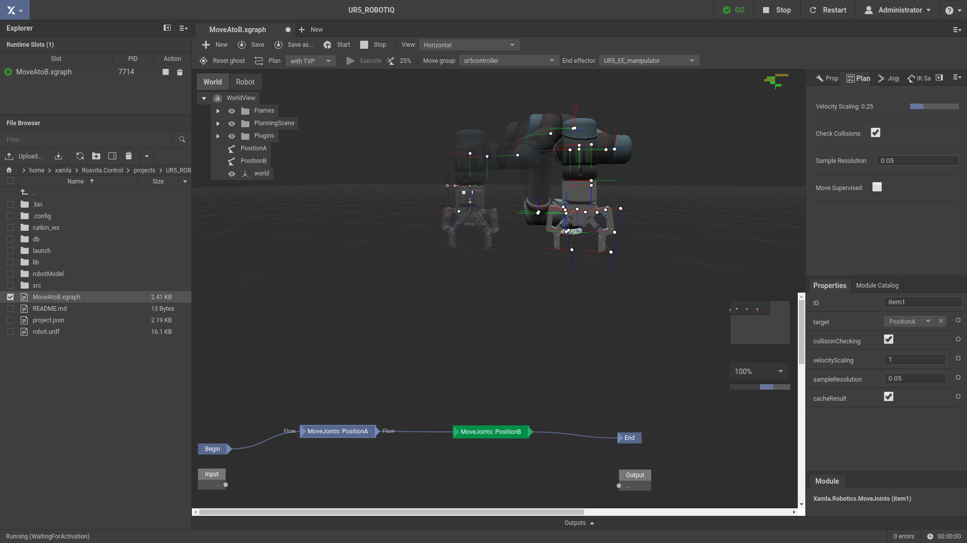
Intro of ROSVITA
26/50
7.3 World view
Planning view
  Velocity scaling
  Check collisions
  Sampling Resolution
  Move Supervised

Slide 28
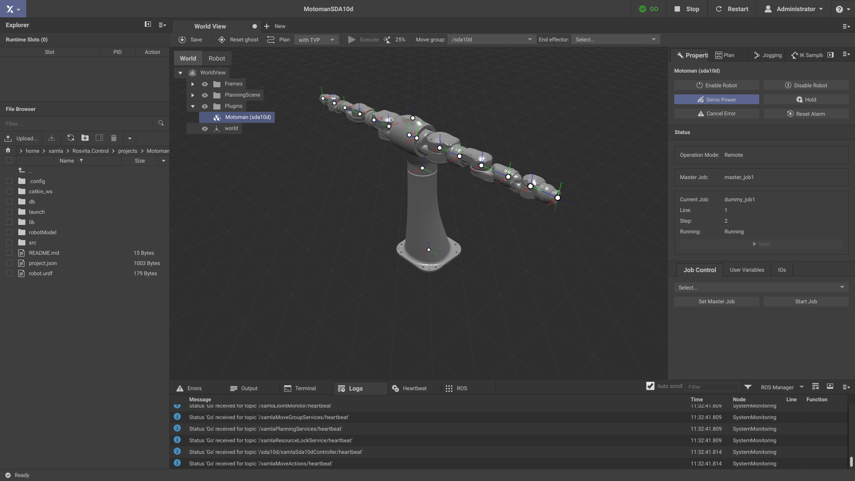
Intro of ROSVITA
27/50
7.4 World view
Property view
  Detailed information of all datatypes in the tree view.
  Plugins

Slide 29
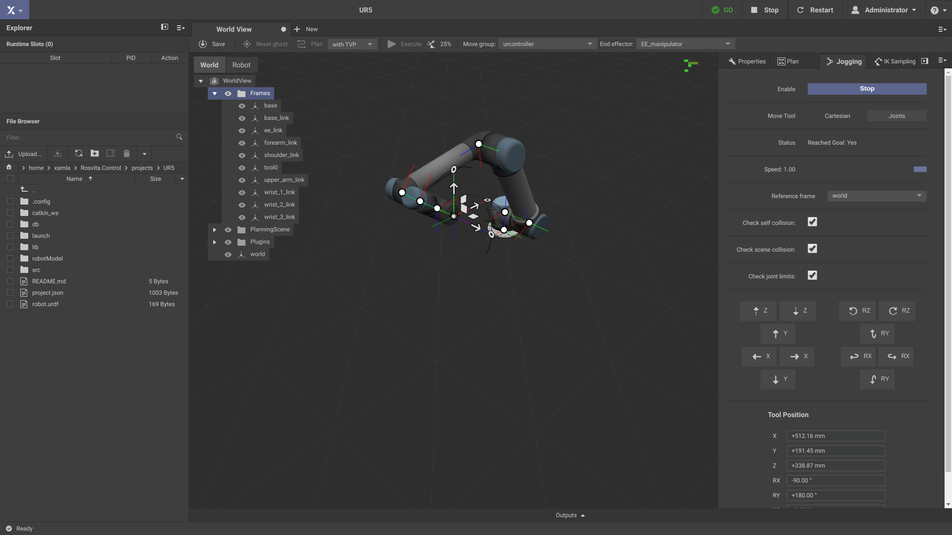
Intro of ROSVITA
28/50
7.5 World view
Property view
  Detailed information of all datatypes in the tree view.
  Plugins
Jogging view
  Joint Space
  Cartesian Space

Slide 30
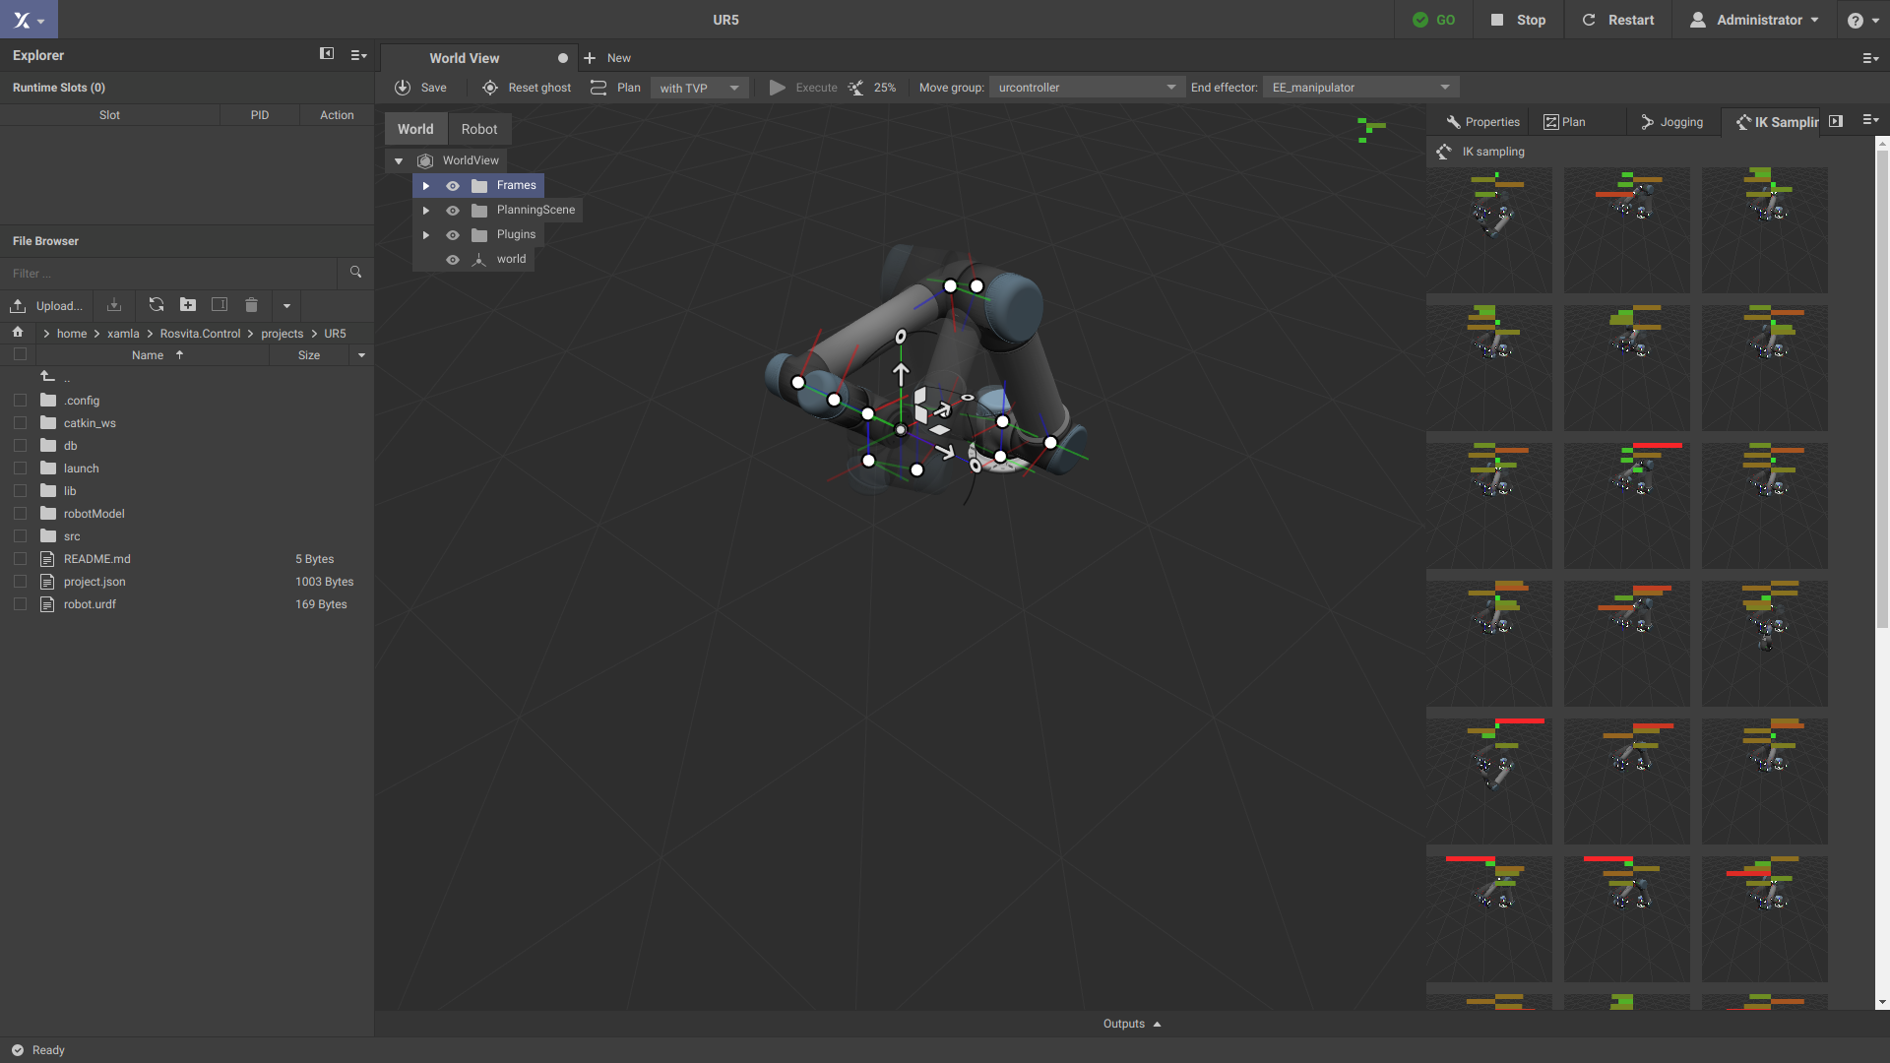
Intro of ROSVITA
29/50
7.6 World view
Property view
  Detailed information of all datatypes in the tree view.
  Plugins
Jogging view
  Joint Space
  Cartesian Space
IK-Sampling
  Find better joint values for Pose

Slide 31
Intro of ROSVITA
30/50
7.8 World view
Conclusion:
  Positioning the robot
  Store data
  Try different things
Jogging view
  Joint Space
  Cartesian Space
IK-Sampling
  Find better joint values for Pose

Slide 32
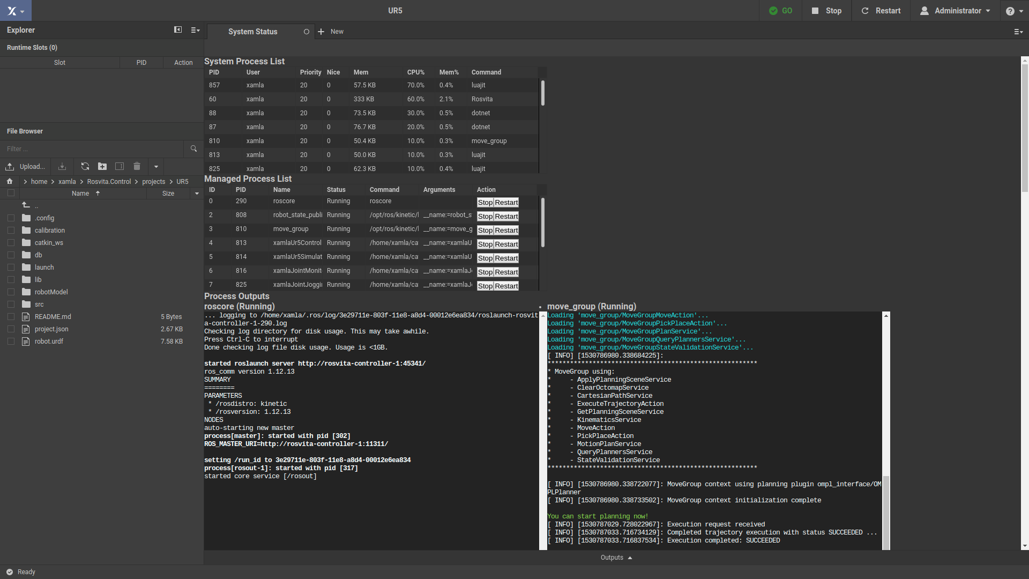
Intro of ROSVITA
31/50
8.1 Status Monitoring
System process list
    Work load on system
Managed process list
    Start/Stop of individual nodes
Split terminal output per node

Slide 33
Intro of ROSVITA
32/50
9.1 Customizing
Add your own link to your setup
Add full robot part
Add ros package
Add your own hardware plugin

Slide 34
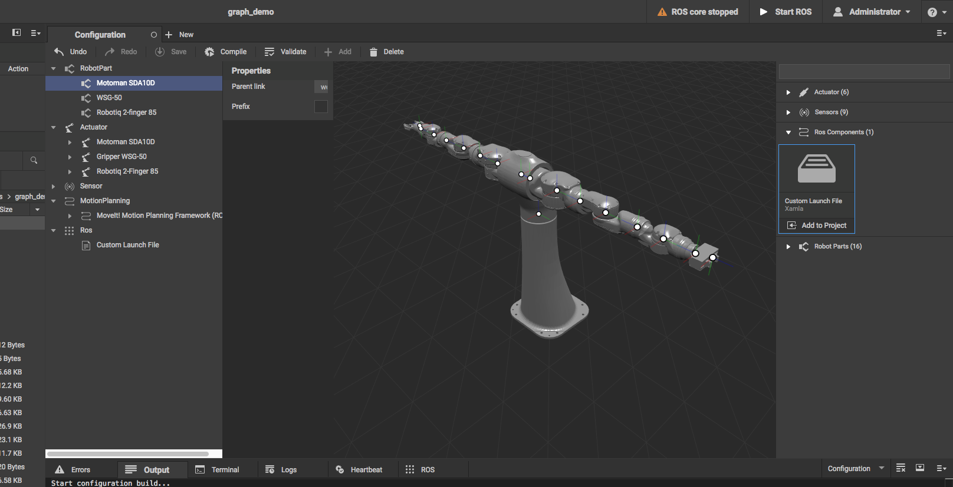
Intro of ROSVITA
33/50
9.2 Costum robot part
How to add a new Head?
  Add a new link to your urdf.

Slide 35
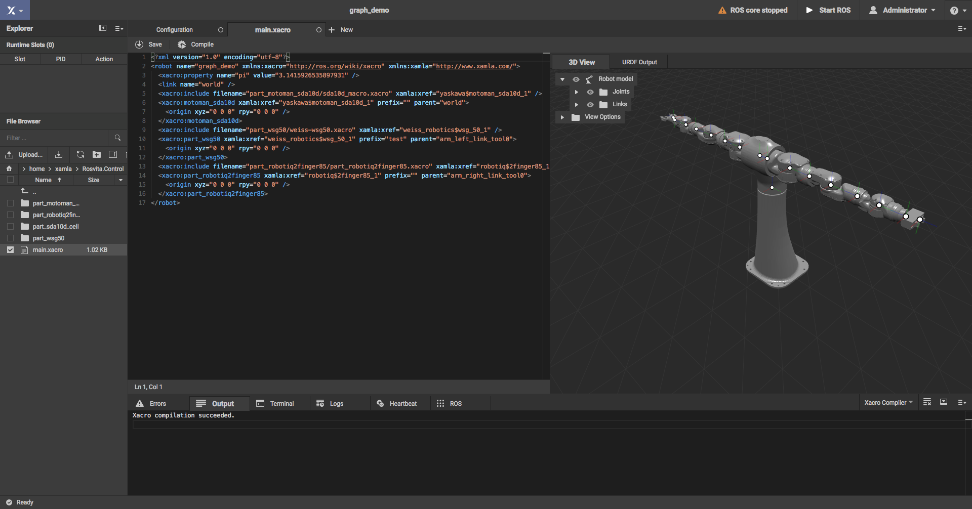
Intro of ROSVITA
34/50
9.2 Costum robot part

Slide 36
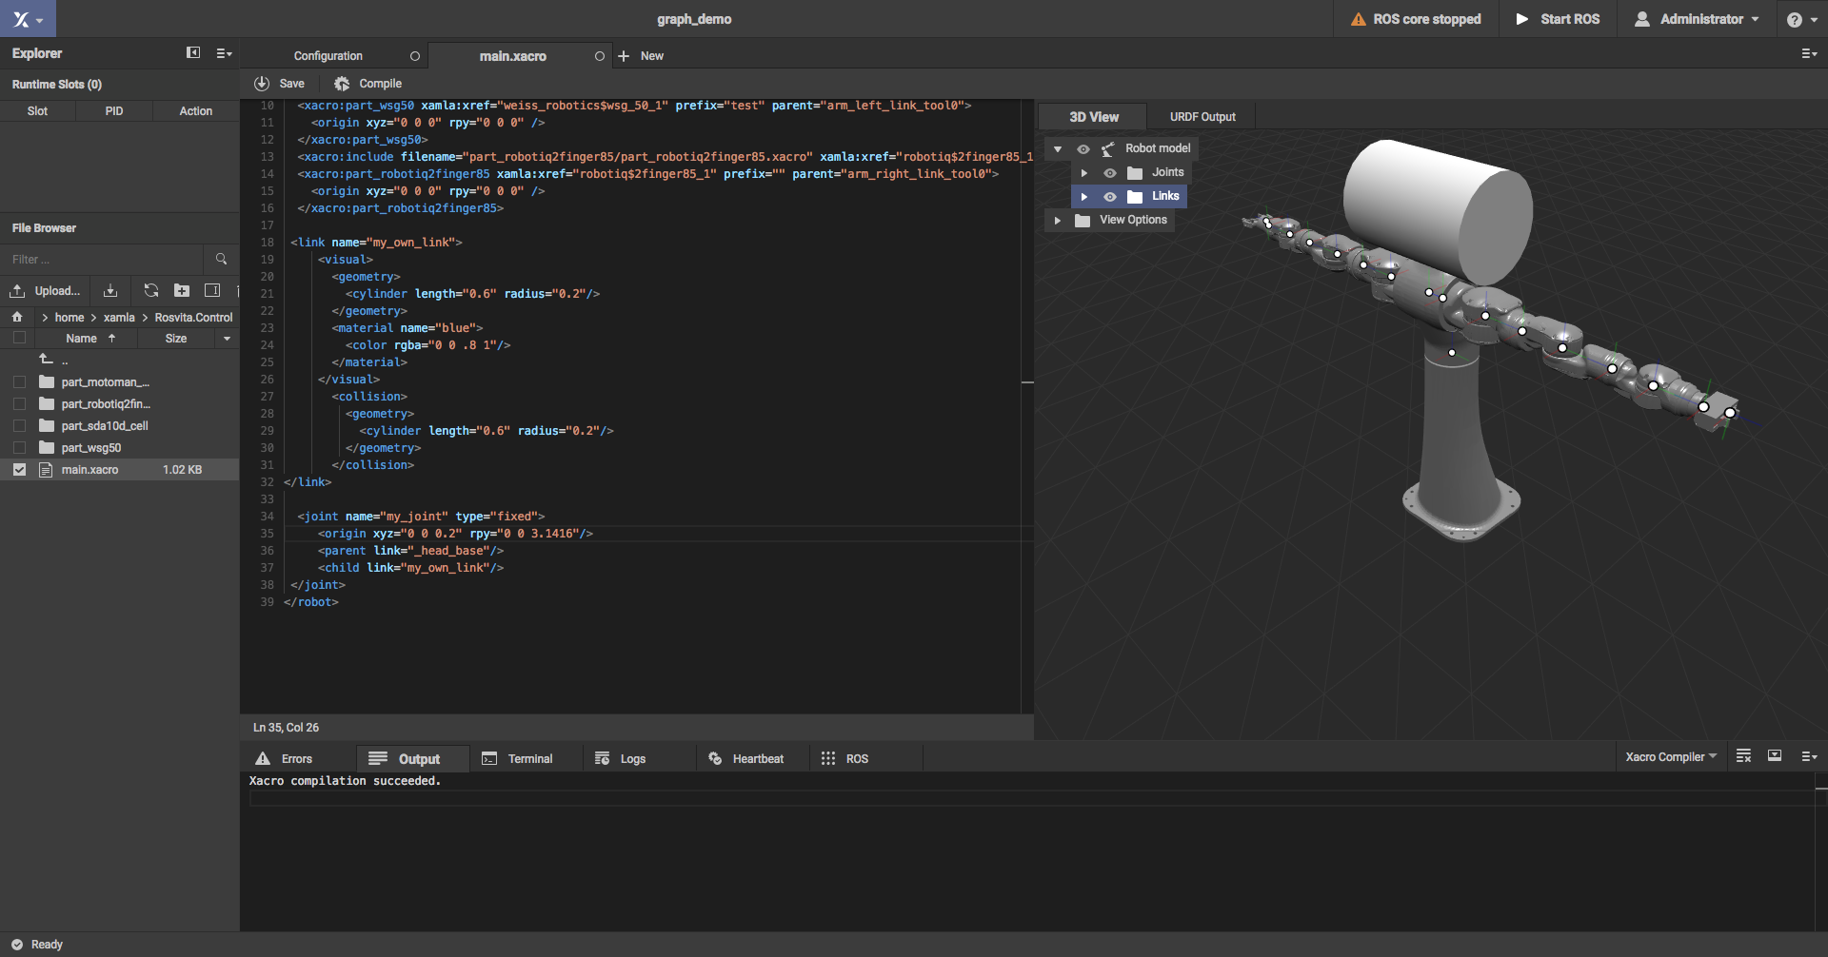
Intro of ROSVITA
35/50
9.3 Costum robot part

Slide 37
Intro of ROSVITA
36/50
9.3 Costum robot part
Simple primitives
Mesh descriptions
  Visual (Collada files)
  Collision (step files)
How to connect to my model?

Slide 38
Intro of ROSVITA
37/50
9.3 Costum robot part
Connect with joints
    Add to the chain
    Parent
    Child
Press compile and you are done!

Slide 39
Intro of ROSVITA
38/50
9.3 Costum robot part
To add one link is nice but how about adding more complex robot parts?
  Add a new robot part as ROS package.

Slide 40
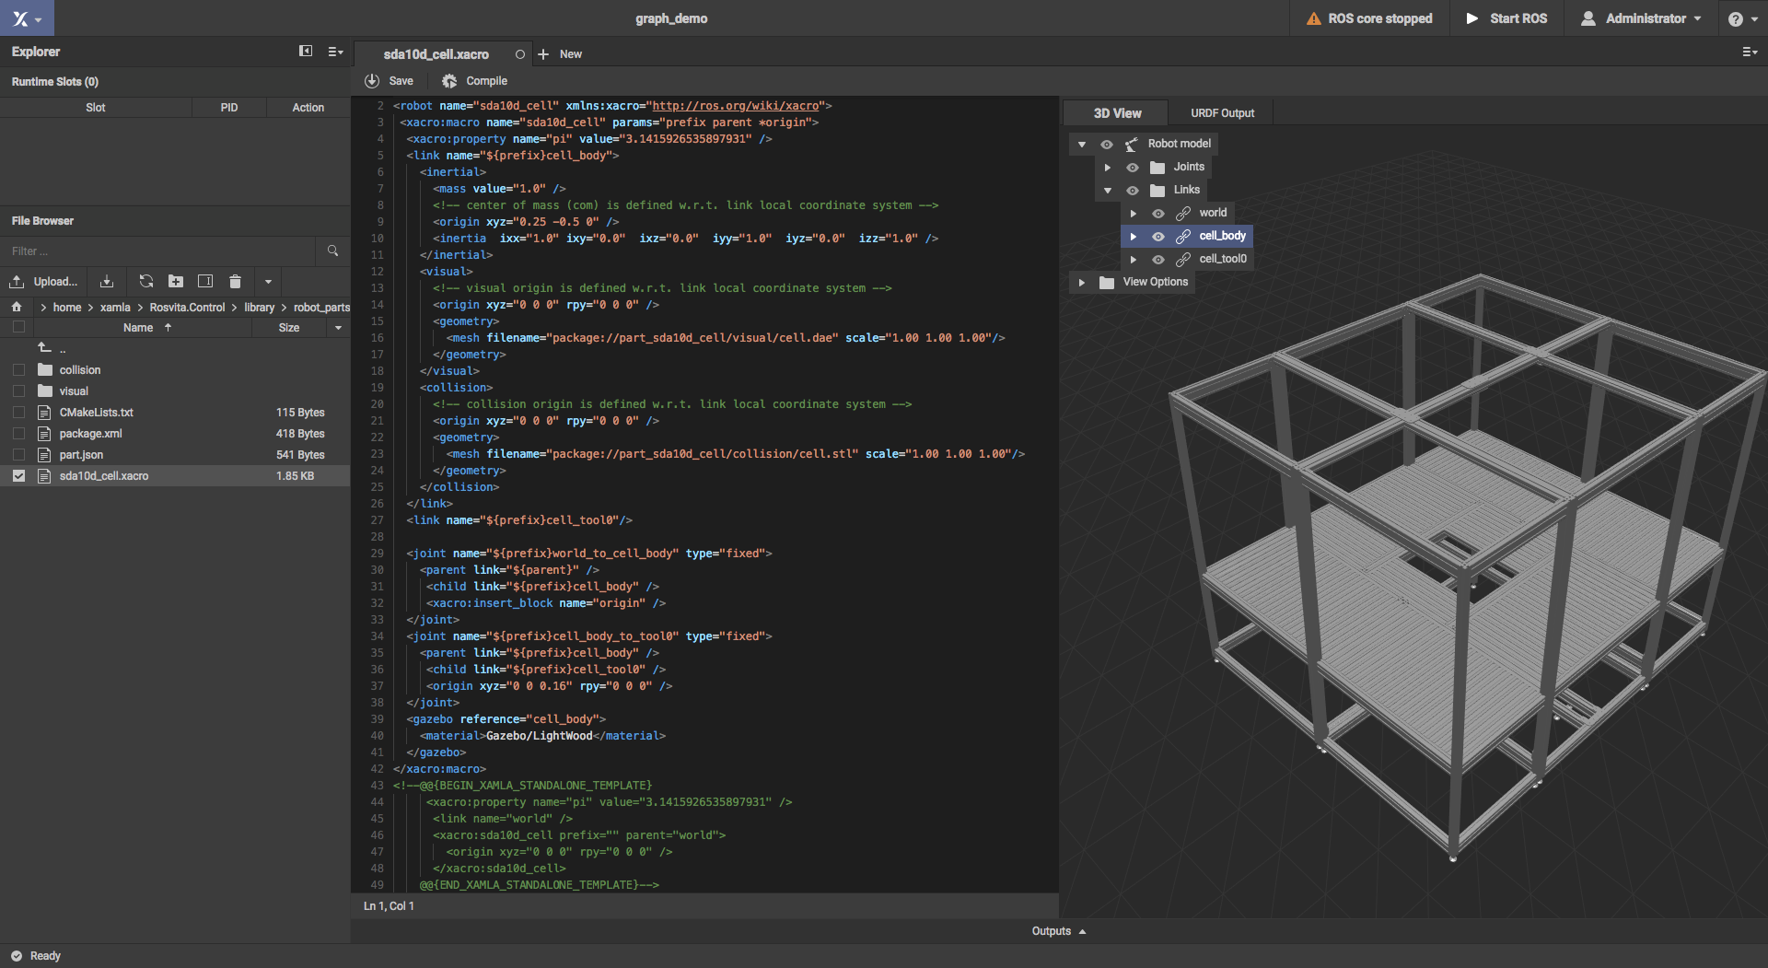
Intro of ROSVITA
39/50
9.4 Costum robot part

Slide 41
Intro of ROSVITA
40/50
9.4 Costum robot part
Prefix
  Make sure your joints have uniqe identifier
Parent
    Where to attache to
Origin
  Releative transformation to parent link

Slide 42
Intro of ROSVITA
41/50
9.5 Costum robot part

Slide 43
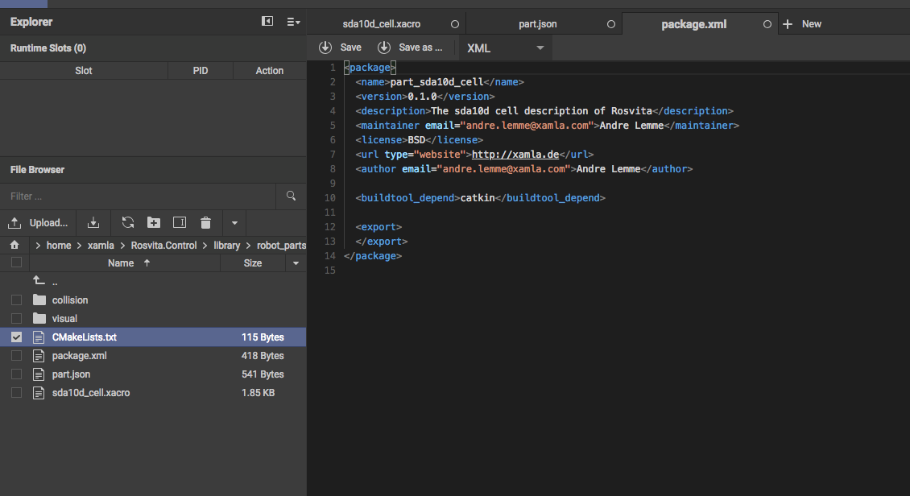
Intro of ROSVITA
42/50
9.5 Costum robot part
ROS package
    CMakeLists.txt
    Package.xml

Slide 44
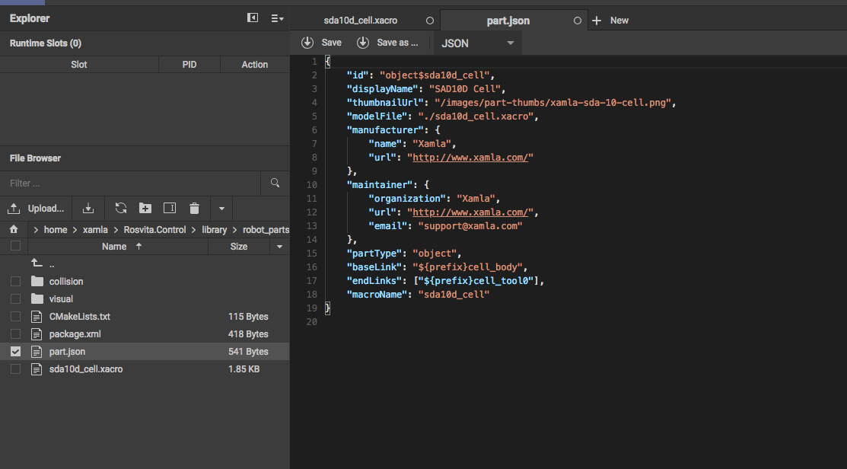
Intro of ROSVITA
43/50
9.5 Costum robot_part
ROS package
    CMakeLists.txt
    Package.xml
ROSVITA additions
  Part.json

Slide 45
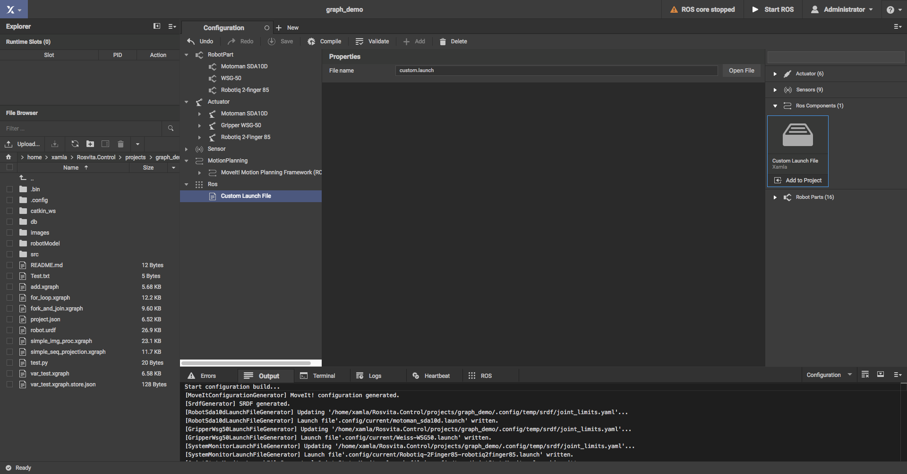
Intro of ROSVITA
44/50
9.6 Costum launch files
Select ROS Launch File in rosvita library
Open launch file

Slide 46
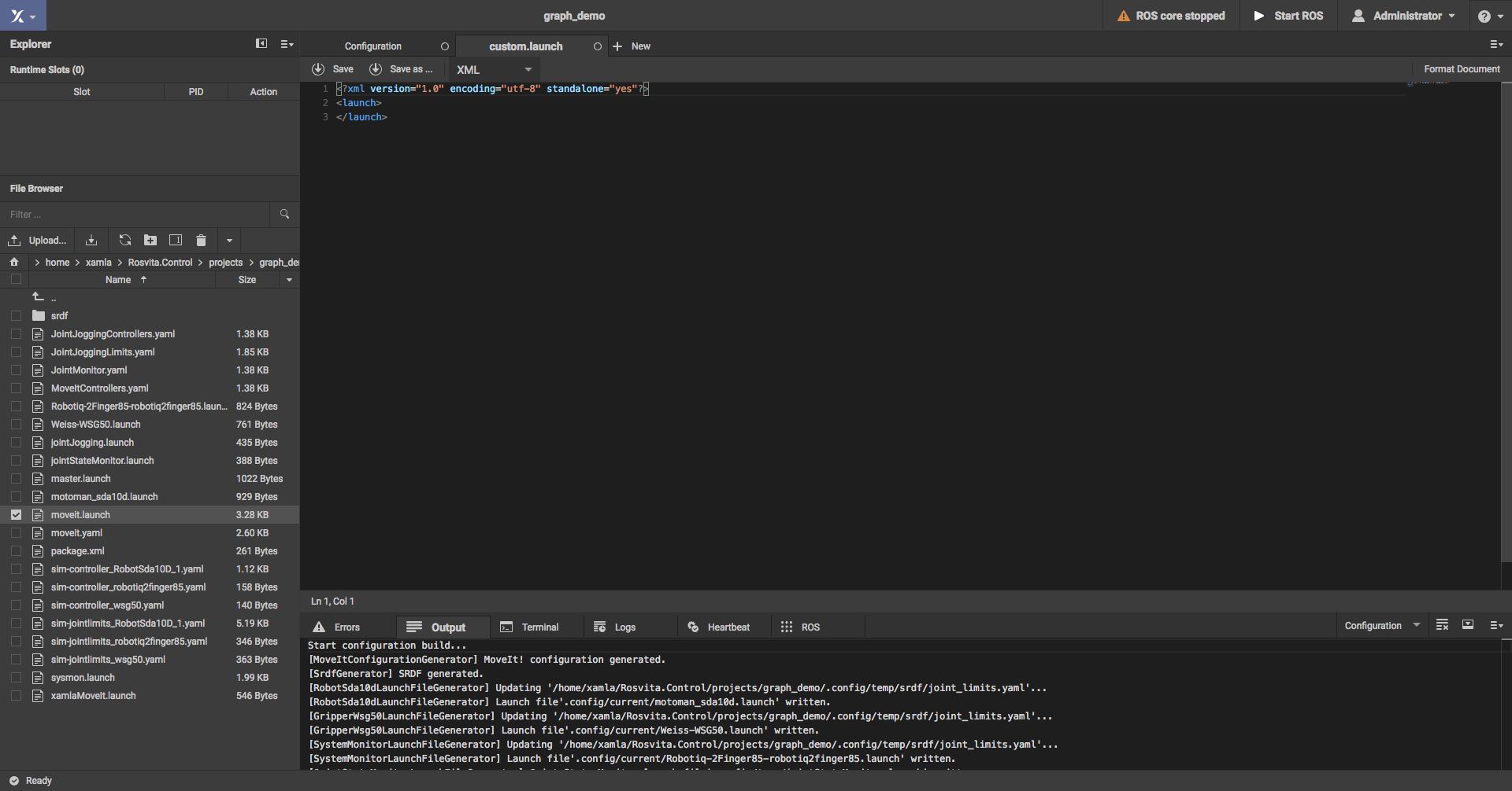
Intro of ROSVITA
45/50
9.6 Costum launch files
Select ROS Launch File in rosvita library
Open launch file
Add any node you want rosvita to launch for you.

Slide 47
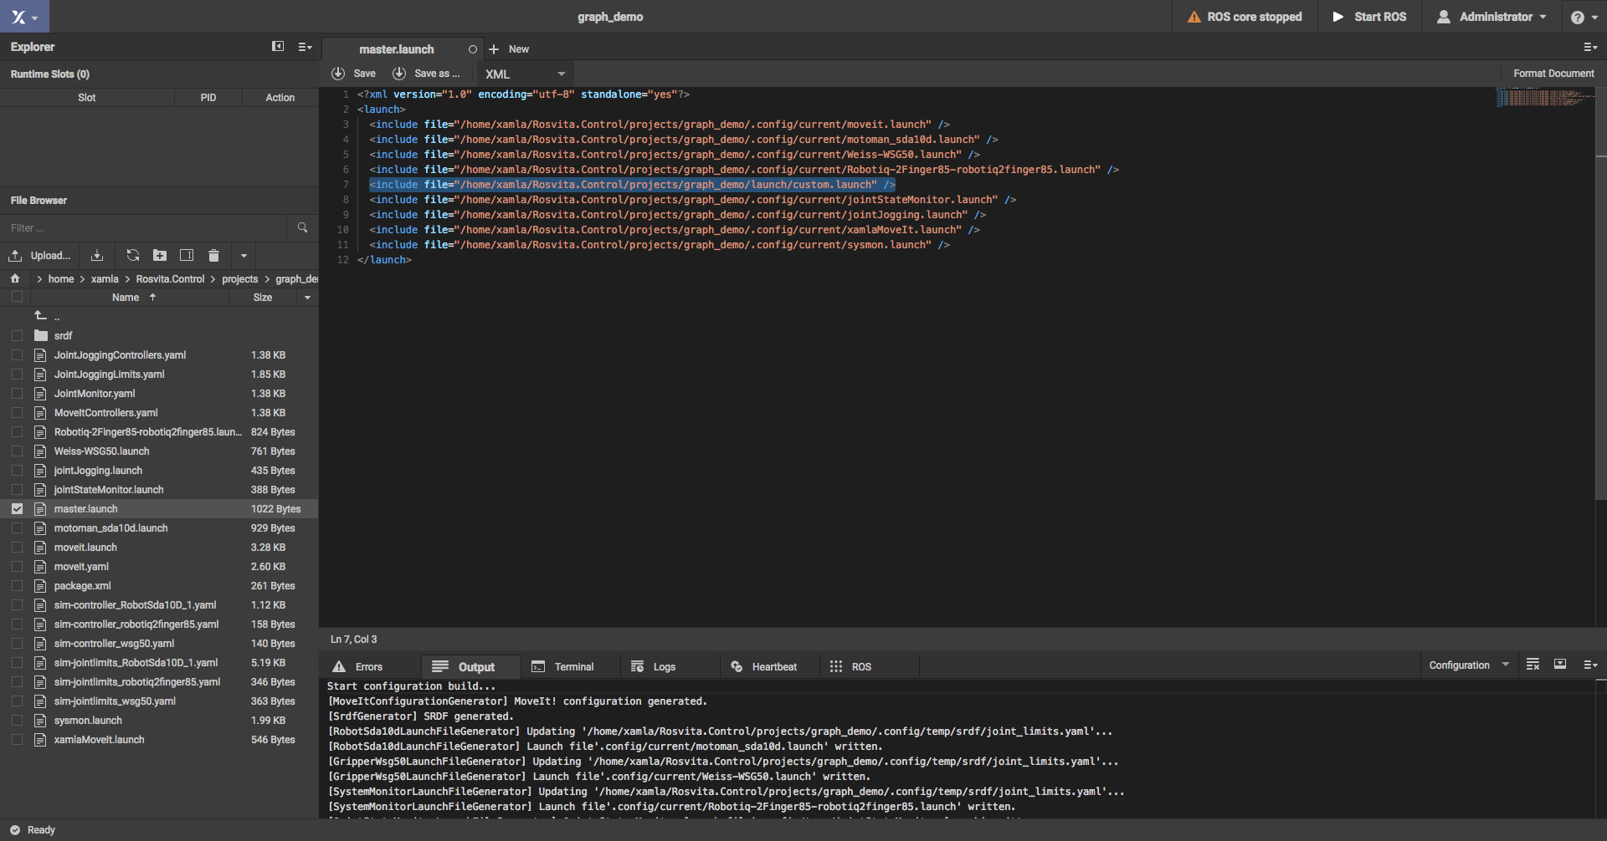
Intro of ROSVITA
46/50
9.6 Costum launch files
Select ROS Launch File in rosvita library
Open launch file
Add any node you want rosvita to launch for you.

Slide 48
Intro of ROSVITA
47/50
10.1 ROSVITA
Based on ROS
Library of robot parts and drivers included
MotionPlanning
  MoveIt configuration and extras
Custemizing on multiple levels
  Robot parts
  Launch files
  Plugins
Rosvita

Slide 49
Coffeebreak
48/50
Quotes
“Technology is nothing. What's important is that you have a faith in people, that they're basically good and smart, and if you give them tools, they'll do wonderful things with them.”
Steve Jobs

Slide 50
Thank you for your attention!

