Slide 1
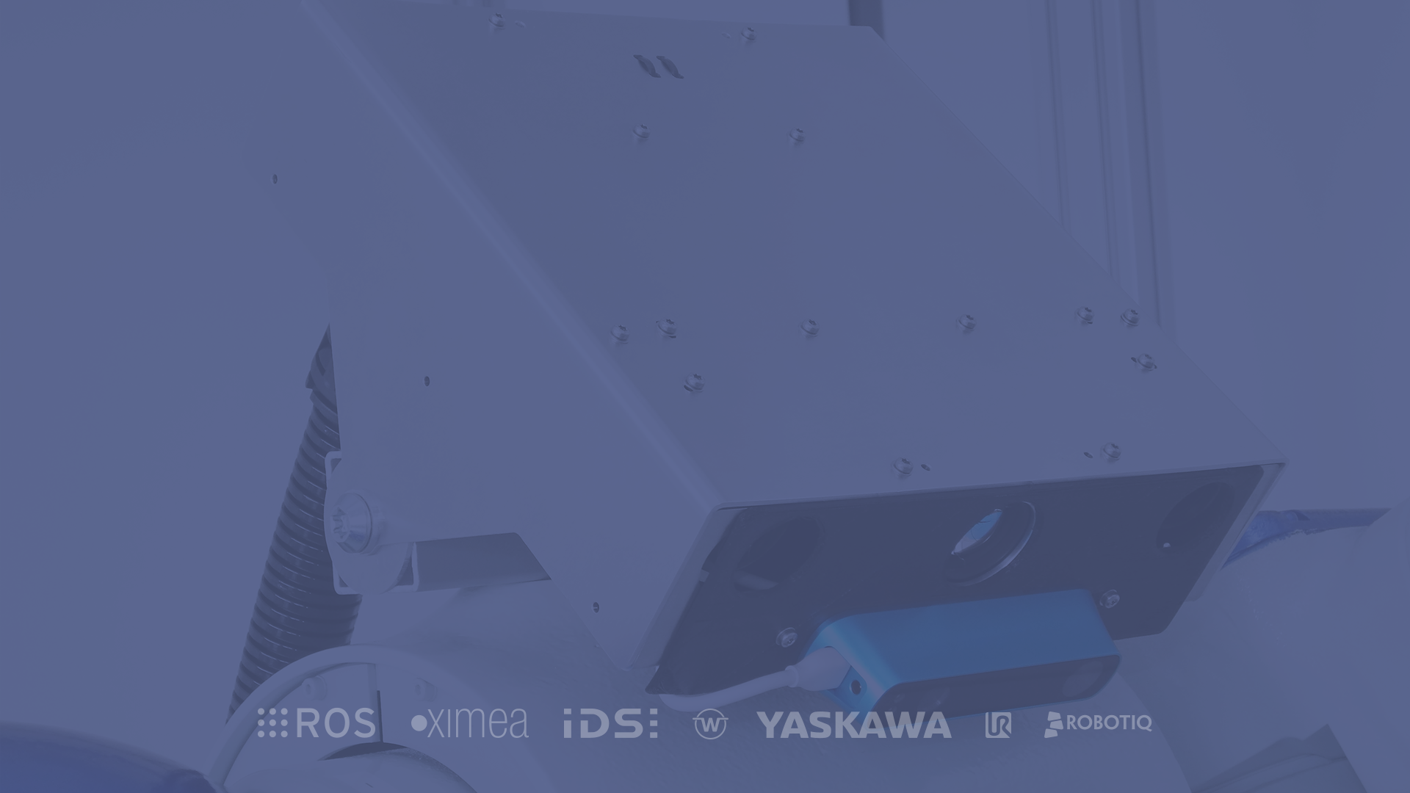


XGraph Workflow Engine
Andreas Köpf
Xamla Robotics Team

Slide 2
ROSVITA XGraph Workflow Engine
1/23
Talk Structure
1
What is XGraph?
5
.Net Extensibility
2
Basic Concepts
6
Converter Details
3
Video Walk-Through
7
Execution Semantics
4
Scripting
8
Outlook

Slide 3
1 _ What is XGraph?

Slide 4
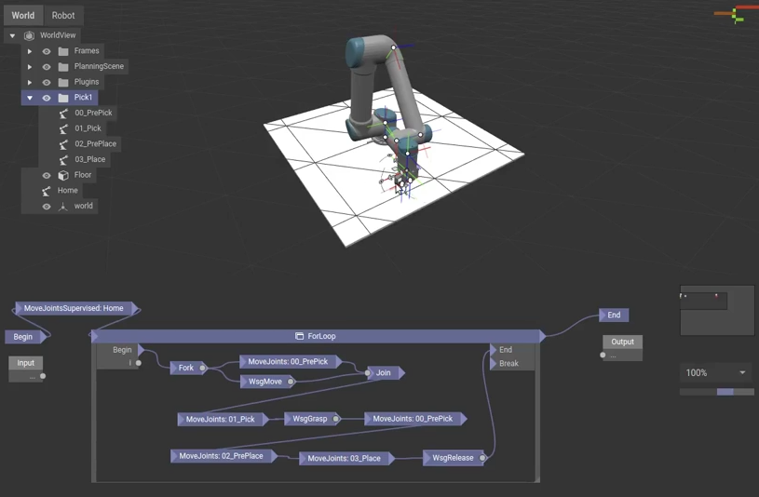
What is XGraph?
2/23
The Rosvita XGraph Workflow Engine
A graphical programming system for Rosvita
Primary use-cases:
Robot operations, sensor input & generic data processing
Strictly typed Visual Programming Language running on .Net Core
Executable graphical representation of programs
Usable by non-programmers (to some extend)
Allows prototyping, explorative development & live parameter adjustments
Easily extensible via .Net (C#) and Python scripts
Arbitrary composition and nesting (via Graph Instances)

Slide 5
What is XGraph?
3/23
Architectural Overview
Browser
XGraph Runtime Host
WebBrowser
Rosvita Server
WebBrowser
Xamla Graph Runtime
WS
RPC
WS
RPC
Python3
Prepared for future cloud use
Multiple XGraphs can be executed simultaneously
0..n users can view/edit a single XGraph
Each XGraph runs in an isolated process
For debugging XGraphs can be executed on other machines (e.g. Windows), still edited via Rosvita Web-App
C-Libs: OpenCV, Skia, ...
ROS Messages /
Service Calls / Actions
ROS, MoveIt, Actuators, Sensors

Slide 6
2 _ Basic Concepts

Slide 7
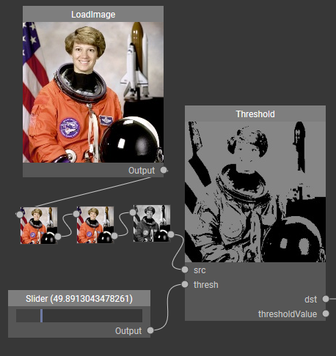
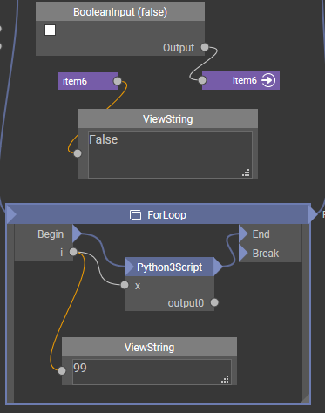
Basic Concepts
4/23
Elements of an XGraph
Graph canvas
Modules
Pins
Cables: Value, Converters, Flow
Property Editor
Interface Modules (Input & Output, Begin & End)
Sub-Graph Modules (Select, SelectMany)
Graph-Instances
Control-Modules (text box, checkbox, slider)
Code & Script Modules (Python, C#)
Comments
Ports (hidden long range connections)
In development: Value inspection system

Slide 8
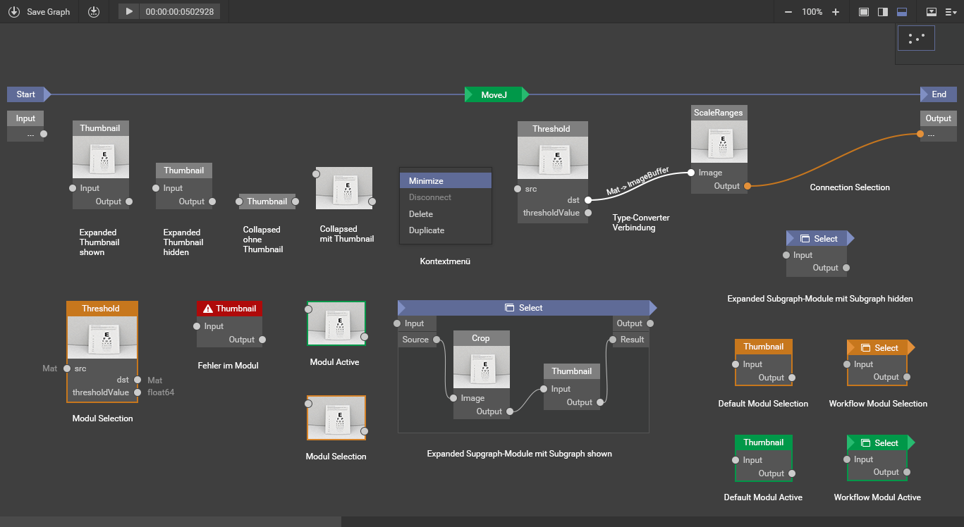
Basic Concepts
5/23

Slide 9
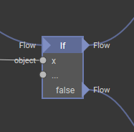
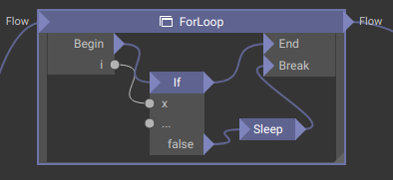
Basic Concepts
6/23
Concept: Flow
Why?
Side-effects of robot operations require strict ordering
Provide conditional branching and controlled parallel execution options
Blue cabels are flow connections
Flow modules:
For-Loop, For-Each
If
Fork/Join
Throw/Catch (in development)

Slide 10
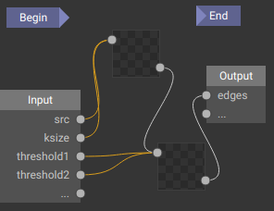
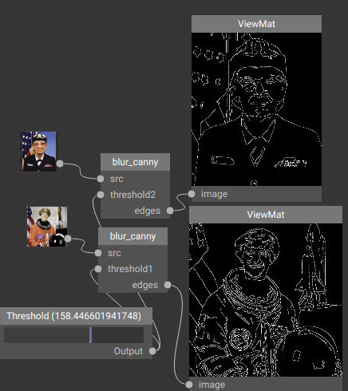
Basic Concepts
7/23
Concept: Graph Instances
Why?
Composition: Break down larger graphs into chunks
Reuse: Instantiate one graph in different workflows
To create a graph-instance: Drag a .xgraph file from file explorer onto a graph canvas
A relative path is stored to a graph instance source graph
If Begin & End are not connected a graph becomes pure functional (the graph instance has no flow)
Methodology: Develop each reusable graph together with a minimal test graph that instantiates it and can be used for debugging

Slide 11
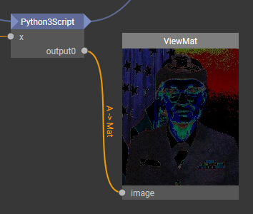
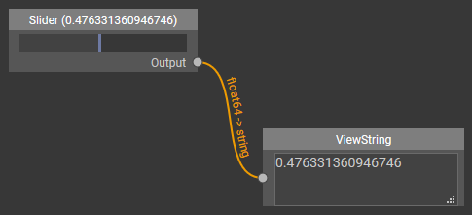
Basic Concepts
8/23
Concept: Implicit Value Conversion
Why?
In a strictly typed system often types do not match (e.g. int16, int32, int64, float32, float64)
Different libraries use different classes for the same data (e.g. OpenCV Mat vs. Skia Bitmap)
Orange Cables indicate a value conversion.
Conversion to intermediate Xamla types (library neutral) is used to effectively allow N:M library conversions
Even implicit conversion between push & pull is possible (e.g. IEnumerable ↔ IObservable)

Slide 12
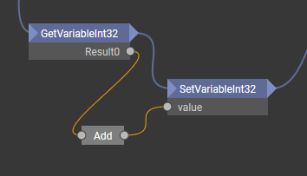
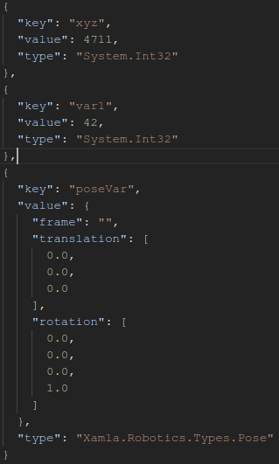
Basic Concepts
9/23
Concept: Persistent Value Store
Why?
Store variables over multiple graph executions
Provide settings from outside via JSON file (.xgraph.store.json)
Modules to access the Value Store:
GetVariable, SetVariable (object with default)
Typed: GetVariabe{Boolean, Int32, Float64, String}
Typed: SetVariabe{Boolean, Int32, Float64, String}
RemoveVariable, ClearStore
SaveStore

Slide 13
3 _ Video Walk-Through

Slide 14

Video Walk-Through
10/23
XGraph Tutorial Videos
Rosvita XGraph Walkthrough
https://youtu.be/LgHPmnLkLqI
XGraph Walkthrough
Pick and Place Workflow
https://youtu.be/MJAHPZibfrA
Pick and Place
Rosvita Camera Modules
https://youtu.be/P9CzGynAyBM
Camera Modules

Slide 15
4 _ Scripting

Slide 16
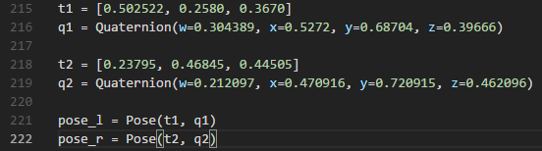
Scripting
11/23
Script Modules
If a module is missing powerful scripting options are available to fill the gap:
C# CSharp.Code, CSharpScript Modules
Python3 Python3Eval, Python3Script, Python3ScriptFile
→ PythonEval & CSharpScript are for simple expressions
Python Libs can be placed in <projet>/libs/python folder
Use xamla_motion for Python Robot interactio:
https://github.com/Xamla/pythonClientLib_XamlaMotion
Recommended: Develop & test Python scripts externally and then paste / reference them inside an XGraph

Slide 17
Scripting
12/23
Python Script Module Details
The module signatue is generated using Python3 type hints placed in the Python function signature. Arguments → Pins
Signature is automatically updated after edits (e.g. new, renamed, deleted pins)
Primitives, List, Dict and ndarray are automatically converted between Python and .Net types
Use Tuple for multiple return values
Numpy, Scikit, OpenCV etc. can be used inside Python modules
Nvidia-docker for GPU use (e.g. DeepLearning) available soon

Slide 18
5 _ .Net Extensibility

Slide 19
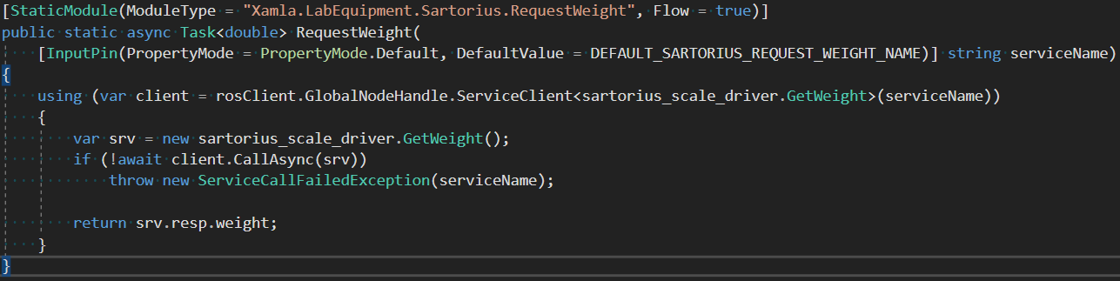
.Net Extensibility
13/23
Writing Custom Modules in .Net
The simple way: StaticMethod Module via Attributes

Slide 20
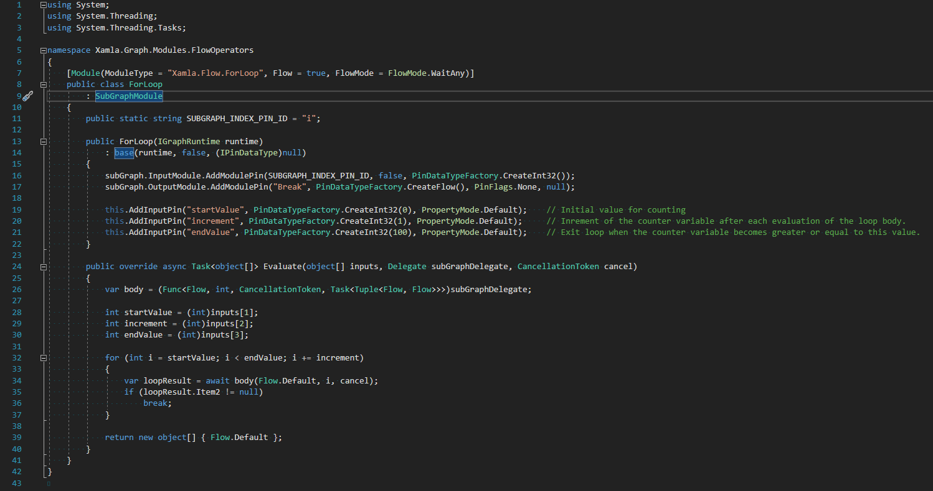
.Net Extensibility
14/23
Complex Example:
FlowLoop

Slide 21
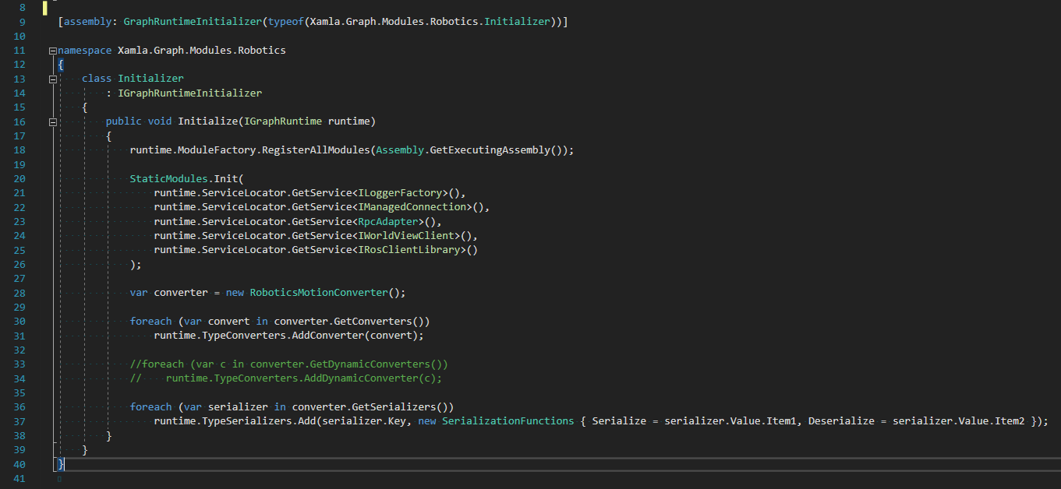
.Net Extensibility
15/23
Initializers & Dependency Injection

Slide 22
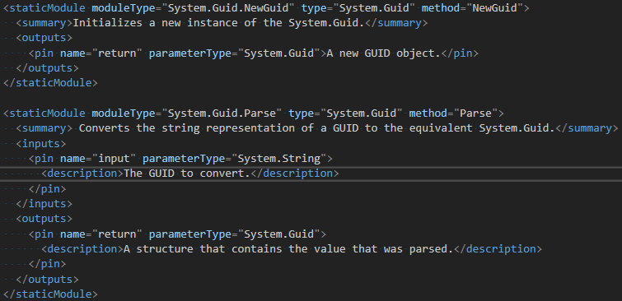
.Net Extensibility
16/23
.xmodule Files
Contain XML descriptions to convert modules from static .Net functions without attributes
Empty .xmodule files, act as sentinal file for graph module assembly discovery (allows drag&drop deployment of module assemblies)

Slide 23
6 _ Converter Details

Slide 24
Value Conversion
17/23
Converter Details: Intermediate Types
Intermedita Data Types help to avoid a quadratic number of library-to-library converters.
A Multi-dimensional array
V 1d vector
M 2d matrix
I ImageBuffer (2d multi-channel)
Examples:
OpenCv.Mat → I → Skia.Bitmap
ImageBuffer → A → np.ndarray

Slide 25
Value Conversion
18/23
Converter Pitfalls
Information might be lost, e.g. the A type does not carry information about image channels, therefore BGR might become RGB
The type converter system tries to use all kinds of base classes to find an intermediate type:
Select orange connections to see if it makes sense for you!
Sometimes unintuitive conversions are selected, e.g. if a string is converted into a sequence a single element sequence of string is created (not a sequence of characters)

Slide 26
7 _ Execution Semantics

Slide 27

Execution Semantics
19/23
Semantics of an XGraph [1/2]
Lazy: Only connected modules are evaluated
Modules without output pins have invisible sink connections: e.g. WriteFile, ViewImage
Flow carries Execute-Signal or Exception
Non-Flow modules are evaluated (in parallel) as soon as values for their inputs have been generated
Fow modules additionally wait to receive a flow signal
Flow is cancelled when first flow-signal reaches End module
Join: Currently wait completes on 1st exception: Fail-early
One Evaluation Context per Graph / Sub-graph canvas
Non-flow modules are evaluated only once per evaluation of their context

Slide 28
Execution Semantics
20/23
Semantics of an XGraph [2/2]
Pin connections: Other modules or Property Container
Pin cardinalities (default):
  Value: In: 1 Out: n
  Flow: In: n Out: 1
Input pins in Sub-Graphs can be connected to outputs of modules in outer graphs (but not the other way round)
Generic modules compute pin type & type converter upon connection
Sequences are lazy-evaluated (infinite generators)
Sequences soures can be interactive or reactive (e.g. events)

Slide 29
8 _ Outlook

Slide 30
Outlook
21/23
Future Development
1000+ ideas exist - prioritization is the hard thing!
Here are some near-term candidates:
Improve error display & handling
Inspection/Output Visualizer system
Flow-Module Stacking (simplified display)
More Drag&Drop Options, e.g. JointValues, Poses, Paths, Trajectories
Provide option lists in Property Editor (e.g. available MoveGroups, Action names for Grippers etc.)
Simplify Navigation to Script Source-Files (double click)
Sub-Graph extraction via range-selection
XML Copy & Paste module sharing (via Mail, Chat etc.)
.Net ↔ Python Robotic Type conversions
Python module registry
Online module registry
Undo system
Option to pause a graph
Improve robustness of library calls (e.g. OpenCV)
Re-evaluation of non-flow modules due to flow source changes
Generic ROS Modules
Auto-Start Graph
Value Plotting Modules
3D Processing Modules (e.g. Point Clouds)

Slide 31
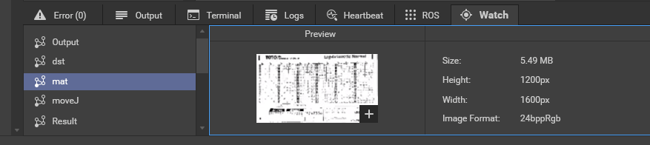
Outlook
22/23
Inspection System / Watch Window

Slide 32
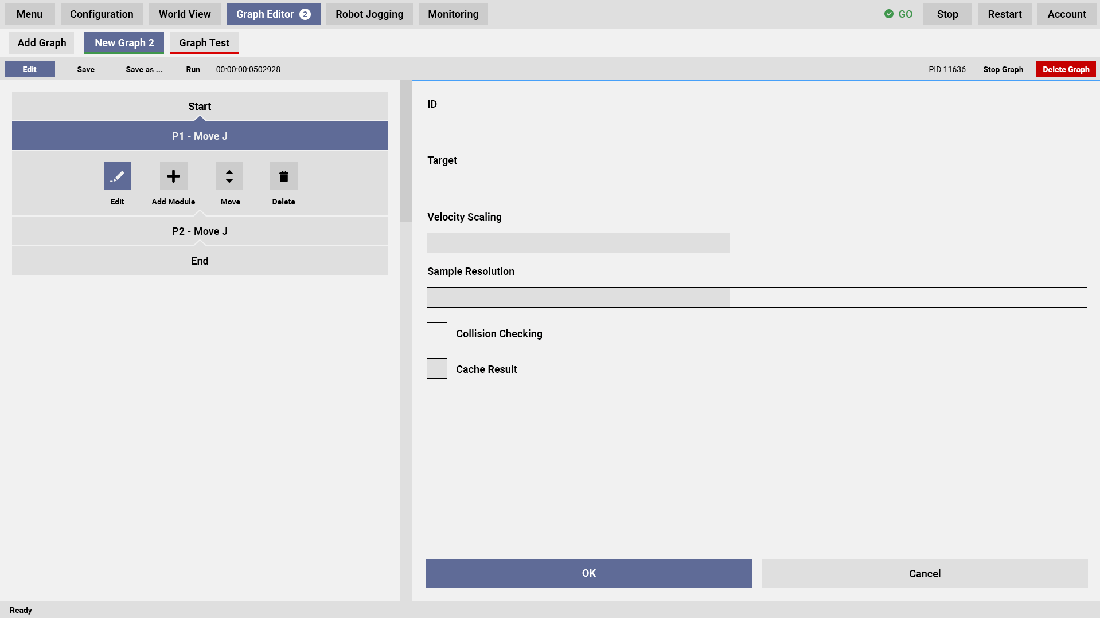
Outlook
23/23
Joystick friendly Waypoint Teaching

Slide 33
Thank you for your attention!
Questions?
Tutorial Videos:
http://www.youtube.com/xamla

