Slide 1
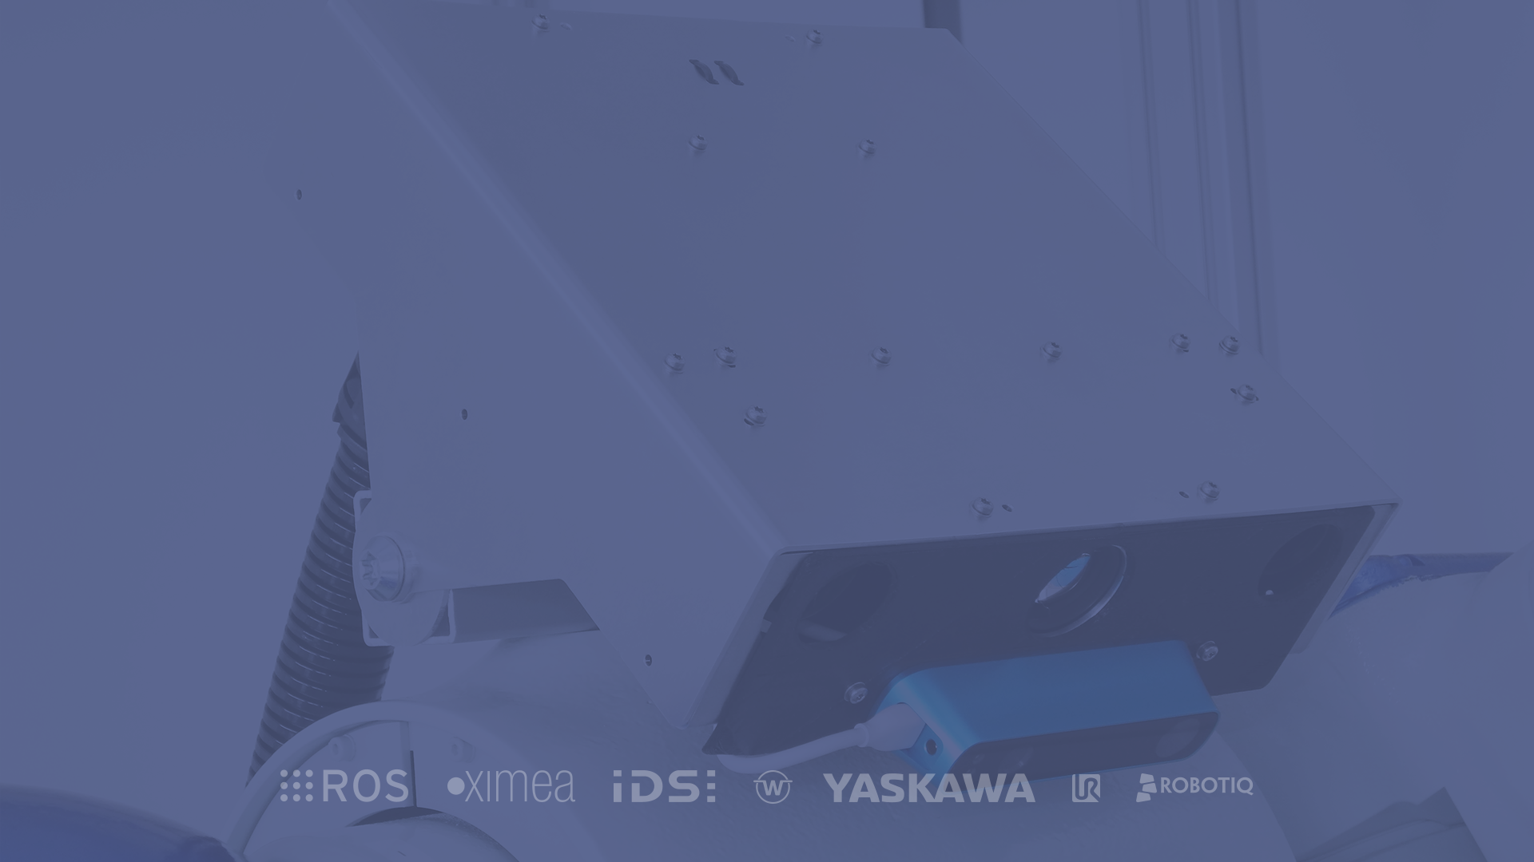


Fast and intuitive robot programming based on ROS!

Slide 2
Intro of ROSVITA
1/10
Table of contents
1
Get together
6
WorldView
2
Start Intro of Rosvita
7
Short Coffee Break
3
Overview of Main window
8
Creating xGraph
4
Configuration a setup
9
Lunchbreak
What information do I get
from Rosvita at startup?
Hands on Session on
2 robots
5
10

Slide 3

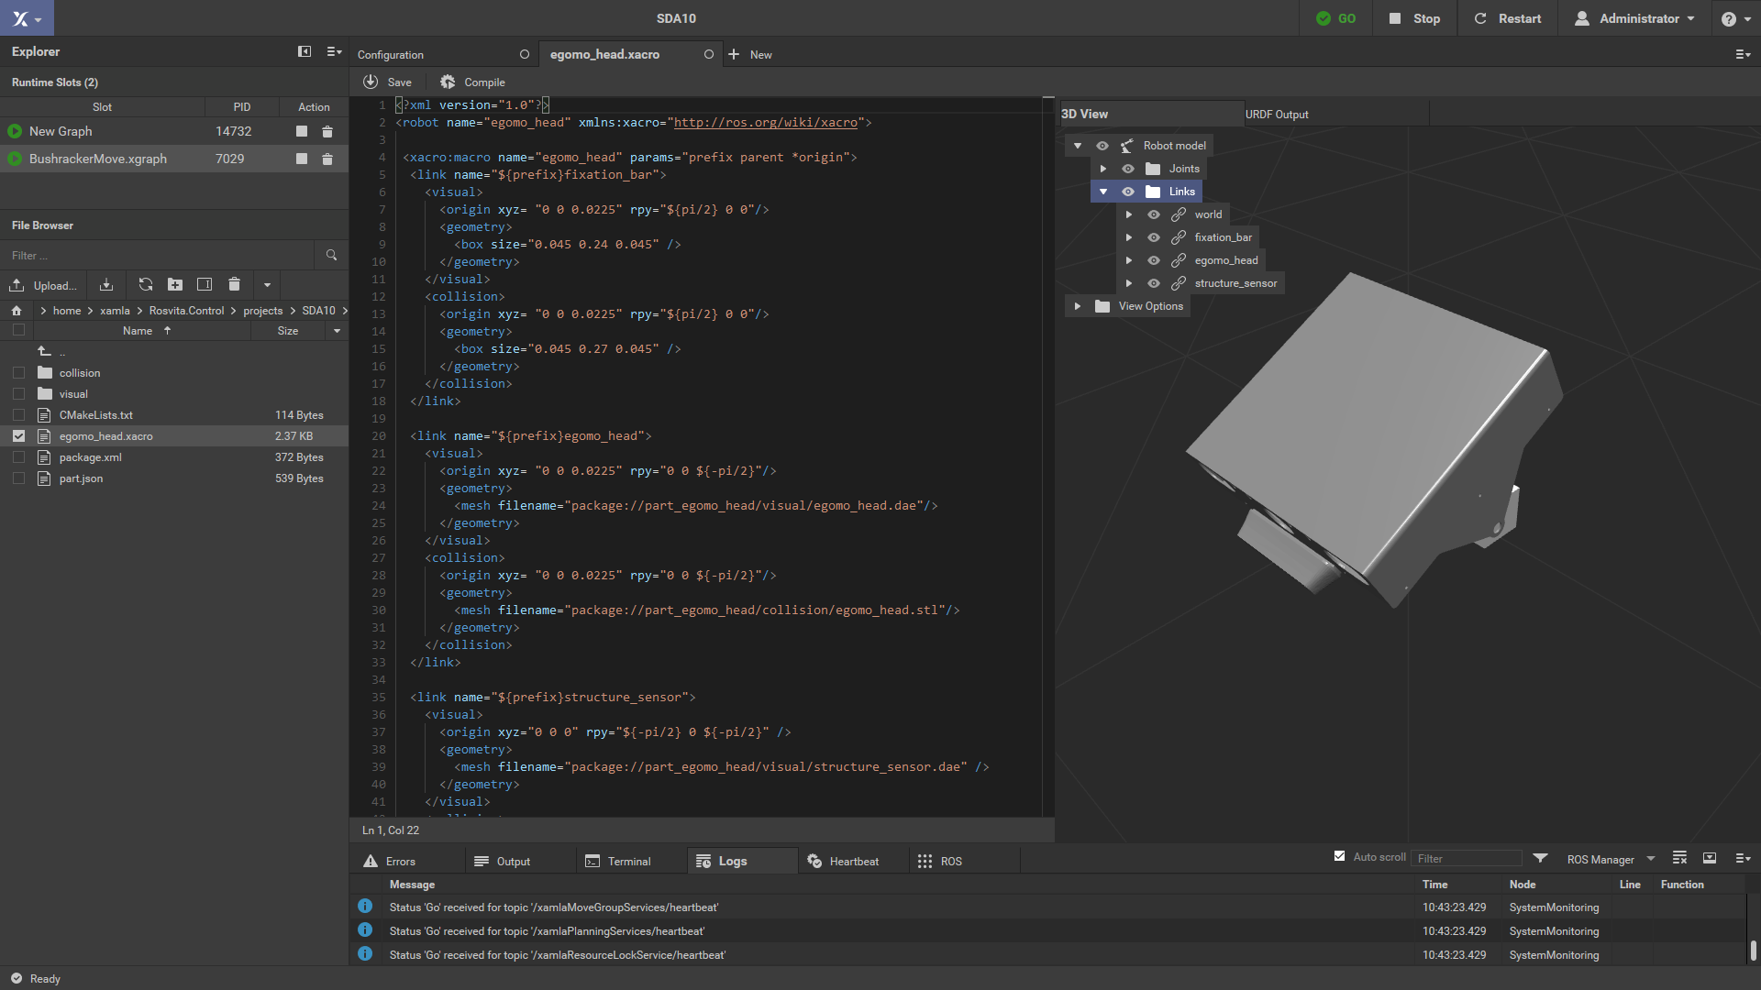
Intro of ROSVITA
2/10
1.1 How is ROSVITA Based on ROS
Allows for easy programming of complex sensor feedback driven robot behavior
High quality 2D and 3D visualization
Ready-for-Industry robot drivers and other reliable ROS components
Xacro Editor
Visual workflow editor with an expandable module system

Slide 4
ROSVITA
3/10
2. ROS Distribution
ROS
Box Turtle
ROS
C Turtle
ROS
Diamondback
ROS
Fuerte Turtle
ROS
Groovy Galapagos
March 2, 2010
August 2, 2010
March 2, 2010
March 2, 2010
March 2, 2010

Slide 5
ROSVITA
4/10
2.1 ROS Distribution
ROS
Box Turtle
ROS
C Turtle
ROS
Diamondback
ROS
Fuerte Turtle
ROS
Groovy Galapagos
March 2, 2010
August 2, 2010
March 2, 2010
March 2, 2010
March 2, 2010

Slide 6
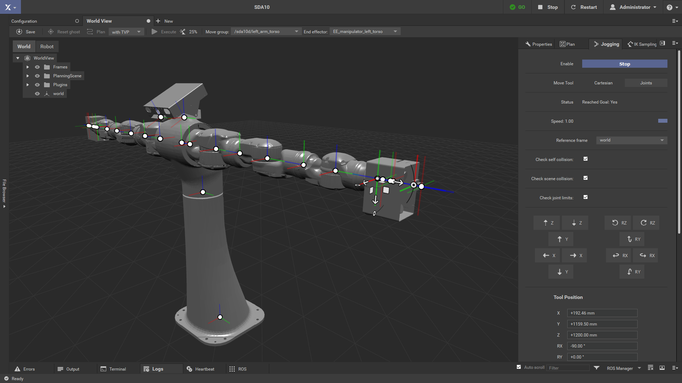
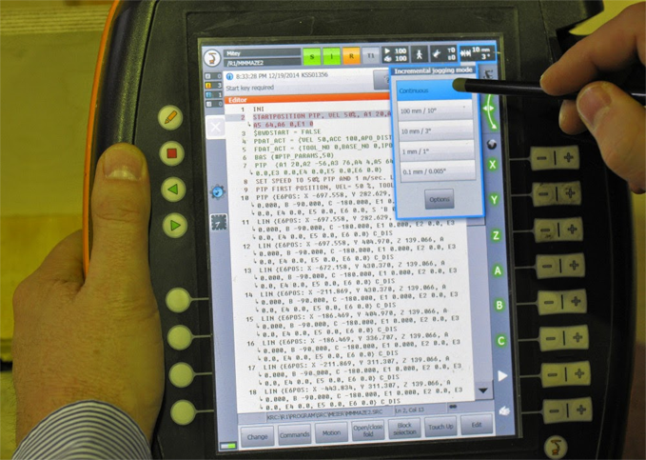
Robot Jogging
5/10
5. That‘s why ROSVITA is better than others
Rosvita Robot Jogging
Other Robot Jogging

Slide 7
Lunchbreak
5/10
Quotes
“Technology is nothing. What's important is that you have a faith in people, that they're basically good and smart, and if you give them tools, they'll do wonderful things with them.”
Steve Jobs

Slide 8
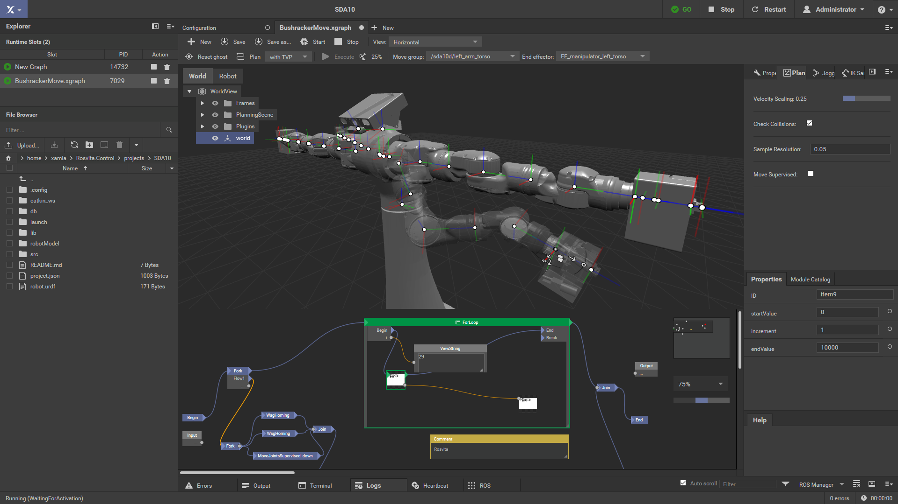
World View
6/10
7.4 Main Control
Visual workflow editor with an expandable module system incl. ROS, REST & .Net Motion APIs. Develop in .Net, C++, Python & Lua.
Graph Editor

Slide 9
Thank you for your attention!

