Slide 1
The N-Body Problem
AU25, Physics 5300, Xander Carroll

Slide 2
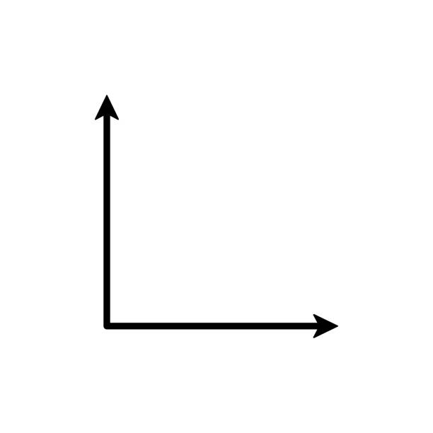








The Coordinates
$$\dot{r_{1} }$$
$${ m}_{1}$$
$$\hat{x}$$
$$r_{1}$$
$${ m}_{2}$$
$$r_{2}$$
$$\dot{r_{2} }$$
$$\hat{y}$$
Notes:
Each body is described by a mass, position, and velocity. Given the initial position and velocity of each mass, we would like to know the resulting orbits.

Slide 3
The Lagrangian
Notes:
We are going to solve this problem using a Lagrangian approach. So we need to know the KE and PE of the system.

Slide 4
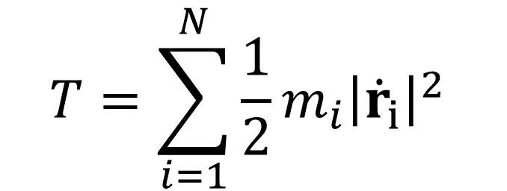
The Lagrangian
$$T=\sum_{i=1}^{N}{\frac{1}{2}}m_{i}{\left|{\dot{r}}_{i}\right|}^{2}$$
Notes:
The KE is simple. It is just the sum of kinetic energies from each body.

Slide 5

The Lagrangian
$$U=−G\sum_{i=1}^{N}{\sum_{j>i}^{N}{\frac{m_{i}m_{j}}{\left|r_{i}−r_{j}\right|}}}$$
Notes:
The PE is also fairly simple. It is the sum of gravitational potentials between each pair of bodies.

Slide 6

The Lagrangian
$$ℒ=T−U=\sum_{i=1}^{N}{\frac{1}{2}}m_{i}{\left|{\dot{r}}_{i}\right|}^{2}+G\sum_{i=1}^{N}{\sum_{j>i}^{N}{\frac{m_{i}m_{j}}{\left|r_{i}−r_{j}\right|}}}$$
Notes:
This gives us our Lagrangian.

Slide 7
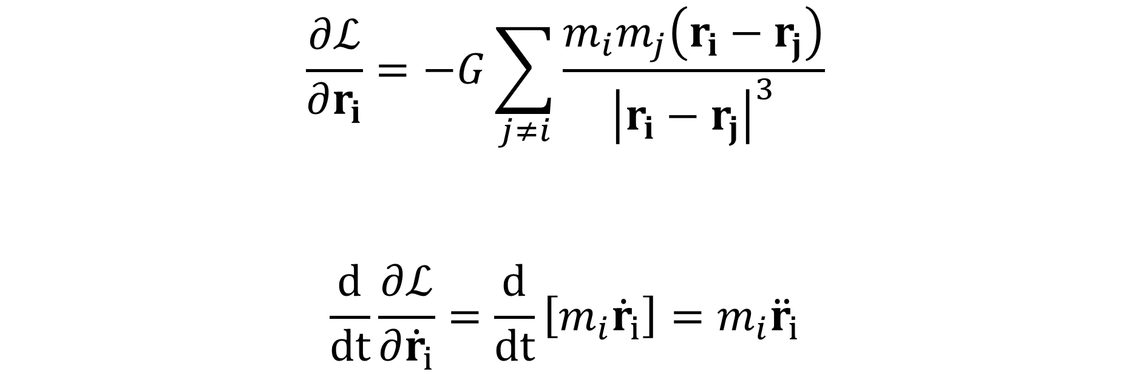
The Equations of Motion
$$\frac{∂ℒ}{∂r_{i}}=−G\sum_{j≠i}{\frac{m_{i}m_{j}\left(r_{i}−r_{j}\right)}{{\left|r_{i}−r_{j}\right|}^{3}}}$$
$$\frac{d}{dt}\frac{∂ℒ}{∂{\dot{r}}_{i}}=\frac{d}{dt}\left[m_{i}{\dot{r}}_{i}\right]=m_{i}{\ddot{r}}_{i}$$
Notes:
Which we can use to solve for our equations of motion.
Integrating r-dot is easy.
Integrating r is a little harder.

Slide 8
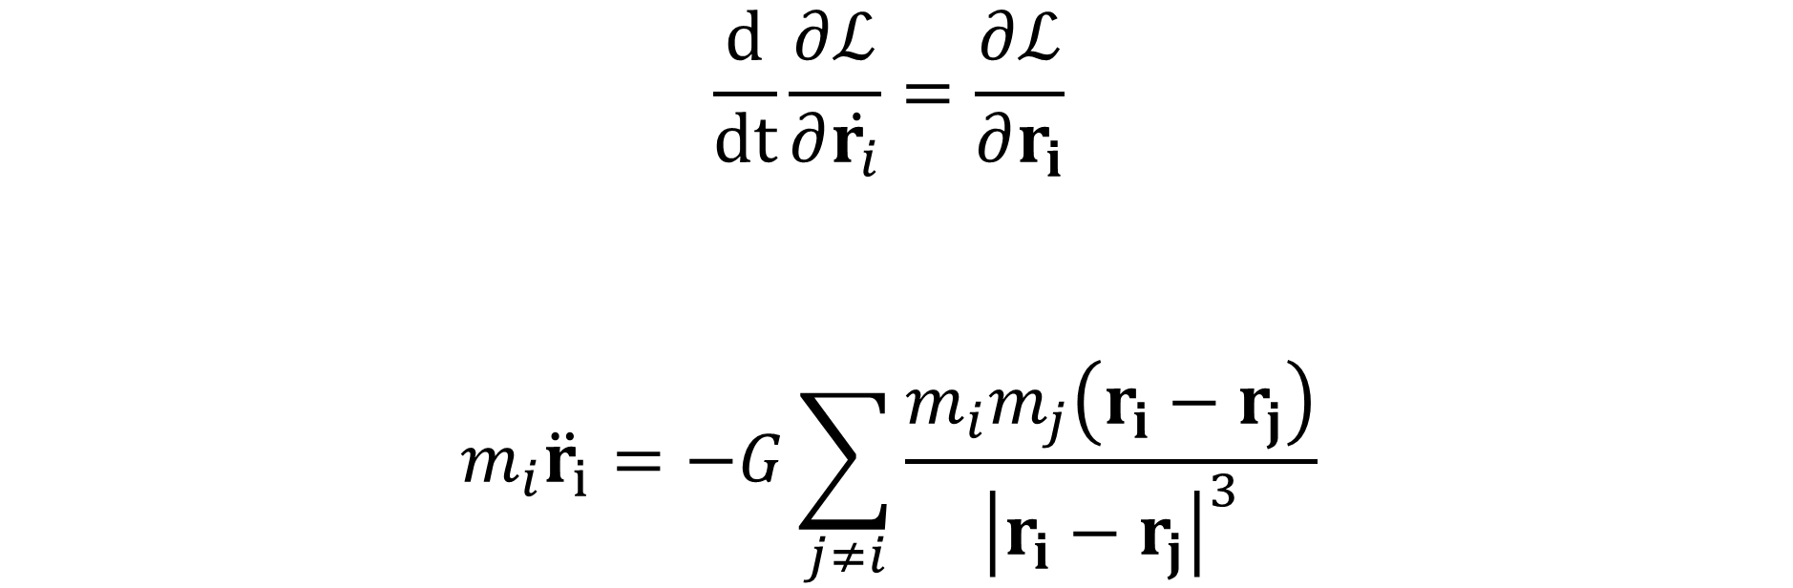
The Equations of Motion
$$\frac{d}{dt}\frac{∂ℒ}{∂\dot{r_{i}}}=\frac{∂ℒ}{∂r_{i}}$$
$$m_{i}{\ddot{r}}_{i}=−G\sum_{j≠i}{\frac{m_{i}m_{j}\left(r_{i}−r_{j}\right)}{{\left|r_{i}−r_{j}\right|}^{3}}}$$
Notes:
The equation of motion then looks very familiar.
The force acting on each body is the sum of gravitational forces from each other body. F = Gmm/r^2.
- The (ri - rj) term in the numerator gives the direction of the force.

Slide 9

Leapfrog Integration
$$v_{i+1/2}=v_{i}+a\left(r_{i}\right)Δt/2$$
$$r_{i+1}=r_{i}+v_{i+1/2}Δt$$
$$v_{i+1}=v_{i+1/2}+a\left(r_{i+1}\right)Δt/2$$
Notes:
We can then use your favorite numerical integration method to solve the problem. In this case, Leapfrog was used.
We find the velocity half a time step out.
We use that velocity to find the position a full time step out.
Then we move the velocity the other half time step forward.
At this point I was ready to begin testing. I choose a few simple test cases to verify that the integrator was working as expected.

Slide 10
3-Body Animation
Notes:
I started working with 3-body cases for most of my tests.

Slide 11
Solar System (N=9) Animation
Notes:
Then I thought it would be fun to test using our solar system as initial conditions for the bodies.

Slide 12
Solar System (N=109) Animation
Notes:
But I really wanted to test a simulation with more bodies, so I decided to add a random “asteroid belt” to the solar system simulation.

Slide 13
Expanding the Simulation
We would like to run the simulation for n → ∞ bodies.
Notes:
But I am more of a computer scientist that a physicist.
And computer scientist are really concerned with optimization and analysis of algorithms.
Which begs the question: how should I run a simulation with a very large number of bodies. Say I wanted to simulate whole galaxies.

Slide 14
Expanding the Simulation
We would like to run the simulation for n → ∞ bodies.
We would like to do this without emptying Dr. Brandenburg’s OSC budget.
Notes:
And say I wanted to do that without using hundreds of GPU hours.

Slide 15
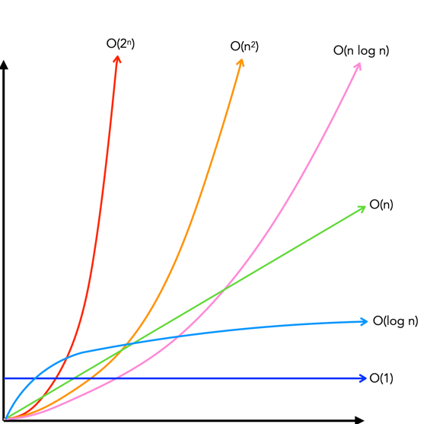
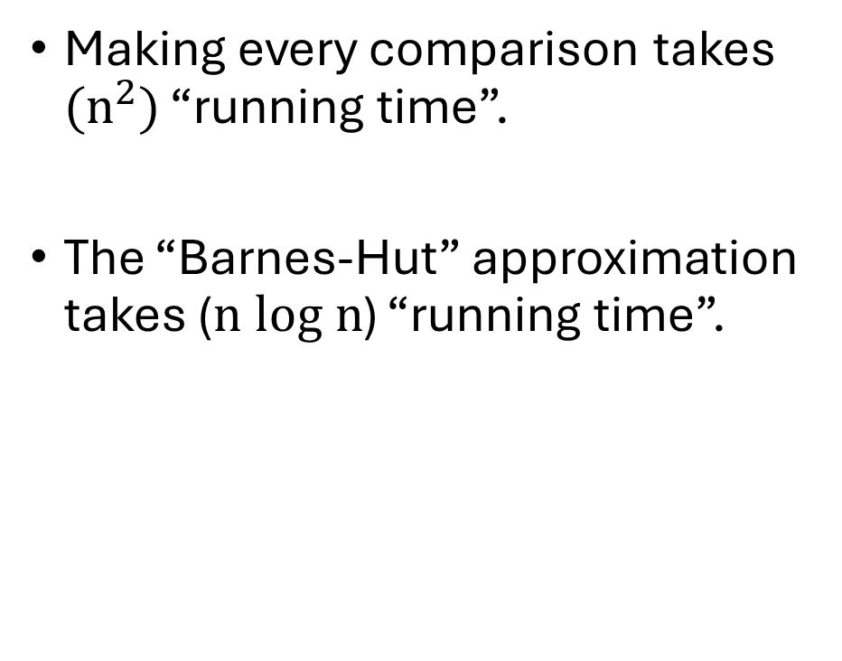
Running Time
Making every comparison takes $(n^{2})$ “running time”.
The “Barnes-Hut” approximation takes ($n log n$) “running time”.
Time
Input Size (n)
Notes:
That is where the idea of “running time” comes in. Computer scientists don’t measure algorithm performance “seconds”.
There are too many variables for that to be a reliable metric.
Instead, we care about how algorithms scale in terms of “operations”. In the N-body problem, operations are a function of the number of bodies.
If we were to use my integrator, it would be n^2 running time. But there is an optimization that lets us bring that down to n log n!

Slide 16
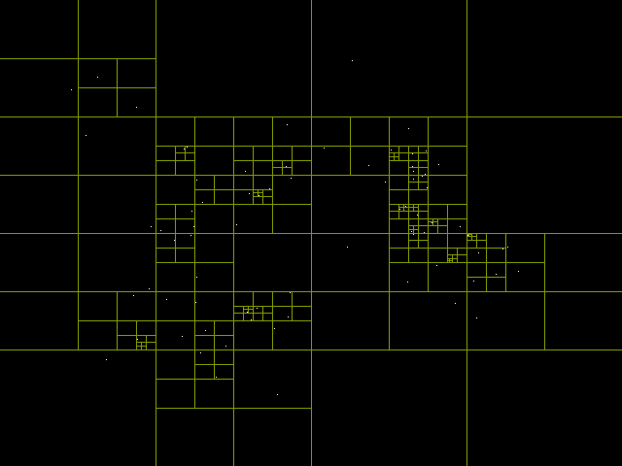
Barnes-Hut
Notes:
This is a Barnes-Hut implementation.
We continuously divide into quadrants until every point gets its own square. Then we treat all of the points in a larger square as a single point at their center of mass.
This lets us compute signifyingly fewer force terms – if we are willing to sacrifice some of the physics.
When we decide that this is too difficult to implement, we can keep our research-quality code and ask OSC for more cores.

Slide 17
What I Learned
How to use the Manim Library

Slide 18
What I Learned
How to use the Manim library.
What a Hamiltonian is.

