Slide 1
Blockchain Loving Token
PRESENTED BY DEPRESSED PEPE GROUP

Slide 2
Inspiration

Slide 3
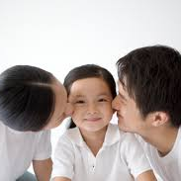

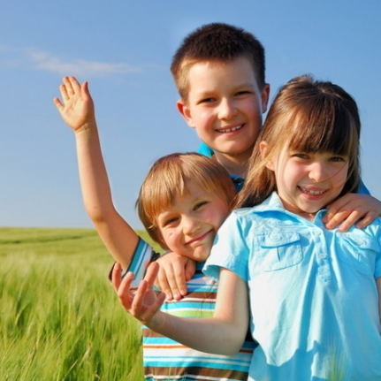
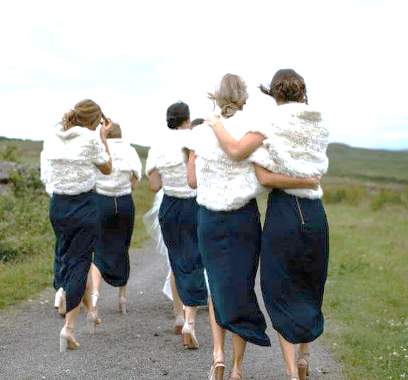
Relations
Parent
Couple
Sibling
Friend

Slide 4





Eternal Links
Birth
2003
Best Friend
2010
Soulmate
1998
Younger brother
2005
Younger Sister
2022

Slide 5
How to Record

Slide 6
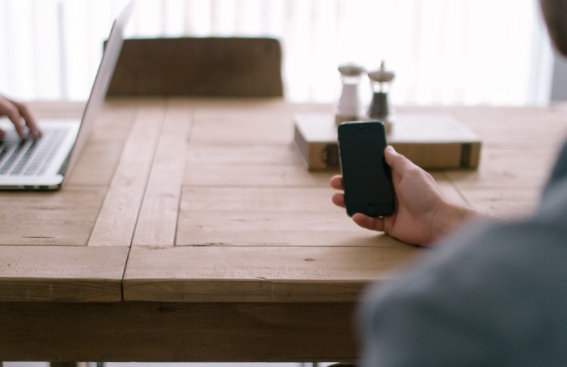

How to Record
Want to record your relations forever?
Simply take a photo with him/her.
The face id is unique. Search for all relations by starting your camera.

Slide 7
Forever record
Create a User
Eternal Promise
Record by Trading
Unerasable

Slide 8


High Security
Public or Private
Secure frontend process
Feature of blockchain uneraserable
Live Human Recognize

Slide 9
A big Family Tree

Slide 10
Future Plan

Slide 11
THANK YOU!
PRESENTED BY OfficePLUS

