Slide 1

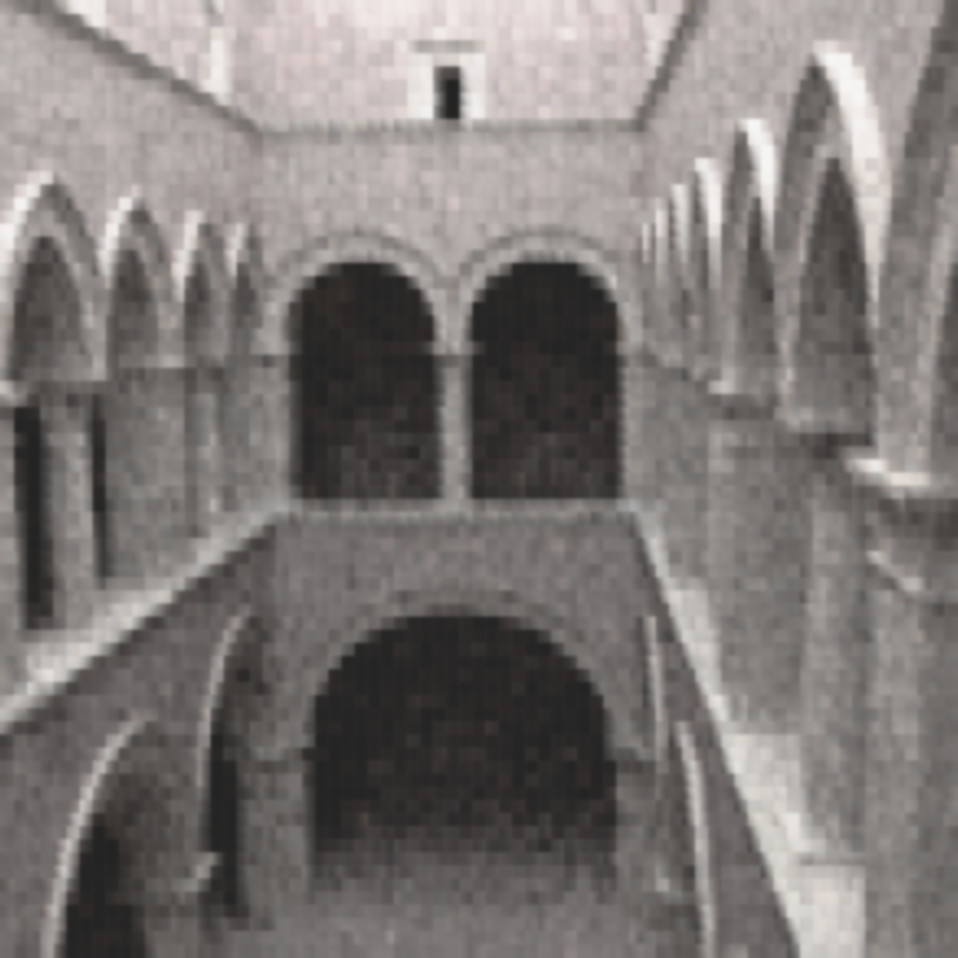
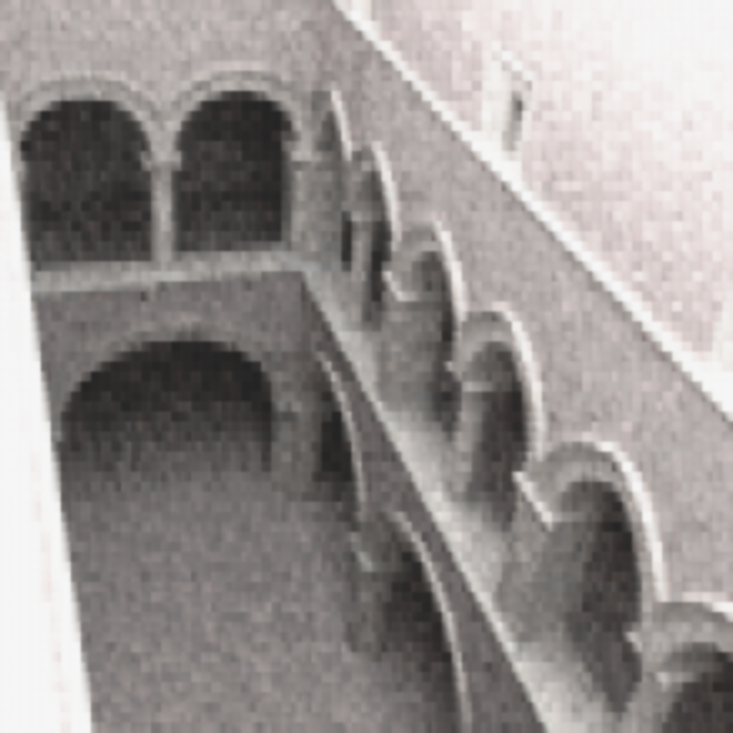
Investigating Machine Learning to remove Monte-Carlo noise in rendered images
Andrea Luongo, Alessandro Dal Corso
Introduction
Problem statement
Related vork and references
Our work
Why it is important (we have reference images so we can do supervised learning)
Method
Using neural network as standard Stacked denoising autoencoder Sda for pretraining
Finetuning is a MLP
Patch based approach
Minibatch
Results
Test scene, Sponza images generated con optix,
Different noise levels
Different views of the scene
Conclusions and Future work
Promising approach
Need more investigation and validation on the hyperparameters
CNN
Investigatring approach from otrher paper
Materails
References
Noise in montecarlo images
Survey on denoising techniques in Monte Carlo Rave, Jensen
Da vincent 08
Sda vincent 10
Deep learning for image denoising
SIGGRAPH 2015 ML for image denoising in monte carlo
Note eller Institutnavn (Arial Regular 18/24pt.)
Note eller Institutnavn (Arial Regular 18/24pt.)
Notes:
Tekst og Streger i 100% farve – Baggrund i 90% Transparent.

