Slide 1
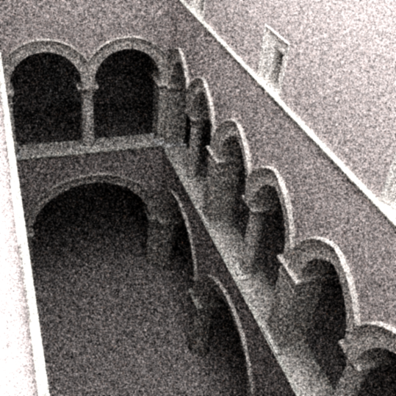
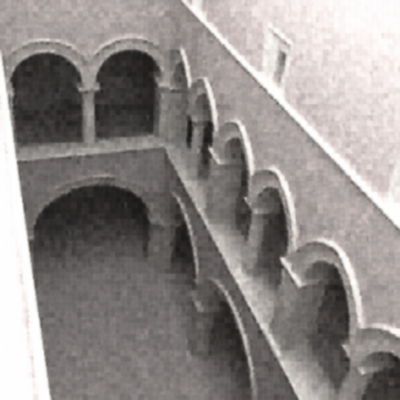
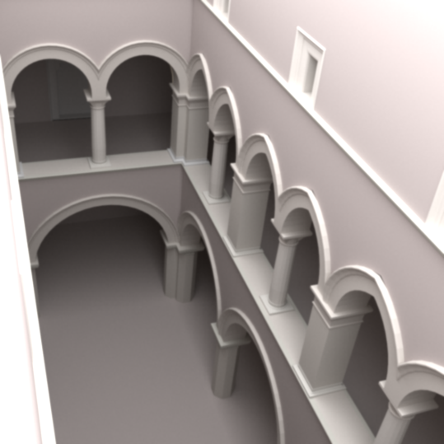
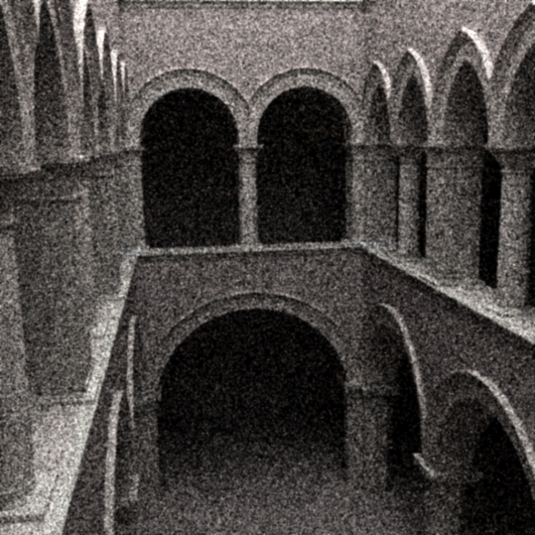
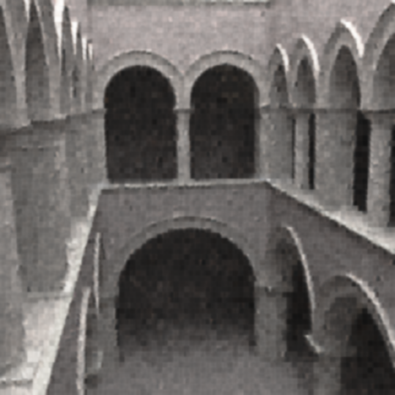
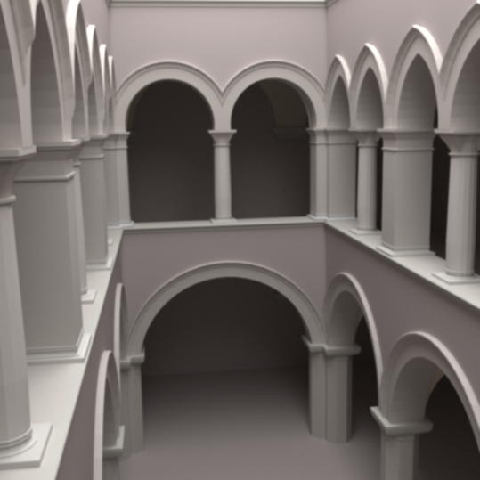
Investigating Machine Learning for Monte-Carlo noise removal in rendered images Andrea Luongo, Alessandro Dal Corso
Training set image
Validation set image
Noisy (5 samples)
Filtered
Reference (10000 samples)
Notes:
Hi, we are Alessandro and Andrea
Our work is titled
Challenges in Monte Carlo noise removal
We made an initial study and some experiments, and obtained some results
Exploting coherence!

