Slide 1
Enhancing quality in innovative higher education about consumer awareness
Consume-aware Erasmus+ Action 2

Slide 2

CHAPTER 9
CUSTOMER RIGHTS UNDERSTANDING IN SERVICES SECTOR

Slide 3
1.
Understand the concept of the services on the market
GOALS
2.
Describe the main difficulties to protect customer on service markets in EU
3.
Give the example of activities and institutions responsible for customer protection on service markets in EU

Slide 4
MOBILE APPLICATION
1
2
3
Take your smartphone or laptop
Go to the app https://appcage.howest.be/
Moderate level

Slide 5
WHY SERVICES ARE DIFFERENT
THAN PHYSICAL PRODUCTS?
One of the main goals and the most important pillars of the European Union is a unique market promoting four freedoms: free movement of people, free movement of goods, free movement of services and free movement of capital.
Free movement of goods and services has contributed to the development of a unique market from which both the citizens and the business sector benefit daily.

Slide 6
WHY SERVICES ARE DIFFERENT THAN PHYSICAL PRODUCTS?
EU unique market, with the population of over 500 million people, makes buying and selling goods and services easier and enables consumers to choose from a wide range of products and services
Free movement of goods and services has contributed to the development of a unique market from which both the citizens and the business sector benefit daily.

Slide 7
WHY SERVICES ARE DIFFERENT THAN PHYSICAL PRODUCTS?
Starting point should be connected with the basic understanding of its specifics
A service may be describeed as any activity or benefit that a supplier offers a customer that is usually intangible and does not result in the ownership of anything.
The provision of a services may or may not be tied to a physical product. It means the customer in the same time can buy “two or more things” the service/s and the product/s.

Slide 8
WHY SERVICES ARE DIFFERENT THAN PHYSICAL PRODUCTS?
Services according to the International Standard Industrial Classification (ISIC), include the following:
wholesale and retail trade
restaurants and hotels transport, storage and communications; financial, insure, real estate and business services;
personal, community and social services;
government services.

Slide 9
WHY SERVICES ARE DIFFERENT THAN PHYSICAL PRODUCTS?
Consumer in process of buying the service and the organisations selling the service must consider five main service characteristics:
intangibility - inseparability - variability perishability - lack of ownership.
It means that all five of them in the same time influence on customer and his behaviour. What about customer rights protection?

Slide 10
CAN CUSTOMER EXPERIENCE THE SINGLE SERVICE MARKET IN EU?
The EU services market is an important part of the EU Internal Market, where many administrative and regulatory barriers still exist.
A breakthrough in the process of eliminating those barriers and liberalizing access to markets for service enterprises was supposed to be the connected with the implementation of the Services Directive in 2009 (Directive 2006/123).

Slide 11
CAN CUSTOMER EXPERIENCE THE SINGLE SERVICE MARKET IN EU?
With regard to the elimination of barriers, the directive it has primarily forced the Member States to simplify procedures related to starting and running a service activity and the introduction of single points of contact.
Additionally to prevent introducing the new barriers instead of the ones abolished by the directive, provisions Directives obliged EU Member States not to introduce their own requirements / procedures, if they are not necessary in all activities targeted at service providers and recipients

Slide 12
IMPORTANT

Slide 13
The service market includes both consumer services (so-called services to the public) and services purchased by institutions, in particular business entities (production and investment services). The service market is very diverse.
The services market includes the government sector (courts, employment agencies, hospitals, police, armed forces, fire brigades, post offices and schools), non-profit private sector (museums, churches, colleges, foundations), a significant part of the business sector (lines airports, banks, hotels, insurance companies, law offices, etc.).
Service providers are also employees of the production sector, such as IT specialists, accountants and lawyers.

Slide 14
CAN CUSTOMER EXPERIENCE THE SINGLE SERVICE MARKET IN EU?
The EU services market is an important part of the EU Internal Market, where many administrative and regulatory barriers still exist.
A breakthrough in the process of eliminating those barriers and liberalizing access to markets for service enterprises was supposed to be the connected with the implementation of the Services Directive in 2009 (Directive 2006/123).

Slide 15
INSTITUTIONAL DIMENSIONS OF CONSUMER PROTECTION
INTERNATIONAL PERSPECTIVE

Slide 16
INSTITUTIONAL DIMENSIONS OF CONSUMER PROTECTION
There are two separate frameworks that could be distinguished when institutional consumer protection schemes are analyzed.
The first framework covers the European Union decision making bodies that are involved with consumer protection: European Parliament, European Commission and Council of the European Union.
Those bodies, directly connected with the legal customer protection, create not only consumer regulations and laws, but also different legal standards, strategies and agendas that shape the customer policy in the European Union.

Slide 17
INSTITUTIONAL DIMENSIONS OF CONSUMER PROTECTION
The second framework involves European and international non-government consumer organizations and scientific committees that aim to promote and protect the interests of all the customers in the European Union

Slide 18
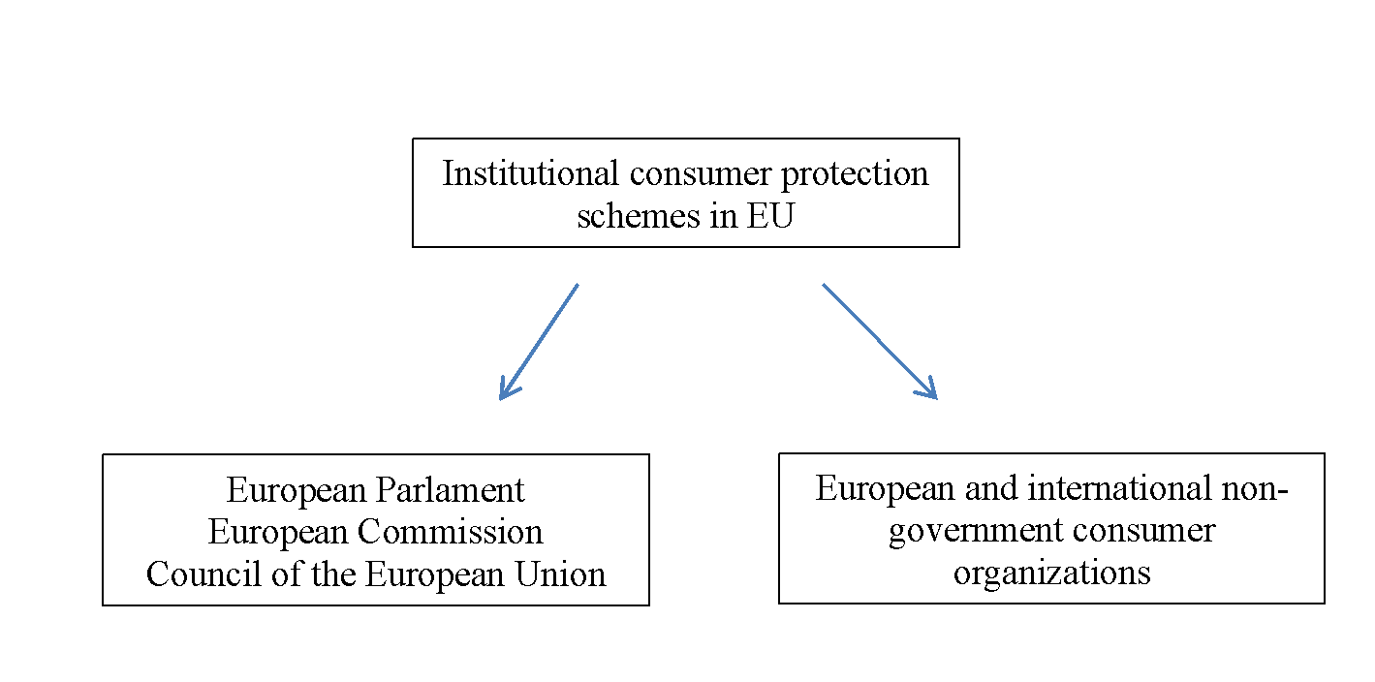
INSTITUTIONAL DIMENSIONS OF CONSUMER PROTECTION

Slide 19
EUROPEAN UNION
CONSUMER PROTECTION INSTITUTIONS
The European Parliament together with the European Council implements the legislative function in relation to consumer legislation
There are two committees that work within European Parliament: the Committee on Internal Market and Consumer Protection (IMCO) and the Committee on the Environment, Public Health and Food Safety (ENVI).

Slide 20
EUROPEAN UNION
CONSUMER PROTECTION INSTITUTIONS
The second major institution that deals with consumer protection within European Union is the European Commission. It prepares, develops and implements legislation on consumer protection.

Slide 21
EUROPEAN AND INTERNATIONAL CONSUMER ORGANIZATIONS
The second scheme of institutional consumer protection in European Union is represented by independent, non-governmental consumer organizations and scientific committees.
Their informational, advisory, educational and promotional forms of activities that include large number of different initiatives and campaigns imply the necessity of setting the relevant legal solutions and regulations.

Slide 22
INSTITUTIONAL DIMENSIONS OF CONSUMER PROTECTION
NATIONAL PERSPECTIVE

Slide 23
INSTITUTIONAL DIMENSIONS OF CONSUMER PROTECTION
In each EU Member State, there are national authorities competent for the protection of consumers' rights when dealing with specific service situation for example financial, tourism, internet and telecoms markets;
If we start with financial service customer protection….
In each EU country there are the deducted institutions

Slide 24
Or healthcare services:
In some industries like health care it can be identify strong involvement of the non-governmental institutions dedicated to increase patient awareness and protect the patients' right.
Very good example is the Active Citizenship Network which is decided to organize a widespread campaigns in cooperation with some of the national patient associations involved in its network.

Slide 25
https://ec.europa.eu/social/main.jsp?catId=1101&langId=en&videosId=2656&furtherVideos=yes
European Health Insurance Card: Travel light
VIDEOS
CONCERNING TOPIC
Patients' rights

Slide 26
Or help for passengers:
In transportation sector it is also possible to find big number of institutions dedicated to protect passenger rights.
Due to number of different means of transportations in EU organizations and are specialised in: air passengers right, rail passengers rights, bus and coach passenger rights and ship passengers rights.
All of them have a detailed description on EU website concentrating mainly on delays and cancellations, and information where the passengers can find help.

Slide 27
https://ec.europa.eu/social/main.jsp?catId=1101&langId=en&videosId=2656&furtherVideos=yes
Croatia
SOME
NATIONAL CASES
LINKS
Germany

Slide 28
1
SOME
INTERNATIONAL CASES
LINKS
2

Slide 29
LEGAL DIMENSIONS OF CONSUMER PROTECTION IN EU
Four different models of institutional customer protection could be distinguished in Europe Union:
administrative scheme,
ombudsman scheme,
judicial scheme and
German scheme

Slide 30
GOOD PRACTICE IN A SERVICE MARKET
As discussed the consumer protection is based on two main elements: legislative (law) and non-legislative (institutions) means of consumer protection.
Apart of governmental institutions, the non-governmental and a privet persons can be identify as a examples of the non-legislative entities. They can be involved in economical, organisational and educational activities aimed to protect the customer rights.
As a non-legislative regulations the self-regulation, soft law and deregulation can be described as the most popular on the service market in Europe.

Slide 31
GOOD PRACTICE IN A SERVICE MARKET
Protecting the customer rights in service advertising campaign: The European Advertising Standards Alliance (EASA)
Advertising standards
Communication agencies in Europe

Slide 32
GOOD PRACTICE IN A SERVICE MARKET
Protecting the passengers’ rights: Association of Passenger Rights Advocates (APRA)
APRA

Slide 33
In what way the services are different from physical products?
Can customers experience the single service market in EU ?
Is the service market more challenging to keep the rights of customers?
_ _ _ QUESTIONS

Slide 34
Are only legislative regulations on service market in EU dedicated to protect customer rights?
What can be done more to protect the customers?
_ _ _ QUESTIONS

Slide 35
Consumer awareness is an act of making sure that consumer is aware of the information about products, goods, services, and consumers rights.
CONCLUSION
Consumers have the right to information, right to choose, right to safety. It is especially challenging when the services are discussed.
The specifics of the services, its intangibility, can be misleading and make the customer susceptible to illegal practices.

Slide 36
Both legal systems and institutional systems should protect the rights of the customer and in the same time give him the opportunity for education.
CONCLUSION
The strong impact apart of governmental bodies have non-governmental institutions in Europe.

Slide 37
DEFINITIONS

Slide 38
A service may be describe as any activity or benefit that a supplier offers a customer that is usually intangible and does not result in the ownership of anything.
Five main service characteristics: intangibility, inseparability, variability, perishability and lack of ownership.
The service market includes both consumer services (so-called services to the public) and services purchased by institutions, in particular business entities (production and investment services). The service market is very diverse.

Slide 39
Four different models of institutional customer protection could be distinguished in Europe Union: administrative scheme, ombudsman scheme, judicial scheme and German scheme.
As discussed the consumer protection is based on two main elements: legislative (law) and non-legislative (institutions) means of consumer protection.

Slide 40
THANK YOU

