Slide 1
Enhancing quality in innovative higher education about consumer awareness
Consume-aware Erasmus+ Action 2

Slide 2

CHAPTER 3
CUSTOMER AWARENESS
IMPORTANCE

Slide 3
1.
Understand the notion of consumer rights
2.
GOALS
Understand the notion of consumer awareness
3.
Understand the notion of consumer protection
4.
Understand the importance of customer awareness

Slide 4
US President declared four basic consumer rights:
THE RIGHT TO BE INFORMED
THE RIGHT TO SAFETY
Consumer rights –
J.F. Kennedy
THE RIGHT TO CHOOSE
THE RIGHT TO BE HEARD

Slide 5
CONSUMER RIGHTS - 80s
Four more rights were added by the international coalition of consumer groups:
the right to satisfaction of basic needs
the right to redress
the right to consumer education
the right to a healthy environment

Slide 6
CONSUMER AWARENESS
Consumer awareness refers to the combination of the following (Sharma, 2013: 84):
The knowledge of the product quality
The education about the various types of hazards and problems associated with marketing of a product
The knowledge about ‘Consumer Rights’
The knowledge about consumer’s own responsibilities

Slide 7
CONSUMER PROTECTION GUIDELINES
In 2016, the United Nations have underlined the importance of consumer protection and launched the consumer protection guidelines. Member States should develop, strengthen or maintain a strong consumer protection policy, taking into account the guidelines and relevant international agreements. Each Member State is obliged therefore to set its own priorities for the protection of consumers in accordance with the economic, social and environmental circumstances of the country and the needs of its population and bearing in mind the costs and benefits of proposed measures (United Nations, 2016: 7-8).

Slide 8
CONSUMER AWARENESS NEED
Privacy
Misleading information
Lack of unity
Globalization
Others?

Slide 9
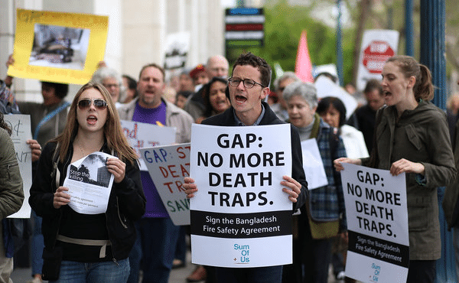
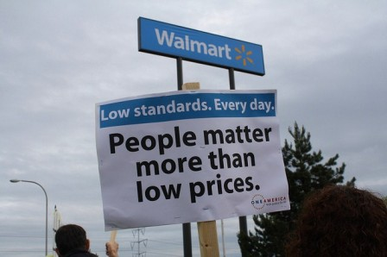
CONSUMER MOVEMENTS

Slide 10
QUESTIONS
Identify 3 consumer rights which are the most important for you. Have they ever been threatened? How?
Are there any consumer protection guidelines in your country? How do they differ from those introduced by the United Nations?
Identify reasons to be aware as consumer

Slide 11
THANK YOU

