Slide 1

Communications 150
Public Speaking
Rhetorical Methods &
Group Presentations

Slide 2
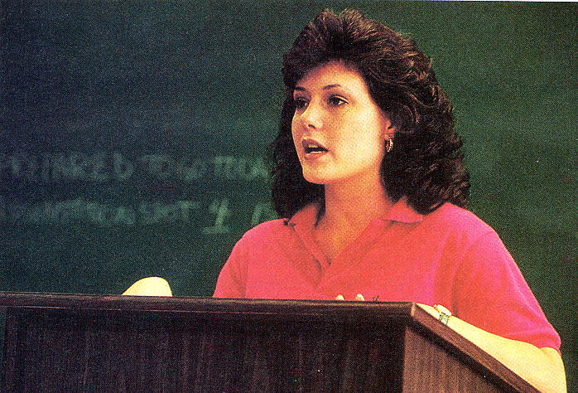

Slide 3
CONNECTIVES
Connectives are words or phrases
that connect the ideas
of a speech and indicate
the relationship between them.

Slide 4
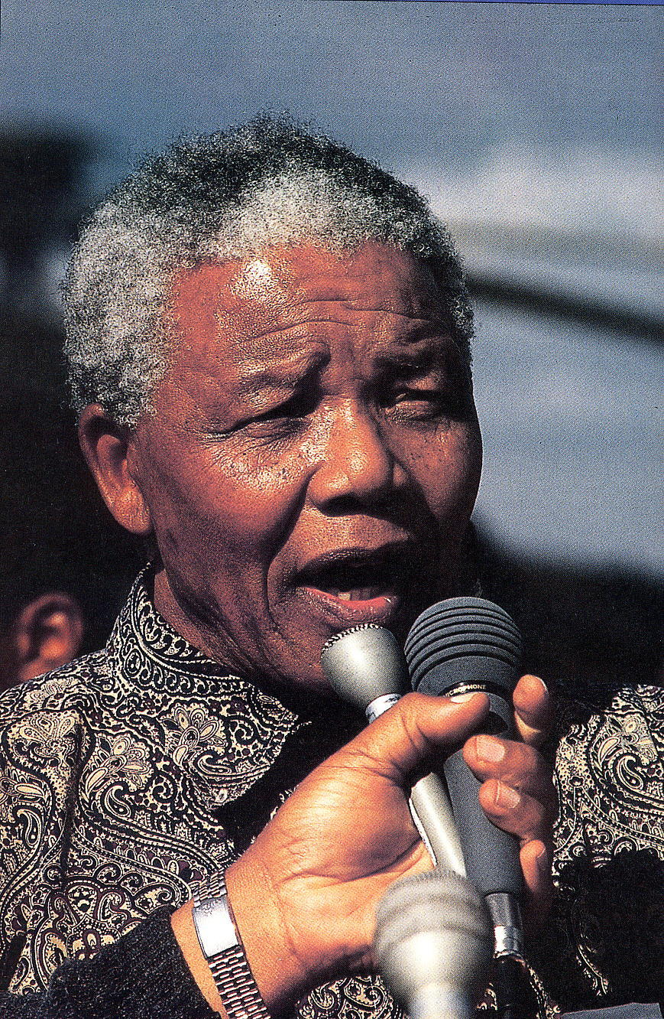

Slide 5
Four Types of Connectives
Transitions
Internal Previews
Internal Summaries
Signposts

Slide 6
1. Transition
A word or phrase that indicates when a speaker has finished one thought and is moving on to another.
“In addition to …
“Now that we’ve seen…
“Not only…
“So the evidence is…
“Let’s look at…

Slide 7
2. Internal Preview
A statement in the body of the speech that lets the audience know what the speaker is going to discuss next.
Transition ~ “Now that we have seen how serious the problem of faulty credit reports is…
Internal Summary ~ “I will focus on the following three solutions…

Slide 8
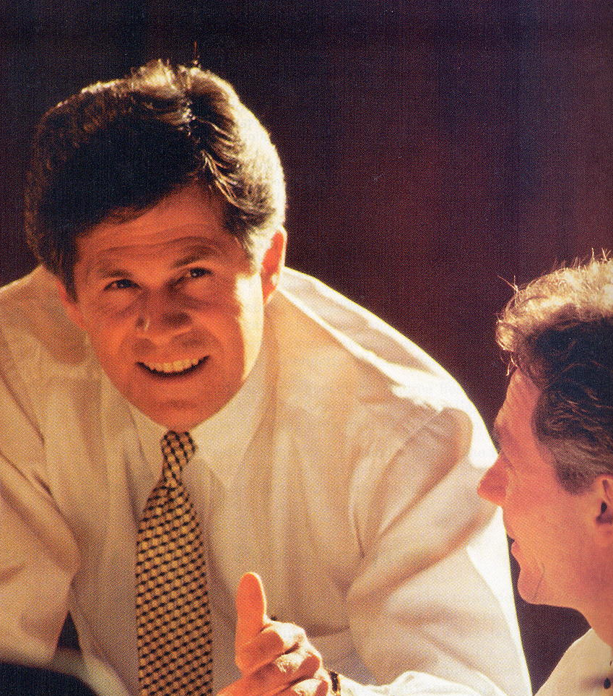

Slide 9
3. Internal Summary
A statement in the body of the speech that summarizes the speaker’s preceding point or points.
“I hope I’ve made clear the benefits of walking as a form of exercise. Unlike running, which often causes injuries, walking is a gentle but effective way to keep in shape.”

Slide 10
4. Signpost
A very brief statement that indicates where a speaker is in the speech, or that focuses attention on the key ideas.
Enumerate ~ “Four simple principles guide our policy. First… Second…
Question ~ “What is the most effective approach for us?
Key Idea ~ “The most important thing to remember is …

Slide 11
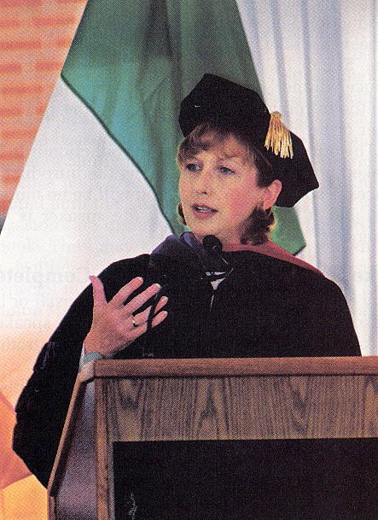

Slide 12
CONNECTIVES
Remember that connectives can help to tie your speech together.
Using them effectively will make your speeches more unified and coherent.

